Slide 1
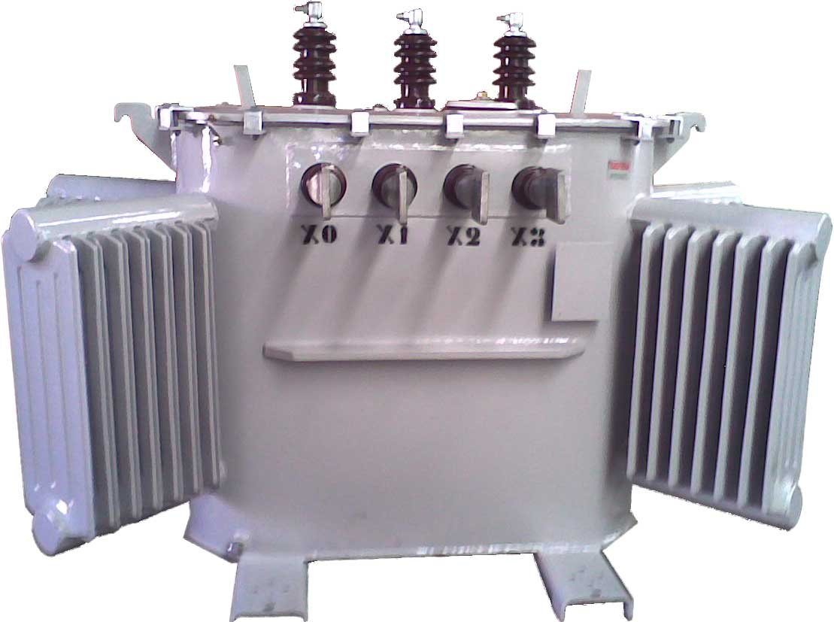

Electrical USAGE in buildings
Dr Hassan Hassoon ALDelfi
Sustainability and Human Response
INDS 328
Semester 2
Week 10
Date

Slide 2
Outline
Power supply to buildings
Single and three phase power supply
Power distribution in building
Power circuits to serve specific functions in buildings.

Slide 3
Objectives
When completed this lecture student is expected to:
1-understand the difference between single phase and three phase power supply
2- Able to understand the power usage
3- To familiarize students with some terminologies
4- single phase and three phase systems

Slide 4
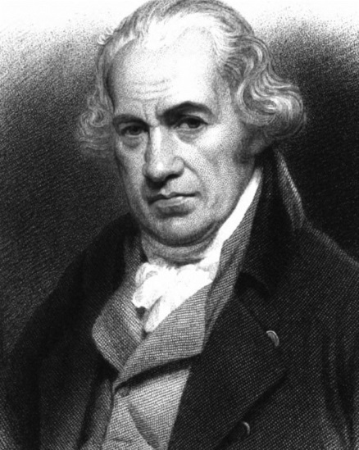
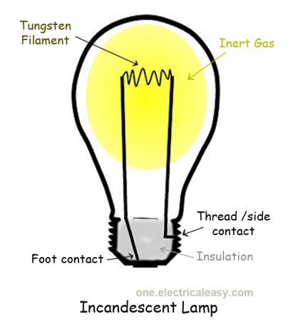
ELECTRICAL INSTALLATION
Definitions:
Watt: is one ampere flowing under the electromotive force of 1 volt.
Ampere: is one Coulomb per Second flowing past a given point.
1 Coulomb = 6.28x10^10 Electron.
V= A.R
V = volt, A= ampere
R= electrical resistance

Slide 5
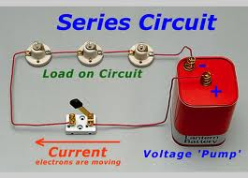
Electrical Circuit
Circuit : is a continuous path forming a closed loop of a conductor in which electricity can flow.

Slide 6
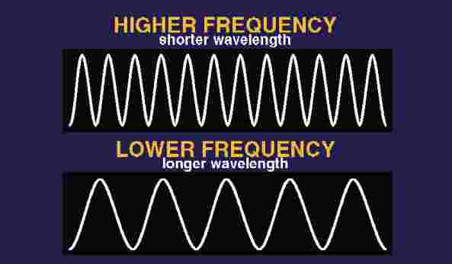
Frequencies
Frequencies: frequency. The number of cycles per second (Hertz) (abbreviated as, hz) of anything that oscillates is called the "frequency". The electricity of an AC wall outlet is said to have a frequency of 60 Hertz as it cycles negative then positive 60 times each second
The standard unit of frequency is the hertz, abbreviated Hz. If a current completes one cycle per second, then the frequency is 1 Hz; 60 cycles per second equals 60 Hz (the standard alternating-current utility frequency in some countries).
Frequency in USA 60 Hz in Iraq 50 Hz

Slide 7

Power
Power : is the ability to do work per unit time
Most bills quote electrical energy consumption in kilowatt hours (kWh's). One kilowatt hour is defined as the amount of energy used by a one kilowatt appliance (i.e. one that uses 1000 joules per second) that is run for one hour.
P= V I = RI^2
P= Energy(KW/hr.)/Time(hr.)

Slide 8
Types of Electrical Loads
a-Lights
b-motors
c-Heating elements
d-electronic devices
e-special process equipments

Slide 9
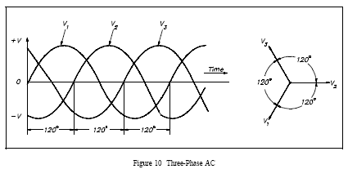
Types of Electrical Supply
A-Single Phase: (Neutral + live + Erath) 220/240
B-Three Phase supply: ( Neutral + Live + Erath)
380 V and over

Slide 10
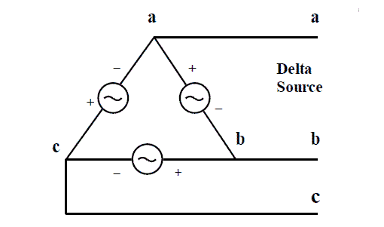
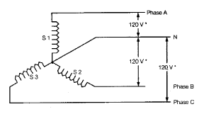
C- High Voltage Supply: with diversity factor around 60%-90%

Slide 11
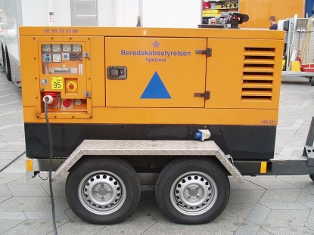
KW, KVA and Power Factor
Have you ever wondered why some power ratings are expressed in WATTS, some in AMPERES or AMPS, some in VOLTS, and some in KVA? This page will explain in simple terms the difference between the power ratings and describe when each should be used in your data center and network architecture planning.
A KVA is simply 1,000 volt amps. A volt is electrical pressure. An amp is electrical current. A term called apparent power (the absolute value of complex power, S) is equal to the product of the volts and amps.
On the other hand, a watt (W) is a measurement of real power. Real power is the amount of actual power that can be drawn from a circuit. When the voltage and current of a circuit coincide, the real power is equal to the apparent power. However, as waves of current and voltage coincide less, less real power is transferred, even though the circuit is still carrying current. Differences between real and apparent power, and thus watts and volt amps, arise because of inefficiencies in electrical transmission.
The resulting inefficiency of electrical transmission can be measured and expressed as a ratio called the power factor. The power factor is a ratio (a number from 0 to 1) of real power and apparent power. In the case of a 1.0 power factor, the real power equals the apparent power. In the case of a 0.5 power factor, real power is approximately half that of the apparent power.
Deploying systems that have higher power factors result in less electrical loss and can help improve your Power Usage Effectiveness (PUE). Most Universal Power Supply(UPS) units will list the average power factor and real-time load capacity of the UPS, in addition to the KVA.

Slide 12
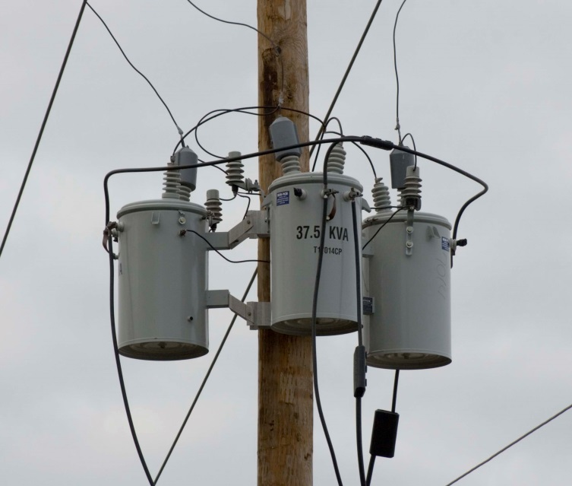
Example
You own a 500 KVA UPS unit (apparent power) with a 0.9 power factor. The resulting real power is 450 kilowatts.
Some Useful Conversion Factors and Formulas
VA = Voltage x Amps
Watts = Voltage (root-mean-squared) x Amps (root-mean-squared) x Power Factor (PF) (a three-phase circuit would multiply the voltage by the square root of 3 or approximately 1.732)
1 BTU (British thermal unit) = Watts x 3.413
1 BTU = 1,055.053 joules (J)
1 watt = 3.413 BTU/hour
1 ton = 200 BTU/minute
1 ton = 12,000 BTU/hour
1 ton = 3.517 kilowatts

