Slide 1

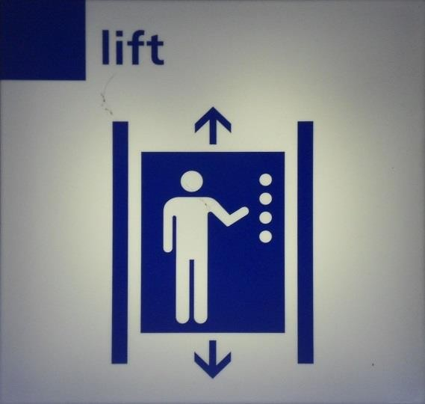
LIFT DESIGN AND REQUIREMENTS IN BUILDINGS
Dr Hassan Hassoon ALDelfi
Sustainability and Human Response
INDS 328
Semester 2
Week 11
Date

Slide 2
Outline
Building specifications
Door openings in lifts
Types of lifts
Lifts for residential and office buildings
Applications for lift design

Slide 3
Objectives
When completed this lecture student is expected to:
1-Understand how to design lifts in terms of shaft sizes
2- Design and estimate lifts needed for residential and office used buildings

Slide 4

Size of Lift
The lift load depends on its usage, load limitation should be set with warning system for safety consideration.
0.2 m^2/person in normal situation and usage.
Considerations: VIP, the old, the ill, …etc
Clearances with walls:
230mm clearance on the side.
150 mm clearance on front for double doors sets.
300 mm clearance on the back for counter balance weight. Depends on the manufactured lifts.

Slide 5

Doors Opening in Lifts
One direction
Two direction
More than two but require special solutions:
1- Linear ( up to 4 lifts)
2- facing ( 4-8 lifts)
3- Functional Growing ( operating theatre)

Slide 6
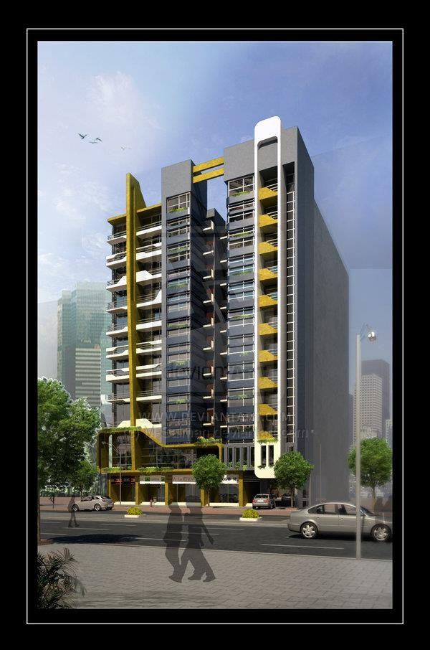

Slide 7

Lifts or Elevators
All building are classified, in terms of lifts requirements as either :
a-Office Buildings
b-Residential buildings
In (a) the traffic served is assumed to be 75% of the population. ( G+1st floors they require no lift service generally in period of 30 minutes.
The size of the lift is decided by the designer
The Round Trip Time is given by the manufacturer R.T.T

Slide 8
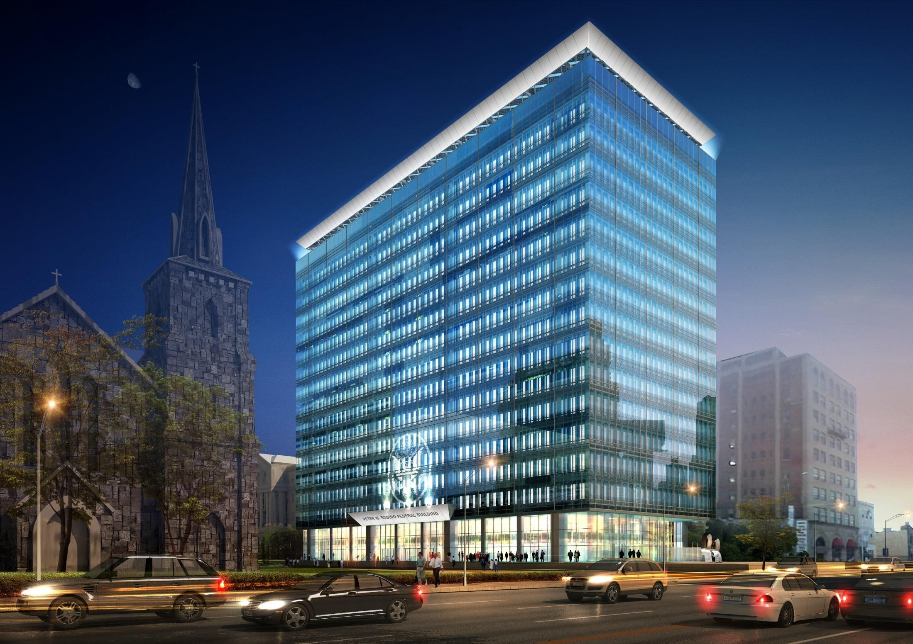

Slide 9
Estimation of Number of Lifts
No of passengers discharged by one lift :
₌ 30 𝑚𝑖𝑛𝑢𝑡𝑒𝑠𝑋𝐿𝑖𝑓𝑡 𝑐𝑎𝑝𝑎𝑐𝑖𝑡𝑦
𝑅. 𝑇. 𝑇
Number of lifts required after approximated:
=
𝐶𝑎𝑙𝑐𝑢𝑙𝑎𝑡𝑒𝑑 𝑁𝑜. 𝑜𝑓 𝑃𝑎𝑠𝑠𝑒𝑛𝑔𝑒𝑟𝑠
𝑁𝑢𝑚𝑏𝑒𝑟 𝑜𝑓 𝑝𝑎𝑠𝑠𝑒𝑛𝑔𝑒𝑟𝑠 𝑝𝑒𝑟 𝑙𝑖𝑓𝑡
R.T.T is the time taken by the lift to complete one cycle with stops as programmed.

Slide 10
In residential buildings, the traffic served is assumed to be 6% of total population on the second floor and above in a period of 5 minutes.
Then No. of passengers / 1 lift car is:
₌ 𝟓 𝒎𝒊𝒏𝒖𝒕𝒆𝒔𝑿 𝑳𝒊𝒇𝒕 𝑪𝒂𝒑𝒂𝒄𝒊𝒕𝒚
𝑹. 𝑻. 𝑻
𝒄𝒂𝒍𝒄𝒖𝒍𝒂𝒕𝒆𝒅 𝒏𝒖𝒎𝒃𝒆𝒓 𝒐𝒇 𝒑𝒂𝒔𝒔𝒆𝒏𝒈𝒆𝒓𝒔
No. of Lifts required=
𝑵𝒐.𝒐𝒇 𝒑𝒂𝒔𝒔𝒆𝒏𝒈.𝒆𝒓𝒔 𝒑𝒆𝒓 𝟏 𝒍𝒊𝒇𝒕 𝒄𝒂𝒓

Slide 11
Lift Usage and waiting Intervals
Number of lifts required depends on:
a-Disabled usage, furniture movements, patients..etc..
b-waiting interval should be 30- 60 sec. Office Building, and 90 to 120 seconds in residential buildings.
c-loading conditions number of persons should be stated 340 kg/m^2

Slide 12
Example 1
How many lifts required in a 15 story office building . If each floor is occupied by 50 person and lift car capacity is 10 person with R.T.T of 3 minutes?
No. of persons requiring lift service= (15- 2)X50X0.75 = 487.5 Persons
No. of persons per lift = 30X10/3=100 persons
No. of lifts calculated = 487.5/100 = 5 lifts

Slide 13
EXAMPLE 2
If same building is used as residential , how many lifts required?
No. of persons required lift service= (15- 2)X50X6% = 30
No of person per lift= 5X10/3 = 16.5 persons.
No of lifts calculated = 39/16.5 = 3 lifts

Slide 14
Tutorial
Each student:
Class work :
Refer to your design project to estimate the number of lifts required to serve your building.

