Slide 1

HVAC System
AHU Control & Troubleshooting
Dr Hassan Hassoon ALDelfi
Sustainability and Human Response
INDS 328
Semester 1
Week 7
Date

Slide 2
Outline
What is HVAC system
HVAC system components

Slide 3
Objectives
When completed this lecture student is expected to:
1-Understand how HVAC units are related to provide airconditioned built space
2- know what are : compressors, expansion valve , condenser and evaporator , cooling tower
3-Know controls adopted in the operation of HVAC systems.

Slide 4
Introduction to HVAC Systems
Objective Comfort Zone
Temperature 22 °C 24 °C
Relative Humidity 40 % R.H 60 % R.H
Comfort Zone 24 °C & 50 % R.H
Notes:
HVAC : Heating, Ventilation and Air Conditioning
Comfort zone for human is at 24 °C & 50 % R.H but this is not the only reason
The other reason to achieve comfort zone is to control the quality of air

Slide 5


Indoor Air Quality (IAQ)
Notes:
IAQ : Indoor Air Quality,
It’s a parameter that indicates the amount or percentage of fresh air in the air to be conditioned
American High Rise Building in the beginning of 1960 was a very fantastic skyscrapers and the view from a window at floor 60 or 70 was very amazing so it was a very good place to work in for such a commercial company but it was observed that most of the employees working there in these amazing buildings are not having a good environment to achieve or innovate the required work and it was found that when an employee take a short break for having a cup of tea with smoking cigarette in a place that is opened to outside, he then felt more active.
On the other side, the employee who is working all the day in his office and his break is just looking at the wonderful view from his office window, he is feeling more lazy and sleep is just what he want.
It is found that the air quality inside these building is matter of this problem although the temperature and relative humidity inside are at the range of comfort zone.
So, the action then is taken to improve the quality of the conditioned air inside these building by adding fresh air side to the equipment responsible for the conditioning process.

Slide 6
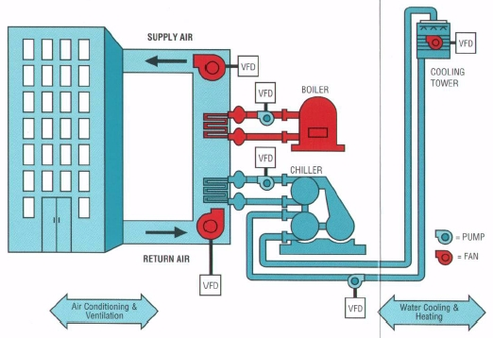
HVAC System Components
Where’s the fresh air duct ?!?!!

Slide 7
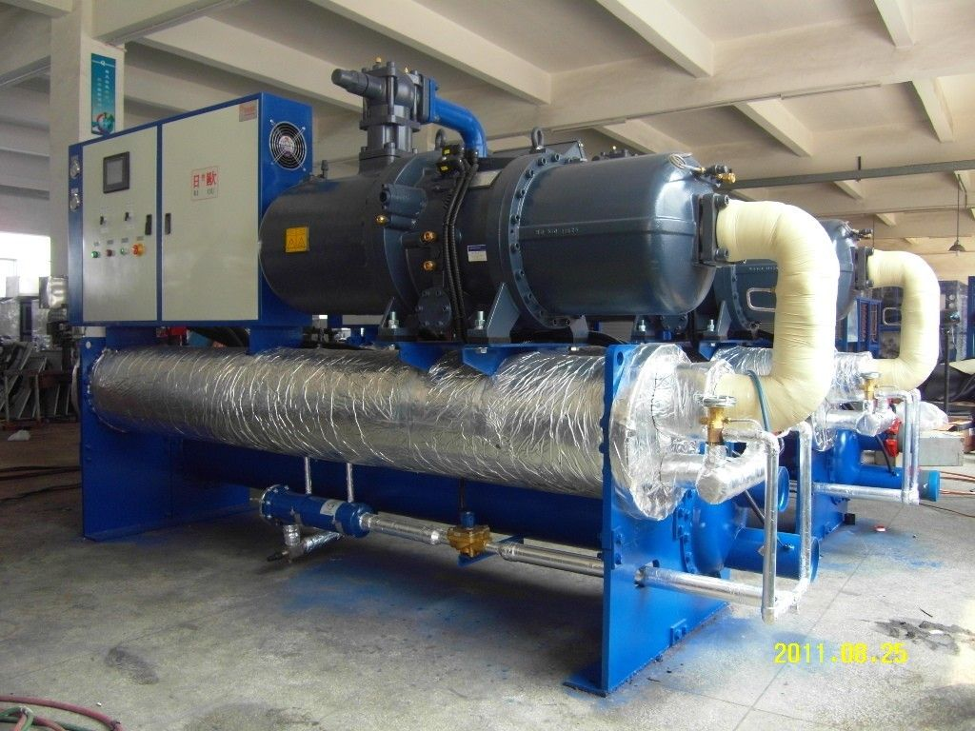
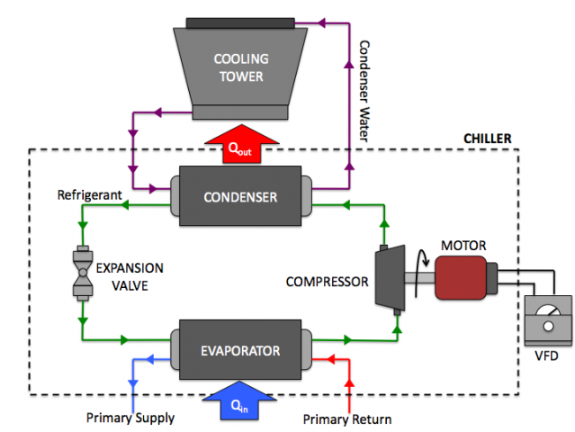
HVAC System Components
Chiller

Slide 8
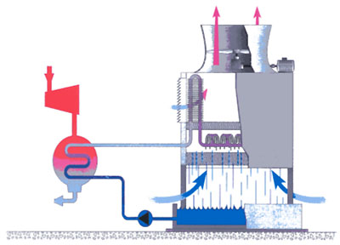
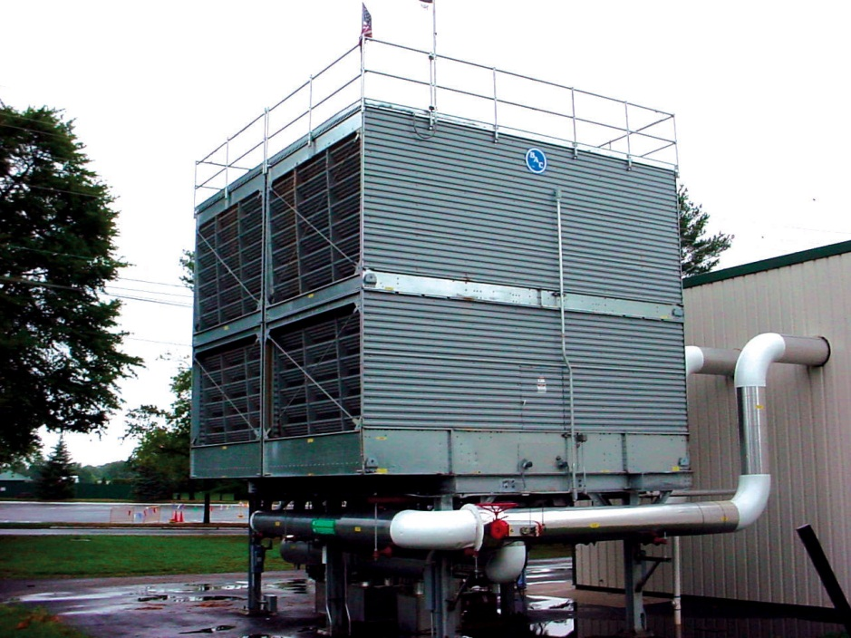
HVAC System Components
2. Cooling Tower
Chiller Refrigerant Cycle
Compressor
Condenser

Slide 9
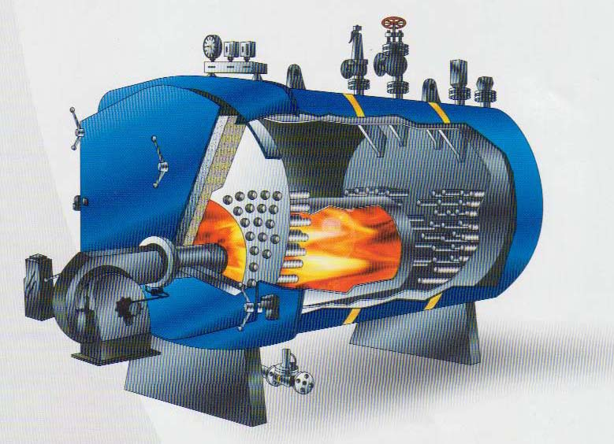
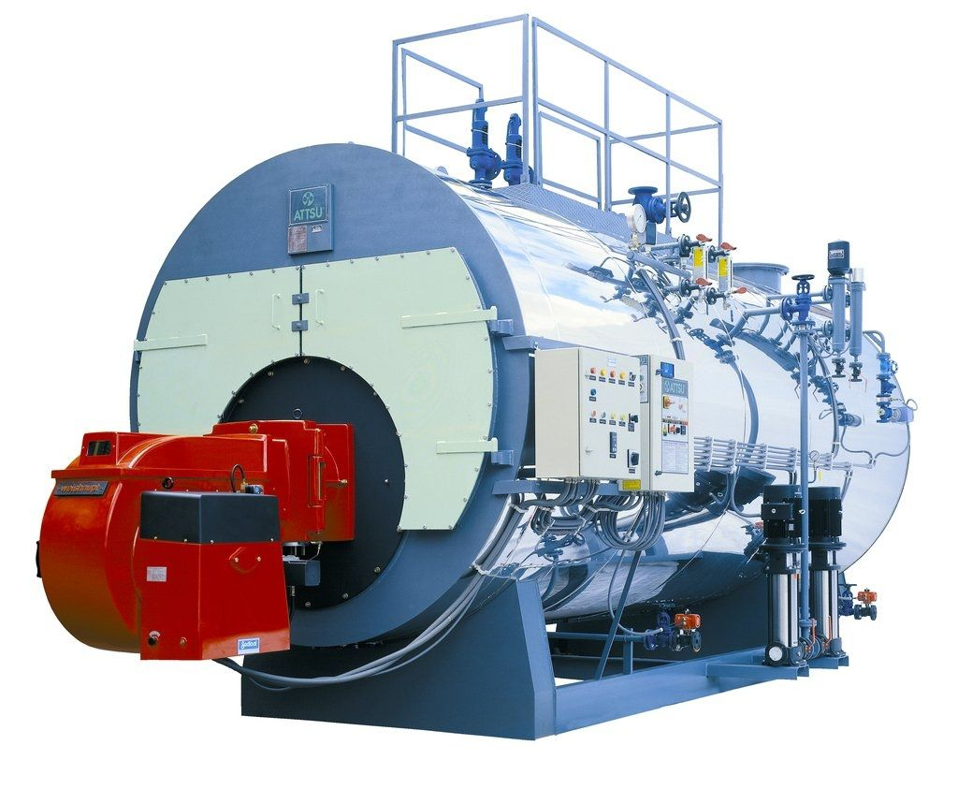
HVAC System Components
3. Boiler

Slide 10
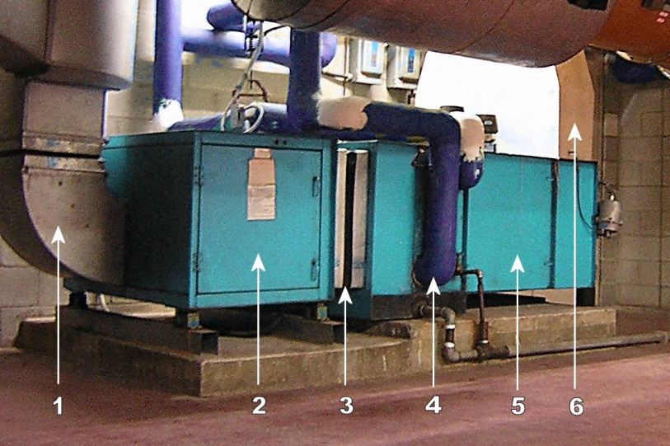
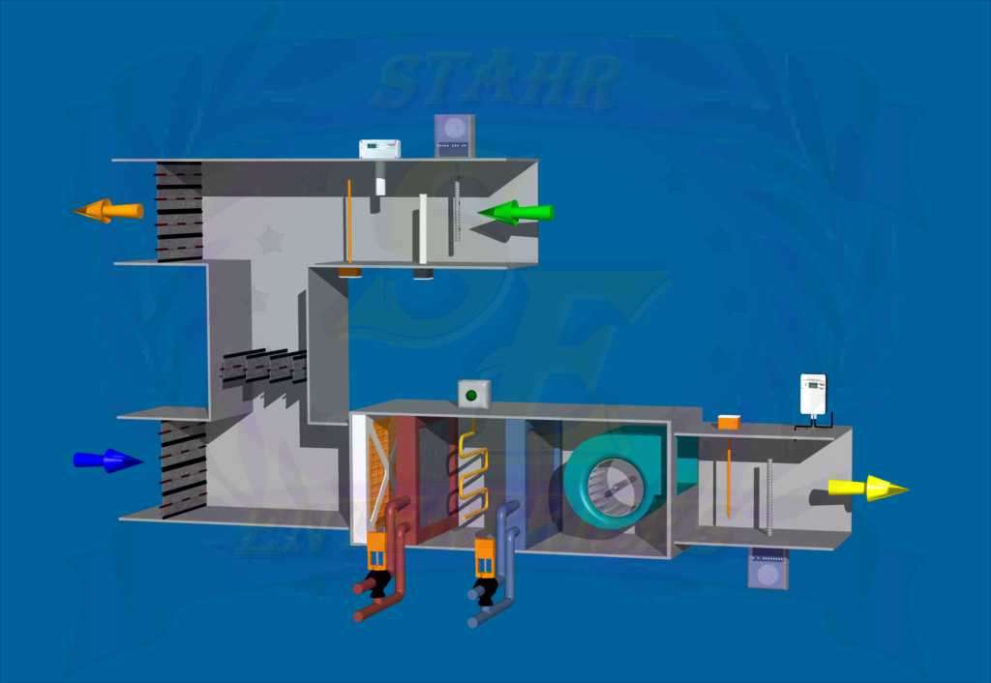
HVAC System Components
4. Air Handling Unit (AHU)
Supply Duct
Fan
Vibration Connection
Cooling Coil
Filter Section
Return Duct

Slide 11
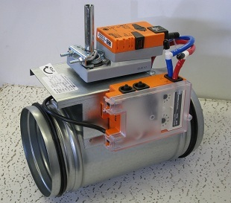
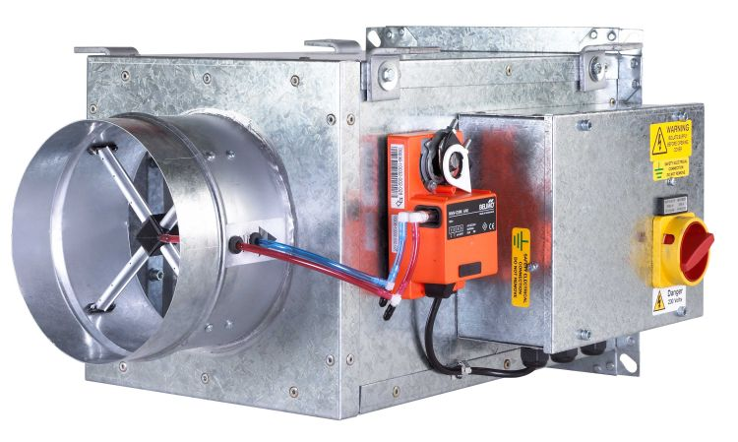
HVAC System Components
5. VAV (Variable Air Volume)

Slide 12
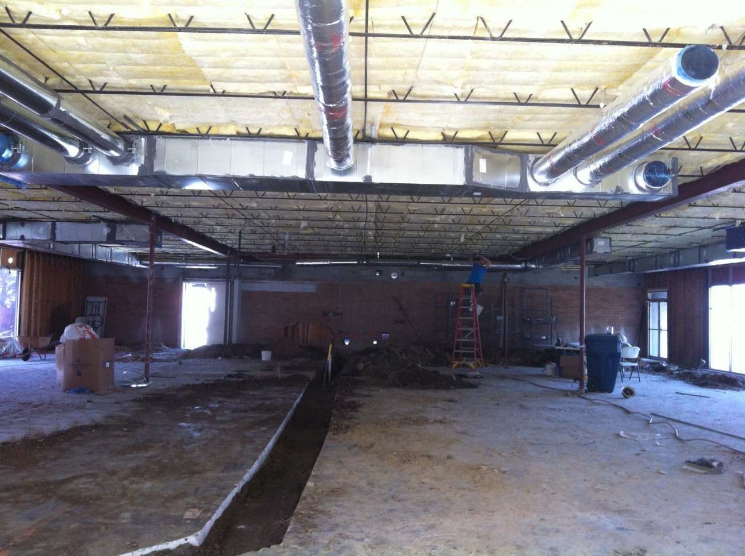
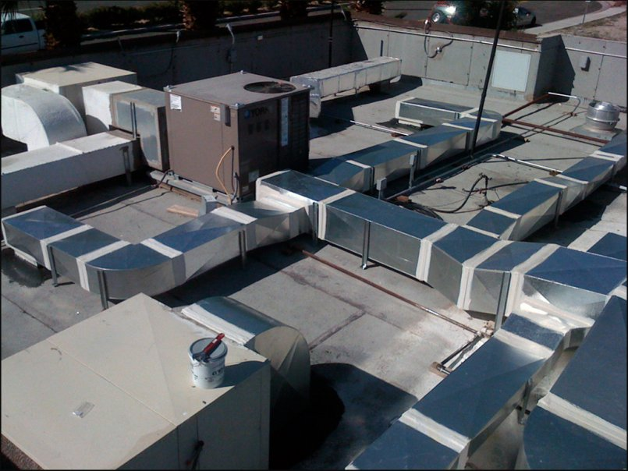
HVAC System Components
6. Ductworks & Air Terminals

Slide 13
AHU Control & Troubleshooting
Control Concept
Sensor
Controller Device (Brain)
Actuator
Sensor
Input
Controller
Output
Actuator
Set Point (Value)

Slide 14
AHU Control & Troubleshooting
Sensor
Input
Controller
Output
Actuator
1- Thermostat
2- Pressure Gauge
3- R.H % Sensor
4- DPS
5- Flow Switch
BMS
DDC
MCC
1- Motorized Damper
2- Two-way Valve
3- Three-way Valve
4- VSD

Slide 15
AHU Control
AI
T
M
DPS
AI
Exhaust Air
Return Air
Return Fan
AI
M
T
DPS
Supply Air
E
AO
H
M
M
Supply Fan
AO
AO
DI
DO
AO
AO
MCC
DDC
AI

