Slide 1

Heating, Ventilation, and Air Conditioning
Dr Hassan Hassoon ALDelfi
Sustainability and Human Response
INDS 328
Semester 2
Week 8
Date

Slide 2
Outline
Air movement, Wind pressure and Wind Direction
Wind Shadow.
The importance of natural ventilation
The advantages of natural ventilation in built environment
The chimney effects

Slide 3
Objectives
When completed this lecture student is expected to:
Describe the evolution of the modern-day
air-conditioning system.
Explain the purpose of the compressor.
Describe the function of the condenser.
Explain the key differences between an orifice tube and a thermostatic expansion valve.
Explain the purpose of a drier.
Describe the function of the evaporator.
Explain how the accumulator works and its function.
Describe the uses for the manifold gauge set.

Slide 4
Introduction
We have come a long way in a brief time period regarding the development of climate control systems in modern vehicles.
A technician must understand what functions a heating, ventilation, and air conditioning (HVAC) system performs and how it accomplishes these tasks.

Slide 5
Introduction (continued)
A technician must also recognize the components of a modern HVAC system and the tools required to maintain them.

Slide 6
System Overview
In this chapter, you will learn about:
The history of the modern HVAC system.
The purpose of the heating, ventilation, and air-conditioning system.
The components that make up modern HVAC systems.
Some of the specialty tools used by technicians in the HVAC field.

Slide 7
History of Air Conditioning
People tried to control the temperature of their environment as far as the Egyptian pharaohs.
In 1884, William Whiteley placed blocks of ice in a tray under a horse carriage and used a fan attached to a wheel to force air inside.
Later, a bucket of ice in front of a floor vent became the automotive equivalent.

Slide 8
History of Air Conditioning (continued)
Automobiles were not very comfortable for passengers in the early years because the cabins were open.
Eventually, car companies began to close up the passenger cabins, which required a change in temperature control systems.
At first, vents were put in the floors of cars, bringing in more dirt and dust than cool air.

Slide 9
History of Air Conditioning (continued)
In 1939, Packard produced the first passenger cars using refrigeration components. A huge evaporator was mounted in the trunk.
Cadillac introduced an air-conditioned car in 1941.
In 1954, Delphi Harrison Thermal Systems introduced an air-conditioning system that located all the major components under the car’s hood (Figure 1-1).

Slide 10
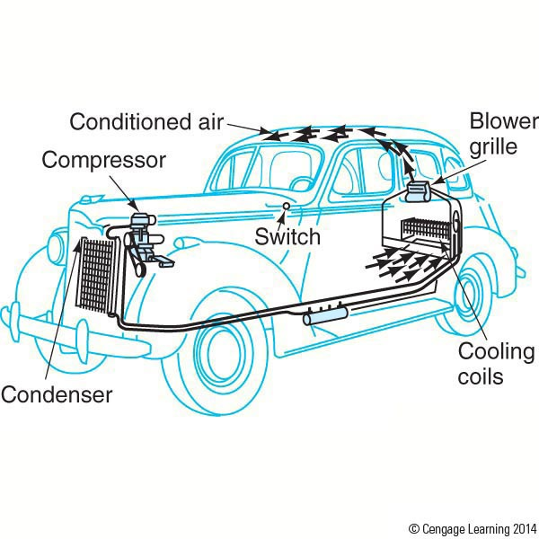
History of Air Conditioning (continued)
Figure 1-1. A 1939 Packard with air conditioner.

Slide 11
Today’s Air-Conditioning Systems
Today’s vehicles are very comfortable no matter what the weather is like outside.
Innovations and improvements in overall durability have increased the complexity of today’s air-conditioning systems.
As today’s truck drivers travel through different regions, they can enjoy the same comfort levels as they do at home.
Climate-control systems automatically make the transition from heating to cooling and back.

Slide 12
Today’s Air-Conditioning Systems (continued)
For vehicles operating in the northern U.S. or Canada, heating systems keep occupants warm and comfortable and help keep the windshield clear of ice and snow.
For those operating in the southern U.S. or Canada, air conditioning greatly improves the comfort level of the occupants.
An added benefit of air conditioning systems is that they remove humidity from the circulating air.

Slide 13
Today’s Air-Conditioning Systems (continued)
The ‘‘do it yourself’’ approach to air-conditioning repair is a thing of the past.
Technicians today must work within stringent environmental regulations.
The technician must be certified to purchase refrigerant and to repair air-conditioning systems.
Repair shops must have equipment that can remove all refrigerant from a vehicle to prevent ozone-depleting chemicals from escaping into the air.

Slide 14
Vehicle Heat and Cold Sources
The heat and cold that an HVAC system must overcome originates from many different sources.
Ambient air temperature and solar radiation are two such sources.
Tinting of windows can reduce the effects of solar radiation.

Slide 15
Vehicle Heat and Cold Sources (continued)
Other heat sources are those generated by the engine and cooling system. These include transmission heat, exhaust system heat, and heat radiated up through the floor of the vehicle.
Human body heat and warm moist air from breathing constantly radiate into the air in the cab.
All add to the heat and moisture that must be removed by an HVAC system (Figure 1-2).

Slide 16
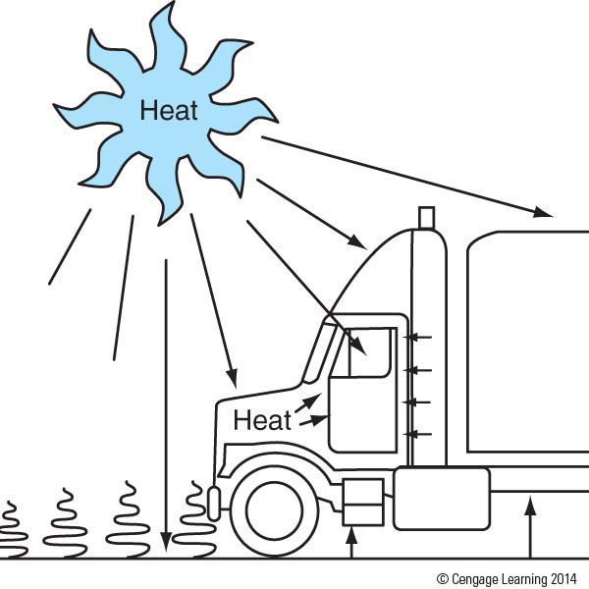
Vehicle Heat and Cold Sources (continued)
Figure 1-2. Heat enters the cab through windows. Engine heat enters through the firewall, and heat radiates up through the floor of the vehicle.

Slide 17
Vehicle Heat and Cold Sources (continued)
Another source of hot or cold air is the fresh air ventilation system. Air is circulated by a fan, usually referred to as a blower motor.
Outside air coming into the cab must either be heated or cooled before it reaches the vehicle interior.
The ventilation system improves the performance of the air-conditioning or heating system by improving air flow within the vehicle.

Slide 18
Purpose of the HVAC System
HVAC systems perform three very important functions:
Temperature control. The HVAC maintains the temperature within the passenger compartment as selected by the operator.
Humidity control. The HVAC system reduces the humidity within the passenger compartment.
Air circulation control. The HVAC refreshes the air in the vehicle’s interior.

Slide 19
Air-Conditioning Components
The most common components of truck air-conditioning systems are:
Compressor
Condenser
Pressure regulating devices:
Orifice tube
Thermostatic expansion valve
Evaporator
Receiver-drier
Accumulator

Slide 20
Compressor
The compressor can be referred to as the heart of the HVAC system.
Compressors are bolted to the engine and are belt-driven by either a V-belt or a serpentine belt.
The compressor is responsible for compressing and transferring refrigerant gas (Figures 1-3 and 1-4).

Slide 21
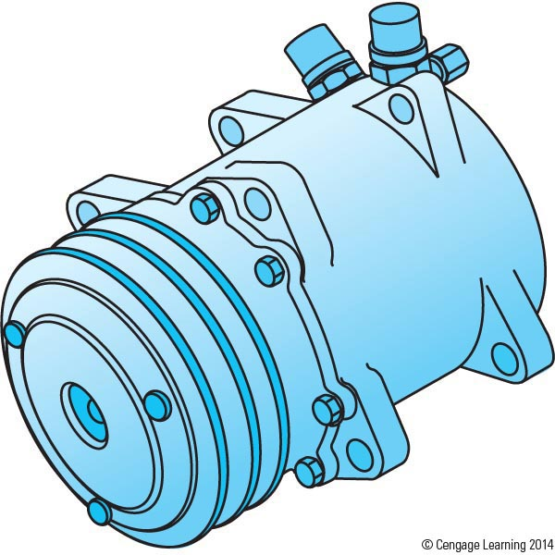
Compressor (continued)
Figure 1-3. Swash plate compressor.

Slide 22
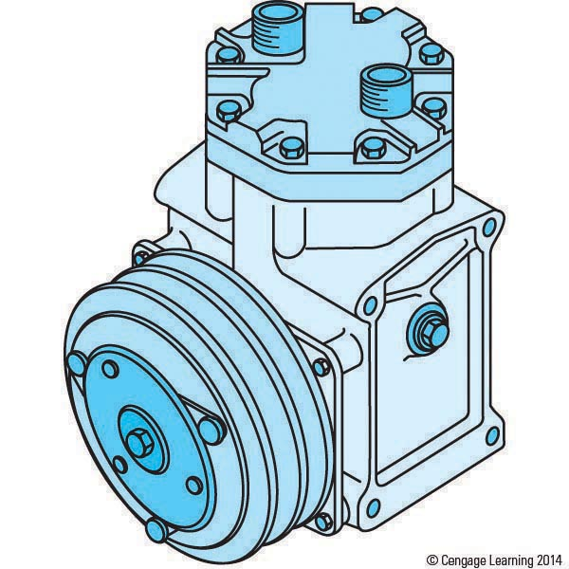
Compressor (continued)
Figure 1-4. Two-piston type compressor.

Slide 23
Compressor (continued)
The air-conditioning system may be divided into two different sides: the high-pressure (discharge) side and the low-pressure (suction) side.
The compressor is the dividing point between the suction and discharge sides of the air-conditioning system.

Slide 24
Compressor (continued)
The suction side of the compressor draws in refrigerant gas from the outlet of the evaporator.
Once refrigerant is drawn into the suction side, it is compressed, which concentrates the heat in the vapor, raising its temperature.
The vapor leaving the compressor must be hotter than the atmosphere so that, while it is in the condenser, it will dissipate the heat that it carries to the cooler ambient air.

Slide 25
Condenser
The condenser dissipates the heat that was once inside the cab of the truck.
The condenser is designed to radiate heat, and it is usually located in front of the radiator.
In some retrofit applications, it may be located on the cab roof (Figure 1-5).

Slide 26
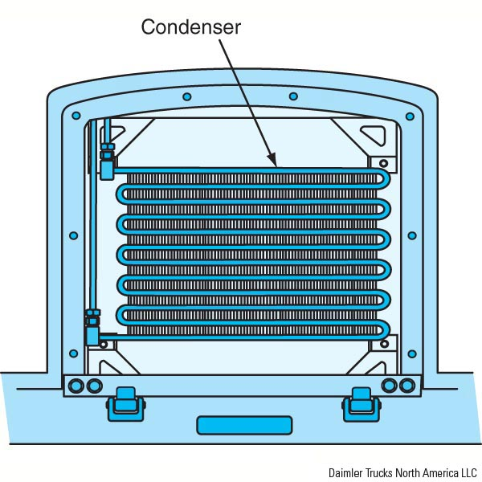
Condenser (continued)
Figure 1-5. Refrigerant surrenders heat from the cab to the ambient air in the condenser.

Slide 27
Condenser (continued)
Condensers must have air flow any time the system is in operation. This is accomplished by the ram air effect or by the engine cooling fan.
The compressor pumps hot refrigerant gas into the top of the condenser.
The gas is then cooled and condenses into high-pressure liquid refrigerant at the bottom of the condenser or condenser outlet.

Slide 28
Pressure Regulating Devices
The desired temperature of an evaporator is maintained by controlling refrigerant pressure. Two pressure-regulating devices are:
Orifice Tube. This is a simple restriction located in the liquid line between the condenser outlet and the evaporator inlet (Figure 1-6).
Thermostatic Expansion Valve (TXV). The TXV’s job is to regulate the flow of refrigerant so that any liquid refrigerant metered through it has time to evaporate or change states from liquid to gas before leaving the evaporator (Figure 1-7).

Slide 29
Evaporator
The evaporator’s primary function is to remove heat from within the cab of the vehicle. It is also used for dehumidification.
It is usually located within the controlled space or is in some way isolated from the outside of the vehicle.
A blower motor circulates air from the cabin through the evaporator coil.

Slide 30
Evaporator (continued)
As the warmer air travels through the cooler fins of the evaporator, the moisture in the air condenses on their surface.
In order to keep the evaporator from freezing, several different temperature- or pressure-regulating devices may be used.
Keeping the evaporator from freezing is extremely important because a frozen evaporator will not absorb very much heat (Figure 1-8).

Slide 31
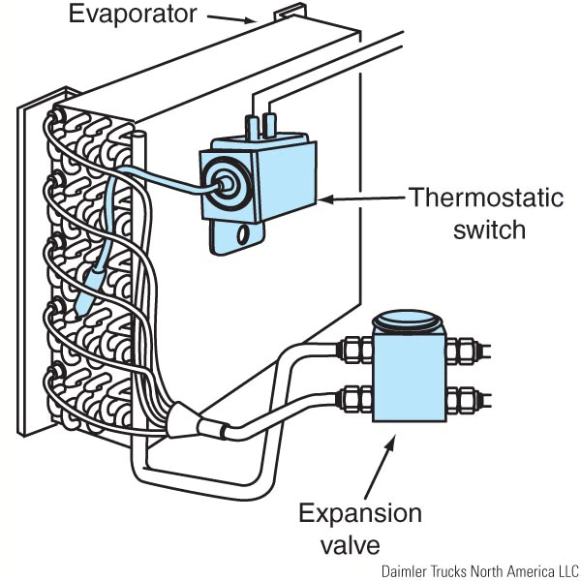
Evaporator (continued)
Figure 1-8. The evaporator is the component that
absorbs heat from the truck’s cab.

Slide 32
Evaporator (continued)
Refrigerant enters the evaporator as a low-pressure liquid.
The refrigerant temperature is lower than that of the air inside the cab, and heat flows from a warm substance to a cooler one.
The warm air from the cabin passes through the evaporator fins and causes the liquid refrigerant in the evaporator to boil.

