Slide 1

Electrical installation in buildingS
Dr Hassan Hassoon ALDelfi
Sustainability and Human Response
INDS 328
Semester2
Week 9
Date

Slide 2
Outline
Power supply to buildings
Single and three phase power supply
Power distribution in building
Power circuits to serve specific functions in buildings.

Slide 3
Objectives
When completed this lecture student is expected to:
1-understand the difference between single phase and three phase power supply
2- Able to understand the power and lighting distribution in buildings

Slide 4

Most domestic premises receive a single- phase supply of electricity from an area electricity board at a rating of 220 volts and frequency of 50 hertz.
The area electricity board's cable, from which the domestic supply is taken, consists of four lines, three lines each carrying a 220 volt supply and the fourth is the common return line or neutral

Slide 5
Single phase and 3-phase electrical supply
Neutral is connected to earth at the transformer or substation as a safety precaution should a fault occur on the electrical appliance.
Single –phase : Each line or phase is tapped in turn together with the neutral to provide the single-phase 220 V supply

Slide 6
The supply or intake cable may enter building in two ways
Underground duct
Overhead supply.
An underground supply is preferred since all of the electrical service is hidden.
Advantages: ?

Slide 7
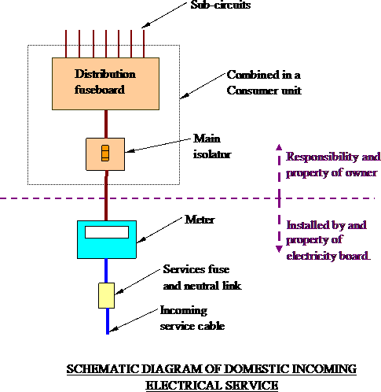

Slide 8
From the sealing chamber the supply passes through the meter, which records the electricity consumed in units of kilowatt/hours, to the consumer unit which has a switch controlling the supply to
the circuit breakers or circuit fuses
These fuses are a protection against excess current or overload, the fuse or circuit breaker will isolate the circuit from the source of the problem.

Slide 9
The consumer unit should be fitted close to the point of service entry and from here the service is divided into a number of sub- circuits.
It is normal in a domestic installation to separate power circuits and lighting circuits so that if a fault occurs then not all socket outlets or lights are isolated.

Slide 10
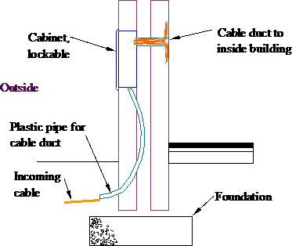
Sometimes an external cabinet is used for easy meter reading. This is located in an outside wall as shown below.
EXTERNAL CABINET

Slide 11

When deciding on the number of circuits for a house, a useful rule is; one power circuit for every 100m² of floor area.
In larger houses this means that two circuits can be used for power socket outlets, in a two-storey house this would be one circuit for upstairs and one for downstairs.
In some larger houses a separate power circuit is also installed for the garage / utility area

Slide 12
In all domestic installations a separate power circuit is required for the cooker since the electrical demand is likely to be high. The immersion heater in the hot water cylinder can also be supplied from a separate circuit since a 3kW load is quite high.
Ring circuits are used as a safe and economic method of distribution of electricity to socket outlets.
Many consumer unit manufacturers produce 8 way and 12 way units.

Slide 13
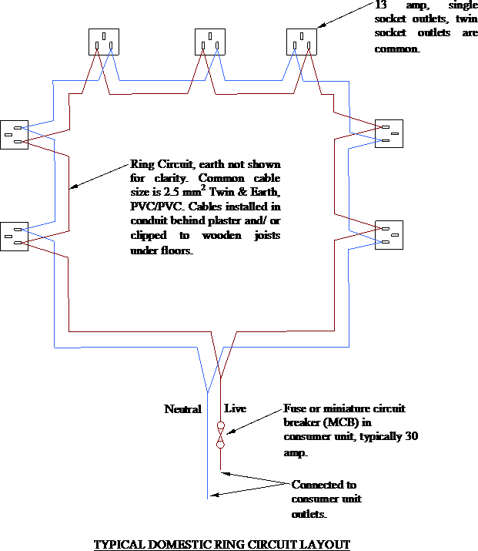

Slide 14
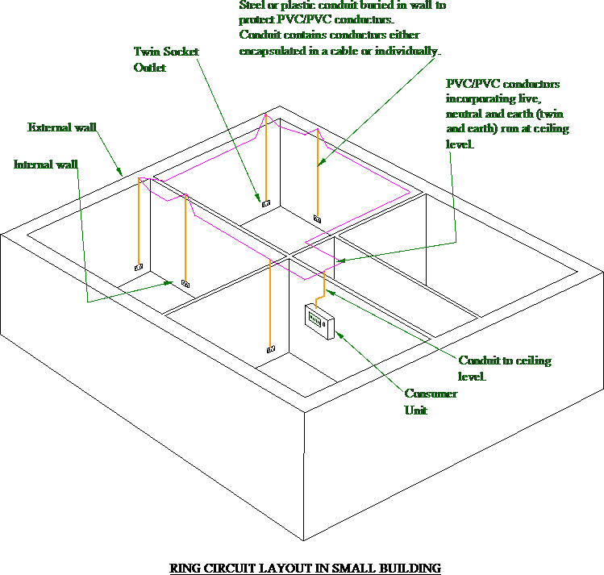

Slide 15
Protection against electric shock is provided by insulating and placing live parts out of reach in suitable enclosures, earthing and bonding metal work and providing fuses or circuit breakers.
A fuse or miniature circuit breaker (MCB) will disconnect the supply automatically before the overload current can cause a rise in temperature which would damage the installation.

Slide 16
An isolator is a mechanical device, which is opened manually and is provided so that the whole of the installation, one circuit or one piece of equipment may be cut off from the live supply.
In addition, a means of switching off for maintenance or emergency switching must also be provided.
In practice it is the aim to bring the Electrical supply to the appliance with as small a loss of voltage through the conductor as possible.
This means that the wiring must have the smallest resistance that is economical

Slide 17
The electrical distribution system in high rise flats and office buildings uses a busbar system.
A busbar is a solid copper bar that carries the electrical current.
The busbars run vertically inside trunking and are supported by insulated bars across the trunking chamber.
The electrical supply to each floor is connected to the rising main by means of tap-off units.

Slide 18
To balance electrical distribution across the phases, connections at each floor should be spread between the phase bars.
To prevent the spread of fire and smoke, fire barriers are incorporated with the busbar chamber at each compartment floor level.
The chamber must also be fire stopped to the full depth of the floor.

Slide 19

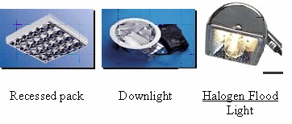
The types of light fitting that we use in modern buildings can be divided into five sections.
Decorative lighting
Commercial lighting
Industrial lighting
Outdoor lighting
Emergency lighting

Slide 20

Quantity of light
The amount of light emitted from a light fitting is given in lumens (lm).
A lumen is the unit of luminous flux.
The amount of light falling on a surface is measured in lux.
One lux is equal to 1 lumen per square metre
…….. 1 lux = 1 lm/m².

Slide 21
Illuminance (lux) | Activity | Area
100 | Casual seeing | Corridors, changing rooms, stores
150 | Some perception of detail | Loading bays, switch rooms, plant rooms
200 | Continuously occupied | Foyers, entrance halls, dining rooms
300 | Visual tasks moderately easy | Libraries, sports halls, lecture theatres.
500 | Visual tasks moderately difficult | General offices, kitchens, laboratories, retail shops.
750 | Visual tasks difficult | Drawing offices, meat inspection, chain stores.
1000 | Visual tasks very difficult | General inspection, electronic assembly, paintwork, supermarkets.
1500 | Visual tasks extremely difficult | Fine work and inspection, precision assembly.
2000 | Visual tasks exceptionally difficult | Assembly of minute items, finished fabric inspection.

Slide 22

25-Apr-13
ND PHTGRPHY
20

