Slide 1

Tishk International University
Intro to IT course
Fall 2025-2026
Computer Memory
Ms.Yara Arjuman Hashim
Email: yara.arjuman@tiu.edu.iq
Office number: Education Building- 220

Slide 2
Outline
Computer Memory
Difference between RAM and ROM
Memory Units
Motherboard
Ports
Data and Information

Slide 3
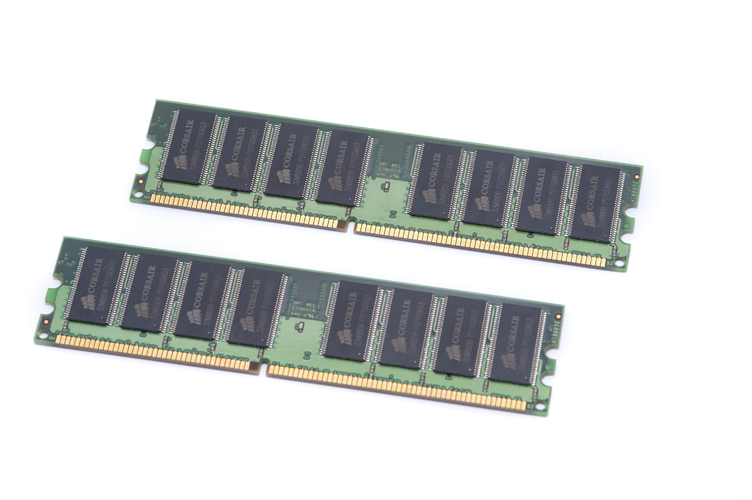
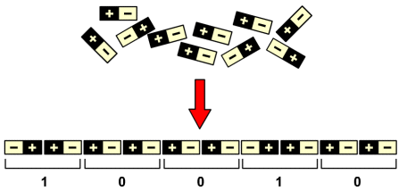
Computer Memory
A memory is just like a human brain. It is used to store data and instructions.
Computer memory is the storage space in the computer, where data is to be processed, and instructions required for processing.
Since computers are electronics machines, it can only understand electricity that flows through it using two states one state is on which is represented by 1 and off which is represented by 0.
Similarly, the binary language consists of two digits only.

Slide 4
What is computer memory video: https://www.youtube.com/watch?v=p3q5zWCw8J4

Slide 5
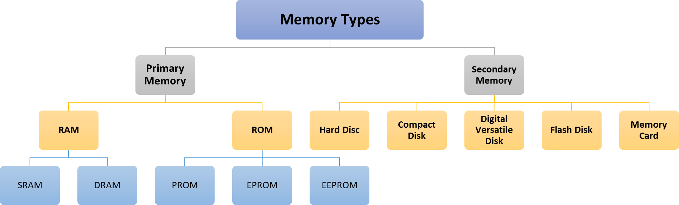
Computer Memory

Slide 6
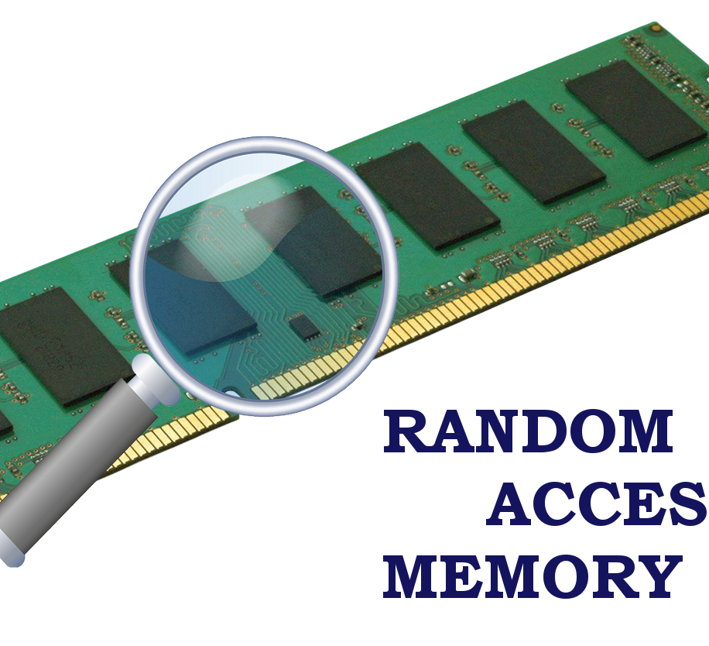
Computer Memory Primary Memory: RAM
RAM is a Random Access Memory; it means the CPU can directly access any address location of RAM memory. RAM is a quickly accessible memory of the computer. It stores the data temporarily.
RAM is a volatile memory. It stores data while the power is on, but once the power is turned off, all data in RAM is erased. The data that needs to be processed currently must be in RAM.
RAM is the fastest and most costly memory of the computer. It is a read-write memory of the computer. The processor can read the instructions from RAM and write the result to the RAM. The data in RAM can be modified.

Slide 7
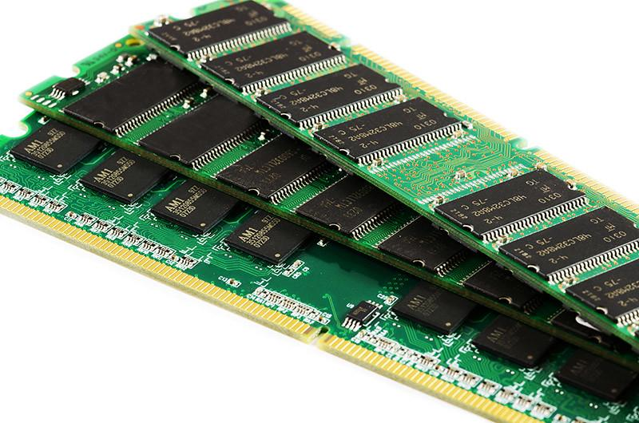
Computer Memory Primary Memory: RAM ( Types )
There are two kinds of RAM, Static RAM and Dynamic RAM.
Static RAM is one which requires the constant flow of the power to retain the data inside it. It is faster and more expensive than DRAM. It is used as a cache memory for the computer.
Dynamic RAM needs to be refreshed to retain the data it holds. It is slower and cheaper than static RAM.
The difference between SRAM and DRAM?
Static RAM is fast and expensive, and dynamic RAM is less expensive and slower. Therefore, static RAM is used to create the CPU's speed-sensitive cache, while dynamic RAM forms the larger system RAM space.

Slide 8
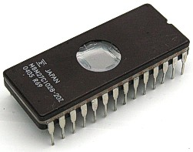
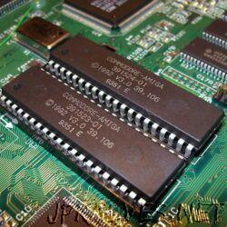
Computer Memory Primary Memory: ROM
ROM is a Read Only Memory. The data in ROM can only be read by CPU but, it can not be modified.
The CPU can not directly access the ROM memory, the data has to be first transferred to the RAM, and then the CPU can access that data from the RAM.
ROM stores the instruction that computer requires during Bootstrapping (a process of booting up of the computer). The content in ROM can not be modified. ROM is a non-volatile memory, the data inside the ROM retains even if the power of the CPU is switched off.
The Basic Input Output System, or BIOS, is a very small piece of code contained on a chip on your system board. When you start your computer, BIOS is the first software that runs. It identifies your computer’s hardware, configures it, tests it, and connects it to the operating system for further instruction.

Slide 9
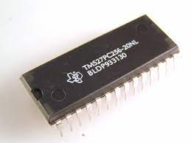
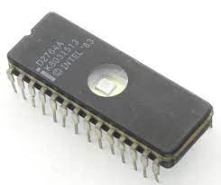
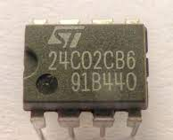
Computer Memory Primary Memory: ROM ( Types )
PROM: Programmable ROM, it can be modified only once by the user.
EPROM: Erasable and Programmable ROM, the content of this ROM can be erased using ultraviolet light and the
ROM can be reprogrammed.
EEPROM: Electrically Erasable and Programmable ROM, it can be erased electrically and reprogrammed by electrical charge.

Slide 10
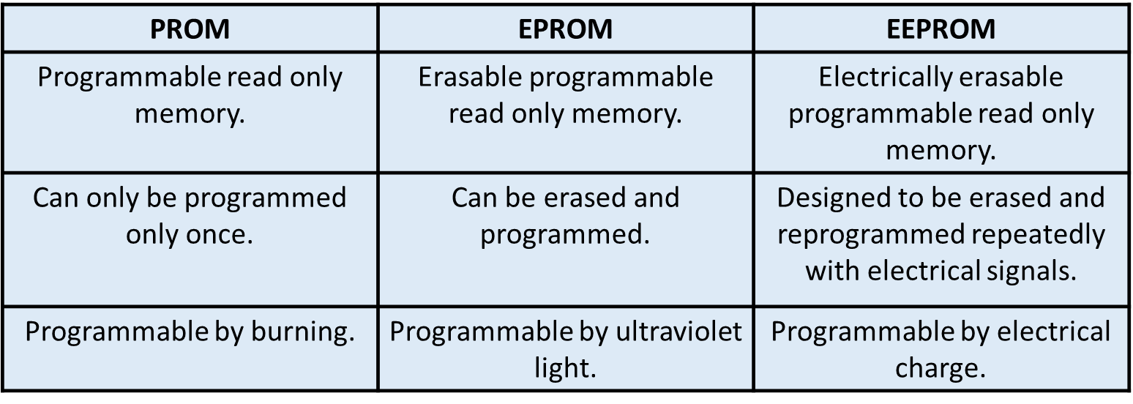
Computer Memory Primary Memory: ROM

Slide 11
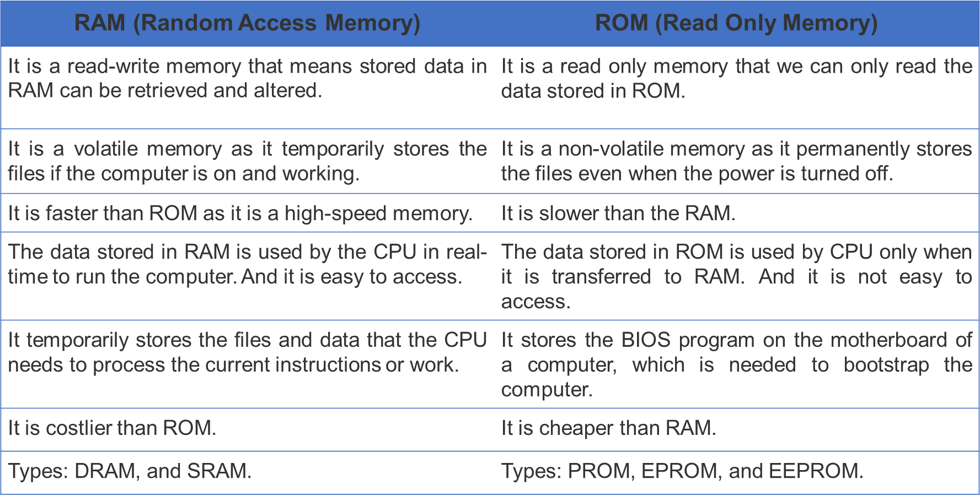
Computer Memory Difference between RAM and ROM

Slide 12
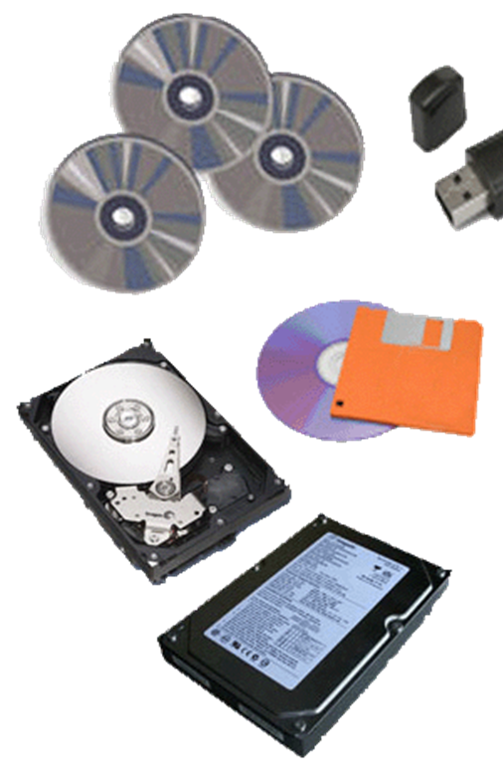
Computer Memory- Secondary Memory
The data that has to be permanently stored is kept in secondary memory. The CPU can not directly access the data in secondary memory. The secondary memory can be accessed using the input-output channel.
The secondary memory is nonvolatile, which means that the content of the secondary memory exist even if the power is switched off.
Secondary memory is always larger than primary memory. A computer can even work without secondary memory.
The examples of secondary memory are the hard drive, CD, DVD, floppy disk, flash disk, etc.

Slide 13
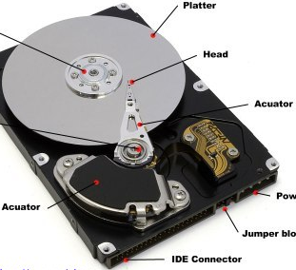
Secondary Memory- Hard disk
A hard disk drive (HDD), commonly referred to as a hard drive is a device that stores digitally encoded data on rapidly rotating platters with magnetic surfaces.
Hard disks are the main large data storage area inside your computer. Hard disks are used to store your programs and data.

Slide 14
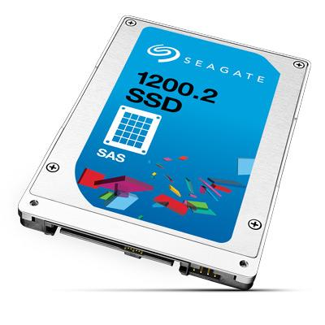
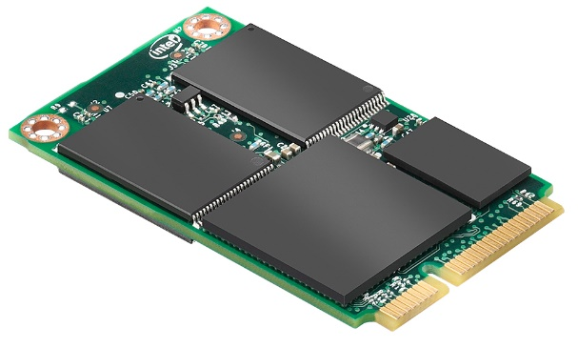
Secondary Memory- SSD, Solid State Drive
SSDs are the newer of the type of hard drive.
Solid-state drives use flash memory, which is also what’s used in USB flash drives and memory cards for digital cameras. There are no magnets involved here, SSDs use semiconductors that store data by altering the electrical state of the trillions of circuits contained within the SSD.

Slide 15
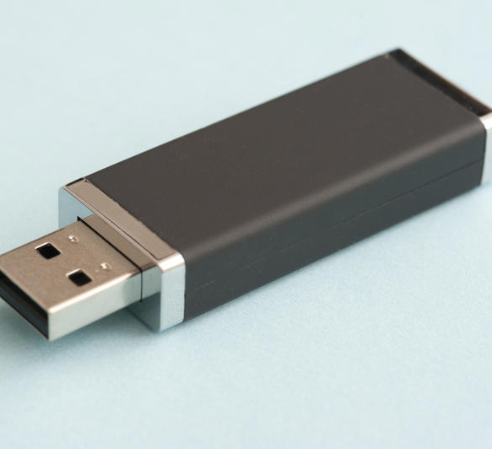
Secondary Memory- Flash Disk ( pen Drive )
Pen drive is a portable memory device that uses solid state memory rather than magnetic fields or lasers to record data. It uses a technology like RAM, except that it is nonvolatile. It is also called USB drive, key drive or flash memory.

Slide 16
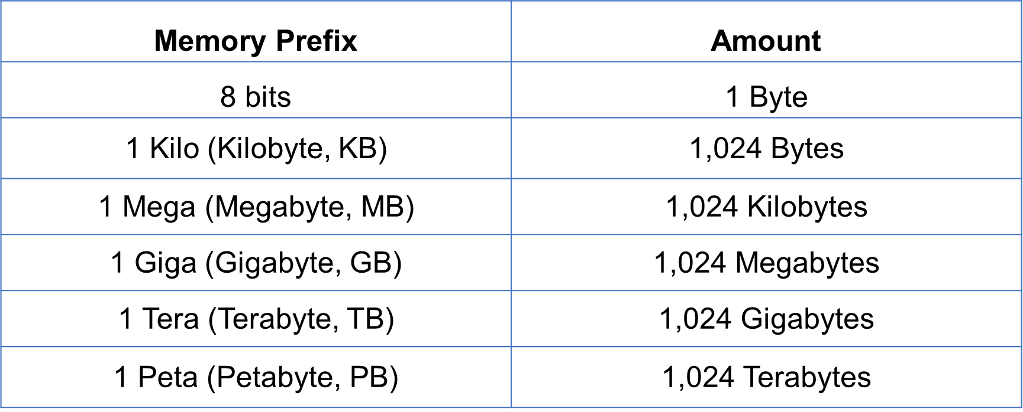
Memory units

Slide 17
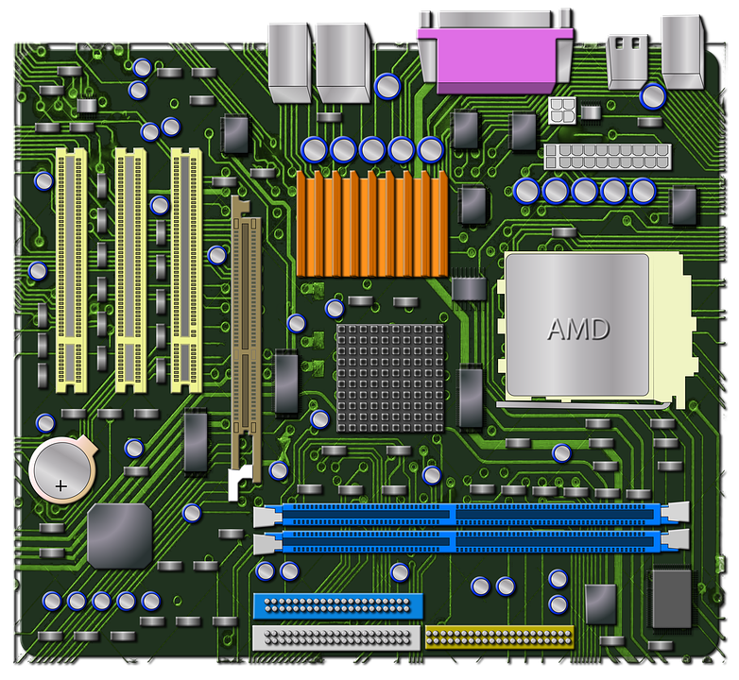
Motherboard
The motherboard is a printed circuit board which acts as the main platform for communication between all other components of a system. All the other computer parts are either directly installed or connected to various motherboard components and all the data is transferred between them through the motherboard.
The motherboard is mounted inside the case and is securely attached via small screws through pre-drilled holes. Motherboard contains ports to connect all of the internal components.
It provides a single socket for CPU, whereas for memory, normally one or more slots are available.
Motherboards provide ports to attach the hard drive, and optical drives via ribbon cables. Motherboard carries fans and a special port designed for power supply.

Slide 18
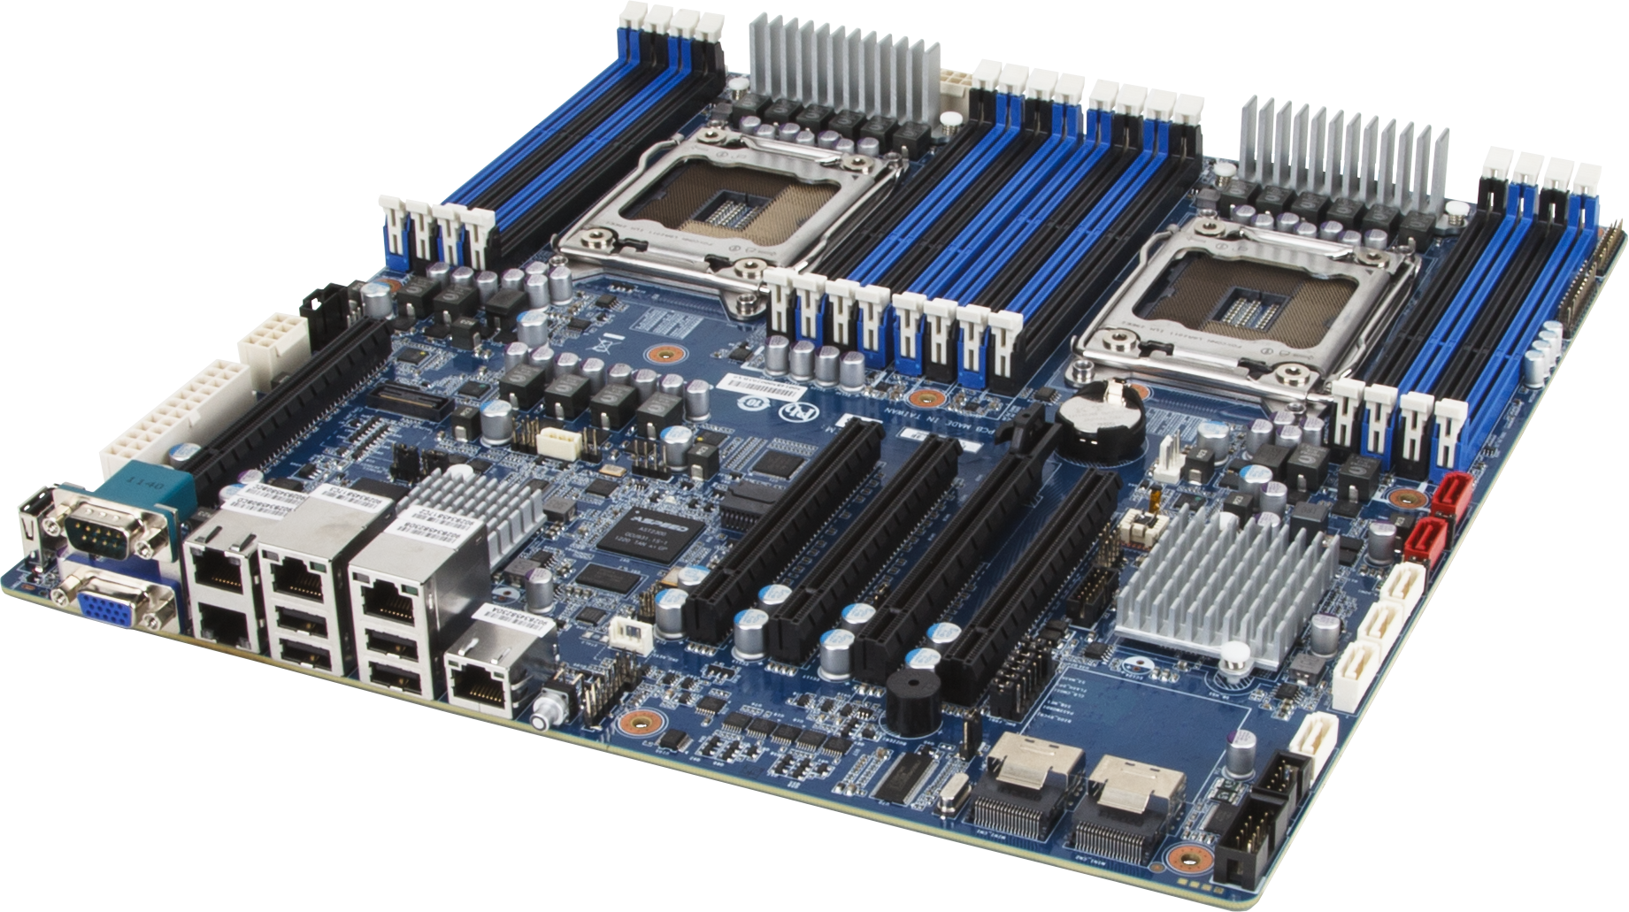
Motherboard- cont.
There is a peripheral card slot in front of the motherboard using which video cards, sound cards, and other expansion cards can be connected to the motherboard.
On the left side, motherboards carry a number of ports to connect the monitor, printer, mouse, keyboard, speaker, and network cables. Motherboards also provide USB ports, which allow compatible devices to be connected in plug-in/plug-out fashion. For example, pen drive, digital cameras, etc.

Slide 19
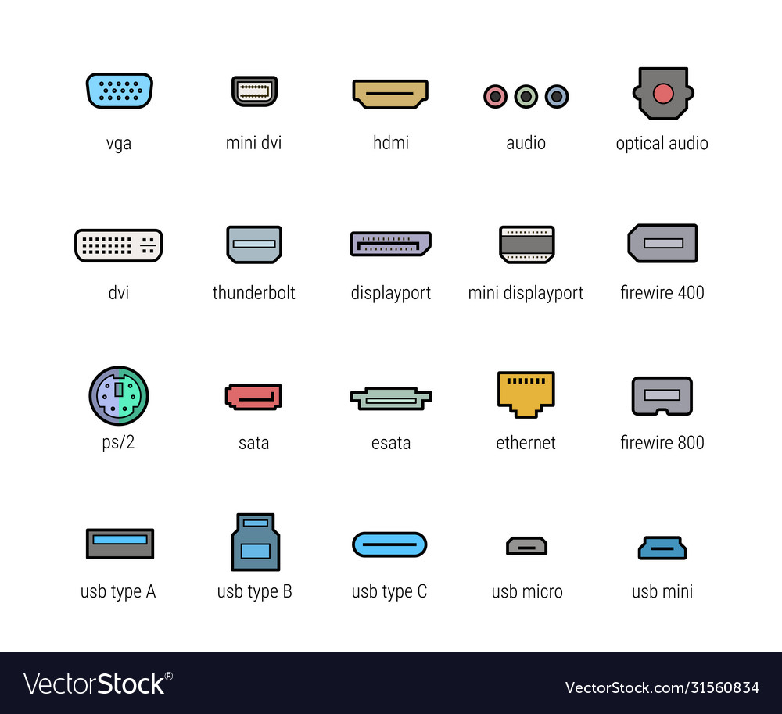
Ports
A Computer Port is an interface or a point of connection between the computer and its peripheral devices.
The main function of a computer port is to act as a point of attachment, where the cable from the peripheral can be plugged in and allows data to flow from and to the device.

Slide 20
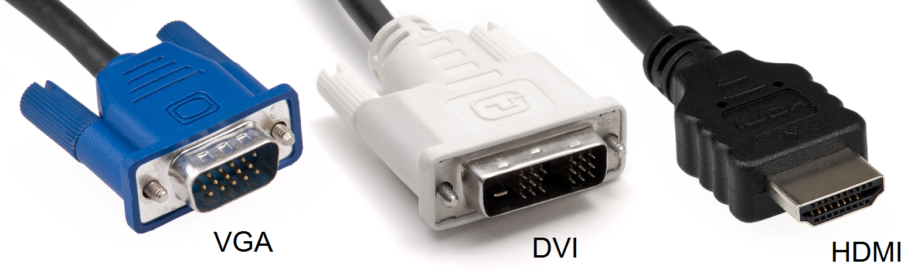
Ports
HDMI Port
The HDMI port is a type of computer port that support the external graphic card of a computer. HDMI stands for High-Definition Multimedia Interface. An HDMI port supports all types of multimedia hardware devices.
VGA Port
In a computer, VGA (Video Graphics Array) port belongs to the graphic card. The primary function of a VGA port is to transmit the graphic data from the computer to the monitor screen display or output.

Slide 21
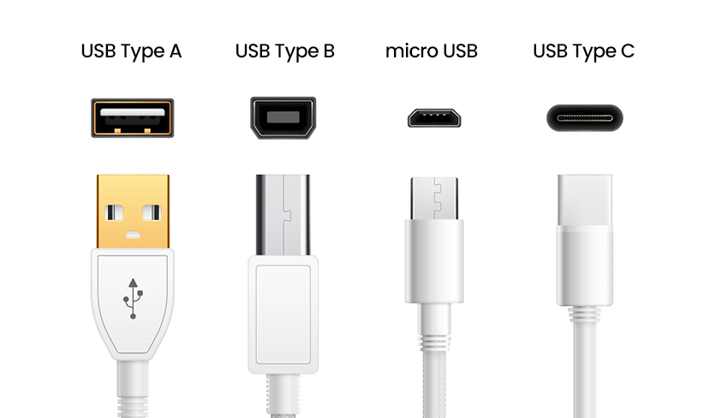
Ports
USB Port
Universal Serial Bus, USB is a plug and play interface that allows a computer to communicate with peripheral and other devices. USB may also send power to certain devices, such as powering smartphones and tablets and charging their batteries. The first commercial release of the Universal Serial Bus (version 1.0) was in 1996.

Slide 22
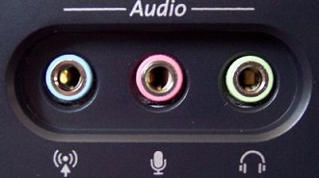
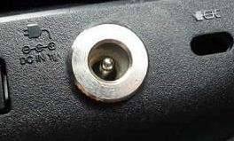
Ports
Audio Port
The function of an Audio Port audio port is to transmit the sound produced by the computer to the external audio output, such as speakers or headphones. An audio port of a computer works with a sound card.
Power Source Port
Without a power source port, a computer will not work at all. The power source port is assigned to provide the power supply for the computer.

Slide 23
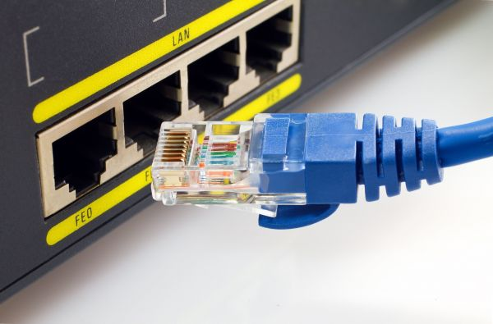
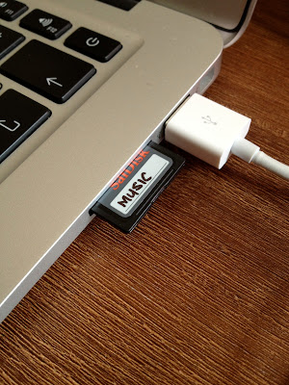
Ports
RJ-45 Port
It is an Ethernet style network port found on the computer and other devices such as routers, switches, etc. This port allows your computer to interact or communicate with other computers and networking devices where Ethernet networking is required.
SD Card Reader Port
An SD card reader exists to receive and transmit data, often as pictures or videos. Cameras, laptops and desktops often have SD card readers. In order to allow the transmission of data, you insert the card into the SD slot.

Slide 24
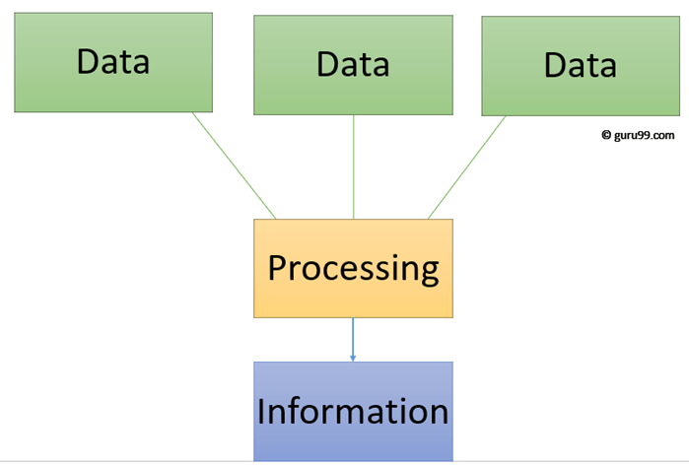
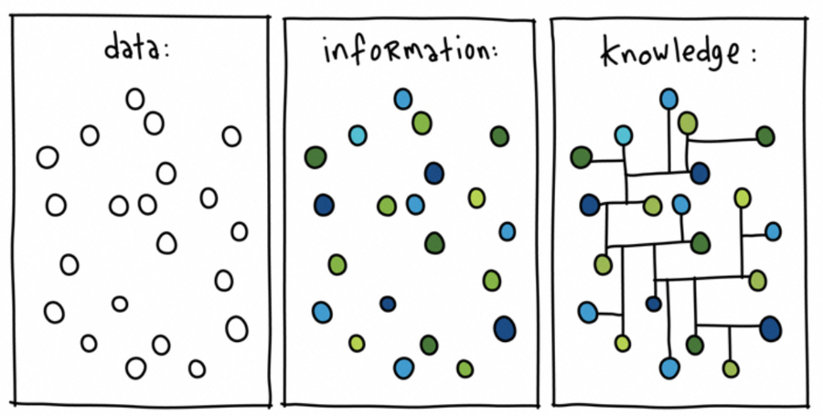
Data and Information
Data: can be defined as a representation of facts, concepts, or instructions in a formalized manner, which should be suitable for communication, interpretation, or processing by human or electronic machine.
(A-Z, a-z)
digits (0-9)
special characters (+,-,/,*,<,>,= etc.)
Information: is organized or classified data, meaningful values for the receiver. Information is the processed data.

Slide 25
Group discussion: 1. Why is RAM important in running applications like zoom and MS Word ? 2. What could happen if a computer didn’t have ROM ? 3. Which is better for Performance: HDD or SSD? Why ?

Slide 26

References
Computer Fundamentals. By Tutorials Point. (2017).
Computing Essentials. By Timothy J. O’Leary. (2017).

Slide 27
Any questions ?

