Slide 1

Tishk International University
Intro to IT course
Fall 2025-2026
Introduction to Passwords and Digital Security
Ms.Yara Arjuman Hashim
Email: yara.arjuman@tiu.edu.iq
Office number: Education Building- 220

Slide 2
Outline
What is a password?
Why passwords matter
Examples of Weak passwords
Risks of Weak passwords and Characteristics of Strong passwords
Common Password attacks
What is Phishing?
Summary

Slide 3
Introduction to passwords and Digital security
Passwords protect our digital identity
They are the first layer of Cybersecurity
Used in Emails, Banking, Social media, and University Systems

Slide 4
What is a password?
A secret string of characters used to confirm identity
Ensures only authorized users access a system
Works together with usernames

Slide 5
Why passwords matter?
Protect personal and academic information
Prevent unauthorized financial access
Keep university systems secure
Protect digital reputation

Slide 6
Examples of Weak passwords
123456, password, qwerty
Names with birth years (Ali2003)
Short and simple patterns

Slide 7
Risks of Weak Passwords
Easily guessed by attackers
Found in hacker password databases
Can be cracked in seconds

Slide 8
Characteristics of Strong Passwords
At least 12–14 characters long
Combination of letters, numbers, and symbols
No personal information
Unique for each account

Slide 9
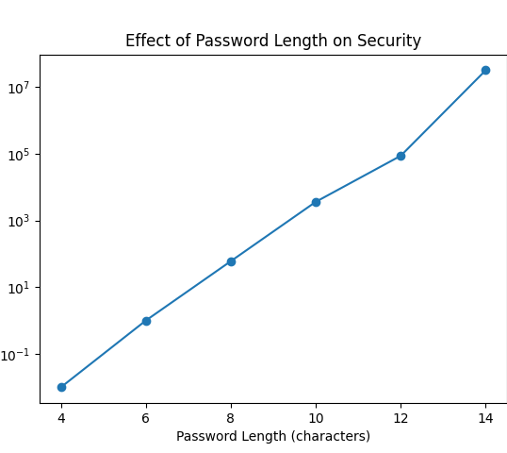
Password Length vs Security
Longer passwords dramatically increase cracking time.
Even small length increases make attacks harder.

Slide 10
Common Password attacks
1. Brute Force –
tries every combination
2. Dictionary –
uses common password lists
3. Phishing –
fake websites/emails
4. Social Engineering – tricking people

Slide 11
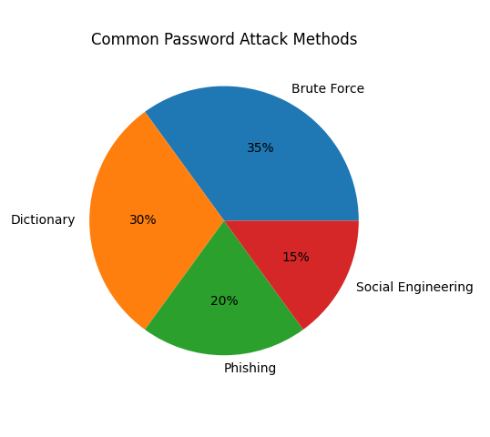
Distribution of Attack methods
Attackers use multiple techniques.
Human mistakes often make attacks easier.

Slide 12
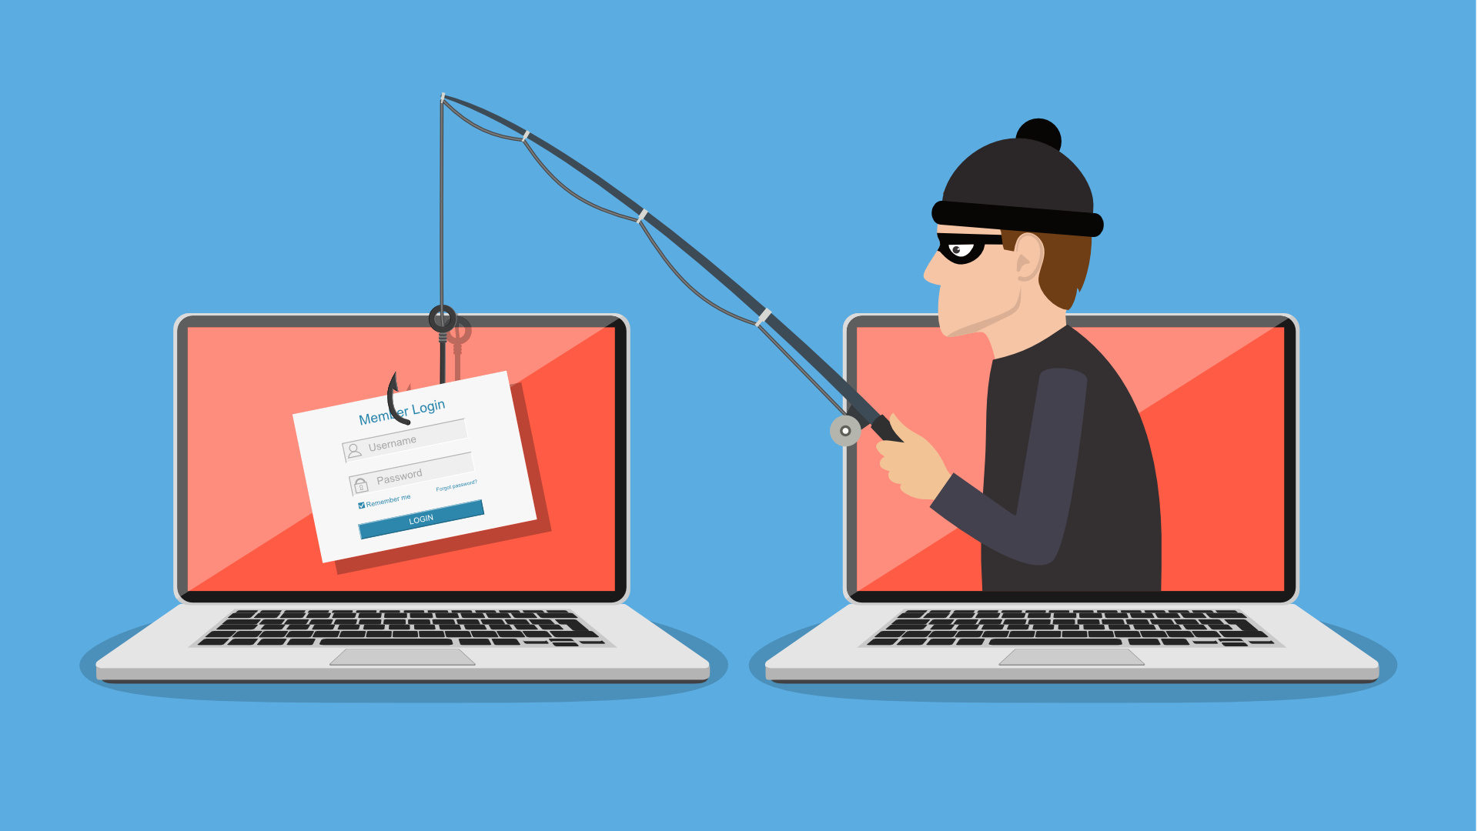
What is Phishing?
Fake emails or websites pretending to be trusted
Goal: trick users into typing passwords
Always verify website addresses

Slide 13
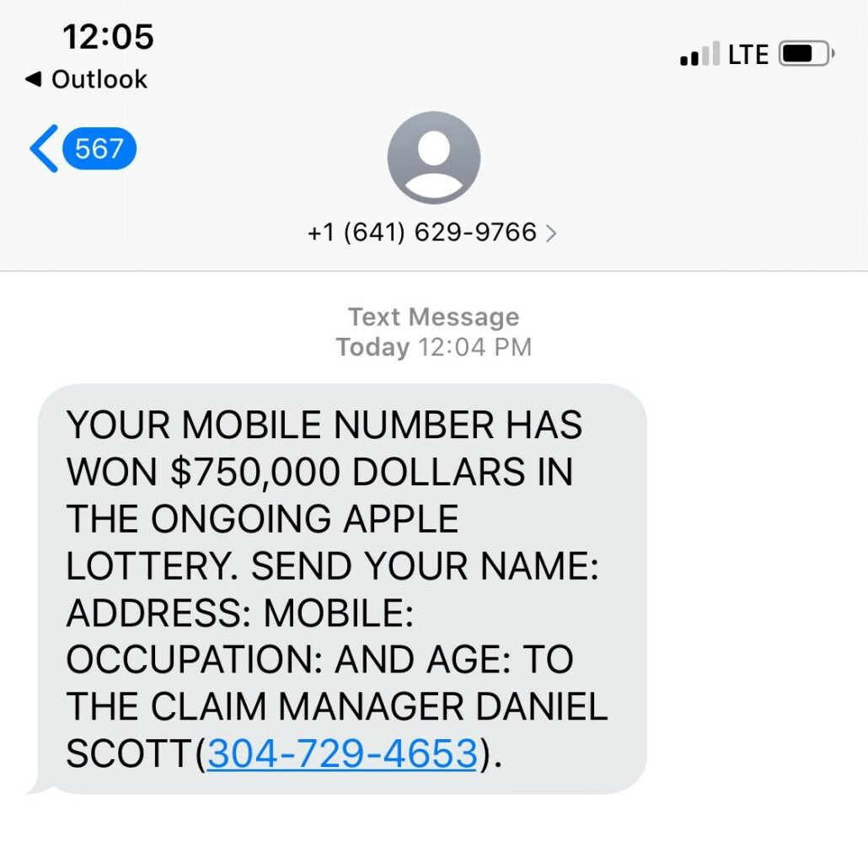
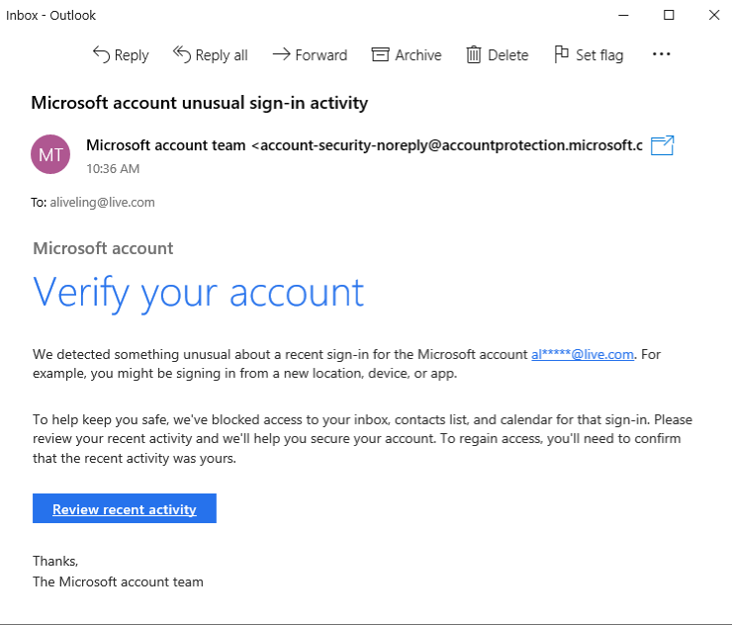

Slide 14
Social Engineering explained
Psychological manipulation
Attackers pretend to be IT staff or officials
Never share passwords with anyone

Slide 15
Password Reuse Danger
One leaked password can unlock many accounts
Hackers use credential stuffing
Email accounts are the biggest risk

Slide 16
Password Managers
Store passwords securely in encrypted form
Generate strong random passwords
You only remember one master password

Slide 17
Two-Factor Authentication (2FA)
Adds a second security layer
Password + phone code or app
Prevents access even if password is stolen

Slide 18
Best Practices
Use long and unique passwords
Enable 2FA on important accounts
Avoid public computer password saving
Be alert to phishing attempts

Slide 19
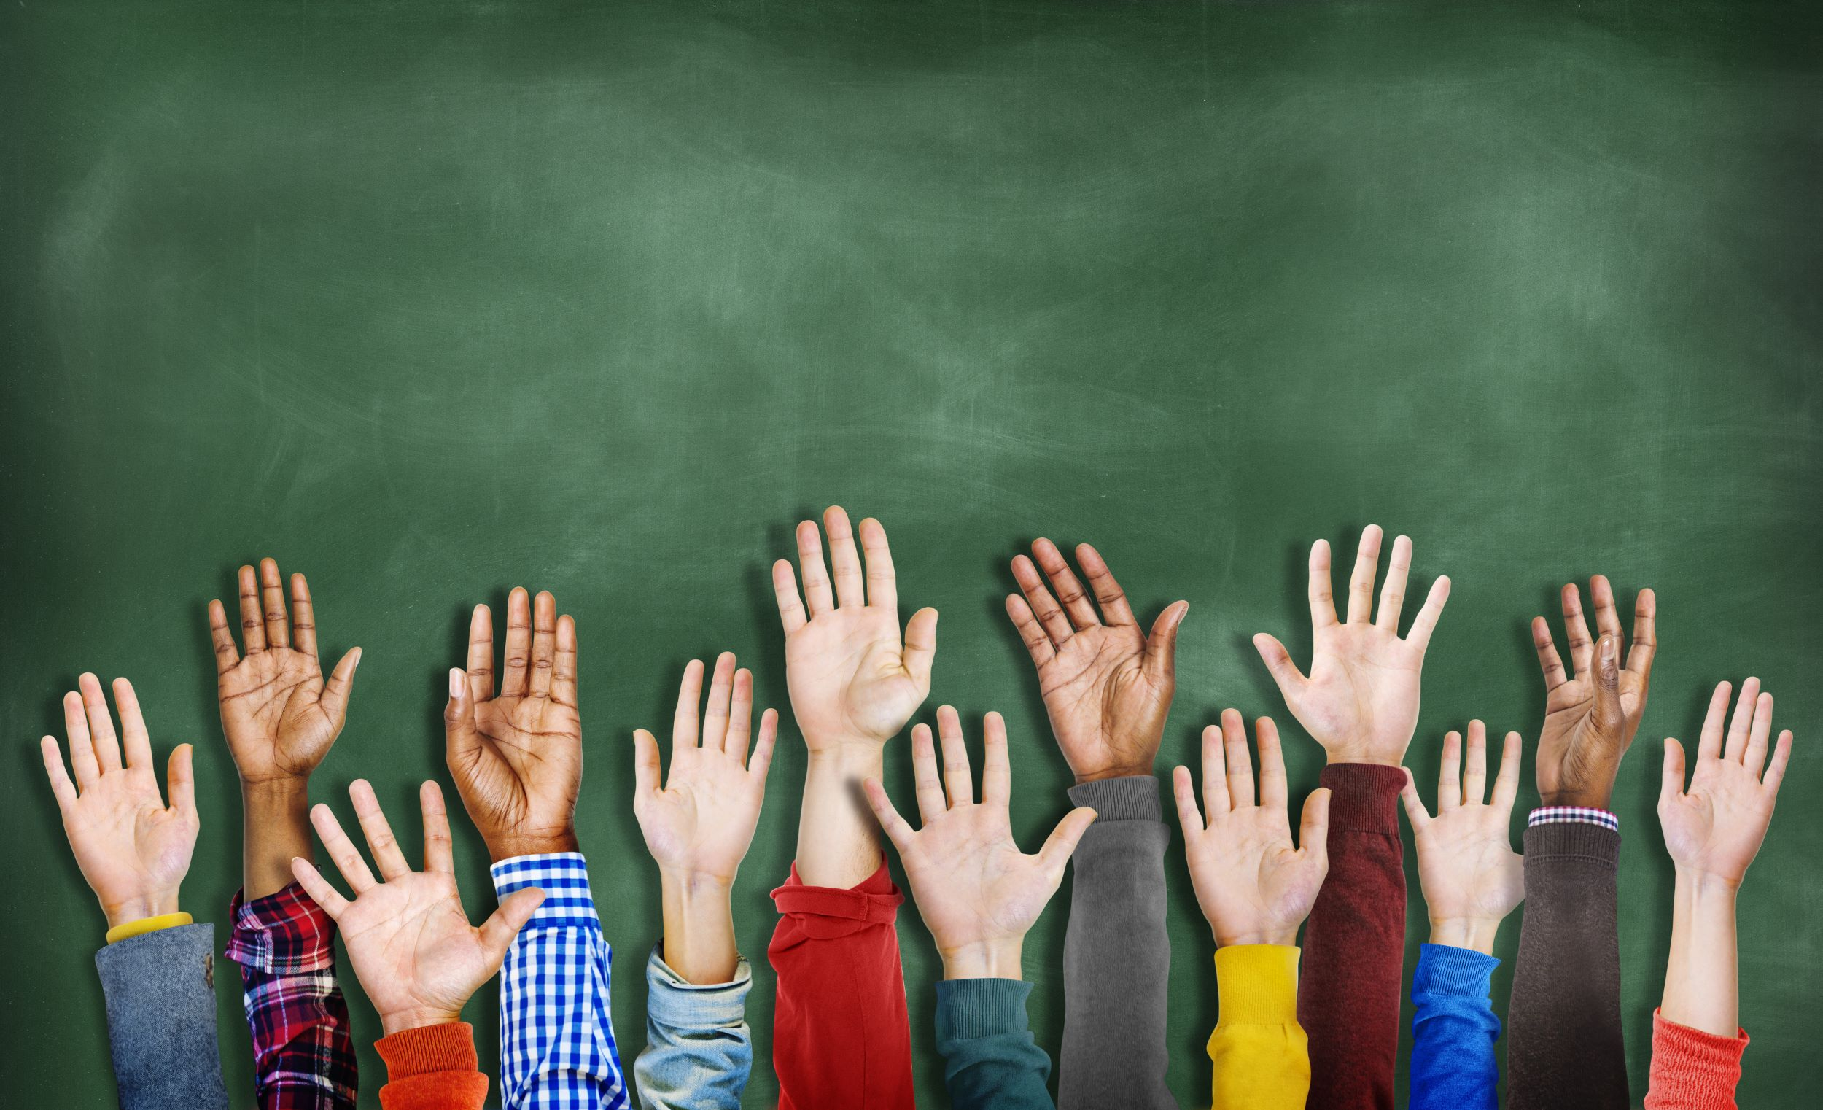
Class Activity
Is Muhammed2004 a strong password? Why?
Compare short complex vs long passphrase
What to do after entering password on a fake site?

Slide 20
Summary
Passwords are the first defense line
Weak passwords are easy to crack
Length + uniqueness = strong protection
2FA greatly improves security

Slide 21
Any questions ?

