Slide 1

Somatic Symptom and Related Disorders
Hilal Farouq Hussein
09/04/2026

Slide 2

Introduction
Psychosomatic began to be used to convey the connection between the mind (psyche) and the body (soma) in states of health and illness.
Real symptoms can begin, continue, or be worsened as a result of emotional factors.
Examples include diabetes, hypertension, and colitis, all of which are medical illnesses influenced by stress and emotions.

Slide 3
Con
Sigmund Freud, working with Charcot, observed that people with hysteria improved with hypnosis and experienced relief from their physical symptoms when they recalled memories and expressed emotions.
This development led Freud to propose that people can convert unexpressed emotions into physical symptoms, a process now referred to as somatization .

Slide 4

Types of Psychosomatic Illnesses
Somatic symptom disorder is characterized by one or more physical symptoms that have no organic basis.

Slide 5
Somatic Symptom
Disorder
DSM-5 Diagnostic Features | A Guide for Students
Understanding • Identifying • Teaching

Slide 6
What Is Somatic Symptom Disorder?
CORE DEFINITION
A disorder in which individuals experience multiple, current somatic (body-based) symptoms that are either distressing or significantly disrupt their daily life — regardless of whether a medical explanation exists.
Criterion A
Key Note
Important
Multiple somatic symptoms
causing distress or disruption
Sometimes just ONE severe
symptom (often pain) is enough
Suffering is real & authentic
whether explained or not
Slide 2 of 8

Slide 7
Types of Symptoms
🎯 Specific Symptoms
Localized pain (e.g., back pain, headache) | Pain in a defined body part | Clearly identifiable and described by the patient
🌐 Non-Specific Symptoms
Generalized fatigue or weakness | Vague discomfort or malaise | Harder to pin to a single cause or location
⚠️ Normal Bodily Sensations
Everyday sensations perceived as threatening | Normal discomfort magnified into serious concern | Does NOT mean the person is faking pain
Slide 3 of 8

Slide 8
Criterion B — The Psychological Dimension
Beyond physical symptoms, patients show EXCESSIVE thoughts, feelings, and behaviours:
B1
Disproportionate / Persistent Thoughts
Patient believes their symptoms are more serious than evidence suggests; thoughts are ongoing and hard to shift
B2
High Anxiety About Health
Persistent, elevated worry about illness; even reassurance doesn't bring lasting relief; always fearing the worst
B3
Excessive Time & Energy on Symptoms
Daily life revolves around health concerns; frequent doctor visits; symptoms dominate conversations & relationships
Slide 4 of 8

Slide 9
Co-occurrence With Medical Conditions
Somatic
Symptom
Disorder
Medical
Condition
BOTH
can
coexist
Example: A patient with a heart attack (myocardial infarction) that caused no lasting disability may still become seriously impaired from SSD symptoms after recovery.
Slide 5 of 8

Slide 10
Severity Specifiers
MILD
Criteria: 1 Criterion B symptom fulfilled
Impact: More prevalent; limited impairment
MODERATE
Criteria: 2 or more Criterion B present
Impact: Higher impairment in daily function
SEVERE
Criteria: 2+ B criteria + multiple somatic complaints
or one very severe somatic symptom
Impact: Marked impairment; can lead to invalidism if persistent
Slide 6 of 8

Slide 11
Somatic Symptom Disorder and Diagnostic Criteria
One or more somatic symptoms that are distressing or result in significant disruption of daily life.
B. Excessive thoughts, feelings, or behaviors related to the somatic symptoms or associated health concerns as manifested by at least one of the following:
Disproportionate (unequal) and persistent thoughts about the seriousness of one’s symptoms.
2. Persistently high level of anxiety about health or symptoms.
3. Excessive time and energy devoted to these symptoms or health concerns.

Slide 12
Somatic Symptom Disorder and Diagnostic Criteria
C. The state of being symptomatic is persistent (typically more than 6 months).

Slide 13
Specify current severity:
Mild: Only one of the symptoms specified in Criterion B is fulfilled.
Moderate: Two or more of the symptoms specified in Criterion B are fulfilled.
Severe: Two or more of the symptoms specified in Criterion B are fulfilled, plus there are multiple somatic complaints (or one very severe somatic symptom).

Slide 14
Somatic Symptom Disorder
The prevalence of somatic symptom disorder in the general adult population may be around 5%–7%. Females more than males.
Comorbidity
Somatic symptom disorder is associated with high rates of comorbidity with medical disorders as well as anxiety and depressive disorders.

Slide 15
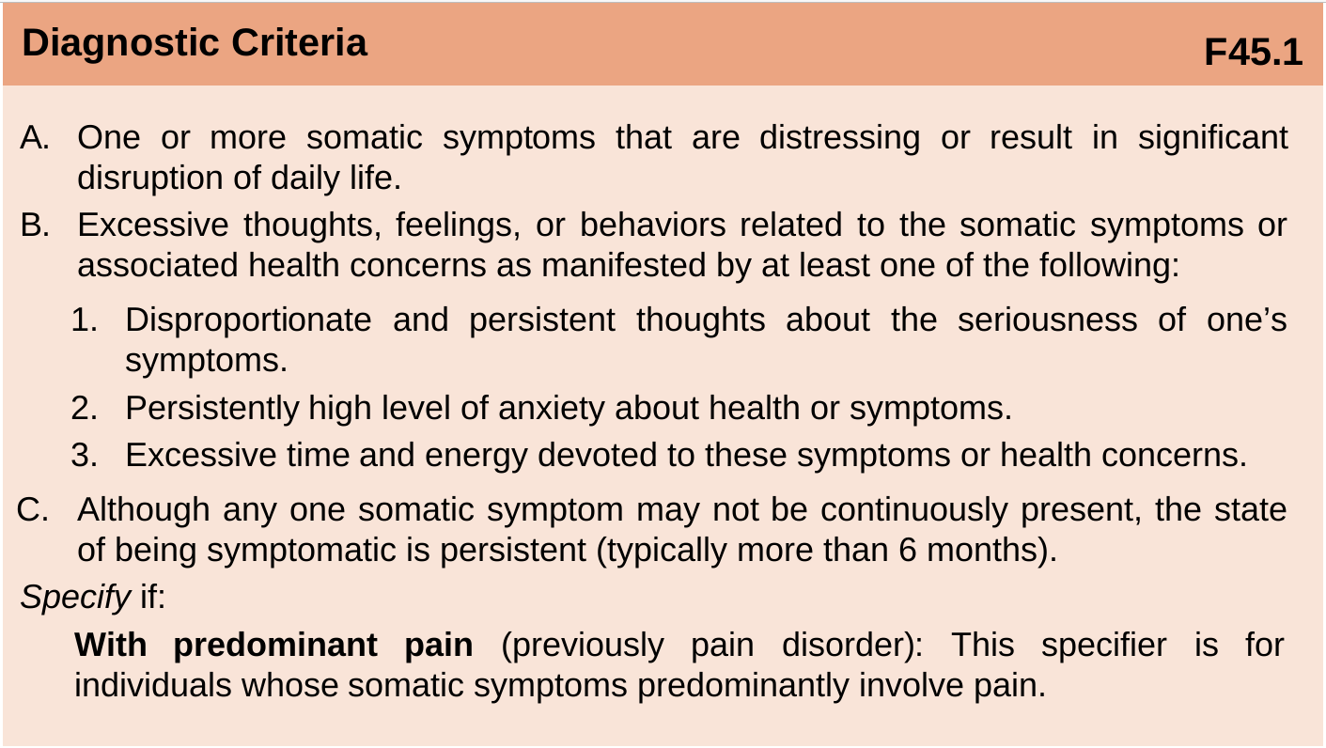

Slide 16
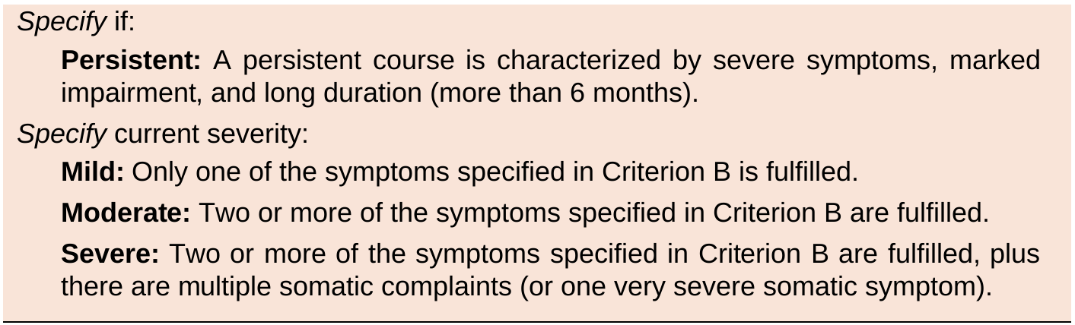

Slide 17
🧒 SSD Across the Lifespan - Children
Common Symptoms in Children
🤢
Recurrent abdominal pain
🤕
Headache
😴
Fatigue
🤧
Nausea
⚠️ Single prominent symptom more common in children than adults
Slide 10 of 12

Slide 18
Key Takeaways & Special Populations
📋 Key Takeaways
👶 Children &
Adolescents
✓ Somatic symptoms can be specific OR non-specific
✓ SSD and a real medical illness can occur together
✓ Criterion B captures the psychological/behavioral dimension
✓ Severity ranges from Mild → Moderate → Severe
✓ Impairment in quality of life — physically and mentally
The DSM-5 criteria for SSD are considered appropriate for use in children and adolescents.
However, these criteria have been less studied in youth than in adults — an important area for ongoing research.
Remember: Patient suffering is authentic — our role is to understand, not dismiss.

Slide 19

Illness Anxiety Disorder
Illness anxiety disorder: formerly hypochondriasis, is preoccupation with the fear that one has a serious disease (disease conviction) or will get a serious disease (disease phobia).
It is thought that clients with this disorder misinterpret bodily sensations or functions.

Slide 20
Illness Anxiety Disorder
A. Preoccupation with having or acquiring a serious illness.
B. Somatic symptoms are not present or, if present, are only mild in intensity.
The preoccupation is clearly excessive or disproportionate (unequal).

Slide 21
Illness Anxiety Disorder
C. There is a high level of anxiety about health, and the individual is easily alarmed about personal health status.
D. The individual performs excessive health-related behaviors (e.g., repeatedly checks his or her body for signs of illness) or exhibits maladaptive avoidance (e.g., avoids doctor appointments and hospitals).

Slide 22
Illness Anxiety Disorder
E. Illness preoccupation has been present for at least 6 months.
F. The illness-related preoccupation is not better explained by another mental disorder, such as somatic symptom disorder, panic disorder, generalized anxiety disorder, body dysmorphic disorder, obsessive-compulsive disorder, or delusional disorder.

Slide 23
Illness Anxiety Disorder
3% and 8%.
The prevalence of the disorder is similar in males and females.

Slide 24
Conversion Disorder
Conversion disorder, sometimes called conversion reaction, involves unexplained, usually sudden deficits in sensory or motor function (e.g., blindness, paralysis).
These deficits suggest a neurologic disorder but are associated with psychological factors.

Slide 25
Conversion Disorder
(Functional Neurological Symptom Disorder)
A. One or more symptoms of altered voluntary motor or sensory function.
B. Clinical findings provide evidence of incompatibility between the symptom and recognized neurological or medical conditions.
C. The symptom or deficit is not better explained by another medical or mental disorder.
D. The symptom or deficit causes clinically significant distress or impairment in social, occupational, or other important areas of functioning or warrants medical evaluation.

Slide 26
Conversion Disorder and prevalence
The incidence of individual persistent conversion symptoms is estimated to be 2–5/100,000 per year.
Conversion disorder is two to three times more common in females.

Slide 27
Factitious Disorder
Factitious disorder, imposed on self, occurs when a person intentionally produces or feigns physical or psychological symptoms solely to gain attention.
People with factitious disorder may even inflict injury on themselves to receive attention.
The common term for factitious disorder imposed on self is Munchausen syndrome

Slide 28
Con
A variation of factitious disorder, imposed on others, is commonly called Munchausen syndrome by proxy, and occurs when a person inflicts illness or injury on someone else to gain the attention of emergency medical personnel or to be a “hero” for saving the victim

Slide 29
Factitious Disorder Imposed on Self and Diagnostic Criteria
Falsification of physical or psychological signs or symptoms, or induction of injury or disease, associated with identified deception.
B. The individual presents himself or herself to others as ill, impaired, or injured.
C. The deceptive behavior is evident even in the absence of obvious external rewards.
D. The behavior is not better explained by another mental disorder, such as delusional disorder or another psychotic disorder.

Slide 30
Factitious Disorder Imposed on other
Falsification of physical or psychological signs or symptoms, or induction of injury or disease, in another person, associated with identified deception.
B. The individual presents another individual (victim) to others as ill, impaired, or injured.
C. The deceptive behavior is evident even in the absence of obvious external rewards.
D. The behavior is not better explained by another mental disorder, such as delusional disorder or another psychotic disorder.

Slide 31
The prevalence of factitious disorder
Among patients in hospital settings, it is estimated that about 1% of individuals have presentations that meet the criteria for factitious disorder.

Slide 32
Related Disorders
Malingering is the intentional production of false or grossly exaggerated physical or psychological symptoms; it is motivated by external incentives such as avoiding work, evading criminal prosecution, obtaining financial compensation, or obtaining drugs.
Their purpose is some external incentive or outcome that they view as important and results directly from the illness.
People who malinger can stop the physical symptoms as soon as they have gained what they wanted (Bass & Wade, 2019).

Slide 33
Primary and Secondary Gain
Primary gains are the direct internal benefits that being sick provides, such as relief of anxiety, conflict, or distress.
Secondary gains are the external or personal benefits received from others because one is sick, such as attention from family members and comfort measures (e.g., being brought tea, receiving a back rub).

Slide 34
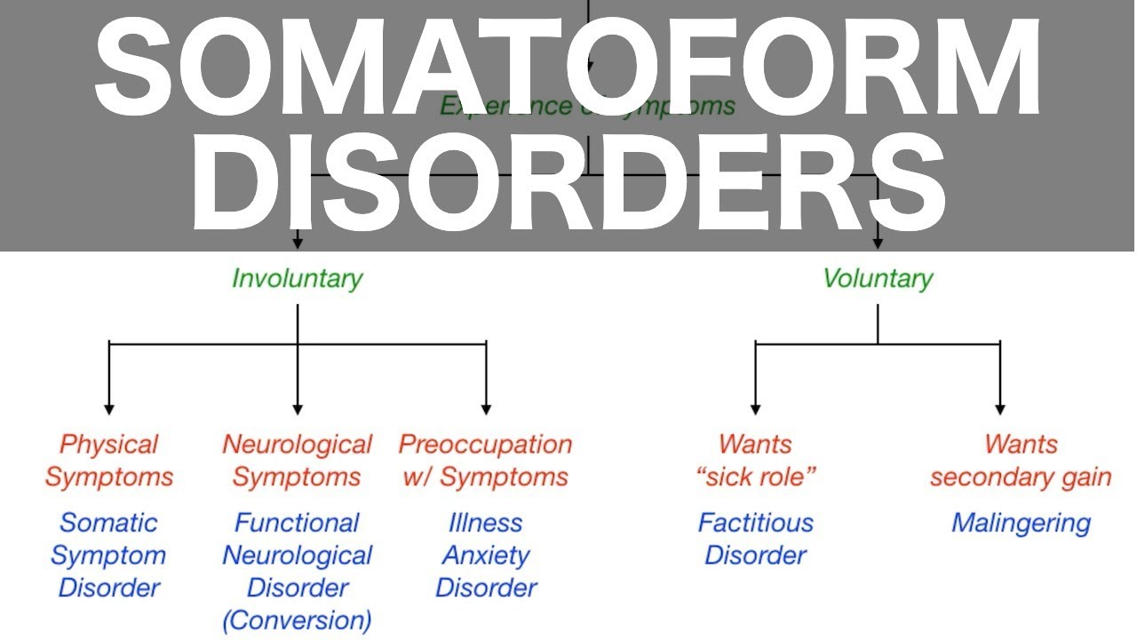

Slide 35
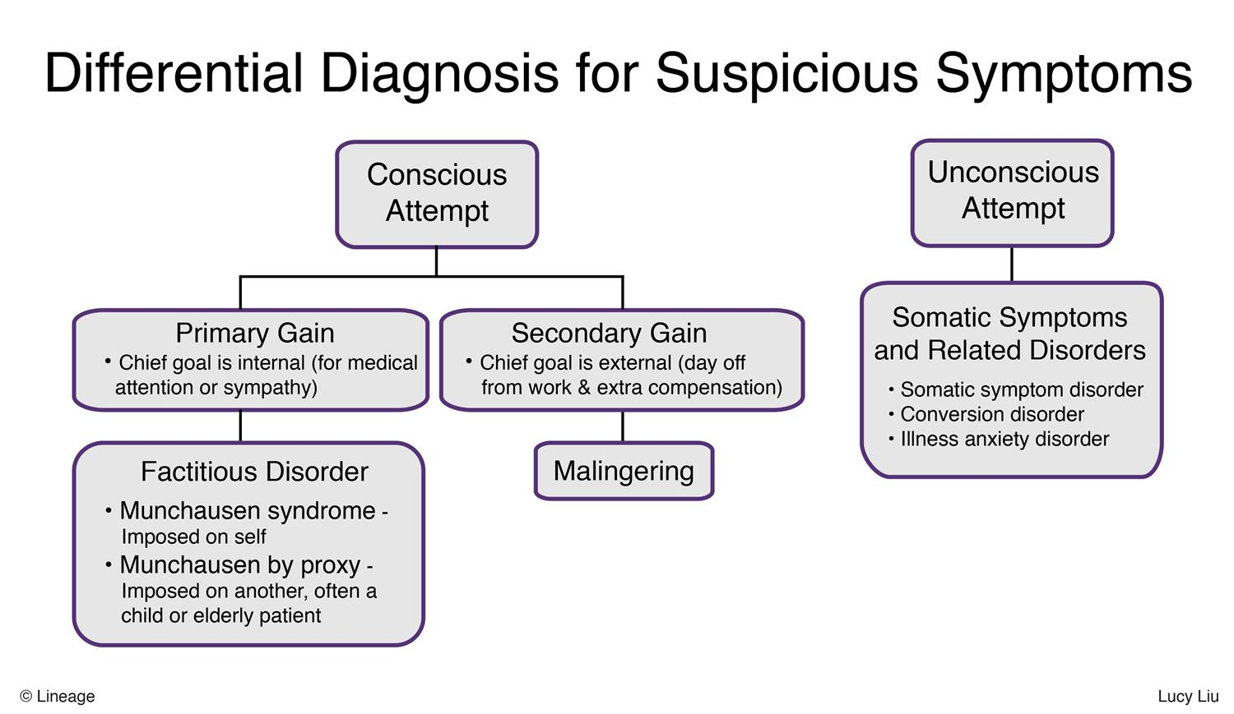

Slide 36
Reference
Shelia L.Videbeck. Psychiatric – Mental Health Nursing 8th ed. Wolters Kluwer
DSM-5

Slide 37


