Slide 1
Free radicals, oxidaive stress and anti-oxidants
Yaseen Galali

Slide 2
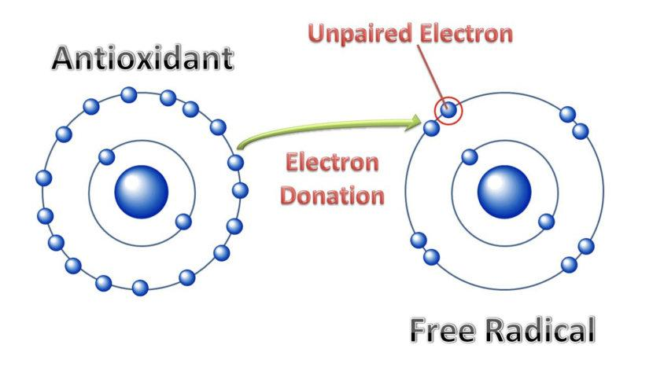
WHAT ARE FREE RADICALS?
Free radicals, including reactive oxygen species, are molecules with one or more unpaired electron. Examples of free radicals include:
superoxide
hydroxyl radical
nitric oxide radical

Slide 3
WHY WE HAVE FREE RADICALS
Cells contain small structures called mitochondria, which work to generate energy in the form of adenosine triphosphate (ATP).
Mitochondria combine oxygen and glucose to produce carbon dioxide, water, and ATP. Free radicals arise as byproducts of this metabolic process.

Slide 4
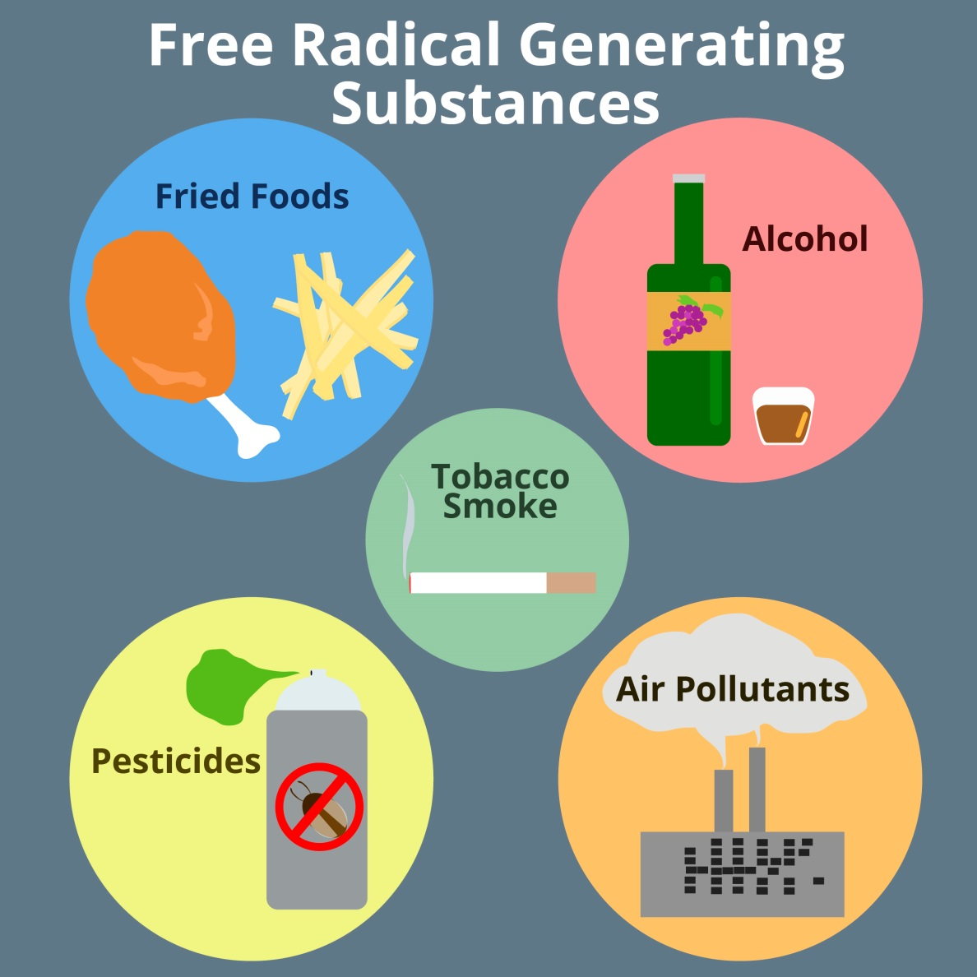
OTHER FACTORS FOR FREE RADICALS
Smoking
Air pollution
Pesticides
Diet
Alcohol
Radiation and UV light

Slide 5
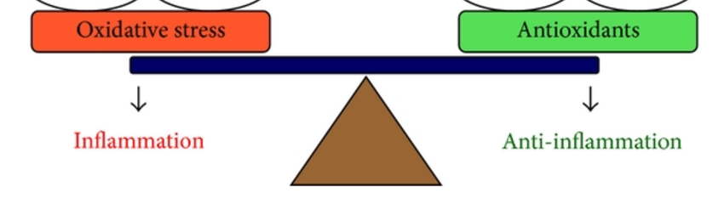
OXIDASE STRESS
Oxidative stress can occur when there is an imbalance of free radicals and antioxidants in the body.

Slide 6
The body’s cells produce free radicals during normal metabolic processes. However, cells also produce antioxidants that neutralize these free radicals. In general, the body is able to maintain a balance between antioxidants and free radicals.

Slide 7

EFFECTS OF OXIDATIVE STRESS
The effects of oxidative stress vary and are not always harmful. For example, oxidative stress that results from physical activity may have beneficial, regulatory effects on the body.
Exercise increases free radical formation, which can cause temporary oxidative stress in the muscles. However, the free radicals formed during physical activity regulate tissue growth and stimulate the production of antioxidants.

Slide 8
Mild oxidative stress may also protect the body from infection and diseases. In a 2015 study, scientists found that oxidative stress limited the spread of melanoma cancer cells in mice.
However, long-term oxidative stress damages the body’s cells, proteins, and DNA. This can contribute to aging and may play an important role in the development of a range of conditions.

Slide 9
CONDITIONS LINKED TO OXIDATIVE STRESS
Chronic Oxidative stress may play a role in the development of a range of conditions, including:
cancer
Alzheimer’s disease
Parkinson’s disease
diabetes
cardiovascular conditions such as high blood pressure, atherosclerosis, and stroke
inflammatory disorders
chronic fatigue syndrome
asthma
male infertility

Slide 10
ANTIOXIDANTS
Antioxidants are substances that neutralize or remove free radicals by donating an electron. The neutralizing effect of antioxidants helps protect the body from oxidative stress. Examples of antioxidants include vitamins A, C, and E.

Slide 11
ANTIOXIDANTS PREVENTS
Lipid peroxidation
Oxidative damage to protein
Oxidative damage to DNA
•ANTIOXIDANTS have low redox potential and will sacrifice themselves to prevent oxidative damage

Slide 12
SOURCES OF ANTIOXIDANTS
Like free radicals, antioxidants come from several different sources.
Cells naturally produce antioxidants such as glutathione.
A person’s diet is also an important source of antioxidants. Foods such as fruits and vegetables provide many essential antioxidants in the form of vitamins and minerals that the body cannot create on its own.

Slide 13
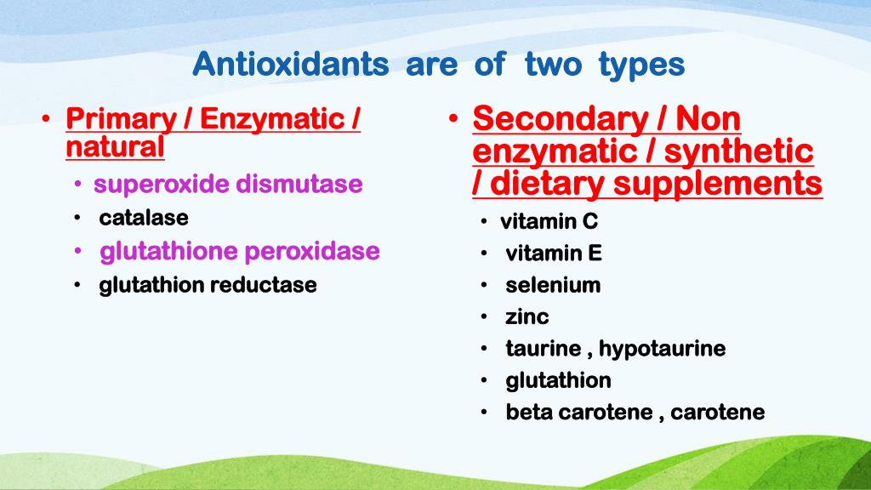
Types of anti-oxidants

