Slide 1
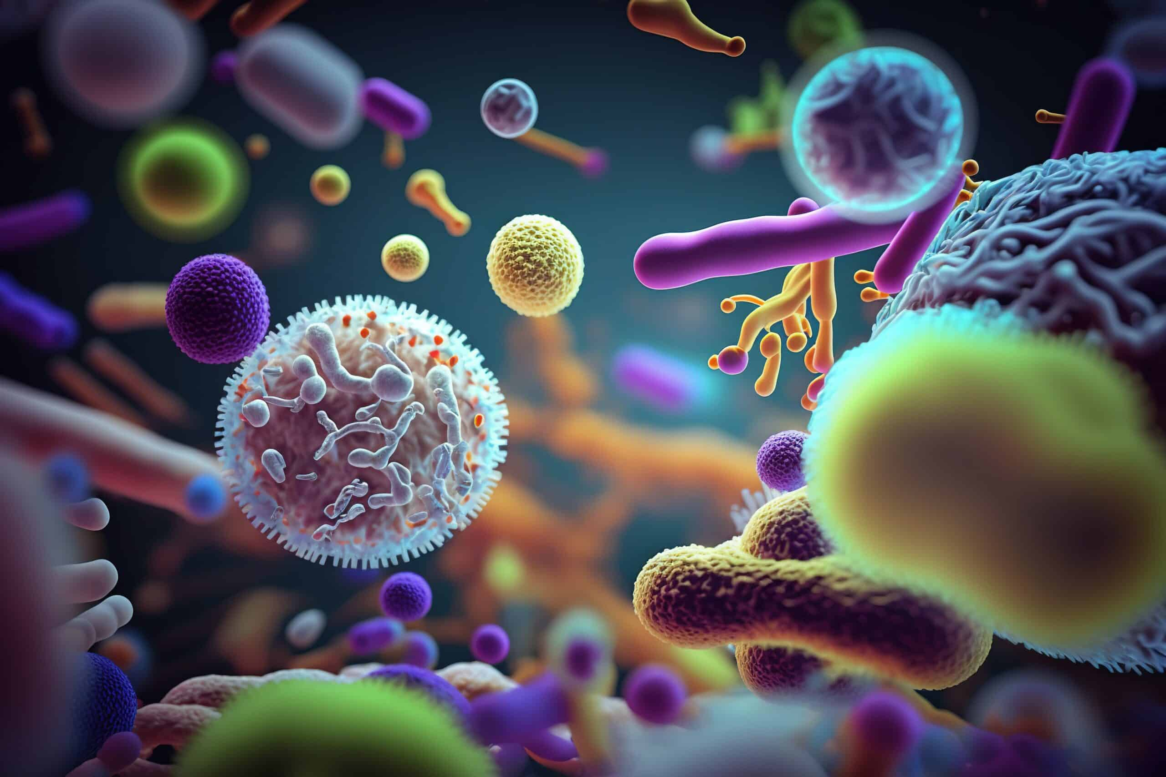

CORYNEBACTERIA
Ms. Heshu J. Ahmed
PhD Candidate
Medical Bacteriology 423
Spring Semester
Week Seven

Slide 2
Outline
Characteristics of the bacteria
Epidemiology
Pathogenesis
Immunity
Manifestations
Diagnosis
Treatment

Slide 3
Objectives
1. Introduce streptococci and group characteristics.
2. Explore streptococci virulence factors and mechanisms.
3. Discuss streptococci infections epidemiology.
4. Examine streptococci infection diagnostic methods.

Slide 4
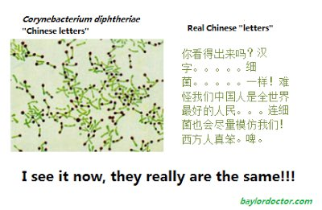
Genus's characteristics
Gram-positive rods.
Aerobic and facultative.
The cells tend to have clubbed ends and often remain attached after division, forming “Chinese letter” arrangements.
Not spore forming.
Catalase is produced.

Slide 5
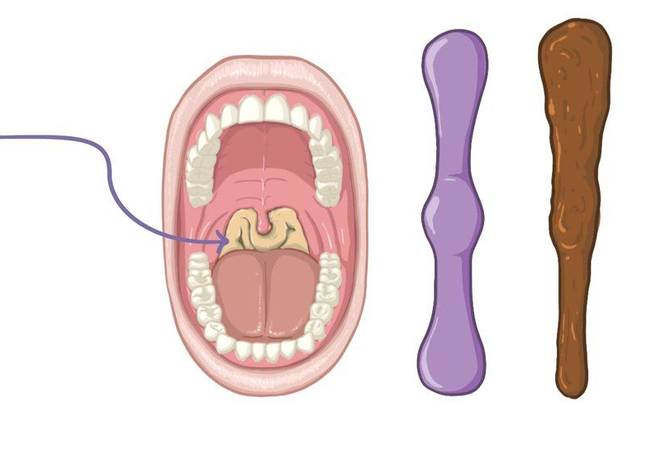
Corynebacterium diphtheriae
Corynebacterium diphtheriae produces a powerful exotoxin known as Diphtheria toxin (DT).
Strains of C diphtheriae may or may not produce DT.
Causes Diphtheria diseases
Diphtheria is characterized by formation of pseudo-membrane

Slide 6
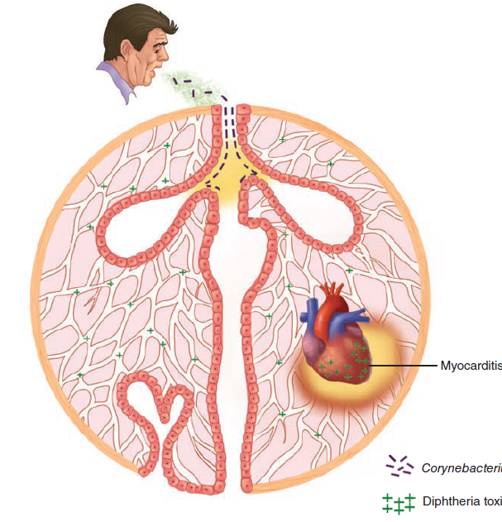
Epidemiology
Infection with Corynebacterium diphtheriae is acquired by respiratory droplet spread.
The throat and upper airways are infected, but there is no invasion.
Diphtheria toxin (DT) produced at the primary side is absorbed into the bloodstream and affects multiple organs, particularly the heart where acute myocarditis is produced.

Slide 7
Pathogenesis
Corynebacterium diphtheriae has weak invasive capacity,
Diphtheria is due to the local and systemic effects of DT, a protein exotoxin with potent cytotoxic features
It inhibits protein synthesis
DT enters bloodstream, spreads throughout the body.
Eventually, acute myocarditis develops.

Slide 8
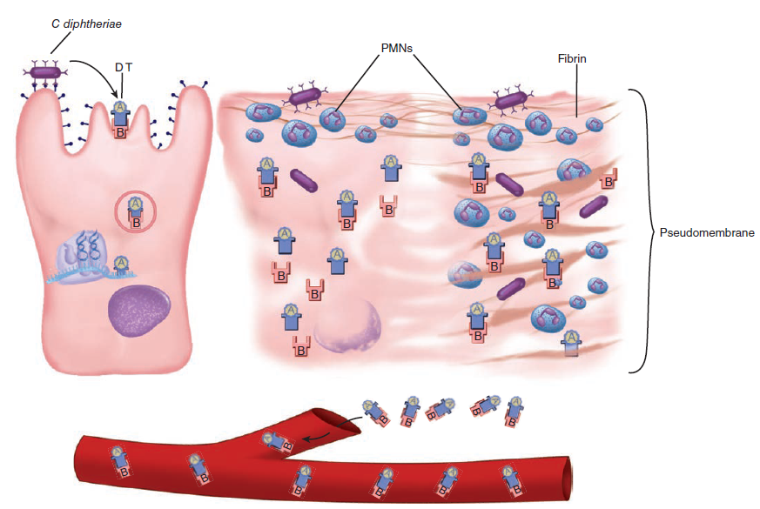

Slide 9
Pathogenesis
After binding mediated by the B subunit, both the A and B subunits enter the cell in an endocytotic vacuole.
In the low pH of the vacuole, the toxin unfolds, exposing sites that facilitate translocation of the A subunit from the phagosome to the cytosol.

Slide 10
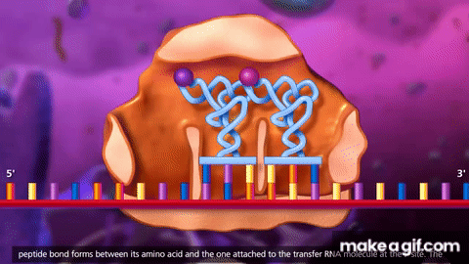
Pathogenesis
The target is elongation factor 2 (EF-2), which transfers tRNA from acceptor to donor sites on the ribosome of the host cell.
This shuts off protein synthesis.
Corynebacterium diphtheriae itself is unaffected because it uses a protein other than EF-2 for the same steps in protein synthesis.
The production of DT’s action on epithelial cells leads to necrosis and inflammation, forming a pseudo-membrane composed of a coagulum of fibrin, leukocytes, and cellular debris.

Slide 11
Immunity
DT is antigenic, stimulating the production of protective antitoxin antibodies during natural infection.
Formalin treatment of toxin produces toxoid, which retains the antigenicity but not the toxicity of native toxin and is used in immunization against the disease

Slide 12
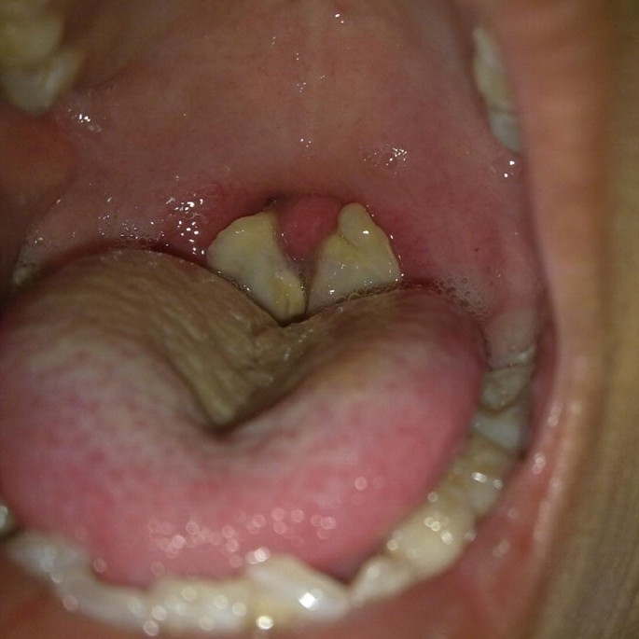
Manifestations
After an incubation period of 2 to 4 days, diphtheria usually manifests as pharyngitis or tonsillitis.
Typically, malaise, sore throat, and fever occur, and a patch of exudate or membrane develops on the tonsils, uvula, soft palate, or pharyngeal wall.
The gray-white pseudo-membrane adheres to the mucous membrane and may extend from the oropharyngeal area down to the larynx and into the trachea.

Slide 13
Manifestations
the infection gradually resolves, and the membrane is coughed up after 5 to 10 days.
The complications and lethal effects of diphtheria are caused by respiratory obstruction or by the systemic effect of DT.
In complicated cases, It appears during the second or third week and is manifested by cardiac enlargement, arrhythmia, and congestive heart failure with dyspnea.

Slide 14

DIAGNOSIS
The initial diagnosis of diphtheria is entirely clinical.
Direct smears of infected areas of the throat are not reliable diagnostic tools.

Slide 15

Treatment
Treatment of diphtheria is directed at neutralization of the toxin.
Parallel with antibiotics to eliminate the bacteria.
Erythromycin is the most effective antimicrobial therapy

Slide 16
References
Sherris Medical Microbiology: An Introduction to Infectious Diseases.
Jawetz, Melnick & Adelberg's Medical Microbiology by Geo. F. Brooks, Karen C. Carroll, and Janet S. Butel
Prescott's Microbiology by Joanne Willey, Linda Sherwood, and Christopher J. Woolverton

