Slide 1


Clostridium
Ms. Heshu J. Ahmed
PhD Candidate
Medical Bacteriology 423
Spring Semester
Week Five

Slide 2
Outline
Anaerobic infections
Clostridium Tetanus
Clostridium botulinum
pathogenesis
Manifestations

Slide 3
Objectives
1. Understanding Anaerobic Infections Pathogenesis
2. Identifying Manifestations of Clostridial Infections
3. Assessing the pathogenesis of species

Slide 4
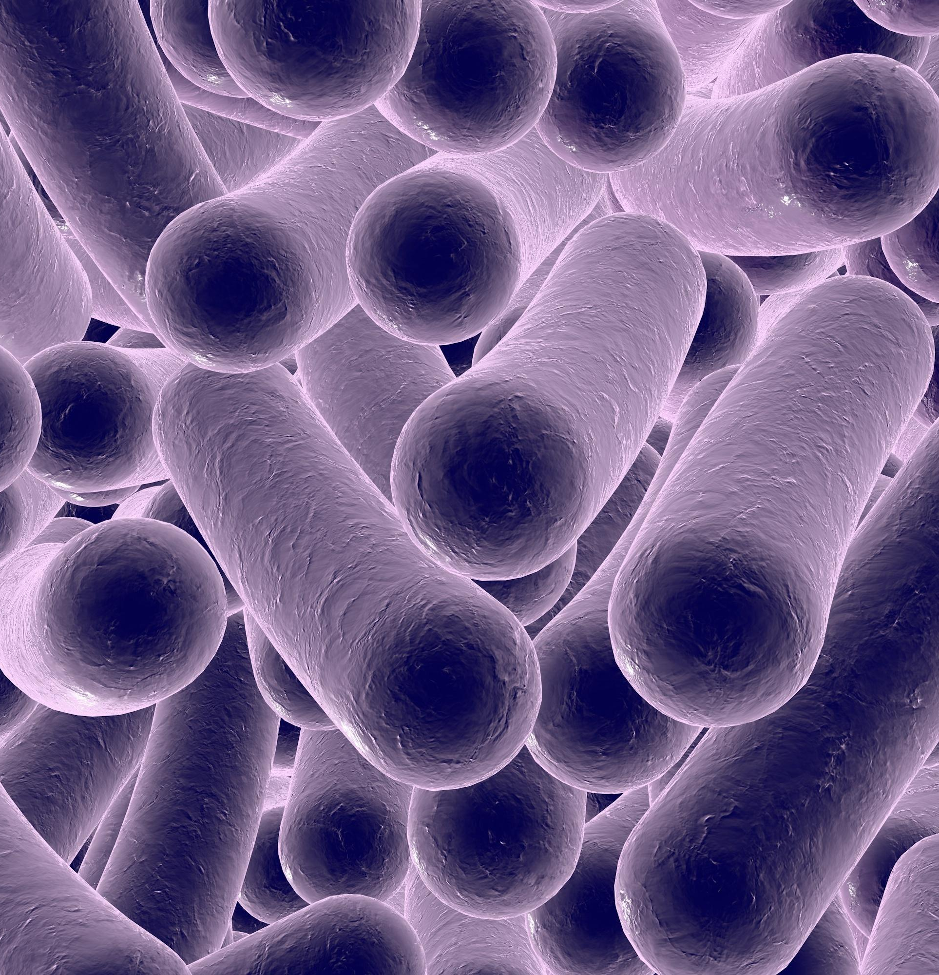
Clostridium genus
large, gram-positive, spore-forming bacteria.
Their spores resist heat, drying, and disinfectants.
They can survive for years and become active again in suitable conditions.

Slide 5
Clostridium genus
Some Clostridia cause tissue damage — the histotoxic group (like C. perfringens) produces toxins that destroy blood and other cells at infection sites.
Others affect the nervous system — the neurotoxic group (C. tetani, C. botulinum) releases toxins that act on distant nerve cells.
One species targets the gut — C. difficile produces toxins that lead to intestinal disease.

Slide 6
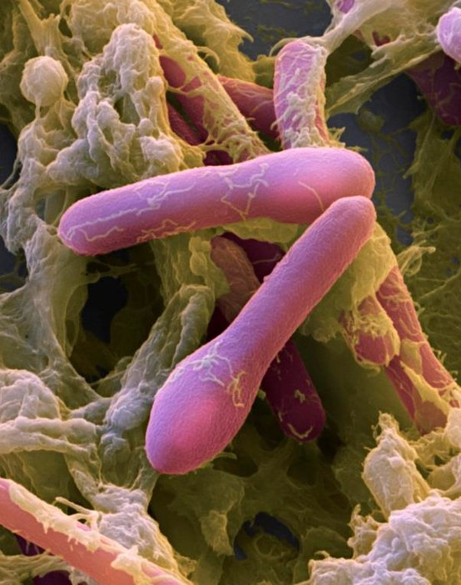
CLOSTRIDIUM BOTULINUM
Like other clostridia, C. botulinum is a large, gram-positive rod.
Its spores are highly resistant — they can survive boiling and need 121°C moist heat to be destroyed.
In low-oxygen environments, its spores can grow in neutral or alkaline foods.

Slide 7
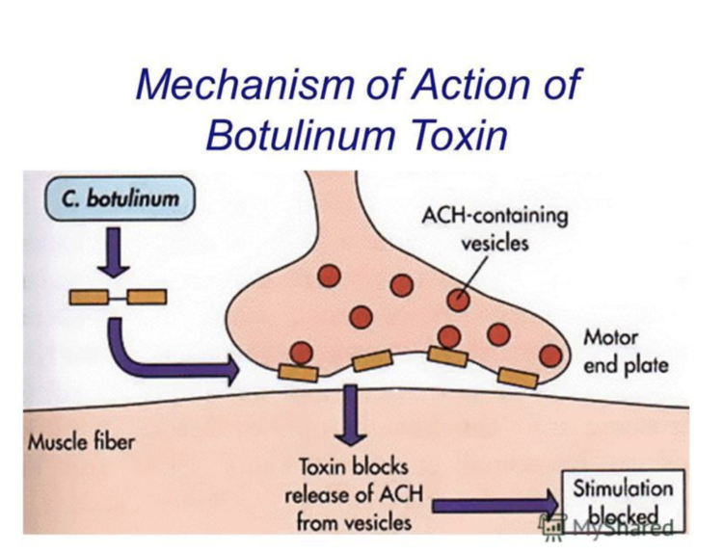

Slide 8
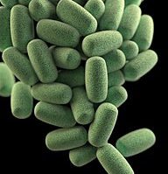
CLOSTRIDIUM PERFRINGENS
C. perfringens is a large, gram-positive, nonmotile rod with square ends.
It grows quickly in low oxygen, forming hemolytic colonies on blood agar.
It produces gas during growth, especially in tissues, leading to the condition known as gas gangrene.
It releases several exotoxins, with different effects depending on the strain type (A to E).

Slide 9
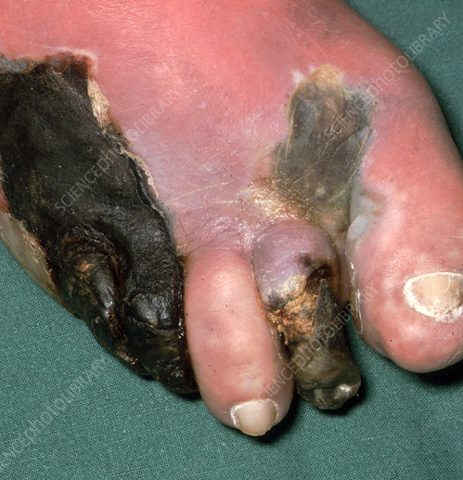
Pathogenesis
Gas Gangrene
In low-oxygen wounds, C. perfringens spores can germinate and release α-toxin.
The infection spreads quickly, causing swelling, tissue death, and an ideal environment for anaerobes.
As it worsens, the toxin enters the bloodstream, increasing permeability and shock.
α-Toxin is the main factor behind tissue damage and shock.

Slide 10
Pathogenesis
2. Clostridial Food Poisoning
Some C. perfringens spores are highly heat-resistant, surviving even boiling for over an hour.
If food isn’t properly cooled or is reheated, these spores can grow and multiply.
After eating contaminated food, the bacteria release enterotoxin in the gut, especially affecting the ileum and causing fluid loss.

Slide 11
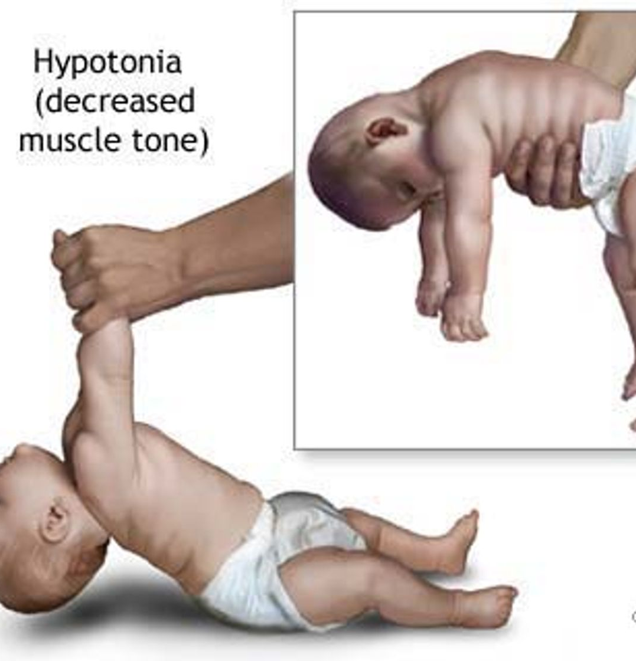
Manifestations
Infant Botulism
Infant botulism affects babies between 3 weeks and 8 months old.
It often starts with contaminated food, especially honey, which may contain C. botulinum spores.
Spores grow in the baby’s gut, releasing small amounts of toxin.
Symptoms include constipation, weak muscles, tiredness, feeding issues, and sometimes paralysis, like in foodborne botulism.

Slide 12
Manifestations
2. Wound Botulism
In rare cases, C. botulinum can grow in infected wounds.
Wound botulism has been seen in people who inject or snort cocaine.
Sometimes, botulism appears in older individuals without a clear food or wound source.

Slide 13
Clostridium Tetani

Slide 14
Characteristics
In lab cultures, C. tetani forms a round terminal spore, giving it a “drumstick” look.
It grows only in strict anaerobic conditions and is identified by its toxin.
Spores survive for years in soil, resistant to many disinfectants and brief boiling.
Its main toxin, tetanospasmin, is similar to botulinum toxin but affects inhibitory neurons (GABA and glycine).
This causes constant muscle firing, leading to spasms and spastic paralysis (opposite of flaccid paralysis).
The toxin is heat-sensitive and antigenic, and can be neutralized by antitoxin or made into a vaccine (toxoid).

Slide 15
Pathogenesis
Tetanus usually starts in low-oxygen areas, like wounds with splinters, dead tissue, or contaminated drug injections.
Other bacteria may help create anaerobic conditions, allowing C. tetani spores to germinate.
The bacteria stay local, but the toxin (tetanospasmin) travels along nerves to the spinal cord.
There, it blocks inhibition of motor reflexes, causing muscle spasms in both opposing muscle groups.
Spasms often begin near the wound but can spread throughout the body and be triggered by small stimuli like noise or touch.

Slide 16
Manifestation
Tetanus symptoms can appear from 4 days to several weeks after infection.
Shorter incubation periods, especially with head wounds, usually mean more severe disease.
Diagnosis is based on symptoms, not lab tests.
It often starts with jaw stiffness (trismus or “lock-jaw”) and can spread to swallowing and breathing muscles.
In severe cases, back muscles spasm, causing the body to arch (opisthotonos).
Patients stay conscious and sensitive to touch or sound, which can trigger more spasms.
Death usually results from breathing failure, with a mortality rate of 15–60%, highest in newborns and the elderly.

Slide 17
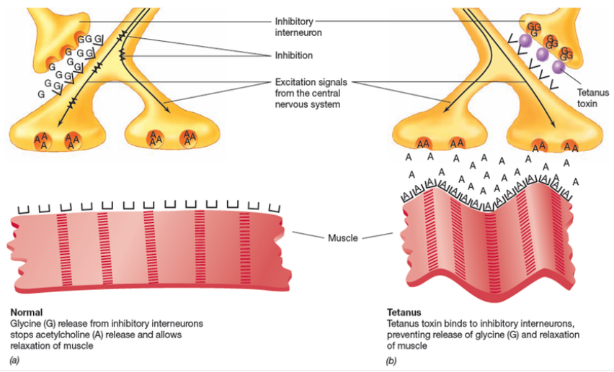

Slide 18
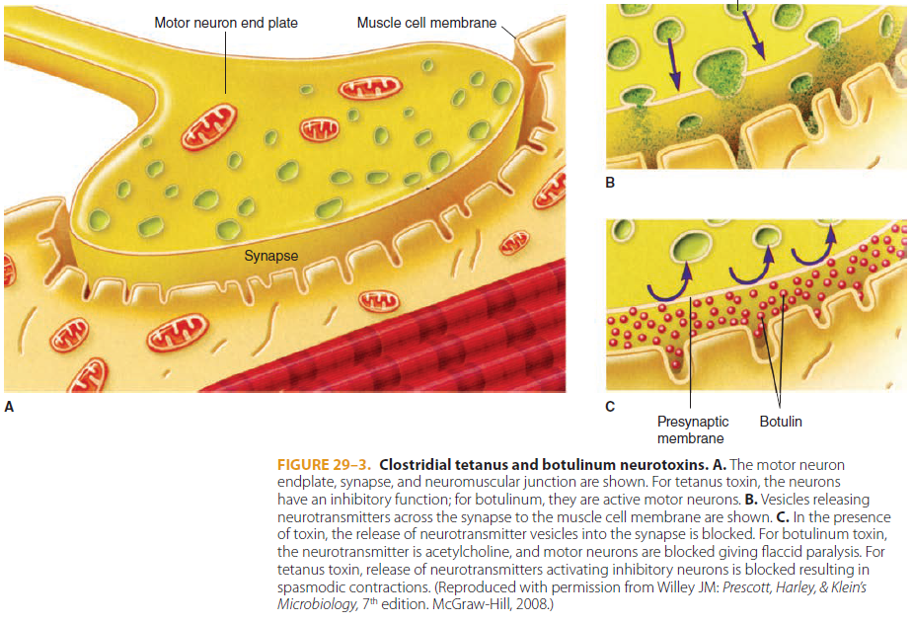

Slide 19
References
Sherris Medical Microbiology: An Introduction to Infectious Diseases.
Jawetz, Melnick & Adelberg's Medical Microbiology by Geo. F. Brooks, Karen C. Carroll, and Janet S. Butel
Prescott's Microbiology by Joanne Willey, Linda Sherwood, and Christopher J. Woolverton

