Slide 1


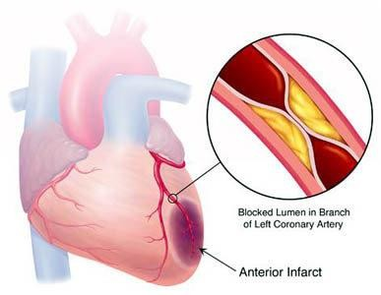

Coronary Heart Disease
Yaseen Galali Nutrition and dietetics Department

Slide 2
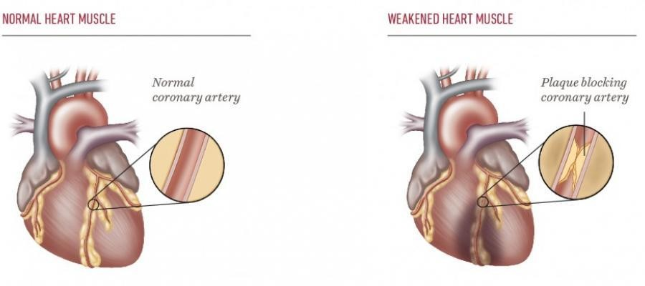
Coronary Heart Disease
ATHEROSCLEROTIC HEART DISEASE
CORONARY ATHEROSCLEROSIS
CORONARY ARTERIOSCLEROSIS
CORONARY ARTERY DISEASE
is the abnormal accumulation of lipid or fatty substances or fatty atheroma(plaque) in the lumen of coronary artery

Slide 3

RISK FACTORS

Slide 4
MODIFIABLE
High blood cholesterol level
Cigarette smoking, tobacco use
Hypertension
Diabetes mellitus
Lack of estrogen in women
Physical activity
obesity

Slide 5
NON MODIFIABLE
Family history of CAD Increasing age Gender(male)
Race(non white populations)

Slide 6
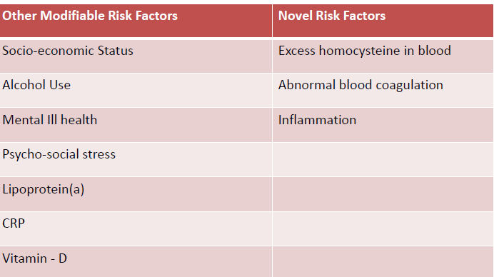

Slide 7
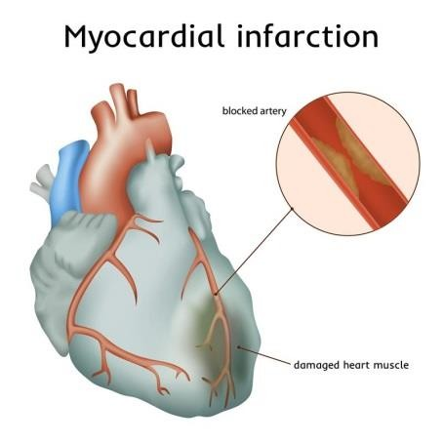
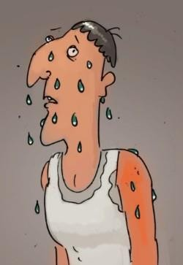
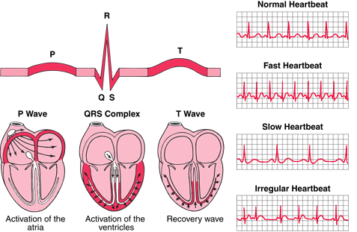
SIGNS & SYMPTOMS
Chest pain (Angina pectoris)
Myocardial infarction (Blood flow decreases or stops to a part of the heart)
Diaphoresis (Sweating )
Ecg changes (electrocardiogram)
Dysarrithmias (irregular heart rate)
Chest heaviness
Dyspnea (shortness of breath)
Fatigue

Slide 8
Genetics
Many cardiac disorders can be inherited, including arrhythmias, congenital heart disease, cardiomyopathy, and high blood
cholesterol. Coronary artery disease leading to heart attack, stroke, and heart failure can run in families, indicating inherited genetic risk factors.

Slide 9
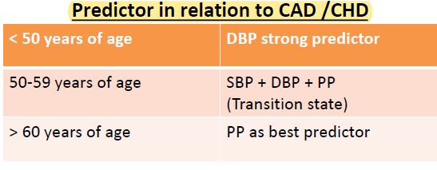
Blood Pressure
High blood pressure (hypertension) is one of the most important preventable causes of premature death worldwide.
Even a blood pressure at the top end of the normal range increases risk.
High BP is SBP >140 mmHg and/or DBP >90 mmHg

Slide 10
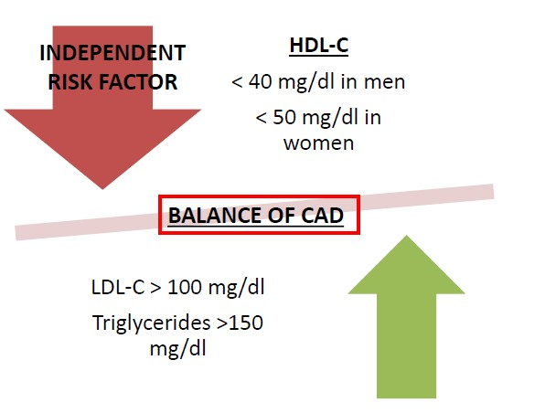
ROLE OF HDL AND LDL

Slide 11
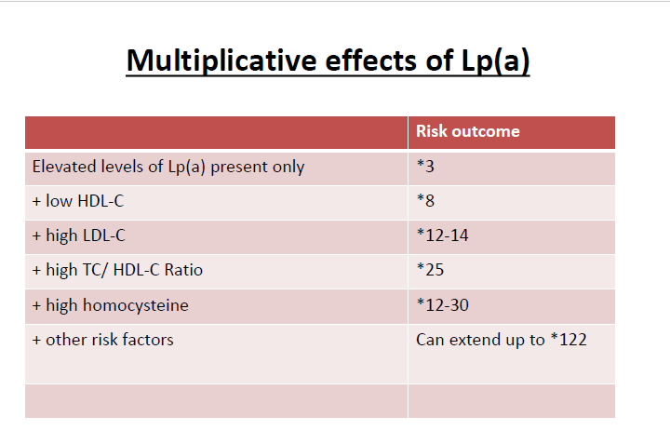

Slide 12

Tobacco
Tobacco causes a fifth of cardiovascular disease worldwide.
In the USA, up to 62 000 people die each year from heart disease caused by passive smoking.
Quitting smoking effectively reduces cardiovascular risk to close to that of a person who has never smoked.
Smoking damages the lining of arteries, leading to a build up of fatty material (atheroma) which
narrows the artery.
The nicotine in cigarettes stimulates the body to produce adrenaline, which makes the heart beat faster and raising the blood pressure, making the heart work harder and raising myocardial oxygen demand.

Slide 13
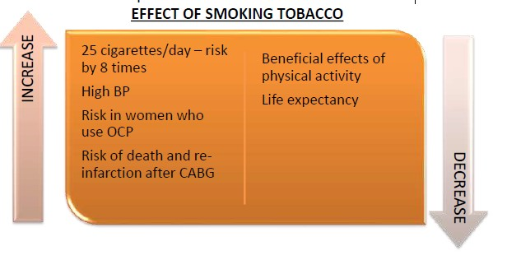
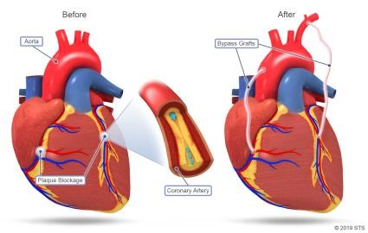
The carbon monoxide induced atherogenesis (formation of fatty deposits in the arteries) and in tobacco smoke reduces the amount of oxygen in the blood. This means the heart has to pump harder to supply the body with the oxygen it needs.
OCP=Oral Contraceptive Pills

Slide 14

Physical inactivity
Worldwide, physical inactivity causes about 1.9 million deaths, 20% of cardiovascular disease and 22% of coronary heart disease
Being physically inactive increases your risk of coronary heart disease and ischaemic stroke by around 1.5 times.

Slide 15
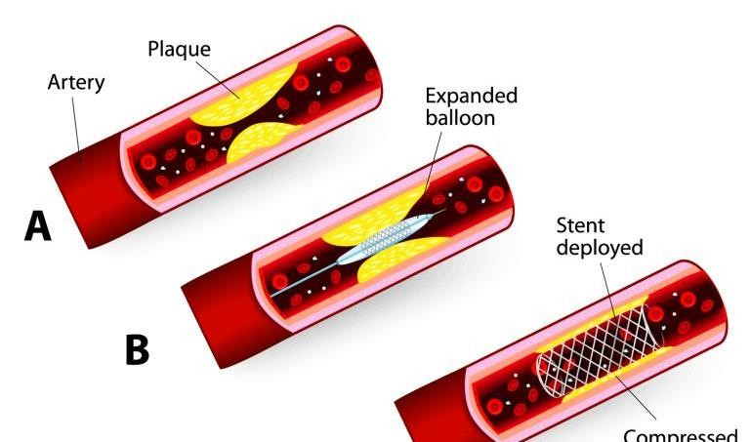
Diabetes and CAD
12-40 times the rate of CAD as in non-diabetic.
More advanced atherosclerosis
High blood glucose is a greater risk factor for CAD and stroke than smoking
Poor success and survival rates following angioplasty and bypass surgery.
2 Times more mortality rate

Slide 16
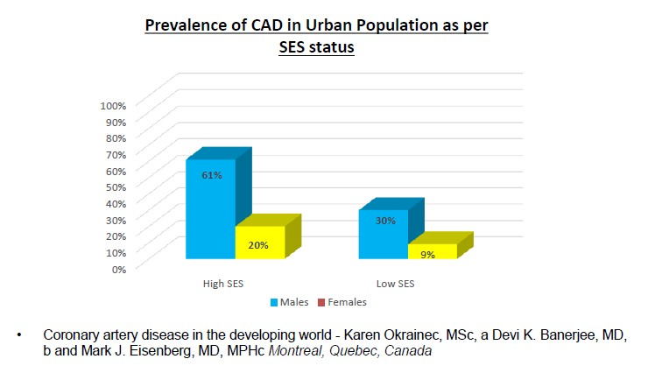
Socio-economic status
In developing countries, higher socioeconomic class has been associated with a higher prevalence of CAD.

Slide 17
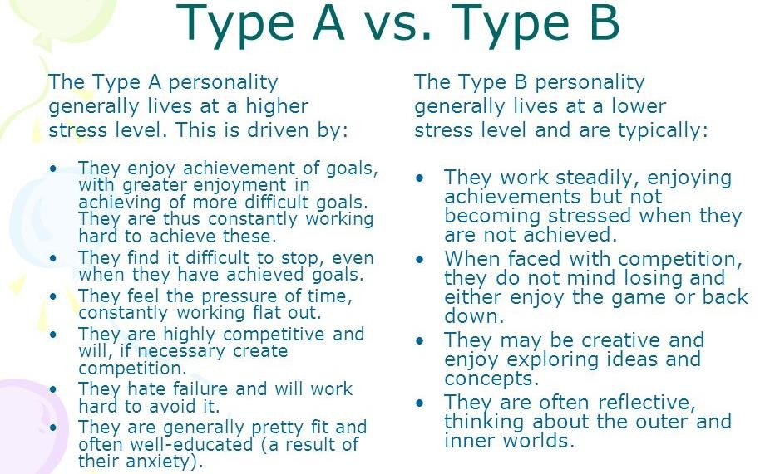
Psychological
Contrary to common belief, type A personality is not associated with an excess of coronary artery disease (CAD).
Type “D” personality: defined as the joint tendency towards negative affectivity and social inhibition. It is associated with coronary heart disease

Slide 18
The high-sensitivity C-reactive protein
Acute phase reactant ( inflammatory marker)
CRP level has been proposed as biomarker for CVD and CAD risk prediction and as a selection marker for initiating statin treatment.
More than 70% of obese women and more than 50% of obese men having elevated levels of CRP.
Smokers have 38% higher CRP levels than Non- smokers

Slide 19
Vitamin-D
Low vitamin D levels are highly associated with endothelial dysfunction, atherosclerosis, heart attack, heart failure, stroke as well as silent and symptomatic CAD
Vitamin D concentrations are inversely associated with insulin resistance (IR) and metabolic syndrome (MS).

Slide 20
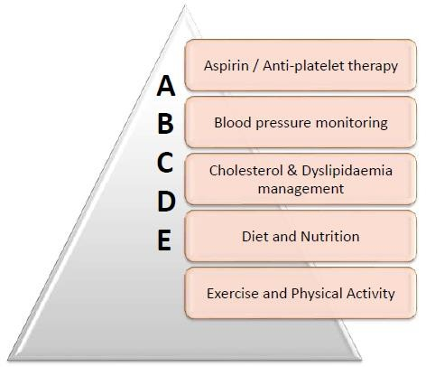
ABCDE Approach

Slide 21
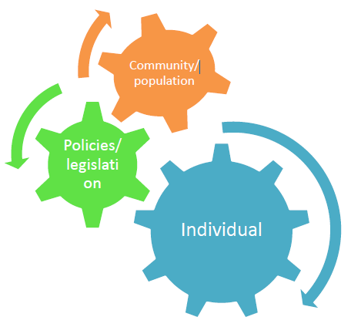
Three Pronged Approach

Slide 22

Individual level
Take moderate physical activity for a total of 30 minutes on most days of the week.
Avoid tobacco use and exposure to environmental smoke; make plans to quit if you already smoke.
Diet: fruits, vegetables and avoid saturated fats and caloriedense meals.
Maintain a normal body weight. Reduce stress at home and work.

Slide 23
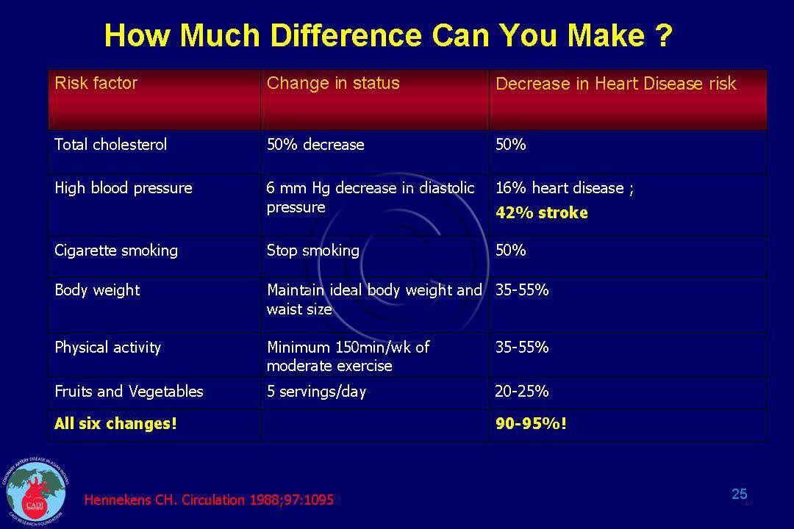

Slide 24
Population / community level
Significant health gains in cardiovascular health can be made
within short time spans, through public health and treatment interventions that have an impact on large segments of the population.
Population based observational studies in Finland, Norway, Mauritius, Poland and the US reported substantial reduction in cholesterol levels and coronary artery disease (CAD) mortality, following the introduction of fiscal policies which reduced animal fat and increased vegetable fat consumption

Slide 25

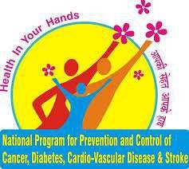
Policies and Legislations
Global Action Plan for the Prevention and Controlof NCDs 2013-2020.
National Programme For Prevention And Control Of Cancer,Diabetes, CVD And Stroke (NPCDCS)

Slide 26
Suggested policy interventions
Establishment of a national regulatory agency to enforce already existing tobacco control legislation (e.g., the Tobacco Control Act and the World Health Organization’s Framework Convention on Tobacco Control).
High rates of use of smoked beedies and of smokeless tobacco (chewing tobacco and paan).
Promote healthy dietary patterns and physical activity in schools and workplaces.

Slide 27
Identification of cultural norms that might hinder CHD prevention efforts
Development of research infrastructure and training of clinical researchers.
Establishment of high-quality national surveillance programmes
Assessment of the knowledge of the CHD burden
Generation of reliable statistics on prevalence and incidence of CAD and its risk factors and CAD-related mortality through the initiation of large cohort studies and trial registries.
Studies documenting childhood risk factors, such as obesity, in both urban and rural settings.

Slide 28
Large registries and case-control studies to document the burden of CHD and its determinants in the community subcontinent.

Slide 29
Dietary changes
Dietary modification is the principal preventive strategy in the prevention of CHD by :
Reduction of fat intake to 20-30% of total energy intake.
consumption of saturated fats must be limited to less than 10 per cent of total energy intake.
Reduction of dietary cholesterol to below 100 mg per 1000 kcal per day.

Slide 30
Dietary changes
4-increase in complex carbohydrate consumption (vegetables, fruits, whole grains and legumes).
avoidance of alcohol consumption.
Reduction of salt intake to 5 g daily or less.

