Slide 1
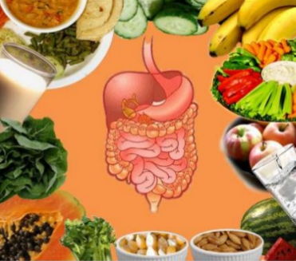
Digestion and metabolism
Yaseen Galali
Nutrition Dept.

Slide 2
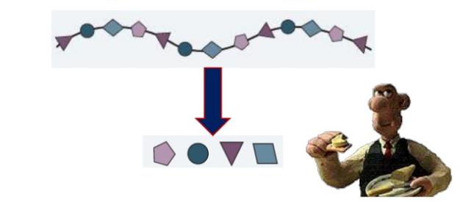
DIGESTION
Digestion is the process by which insoluble food, consisting of large molecules is broken down into soluble compounds

Slide 3
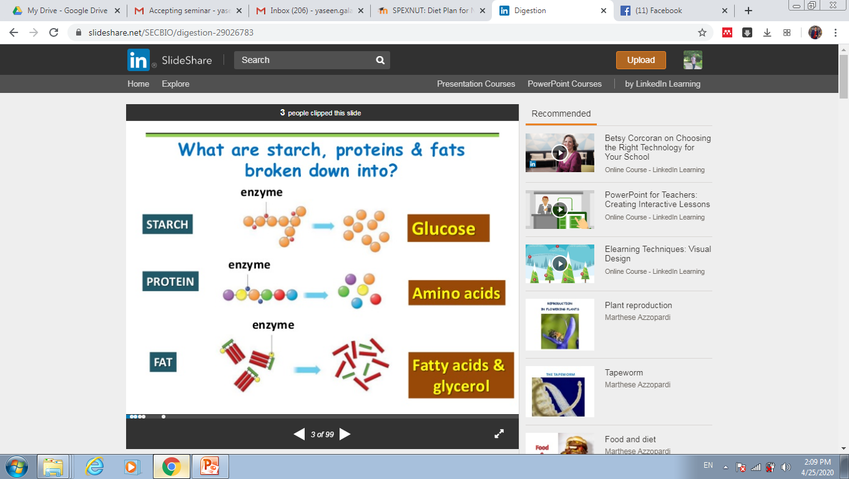

Slide 4
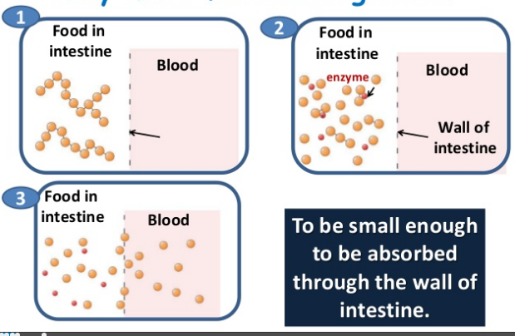
WHY MUST FOOD BE DIGESTED?

Slide 5
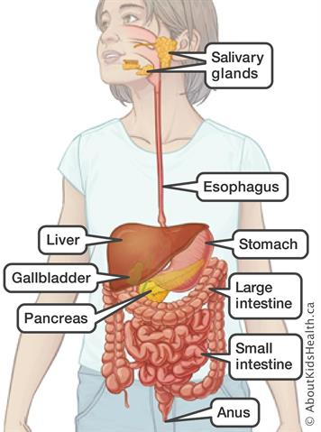
DIGESTION STARTS AT THE MOUTH AND ENDS AT THE ANUS
Digestion starts
at the mouth
and ends at the anus

Slide 6
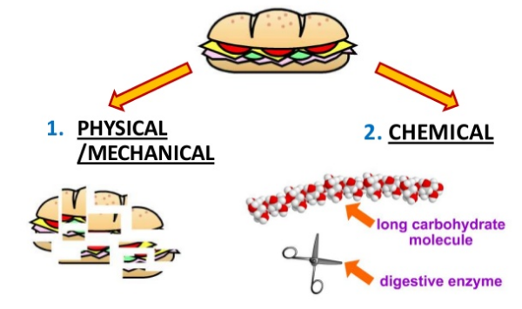
FOOD IS BROKEN DOWN BY TWO ACTIONS

Slide 7
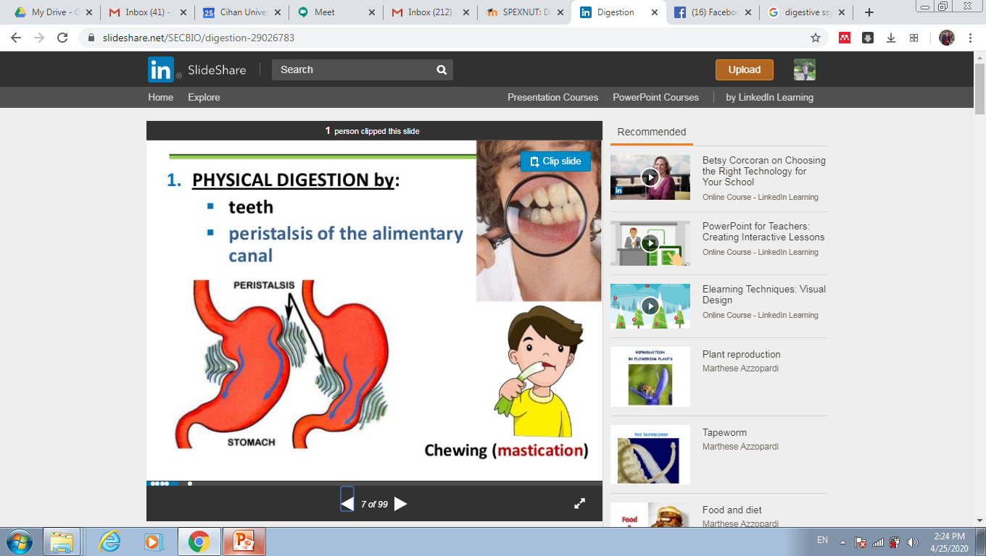
1-PHYSICAL DIGESTION
Teeth
peristalsis of the
alimentary canal

Slide 8
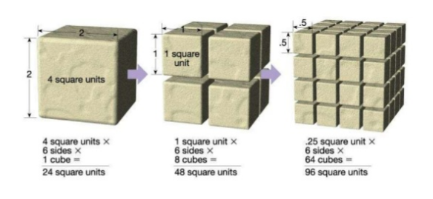
WHY IS IT IMPORTANT TO BREAK DOWN FOOD PHYSICALLY
To increase the surface area for enzyme action.

Slide 9
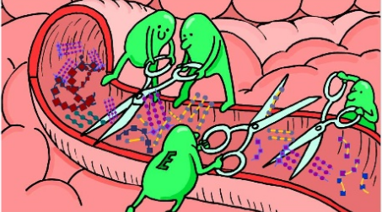
2-CHEMICAL DIGESTION
Enzymes
Digestive enzymes are the chemicals that break large insoluble food molecules into smaller soluble molecules

Slide 10
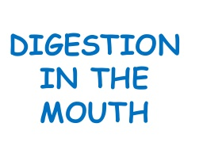

Slide 11
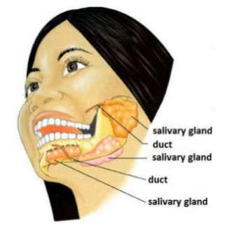
1- MOUTH
-Salivary glands produce SALIVA (pH = 7-8)
-Salivation is a reflex action
which is triggered by:
- Sight
-Smell
-Thinking of food

Slide 12
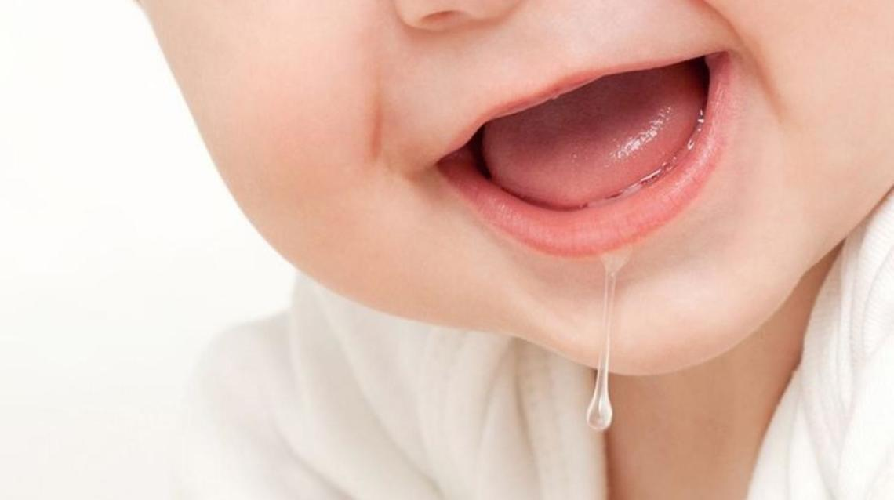
SALIVA COMPOSITION
Mucus
Water
Sodium hydrogen carbonate
Salivary amylase

Slide 13
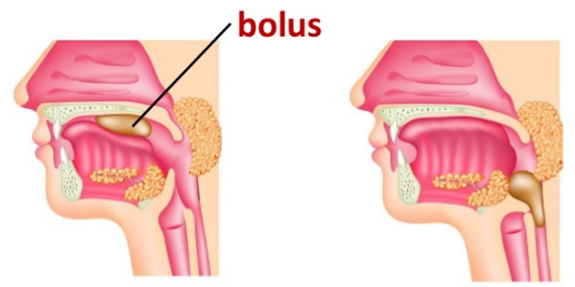
FUNCTIONS OF MUCUS IN SALIVA:
1. lubricates the food
2. sticks the food particles together bolus

Slide 14
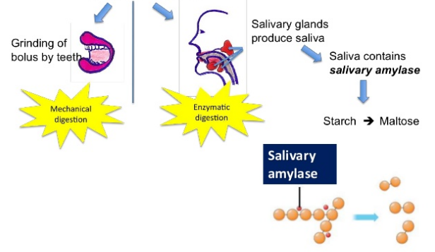
WHAT IS GOING IN MOUTH ?

Slide 15
In swallowing, food is directed into the oesophagus.
A person cannot breathe while swallowing
1.The soft palate closes the nasal cavity
2. The epiglottis closes the trachea.

Slide 16
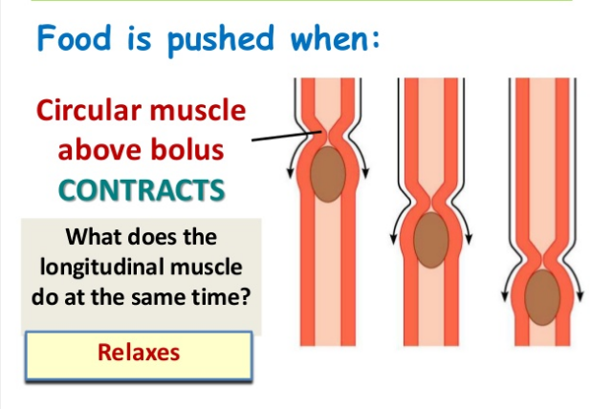
DURING SWALLOWING

Slide 17
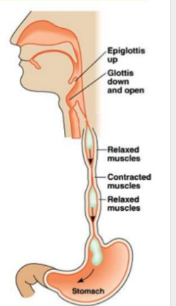
Then Food reaches
Stomach

Slide 18
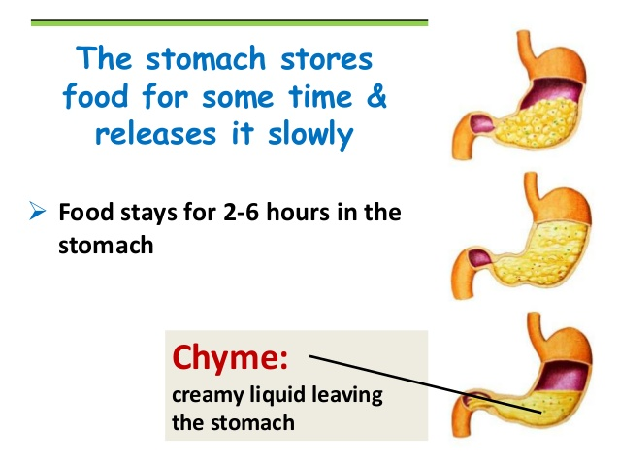
STOMACH
The stomach stores food
for some time & releases
it slowly
Food stays for 2-6 hours

Slide 19
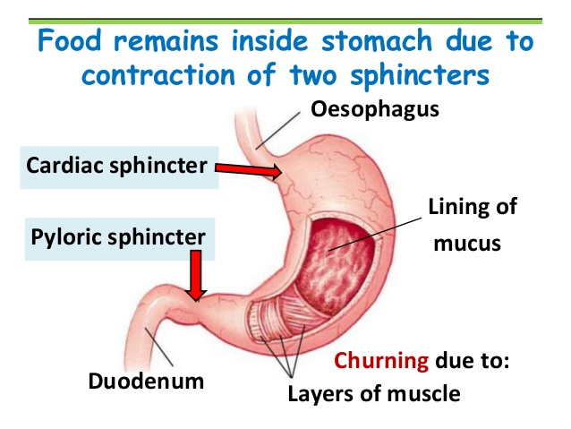
Food remains inside stomach due to contraction of two sphincters;1- Oesophagus Cardiac sphincter 2-Pyloric sphincter

Slide 20
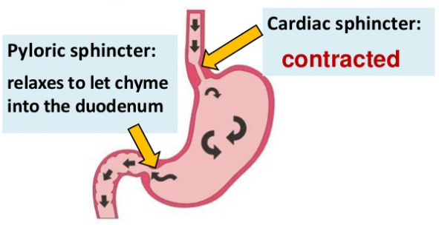
SPHINCTER CONTRACTION

Slide 21
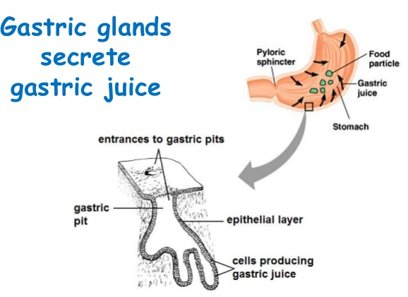

Slide 22
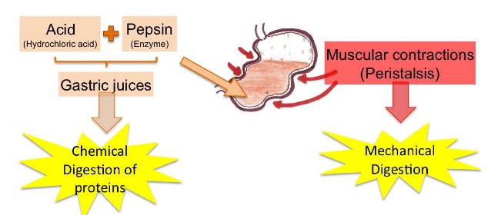
WHAT HAPPENS TO FOOD IN STOMACH
Digesting of food through
1-chemical digestions ( HCL, Pepsin and Reni n
2-Physical digestion

Slide 23
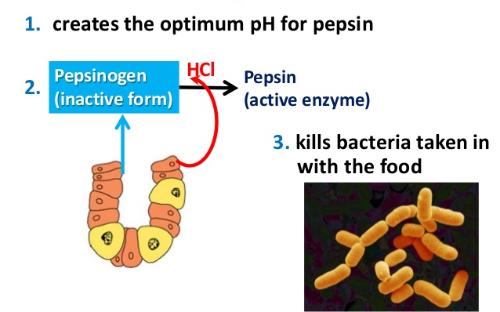

Slide 24
WHY SALIVA AMYLASE CANNOT WORK ON STARCH STOMACH ?
1- pH in stomach is not optimum for amylase
2-There is no enzyme in the stomach to break starch

Slide 25
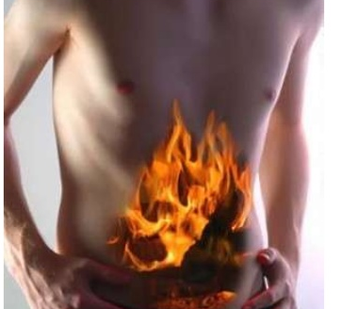
HIGH AMOUNT OF HCL
Secreting of high amount of acid causes burning sensation. Antacids are used.

Slide 26
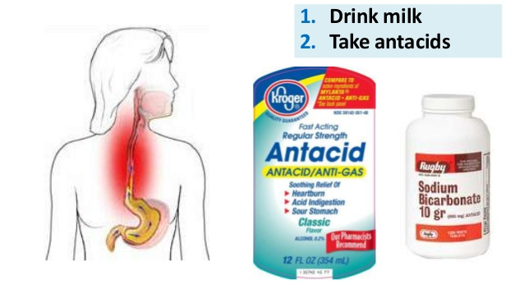
REMEDY FOR BURNING SENSATION IN THROAT AND CHEST

Slide 27
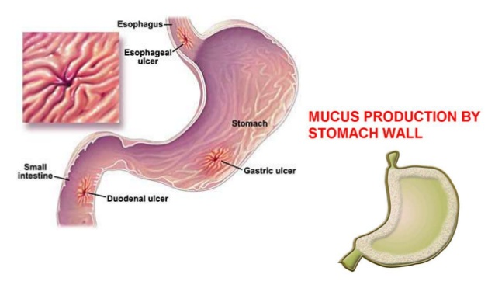
STOMACH ULCERS DUE TO: LITTLE MUCUS IN STOMACH

Slide 28
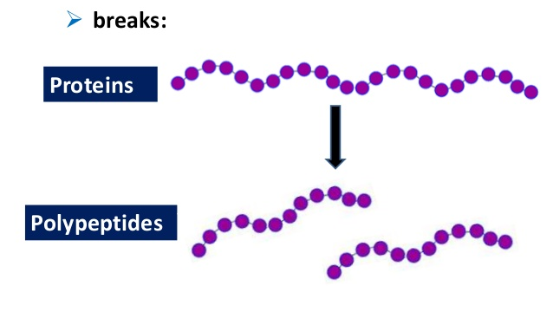
PEPSIN IS A PROTEASE:
Breaks proteins to polypeptides

Slide 29
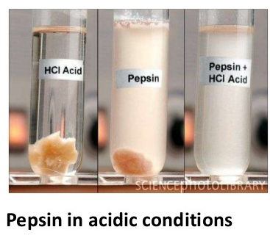
WHICH CONDITIONS ARE NEEDED FOR A PIECE OF MEAT TO BE DIGESTED? ➢ PEPSIN IN ACIDIC CONDITIONS

Slide 30
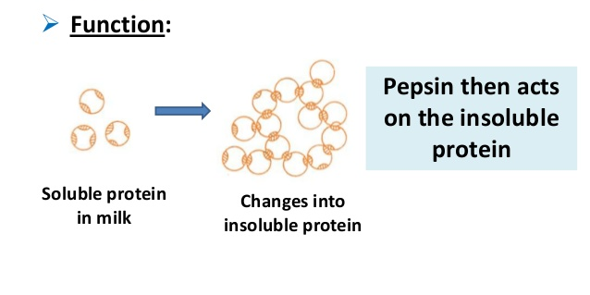
RENNIN
is an enzyme found in the stomach of young children ➢ Function: Pepsin then acts on the insoluble protein. Soluble protein in milk Changes into insoluble protein

Slide 31
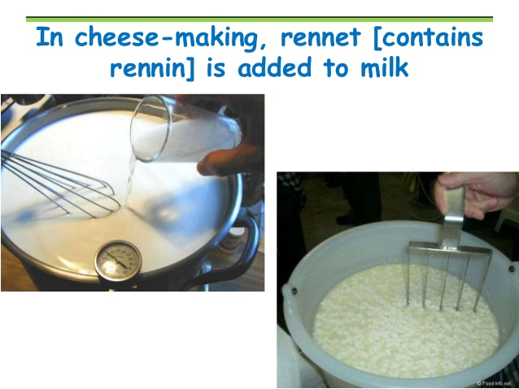

Slide 32
INTESTINE

Slide 33
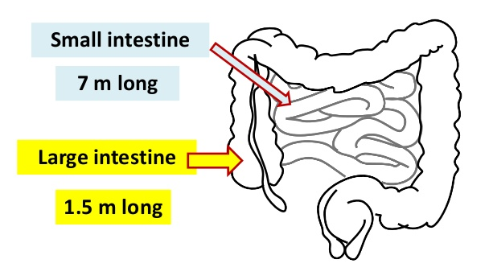
THE INTESTINE

Slide 34
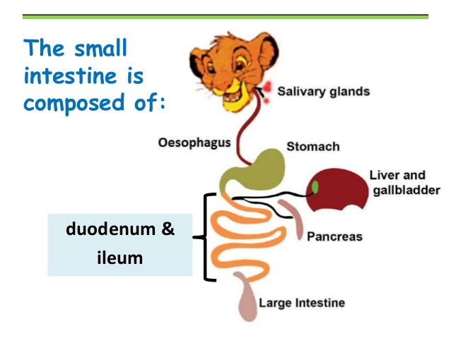
INTESTINE PARTS

Slide 35
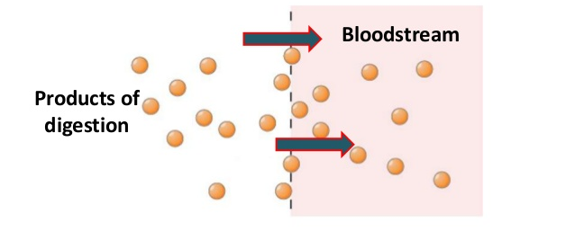
FUNCTIONS OF SMALL INTESTINE
1- digestion is completed
2. digested food is absorbed

Slide 36
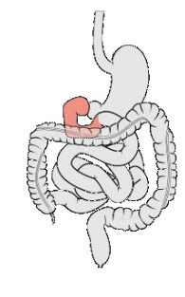
DUODENUM
U-shaped
first part of small intestine (most digestion occurs here)
about 25 cm long

Slide 37
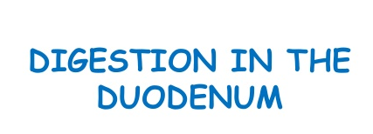

Slide 38
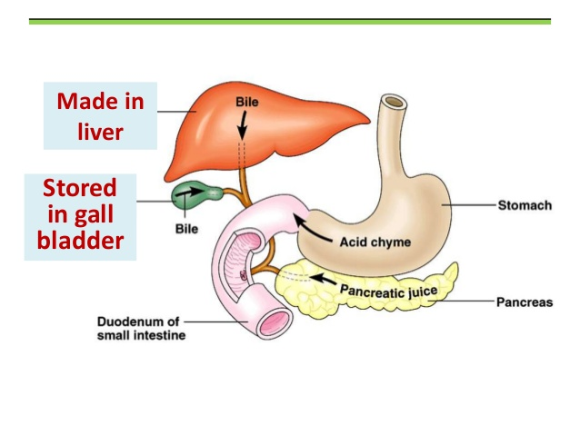
BILE ACID MADE AND STORED

Slide 39
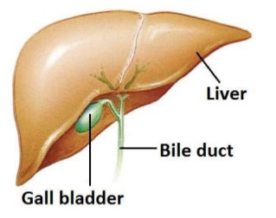
BILE
Bile: has no enzymes
consists of:
1-water
2- sodium chloride
3-bile salts
4- bile pigments
pH = 8

Slide 40
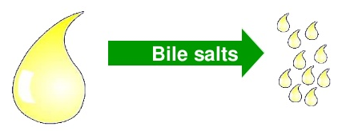
FUNCTIONS OF BILE
dilutes contents from stomach
1-0creates optimum pH for pancreatic enzymes to work in duodenum
2-contains bile salts which emulsify fats Bile salts

Slide 41
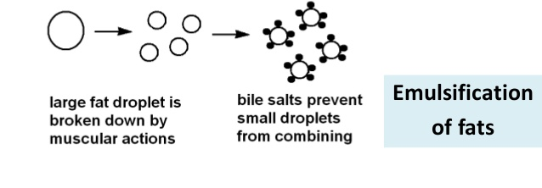
BILE SALTS EMULSIFY FATS
Break large fat globules into smaller globules
What is the benefit of emulsification?
The surface area where lipase can act is increased.

Slide 42
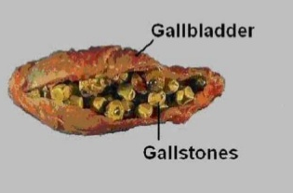
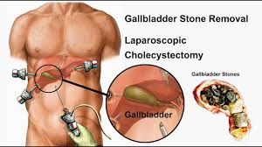
A person had his gall bladder removed.
Explain why the doctor told him to limit fats in the diet?
Fats cannot be emulsified; difficult to digest fats by lipase.

Slide 43
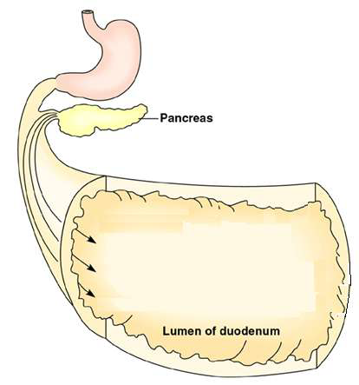
THREE ENZYMES IN
PANCREATIC JUICE:
Pancreas
Pancreatic amylase
Trypsin
Lipase

Slide 44
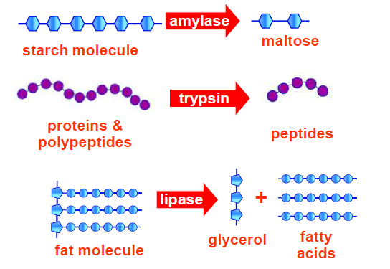
ACTION OF EACH ENZYME

Slide 45
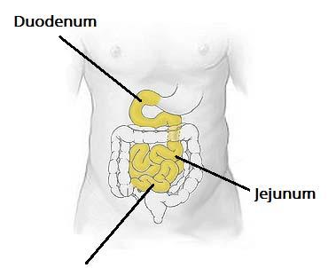
DIGESTION IN THE ILEUM
Ileum

Slide 46
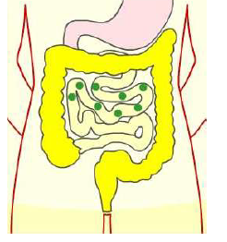
ILEUM
The wall of the ileum has
intestinal glands that produce intestinal juice

Slide 47
ENZYMES IN INTESTINAL JUICE
SUBSTRATE | ENZYME | END PRODUCT
Peptides | Peptidase | Amino acids
Lipids | Lipase | Fatty acids & glycerol
Maltose | Maltase | Glucose + glucose
Sucrose | Sucrase | Glucose + fructose
Lactose | Lactase | Glucose + galactose

Slide 48
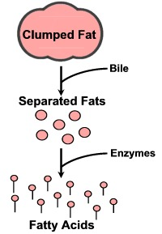
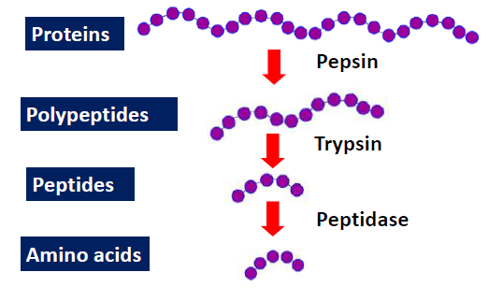
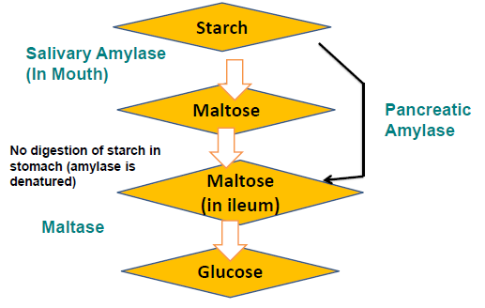
REMEMBER!

Slide 49
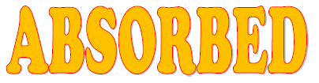
Digestion is complete in the ileum.
What happens to the digested food?

