Slide 1



Tishk International University
Faculty of Applied Science
Nutrition and Dietetics Department
Food Preservation by Low Temperature
Food Microbiology /4th Lecture
2nd Grade / Spring Semester
Cooling & Freezing
Microbial Effects
Food Safety
Instructor: Adam Jalal Mohammed
Email: adam.jalal@tiu.edu.iq
Food Microbiology
2025 - 2026

Slide 2
LECTURE ROADMAP
Lecture Overview
Introduction to Low Temperature Preservation
Temperature Ranges for Food Storage
Freezing Methods: Quick vs Slow
01
02
03
Basic principles and why temperature matters
Chilling, Refrigerator, and Freezer temperatures
Comparing industrial and home freezing
04
Ice Crystal Formation
05
Chilling Injury
06
Effects on Microorganisms
Impact on food quality and cell structure
Types and mechanisms of cold damage
Survival rates and physiological changes
Factors Affecting Microbial Survival
Cell Injury Mechanisms
Key Takeaways
07
08
09
9 critical factors to consider
How freezing causes cell death
Practical applications and summary

Slide 3
FOUNDATION CONCEPTS
Introduction: Why Low Temperature?
Understanding the scientific basis of cold preservation
The Core Principle
Temperature vs Reaction Rate
Low temperatures slow down or stop microbial activities that cause food spoilage. At temperatures above freezing, microbial growth slows significantly. At subfreezing temperatures, growth generally stops completely.
↑
Rising Temperature → Increased reaction rate → Faster microbial growth
↓
Decreasing Temperature → Decreased reaction rate → Slower microbial growth
Why Temperature Matters
Key Insight
All metabolic reactions in microorganisms are enzyme-catalyzed, and enzyme reaction rates are highly dependent on temperature. Lower temperatures = slower reactions = less spoilage.
Freezing doesn't kill all microorganisms—it preserves food by preventing microbial growth. When thawed, surviving microbes can become active again!

Slide 4
TEMPERATURE CLASSIFICATION
Three Temperature Ranges for Food Storage
Each range serves different food types and preservation goals
Chilling
Refrigerator
Freezer
5-15°C
0-7°C
≤-18°C
41-59°F
32-45°F (Ideal: 4.4°C/40°F)
≤0°F
Best For:
Best For:
Best For:
Certain vegetables and fruits that are sensitive to colder temperatures
Most perishable foods including dairy, meats, and prepared foods
Long-term storage of most foods, preventing spoilage
Examples:
Examples:
Examples:
Cucumbers, potatoes, limes, tropical fruits, tomatoes
Milk, eggs, fresh meat, poultry, fish, leftovers
Frozen vegetables, meat, ice cream, prepared meals
Microbial Activity: Significantly slowed but not stopped
Microbial Activity: Greatly reduced, extends shelf life
Microbial Activity: Growth prevented (some survive)
Important Note: At freezer temperatures, growth of all microorganisms is prevented, but some can still survive and grow at extremely slow rates. Freezing is preservation, not sterilization!

Slide 5
FREEZING TECHNOLOGIES
Quick Freezing vs Slow Freezing
Understanding the differences that affect food quality
Quick Freezing
Slow Freezing
Industrial Standard
Home Freezers
Speed
Speed
Reaches -20°C within 30 minutes—rapid temperature drop
Takes 3-72 hours to reach desired temperature—gradual cooling
Methods
Common Use
• Direct immersion in refrigerant
Standard in domestic/home freezers—convenient but slower
• Indirect contact with cold surfaces
• Air blasts of frigid air
Ice Crystals
Forms large extracellular crystals—causes more damage
Ice Crystals
Forms small intracellular crystals—better food quality
Advantage: Superior product quality, minimal cell damage
Result: More drip loss, texture changes upon thawing
Key Point: Quick freezing possesses more advantages than slow freezing from the standpoint of overall product quality

Slide 6
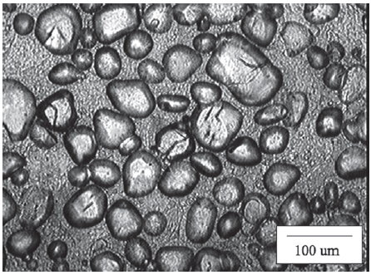
FOOD QUALITY IMPACT
Ice Crystal Formation & Food Quality
How crystal size and location affect food texture and flavor
Comparison: Slow vs Quick Freezing
What Happens During Freezing
SLOW FREEZING
QUICK FREEZING
Water is removed from the food solution and transformed into ice crystals of variable but high purity. This process changes multiple food properties including pH, acidity, ionic strength, viscosity, and osmotic pressure.
Large Extracellular Crystals
Small Intracellular Crystals
Crystal Growth Problem
Crystal growth is a major factor limiting freezer life. Ice crystals grow in size over time , causing cell damage by disrupting membranes, cell walls, and internal structures. This results in texture and flavor changes when thawed.
Form OUTSIDE cells
Form INSIDE cells
Large size damages cell walls
Small size = minimal damage
More drip loss upon thawing
Less drip loss
Texture becomes mushy
Better texture retention
Practical Impact: Upon thawing, slow-frozen foods lose more drip (meats) or leakage (vegetables) compared to quick-frozen foods held for the same time period.

Slide 7
MICROBIAL DAMAGE
Understanding Chilling Injury
Damage to microbial cells during cooling and cold storage
What is Chilling Injury?
Chilling injury occurs when microbial cells are damaged as they are cooled from ambient temperatures to chilling temperatures. This phenomenon affects cell viability and can lead to cell death.
1
Cold Shock
2
Indirect Chilling Injury
Direct Chilling Injury
From Prolonged Cold Storage
When It Occurs
When It Occurs
During the cooling process from ambient to chill temperature
From holding food at chill temperatures for extended periods
Injury Level
Independence
Depends on cooling rate—slower cooling causes MORE damage than fast cooling
Damage is independent of cooling rate—depends on storage duration
Mechanism
Mechanism
Changes in cell membrane structure cause leakage of important metabolites (amino acids, ATP)
Lack of material exchange with environment leads to toxic metabolite accumulation and ATP depletion
More susceptible: Actively growing cells
Result: Cell starvation and eventual death

Slide 8
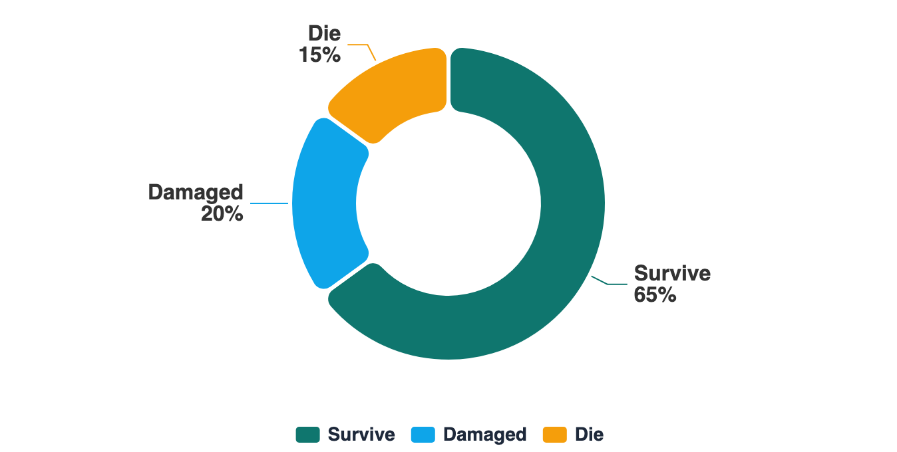
SURVIVAL DATA
Microbial Survival Under Freezing
The reality: Freezing doesn't kill all microorganisms
What Happens to Microorganisms?
40-90%
Survival Rate
of microorganisms survive freezing in foods
Critical Insight
When a population of microorganisms is frozen, only a proportion survives. The rest undergo changes that lead to death. This means freezing is a preservation method, not a sterilization technique.
Survivors
Damaged Cells
Dead Cells
Remain viable but dormant during freezing
Injured cells that may or may not recover
Cells that undergo irreversible damage

Slide 9
CRITICAL VARIABLES
9 Factors Affecting Microbial Survival
Understanding what determines survival rates
1
Type of Organism
2
Cell Age
3
Initial Cooling Rate
Gram negative organisms are more susceptible than Gram positive. Bacterial spores and viruses are highly resistant and virtually unaffected.
Actively growing cells are more susceptible to freezing damage than stationary phase cells . Older cells have higher lipid content in membranes.
The rate at which a product is cooled to the temperature at which freezing begins affects chilling injury levels.
4
5
Final Temperature
6
Food Composition
Final Cooling Rate
The rate of cooling to the final storage temperature matters—the faster the rate, the less damage to cells.
The lower the temperature , the higher the number of organisms likely to survive. Adverse effects are greater near the freezing point.
Acid conditions increase freezing damage, while certain constituents act as cryoprotectants (protect cells from damage).
7
Storage Time
8
9
Thawing Rate
Pre-Freezing Treatment
There's a progressive decline in living cells over time—initial rapid drop followed by slower decline, especially in gram-negative rods.
Cells already damaged by processes like blanching before freezing are more likely to be killed.
Fast freezing + slow thawing = crystal growth and more damage. Fast freezing + fast thawing = minimal additional damage.
Remember: All these factors interact to determine the final survival percentage of microorganisms in frozen foods.

Slide 10
MECHANISMS OF DAMAGE
How Freezing Causes Cell Injury & Death
Three freezing methods and their cellular effects
SLOW FREEZING
FAST FREEZING
ULTRA-FAST
Domestic Freezers
Food Industry
Liquid Nitrogen
3-72 hours to freeze
Within 30 minutes
-196°C (Cryogenic)
Crystal Location
Crystal Location
Crystal Formation
Ice crystals form OUTSIDE the cell (extracellular)
Ice crystals form INSIDE cells (intracellular)
Water freezes to form a glass-like substance —damaging intracellular ice crystals are reduced
Mechanism
Mechanism (a)
Increases solute concentration outside → plasmolysis → cell shrinkage
Mechanical damage to cell membranes and DNA from ice crystals
Cell Damage
Cell damage is minimized —most injury occurs during thawing rather than freezing
Result
Mechanism (b)
Eventually leads to cell death
Increased internal solutes → pH changes → damage to proteins and nucleic acids
Application
Used for preserving sensitive biological samples and high-value foods
Mechanism (c)
No mechanical damage from extracellular crystals—this is the most lethal type
Gas bubbles during thawing cause mechanical damage
Best method for preserving cell viability and food quality
Summary: Slow freezing causes lethal damage through solute concentration effects. Fast freezing causes mechanical damage from intracellular crystals. Ultra-fast freezing minimizes damage through glass formation.

Slide 11
SUMMARY
Key Takeaways & Practical Applications
Essential points to remember about low temperature food preservation
Temperature Effect
Rate Matters
Low temperatures slow or stop microbial growth by reducing enzyme-catalyzed reaction rates. However, freezing does NOT kill all microorganisms.
Both freezing rate and thawing rate affect cell survival. Fast freezing followed by fast thawing minimizes additional damage.
Quick Freezing is Better
Freezing ≠ Sterilization
Quick freezing (industrial) maintains better food quality than slow freezing (home freezers) by forming smaller intracellular ice crystals.
Freezing is a preservation method , not a sterilization technique. Surviving microbes can become active again when food is thawed.
Microbial Resistance Varies
Multiple Factors
Gram-negative bacteria are more susceptible than Gram-positive. Spores and viruses are highly resistant. Survival rates range from 40-90%.
9 factors interact to determine survival: organism type, cell age, cooling rates, temperature, food composition, storage time, pre-treatment, and thawing rate.
Bottom Line: Understanding these principles helps optimize food storage conditions, maintain quality, and ensure safety!

Slide 12
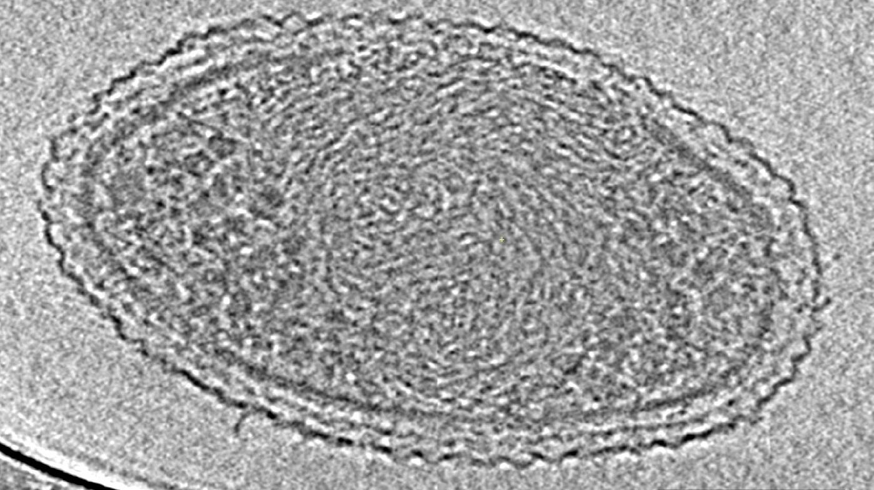
Thank You!
Questions & Discussion
Temperature Matters
Speed is Key
Microbes Survive
Lower temps = slower microbial growth
Quick freezing = better food quality
40-90% survive freezing
Food Preservation by Low Temperature
Understanding Cooling, Freezing, and Their Effects on Microorganisms

