Slide 1
Colonic functional foods

Slide 2
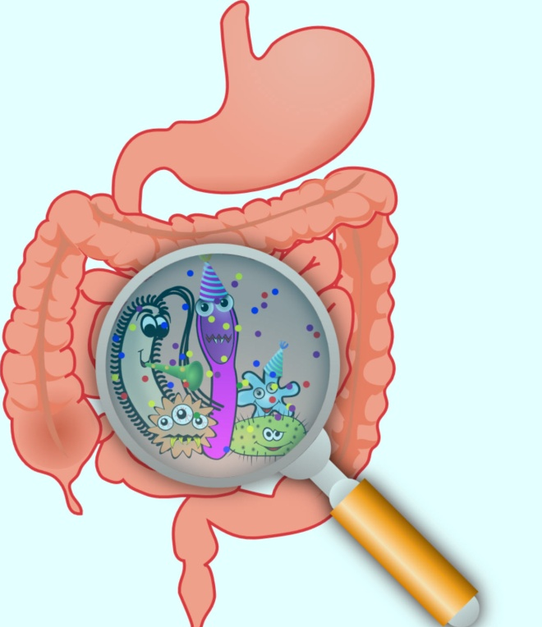
The microbiota of the human gastrointestinal tract plays a key role in nutrition and health. Through the process of fermentation, gut bacteria metabolise various substrates (principally dietary components) to form end products such as short chain fatty acids and gases
This anaerobic metabolism is thought to
contribute positively towards host daily energy requirements

Slide 3
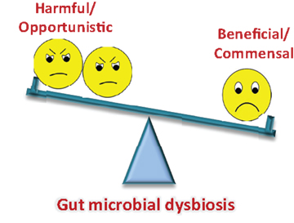
Usually, the human host lives in harmony with the complex gut microbiota. However, under certain circumstances like
antimicrobial intake, stress,
poor diet and living condition
s, the microflora balance’ may
be upset

Slide 4
Moreover, the normal fermentative process may produce undesirable metabolites like ammonia, phenolic compounds, toxins, etc. The gut flora is also susceptible to contamination from transient pathogens, which further upset the normal community structure.

Slide 5
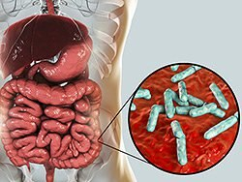
It is clear that the colonic microbiota is susceptible to manipulation through dietary mechanisms that target specific bacterial groups.3There is current interest in the use of dietary components that help to maintain, or even improve, the normal gut microflora composition and activities

Slide 6
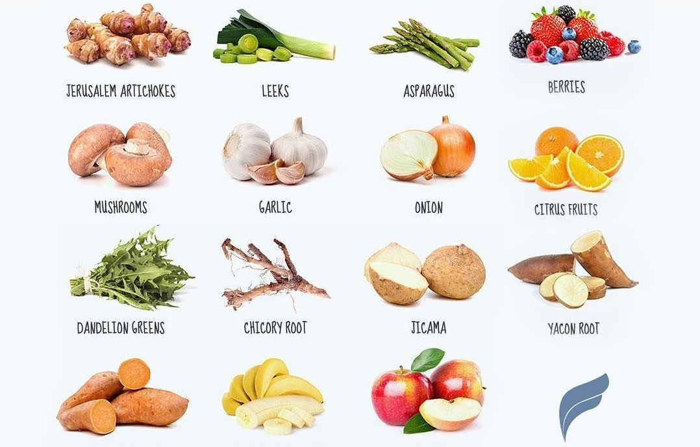
Prebiotics serve a similar purpose to probiotics in that they aim to improve the gut microflora community structure.
A prebiotic is a non-digestible food ingredient that beneficially affects the host by selectively stimulating the growth and/or activity of one or a limited number of bacteria in the colon, that may improve the host health

Slide 7
A complex, resident gastrointestinal microflora is present in humans. While the transit of residual foodstuffs through the stomach and small intestine is probably too rapid for the microflora to exert a significant impact, this slows markedly in the colon

Slide 8
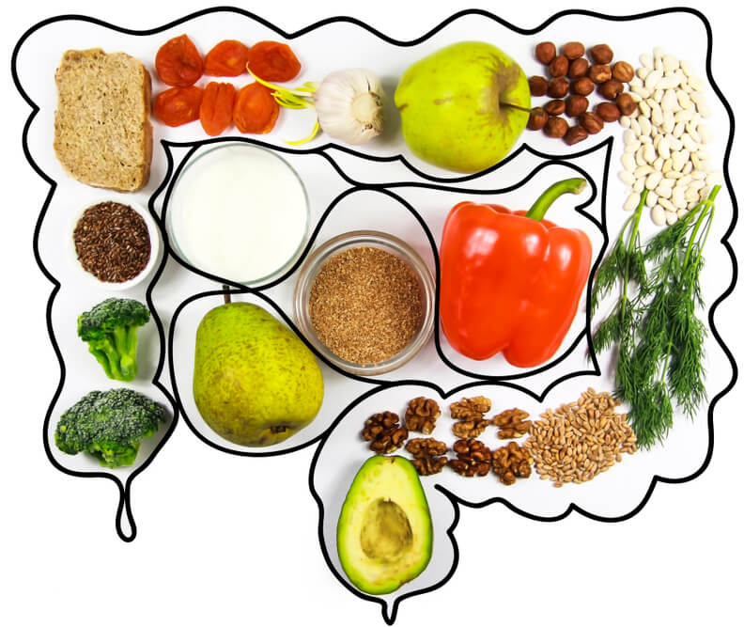
As such, colonic micro-organisms have ample opportunity to degrade available substrates, of which around 70g/d may be derived from the diet. These can be recognised as ‘colonic foods’, metabolism of which occurs through the anaerobic metabolic process known as fermentation

Slide 9
Type of substrates available for bacterial growth in the human large intestine
Substrate | Estimated quantity (g/d)
Resistant starch | 8–40
Non-starch polysaccharides | 8–18
Unabsorbed sugars | 2–10
Oligosaccharides | 2–8
Dietary protein | 3–9

Slide 10
How are colonic foods metabolised?
Bacteria resident in the large gut depend upon a supply of fermentable substrate for their growth and activities.
Principally, this is provided by the diet, ( any food that resists digestion) although there is also a contribution from endogenous sources like mucins and chondroitin sulphate

Slide 11
Any foodstuff that resists digestion in the upper gastrointestinal tract (stomach, small intestine) can serve as a colonic food in that it feeds the resident microbiota
Major SCFA produced are acetate, propionate and butyrate. It is thought that acetate is cleared
in peripheral tissues such as muscle. Propionate is largely broken down in the liver.

Slide 12
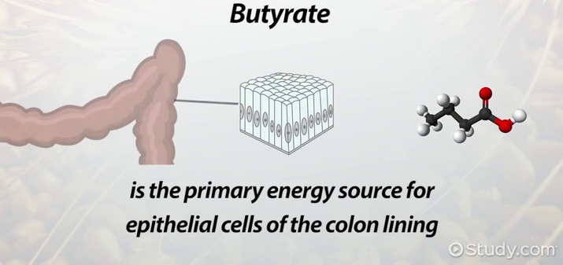
whereas butyrate acts as the primary source of fuel for colonocytes. The systemic metabolism of SCFA in the liver is thought to contribute about 7–8% of host daily energy requirements which in itself confirms the significant role of gut micro-organisms in human nutritional processes

Slide 13
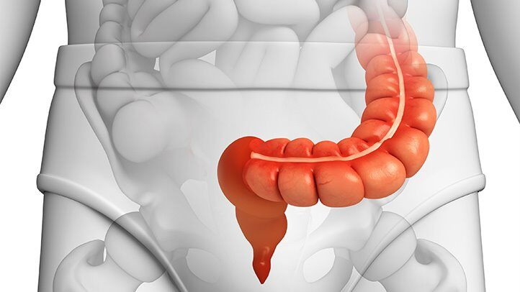
Gases are also derived by bacterial action in the large intestine. Principally,these are hydrogen, carbon dioxide, methane and hydrogen sulphide. While gas formation is usually considered to be the terminal stage of food digestion , it remains an enigmatic process through the ‘balance’ of H2 generation/ metabolism

Slide 14

A number of possible fates occur for intestinal H2 in that it may be excreted or further metabolised by gut bacteria. In the latter case, sulphate reducers (producing H2S), methanogens (expiring CH4) and acetogens(excreting acetate) may all be involved
Medically, H2 and its fate have been, at least tenuously but usually scientifically, linked with pneumatosis cystoides intestinalis, ulcerative colitis and bowel cancer

Slide 15
Factors affecting colonisation and growth of bacteria in the gut
Physicochemical | Microbial
Amount and type of substrate | Competition between species for colonisation sites and nutrients
pH of gut contents | Inhibition through metabolic end products, e.g. acids, peroxides
Redox potential | Specific inhibitory substances, e.g. bacteriocins Bile salts Immunological events

Slide 16
Predominant end products of protein fermentation are SCFA, including branched chain forms, as well as phenolic compounds, ammonia and some amines
These metabolites have been associated with various clinical states such as tumourigenesis, schizophrenia, migraine

Slide 17
In very general terms, the metabolites of a saccharolytic metabolism in the gut are benign, whereas those that arise from proteolysis can be detrimental. As such, there can be positive or
negative outcomes associated with gut bacterial fermentation.

Slide 18
Probiotics
The first records of ingestion of live bacteria by humans are over hundred years ago. However, at the beginning of this century probiotics were first put onto a scientific basis by the work of Metchnikoff at the Pasteur Institute in Paris.

Slide 19
Metchnikoff hypothesised that the normal gut microflora could exert adverse effects on the host and that consumption of ‘soured milks’ reversed this effect.
Metchnikoff refined the treatment by using pure cultures of what is now called Lactobacillus delbrueckii subsp. bulgaricus which, with Streptococcus salivarius subsp.thermophilus, is used to ferment milk in the production of traditional yoghurt

Slide 20
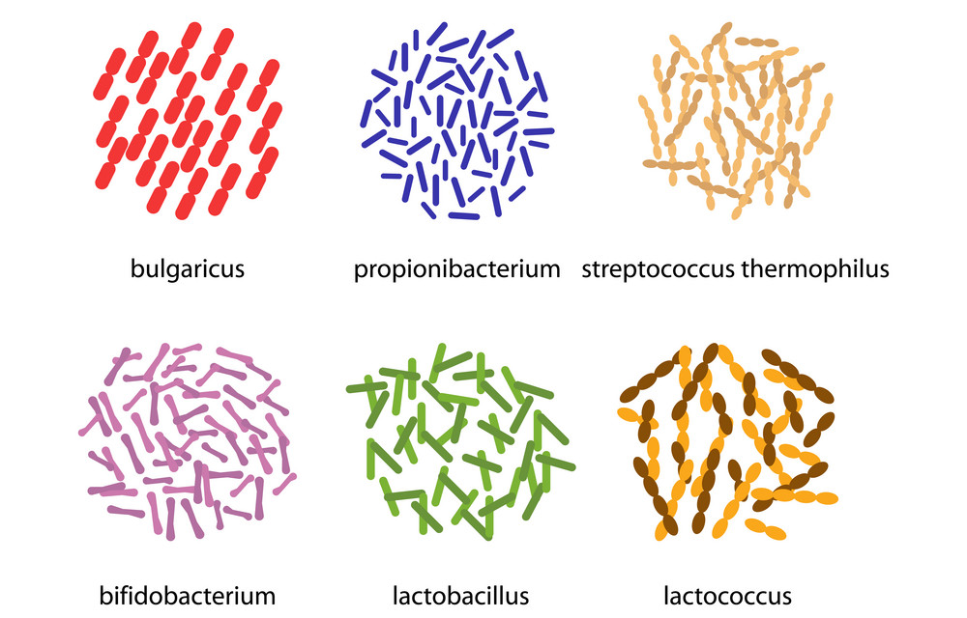
Probiotic definitions
A formal probiotic definition is a live microbial feed supplement which beneficially affects the host animal by improving its intestinal microbial balance
Over the years, many speciesof micro-organisms have been used. They consist not only of lactic acid bacteria (lactobacilli, streptococci, enterococci, lactococci, bifidobacteria) but also Bacillus spp. and fungi such as Saccharomyces spp. and Aspergillus spp.

Slide 21
Benefits of probiotics
Main positive effects associated with probiotics include
cholesterol and/or triglyceride reduction, Anti-tumour properties.
protection against gastroenteritis,
improved lactose tolerance
stimulation of the immune system through non pathogenic means

Slide 22
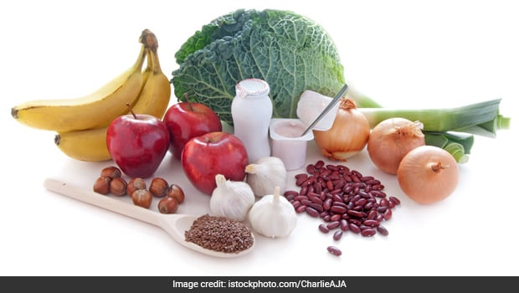
Prebiotics
Prebiotics allow the selective growth of certain indigenous gut bacteria. Thus, the prebiotic approach involves administration of a non-viable food component and considers that many potentially health-promoting micro-organisms such as bifidobacteria and lactobacilli are already resident in the human colon

Slide 23
To be an effective prebiotic a colonic food must
Neither be hydrolysed nor absorbed in the upper part of the gastrointestinal tract;
Have a selective fermentation such that the composition of the large intestinal microbiota is altered towards a healthier composition

Slide 24
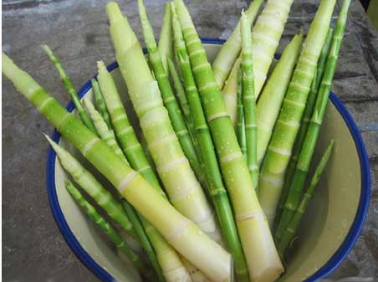
Commercially available
fructose-containing oligosaccharides (FOSs) banana, onions, legumes, Jerusalem artichoke……
Galacto-oligosaccharides (GOSs) are another class of prebiotics that are manufactured and marketed in Europe as well as Japan. dairy products Legumes, Cashews and pistachios, soya milk or soya drink and Oat milk.
Xylo-oligosaccharides (XOSs) are also used as prebiotics in Japan. Sources: bamboo shoots, fruits, vegetables, milk, and honey

Slide 25
Synbiotics
A synbiotic is a marriage of the concepts of probiotics and prebiotics. A synbiotic consists of a live microbial food additive together with a prebiotic oligosaccharide. They can deliver the benefits of probiotics and prebiotics.

