Slide 1



Tishk International University
Faculty of Applied Science
Nutrition and Dietetics Department
Introduction to Food Microbiology
Food Microbiology / 1st Lecture
2nd Grade / Spring Semester
02.02.2026
Instructor: Adam Jalal Mohammed
Email: adam.jalal@tiu.edu.iq
Food Microbiology
2025 - 2026

Slide 2
COURSE STRUCTURE
Lecture Overview
01
Historical Foundations
05
Detection and Study Methods
From Ancient Observations to Modern Science - tracing the evolution from Leeuwenhoek's first observations to Pasteur's revolutionary experiments
Tools for Observing and Understanding Microbes - microscopy, staining, and genetic techniques
06
Food Safety and Pathogens
02
Fundamentals of Food Microbiology
Understanding and Controlling Harmful Microbes - major pathogens, spoilage, and prevention
Understanding the Microbial World in Food Systems - definitions, subdivisions, and key applications
07
Beneficial Microorganisms
03
Bacterial Cell Biology
Fermentation and Food Production - lactic acid bacteria, fermentation processes, and applications
Structure, Organization, and Function - size, shape, arrangements, and specialized structures
08
Modern Food Microbiology
04
Bacterial Growth and Culturing
Advanced Techniques and Future Directions - rapid detection, genomics, and emerging technologies
Understanding Microbial Multiplication - culture media, growth conditions, and growth kinetics

Slide 3
CHAPTER 01
Historical Foundations
From Ancient Observations to Modern Science

Slide 4
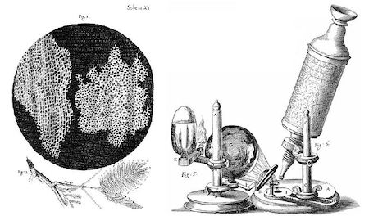
HISTORICAL FOUNDATIONS
The Birth of Microbiology: Key Pioneers
1665
Robert Hooke
English scientist who used the first compound microscope to observe cork cells, publishing detailed drawings in "Micrographia" and coining the term "cell."
Published "Micrographia" - foundational microscopy text

Slide 5
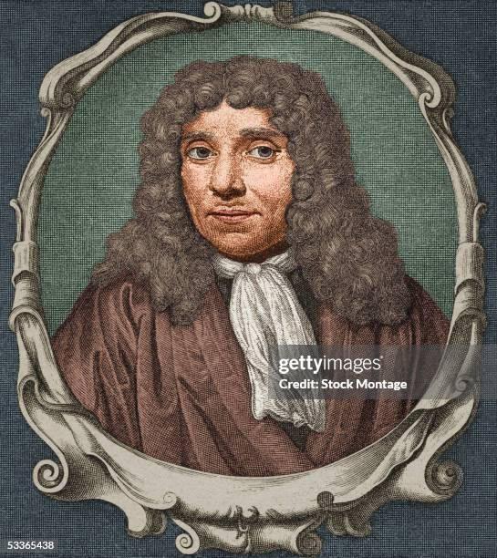
HISTORICAL FOUNDATIONS
The Birth of Microbiology: Key Pioneers
17th
Antonie van Leeuwenhoek (1632-1723)
"Father of Microbiology" - Dutch scientist who designed simple microscopes and was the first to observe and describe single-celled organisms, including bacteria and protozoa (1673-1723).
Discovered "Animalcules" - live microorganisms

Slide 6
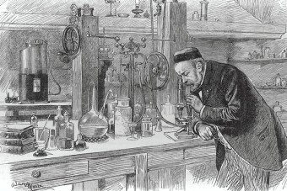
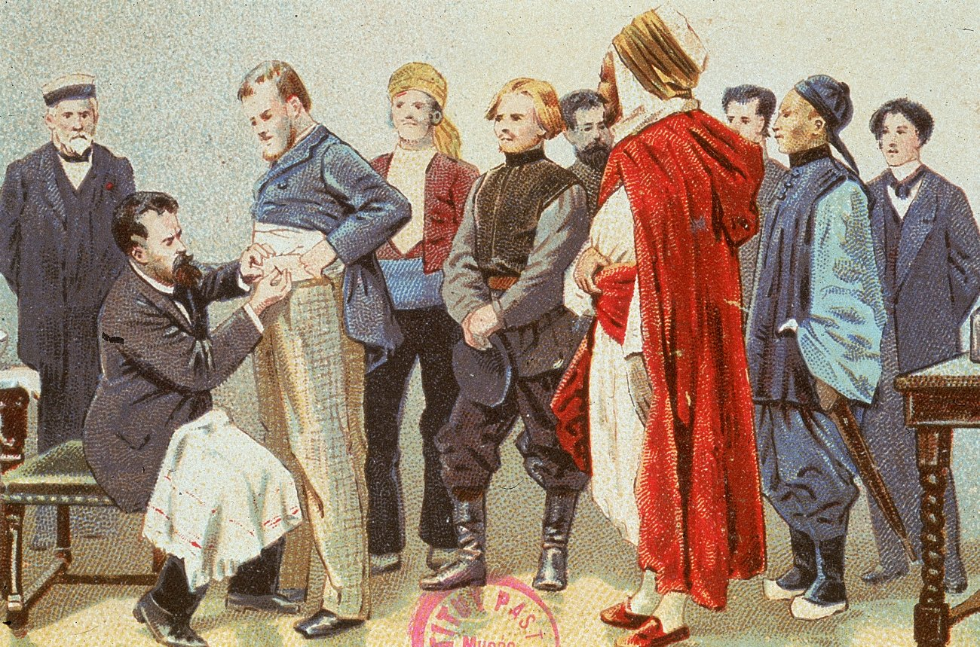
HISTORICAL FOUNDATIONS
The Birth of Microbiology: Key Pioneers
19th
Louis Pasteur (1822-1895)
French chemist and microbiologist who revolutionized science through multiple breakthrough discoveries:
• Disproved spontaneous generation with swan-neck flask experiments
• Developed germ theory of disease - microorganisms cause diseases
• Created pasteurization process - heat treatment to kill harmful microbes
• Developed rabies vaccine (1885) - major immunization breakthrough
• Demonstrated microorganisms perform fermentation

Slide 7
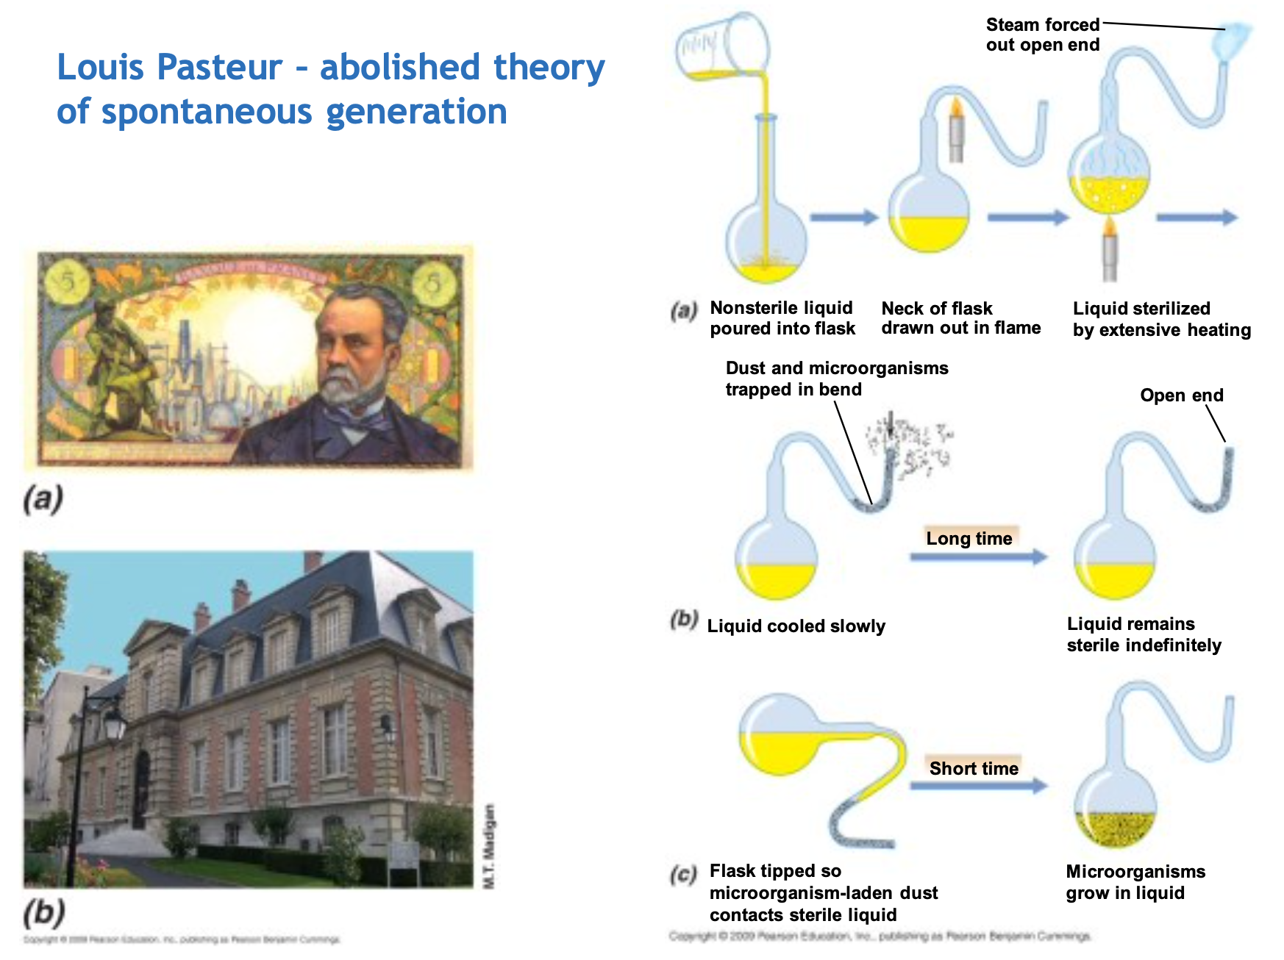

Slide 8
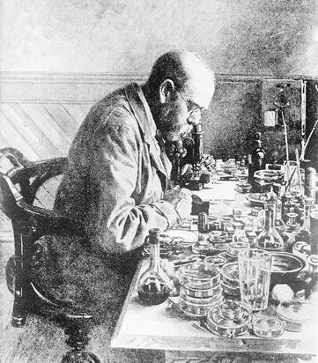
HISTORICAL FOUNDATIONS
The Birth of Microbiology: Key Pioneers
1880s
Robert Koch (1843-1910)
German physician and microbiologist who identified causative agents of major diseases and established rigorous scientific criteria for proving disease causation.
Identified:
• Vibrio cholerae - Cholera
• Mycobacterium tuberculosis - Tuberculosis
• Bacillus anthracis - Anthrax

Slide 9
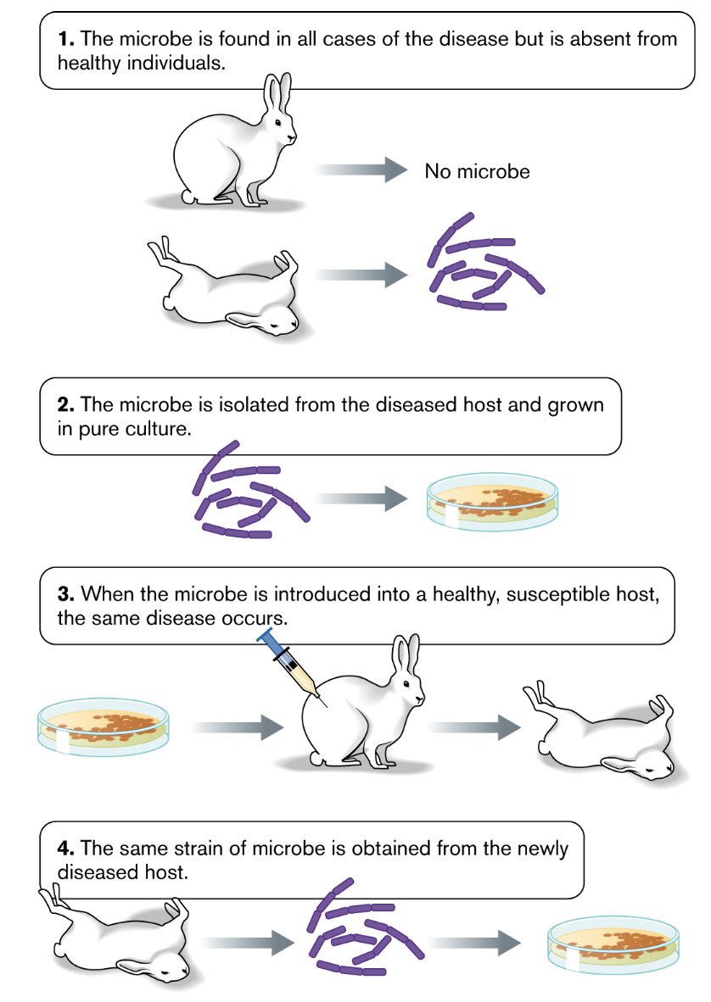
Koch’s Postulates

Slide 10
HISTORICAL FOUNDATIONS
The Birth of Microbiology: Key Pioneers
19th
Louis Pasteur (1822-1895)
17th
Antonie van Leeuwenhoek (1632-1723)
French chemist and microbiologist who revolutionized science through multiple breakthrough discoveries:
"Father of Microbiology" - Dutch scientist who designed simple microscopes and was first to observe and describe single-celled organisms, including bacteria and protozoa (1673-1723).
• Disproved spontaneous generation with swan-neck flask experiments
• Developed germ theory of disease - microorganisms cause diseases
• Created pasteurization process - heat treatment to kill harmful microbes
Discovered "Animalcules" - live microorganisms
• Developed rabies vaccine (1885) - major immunization breakthrough
• Demonstrated microorganisms perform fermentation
1880s
Robert Koch (1843-1910)
1665
Robert Hooke
German physician and microbiologist who identified causative agents of major diseases and established rigorous scientific criteria for proving disease causation.
English scientist who used the first compound microscope to observe cork cells, publishing detailed drawings in "Micrographia" and coining the term "cell."
Identified:
Published "Micrographia" - foundational microscopy text
• Vibrio cholerae - Cholera
• Mycobacterium tuberculosis - Tuberculosis
• Bacillus anthracis - Anthrax

Slide 11
CHAPTER 02
Fundamentals of
Food Microbiology
Understanding the Microbial World in Food Systems

Slide 12
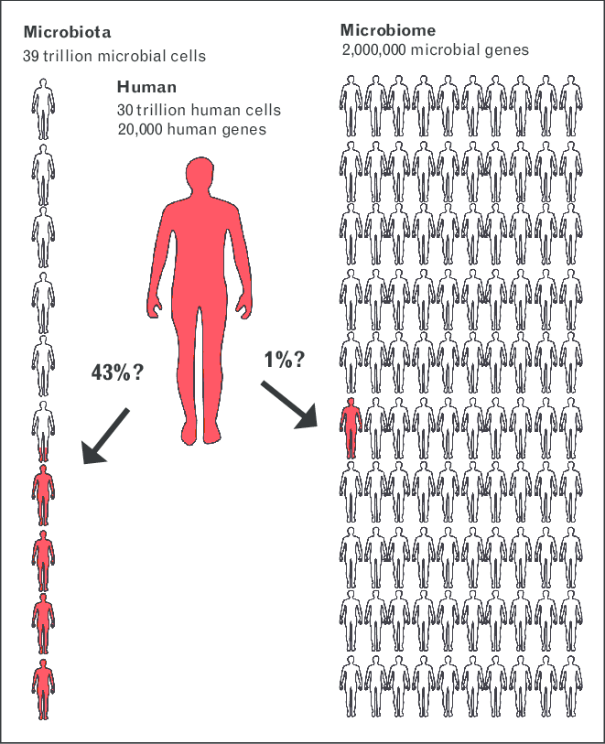

Slide 13
DEFINITIONS & SCOPE
What is Microbiology?
Microbiology: The Study of Invisible Life
Microbiology is the scientific study of all living organisms too small to be visible with the naked eye. These microscopic life forms are collectively known as 'microbes' .
Major Subdivisions
• Bacteriology: Study of bacteria
• Mycology: Study of fungi
Bacteria
Viruses
Fungi
• Phycology: Study of algae
Prokaryotic cells
Obligate parasites
Yeasts & molds
• Virology: Study of viruses
• Protozoology: Study of protozoa
Protozoa
Algae
Archaea
Single-celled eukaryotes
Photosynthetic
Extremophiles

Slide 14
APPLICATION DOMAINS
Branches and Applications of Microbiology
Food Microbiology
Agricultural Microbiology
Key Applications
Deals with microorganisms that contaminate/damage food and those used for food processing and modification.
Solves issues in agricultural practices while helping increase yields for farmers.
• Medicine & Healthcare
Infectious disease diagnosis, vaccine development, antibiotic discovery
Focus: Safety & Quality
Focus: Crop & Livestock Health
• Water & Wastewater
Microbial treatment, water quality monitoring
Medical Microbiology
Soil Microbiology
• Biotechnology
Concerned with diagnosis, prevention and treatment of diseases caused by infectious agents.
Studies soil microorganisms and their impact on soil properties and plant growth.
Genetic engineering, enzyme production, biofuels
• Food Industry
Fermentation, quality control, safety testing
Focus: Disease Management
Focus: Soil Health
Industrial Microbiology
Pharmaceutical Microbiology
Used in industrial processes: fermentation for food/beverage production, antibiotic production, bioremediation.
Uses microorganisms for inhibiting contamination and developing pharmaceuticals.
Veterinary Microbiology
Focuses on microbes causing diseases in animals and production from animals.
Focus: Large-Scale Production
Focus: Drug Development

Slide 15
DEFINITIONS & SCOPE
What is Food Microbiology?
Food Microbiology: A Specialized Discipline
Food microbiology is a specialized branch of microbiology that deals with:
Harmful microorganisms that contaminate or spoil food
Beneficial microorganisms used for food processing and modification
Detection and control methods for ensuring food safety and quality
Key Roles of Microbes in Food Systems
Nutrient Cycling: Breaking down organic matter
Biodegradation: Decomposing food waste
Food Spoilage: Causing deterioration
Disease Control: Pathogen management
Biotechnology: Fermentation & production
Industrial Use: Enzyme & chemical production

Slide 16
CHAPTER 03
Bacterial Cell Biology
Structure, Organization, and Function

Slide 17
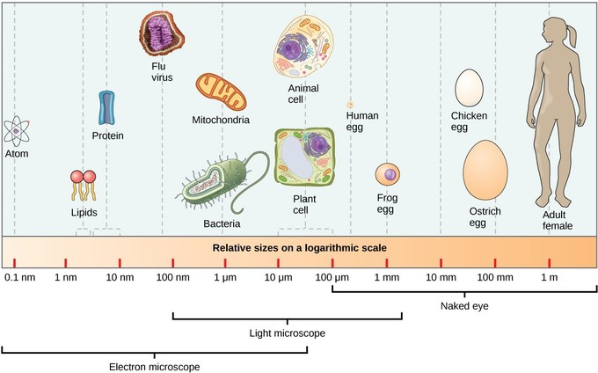
CELL MORPHOLOGY
Bacterial Cell Size, Shape, and Arrangement
Cell Size Comparison
1-10
Most Bacteria & Archaea
μm
Typical prokaryotic cell size range
10-100
Eukaryotic Cells
μm
Yeasts, protozoa, and human cells

Slide 18
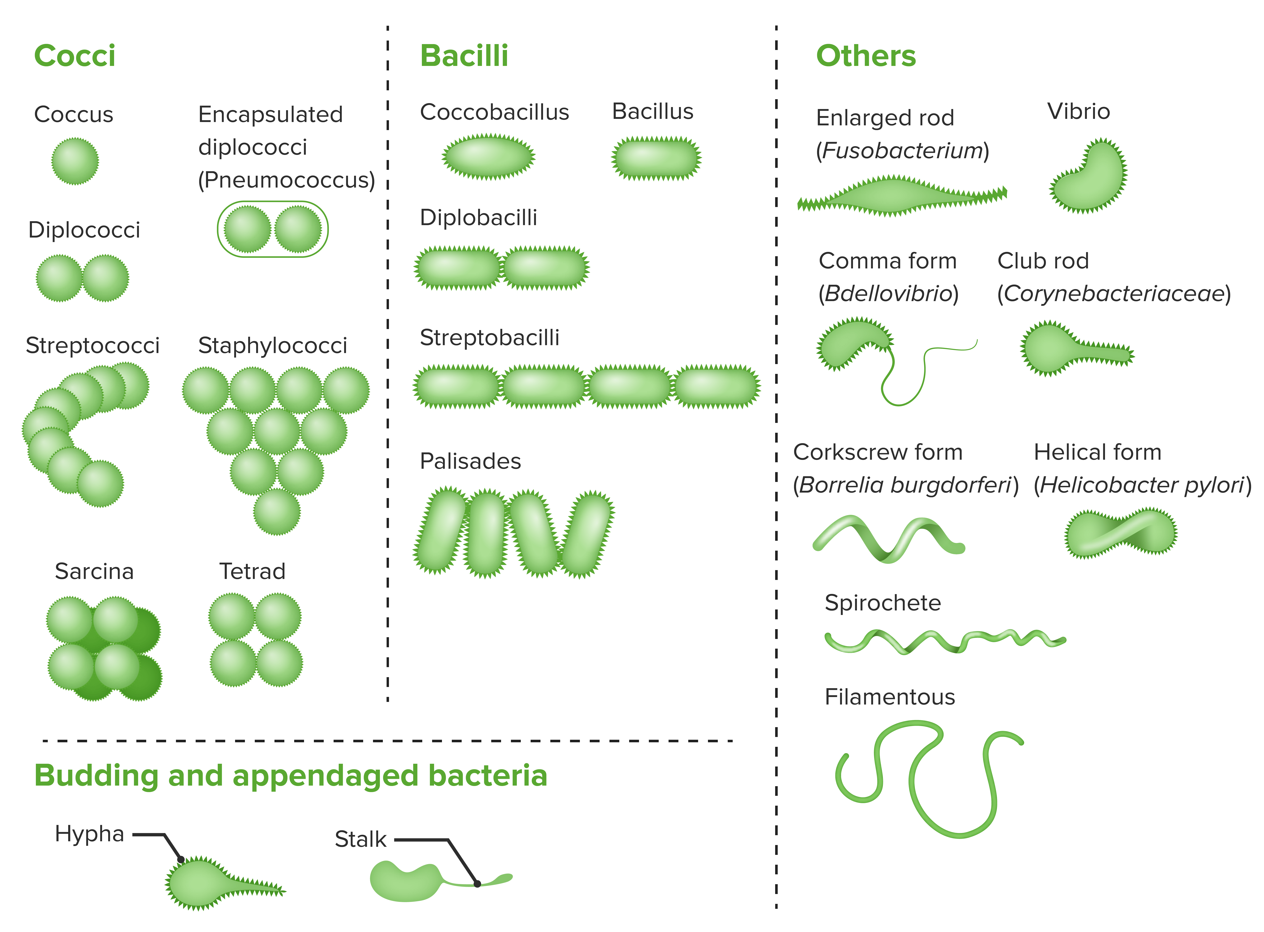
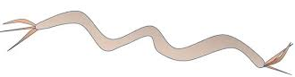
CELL MORPHOLOGY
Bacterial Cell Size, Shape, and Arrangement
Basic Bacterial Shapes
Coccus
Spherical
Bacillus
Rod-shaped
Spirillum
Spiral

Slide 19
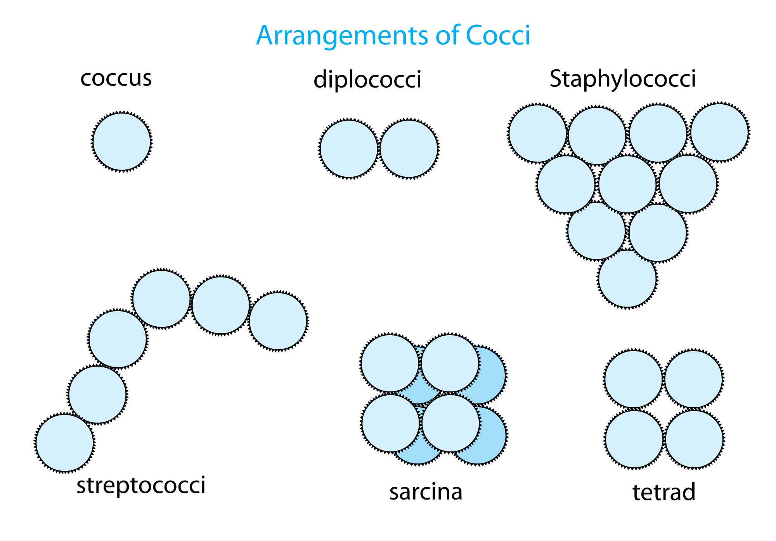
CELL MORPHOLOGY
Bacterial Cell Size, Shape, and Arrangement
Cell Arrangements
Single Cells
Individual bacteria
Diplococci
Pairs (2 cells)
Streptococci
Chains
Staphylococci
Clusters (grape-like)
Tetrads & Sarcinae
Groups of 4 or 8 cells in cubical packets

Slide 20
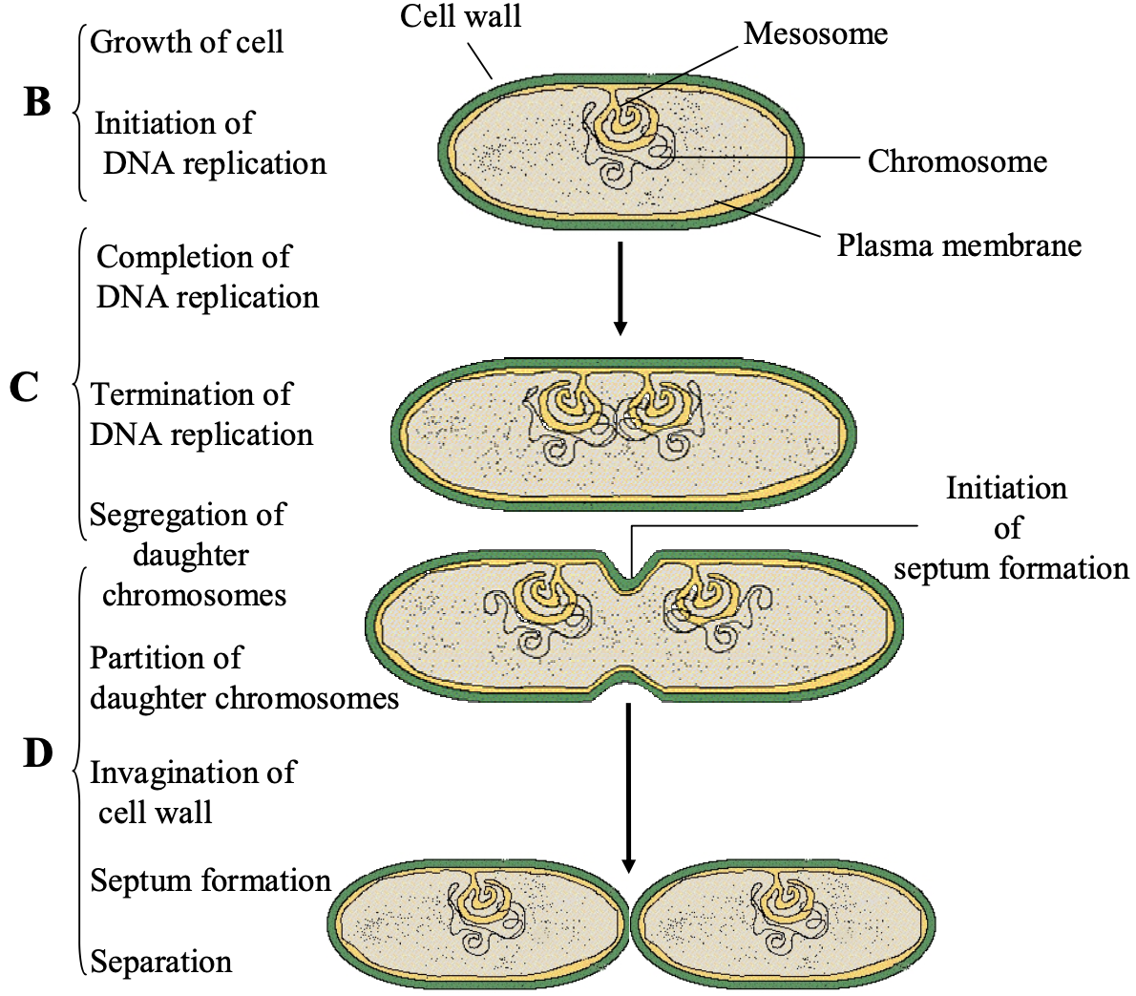
CELL MORPHOLOGY
Bacterial Cell Size, Shape, and Arrangement
Cell Division Process
1
2
Cell Elongation
Septum Formation
The cell grows in size
Division site created
3
4
Cell Wall Synthesis
Cell Separation
New wall material
Two daughter cells

Slide 21
CHAPTER 05
Bacterial Growth
and Culturing
Understanding Microbial Multiplication

Slide 22
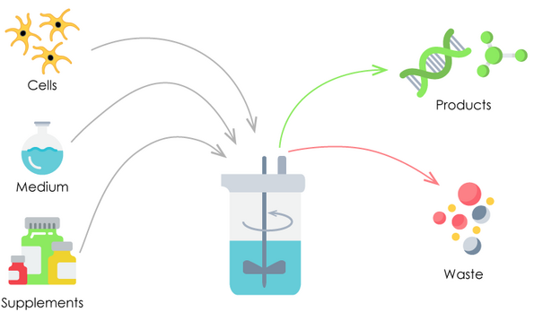
CULTURE TECHNIQUES
Culture Media and Growth Conditions
Essential Media Components
Energy Sources
Carbohydrates, proteins, lipids for metabolism
Essential Elements & Ions
N, P, S, K, Na, Mg, trace elements
Growth Factors (for auxotrophs)
Amino acids, vitamins, nucleotides

Slide 23
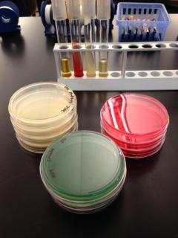
CULTURE TECHNIQUES
Culture Media and Growth Conditions
Media Classifications
Physical State
Composition
Function
• Solid (agar)
• Defined
• Universal
• Liquid
• Complex
• Selective
• Semiliquid
• Differential

Slide 24
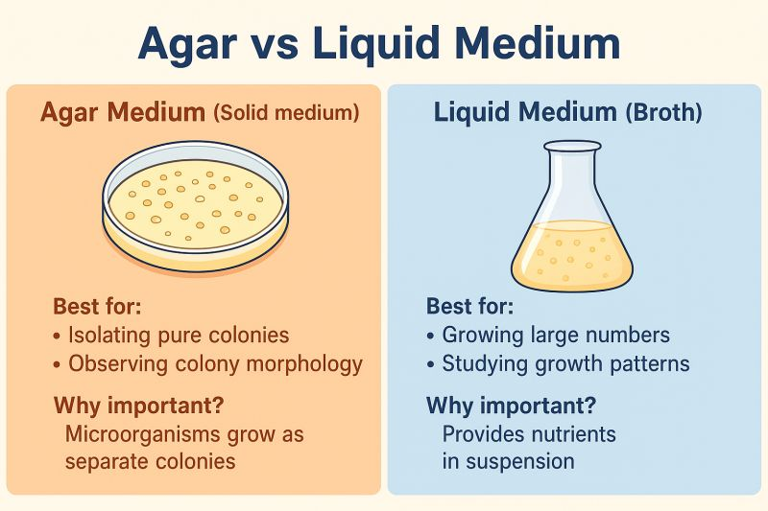
CULTURE TECHNIQUES
Culture Media and Growth Conditions
Solid vs. Liquid Cultures
Solid Cultures (Agar Plates)
Colony formation: 10⁷-10⁸ cells derived from
single cell. Characteristic morphology: color,
shape, edges, texture.
Liquid Cultures
Uniform growth, optical density measurements,
determination of CFU (colony-forming units).

Slide 25
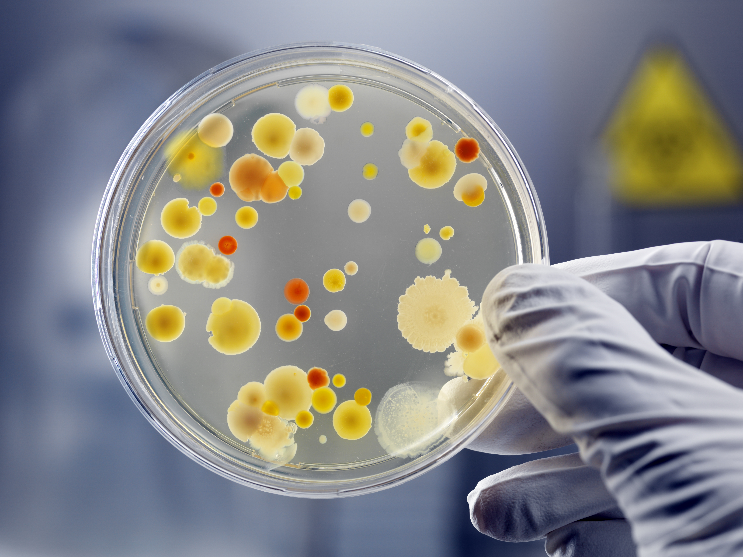
CULTURE TECHNIQUES
Culture Media and Growth Conditions
Factors Affecting Growth
Medium Composition
pH
Nutrient availability
Acidity/alkalinity
Temperature
Oxygen Availability
Psychrophiles, mesophiles, thermophiles
Aerobes, anaerobes, facultative

Slide 26
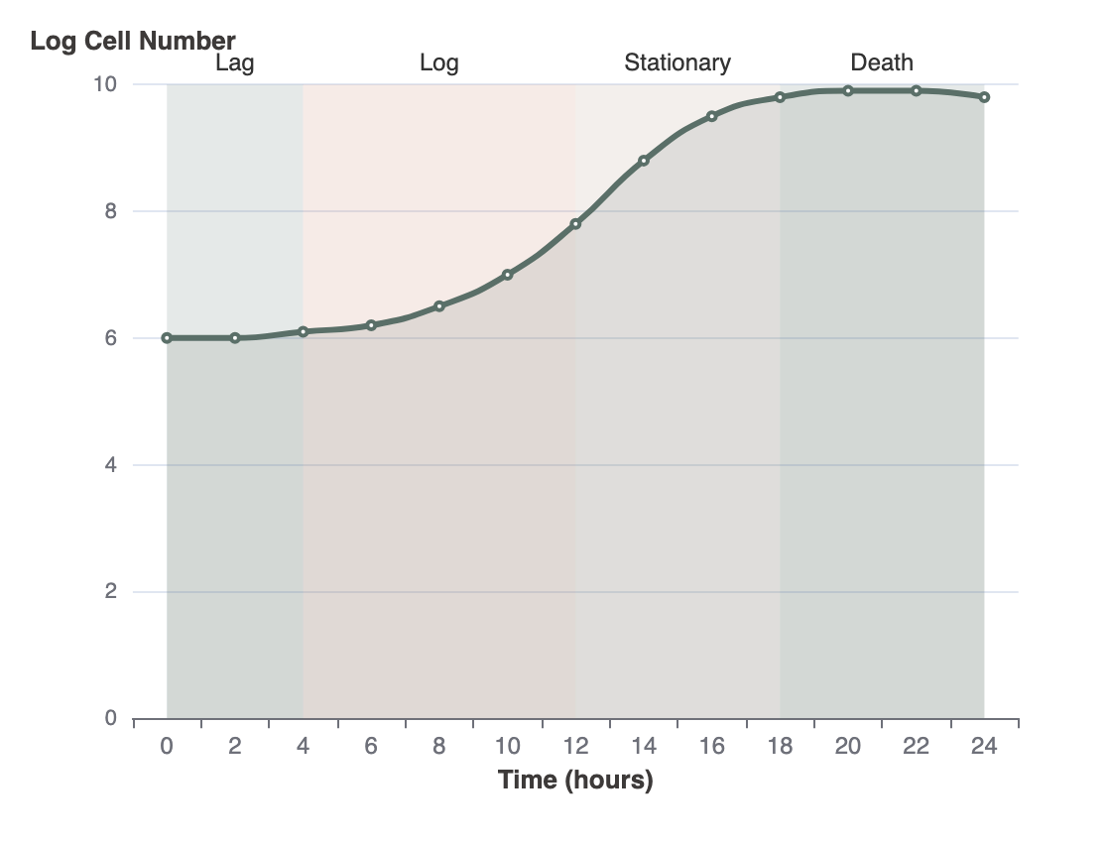
GROWTH KINETICS
Bacterial Growth Curve and Kinetics
Four Phases of Bacterial Growth
Phase Descriptions
1
Lag Phase
Cells adapting to new environment. No cell division, but metabolic activity increases. Preparing for growth.
2
Log/Exponential Phase
Rapid cell division at constant rate. Population doubles at regular intervals. Cells most metabolically active.
3
Stationary Phase
Growth rate equals death rate. Nutrient depletion and waste accumulation. Cells enter survival mode.
4
Death/Decline Phase
Cell death exceeds division. Nutrient exhaustion and toxic waste buildup. The population decreases exponentially.

Slide 27
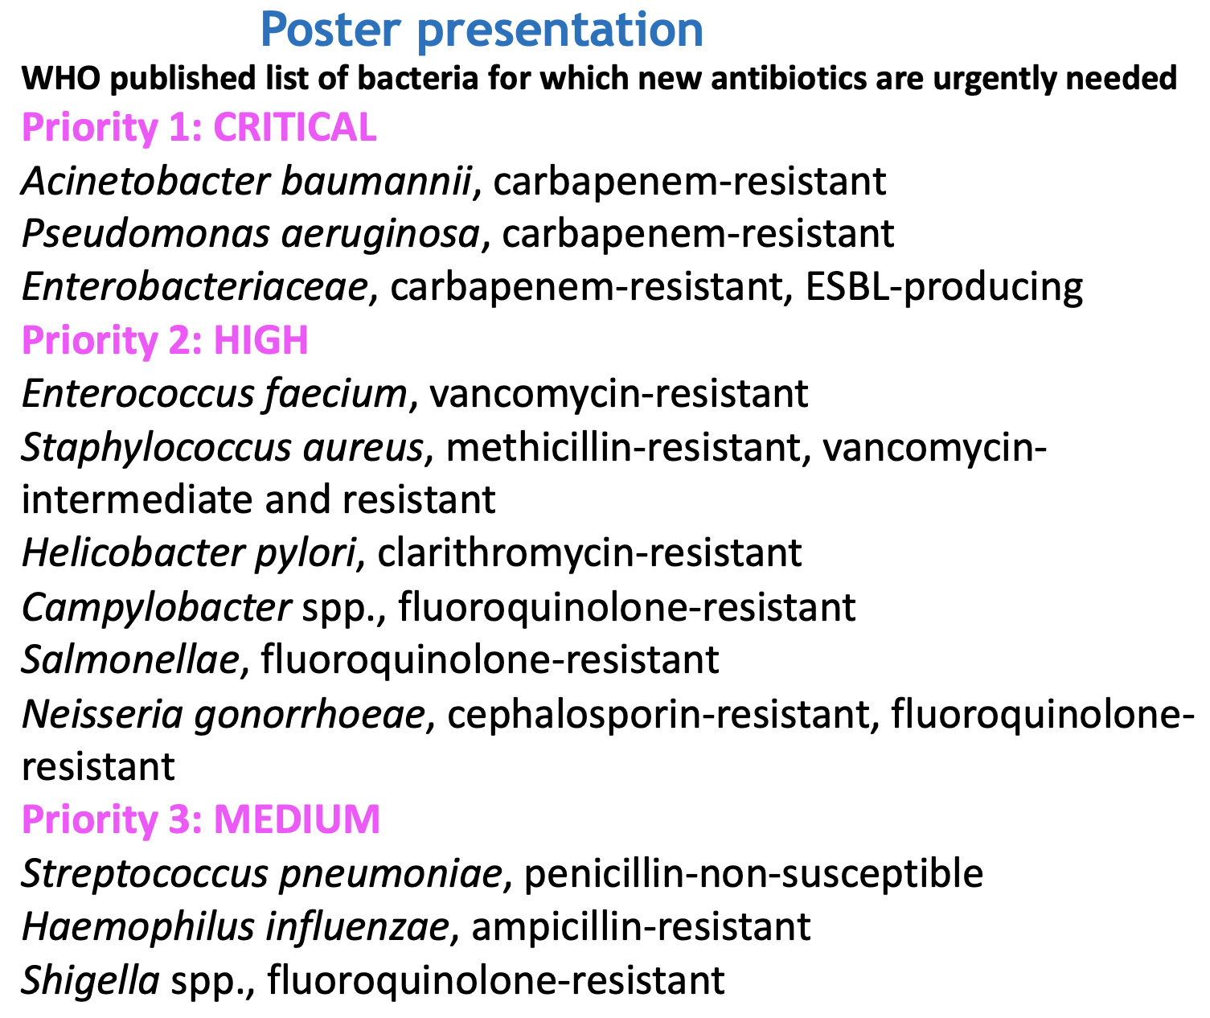
Poster Presentation
1. Escherichia coli (especially Shiga toxin–producing strains, multidrug‑resistant)
2. Salmonella enterica (non‑typhoidal, multidrug‑ and fluoroquinolone‑resistant)
3. Campylobacter jejuni (fluoroquinolone‑ and macrolide‑resistant)
4. Staphylococcus aureus (including MRSA, food‑handling contamination)
5. Enterococcus faecium (vancomycin‑resistant strains in food animals/products)
6. Clostridium perfringens (toxin‑producing, resistant strains reported)
7. Vibrio parahaemolyticus (seafood‑borne, multidrug‑resistant strains)
8. Yersinia enterocolitica (foodborne, resistant strains in pork and dairy)
9. Shigella spp. (multidrug‑ and fluoroquinolone‑resistant)
10. Clostridioides difficile
11. Cronobacter sakazakii
12. Aeromonas spp.
13. Aliarcobacter (Arcobacter) butzleri
14. Bacillus cereus (toxin‑producing, some antibiotic resistance)
15. Vibrio vulnificus (seafood‑borne, multidrug‑resistant strains)
16. Listeria monocytogenes (multidrug‑resistant strains emerging)

