Slide 1


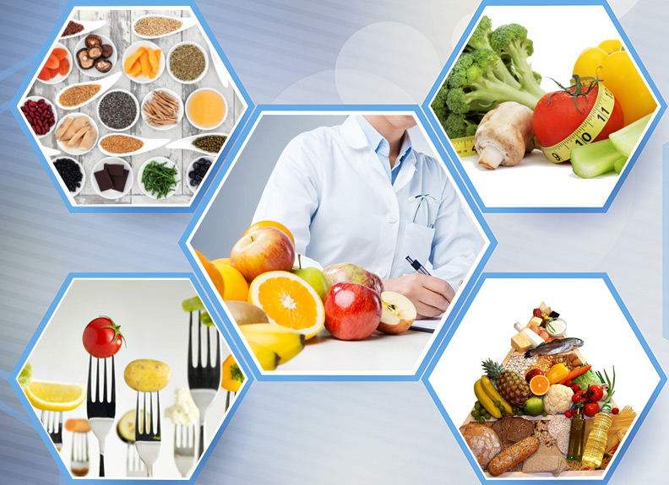

Introduction to dietetics
Assist Prof Yaseen Galali
Nutrition Department
Notes:
.

Slide 2
OUTLINE!
Week1: A review on first semester and water
Week2: minerals and health benefits
Week 3: Anti-oxidants
Week 4: Digestion and metabolism
Week5:misterm exam
Week6:Diet related diseases.
Week7:Diabetes
Week8: Obesity
Week9:cancer
Week10: Cardiovascular Disease
Week11:Diets
Week12:diet planning

Slide 3
Minerals and their health benefits
Yaseen Galali
Nutrition department

Slide 4
MINERALS
Inorganic elements essential to the nutrition of humans
Inorganic ions and compounds.
Not destroyed by heat, acid, O2, or
UV light.
Remain intact during digestion.
Play several key roles in overall health and well being

Slide 5
MINERALS
• 14 out of 92 are Essential to Body Function.
Very Important Roles in overall health and well-being
• Assist in Chemical Reactions in Cells
• Crucial to the Immune System Function
• Fluid Balance
• Nutrient Transport into Cells
• Help Skeletal Muscle Contract
• Maintain Heart Beat!

Slide 6
MINERALS
The body needs many minerals; these are called essential minerals. Essential minerals are sometimes divided up into
major minerals (macrominerals) and trace minerals (microminerals).
These two groups of minerals are equally important.

Slide 7
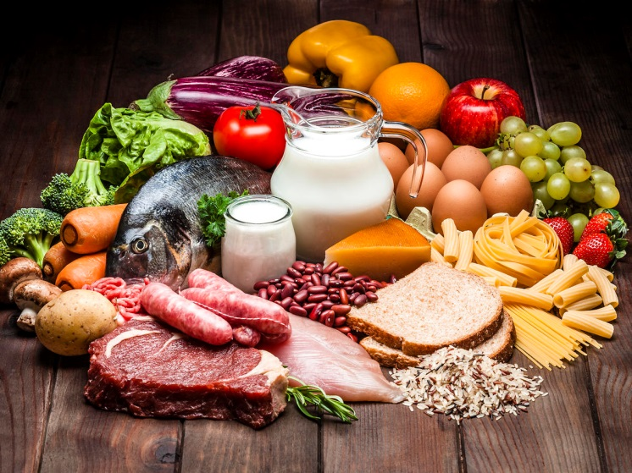
But trace minerals are needed in smaller amounts than major minerals.
The amounts needed in the body are not an indication of their importance.
A balanced diet usually provides all of the essential minerals.

Slide 8
MAJOR MINERALS
Major Minerals (macrominerals)
Need more than 100 mg/day.
These Include:
• Calcium
• Phosphorus
• Potassium
• Sulfur
• Sodium
• Chloride
The major minerals are
the 6 dietary minerals
your body needs in the
largest amounts.

Slide 9
CALCIUM (CA2+)
• Most abundant mineral in body!
• 99% of body's Ca2+ located in bones and teeth.
Some of the Top Foods for Calcium!
#1: Cheese (Mozzarella) - 961mg (95% DV)
#2: Milk & Yogurt - 125mg (13% and 49% DV)
#3: Dark Leafy Greens (Watercress, Kale) - 120mg (12% DV)
#4: Cabbage (Bok Choy) - 105mg (11% DV)
#5: Okra (Cooked) - 77mg (8% DV)
#6: Broccoli - 47mg (5% DV)
#7: Green Beans - 37mg (4% DV)
#8: Almonds - 264mg (26% DV)
#9: Sardines (in Oil with Bones) - 383mg (38% DV)
#10: Pink Salmon - (8%)

Slide 10
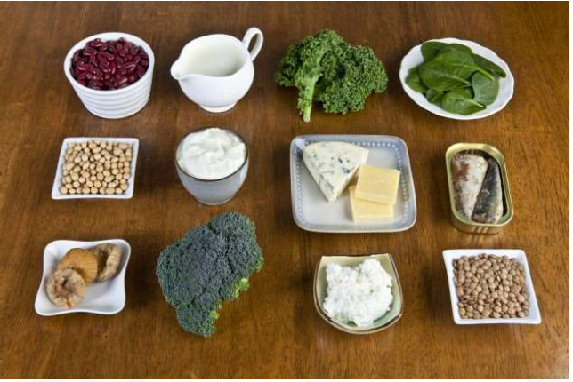
BIOAVAILABILITY
Vitamin D and lactose increases absorption.
Low Protein intake decreases absorption.
Phytates and Oxalates decreases Ca2+ bioavailability.

Slide 11
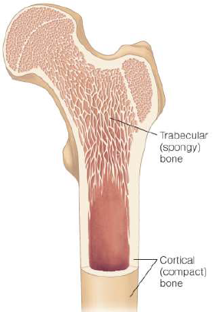
FUNCTIONS OF CALCIUM
Ca2+ helps build strong
bones and teeth.
Hard Outer Bone Surface
Trabecular (Porous) Bone:
Inside of bone; more sensitive
to changes in dietary calcium

Slide 12
CALCIUM FUNCTIONS: MANY IMPORTANT ROLES:
Muscle Contraction
Nerve Transmission – release of Neurotransmitter!
Regulating Hormones and Enzymes
Blood Vessel Dilation/Constriction: Blood Pressure
Blood Clotting

Slide 13
CALCIUM MAY:
Prevent Colon Cancer – by protecting lining of tract from caustic and abrasive substances.
Reduce the risk of kidney stones – Ca2+ binds to oxalates in foods.
Reduce the risk of obesity – by normalizing interactions between hormones and increase energy burn.

Slide 14
DAILY NEEDS FOR CA2+
RDA for Adults: 1,000 to 1,100 mg/day
Ca2+ Toxicity
Hypercalcemia: Too much Ca2+ in blood
Symptoms:
• Constipation
• Bone pain
• Muscle weakness
• Mental confusion
• Impairs absorption of Fe, Zn, Mg and P

Slide 15
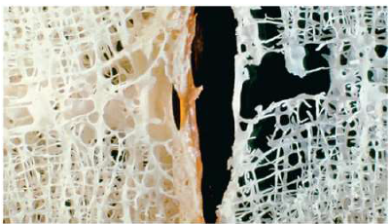
CA2+ DEFICIENCY
Hypocalcemia: Blood Ca2+ levels below normal
Bones less dense, weakened and brittle.
Increases risk of Osteoporosis and Bone Fractures
Do not take a calcium supplement at the
same time of day as an iron supplement!

Slide 16
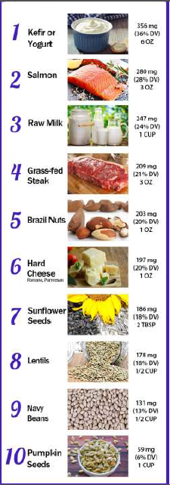
PHOSPHORUS (PO4 3-)
2nd most abundant Mineral in Body
Most (85%) in Bone Tissue
the rest in muscle extra cellular fluid
cell membrane and
Absorbed in the Small Intestine
Vitamin D enhances bioavailability.
Phytate, aluminum, magnesium
and calcium reduce absorption.
Notes:
Vitamin D functions by stimulating intestinal calcium and phosphorus absorption, by stimulating bone calcium mobilization, and by increasing renal reabsorption of calcium in the distal tubule.
Phytate or phytic acid is the principal storage form of phosphorus in many plant tissues, especially bran and seeds. It can form complexes with metals or proteins and therefore reduce their bioavailability in the gastrointestinal tract. Phytate is thus considered an anti-nutrient compound in oats.
Calcium (Ca) interacts with phosphorus (P) in many ways in the body. High Ca intake inhibits P uptake from the gut, and a high P intake may decrease the absorption of Ca, both due to the formation of Ca-P salts.

Slide 17
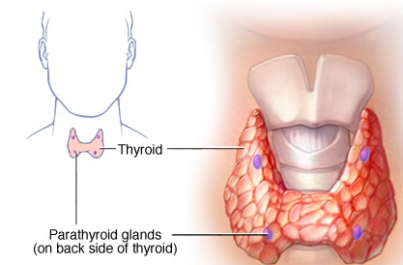
PARATHYROID HORMONE (PTH)
This hormones regulates P homeostasis.
– Stimulates resorption of P from bone
– Stimulates P excretion from kidney
Excretion – most P lost in Urine, some in Feces
Notes:
A hormone called parathyroid hormone (PTH) regulates the levels of calcium and phosphorus in your blood. When the phosphorus level is measured, a vitamin D level, and sometimes a PTH level, is measured at the same time. Vitamin D is needed for your body to take in phosphate.

Slide 18
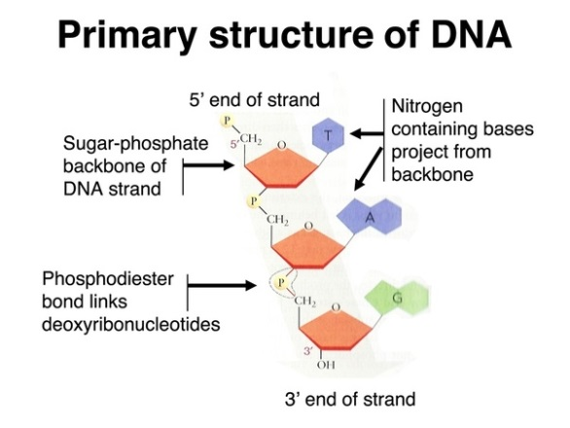
PHOSPHORUS NEEDS IN THE BODY!
Formation of Bones and Teeth
Along with Ca2+ makes Calcium Hydroxyapatite
Phosphorus Needs in the Body!
Integral part of cell membrane Phospholipids
Required for ATP and Creatine Phosphate
Acts as a Buffer in acid-base balance
“Phosphate Backbone” is part of DNA and RNA
in every cell!
Notes:
Pure hydroxyapatite is white in color. It makes up most of the human bone structure, builds tooth enamel, and collects in tiny amounts in part of the brain.

Slide 19
DAILY REQUIREMENT
RDA Adult: 700 mg/day
Tolerable upper intake: 4,000 mg/day
Americans consume 1,000 mg/day.
Food Sources of Phosphorus
• Foods from animal sources
• Plant seeds – 50% of P is bioavailable due to phytates.
• Soft drinks and colas contain phosphoric acid.

Slide 20
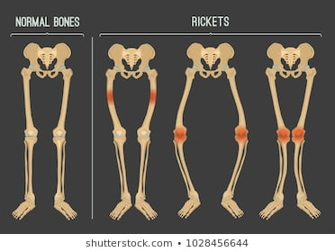
P TOXICITY
Hyperphosphatemia - Only with kidney disease
High intake of P with low Ca2+ intake can
decrease bone mass.
Can lead to Ca2+ deposits in soft tissue
P Deficiency is rare.
Hypophosphatemia
Muscle weakness, bone pain, rickets, confusion ,and death in extreme
cases!

Slide 21
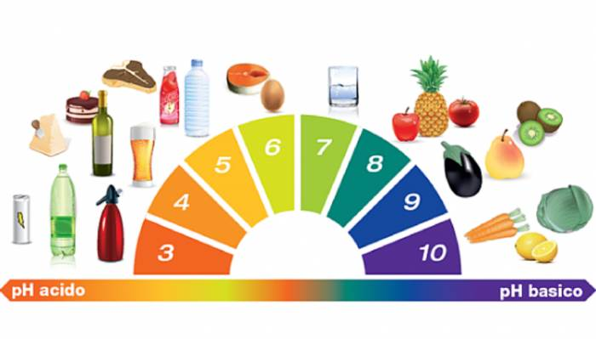
POTASSIUM (K+)
• Major Cation in intracellular fluid (ICF)
• Absorbed in Small Intestine and Colon
• Kidneys regulate balance excreting excess.
• Muscle Contraction and Nerve Impulse.
• Rhythmic Heart Beats.
• Regulate Blood Pressure
• Acts as a Buffer in Blood.
• Preserves Ca2+ and (PO4) 3- in bones.
Minor amounts are lost in sweat.
Notes:
n summary, potassium or alkaline potassium salts from fruits and vegetables might protect against bone resorption via pH homeostasis. Furthe-rmore, potassium treatment raises calcium retention in renal tissue, while a low dietary potassium level increases calcium secretion in the kidneys

Slide 22
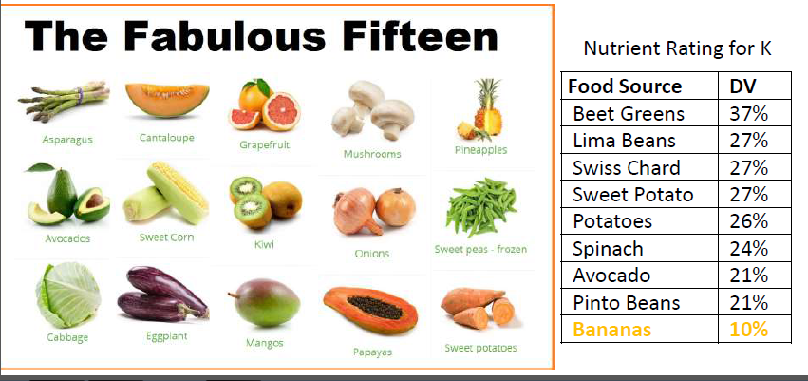
DAILY NEEDS
Adults: 4,700mg/day.
May reduce Hypertension.
May reduces bone losses and risk of kidney stones.
Notes:
Normal body levels of potassium are important for muscle function. Potassium relaxes the walls of the blood vessels, lowering blood pressure and protecting against muscle cramping. A number of studies have shown an association between low potassium intake and increased blood pressure and higher risk of stroke. On the flip side, people who already have high blood pressure can significantly lower their systolic (top number) blood pressure by increasing their potassium intake when they choose to eat healthy foods.

Slide 23
K TOXICITY
Hyperkalemia: Too much K+ in blood!
Cannot occur from food intake – but with supplementation or salt substitutes!
This can lead to:
• Irregular heart beat
• Heart damage
• Death
If kidneys impaired or taking medications for heart disease or diuretics increase risk and need to be cautious.

Slide 24
K+ DEFICIENCY
Hypokalemia: Too little K+ in blood.
Increases risk of hypertension, kidney stones, and loss of bone mass.
Caused by prolonged vomiting or diarrhea
Can lead to:
• Muscle Weakness and Cramps
• Glucose intolerance and diuretics
• Irregular Heart Beat and Paralysis
Notes:
These studies determined that experimentally induced hypokalemia led to impaired glucose tolerance by reducing insulin secretion in response to glucose loads.
High pottasium with diuretics leads to decreased insulin seceretion.
This is because the flow of potassium in and out of heart cells helps regulate your heartbeat. (Potassium affects the way your heart's muscles work)

Slide 25
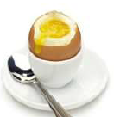
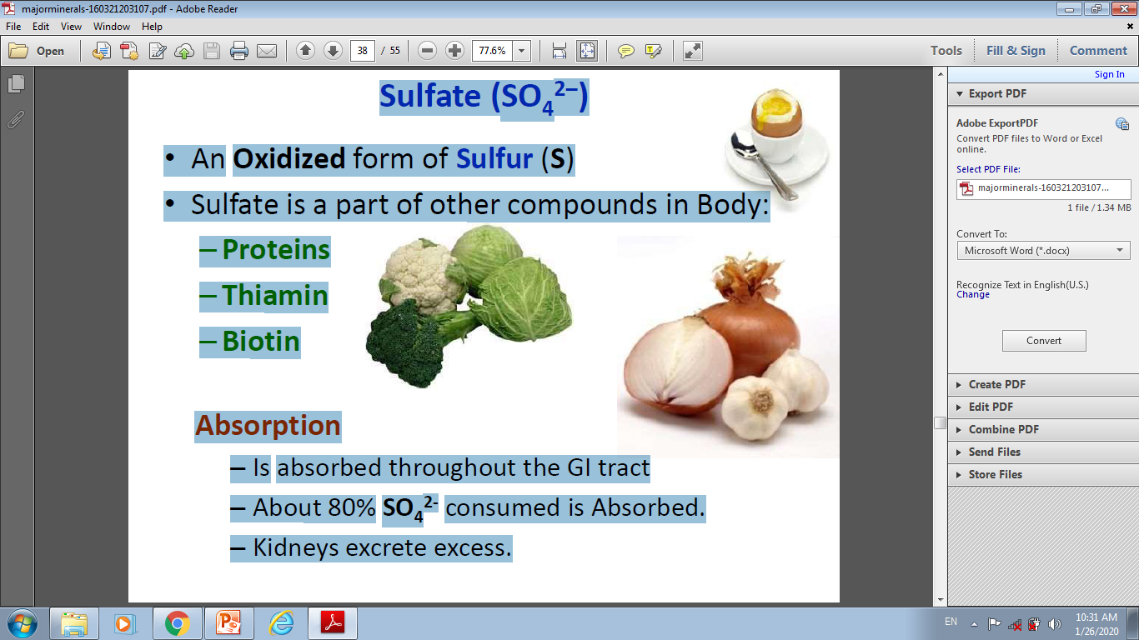
SULFATE (SO4 2–)
• An Oxidized form of Sulfur (S)
• Sulfate is a part of other compounds in Body:
– Proteins
– Thiamin
– Biotin
Absorption
Is absorbed throughout the GI tract
About 80% SO4 2- consumed is Absorbed.
Kidneys excrete excess.

Slide 26
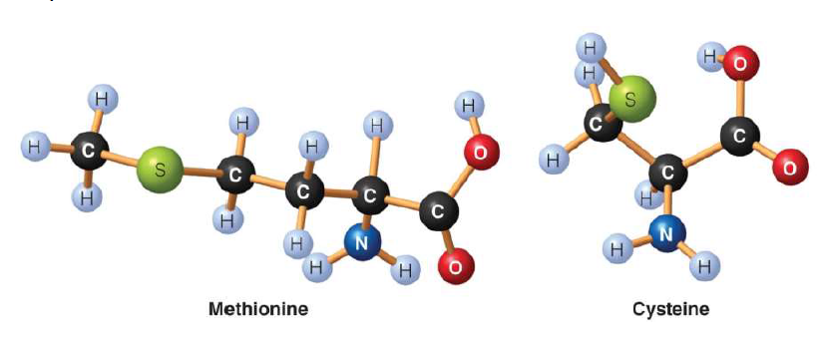
METABOLIC FUNCTIONS OF SULFATE
Part of Amino Acids Methionine and Cysteine
Involved in the tertiary and quaternary structure of proteins

Slide 27
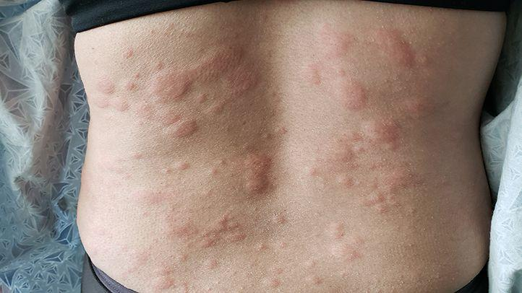
Sulfur - Can be used as a Preservative
Sulfites prevents spoilage and discoloration in foods
those sensitive may get:
Headaches, sneezing, swelling of the throat, hives
Food Sources of Sulfate
• Meat, poultry, fish, and eggs
• Legumes
• Dairy foods
• Fruits and vegetables
• Beverages: Beer, wine
No RDA, no UL! - No Toxicity or Deficiency symptoms

Slide 28
SODIUM (NA)
• Major Mineral => Na+ Electrolyte
• Cation usually combined with chloride (NaCl)
• Primarily in Blood and extracellular fluid (ECF)
• Regulates Blood Volume
Na also Located:
• Within Hydroxyapatite crystals in bone;
• In Nervous Tissue;
• In Muscular Tissue.
Table salt – accounts for 90% of our Na - part
of our problem? Can use Sea Salt!

Slide 29
ABSORPTION, TRANSPORT, AND EXCRETION OF NA
• 95-100% absorbed in Small Intestine!
• About 5% Excreted in Feces.
• Blood levels Maintained by Kidneys.
Na Regulates Fluid Volumes:
High [Na+] signals need to Conserve Water.
Hypertonic (‘salty’) blood triggers Thirst mechanism in
Hypothalamus – signals drinking!
Also triggers Renin release, then Angiotensinogen activation and also ADH release to reduce urine excretion!
Notes:
The Release of Renin
Detection by one or both of these mechanisms leads juxtaglomerular cells in the kidneys to release an enzyme called renin. Renin is an enzyme released by the juxtaglomerular cells of the kidneys in response to low blood pressure, causing the transformation of angiotensinogen to angiotensin I.

Slide 30
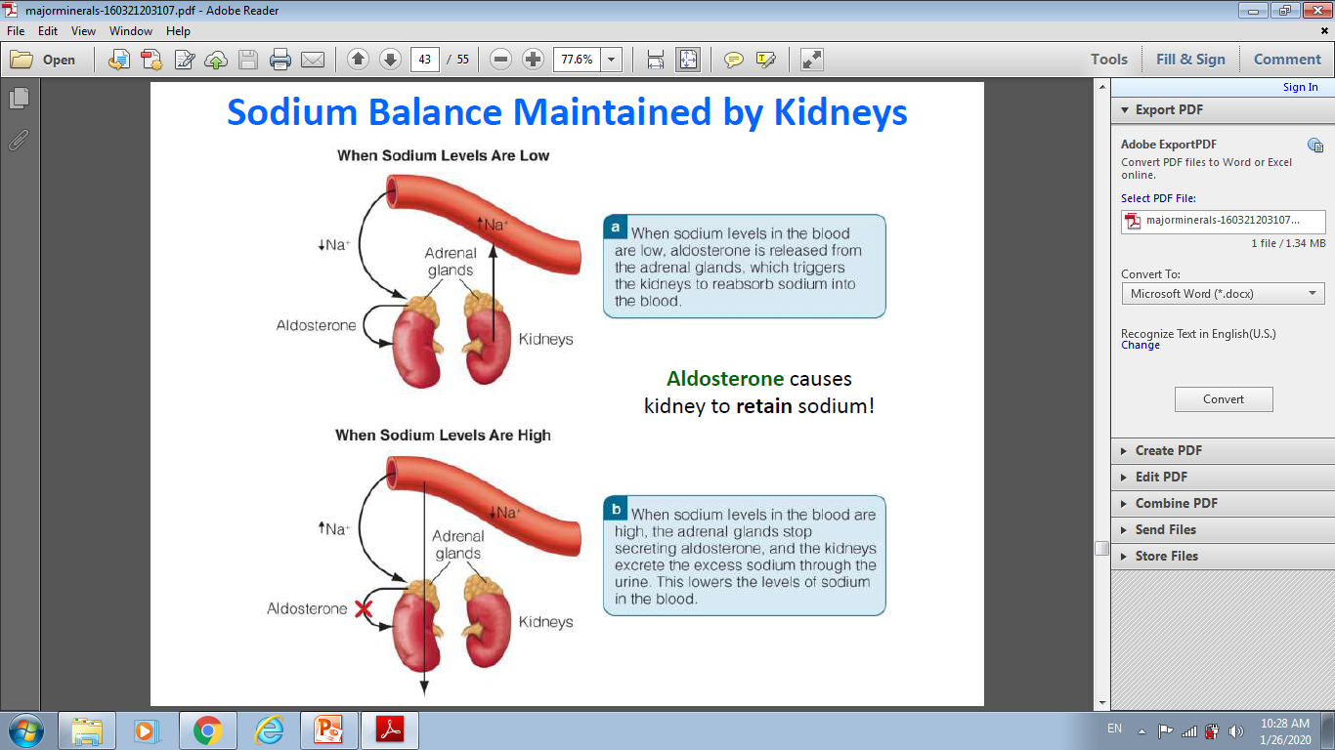

Slide 31
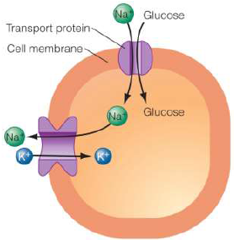
Na plays a role in nerve impulse transmission
and participates in muscle contraction
Helps transport some nutrients
Preserves and enhances
food flavor!

Slide 32
FOOD SOURCES OF SODIUM
Some Facts and Figures about Na use:
About 70% of Na is from processed foods.
Canned, processed meats, frozen or pre-packaged meals
Only 12% comes from natural food sources
About 5% added during cooking.
About 6% added at the table.

Slide 33
Hypernatremia (excess Na in blood) – when fluids not replenished as water is lost (e.g. vomiting or diarrhea)
* Or, from ingesting too much Na+
Sodium deficiency is rare.
Hyponatremia - from consuming too much water in a short time, e.g. endurance athletes.
Symptoms: Headache, muscle weakness, fatigue,
seizures, as we have seen, can cause death.
* Also occurs with Diuretic use.

Slide 34
CHLORIDE (CL–)
• A Major Electrolyte
• An Anion bound to Na (NaCl in foods)
• Primarily in blood (88%), the other 12% is:
– in intracellular fluid (ICF)
– part of HCl (hydrochloric acid) in stomach
• After ingestion, dissociates in the stomach.
• Absorbed in Small Intestine - Excreted in Urine
• Not to be confused with chlorine, a powerful
disinfectant, poisonous if inhaled or ingested.

Slide 35
METABOLIC FUNCTIONS OF CHLORIDE
• Maintains Fluid Balance.
• Assists in the removal of CO2 from blood.
• Maintains normal pH range of blood.
• Part hydrochloric acid (HCl).

Slide 36
MAGNESIUM (MG2+)
~60% in bones, 25% in muscles, the rest in cells.
Bioavailability is about 50%.
Absorption
A high-fiber, whole-grain, high phytates, lowers absorption.
Intestinal absorption and kidney excretion

Slide 37
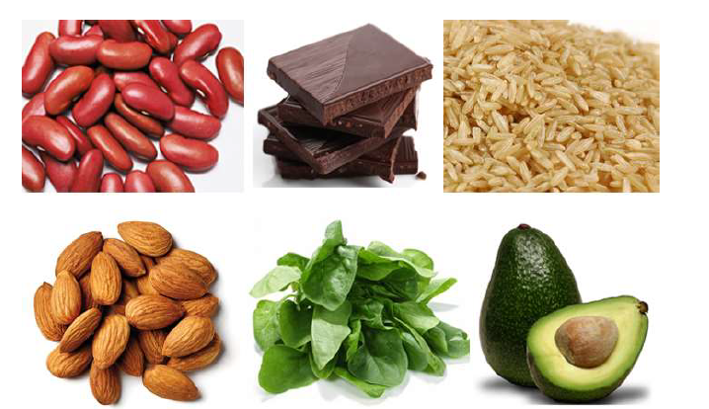
DAILY NEEDS FOR MG
Adults: 300 to 400 mg/day

Slide 38
MG2+ TOXICITY
Consuming excess supplements
can cause Intestinal problems.
Diarrhea, cramps, nausea
Mg2+ Deficiency Rare.
Some medications cause deficiency.
Poorly controlled diabetes and alcohol abuse
Symptoms:
Muscle weakness, seizures, fatigue, depression, and irregular heart beats.

Slide 39
mineral | Function | Sources
Iodine | -Part of many enzymes -Needed for making protein and genetic has a function in taste perception, wound healing, normal fetal development, production of sperm, normal growth and sexual maturation, immune system health | Meats, fish, poultry, leavened whole grains, vegetables
Iodine | Found in thyroid hormone, which helps regulate growth, development, and metabolism | Seafood, foods grown in iodinerich soil, iodized salt, bread, dairy Products
Copper | Part of many enzymes; needed for iron metabolism | Legumes, nuts and seeds, whole grains, organ meats, drinking water

Slide 40
Fluoride | Fluoride Involved in formation of bones and teeth; helps prevent tooth decay | Drinking water (either fluoridatedor naturally containing fluoride), fish, and most teas
Chromium | Work closely with insulin to regulate blood glucose | Unrefined foods, especially liver, brewer's yeast, whole grains, nuts, cheeses
Selenium | antioxidant | Legumes, nuts and seeds, whole grains, organ meats, drinking water

Slide 41
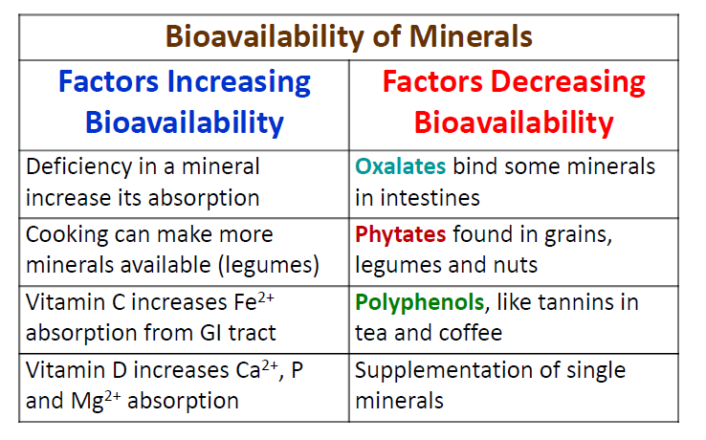

Slide 42
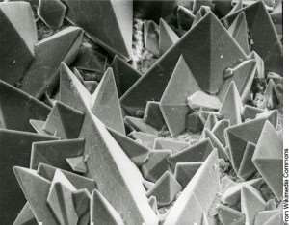
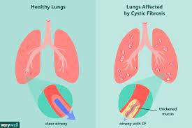
1. OXALATES
Found in many vegetables,
fruits, grains, legumes, spices,
herbs, and almost all nuts and
Seed
If too much oxalate absorbed can associate with excess
calcium to form sharp calcium-oxalate crystals – wedging
into tissue in the body causing damage and inflammation.
Excess oxalate can deplete Glutathione, essential for
metabolizing toxic chemicals that enter the body.
Some examples of disease states from Oxalates:
Kidney Stones; Gallstones; Thyroid Disease; Vulvodynia; Cystic Fibrosis.

Slide 43
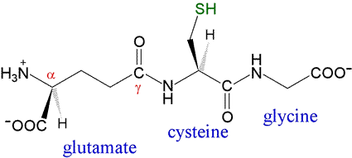
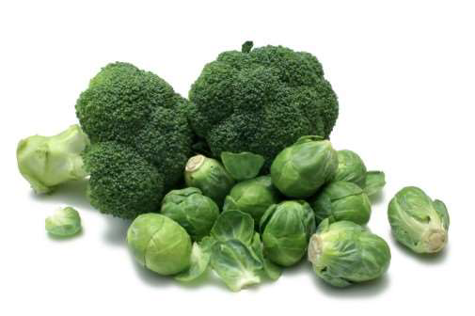
GLUTATHIONE
= 3 Amino Acids:
Cysteine, Glycine and Glutamate
Antioxidant, master detoxifier and
stimulator of the immune system

Slide 44
HOW TO GET ENOUGH GLUTATHIONE:
Exercise - it Boosts Glutathione Levels
1. Consume Sulfur-Rich Foods
broccoli, Brussels sprouts, cauliflower, kale, watercress and mustard greens.
2. Increase Your Vitamin C Intake
3. Add Selenium-Rich Foods to Your Diet
beef, chicken, fish, organ meats, cottage cheese, brown rice and Brazil nuts.
4. Eat Foods Naturally Rich in Glutathione
Spinach, avocados, asparagus and okra
5. Supplement With Whey Protein
8. Antioxidants family vitamins C and E
9.Try Turmeric Extract

Slide 45
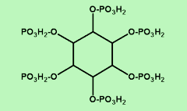
2. PHYTATES
Phytates (Phytic Acid) is a P store of plants.
Considered an anti-nutrient for humans -
interferes with absorption of nutrients.
(we do not have phytase!)
Chelators of: magnesium, calcium, zinc and iron in your gut.

Slide 46
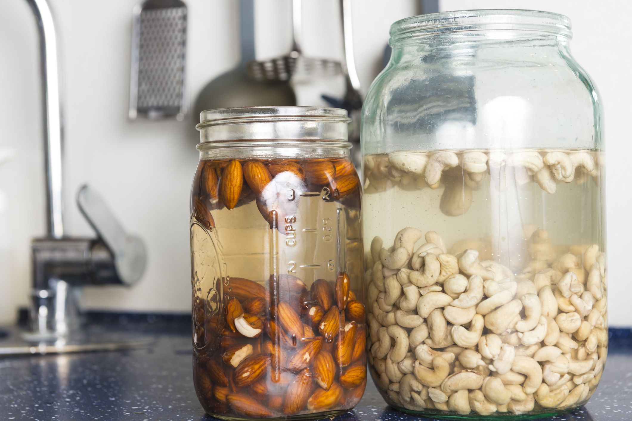

Found in Grains, Legumes, Nuts and Seeds:
Wheat has 720mg/100g phytic acid. Soybeans 1,433mg/100g;
Cashews 1,866mg/100g and Almonds 1,280mg/100g.
Sprout, Soak and Ferment out the Phytates

Slide 47
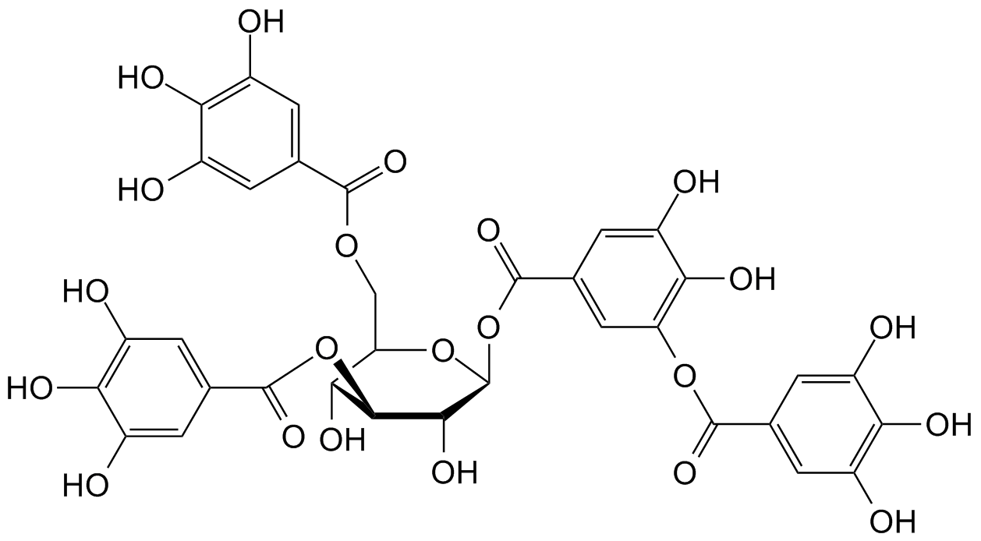
3. POLYPHENOLS (E.G. TANNINS)
Are benzoid ‘phenyl’ rings and hydroxyl (OH).
Some are antinutrients, as they interfere
with absorption iron and other metal ions.
Also bind to digestive enzymes and proteins.

