Slide 1



Tishk International University
Faculty of Applied Science
Nutrition and Dietetics Department
Introduction of Microbiology Lab
Food Microbiology /1st Lab
2nd Grade / Spring Semester
Instructor: Adam Jalal Mohammed
Email: adam.jalal@tiu.edu.iq
Food Microbiology
2025 - 2026

Slide 2

Definition of Microbiology
Microbiology is a branch of biology which is dealing with microorganisms and their effects on other living organisms
Meaning of Microbiology:
Micro: very small
Bio: living organisms
Logy: the study of.
Microbiology is the study of very small living organisms (microorganisms)
Food Microbiology
2025 - 2026

Slide 3
Branches of Microbiology
Bacteriology: study of bacteria
Phycology: study of various types of algae
Virology: study of viruses
Mycology: study of fungi
Parasitology: is the study of parasites
Food Microbiology
2025 - 2026

Slide 4
Importance of Microbiology
Production of antibiotic.
Diagnosis of disease and treatment.
Sterilization (process of killing microorganisms)
Eg: moist heat sterilization, dry heat sterilization
Identification of microorganisms. Eg: morphological, cultural or microscopic study.
Food Microbiology
2025 - 2026

Slide 5
Tools in Microbiology lab
Microbiology laboratories use a variety of tools and equipment for studying microorganisms, experiments, and analyzing samples.
common tools and equipment found in a microbiology laboratory:
Food Microbiology
2025 - 2026

Slide 6
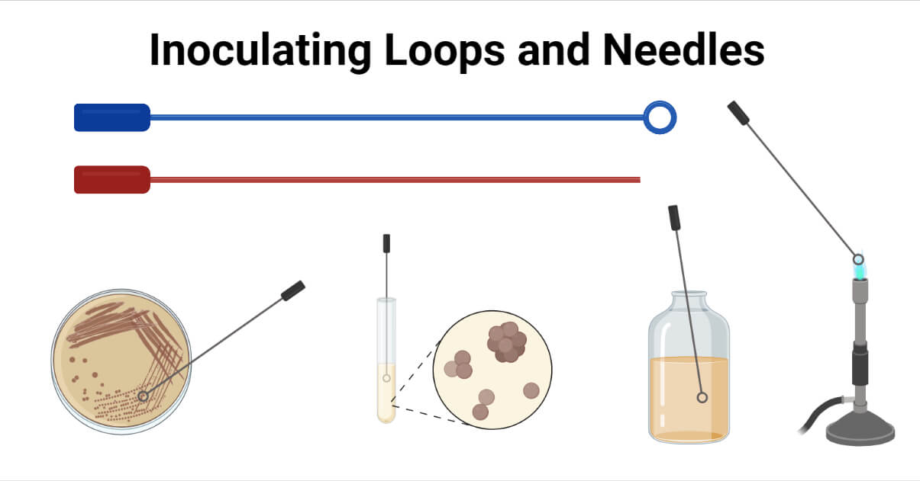
Inoculation Needle & Inoculation Loop.
These are used to transfer microorganisms from one culture to another or to streak samples on agar plates.
Even smaller amount of liquid culture can be manipulated by using straight needle
Food Microbiology
2025 - 2026

Slide 7
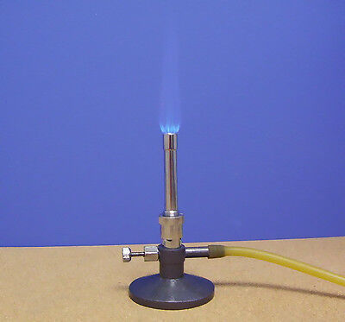
Bunsen burner
These gas burners are used to sterilize metal inoculating loops and needles by passing them through a flame
Food Microbiology
2025 - 2026

Slide 8
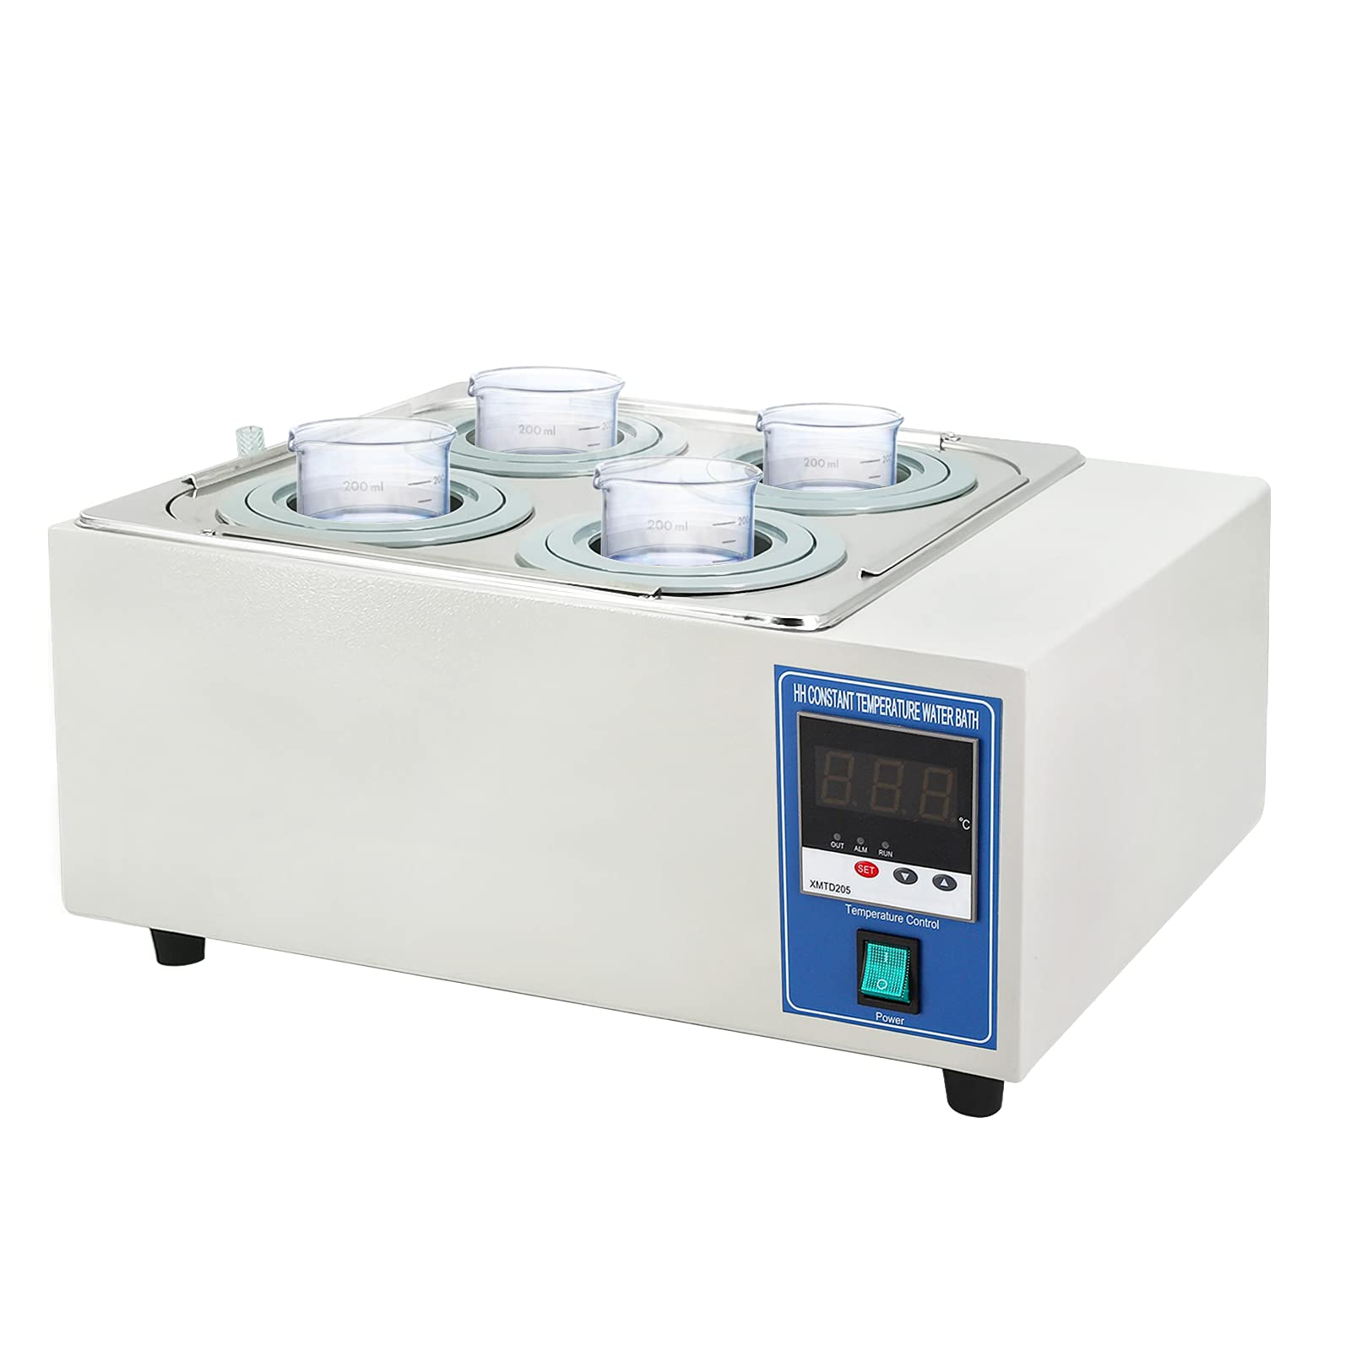
Water bath
Water bath is an instrument that is used to provide constant temperature to a sample.
It consists of an insulating box made up of steel fitted with electrode heating coil
Food Microbiology
2025 - 2026

Slide 9
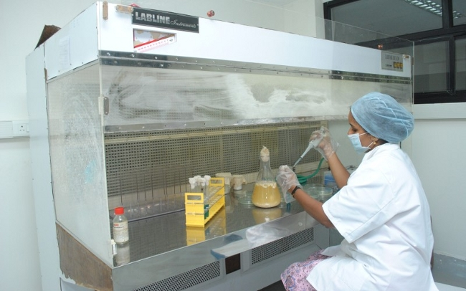
Laminar air flow chamber
Laminar flow cabinets are used in laboratories for contamination sensitive processes like plant tissue culture.
Other laboratories processes like media plate preparation and culture of organisms can be performed inside the cabinet.
Food Microbiology
2025 - 2026

Slide 10
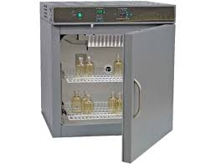
Incubator
These are used to maintain a controlled temperature for the growth of microorganisms, typically at 37°C for bacteria and 25°C for fungi
Food Microbiology
2025 - 2026

Slide 11
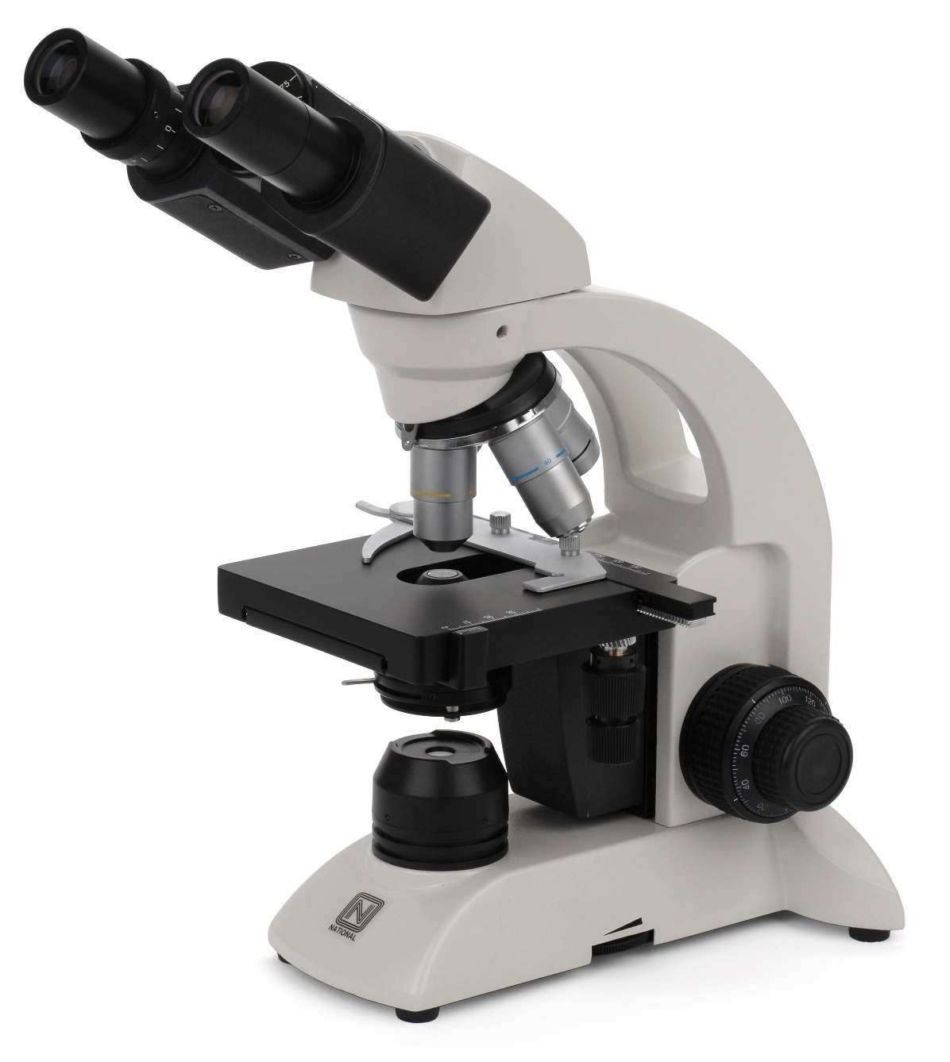
Microscope
A good microscope is an essential tool for any microbiology laboratory.
There are many kinds of microscopes but the type most useful in diagnostic work is the compound microscope
Food Microbiology
2025 - 2026

Slide 12
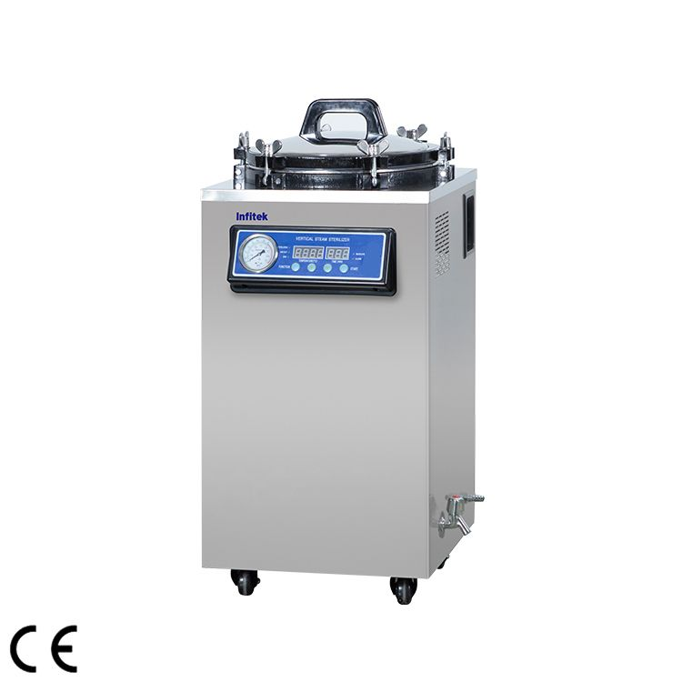
Autoclave
Autoclaves are used to sterilize equipment, media, and culture vessels by subjecting them to high-pressure steam at temperatures above 121°C
Food Microbiology
2025 - 2026

Slide 13
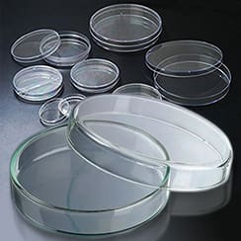
Petri dish
Petri dishes are shallow, flat, cylindrical lidded dishes used for growing microorganisms on solid agar media
Food Microbiology
2025 - 2026

Slide 14
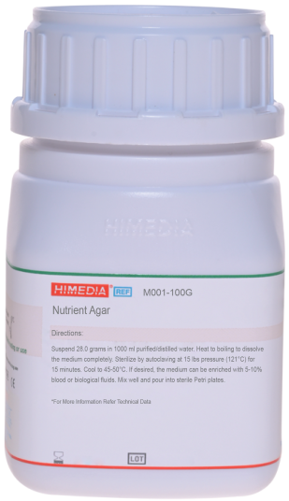
Agar
Agar is a gel-like substance used in microbiology to grow microorganisms. It is made from red seaweed and is mixed with nutrients to provide food for bacteria and fungi. When heated, agar melts, and when cooled, it solidifies, forming a firm surface. It is used because most microbes cannot break it down, it stays solid at incubation temperatures, and it allows scientists to observe microbial growth clearly.
Food Microbiology
2025 - 2026

Slide 15
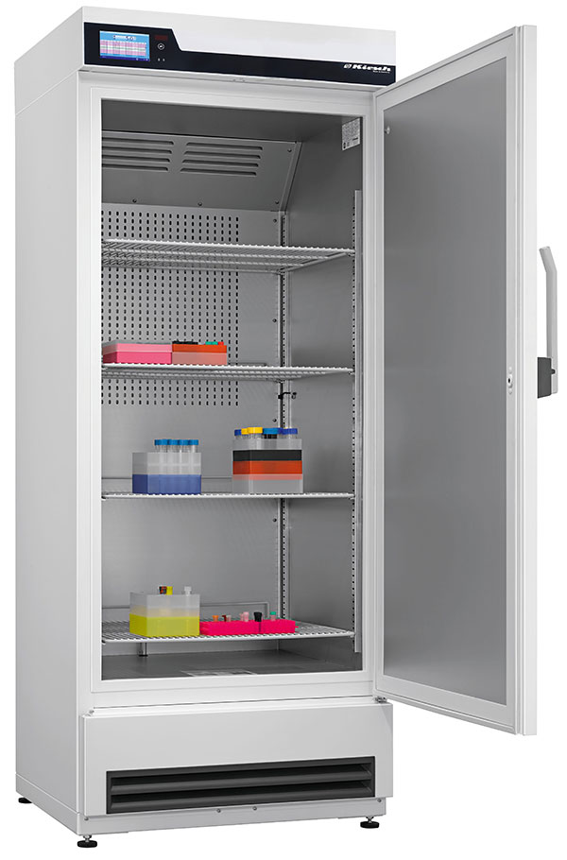
Refrigerators and Freezers
These are used for storing culture stocks, reagents, and samples at specific temperatures to preserve their viability.
Food Microbiology
2025 - 2026

Slide 16
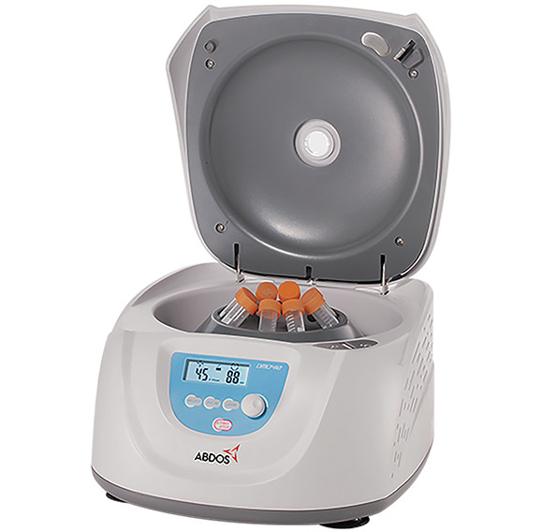
Centrifuge
Are used to separate components of a sample based on their density through rapid spinning.
Food Microbiology
2025 - 2026

Slide 17
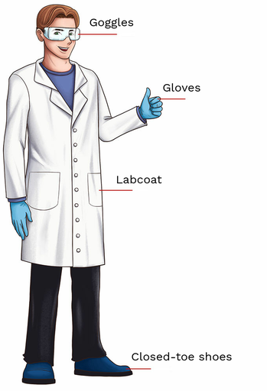
Personal protective equipment (PPE)
lab coats, gloves, safety glasses, and masks are essential for protecting laboratory personnel
Food Microbiology
2025 - 2026

