Slide 1



Tishk International University
Faculty of Applied Science
Nutrition and Dietetics Department
Pasteurization
Food Microbiology /5th Lecture
2nd Grade / Spring Semester
Instructor: Adam Jalal Mohammed
Email: adam.jalal@tiu.edu.iq
Food Microbiology
2025 - 2026

Slide 2
Introduction
Pasteurization is a process that kills microorganisms (mainly Bacteria) in foods and drinks, such as milk, juice, canned food, and others.
Pasteurization involves heating food to a temperature that kills disease-causing microorganisms and substantially reduces the level of spoilage organisms.

Slide 3
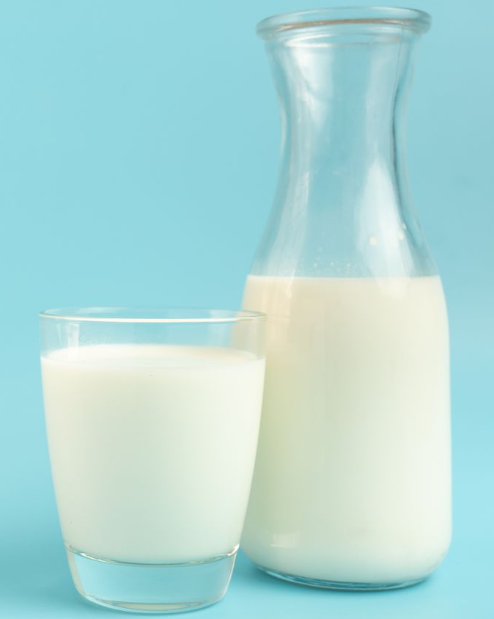
Introduction
Pasteurization is not intended to kill all microorganisms in the food. Instead, pasteurization aims to reduce the number of viable pathogens, so they are unlikely to cause disease (assuming the pasteurized products are stored as indicated and consumed before their expiration date).
Heat also destroys enzymes that make milk spoil, so pasteurized milk is drinkable
for a longer time.

Slide 4
History
It was invented by the French scientist Louis Pasteur during the 19th century.
In 1864 Pasteur discovered that heating beer and wine was enough to kill most of the bacteria that cause spoilage, preventing these beverages from turning sour.
The process achieves this by eliminating pathogenic microbes and lowering microbial numbers to prolong the quality of the beverage.
Today, pasteurization is used widely in the dairy industry and other food processing industries to achieve food protection and food safety.

Slide 5
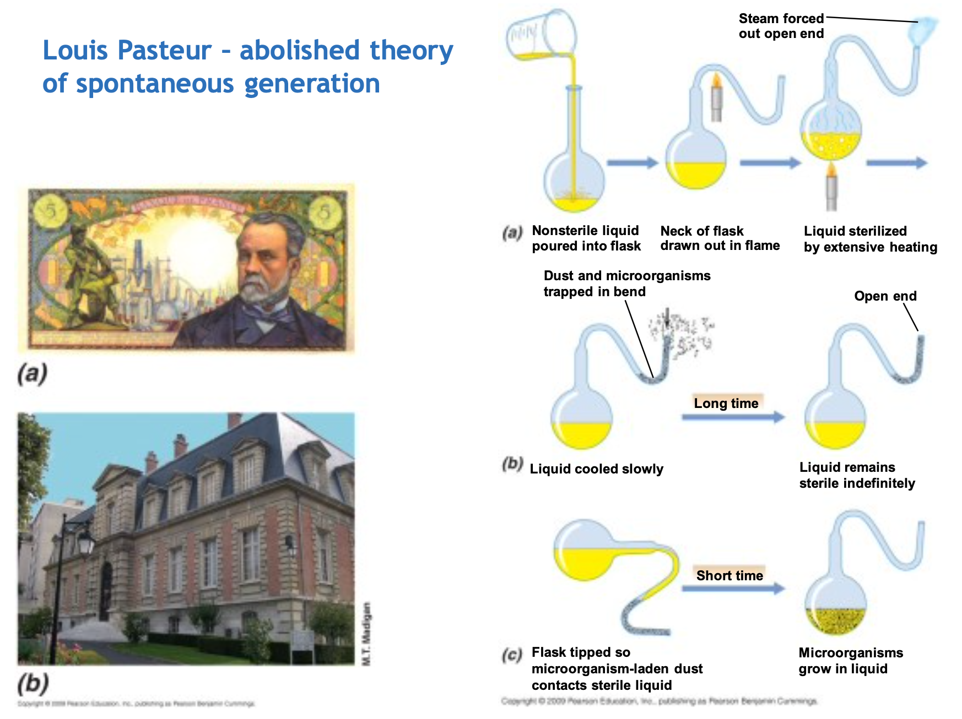

Slide 6
Objectives
To kill the pathogens that may have entered the milk and be transmitted to the people
To keep the quality of the milk
To increase the shelf-life of products

Slide 7
Efficiency of Milk Pasteurization
The percentage of reduction of the number of microorganisms in milk depends on:
  Temperature of pasteurization
  The holding time
  The total number of microbial loads that are spore formers or thermoduric organisms.

Slide 8
Methods of Pasteurization
Milk Pasteurization: There are four common types of milk pasteurization that vary with temperature and time the milk is held at that temperature.
  Low Temperature / Long Time (LTLT)
  High Temperature / Short Time (HTST)
  Ultra Pasteurization (UP)
  Ultra High Treatment (UHT)

Slide 9
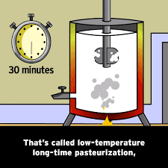
Methods of Pasteurization
  Low Temperature / Long Time (LTLT)
  A less conventional and typically home-use method of pasteurization is to heat milk at 63 °C (145 °F) for 30 minutes.
  It is then quickly cooled to 39 °C.

Slide 10
Methods of Pasteurization
  High Temperature / Short Time (HTST)
  This process of pasteurization involves heating milk to 71.7 °C for at least 15 seconds.
  Then rapidly cooled to 10 °C.
  HTST Milk is forced between metal plates or through pipes heated on the outside by hot water. It is a high-tech commercial used dairy pasteurization method.
  Milk simply labeled “Pasteurized” is usually treated with the HTST method.

Slide 11
Methods of Pasteurization
  Ultra Pasteurization (UP)
  The milk is heated to 138 °C (280 °F) for 2 seconds.
  NOTE: This is above boiling temperature, which means that high pressure must be applied to the milk to achieve this temperature, and it is destructive to its nutritional quality.
  This method is used because it extends the refrigerated shelf-life of the milk to 60-90 days and is the method of choice for national or regional milk brands because it allows time for warehousing and shipment of milk.

Slide 12
Methods of Pasteurization
  Ultra High Treatment (UHT)
  UHT, also known as ultra heat treating, processing hold the milk at a temperature of 140 °C (284 °F) for 4 seconds.
  This method lets consumers store milk for several months without refrigeration.
  Milk labeled “Ultra-High-Treatment” or simply “UHT” has been treated with the UHT method.
  Most commercial milk brands use this form of pasteurization since it is the quickest and cheapest.

Slide 13
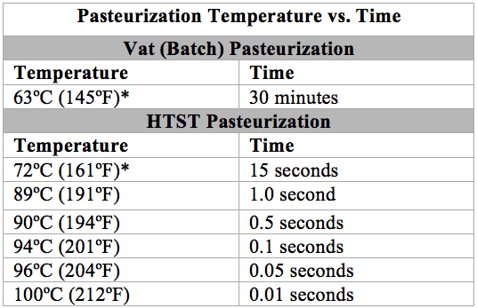
Methods of Pasteurization

Slide 14
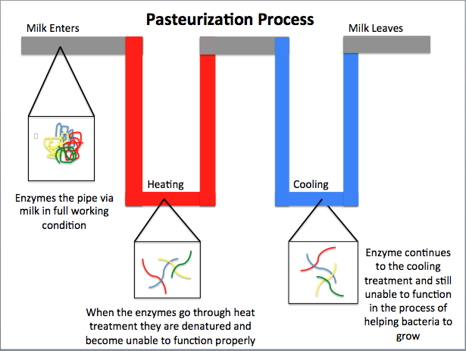
Methods of Pasteurization

Slide 15
Milk-borne diseases
  Infections of animals that can be transmitted to humans.
  Primary Importance:
  Tuberculosis
  Brucellosis
  Streptococcal infection
  Staphylococcal enterotoxin poisoning
  Salmonellosis
  Q fever
  Lesser Importance:
  Cox-Pox
  Foot and Mouth disease
  Anthrax
  Leptospirosis
  Tick-borne encephalitis

Slide 16
Milk-borne diseases
  Infections primary to human that can be transmitted through milk
  Typhoid and paratyphoid fevers
  Enteropathogenic Escherichia Coli
  Shigellosis
  Cholera

Slide 17
Methods of Pasteurization
Other methods (used for other foods)
  Flash Pasteurization
  Steam Pasteurization
  Irradiation Pasteurization

Slide 18
Methods of Pasteurization
Other methods (used for other foods)
  Flash Pasteurization
  Steam Pasteurization
  Irradiation Pasteurization
Used for drink boxes and other liquids that can be stored for long periods of time without refrigeration. This method involves high temperature for 3 – 15 seconds, followed by cooling and packing. Very similar to the UHT treatment of milk.

Slide 19
Methods of Pasteurization
Other methods (used for other foods)
  Flash Pasteurization
  Steam Pasteurization
  Irradiation Pasteurization
Used to kill E. Coli, Salmonella, and Listeria in beef carcasses. This results in a surface temperature of about 200 °F.

Slide 20
Methods of Pasteurization
Other methods (used for other foods)
  Flash Pasteurization
  Steam Pasteurization
  Irradiation Pasteurization
Used on such foods as meats (especially prepared meat, sausages, and cold cuts). The food is exposed to a type of radiation known as gamma rays.

