Slide 1



Tishk International University
Faculty of Applied Science
Nutrition and Dietetics Department
Microbiology of Milk
Food Microbiology /6th Lecture
2nd Grade / Spring Semester
Instructor: Adam Jalal Mohammed
Email: adam.jalal@tiu.edu.iq
Food Microbiology
2025 - 2026

Slide 2
Lecture Overview
01
Sources of Milk Contamination
02
Factors Affecting Microbial Growth
Understanding where microbial contamination originates in the milk production chain
Intrinsic and extrinsic factors that influence microbial proliferation
03
Milk Microorganisms
04
Spoilage of Raw Milk
The diverse microbial population found in milk and their origins
Different types of microbial spoilage in untreated milk
05
Spoilage of Processed Milk
06
Cheese & Butter Microbiology
Microbial challenges in pasteurized, sterilized, and dried milk
Microbial contamination and spoilage in dairy products

Slide 3
CHAPTER 01
Sources of Milk
Contamination
Understanding where microbial contamination originates in the milk production chain

Slide 4
01
Primary Contamination Sources
Animal Sources
Milking Equipment
Udder and adjacent parts are primary sources of microorganisms. The udder canal and teat surface harbor natural microflora including Micrococci, Streptococci, and Corynebacteria.
Milking machines and milk cans can harbor bacteria if not properly sanitized. Equipment surfaces provide ideal environments for microbial biofilm formation.
Improper cleaning allows bacterial proliferation
These organisms can enter milk during the milking process
Milking Environment
Dairy Workers
Environmental factors include airborne contaminants, dust particles, insects, and animal feed. These can introduce gram-negative rods, spore-forming bacteria, and other environmental microbes.
Human sources include hands, clothes, sneezing, coughing, and poor personal hygiene. Workers can transfer pathogens and spoilage organisms directly to milk.
Proper hygiene training is essential
Poor ventilation increases contamination risk
Transportation Contamination
Milk can become contaminated during transport through unclean containers, temperature abuse, and extended storage times. Transportation vehicles must be properly sanitized and maintained at appropriate temperatures.

Slide 5
CHAPTER 02
Factors Affecting
Microbial Growth
Intrinsic and extrinsic factors that influence microbial proliferation in milk

Slide 6
02
Intrinsic Factors
Natural properties of milk that support microbial growth
Rich Nutrient Composition
Key Parameters
Milk contains amino acids, nucleotides, vitamins, inorganic salts, and trace elements that make it an ideal growth medium for microorganisms.
Water Activity
0.98
However, only trace glucose is present, and lactose is not available as a carbon source to all contaminants
pH Level
6.6
Redox Potential
+200 mV
High Water Activity
Milk has a water activity of 0.98, which is highly conducive to rapid growth of a wide range of organisms. This near-optimal water availability allows microbes to thrive.
Redox Potential
The +200 mV redox potential indicates an oxidized environment that supports aerobic and facultative anaerobic microorganisms.
Optimal pH Level
With a pH of 6.6, milk provides a near-neutral environment that supports the growth of diverse microorganisms, from bacteria to yeasts and molds.
Teaching Tip: Emphasize how these intrinsic factors combine to make milk an excellent growth medium, requiring careful handling and processing.

Slide 7
02
Extrinsic Factors & Natural Defense
Lactoperoxidase System (LPS)
Temperature Control
Milk contains naturally occurring antimicrobial systems that provide protection against diseases in calves and protect the udder from mastitis-causing organisms.
Temperature is the most critical extrinsic factor affecting milk spoilage. Milk held at ambient temperature spoils rapidly due to accelerated microbial growth.
How LPS Works
Recommended Storage
The lactoperoxidase/thiocyanate/hydrogen peroxide system becomes significantly antimicrobial when low levels of hydrogen peroxide are added, stimulating the LPS system.
2-4
°Celsius
Dairy storage temperature
Chill Chain
From farm to consumer
Application: Adding hydrogen peroxide to milk has been suggested as a method to reduce potential spoilage organisms.
Maintaining cold temperatures from storage at the farm through to the consumer is essential for reasonable shelf life.
Critical Teaching Point
While milk has natural defense mechanisms like LPS, they are not sufficient alone. Proper temperature control throughout the entire production chain is essential to prevent rapid microbial proliferation and ensure product safety and quality.

Slide 8
CHAPTER 03
Milk
Microorganisms
The diverse microbial population found in milk and their origins

Slide 9
03
Types of Microorganisms in Milk
Udder Canal Microflora
Environmental Contaminants
Lactic Acid Bacteria
Natural inhabitants of the udder canal and teat surface:
From soil, water, feed, bedding, and animal feces:
Beneficial bacteria used in fermentation:
Gram-negative rods: Pseudomonas, Alcaligenes, Acinetobacter, Flavobacterium
Streptococcus - includes thermophilic species for yogurt
Micrococci - spherical bacteria commonly found on skin
Enterobacteriaceae - intestinal bacteria indicating fecal contamination
Lactococcus - mesophilic starters for cheese
Streptococci - chain-forming bacteria, some pathogenic
Lactobacillus - diverse group for various fermented products
Spore-forming rods: Bacillus & Clostridium species
Corynebacteria - rod-shaped, generally non-pathogenic
Leuconostoc - produces aroma compounds and CO₂
Yeasts and Molds
Teaching Note
Fungi that can cause spoilage in milk and dairy products, especially under aerobic conditions or in products with lower water activity.
Not all microorganisms are harmful - lactic acid bacteria are essential for producing yogurt, cheese, and other fermented dairy products.

Slide 10
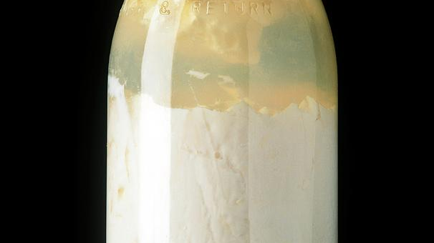
CHAPTER 04
Spoilage of
Raw Milk
Understanding the different types of microbial spoilage in untreated milk

Slide 11
04
Curdling and Protein Breakdown
Acid Curdling
Proteolysis
Causative Organisms: Lactococcus lactis, Lactobacillus bulgaricus
Causative Organisms: Bacillus spp., Pseudomonas spp., Proteus spp.
Homofermentative lactic acid bacteria ferment lactose to produce lactic acid, causing the pH to drop to approximately 4.6.
The hydrolysis of milk protein by microorganisms produces bitter peptides that create an unpleasant bitter flavor.
At this pH, casein (milk protein) precipitates, causing the milk to curdle.
Key Indicator: Bitterness is a clear sign of proteolytic spoilage.
pH Changes During Spoilage
Sweet Curdling
Fresh Milk pH
6.6
Causative Organisms: Bacillus cereus, Pseudomonas shewanella, Streptococcus faecalis var. liquefaciens
Acid Curdling pH
4.6
Caused by rennin-like enzymes excreted by bacteria. These enzymes precipitate casein to form a soft curd without significant acid production.
May be followed by digestion of soft curd by proteolytic bacteria.

Slide 12
04
Lipolysis and Other Spoilage Types
Lipolysis
Ropiness
Abnormal Flavors & Odors
Causative Organisms: Pseudomonas spp., Achromobacter spp.
Causative Organisms: Alcaligenes viscolactis, Enterobacter aerogenes
Bitterness: Streptococcus faecalis, Bacillus subtilis
Milk fat is hydrolyzed by bacterial lipase into fatty acids and glycerol.
Bacterial ropiness is caused by slimy capsular material from the cells, giving milk a stringy, viscous consistency.
Fruity flavor: Pseudomonas perolens
Potato flavor: Pseudomonas graveolens
Some fatty acids like butyric acid create a rancid taste.
Gas Production
Color Changes
Causative Organisms: Coliform bacteria, Bacillus spp., Clostridium spp., yeast
Blue milk: Pseudomonas syncyanea
Yellow milk: Pseudomonas synxantha
Gas production is usually accompanied by acid formation, causing milk containers to swell.
Red milk: Serratia marcescens

Slide 13
CHAPTER 05
Spoilage of
Processed Milk Products
Microbial challenges in pasteurized, sterilized, and dried milk

Slide 14
05
Processed Milk Spoilage
Pasteurized Milk
Sterilized Milk
Dried Milk
Pasteurization kills most pathogenic and spoilage organisms, but some survive and can cause spoilage.
Sterilization at high temperatures should kill all microorganisms, but spoilage can still occur due to:
Dried milk rarely spoils due to processing conditions:
Moisture Content
2-4%
Factors Affecting Spoilage:
1. Heat-Resistant Spores
Heat Treatment
120-140°C
1.
Number of surviving microorganisms - Higher counts lead to faster spoilage
Some spores resist heat treatment due to under-processing:
• Bacillus cereus
• Bacillus coagulans
• Bacillus circulans
Occasional Spoilage:
2.
Temperature of storage - Critical for shelf life
When spoilage occurs, it's typically due to bacterial spores that resist processing conditions.
3.
Post-contamination - Recontamination after pasteurization
2. Post-Heat Contamination
Contamination from utensils and equipment after heat treatment.
Proper refrigeration (2-4°C) is essential to extend shelf life.
Key Concept: Processing methods significantly reduce microbial loads but cannot completely eliminate all spoilage risks. Proper handling, storage temperature, and hygiene practices remain critical throughout the distribution chain.

Slide 15
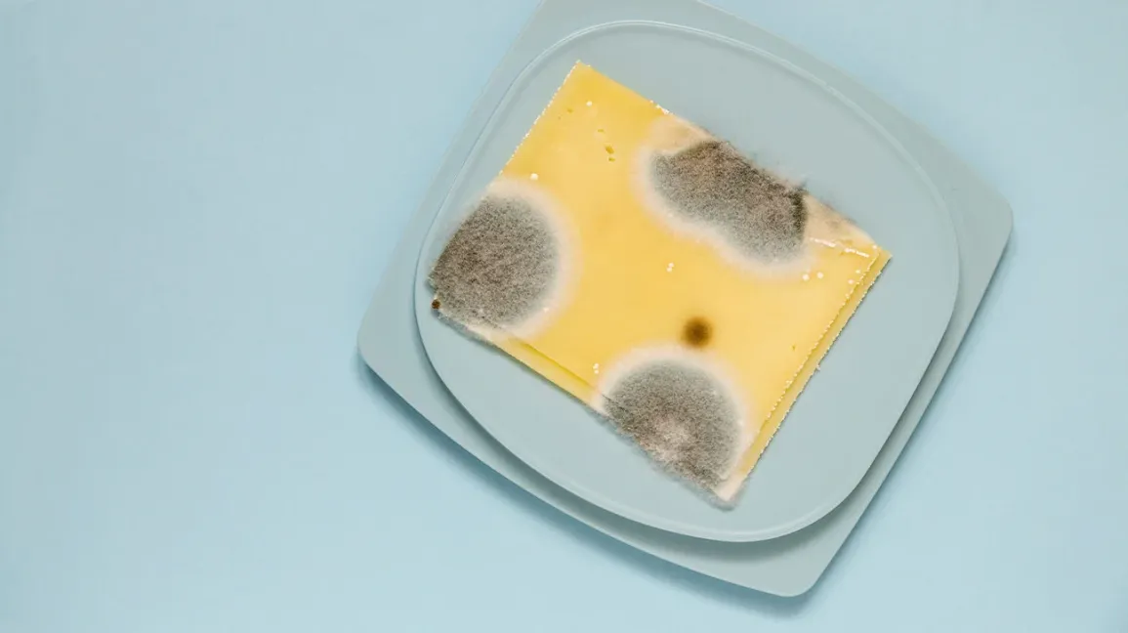
CHAPTER 06
Cheese & Butter
Microbiology
Microbial contamination and spoilage in dairy products

Slide 16
06
Cheese Contamination and Spoilage
Sources of Contamination
Spoilage at Low Temperatures
1. Raw milk
2. Factory environment
Pseudomonas viscosa causes:
3. Equipment & utensils
4. Employees
• Bitterness (from peptides)
• Viscous substances (polysaccharides)
5. Packaging
6. Transporting trucks
Pseudomonas fragi produces:
7. Selling store
• Putrid odor (amines, skatol, indole, H₂S)
• Degraded flavor (diacetyl breakdown)
Spoilage Factors
Pseudomonas fluorescens causes:
• Protein hydrolysis (bitterness)
Type of Cheese:
• Lipid hydrolysis (rancid taste)
Low moisture → molds; High moisture → bacteria
Microbial Content:
Room Temperature Spoilage
Spoilage by Molds
Higher content = faster spoilage
Coliforms: Acid & gas
Common in dried & semi-dried cheese:
Storage Conditions:
Streptococcus cremoris: Bitterness
Aspergillus
Penicillium
Mucor
Geotrichum
Temperature & duration critical
Bacillus & Clostridium: Proteolytic, lipolytic, saccharolytic

Slide 17
06
Butter Contamination and Spoilage
Sources of Contamination
Butter Spoilage Types
1
Cream
1. Surface Taint
2. Rancidity
Primary raw material source
Organism: Pseudomonas shewanella
Organisms: Pseudomonas fragi, Achromobacter lipolyticum
Off odor from protein hydrolysis (isovaleric acids)
2
Flora of Whole Milk
Fat hydrolysis producing off-flavors
Original microbial population
3. Malty Flavor
4. Black Discoloration
3
Equipment & Utensils
Organism: Streptococcus lactis var. maltigenes
Organism: Pseudomonas nigrifaciens
Processing equipment
Unpleasant malt-like aroma
Dark pigment production
4
Employees
Human handling
5. Mold Growth
Common molds in butter:
5
Packaging
Geotrichum
Aspergillus
Penicillium
Mucor
Rhizopus
Post-processing contamination
Note: Butter's high fat content and low water activity make it less susceptible to bacterial spoilage than other dairy products, but surface contamination and mold growth remain concerns.

Slide 18
CONCLUSION
Key Takeaways
1
Milk is an Excellent Growth Medium
Milk's nutrient-rich composition, high water activity (0.98), optimal pH (6.6), and favorable redox potential create ideal conditions for microbial growth.
2
Multiple Contamination Sources
Contamination can occur at every stage: from the animal, equipment, environment, workers, and during transportation. Understanding these sources is crucial for prevention.
3
Temperature Control is Critical
Proper temperature management (2-4°C) throughout the entire production chain is essential to prevent rapid microbial proliferation and ensure product safety and quality.
4
Diverse Spoilage Mechanisms
Microorganisms cause spoilage through acid curdling, proteolysis, lipolysis, gas production, and pigment formation. Each type produces distinct sensory changes.
Understanding microbiology is essential for maintaining dairy product quality and safety

