Slide 1


Fundamental Programming Lecture_4
Dr. Hazha Saeed Yahia

Slide 2
Outline
Rational Operations
Control Structures
If Statements
The IF Block Statement
Nested IF
Flags
Logical Operators
Switch

Slide 3

Objective
By the end of this lesson, you will be able to
Learn to use different control structures, like if statements, nested if, flags, logical operators, and switch statements, according to the complexity of the problem.
Apply rational operations and control structures to solve problems logically.
Develop versatility in choosing and implementing control flow structures such as if statements, nested if, flags, logical operators, and switch statements.
Gain proficiency in using conditional statements for effective decision-making, handling various conditions and scenarios in programming

Slide 4
Relational Operators
Relational operators compare numeric and char values to check if one is greater than, less than, equal to, or not equal to another.
Computers excel at both calculations and value comparisons.
Comparisons are essential for tasks like analyzing sales figures, calculating profit and loss, checking numerical ranges, and validating user input.
Operator | Meaning
< | Is less than
<= | Is less than or equal to
> | Is greater than
>= | Is greater than or equal to
== | Equal to
!= | Not equal to

Slide 5
Relational Operators
Standard algebraic equality or relational operator | C++ equality or relational operator | Sample C++ condition | Meaning of C++ condition
> | > | x > y | x is greater than y
< | < | x < y | x is less than y
≥ | >= | x >= y | x is greater than or equal to y
≤ | <= | x <= y | x is less than or equal to y
= | == | x == y | x is equal to y
≠ | != | x != y | x is not equal to y

Slide 6
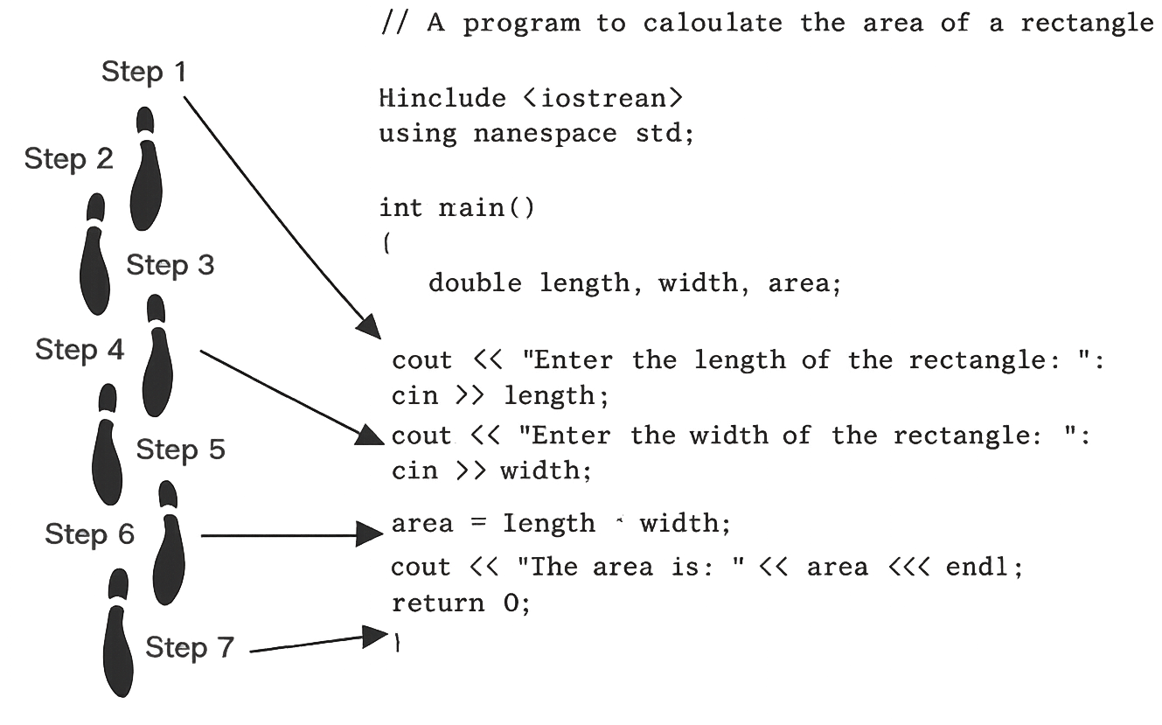
Control Structures

Slide 7
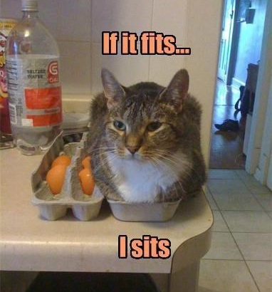
If Statement

Slide 8
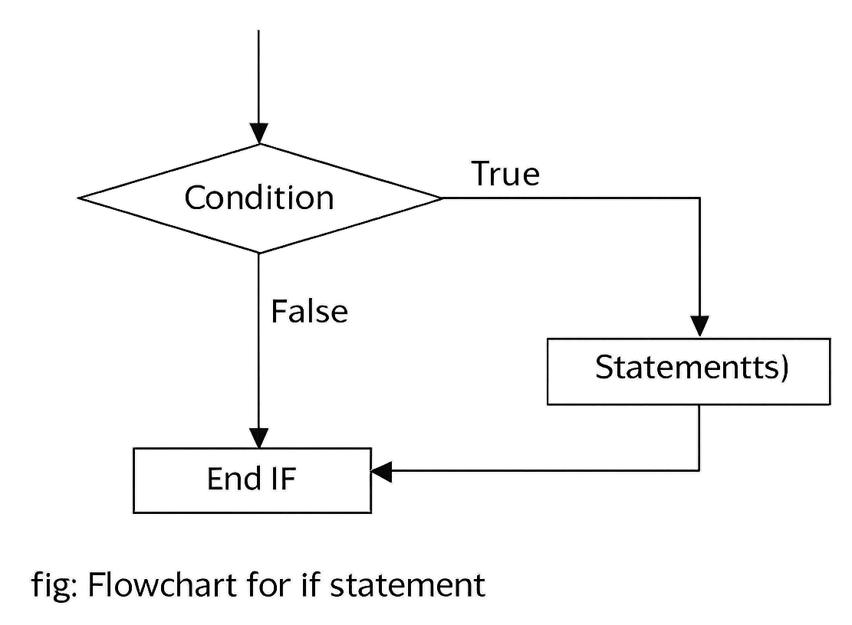
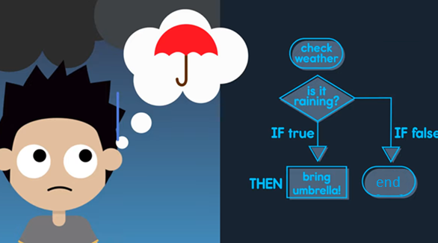
If Statement in C++

Slide 9
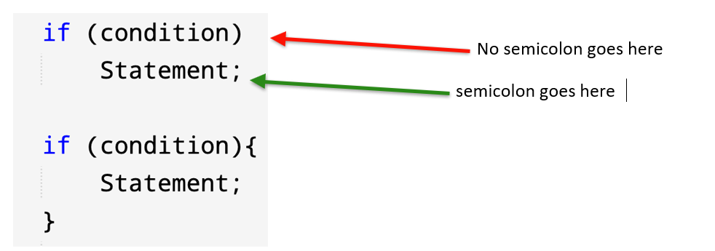
If statement in C++

Slide 10
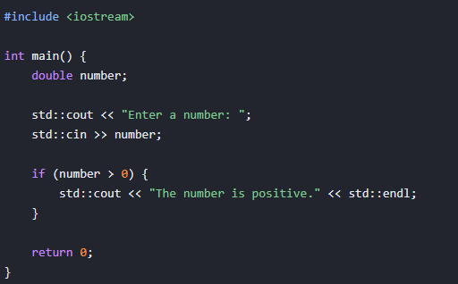
If statement example
Write a C++ program that asks user to input a number, then check the number is positive?

Slide 11
If statement example
#include <iostream> using namespace std;
int main() { int number;
cout << "Input a number: "; cin >> number;
if (number > 0) { cout << number << " is positive."; }
if (number < 0) { cout << number << " is negative."; }
if (number == 0) { cout << number << " is Zero."; }
return 0; }

Slide 12
If statement example
#include <iostream>
using namespace std;
int main() {
int mark;
cout << "Input a number: ";
cin >> mark;
if (mark >= 60) {
cout << "Congratulations, you have passed in programming";
}
return 0;
}

Slide 13
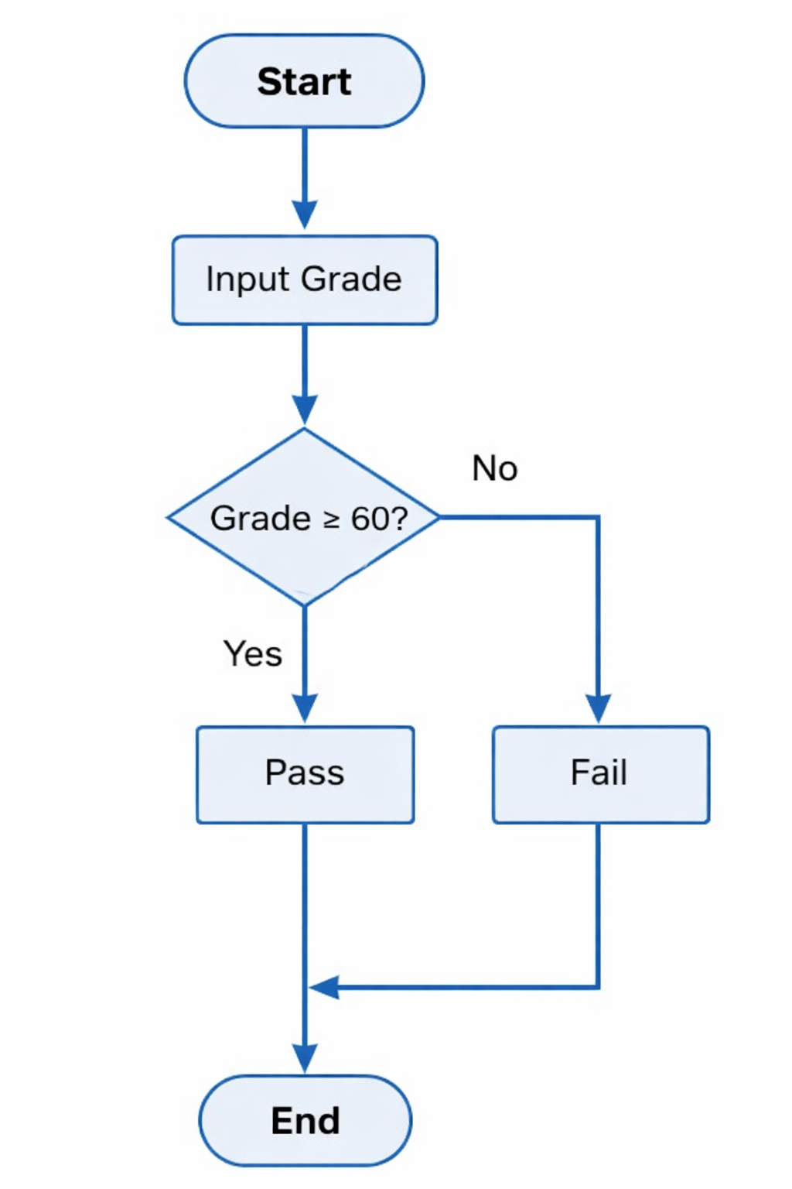
If statement example

Slide 14
If statement example

Slide 15
If statement example

Slide 16
If statement block – example

Slide 17
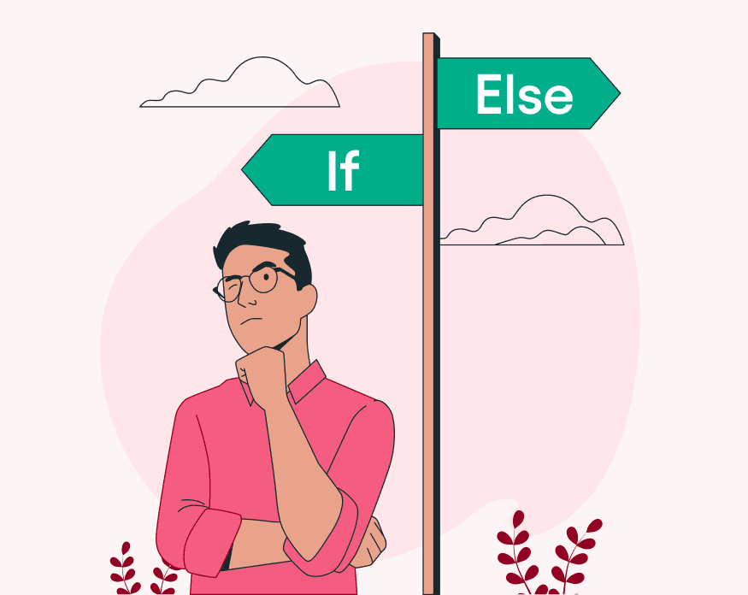
If…. else
In C++, the if-else statement is a conditional branching tool used to execute a block of code if a condition is true, and an alternative block if the condition is false.
In C++, the if-else statement is a conditional branching tool used to execute a block of code if a condition is true, and an alternative block if the condition is false.

Slide 18
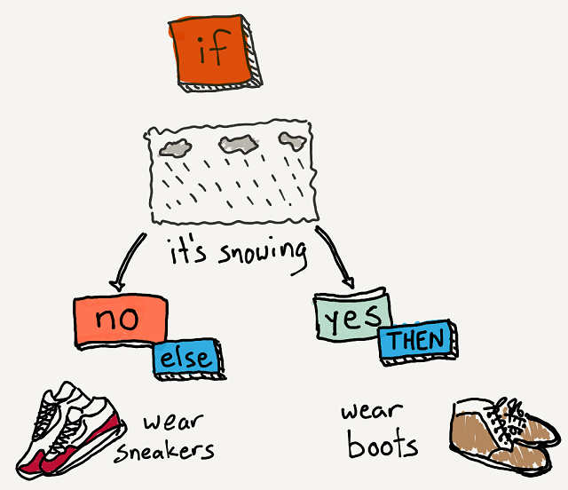
If…. else

Slide 19
If…. else
If statement in C++ • Evaluate an expression (condition) and directs program execution depending on the result of that evaluation.
If the expression evaluate as TRUE, statement is executed, if FALSE, statement is not executed, execution then passed to the code follows the if statement, that is the next statement. • So, the execution of the statement depends on the result of expression.
if (expression) { statement or block; } else { statement or block; }

Slide 20
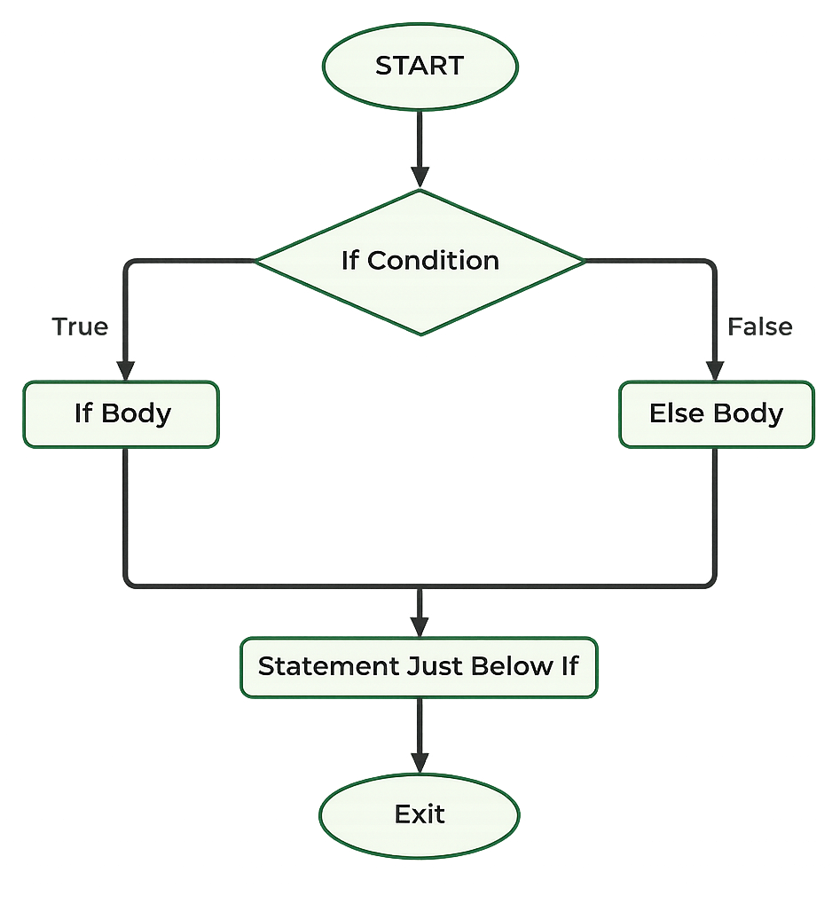
If…. else

Slide 21
If…. else

Slide 22
The If…. else statement – example

Slide 23
The If…. else statement – example
The if/else if statement simplifies testing multiple conditions, often done more efficiently than using nested if/else statements

Slide 24
The If…. else statement – example

Slide 25
The If…. else statement – example

Slide 26
The If…. else statement – example

Slide 27
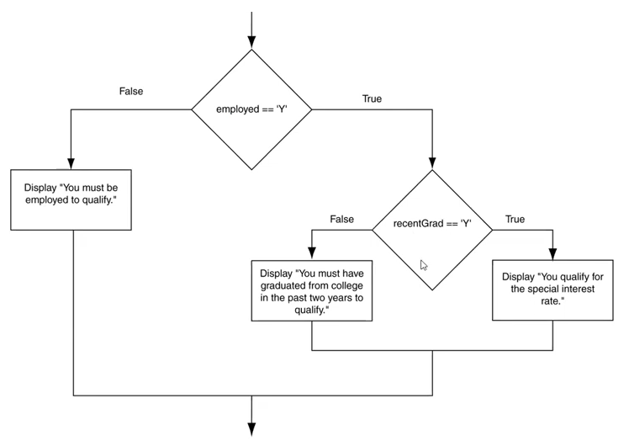
The If…. else statement – example
To test more than one condition, an if statement can be nested inside another if statement.

Slide 28
The If…. else statement – example

Slide 29
Logical Operators
Logical operators connect two or more relational expressions into one or reverse the logic of an expression.

Slide 30
Logical Operators
Logical operators connect two or more relational expressions into one or reverse the logic of an expression.
Operator | Meaning | Effect
&& | AND | Connects two expressions into one. Both expressions must be true for the overall expression to be true.
|| | OR | Connects two expressions into one. One or both expressions must be true for the overall expression to be true, it is only necessary for one to be true, and it does not matter which.
! | NOT | The ! Operator reverses the “truth” of an expression. It makes a true expression false, and a false expression true.

Slide 31
Logical Operators – Example 1 (AND-&&)

Slide 32
Logical Operators – Example 2 (AND-&&)
Create a C++ program that determines if a person is eligible to vote. The program should check if the person is 18 years or older and they are a citizen.

Slide 33
Logical Operators – Example 2 (AND-&&)
Expression | Value of Expression
true && false | false (0)
false && true | false (0)
false && false | false (0)
true && true | true (1)

Slide 34
Logical Operators – Example (OR)
Develop a C++ program that determines if a person is eligible for a discount. Check if the person is a senior citizen (age 60 or above) or a student.

Slide 35
Logical Operators – Example (OR)

Slide 36
Logical Operators - OR (||)
Expression | Value of Expression
true || false | true (1)
false || true | true (1)
false || false | false (0)
true || true | true (1)

Slide 37
Logical Operators – Example (And and OR)

Slide 38
Logical Operators – Example (And and OR)
A flag is a variable used to signal the existence of a condition in a program.
Flags are usually Boolean or integer variables.
When the flag is set to false, it signifies that the condition does not exist.
Setting the flag to true indicates the presence of the specified condition.

Slide 39
Flags and Integer Flags - Example 1

Slide 40
Flags and Integer Flags - Example 1

Slide 41
Logical Operators - NOT (!)

Slide 42
Logical Operators - NOT (!)
Expression | Value of Expression
! true | false (0)
! false | true (1)

Slide 43
Logical Operators - NOT (!)
Character | ASCII Value
‘0’ – ‘9’ | 48 -57
‘A’ – ‘Z’ | 65 – 90
‘a’ – ‘z’ | 97 – 122
Blank | 32
Period | 46

Slide 44
Logical Operators - NOT (!)
Character | ASCII Value
‘0’ – ‘9’ | 48 -57
‘A’ – ‘Z’ | 65 – 90
‘a’ – ‘z’ | 97 – 122
Blank | 32
Period | 46

Slide 45
Blocks and Variable Scope
The scope of a variable is limited to the block in which it is defined. C++ allows you to create variables almost anywhere in a program

Slide 46
Blocks and Variable Scope
The scope of a variable is limited to the block in which it is defined. C++ allows you to create variables almost anywhere in a program
Enter a number greater than 0 Now enter another number: 25 the second number was 25 Your first number was 17

Slide 47
The switch Statement
switch (value) {
case Choice1:
Statement1;
break;
case Choice2:
Statement2;
break;
case Choice-n:
Statement-n;
break;
default:
default Statement;
}
Switch statement: Determines program making a decision based on a value or expression.
Branching: Occurs when one part of the program leads to the execution of another part.
If/else if statement: Allows branching into various paths based on true conditions in a series of tests.
Switch vs if/else if: Switch tests integer expression values for branching, while if/ else if tests relational conditions.

Slide 48
The switch Statement

Slide 49
The switch Statement - Example 1

Slide 50
The switch Statement - Example 2

Slide 51




Thank you

