Slide 1


Fundamental Programming
Lecture_5
Dr. Hazha Saeed Yahia

Slide 2
Outline
Increment and Decrement
Introduction to loops
The while loop
The for loop
Break statement

Slide 3

Objective
By the end of this lesson, you will be able to
Apply increment/decrement operations and loop structures through hands-on coding exercises.
Write efficient and optimized code using the most suitable loop construct and judicious use of increment/decrement operations.
Enhance problem-solving skills by tackling diverse challenges with loops and control flow mechanisms.

Slide 4
The Increment and Decrement Operators
"++" and "--" are operators that add and subtract 1 from their operands. To increment a value means to increase it by one, and to decrement a value means to decrease it by one.
These are two ways to increment the variable
    num = num + 1;
    num += 1;
And num is decremented in both of the following statements:
    num = num - 1;
    num -= 1;

Slide 5
The Increment and Decrement Operators
C++ has operators dedicated to increasing (++) and decreasing (--) variables.
The following statement uses the ++ operator to increment num:
    num++; // Increment by One
    num--; // Decrement by One

Slide 6
Postfix and Prefix Modes
Postfix Mode: (x++)
Operator comes after the operand.
Operand's value is used first, then it's incremented or decremented.
The syntax for the postfix increment and decrement operators is x++ and x--, respectively.
Prefix Mode: (++x)
Operator comes before the operand.
Operand is incremented or decremented first, then its updated value is used.
The syntax for the prefix increment and decrement operators is ++x and --x, respectively.

Slide 7
The Difference Between Postfix and Prefix Modes

Slide 8
Combined Assignment
Combined Assignment, also known as compound assignment, involves combining an arithmetic operation with an assignment.
It allows you to perform an operation (such as addition, subtraction, multiplication, etc.) and assignment in a single statement.
Operator | Example Usage | Equivalent to
+= | x += 5; | x = x + 5;
-= | y -= 2; | y = y - 2;
*= | z *= 10; | z = z * 10;
/= | a /= b; | a = a / b;
%= | c %= 3; | c = c % 3;

Slide 9
Combined Assignment -Example

Slide 10
Introduction to Loops
A loop is a control structure that causes a statement or group of statements to repeat. C++ has three looping control structures:
while loop,
do-while loop, and
for loop.
The difference between these structures is how they control the repetition.

Slide 11
Introduction to Loops
There are two main types of loops: condition-based and number-based loops.
A condition-based loop runs as long as a specific condition is true, and the number of iterations is uncertain. (While Loop)
In contrast, a number-based loop repeats a fixed number of times. (For Loop)

Slide 12
Introduction to Loops

Slide 13
The while Loop
The while loop has two important parts:
an expression that is tested for a true or false value.
a statement or block that is repeated as long as the expression is true.

Slide 14
The while Loop

Slide 15
The while Loop

Slide 16
The while Loop - Example #1

Slide 17
The while Loop - Example #2
Output

Slide 18
Infinite Loops
In most situations, loops need a way to stop. This means that something inside the loop must eventually make the condition false.
The below loop goes on forever because it lacks a statement to modify the number variable. With each test of the expression counter <= 5, the number variable remains at 1, causing an infinite loop.

Slide 19
Using the while Loop for Input Validation - Example #1

Slide 20
Using the while Loop for Input Validation - Example #1
Output

Slide 21
Using the while Loop for Input Validation - Example #2

Slide 22
Using the while Loop for Input Validation - Example #2
Output

Slide 23
Using the while Loop for Input Validation

Slide 24
Using the while Loop for Input Validation - Example #2

Slide 25
Using the while Loop for Input Validation - Example #2
Output

Slide 26
The for Loop
Count-controlled loops are so common that C++ provides a type of loop specifically for them. It is known as the for loop.
The for loop is suitable when a known number of iterations is required.
Three essential elements define a count-controlled loop:
  Initialization: It starts with setting a counter variable to an initial value.
  Termination condition: The loop runs while the counter variable is less than or equal to a maximum value; when false, the loop ends.
Update: The counter variable is modified during each iteration, typically through incrementing.

Slide 27
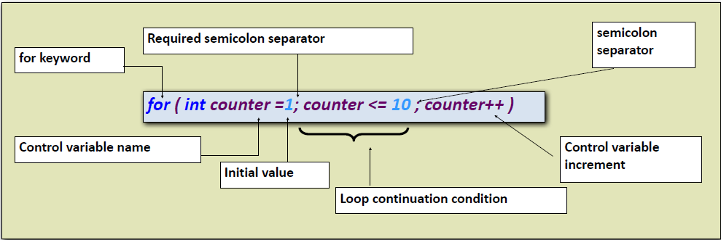
The for Loop

Slide 28
The for Loop

Slide 29
The for Loop - Example #1

Slide 30
The for Loop - Example #2

Slide 31
Other Forms of the Update Expression
Vary the control variable from 1 to 100 in increments of 1.
    for ( int i = 1; i <= 100; i++ )
Vary the control variable from 100 down to 1 in increments of -1 (decrements of 1).
    for ( int i = 100; i >= 1; i-- )
Vary the control variable from 7 to 77 in steps of 7.
    for ( int i = 7; i <= 77; i += 7 )
Vary the control variable from 20 down to 2 in steps of -2.
    for ( int i = 20; i >= 2; i -= 2 )
Vary the control variable over the following sequence of values: 2, 5, 8, 11, 14, 17, 20.
    for ( int i = 2; i <= 20; i += 3 )

Slide 32
Other Forms of the Update Expression

Slide 33
Creating a User Controlled for Loop
Write a C++ program that asks the user to input two numbers and print the numbers between them.

Slide 34
“break" Statement
The break statement is used to prematurely exit a loop (such as a for loop and while loop) when a certain condition is met.
When encountered, the break statement terminates the nearest enclosing loop.
It's useful for avoiding unnecessary iterations and improving code efficiency.

Slide 35
“break" Statement

Slide 36




Thank you

