Slide 1


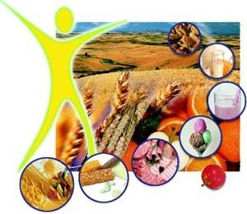

Obesity
Assist Prof Yaseen Galali Nutrition Department

Slide 2
OBESITY
Obesity is a complex, multifactorial, and largely preventable disease
Aﬀecting, along with overweight, over a third of the world’s population today.
If secular trends continue, by 2030 an estimated 38% of the world’s adult population will be overweight and another 20% will be obese.

Slide 3
□ Obesity is typically deﬁned quite simply as excess body weight for height.
□ Obesity greatly increases risk of chronic disease morbidity—namely disability, depression, type 2 diabetes, cardiovascular disease, certain cancers—and mortality.

Slide 4
CLASSIFICATION OF BODY WEIGHT IN
ADULTS
□ Subdivisions of obesity Grade 1 obesity: BMI 30.0-34.9 Grade 2 obesity: BMI 35.0-39.9
Grade 3 obesity: BMI 40.0+ (extreme obesity)

Slide 5
Children (under 5)
6.7% overweight or obese
Prevalence of obesity globally
Adults (18+)
13% obese
600 million
39% overweight
1.9 billion
43 million

Slide 6
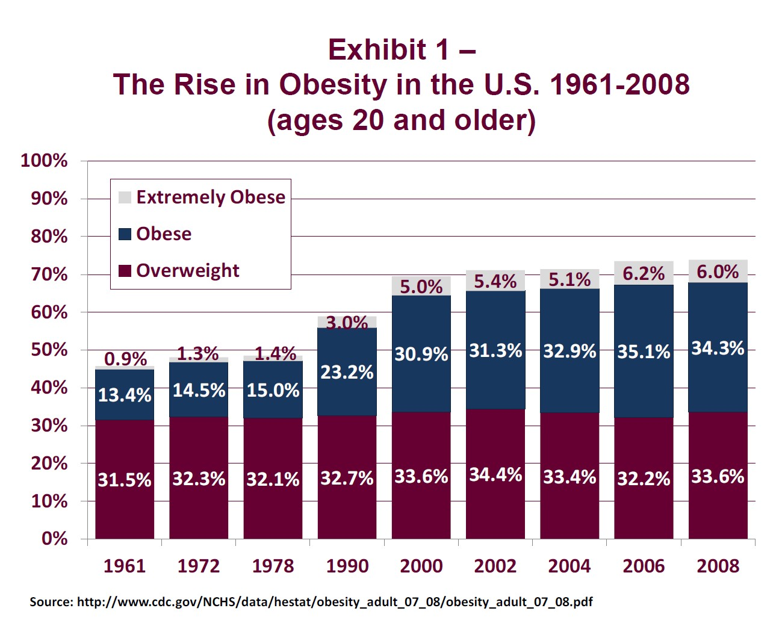

Slide 7
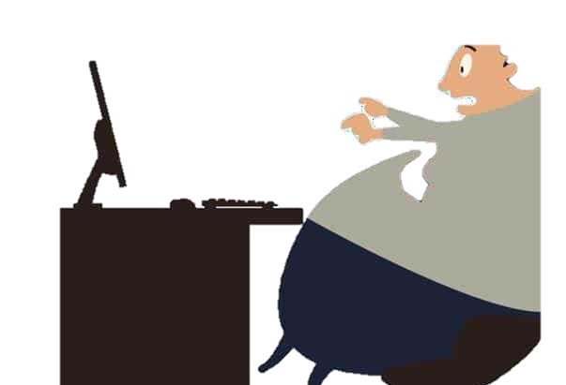
Physical Health, Psychosocial, and Functional Consequences of Obesity Over the Life Course
Physical Health | Psychosocial | Functional
Cardiovascular disease | Stigma | Unemployment
Cancer | Negative stereotyping | Mobility limitations
Glucose intolerance and insulin resistance | Discrimination | Disability
Type 2 diabetes | Teasing and bullying | Low physical fitness
Hypertension | Social marginalization | Absenteeism from school or work
Dyslipidemia | Low self-esteem | Disqualification from active service in the military and fire/police services
Hepatic steatosis | Negative body image | Reduced productivity
Choleslitasis | Depression | Reduced academic performance
Sleep apnea
Reduction of cerebral blood flow
Menstrual abnormalities
Orthopedic problems
Gallbladder disease
Hyperuricemia and gout

Slide 8
□ So while body weight regulation is and should be viewed as a complex interaction between environmental, socioeconomic, and genetic factors, ultimately, personal behaviors in response to these conditions continue to play a dominant role in preventing obesity. Importantly, apart from genetics, every risk factor discussed below is modiﬁable.

Slide 9

1-GENETICS OF OBESITY
□ To date, over 60 relatively common genetic markers have been implicated in elevated susceptibility to obesity

Slide 10
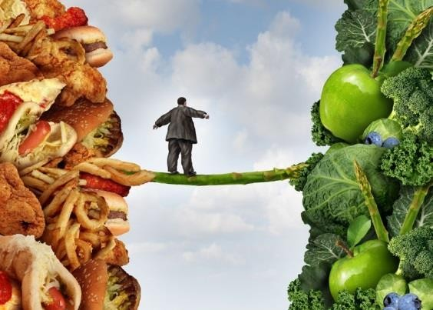
INDIVIDUAL BEHAVIORS
□ Diet:
In the decades preceding the 21st century, the vast majority of research on obesity risk factors focused on
individual-level, largely modiﬁable behaviors.
The role of diet and physical activity in mitigating obesity risk and reducing prevalent obesity have received the most attention, and with good reason: 15% of deaths in 2000 in the USA were attributable to excess weight, owing to poor diet and physical inactivity.

Slide 11

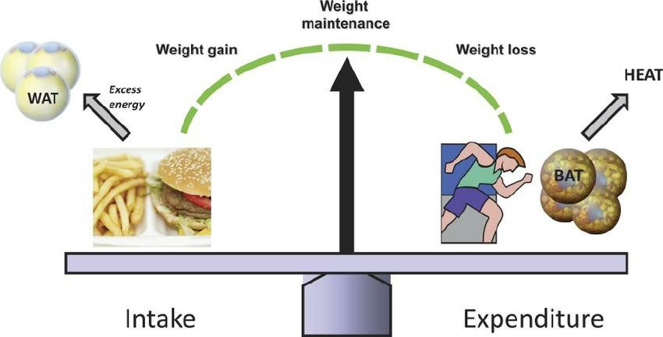
Caloric intake and expenditure needed for weight maintenance or healthy growth has historically taken center stage , and caloric restriction remains today a primary focus of most popular and clinical weight- management and weight-loss approaches

Slide 12
For long-term maintenance of healthy weight, evidence from observational cohorts indicate that diets that are considered “healthier” lead to better long-term weight maintenance, or at least mitigate weight gain typically associated with aging through middle age.
For example, research in US health professionals pointed to averaged 4-year weight gain throughout middle age as being strongly associated with increasing intake of potato chips and potatoes, sugar-sweetened beverages, and processed and unprocessed red meats, but inversely associated with the intake of vegetables, fruits, whole grains, nuts, and yogurt

Slide 13

□ Speciﬁc food groups, such as sugar- sweetened beverages, have received considerable attention largely because added sugar consumption (primarily as sugar-sweetened beverages) has been rising concomitantly with prevalent obesity

Slide 14

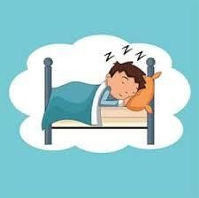
Physical Activity, Sedentary Behaviors, and Sleep:
—Personal behaviors beyond diet (physical activity, sleep, sedentary and screen time, and stress) have also been independently associated with weight change and maintenance in adulthood.
Combined with diet, these elements have synergistic and likely cumulative eﬀects on an individual’s ability to maintain or obtain a healthy body weight over the life course

Slide 15

□ Recently reviewed evidence from randomized trials and observational studies support 2008 US recommendations for weight management, consistently showing that in general, 150–250 minutes per week of moderate intensity activity is required to prevent weight gain, or aid in weight loss when accompanied by dietary restriction.

Slide 16

Leisure-time activities involving sitting, but which are not truly restful behaviors, such as getting 8 hours of sleep in adults and adolescents or less than 10-11 hours sleep in children, television watching are also related to weight gain.

Slide 17
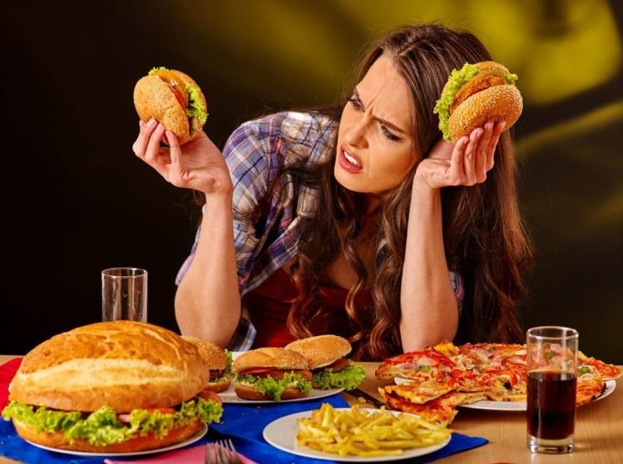
Psychological factors.
For some people, emotions influence eating habits. Many people eat excessively in response to emotions such as boredom, sadness, stress, or anger. While most overweight people have no more psychological disturbances than normal weight people, about 30% of the people who seek treatment for serious weight problems have difficulties with binge eating.

Slide 18
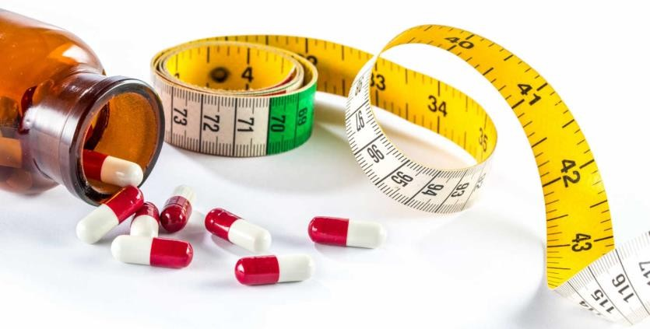
Medications
. Medications associated with weight gain include certain antidepressants. (medications used in
treating depression), anticonvulsants (medications used in controlling seizures such as carbamazepine [Tegretol, Tegretol XR , Equetro, Carbatrol] and valproate [Depacon, Depakene]), some diabetes
medications (medications used in lowering blood sugar such as insulin, sulfonylureas, and thiazolidinediones),

Slide 19
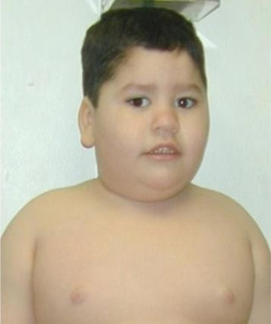
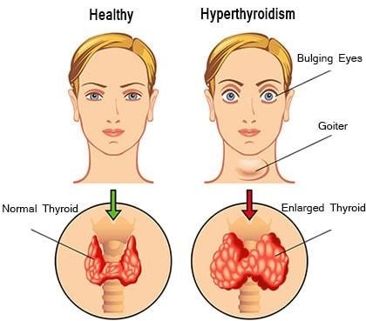
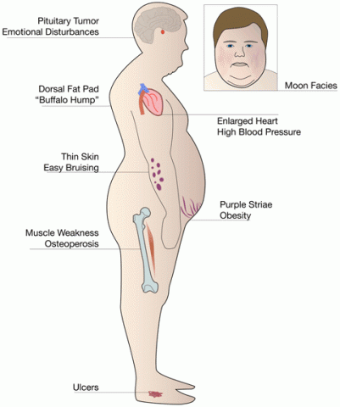
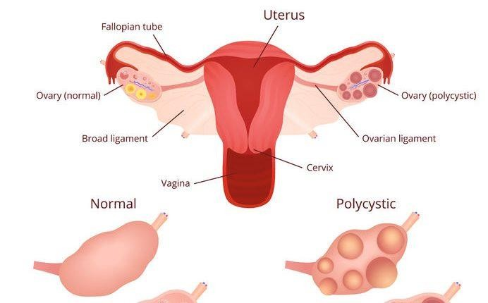
Diseases
such as hypothyroidism, insulin resistance, polycystic ovary syndrome (insulin resistance) , and Cushing's syndrome (high levels of the hormone cortisol as medciation) are also contributors to obesity. Some diseases, such as Prader-Willi syndrome 9gene 15) , can lead to obesity.

Slide 20
Hormones
Insulin:
Insulin is a hormone produced by the pancreas. It helps regulate carbohydrate and fat metabolism and reduces blood glucose after a meal. High level of insulin prevents fat burn and leads to obesity.
Leptin
In the long term it leads to decrease in appetite and an increase in heat generation from energy both leading to a decrease in obesity. However despite these high level, obese people are not sensitive
to the effects of leptin and thus do not have a reduced appetite.

Slide 21
Ghrelin
is produced in the stomach and in the arcuate nucleus of the hypothalamus. In obese individuals the postprandial suppression of ghrelin is attenuated and may contribute to overeating
Sex hormones
Body fat distribution is regulated by
estrogens and androgens (female and male sex hormones respectively). While estrogens are secreted by ovaries, androgens are made and secreted by testes.
In men, and in women who have had menopause, can have more fat accumulation around abdomen and hips.
Growth hormone
The pituitary gland in the brain produces growth hormone. This helps in growth of a child.
Growth hormone also affects metabolism of all the nutrients taken by the body. Levels of growth hormone are lower in obese people than normal individuals.

Slide 22
Lipoprotein lipase
Lipoprotein lipase (LPL) is a multifunctional enzyme produced by many tissues, including adipose tissue, cardiac and skeletal muscle, islets, and macrophages.
LPL is the rate-limiting enzyme for the hydrolysis of the triglyceride.
Mice with overexpression of LPL in skeletal muscle accumulate triglyceride in muscle, develop insulin resistance. Mice with LPL deletion in skeletal muscle have reduced TG accumulation and increased insulin action on glucose transport in muscle

Slide 23

SOCIOECONOMIC RISK FACTORS:
INCOME AND EDUCATION
Income has had a shifting role in obesity risk over the last century. As late as the mid-20th century, the USA and Europe could link wealth directly with obesity—the
wealthier an individual, the more likely to be overweight.
Over the last few decades, however, perhaps owing to the abundance of cheap and highly available food, coupled with changing sociocultural norms, this link has ﬂipped.

Slide 24
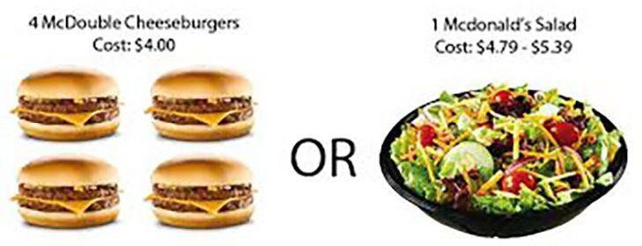
Today, wealth in the USA tends to be inversely correlated with obesity, and it is those who are at or below the level of poverty who appear to have the highest rates of obesity.
Indeed, in US cities where the homeless are surveyed, the prevalence of overweight and obesity parallels that of non- homeless populations, contrary to our typical beliefs about thinness accompanying food insecurity or homelessness.

Slide 25
In men, too, those in low income strata tended to have higher prevalence of obesity, but , in some countries, poverty was associated with more prevalent overweight than wealth.
The diﬀerences between sexes in terms of income status and obesity, in particular the trend reversal in men, may be in part due to low-paying jobs typically involving more physically demanding work performed by men more than by women

Slide 26

Education:
Adding complexity to this picture is the role of education: in the 11 OECD countries discussed above, education showed a strong inverse relationship with overweight/obesity, particularly in women, who had consistently higher prevalence of overweight/obesity the less educated they were.

Slide 27
ENVIRONMENTAL RISK FACTORS
The Built Environment: Research on the built environment tends to focus on a few measurable characteristics of neighborhoods as they relate to weight status, while holding sociodemographic and other person-level characteristics constant.
Such neighborhood characteristics range from more concrete factors (e.g., fast food restaurants, supermarkets, parks, transportation, etc.) to more variably scored factors (e.g., walkability, neighborhood healthiness)

Slide 28
ENVIRONMENTAL RISK FACTORS
□ Environmental “Pathogens”:
Viruses, Microbiomes, and Social Networks—Growing evidence from animal and human studies indicates that obesity may be attributable to infection, or that obesity itself may be a contagion.
Infectious agents include viruses, the trillions of microbiota inhabiting the human gut, and, of course, obese humans as infectious agents themselves

Slide 29
COSTS OF OBESITY: CO-MORBIDITIES,
MORTALITY, AND ECONOMIC BURDEN
□ Obesity is associated with concomitant or increased risk of nearly every chronic condition, from diabetes, to dyslipidemia, to poor mental health. Its impacts on risk of stroke and cardiovascular disease, certain cancers, and osteoarthritis are signiﬁcant.

Slide 30
Costs of obesity
Increases in spending from 1998-2006
15.2% ($ 63.9 billion) pharmaceutical services
10.3% ($ 44.7 billion) inpatient services
5.9% ($ 45.2 billion) non-inpatient services

