Slide 1



Tishk International University
Faculty of Applied Science
Nutrition and Dietetics Department
Primary Sources of Microorganisms in Foods
Food Microbiology /3rd Lecture
2nd Grade / Spring Semester
Instructor: Adam Jalal Mohammed
Email: adam.jalal@tiu.edu.iq
Food Microbiology
2025 - 2026

Slide 2
Lecture Overview
01
Introduction to Food Microbiology
02
How Microorganisms Enter Food
Global impact, definitions, and significance of studying microorganisms in food systems
Overview of contamination pathways and entry routes into food systems
03
Primary Contamination Sources
04
Pathogens of Concern
Nine major sources: soil, water, sewage, plants, utensils, handlers, animals, feeds, air
Major foodborne pathogens: characteristics, sources, and recent outbreak case studies
05
Prevention and Control Strategies
06
HACCP Systems
Cross-contamination prevention, biofilm control, and farm-to-table safety measures
Seven principles, implementation steps, critical control points, and verification procedures

Slide 3
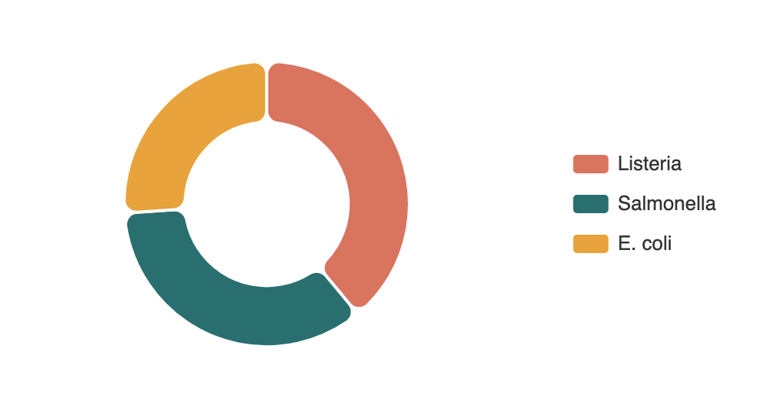
The Global Impact of Foodborne Illness
Global Statistics (WHO)
Top 3 Pathogen Threats
600M
420K
$110B
Annual Cases
Deaths/Year
Economic Cost
United States (CDC 2024)
Annual Illnesses
48 million
Hospitalizations
128,000
Deaths
3,000
Seasonal Pattern
Over 33% of foodborne illness cases occur between June-August due to warmer temperatures promoting bacterial growth and increased outdoor food preparation.

Slide 4
Introduction to Food Microbiology
Definition
Why Study Food Microbiology?
Food microbiology is the study of microorganisms that inhabit, create, or contaminate food. It encompasses the study of bacteria, viruses, parasites, and fungi and their interactions with food systems.
Prevent foodborne diseases and protect public health
Extend shelf life and reduce food waste
Ensure food safety and quality standards
Develop effective preservation methods
The Dual Nature of Microorganisms
Comply with regulatory requirements
Beneficial Microbes
Fermentation (yogurt, cheese, bread), probiotics, biopreservation
Key Concept
Food Contamination refers to the presence of harmful substances or microorganisms in food that can cause illness or disease. Understanding the primary sources of contamination is essential for developing effective prevention strategies.
Harmful Microbes
Food spoilage, foodborne illness, toxin production
Did You Know? Fewer than 20 of the thousands of bacteria species cause more than 90% of food poisoning cases annually. The major culprits include Salmonella, E. coli, Listeria, Campylobacter, Staphylococcus aureus, Clostridium perfringens, Bacillus cereus, and Vibrio species.

Slide 5
CONTAMINATION PATHWAYS
How Microorganisms Enter Food: An Overview
Microorganisms can enter food through a variety of sources at every stage of the food production chain, from farm to table. Understanding these pathways is critical for implementing effective control measures.
Airborne Transmission
Soil Contamination
Water Sources
Microorganisms travel through air currents and settle on food surfaces during processing, storage, and preparation.
Soil harbors billions of microorganisms per gram. Crops carry soil-borne bacteria to processing plants, especially vegetables and fruits.
Contaminated water used for irrigation, washing, or processing introduces microorganisms directly to food products.
Dust particles
Moisture droplets
Spores
Bacteria
Molds
Parasites
Irrigation
Washing
Processing
Animal Contact
Human Handling
Equipment & Utensils
Food animals and birds carry indigenous microorganisms in their digestive tracts, skin, and feathers. Shellfish concentrate organisms from water.
Food handlers can transmit bacteria through poor personal hygiene practices, contaminated hands, or outer garments.
Cutting boards, knives, containers, and processing equipment become contaminated and serve as vectors for cross-contamination.
Hands
Clothing
Respiratory
Cutting boards
Containers
Processing
Intestinal flora
Hide/feathers
Shellfish

Slide 6
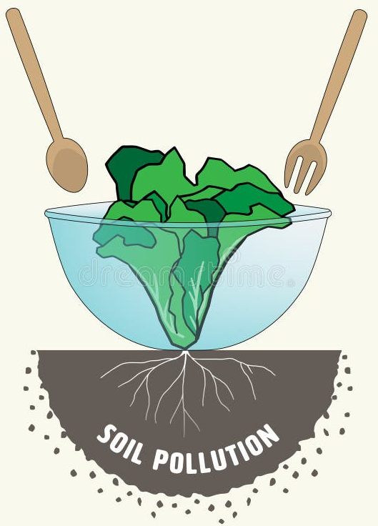
Soil
Soil as a Microbial Reservoir
Soil, especially agricultural soil, contains billions of microorganisms per gram. These organisms can multiply in soil, creating high population densities.
Key Genera Found in Soil:
Enterobacter
Pseudomonas
Proteus
Micrococcus
Enterococcus
Bacillus
Clostridium
It will immediately contaminate plants and edible plant parts, and the surface of animals associated with microorganisms.
Soil Particles are carried to the aquatic environment through wind, rain, and other means. Contamination of water takes place with several soil microflora.
It is not uncommon to find several microorganisms in both soil and water environments.
Some Soil contaminants are: Molds, Yeasts, Enterococcus, Bacillus, Enterobacter, Pseudomonas, Proteus, Micrococcus, and Parasites.

Slide 7
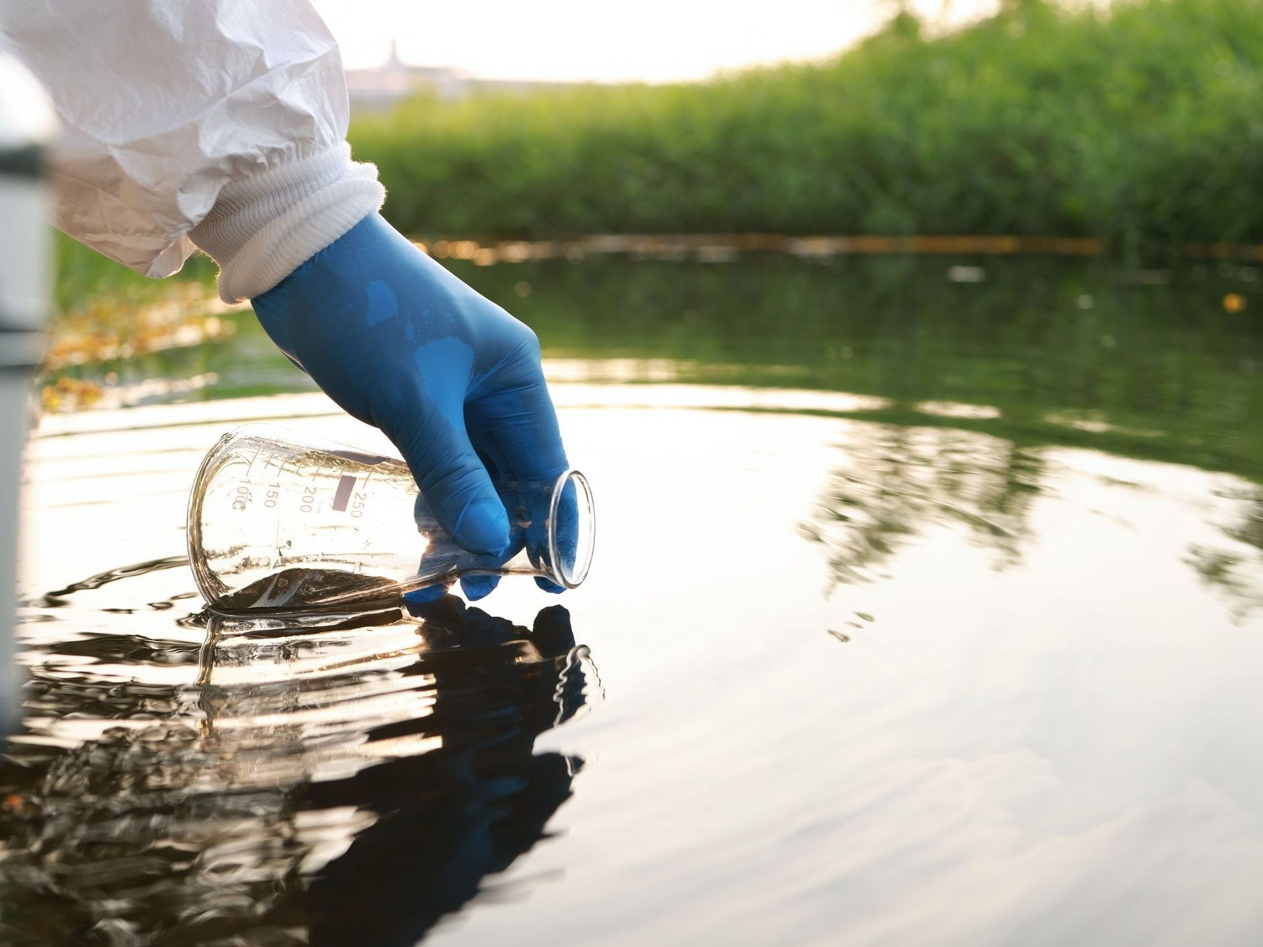
Water
Natural water not only contains microorganisms native to the aquatic environment, but also those from soil, raw or treated sewage, and pollutants entering the water body.
The microbial numbers and types vary in different types of water bodies depending on the nutrient states.
Use of such water for food processing will add microbes from the water to the food.
The water used in food processing should meet acceptable chemical and bacteriological characteristics.
Water Contamination Pathways
Irrigation: Water flows over soils into rivers, lakes, and dams
Washing: Contaminated water is used to wash vegetables and fruits
Processing: Water in food processing operations
Shellfish: Filter-feeding concentrates organisms from water

Slide 8
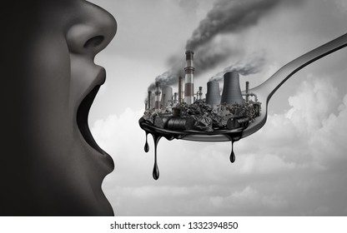
Air and Dust
Air is the transient habitat for many microorganisms.
Contamination of foods from the air is important for sanitary as well as economic reasons. Spoliation organisms may come from the air.
Mold spores from the air may give trouble in cheese, meat, sweetened condensed milk, and sliced bread.
Cocci are more numerous than the Bacillus type in the air.

Slide 9
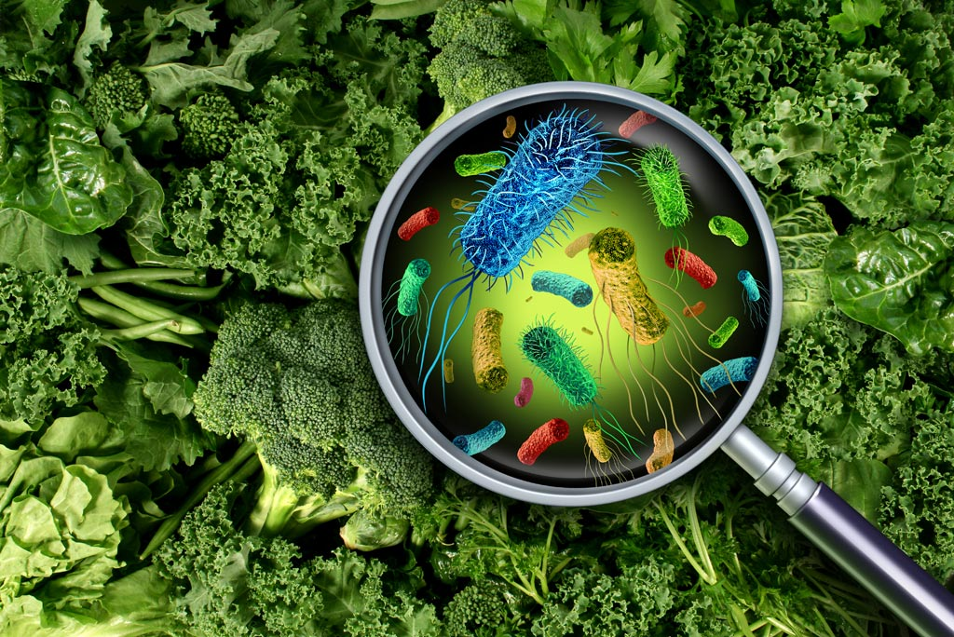
Plant and Plant Products
The Inside tissue of foods from plant sources is essentially sterile except for a few porous vegetables.
Some plants produce natural antimicrobial metabolites that can limit the presence of microorganisms.
Fruits and vegetables harbour microorganisms on their surface. Their type and level vary with Soil condition, type of fertilizer, water used, and the air quality.
Notable contaminants are: lactic acid bacteria, some yeast, molds, Pseudomonas, Alcaligenes, Micrococcus, Erwinia, Bacillus, Clostridium, Enterobacter, Xanthomonas, etc.
Factors Increasing Microbial Numbers
Plant diseases
Surface damage (before, during, after harvest)
Long delay between harvesting and washing
Unfavorable storage and transport conditions
Improper storage after processing

Slide 10
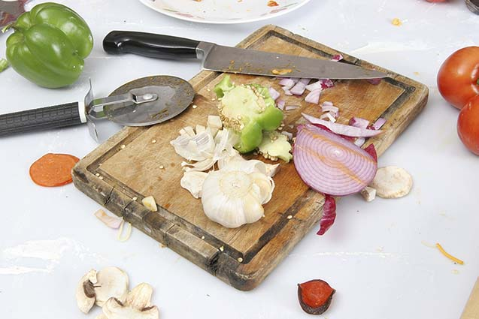
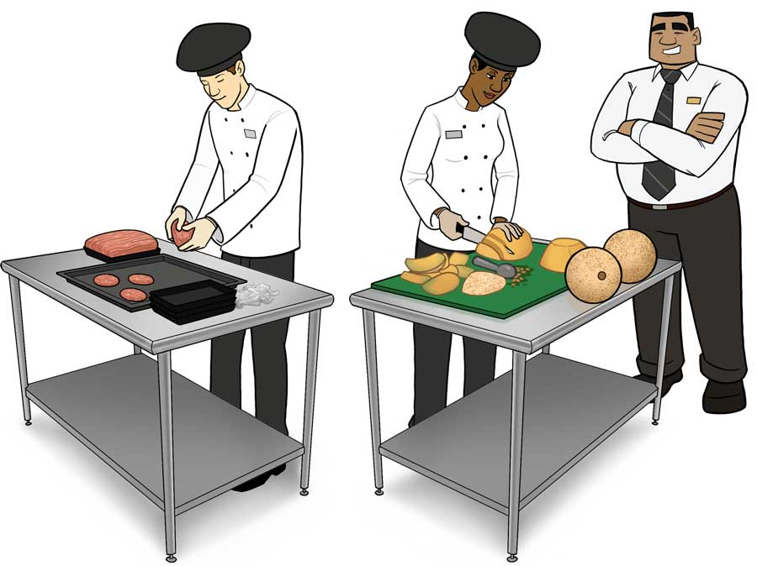
Food Utensils and Handling
Food Utensils
When vegetables are harvested in the container, or the utensils are contaminated with microorganisms, and they have direct contact with the vegetables.
The chopping board in the meat market, along with cutting knives and grinders are contaminated.
Food Handlers
The hands and outer garments of food handlers also serve as a source of microorganisms for contamination of foods.
Poor personal hygiene practices of food handlers also lead to contamination of food.

Slide 11
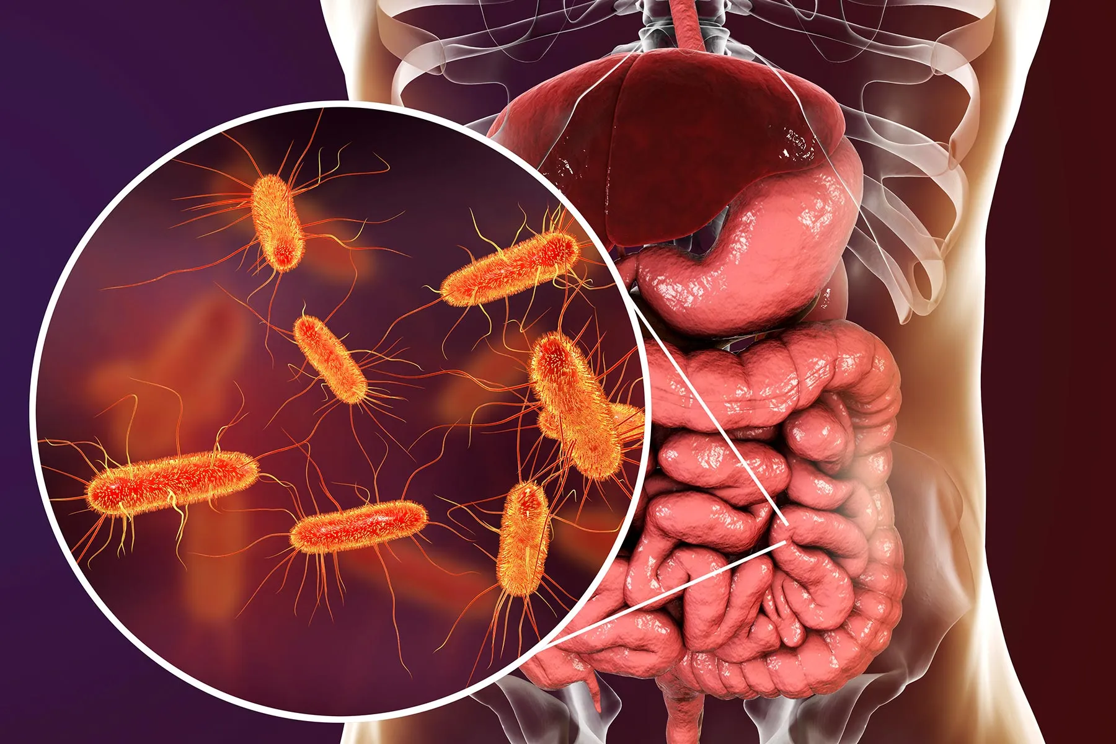
Intestinal Tract of the Humans & Animals
Intestinal flora becomes waterborne when human and animal feces contaminate water.
The intestinal flora consists of many organisms, and some of them are pathogens like Salmonella, parasitic protozoa

Slide 12
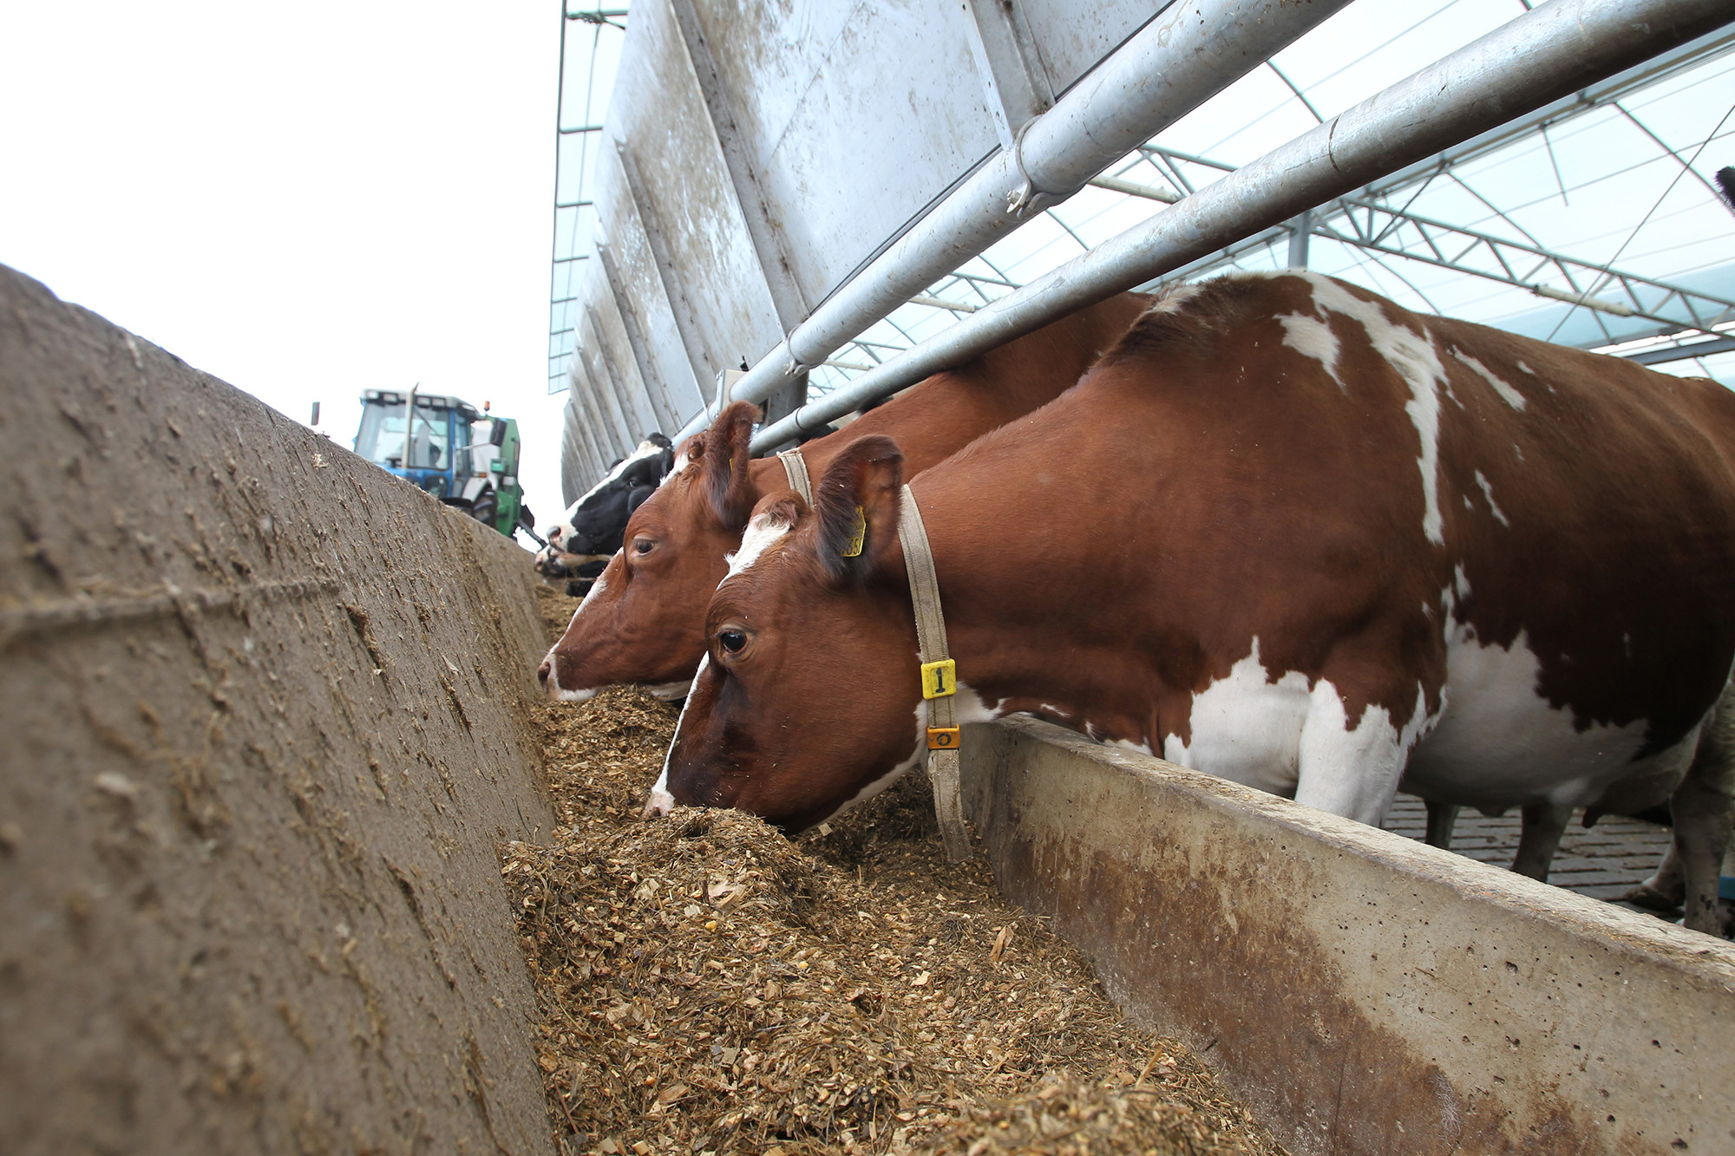
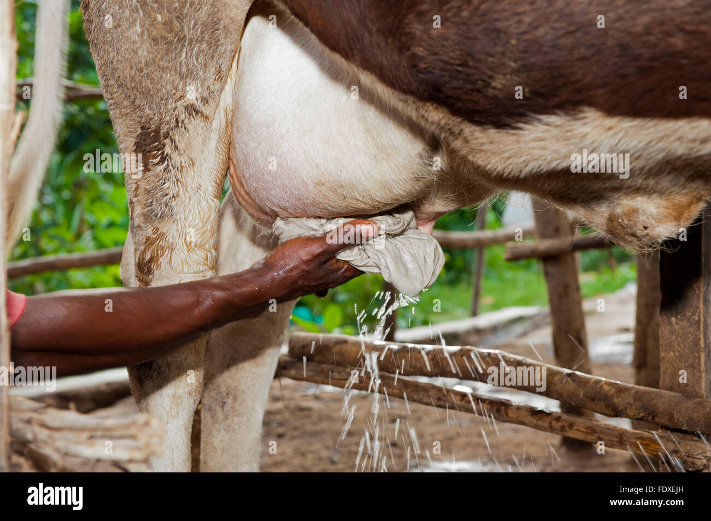
Animal feeds and Animal Hides
Animal Feeds
This is an important source of Salmonella to poultry and other farm animals.
This is also known as a source of Listeria monocytogenes to dairy and meat animals
Animal Hides
In the case of milk cows, the types of organisms found in raw milk reflect the flora of the udder.
The udder and the hide, organisms, can contaminate the general environment, milk container and the hands of the handlers.

Slide 13
PATHOGENS OF CONCERN
Major Foodborne Pathogens: Characteristics and Sources
Salmonella
Campylobacter jejuni
Habitat: GI tracts of animals and humans
Habitat: Animal reservoirs, poultry
Foods: Eggs, poultry, meat, produce
Foods: Raw/undercooked poultry, raw milk
Symptoms: Diarrhea, fever, cramps (12-72 hrs)
Symptoms: Diarrhea, cramps, fever (2-5 days)
Temp: Killed by thorough cooking (165°F)
Temp: Sensitive to drying and freezing
E. coli O157:H7
Staphylococcus aureus
Habitat: Cattle intestines, contaminated water
Habitat: Human skin, nasal passages, throat
Foods: Undercooked beef, produce, raw milk
Foods: Salads, cream-filled pastries, ham
Symptoms: Severe cramps, bloody diarrhea, HUS
Symptoms: Rapid onset vomiting, nausea (1-6 hrs)
Temp: Destroyed by cooking to 160°F
Toxin:
Heat-stable toxin - cooking won't help!
Listeria monocytogenes
2024 Outbreak Statistics
Habitat: Soil, water, vegetation, animals
Salmonella outbreaks
5 major
Foods: Soft cheeses, deli meats, smoked fish
Listeria outbreaks
3 major
Symptoms: Fever, muscle aches, miscarriage
Temp:
Grows at refrigeration temps!
E. coli outbreaks
4 major
Critical Insight: Listeria is especially dangerous because it can grow at refrigeration temperatures . Staphylococcus produces heat-stable toxins that survive cooking . Prevention is the only effective control.

