Slide 1

Course overview Human Anatomy
Assist. Prof. Dr. Sangar M. AHMED
Human Anatomy
Spring Semester
Week NO.1

Slide 2
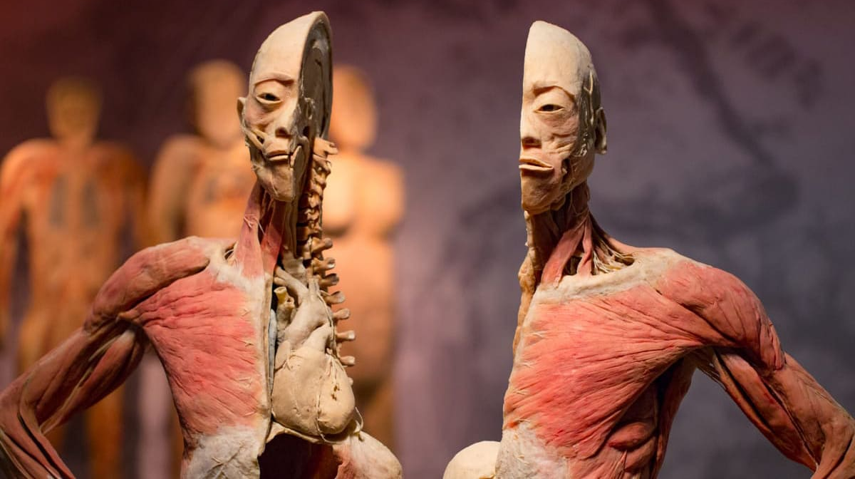
Course name;
Course Overview
 | Human Anatomy

Slide 3
Course Description
Course Overview
This course provides a comprehensive study of the structure and organization of the human body, with a focus on systems relevant to clinical laboratory practice. Students will explore anatomical terminology, body planes, and the detailed morphology of major organ systems including the skeletal, muscular, cardiovascular, respiratory, digestive, urinary, reproductive, nervous, and endocrine systems.

Slide 4
Course Objectives
Course Overview
Identify and describe the major structures and organ systems of the human body using correct anatomical terminology.
Explain the functional relationships between anatomical structures and their relevance to clinical laboratory procedures.
Recognize anatomical features through models, diagrams, and histological slides.
Apply knowledge of human anatomy to interpret laboratory findings in a clinical context.
Demonstrate understanding of body systems relevant to common laboratory diagnostics (e.g., cardiovascular, urinary, endocrine).

Slide 5
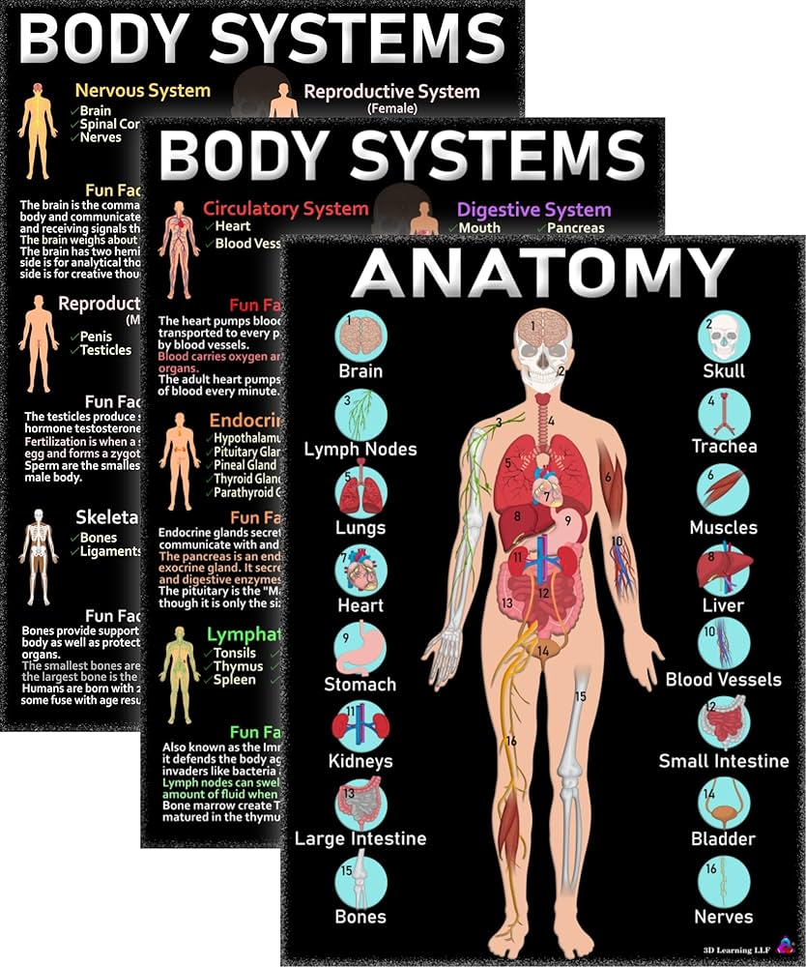
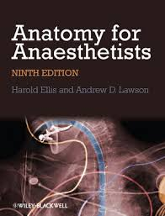
Course Overview

Slide 6
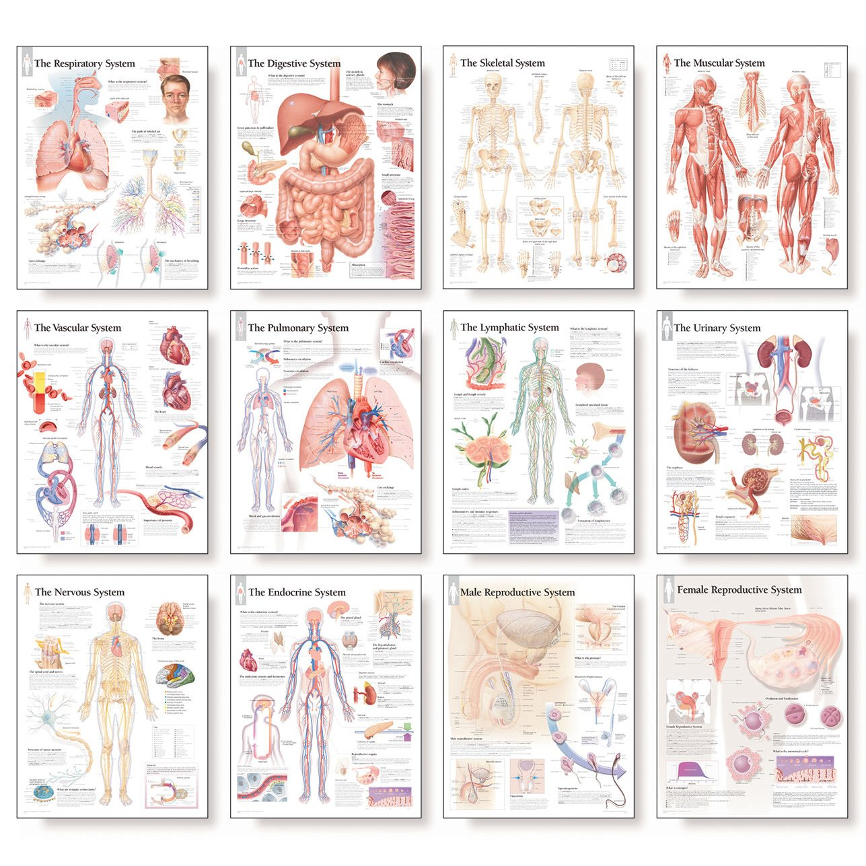
Course Overview

Slide 7
COURSE CONTENT
Course Overview
Weeks | Topics
W1 | Course overview
W2 | Respiratory System
W3 | GIT System
W4 | GIT System
W5 | Nervous System
W6 | Skeletal System
W7 | Midterm exam

Slide 8
COURSE CONTENT
Course Overview
Weeks | Topics
W8 | Cardiovascular System
W9 | Respiratory System
W10 | Digestive System
W11 | Urinary System,
W12 | Reproductive System
W13 | Endocrine System
W14 | Course review
W15+W16 | Final Exam

Slide 9
Course/Student Learning Outcomes
Course Overview
Describe the differences between the anatomy and physiology of the human body. Students will be evaluated by lecture exams, laboratory exams, laboratory reports, and laboratory practical exams.
Explain the different levels of structural organization that make up the human body. Students will be evaluated by lecture exams and laboratory reports.
Describe the anatomical position of the human body. Students will be evaluated by lecture, laboratory exams, and laboratory reports..

Slide 10
Course/Student Learning Outcomes
Course Overview
Explain the directional terms and planes of the human body. Students will be evaluated by lecture, clinical exams, and medical reports.
Describe the body cavities and regional quadrants. Students will be evaluated by lecture, laboratory exams, and laboratory reports.
Describe the nature of atoms, chemical compounds, including organic and inorganic compounds. Students will be evaluated by lecture exams

Slide 11
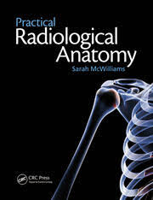
Course Reading List and References
Course Overview
PRINCIPLES OF ANATOMY & PHYSIOLOGY , 15th edition, Gerard J. Tortora and Bryan Derrickson, John Wiley and Sons, Hoboken, N.J. 2017 Volume I

Slide 12
Student's obligation (Special Requirements):
Course Overview
Students are expected to attend all lecture and discussion sessions.
Students are expected to come to class on time to prevent disrupting the lecture and classroom activities.
Any student who misses more than 2 scheduled discussion section meetings will lose points from their discussion section grade.

Slide 13
Student's obligation (Special Requirements):
Course Overview
Technology Policy: - Mobile device (e.g., smart phones, pagers, etc.) ringers will be turned off or placed on vibrate prior to class.
Laptops and tablets can ONLY be used in the classroom to take notes, make calculations, and download/read course materials.
Note that research suggests non-academic use of the Internet is associated with poorer learning outcomes.
Complete homework assignments before the dates.

Slide 14
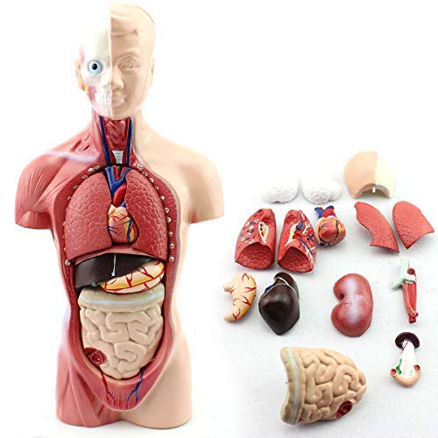
Course Evaluation Criteria
Course Overview

Slide 15


