Slide 1

posterior pituitary AND adh
Zhikal O. Khudhur
Endocrinology BIO 414
Spring Semester
Week number: 4
Date: 2/ 2026

Slide 2

Objectives
Posterior pituitary anatomy
Type of hormones that released by pp.
Oxytocin
Mechanism of oxytocin action
Kidney physiology
Antidiuretic hormone
Mechanism of ADH action

Slide 3
Posterior pituitary gland hormone –Oxytocin
Oxytocin stimulates contraction of the uterus at the end of pregnancy and stimulates the release of milk from the mammary glands.
As labor begins, the cervix of the uterus is stretched, which generates sensory impulses to the hypothalamus, which in turn stimulates the posterior pituitary to release oxytocin. Oxytocin then causes strong contractions of the smooth muscle (myometrium) of the uterus to bring about delivery of the baby and the placenta.
In addition, when a baby is breast-fed, the sucking of the baby stimulates sensory impulses from the mother’s nipple to the hypothalamus. Nerve impulses from the hypothalamus to the posterior pituitary cause the release of oxytocin, which stimulates the contraction of the smooth muscle cells around the mammary ducts to release milk.

Slide 4
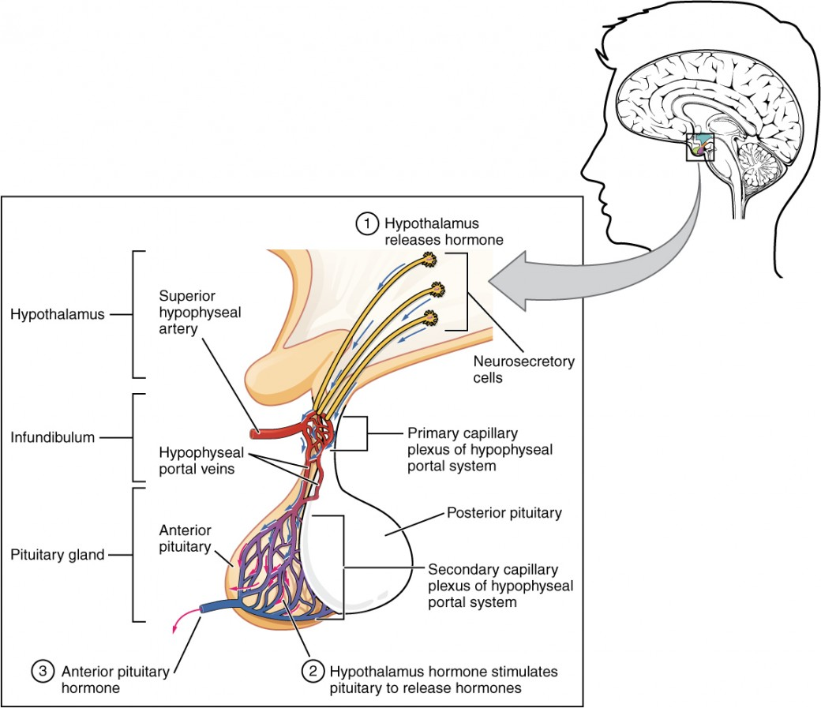
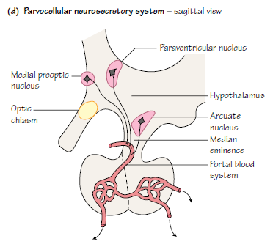

Slide 5
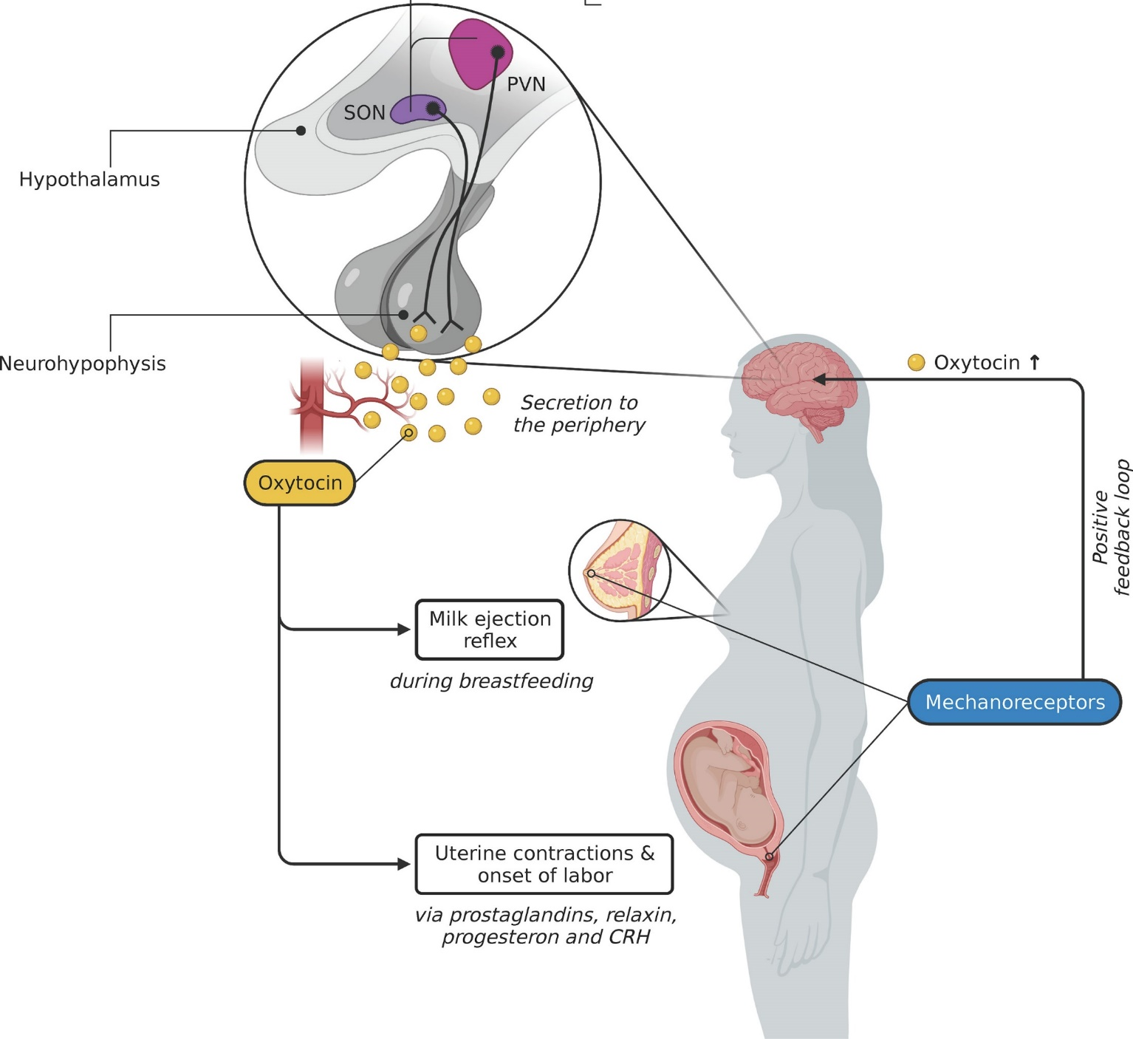
Posterior pituitary gland hormone –Oxytocin

Slide 6
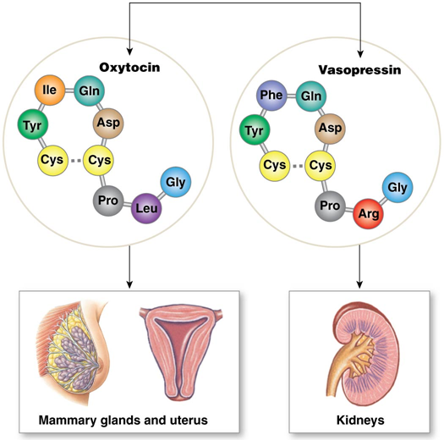
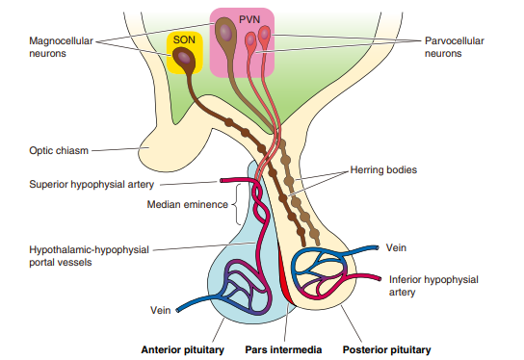

Slide 7
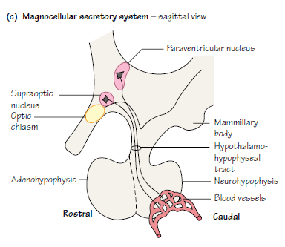
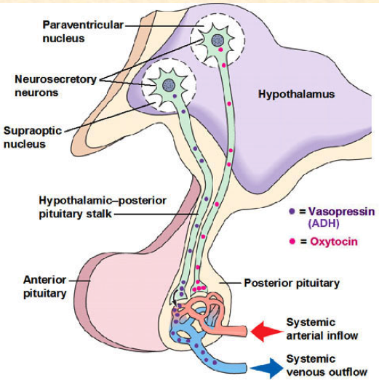
Oxytocin

Slide 8
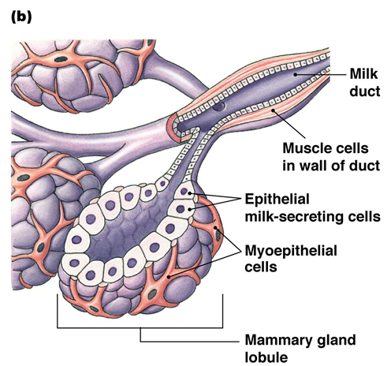
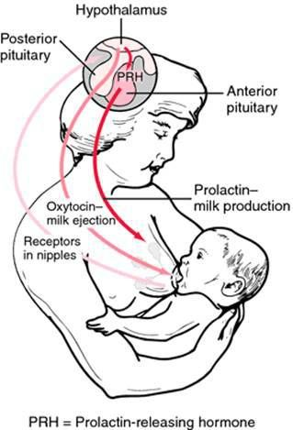
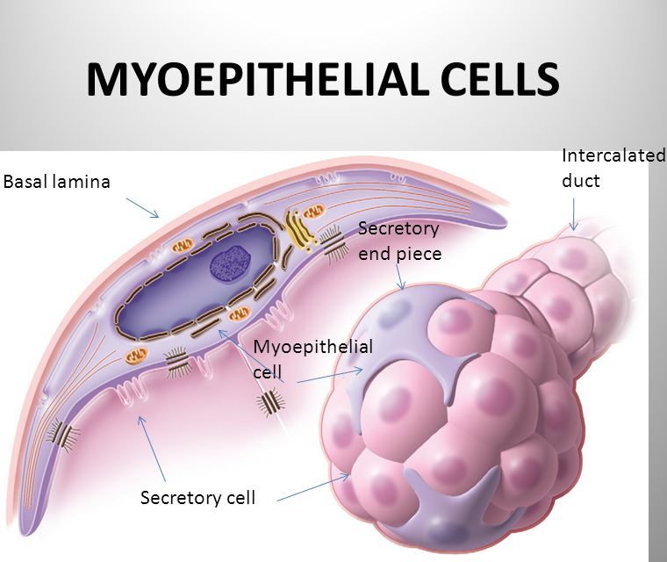
OXYTOCIN

Slide 9
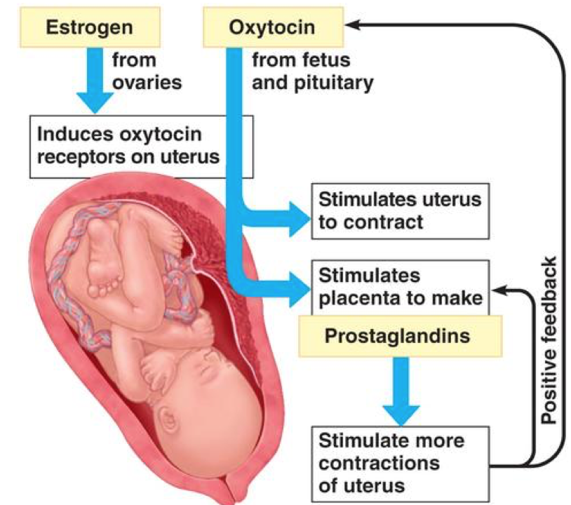
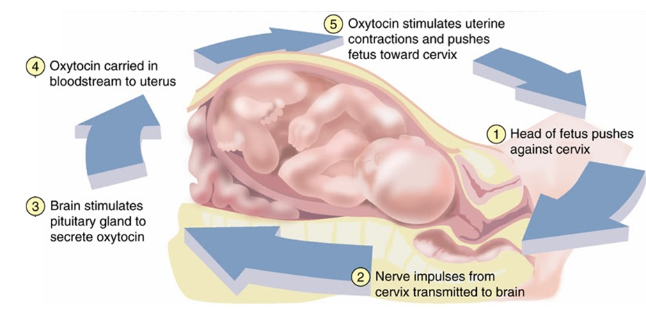

Slide 10
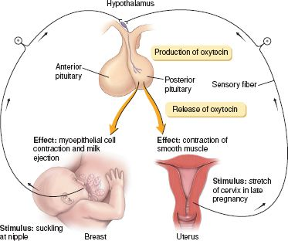

Slide 11
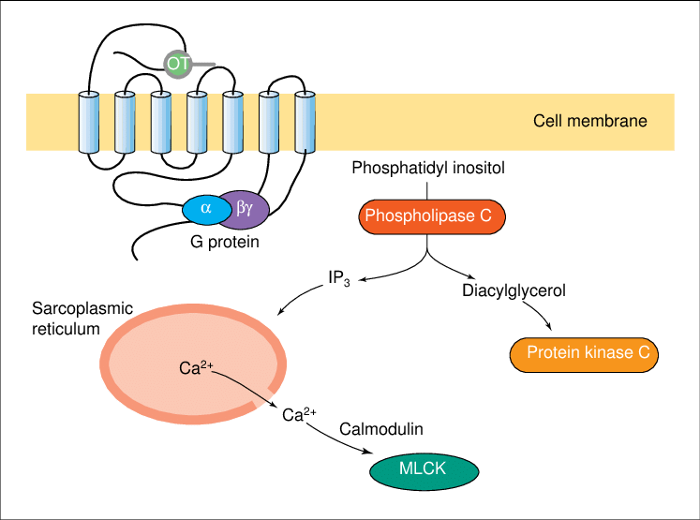
OXYTOCIN RECEPTOR

Slide 12
Why Do We Need ADH?

Slide 13
Posterior pituitary gland hormone –Antidiuretic hormone
Antidiuretic hormone (ADH, also called vasopressin) increases the reabsorption of water by kidney tubules, which decreases the amount of urine formed. The water is reabsorbed into the blood, so as urinary output is decreased, blood volume is increased, which helps maintain normal blood pressure. ADH also decreases sweating, but the amount of water conserved is much less than that conserved by the kidneys.
The stimulus for the secretion of ADH is decreased water content of the body. If too much water is lost through sweating or diarrhea, for example, osmoreceptors in the hypothalamus detect the increased “saltiness” of body fluids. The hypothalamus then transmits impulses to the posterior pituitary to increase the secretion of ADH and decrease the loss of more water in urine.

Slide 14
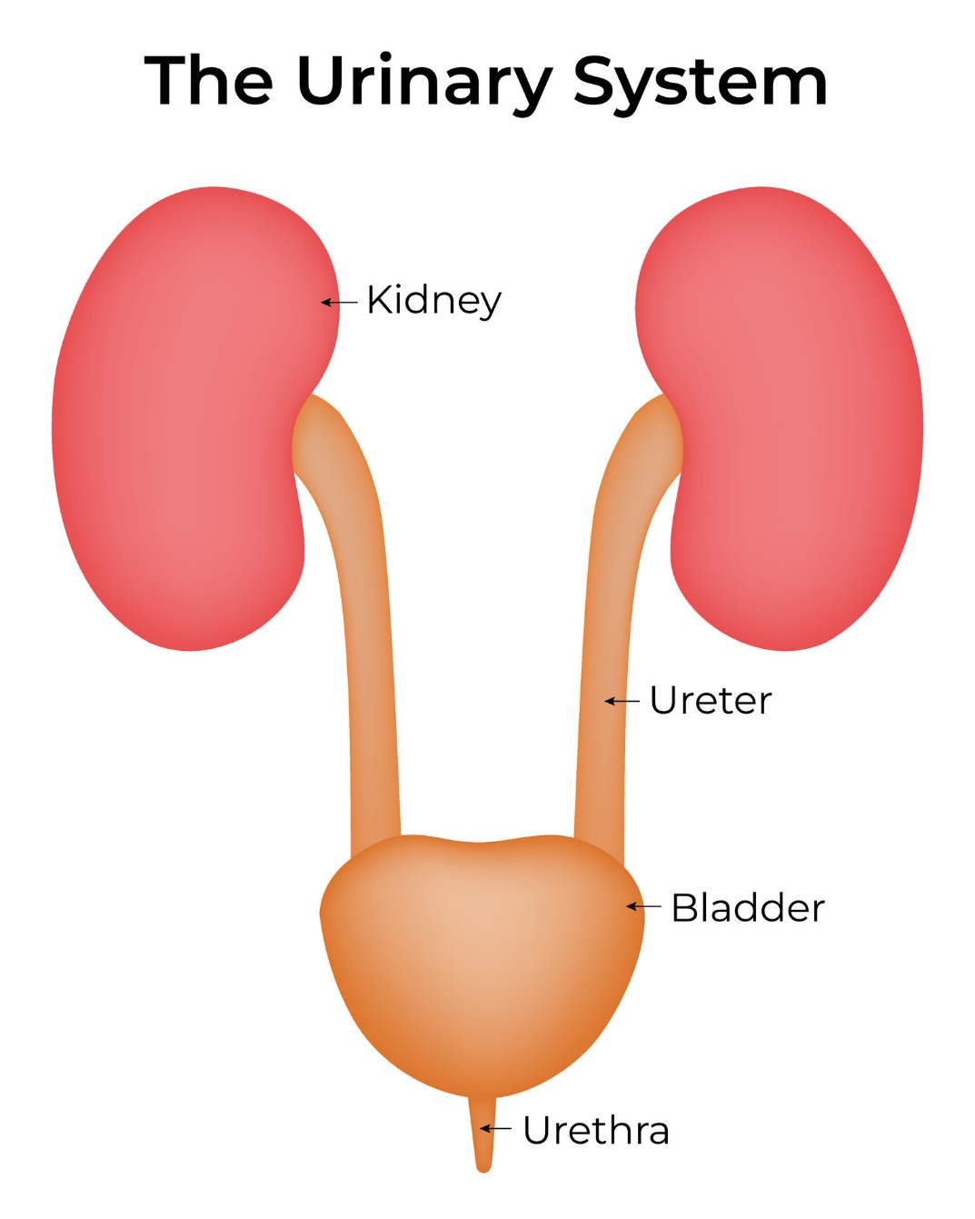
URINARY SYSTEM
Organs of the Urinary System
Kidneys → filter blood
Ureters → carry urine
Urinary bladder → stores urine
Urethra → removes urine
Main organ for ADH action: Kidney

Slide 15
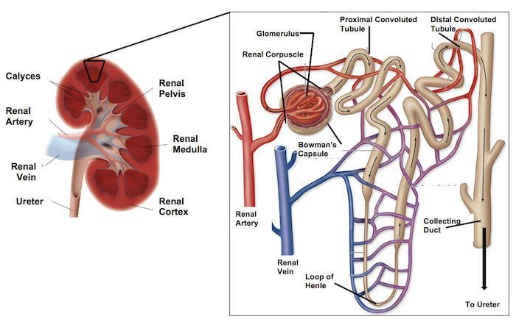
Functional Unit of the Kidney
The functional unit is the nephron
Each kidney contains ~1 million nephrons
Main parts:
Glomerulus
Bowman’s capsule
Tubules
Collecting duct

Slide 16
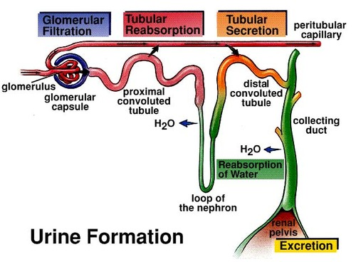
URINE FORMATION
Steps of Urine Formation
Filtration
Reabsorption
Secretion
Excretion
These steps determine final urine composition

Slide 17
Filtration
Occurs in the glomerulus
Blood is filtered into Bowman’s capsule
✔ Small molecules pass:
water
ions
glucose
❌ Large molecules stay:
proteins
blood cells
“Filtration = movement from blood → nephron”

Slide 18
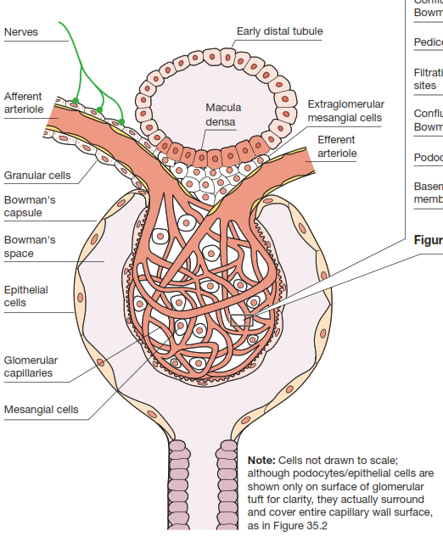
Structure of the Glomerulus
The glomerulus is a network of capillaries surrounded by Bowman's capsule.
Key components include:
Afferent arteriole: brings blood into the glomerulus
Efferent arteriole: carries blood away from the glomerulus
Glomerular capillaries: where filtration occurs
Bowman's capsule: collects the filtered fluid
Mesangial cells: provide structural support and have contractile properties

Slide 19
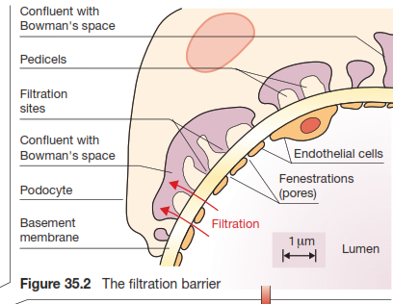
The Filtration Barrier - Overview
The filtration barrier consists of three layers:
Endothelium of glomerular capillaries
Basement membrane
Podocytes (epithelial cells)
Each layer contributes to selective filtration, allowing water and small solutes to pass while retaining larger molecules like proteins.

Slide 20
The Filtration Barrier - Endothelium
The endothelium is the innermost layer of the filtration barrier.
It's characterized by fenestrations (pores) about 70-100 nm in diameter.
These fenestrations make the glomerular endothelium much more permeable than typical capillaries.
The endothelium provides the first level of size selectivity in filtration.

Slide 21
The Filtration Barrier - Basement Membrane
The basement membrane is a thick extracellular matrix between the endothelium and podocytes.
It's composed of type IV collagen, laminin, and proteoglycans.
The basement membrane provides both size and charge selectivity.
Negatively charged molecules are repelled due to the negative charges in the basement membrane.

Slide 22
The Filtration Barrier - Podocytes
Podocytes are highly specialized epithelial cells with interdigitating foot processes (pedicels).
The gaps between pedicels form filtration slits (about 25-60 nm wide).
Filtration slits are bridged by a thin membrane called the slit diaphragm.
Podocytes provide the final barrier to protein filtration and maintain the integrity of the filtration barrier.

Slide 23
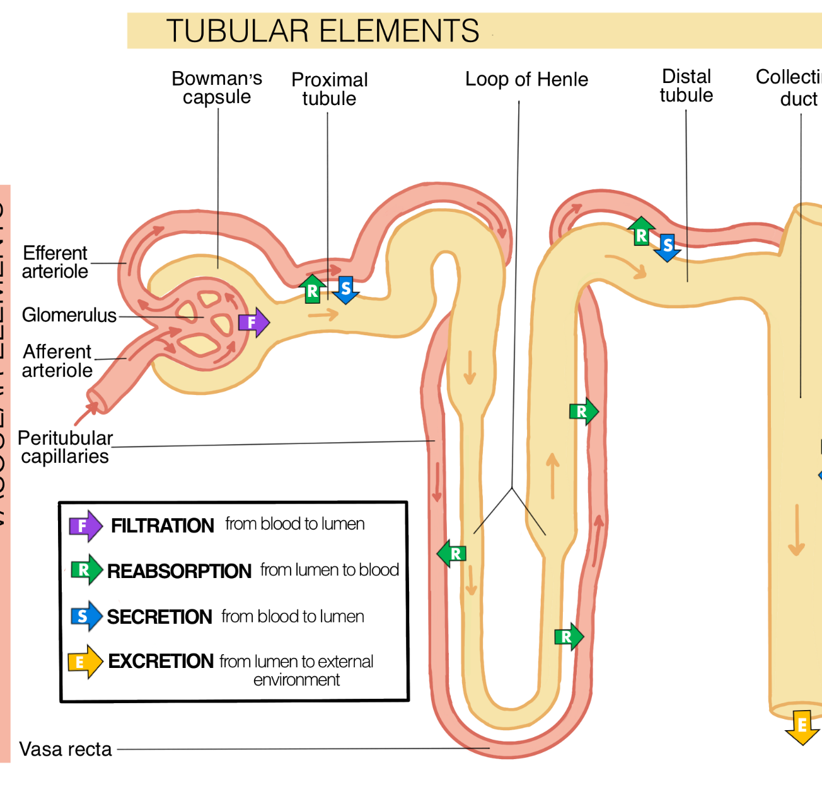
Glomerular Filtration Process
Ultrafiltration is the process by which plasma is filtered across the glomerular capillary wall into Bowman's space.

Slide 24
Reabsorption
Useful substances return to blood
✔ Reabsorbed:
water
glucose
amino acids
ions
“Reabsorption = body takes back what it needs”

Slide 25
Secretion
Additional substances added to tubule
✔ Examples:
hydrogen ions (H⁺)
potassium (K⁺)
drugs
“Secretion = adding waste into tubule”

Slide 26
Excretion
Final step
Remaining fluid becomes urine
Leaves the body via:
ureter → bladder → urethra

Slide 27
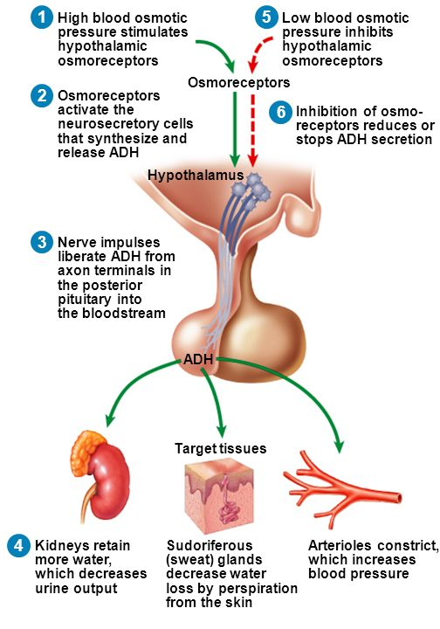
ANTIDIURETIC HORMONE
Where is ADH Produced?
Produced in the hypothalamus
Main nuclei:
Supraoptic nucleus
Paraventricular nucleus
Released from posterior pituitary
Transport in Blood
ADH is a peptide hormone
Travels freely in blood

Slide 28
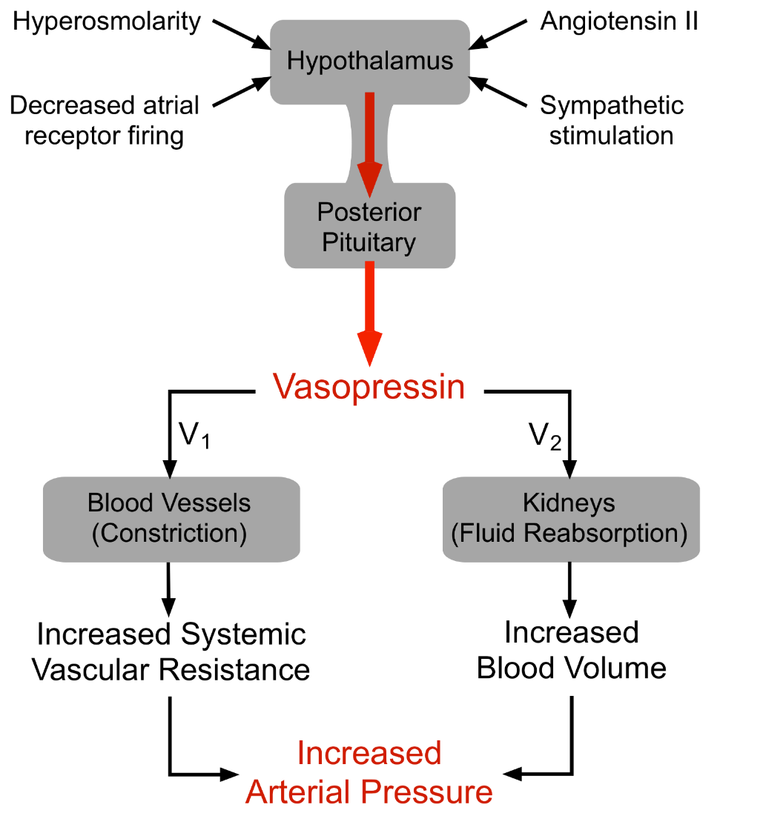
ADH Receptors
V2 receptor → kidney (main effect)
V1 receptor → blood vessels

Slide 29
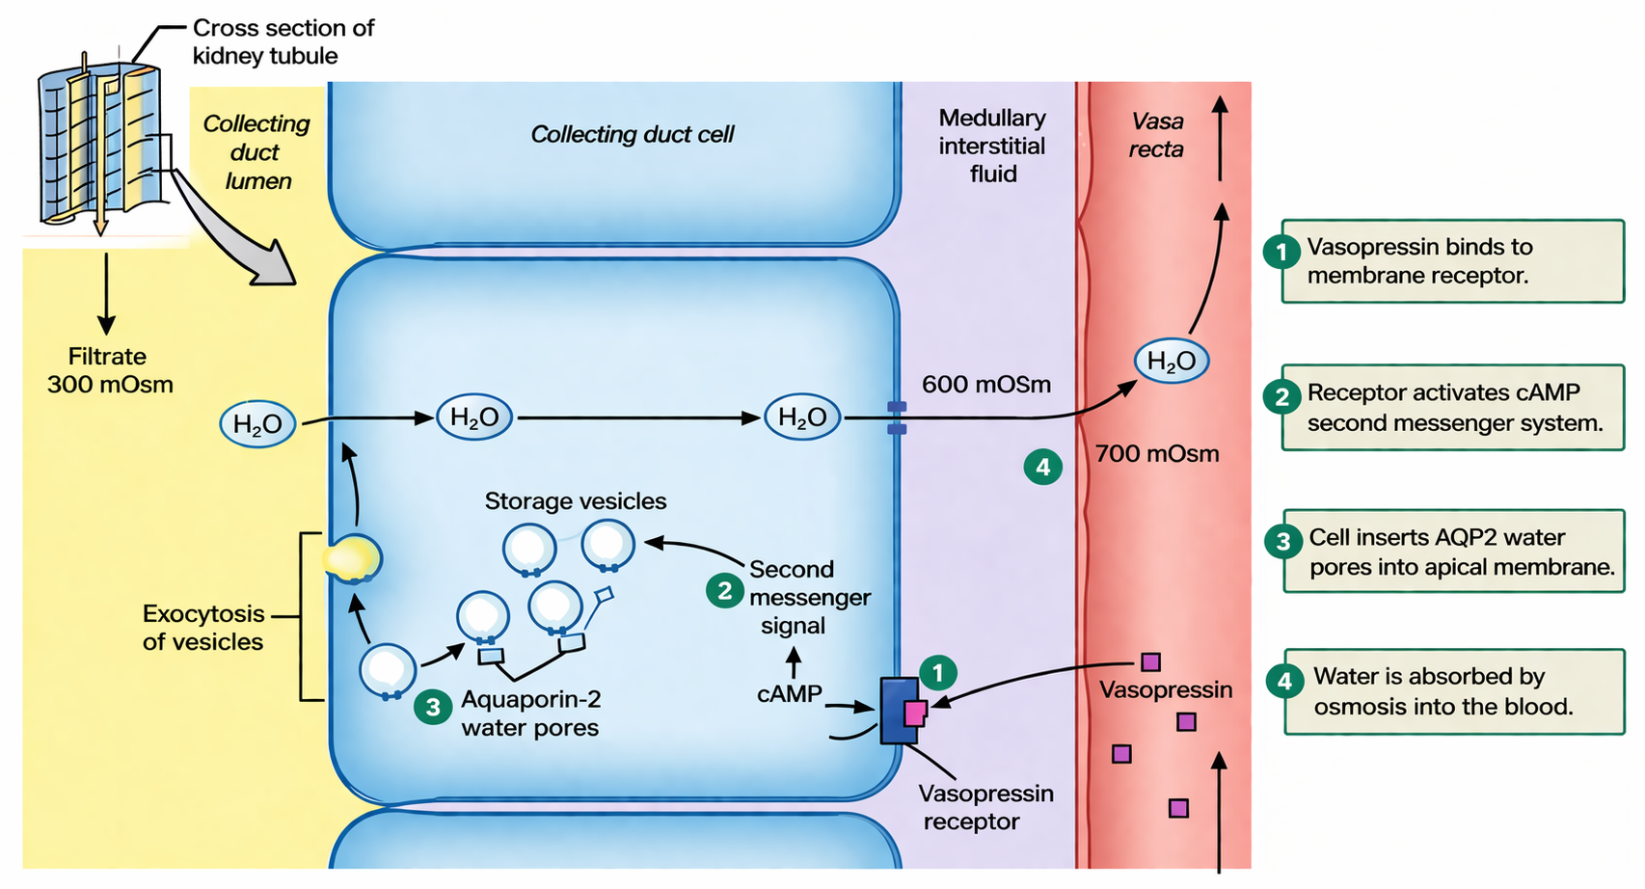

Slide 30
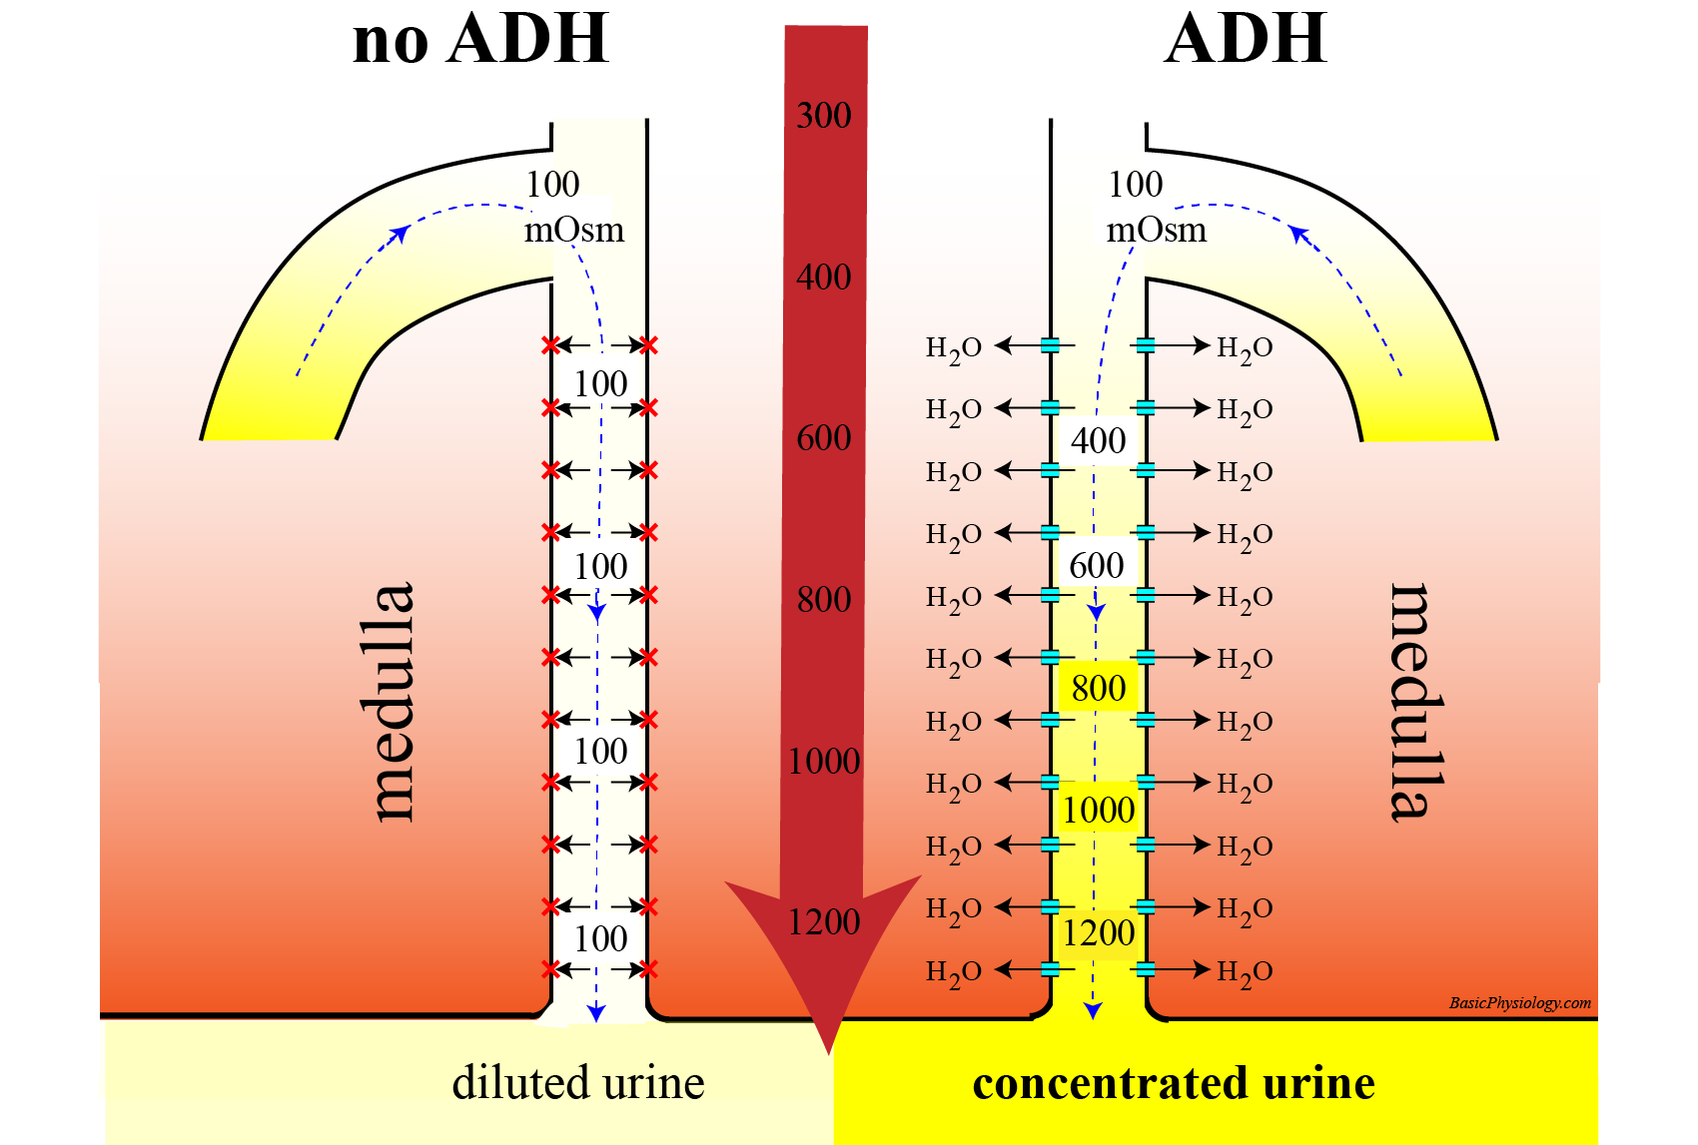
Final Physiological Effect
↑ Water reabsorption
↓ Urine volume
↑ Urine concentration
↑ Blood volume

Slide 31
CLINICAL CONDITIONS
Diabetes Insipidus
👉 Low ADH or poor response
✔ Symptoms:
Excessive urination
Excessive thirst
Dilute urine

Slide 32
References
Greenstein B. & Wood D. F. (2011). The endocrine system at a glance (3rd ed.). Wiley-Blackwell
Melmed S. Auchus R. J. Goldfine A. B. Koenig R. Rosen C. J. & Williams R. H. (2020). Williams textbook of endocrinology (14th ed.). Elsevier. Boron W. F. & Boulpaep E. L. (2021).
Boron & boulpaep concise medical physiology. Elsevier. Barrett K. E. Barman S. M. Yuan J. X.-J. & Brooks H. (2019).
Ganong's review of medical physiology (review questions) (26th ed.). McGraw-Hill Education LLC Molina P. E. (2018). Endocrine physiology (Fifth). McGraw-Hill Education.

Slide 33
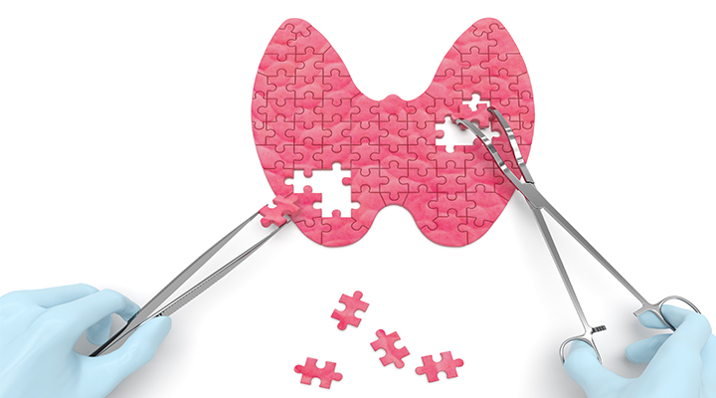
Thank you

