Slide 1

PARATHYROID AND CALCITONIN
Zhikal O. Khudhur
Endocrinology BIO 414
Spring Semester
Week number: 7
Date: 30/ 4/ 2026

Slide 2
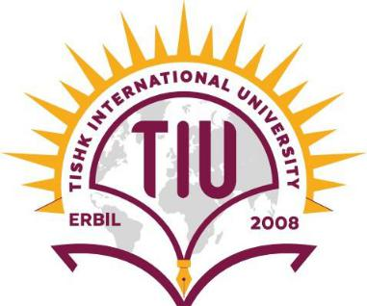
Objectives
Parathyroid glands
PTH target organs
PTH functions and regulations
Calcitonin functions
Mineral deposition and resorption
Calcium and phosphate homeostasis
Calcitriol synthesis
Calcitriol functions
Parathyroid hormone disorders

Slide 3
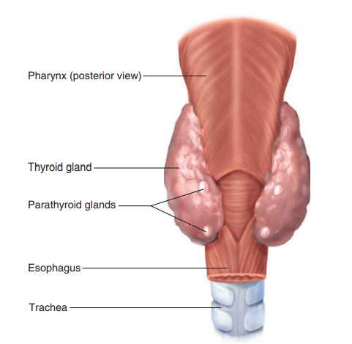
Parathyroid glands
The parathyroid glands are partially embedded in the posterior surface of the thyroid gland.
There are four parathyroid glands, two on the back of each lobe of the thyroid gland.
The hormone they produce is called parathyroid hormone (PTH).

Slide 4
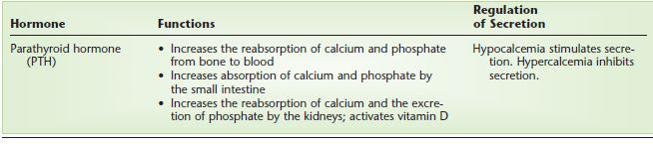
PTH functions and target organs
PTH is important for the maintenance of normal blood levels of calcium and phosphate.
The target organs of PTH are the bones, small intestine, and kidneys.

Slide 5
PTH regulation and functions
PTH secretion is inhibited by hypercalcemia. a high blood calcium level.
Secretion of PTH is stimulated by hypocalcemia, a low blood calcium level.
PTH raises the blood calcium level by:
PTH increases the reabsorption of calcium and phosphate from bones to the blood.
The absorption of calcium and phosphate from food in the small intestine, which also requires vitamin D, is increased by PTH. This too raises the blood levels of these minerals.
In the kidneys, PTH stimulates the activation of vitamin D and increases the reabsorption of calcium and the excretion of phosphate.

Slide 6
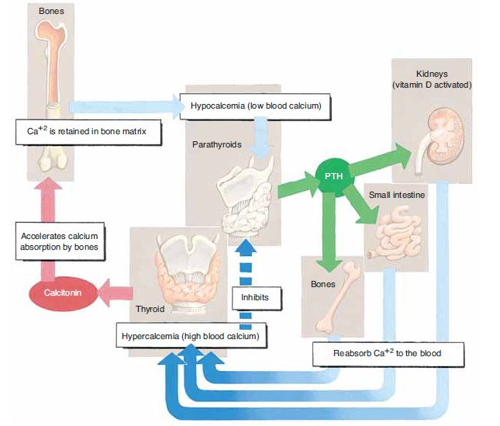
PTH and calcitonin functions
Therefore, the overall effect of PTH is to raise the blood calcium level and lower the blood phosphate level.
The antagonistic effects of PTH and calcitonin. Together, these hormones maintain blood calcium within a normal range.

Slide 7
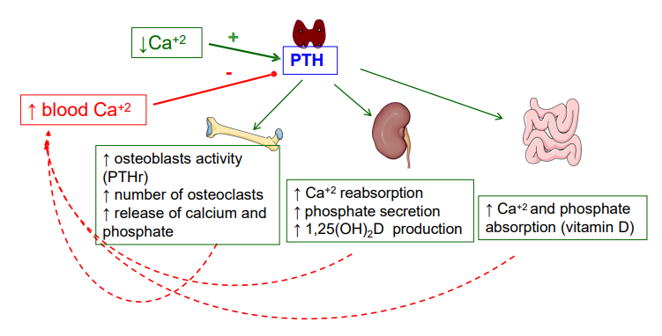
Regulation of calcium by PTH

Slide 8
Mineral deposition and resorption
Mineral deposition (mineralization) is a crystallization process in which calcium and phosphate ions, among others, are taken from the blood plasma and deposited in bone tissue. It begins in fetal ossification and continues throughout life.
Mineral resorption is the process of dissolving bone. It releases minerals into the blood and makes them available for other uses. Resorption is carried out by osteoclasts. Hydrogen pumps in the ruffled border of the osteoclast secrete hydrogen ions into the extracellular fluid, and chloride ions follow by electrical attraction. The space between the osteoclast and the bone thus becomes filled with concentrated hydrochloric acid with a pH of about 4. The acid dissolves the bone minerals. The osteoclast also secretes an enzyme called acid phosphatase that digests the collagen of the bone matrix. Acid phosphatase is named for its ability to function in this highly acidic environment.

Slide 9


Slide 10
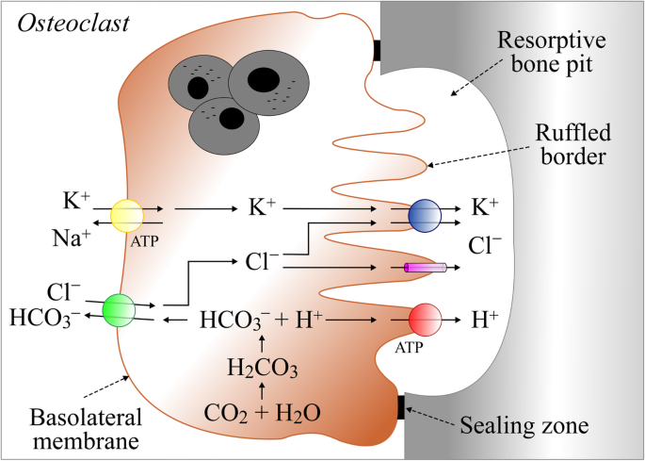
Mineral resorption

Slide 11
Mineral resorption by osteoclast
Osteoclast attaches to bone It forms a tight sealing zone, making a closed space between the cell and bone.
Ruffled border forms The membrane near the bone becomes folded. This increases surface area for secretion.
CO₂ + H₂O form carbonic acid Inside the osteoclast: CO₂ + H₂O → H₂CO₃
Carbonic acid separates H₂CO₃ → H⁺ + HCO₃⁻
H⁺ is pumped into the bone pit Proton pumps use ATP to send H⁺ into the sealed space.
Chloride also enters the pit Cl⁻ moves into the space with H⁺, forming an acidic environment.
Acid dissolves bone minerals The acid dissolves calcium phosphate/mineral part of bone.
Bicarbonate leaves the cell HCO₃⁻ exits through the basolateral membrane in exchange for Cl⁻.

Slide 12
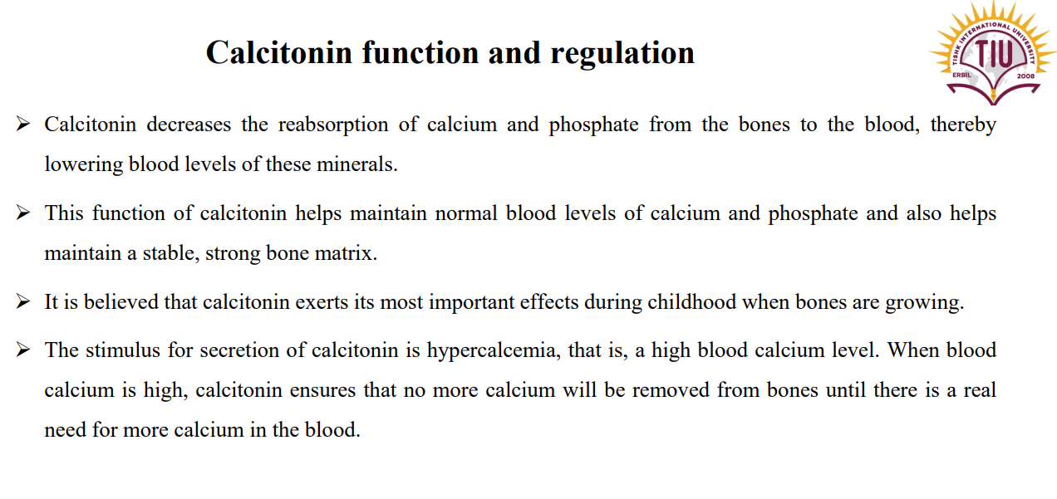

Slide 13
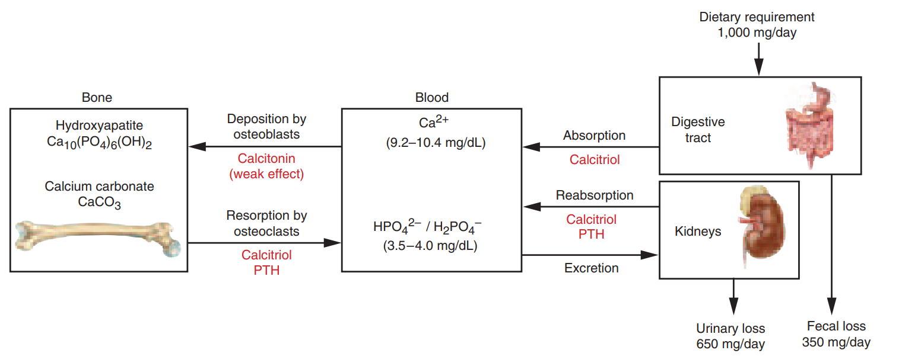
Calcium and phosphate homeostasis
Calcium and phosphate homeostasis depends on a balance between dietary intake, urinary and fecal losses, and exchanges with the osseous tissue.
Calcium and phosphate homeostasis is regulated by three hormones: calcitriol, calcitonin, and PTH.

Slide 14
Calcitriol synthesis
Calcitriol is a form of vitamin D produced by the sequential action of the skin, liver, and kidneys:
Epidermal keratinocytes use ultraviolet radiation from sunlight to convert a steroid, 7- dehydrocholesterol to vitamin D3, and a transport protein carries this to the bloodstream.
The liver adds a hydroxyl group to the molecule, converting it to calcidiol [25(OH)D].
The kidney then adds another hydroxyl group, converting calcidiol to calcitriol [1, 25(OH)2D], the most active form of vitamin D.

Slide 15
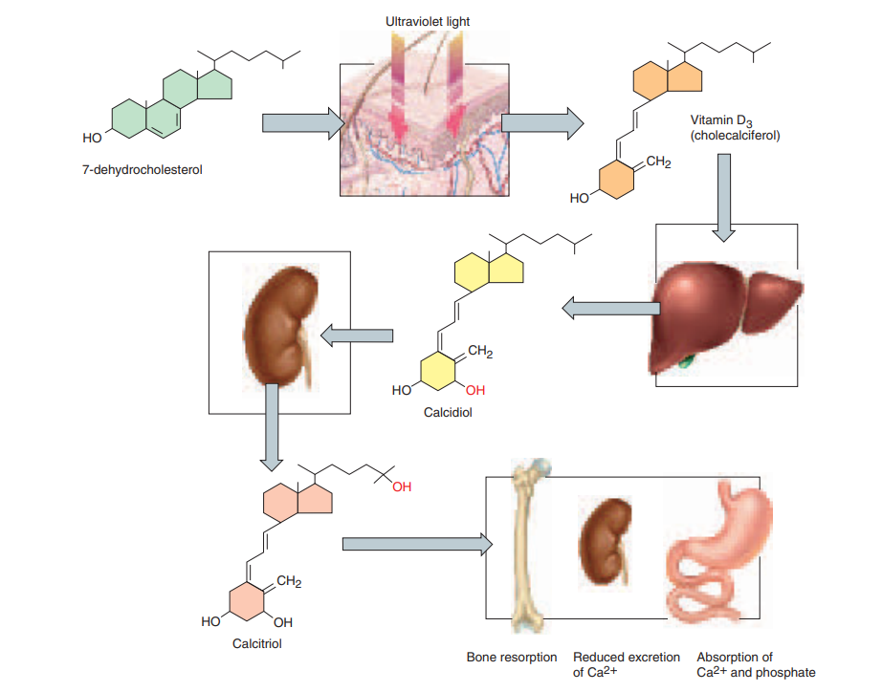
Calcitriol synthesis

Slide 16
Calcitriol function
The principal function of calcitriol is to raise the blood calcium concentration. It does this by three mechanisms:
Increasing calcium and phosphate resorption from the skeleton
Promoting the reabsorption of calcium ions by the kidneys, so less calcium lose in the urine.
Increasing calcium absorption by the small intestine. (It increases the absorption of phosphate and magnesium ions as well)

Slide 17
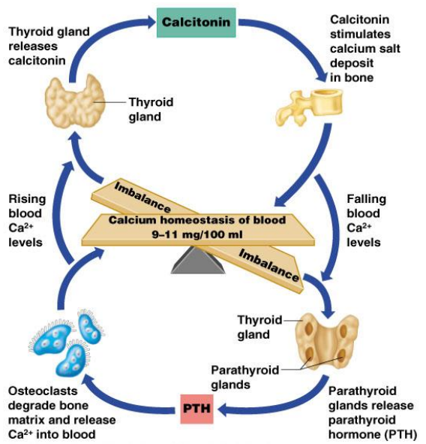
Blood calcium homeostasis
Thyroid gland releases calcitonin when the blood calcium is high.
Parathyroid gland releases PTH when the blood calcium is low.

Slide 18
Parathyroid hormone disorders
A. Hypoparathyroidism
Hypoparathyroidism is an uncommon condition in which body produces abnormally low levels of PTH
It leads to the formation of hypocalcemia
B. Hyperparathyroidism
Hyperparathyroidism is where the parathyroid glands produce too much PTH.
Hyperparathyroidism leads to the formation of hypercalcemia.
Types of hyperparathyroidism
1. Primary hyperparathyroidism
is caused by parathyroid adenoma or rarely by cancer.
The patient will have high PTH, and high calcium level.

Slide 19
Parathyroid hormone disorders
2. Secondary hyperparathyroidism
is due to chronic renal failure where the patient has low calcium and high phosphate.
Now parathyroid glands persistently produce PTH to maintain calcium level.
These patients have high PTH and low or normal calcium
3. Tertiary hyperparathyroidism
Tertiary hyperparathyroidism is characterized by excessive secretion of PTH after longstanding secondary hyperparathyroidism, in which hypercalcemia has ensued
These patients have high PTH and high calcium levels.

Slide 20
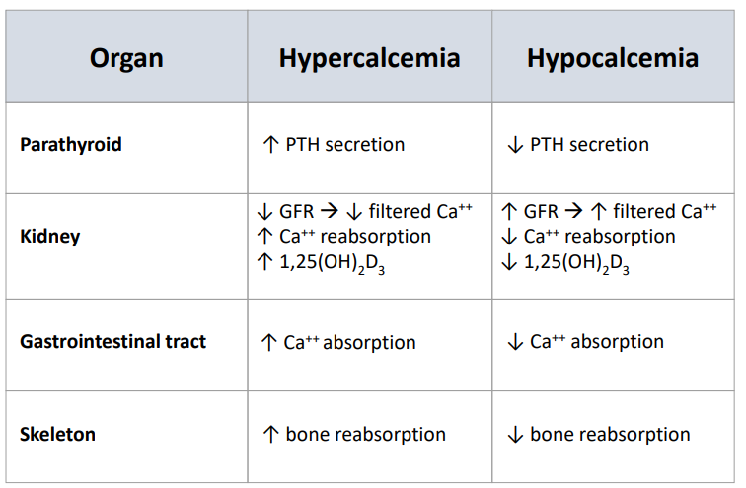
Differences between hypercalcemia and hypocalcemia

Slide 21
Calcium (Ca²⁺) Functions:
Bone and teeth formation (major component of hydroxyapatite)
Muscle contraction
Nerve impulse transmission
Blood clotting
Enzyme activation
Cell signaling

Slide 22
Phosphate (PO₄³⁻) Functions:
Bone and teeth structure (with calcium)
Energy metabolism (part of ATP)
Buffering blood pH (acid-base balance)
Cell membrane structure (phospholipids)
Nucleic acids (DNA & RNA synthesis)

Slide 23
References
Greenstein B. & Wood D. F. (2011). The endocrine system at a glance (3rd ed.). Wiley-Blackwell
Melmed S. Auchus R. J. Goldfine A. B. Koenig R. Rosen C. J. & Williams R. H. (2020). Williams textbook of endocrinology (14th ed.). Elsevier. Boron W. F. & Boulpaep E. L. (2021).
Boron & boulpaep concise medical physiology. Elsevier. Barrett K. E. Barman S. M. Yuan J. X.-J. & Brooks H. (2019).
Ganong's review of medical physiology (review questions) (26th ed.). McGraw-Hill Education LLC Molina P. E. (2018). Endocrine physiology (Fifth). McGraw-Hill Education.

Slide 24
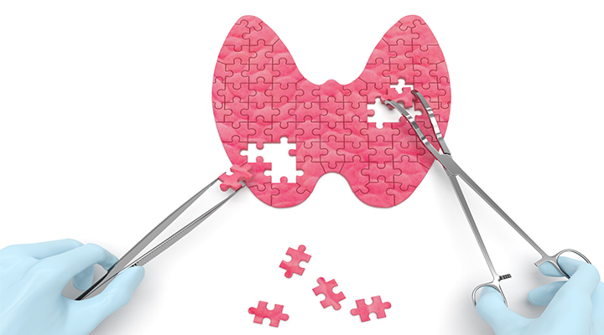
Thank you

