Slide 1
Diabetes mellitus and its reversibility
Assist Prof Yaseen Galali

Slide 2
Outline!
What is diabetes
Classification of diabetes
Symptoms and global impact
Reversing diabetes

Slide 3
What is diabetes?
Diabetes results from reduced production of the hormone insulin, resistance of body tissues to the effect of insulin,
or both.
The result is abnormally high levels of glucose in the blood and widespread disturbances to metabolism.

Slide 4
History
30-90AD: Diabetes named by Greek Physician Aretaeus: means ‘a flowing through’ to describe its constant thirst, excessive urination and weight loss
Japanese name: 'Shoukachi', the thirst disease
1600s: Professor Thomas Willis of Oxford University describes urine in diabetes mellitus as ‘wonderfully sweet’, distinguishing it from diabetes insipidus (vasopressin)
1889: Oskar Minkowski and Joseph von Mering of University of Strasbourg remove a dog’s pancreas - it produces diabetes
1921: Banting & Best isolate insulin, successfully treats a patient, transforming diabetes to a treatable, chronic condition

Slide 5
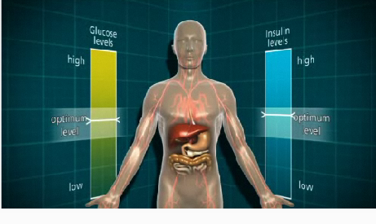
The Healthy Body
1. Glucose, produced from carbohydrates, released into bloodstream
2. The pancreas produces insulin, also released into the bloodstream
3. Insulin triggers liver to take up glucose and turn into glycogen
4. Insulin enables cells to take up glucose

Slide 6
Classifying glucose regulation
“Healthy” | “Diabetic”
Normoglycaemia (low risk of diabetes/CVD) FPG: ≤ 6.0 mmol/l | Impaired glucose regulation (higher risk of diabetes/ CVD) FPG: >6 to <7mmol/l | Diabetic (high risk of CVD) FPG: 7.0 + mmol/l
Risk
Low risk
Glucose levels
Diabetes

Slide 7
Classification
The WHO recognises several types of diabetes
    Type 1
    Type 2
    Gestational diabetes
    Other types

Slide 8
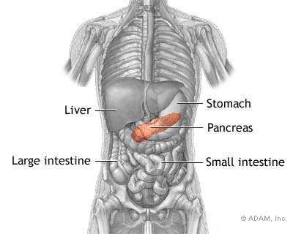
I. Type 1 Diabetes
Accounts for ~15% of diabetes in
the UK
Mainly diagnosed in children/young adults
Characterised by insulin deficiency
Symptoms develop quickly
The pancreas unable to produce insulin
8

Slide 9
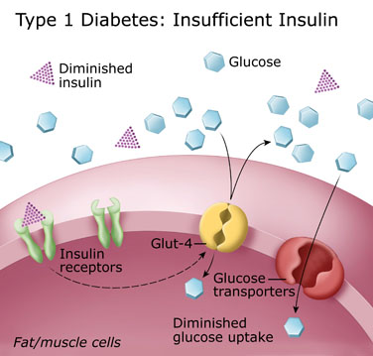
In type 1 diabetes, no insulin is available so cells are unable to take in glucose

Slide 10
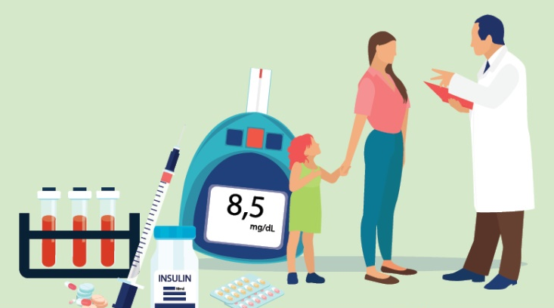

Symptoms of type 1 diabetes
  Frequent and excessive urination
  Thirst
  Dehydration
  Tiredness
  Urinary or genital tract [e.g thrush] infections
  Blurred vision
  Can progress to ketoacidotic coma

Slide 11
Type 2 diabetes
Characterised by insulin resistance, though may also have deficiency
Similar acute symptoms to type 1
Compared with type 1, often develops gradually
Some have no symptoms at diagnosis
Milder forms: can be controlled by diet and exercise
Accounts for ~85% of diabetes
Mainly diagnosed in older adults (after age of 40) though increasingly seen in younger age groups too

Slide 12
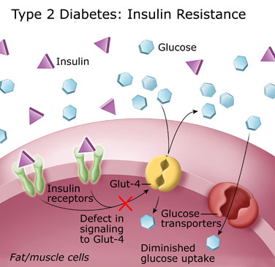
II. Type 2 diabetes
Fat deposits affect cells’ insulin (i) sensitivity.
They are less able to take in glucose (g)
Notes:
Type 2 diabetes is the most common form of diabetes mellitus and is characterised by resistance to insulin. In type 2 diabetes, the body can still produce insulin to varying extents. However, in most cases of type 2 diabetes, insulin can no longer work as effectively to allow glucose into cells because of fat deposits in the cells. So, glucose levels in the blood remain high. This triggers the pancreas to work even harder to produce more insulin to reduce glucose. Eventually the pancreas is unable to produce more insulin and stops working.

Slide 13
III. Gestational diabetes
Excess blood glucose during pregnancy (both diabetes mellitus and impaired glucose regulation)
Increased risk of diabetes related complications in pregnancy
Health consequences for the baby include increased risk of
      birth complications: caesarean sections; still births and perinatal deaths
      very high birth weight babies
      birth defects
      obesity and diabetes in the child.
For the mother:
      increased long term risk of type 2 diabetes (30% as opposed to 10% in the general population)
      higher risk of diabetes-related complications in
      subsequent pregnancies

Slide 14
Long term impact of diabetes
Diabetes is an important cause of death and disability
Retinopathy
Common cause of
blindness in people
of working age in West
Macrovascular
2–4 x increased risk
of CVD, 75% have hypertension
Nephropathy
Foot Problems
15% develop
foot ulcers; 5–15% need
amputation
Erectile Dysfunction
May affect up to 50%

Slide 15
IV. Other types
Maturity-Onset Diabetes of the Young (MODY)?
MODY usually shows up when you're an adolescent or young adult. It's caused by changes in genes, called mutations, that affect how well your body makes insulin, a hormone that helps your body use sugar for energy

Slide 16
Latent Autoimmune Diabetes in Adults (LADA)?
LADA its unofficial name -- "type 1.5 diabetes." Like type 1 diabetes.
LADA happens because your body makes antibodies that cause the immune system -- your body's defense against germs -- to attack the insulin-making cells of your pancreas.
As the ability to make insulin is lost, your body can no longer control blood sugar levels. Unlike type 1 diabetes, your symptoms get worse slowly and you may not need treatment for many months or years after diagnosis.
Starts after age 30 and diagnosed if DM medication is not working.
Life style and eating behavior is recommended. In certain cases shooting is needed.

Slide 17
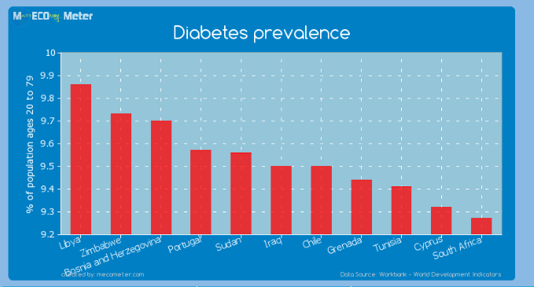
Prevalence of DM in Iraq

Slide 18
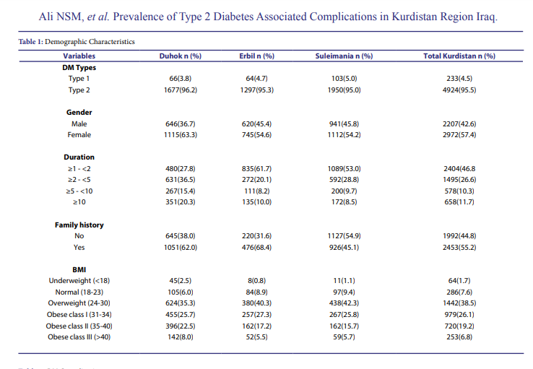

Slide 19
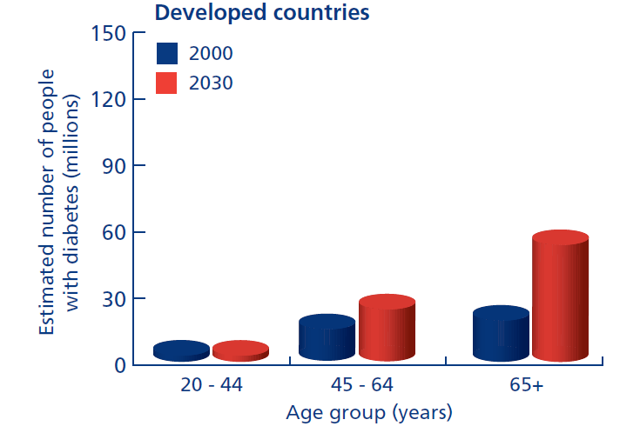
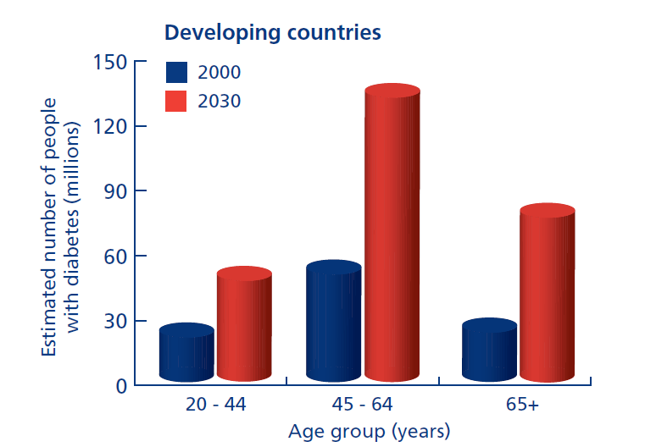
Prevalence of diabetes
WB25
Global impact
Diabetes accounts for estimated 5.2% all world mortality
80% deaths occur in low & middle income countries
Prevalence increasing fastest in these countries
19
LTPHN/JS © 2010

Slide 20
Relative risks of type 2 diabetes
Non-Modifiable (Population factors)
      Family history;
      Age;
      Socioeconomic circumstances
Modifiable risk factors
      Obesity;
      Exercise;
      Smoking

Slide 21
Physical activity, obesity and the risk of diabetes

Slide 22
Age
Prevalence of doctor-diagnosed diabetes, by age
22
LTPHN/JS © 2010

Slide 23
Preventing diabetes
Type 2 diabetes is preventable
Complications of diabetes can be avoidable
Interventions aim to:
  Encourage healthy eating and Bette life style (regular exercise and quit smoking)
  Reduce blood pressure, cholesterol and improve glucose regulation

Slide 24
Can diabetes be reversed?
The recent 2016 World Health Organization (WHO) global report on diabetes added a section on diabetes reversal and acknowledged that it can be achieved through weight loss and calorie restriction.
Reversing means type 2 diabetes that is able to get their HbA1c below (6%) without taking diabetes medication.

Slide 25
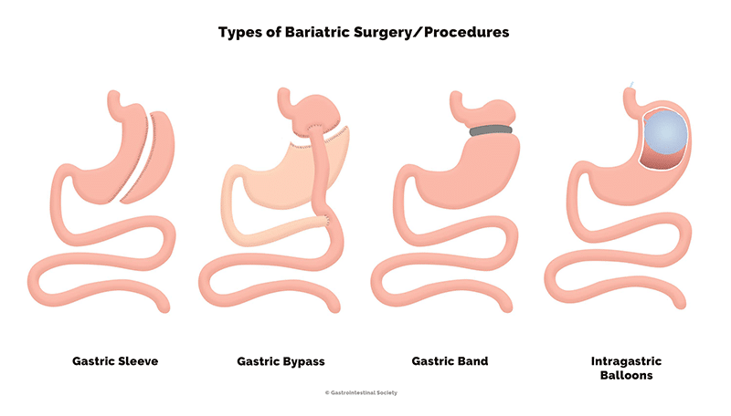
Suggested reversal techniques
This type of surgery helps you lose weight by changing your stomach and digestive system to limit how much you can eat. Aside from helping you lose weight, it may help reverse diabetes through affecting the hormones in your gut to help your body control blood glucose.

Slide 26
Researchers estimate that upwards of three-quarters of people see their diabetes reversed after bariatric surgery. Gastric bypass and gastric sleeve (also called sleeve gastrectomy) surgery have better long-term results than gastric banding.
But side-effects should be considered

Slide 27


Low carb Diet (LC)
it is aim to reduce carb to les than 130 gram
Several studies in England have looked at the effects of a low carb diet on diabetes.
Studies found that nearly half the people who took part reversed their diabetes and kept their blood glucose near the normal range for at least 6 months to a year.

Slide 28
Low-Calorie Diets (LCD)
It is aim to reduce carbohydrate to 20 to 30 gram.
Examples like ketogenic diet.
A handful of studies have reported successful weight loss with decreased insulin resistance, plasma glucose, and medication use following a LCD

Slide 29
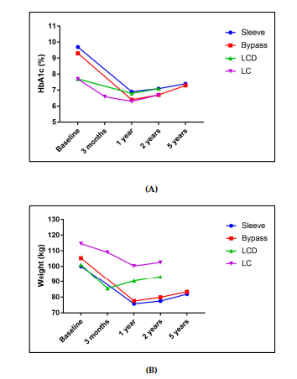
Effectiveness

Slide 30


