Slide 1

Tishk International University
Intro to IT course
Fall 2025-2026
Introduction to Computers
Ms.Yara Arjuman Hashim
Email: yara.arjuman@tiu.edu.iq
Office number: Education Building- 220

Slide 2
Outline
Functions of a Computer
Advantages
Disadvantages
Applications

Slide 3

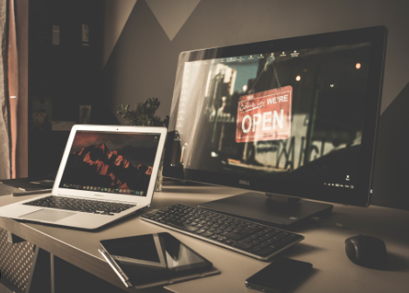
What is computer?
A computer is an electronic device that manipulates information or data. It can store, retrieve, and process data.

Slide 4
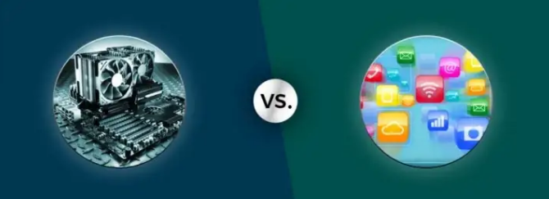
Basic Components
Hardware
Software

Slide 5
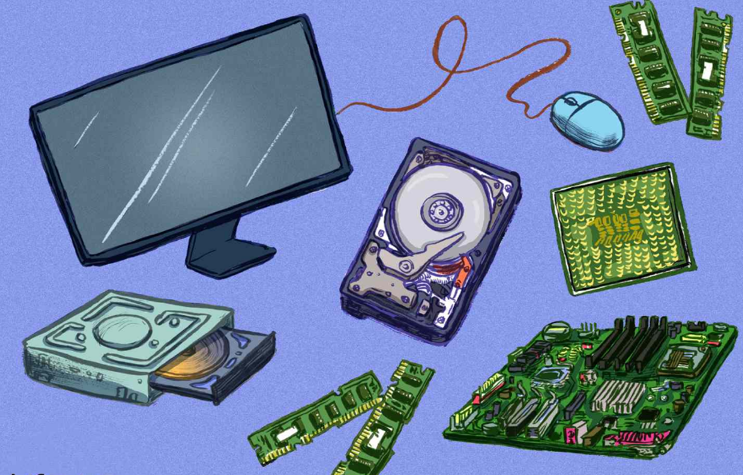
Hardware
Computer hardware is the physical components that a computer system requires to function.
It encompasses everything with a circuit board that operates within a PC or laptop, including the motherboard, graphics card, CPU (Central Processing Unit), ventilation fans, webcam, power supply, and so on.

Slide 6
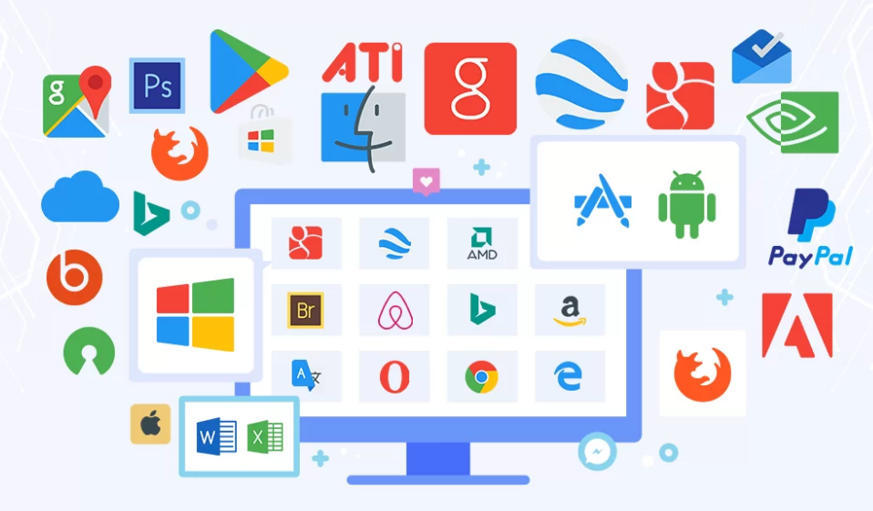
Software
Software is a set of instructions, data, or programs used to operate computers and execute specific tasks.

Slide 7
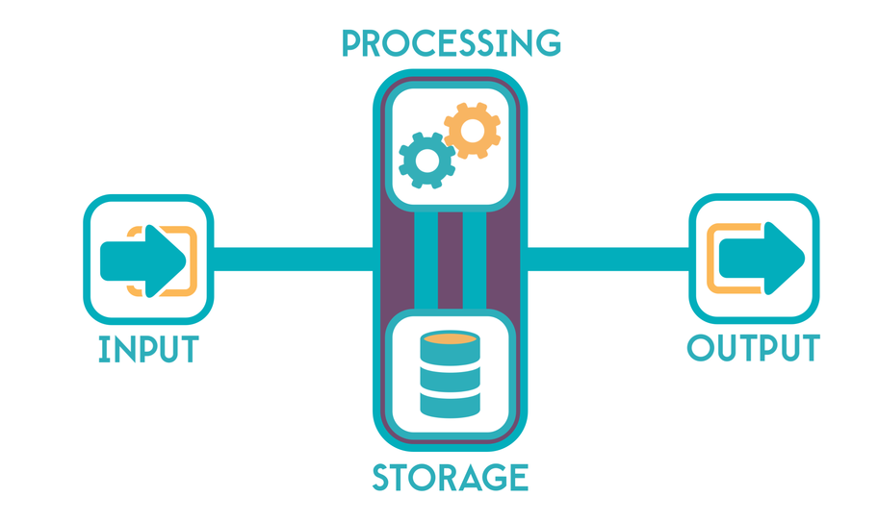
Fundamentals of Computer

Slide 8
Fundamentals of Computer
If we look at it in a very broad sense, any digital computer carries out the following five functions:
Step 1 - Takes data as input.
Step 2 - Stores the data/instructions in its memory and uses them as required.
Step 3 - Processes the data and converts it into useful information.
Step 4 - Generates the output.
Step 5 - Controls all the above four steps.

Slide 9
Advantages (Speed)
High Speed
Computer is a very fast device.
It can perform calculation of very large amount of data.
The computer has units of speed in microsecond, nanosecond, and even the picoseconds.
It can perform millions of calculations in a few seconds as compared to a man who will spend many months to perform the same task.

Slide 10
Advantages Accuracy
Accuracy
In addition to being very fast, computers are very accurate.
The calculations are 100% error free.
Computers perform all jobs with 100% accuracy provided that the input is correct.

Slide 11
Advantages (Storage Capability)
Storage Capability
Memory is a very important characteristic of computers.
A computer has much more storage capacity than human beings.
It can store large amount of data.
It can store any type of data such as images, videos, text, audio, etc.

Slide 12
Advantages (Diligence)
Diligence
Unlike human beings, a computer is free from monotony, tiredness, and lack of concentration.
It can work continuously without any error and boredom.
It can perform repeated tasks with the same speed and accuracy.

Slide 13
Advantages (Versatility)
Versatility
A computer is a very versatile machine.
A computer is very flexible in performing the jobs to be done.
This machine can be used to solve the problems related to various fields.
At one instance, it may be solving a complex scientific problem and the very next moment it may be playing a card game.

Slide 14
Advantages (Reliability)
Reliability
A computer is a reliable machine.
Modern electronic components have long lives.
Computers are designed to make maintenance easy.

Slide 15
Advantages (Automation)
Automation
Computer is an automatic machine.
Automation is the ability to perform a given task automatically. Once the computer receives a program i.e., the program is stored in the computer memory, then the program and instruction can control the program execution without human interaction.

Slide 16
Advantages (Reduce work and cost)
Reduction in Paperwork and Cost
The use of computers for data processing in an organization leads to reduction in paperwork and results in speeding up the process.
As data in electronic files can be retrieved as and when required, the problem of maintenance of large number of paper files gets reduced.
Though the initial investment for installing a computer is high, it substantially reduces the cost of each of its transaction.

Slide 17
Disadvantages
A computer is a machine that has no intelligence to perform any task.
Each instruction has to be given to the computer.
A computer cannot make any decision on its own.
Dependency
It functions as per the user’s instruction, thus it is fully dependent on humans.

Slide 18
Disadvantages
Environment
The operating environment of the computer should be dust free and suitable.
No Feeling
Computers have no feelings or emotions.
It cannot make judgment based on feeling, taste, experience, and knowledge unlike humans.

Slide 19
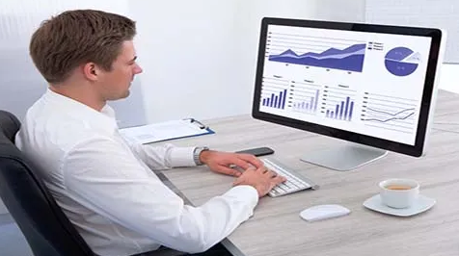
Applications
Business
A computer has high speed of calculation, diligence, accuracy, reliability, or versatility which has made it an integrated part in all business organizations.
Computer is used in business organizations for:
Payroll calculations
Budgeting
Sales analysis
Financial forecasting
Managing employee database
Maintenance of stocks, etc.

Slide 20
Applications
Banking
Today, banking is almost totally dependent on computers.
Banks provide the following facilities:
Online accounting facility, which includes checking current balance, making deposits and overdrafts, checking interest charges, shares, and trustee records.
ATM machines which are completely automated are making it even easier for customers to deal with banks.

Slide 21

Applications
Insurance
Insurance companies are keeping all records up-to-date with the help of computers. Insurance companies, finance houses, and stock broking firms are widely using computers for their concerns.
Insurance companies are maintaining a database of all clients with information showing:
Procedure to continue with policies
Starting date of the policies
Next due installment of a policy
Maturity date
Interests due
Survival benefits
Bonus

Slide 22
Applications
Education
The computer helps in providing a lot of facilities in the education system.
The computer provides a tool in the education system known as CBE (Computer Based
Education.
CBE involves control, delivery, and evaluation of learning.
Computer education is rapidly increasing the graph of the number of computer students.
There are several methods in which educational institutions can use a computer to educate the students.
It is used to prepare a database about the performance of a student, and analysis is carried out on this basis.

Slide 23


Applications
Marketing
Advertising - With computers, advertising professionals create art and graphics, write and revise copy, and print and disseminate ads with the goal of selling more products.
Home Shopping - Home shopping has been made possible through the use of computerized catalogues that provide access to product information and permit direct entry of orders to be filled by the customers.

Slide 24
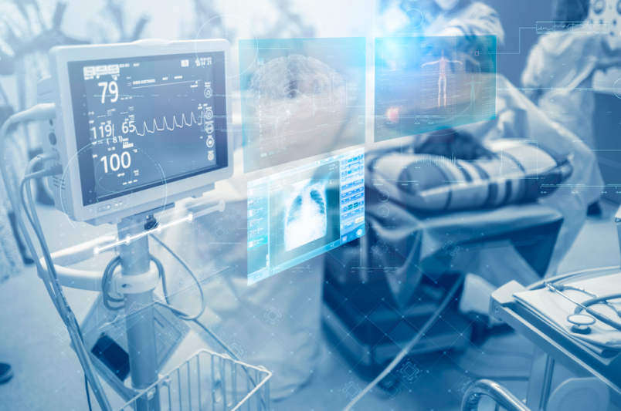
Applications
Healthcare
Computers have become an important part in hospitals, labs, and dispensaries. They are being used in hospitals to keep the record of patients and medicines. It is also used in scanning and diagnosing different diseases. ECG, EEG, ultrasounds and CT scans, etc. are also done by computerized machines.

Slide 25
Applications
Following are some major fields of health care in which computers are used:
Diagnostic System - Computers are used to collect data and identify the cause of illness.
Lab-diagnostic System - All tests can be done, and the reports are prepared by computer.
Patient Monitoring System - These are used to check the patient's signs for abnormality such as in Cardiac Arrest, ECG, etc.
Pharma Information System - Computer is used to check drug labels, expiry dates, harmful side effects, etc.
Surgery - Nowadays, computers are also used in performing surgery.

Slide 26
Applications
Engineering Design
Computers are widely used for Engineering purpose.
One of the major areas is CAD (Computer Aided Design) that provides creation and modification of images. Some of the fields are:
Structural Engineering - Requires stress and strain analysis for design of ships, buildings, budgets, airplanes, etc.
Industrial Engineering - Computers deal with design, implementation, and improvement of integrated systems of people, materials, and equipment.
Architectural Engineering - Computers help in planning towns, designing buildings, determining a range of buildings on a site using both 2D and 3D drawings.

Slide 27
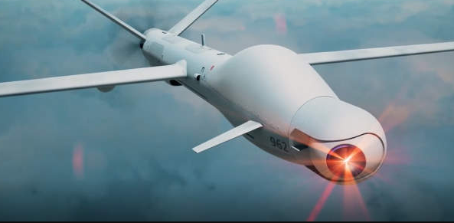
Applications
Military
Computers are largely used in defense. Modern tanks, missiles, weapons, etc. Military also employs computerized control systems. Some military areas where a computer has been used are:
Missile Control
Military Communication
Military Operation and Planning
Smart Weapons

Slide 28

Applications
Communication
Communication is a way to convey a message, an idea, a picture, or speech that is received and understood clearly and correctly by the person for whom it is meant. Some main areas in this category are:
E-mail
Chatting
FTP
Video-conferencing

Slide 29

Applications
Government
Computers play an important role in government services. Some major fields in this category are:
Budgets
Sales tax department
Income tax department
Computation of male/female ratio
Weather forecasting

Slide 30
References
Sipser, M. (2013). Introduction to the Theory of Computation. 3rd ed. Boston: Cengage Learning
Sedgewick, R. and Wayne, K. (2016). Computer Science: An Interdisciplinary Approach. 3rd ed. Boston: Addison-Wesley.

Slide 31
Any questions ?

