Slide 1

Tishk International University
Intro to IT course
Fall 2025-2026
History of Computer Generations
Ms.Yara Arjuman Hashim
Email: yara.arjuman@tiu.edu.iq
Office number: Education Building- 220

Slide 2
Outline
Generation
Generation & Description
First Generation Computers
Second Generation Computers
Third Generation Computers
Fourth Generation Computers
Fifth Generation Computers

Slide 3
Generation
Generation in computer terminology is a change in technology a computer is/was being used. Initially, the generation term was used to distinguish between varying hardware technologies. Nowadays, generation includes both hardware and software, which together make up an entire computer system.

Slide 4
Generation Description
No. | Generation & Description
First Generation | The period of first generation: 1946-1959. Vacuum tube based.
Second Generation | The period of second generation: 1959-1965. Transistor based.
Third Generation | The period of third generation: 1965-1971. Integrated Circuit based.
Fourth Generation | The period of fourth generation: 1971-1980. VLSI microprocessor based.
Fifth Generation | The period of fifth generation: 1980-onwards. ULSI microprocessor based.

Slide 5
A short video regarding the journey of computers in 5 different generations: https://youtube.com/shorts/3O6yHVw7wqA?si=dsYrj6w9kKQqSYiE

Slide 6
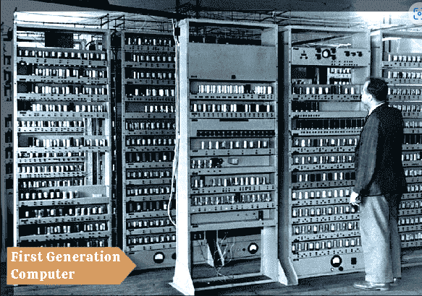
First Generation Computers

Slide 7
First Generation Computers
The period of first generation was from 1946-1959.
The computers of first generation used vacuum tubes as the basic components for memory and circuitry for CPU (Central Processing Unit).
These tubes, like electric bulbs, produced a lot of heat and the installations used to fuse frequently.
Therefore, they were very expensive, and only large organizations were able to afford it.

Slide 8
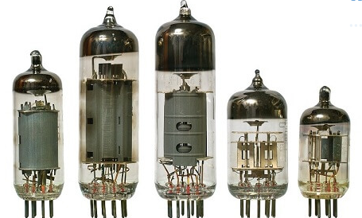
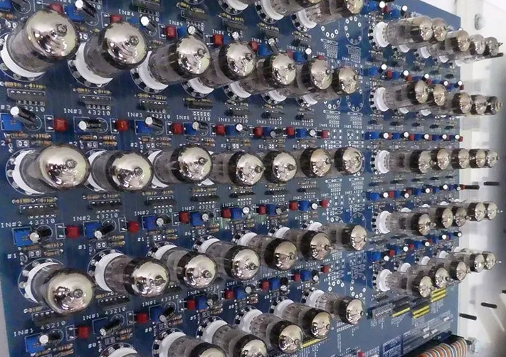
Vacuum tube

Slide 9
In this generation, mainly batch processing operating system was used.
Punch cards, paper tape, and magnetic tape was used as input and output devices.
The computers in this generation used machine code as the programming language.

Slide 10
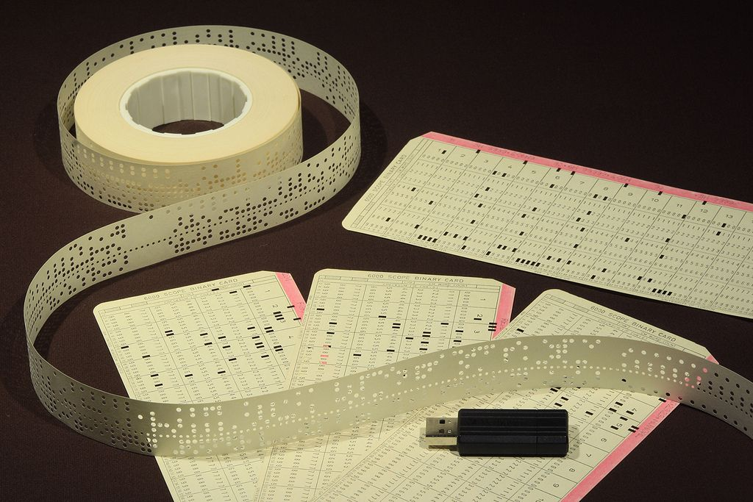
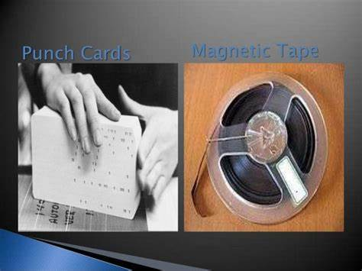
Punch cards and Magnetic Tape

Slide 11
The main features of the first generation
Vacuum tube technology
Unreliable and very costly
Supported machine language only
Generated a lot of heat and also, slow input and output devices
Huge size and need of AC (AC is an electric current that changes direction periodically)
Non-portable ( cannot easily be moved )
Consumed a lot of electricity

Slide 12
Some computers of this generation were:
ENIAC (Electronic Numerical Integrator and Computer)
EDVAC ( Electronic Discrete Variable Automatic Computer )
UNIVAC (Universal Automatic Computer)
IBM-701
IBM-650

Slide 13
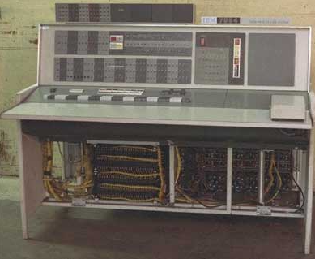
Second Generation Computers

Slide 14
Second Generation Computers
The period of second generation was from 1959-1965.
In this generation, transistors were used that were cheaper, consumed less power, more compact in size, more reliable and faster than the first-generation machines made of vacuum tubes.
In this generation, magnetic cores were used as the primary memory and magnetic tape and magnetic disks as secondary storage devices.
In this generation, assembly language and high-level programming languages like FORTRAN, COBOL were used. The computers used batch processing and multiprogramming operating system.

Slide 15
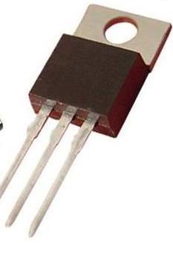
Transistor

Slide 16
The main features of second generation are:
Use of transistors
Reliable in comparison
Smaller size as compared
Generated less heat
Consumed less electricity
Faster than first generation computers
Still very costly and AC required (AC is an electric current that changes direction periodically)
Supported machine and assembly languages

Slide 17
Some computers of this generation
IBM 1620
IBM 7094
CDC 1604 (Control Data Corporation)
CDC 3600
UNIVAC 1108 ( Universal Automatic Computer )

Slide 18
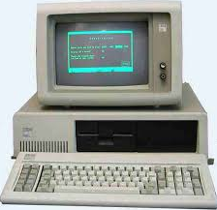
Third Generation Computers

Slide 19
Third Generation Computers
The period of third generation was from 1965-1971. The computers of third generation used Integrated Circuits (ICs) in place of transistors. A single IC has many transistors, resistors, and capacitors along with the associated circuitry.
The IC was invented by Jack Kilby. This development made computers smaller in size, reliable, and efficient. In this generation remote processing, time-sharing, multi-programming operating system were used. High-level languages (FORTRAN-II TO IV, COBOL, PASCAL PL/1, BASIC, ALGOL-68 etc.) were used during this generation.

Slide 20
The main features of third generation are:
IC used (Integrated Circuits)
More reliable in comparison to previous two generations
Smaller size and Faster
Generated less heat
Lesser maintenance
Costly and AC required. (AC is an electric current that changes direction periodically)
Consumed lesser electricity
Supported high-level language

Slide 21
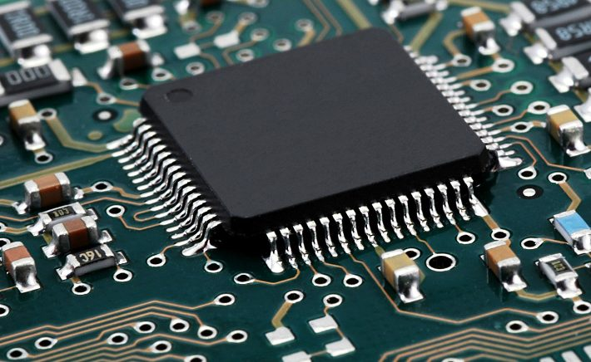
Integrated Circuit

Slide 22
Some computers of this generation
IBM-360 series
Honeywell-6000 series
PDP (Personal Data Processor)
IBM-370/168
TDC-316

Slide 23
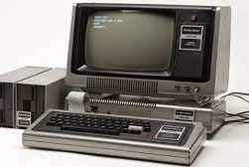
Fourth Generation Computers

Slide 24
Fourth Generation Computers
The period of fourth generation was from 1971-1980. Computers of fourth generation used Very Large Scale Integrated (VLSI) circuits. VLSI circuits having about 5000 transistors and other circuit elements with their associated circuits on a single chip made it possible to have microcomputers of fourth generation.
Fourth generation computers became more powerful, compact, reliable, and affordable. As a result, it gave rise to Personal Computer (PC) revolution. In this generation, time-sharing, real-time networks, distributed operating system were used. All the high-level languages like C, C++, DBASE etc., were used in this generation.

Slide 25
The main features of fourth generation
VLSI technology used (Very Large-Scale Integration)
Very cheap and Very small size
Portable and reliable
Use of PCs
Pipeline processing
No AC required (AC is an electric current that changes direction periodically)
Concept of internet was introduced
Great developments in the fields of networks
Computers became easily available

Slide 26
Some computers of this generation
DEC 10
STAR 1000
PDP 11
CRAY-1(Supercomputer)
CRAY-X-MP(Supercomputer)

Slide 27
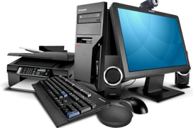
Fifth Generation Computers

Slide 28
Fifth Generation Computers
The period of fifth generation is 1980-till date. In the fifth generation, VLSI technology became ULSI (Ultra Large Scale Integration) technology, resulting in the production of microprocessor chips having ten million electronic components.
This generation is based on parallel processing hardware and AI (Artificial Intelligence) software. AI is an emerging branch in computer science, which interprets the means and method of making computers think like human beings. All the high-level languages like
C and C++, Java, .Net etc., are used in this generation.

Slide 29
AI Includes
Robotics
Neural Networks
Game Playing
Development of expert systems to make decisions in real-life situations
Natural language understanding and generation

Slide 30
The main features of fifth generation
ULSI technology (Ultra Large-Scale Integration)
Development of true artificial intelligence
Development of Natural language processing
Advancement in Parallel Processing
Advancement in Superconductor technology
More user-friendly interfaces with multimedia features
Availability of very powerful and compact computers at cheaper rates

Slide 31
Some computer types of this generation
Desktop
Laptop
NoteBook
Ultrabook
Chromebook

Slide 32

References
Ceruzzi, P.E. (2003) A History of Modern Computing. 2nd ed. Cambridge, MA: MIT Press.
Campbell-Kelly, M. and Aspray, W. (2004) Computer: A History of the Information Machine. 3rd ed. New York: Basic Books.

Slide 33
Any questions ?

