Slide 1
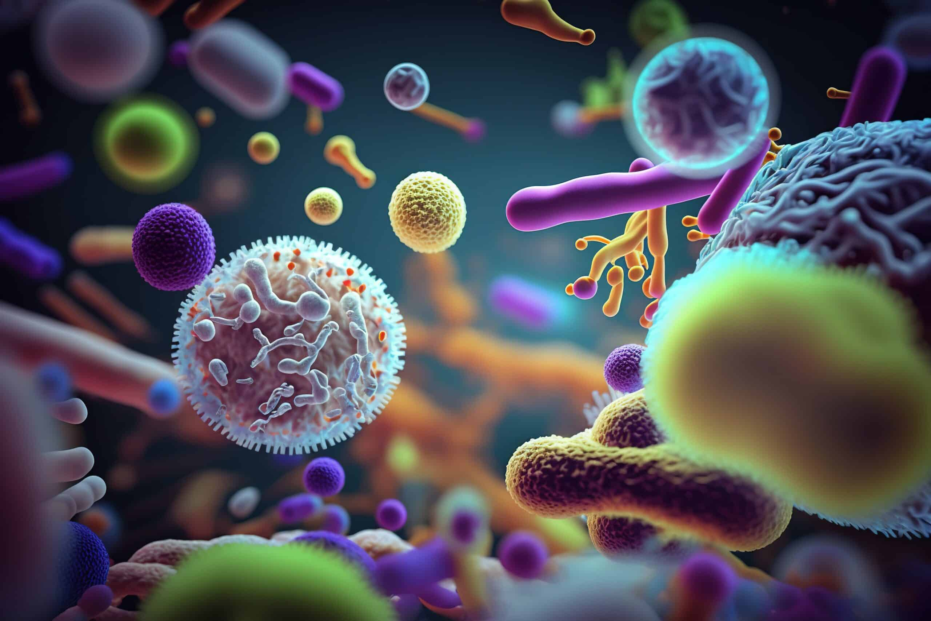

Vibrio Cholera
Ms. Heshu J. Ahmed
PhD Candidate
Medical Bacteriology 423
Spring Semester
Week Nine

Slide 2
Outline
Introduction to Vibrio
Characteristics of Vibrio cholerae
Pathogenesis of Cholera
Clinical Manifestations
Treatment of Cholera

Slide 3
Objectives
Understand the characteristics of Vibrio bacteria.
Learn about the specific features and pathogenicity of Vibrio cholerae.
Explore the pathogenesis of cholera.
Identify the clinical manifestations of cholera.
Discuss the treatment strategies for cholera.

Slide 4
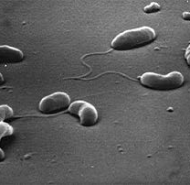
Characteristics of Vibrio
Curved, gram-negative rods.
Commonly found in saltwater.
Cells may link end to end, forming S shapes and spirals.
Highly motile with a single polar flagellum.
Non-spore-forming and oxidase-positive.
Can grow under aerobic or anaerobic conditions.
Cell envelope structure similar to other gram-negative bacteria.

Slide 5
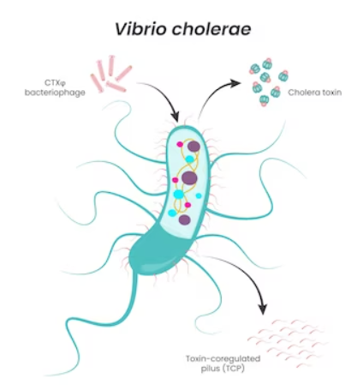
Vibrio cholerae
Low tolerance for acid.
Grows readily under alkaline conditions (pH 8.0-9.5).
Produces cholera toxin (CT).
  A–B type ADP-ribosylating toxin.
  Consists of multiple polypeptide chains.
Produces polysaccharide biofilms in aquatic environments.

Slide 6
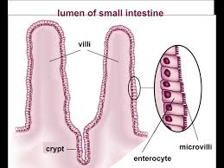
Pathogenesis
V. cholerae reaches the small intestine, swims to the intestinal crypts, multiplies, and produces virulence factors.
Large number of bacteria is required to overcome stomach acid in healthy individuals.
Colonization requires adherence to the epithelial surface via protein and pili.
Virulent strains secrete cholera toxin (CT), causing the disease.

Slide 7
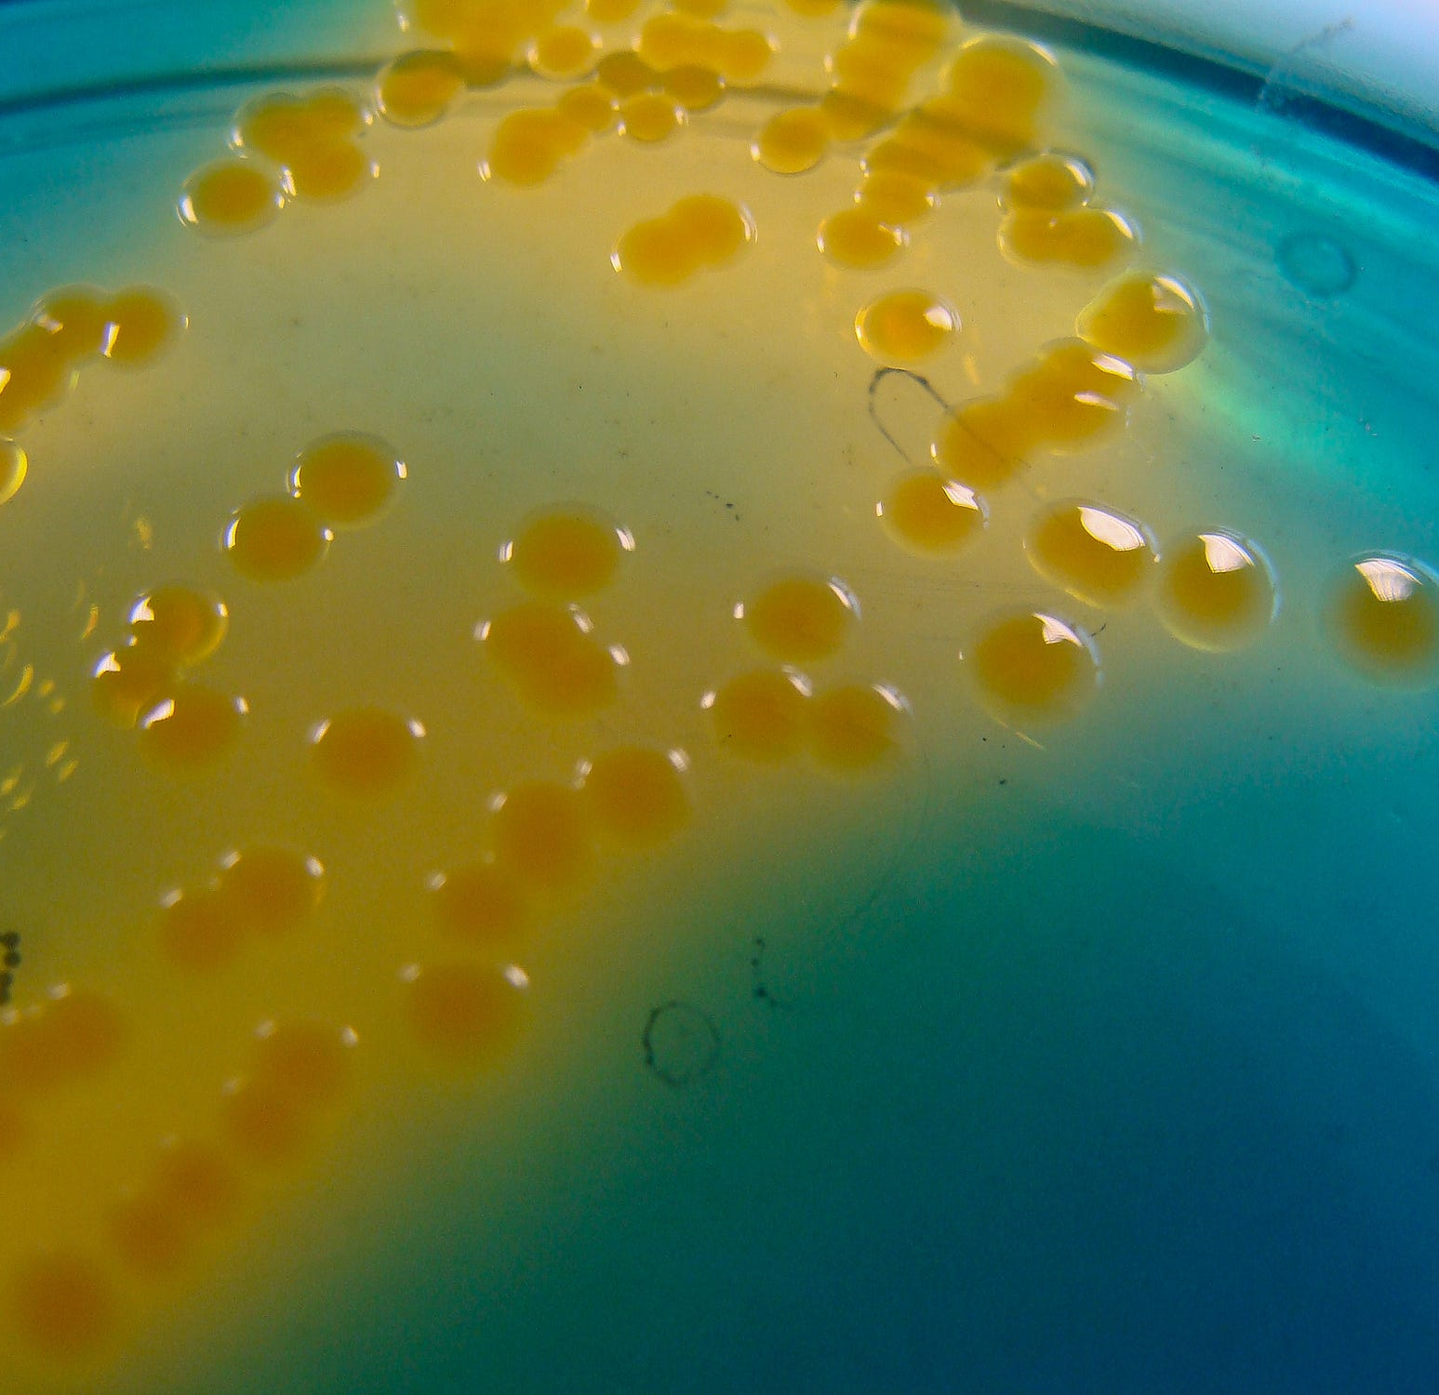
Pathogenesis
Water and electrolyte shift to the intestinal lumen causes watery diarrhea.
Results in dehydration (isotonic fluid loss), hypokalemia (potassium loss), and metabolic acidosis (bicarbonate loss).
V. cholerae does not invade or injure the enterocyte.

Slide 8

Manifestation
Rapid onset with abdominal fullness and discomfort.
Rushes of peristalsis and loose stools.
Possible vomiting.
Stools become watery, voluminous, almost odorless, and contain mucus flecks (rice-water stools).
Extensive fluid loss and electrolyte imbalance lead to:
  Extreme dehydration.
  Hypotension.
  Potential death within hours if untreated.

Slide 9

Treatment
Balance diarrheal fluid and ionic losses with fluid and electrolyte replacement.
Use oral and/or intravenous solutions of glucose
Exact formulas available as dried packets for reconstitution with water.
Oral replacement is sufficient for most cases if started early.
Substantially reduces mortality from cholera.
Optimal therapy: single dose of azithromycin

Slide 10
References
Sherris Medical Microbiology: An Introduction to Infectious Diseases.
Jawetz, Melnick & Adelberg's Medical Microbiology by Geo. F. Brooks, Karen C. Carroll, and Janet S. Butel
Prescott's Microbiology by Joanne Willey, Linda Sherwood, and Christopher J. Woolverton

