Slide 1

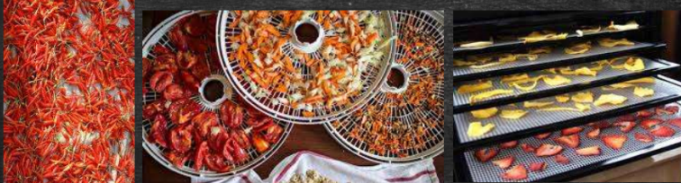

Department of Nutrition and dietetics
Canning
Yaseen Galali
Notes:
.

Slide 2
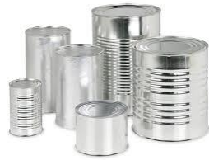
Canning
Food materials processed and packed in air tight containers are known as canned foods.
Various containers like wrought iron, tin and glass vessels are popularly used in canning.
Glass jars are popular in some high value product in home canning.

Slide 3
BENEFITS OF CANNED FOOD
1-Long shelf life
2- Convenient and affordable
4-Safety

Slide 4
Canning involves four steps
1-Preparation of Equipment :
Preheated canns and jars are preheated so that microbes present in jar may get killed’
Preparation can be done in two ways:
Boiling waterbath :- during boiling water bath 1-2 inches of water should be above the top of the jars.

Slide 5
Pressure canner :- 2-3 inches of water is must in the bottom of the canner.
2-Preparation of food materials:
Washing
Rinsing
Soaking is avoided due to loss of flavour and nutrients of food

Slide 6
Packing of food materials:
Packed raw or preheated
Hot pack gives better color and flavour particularly when foods are processed in a boiling water.
Around solid food in the jar should always be enough liquid.
Closing of jar:-
Run a bubble freer or any plastic knife like utensil around the edges of the jar, to release any air bubble.

Slide 7
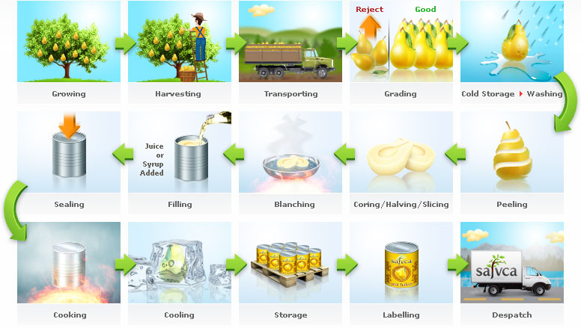

Slide 8
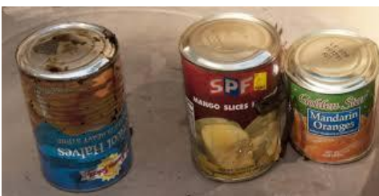
SPOILAGE OF CANNED FOOD
The safety of canned foods is generally of main concern to government.
In U.S, processing allowed survival of C. botulinum spores for 33 years in canned foods.
Spoilage of canned foods can be detected on the basis:
of various signs:- 1-Soft swell 2-Hard swell 3- Flipper 4-Springer
5- Leaker

Slide 9
Factors affecting microbial growth in food:-
Intrinsic factors:- includes
pH, moisture content, water activity, physical structure of food, available nutrients, presence of natural antimicrobial agents, etc.
Extrinsic factors :- involves
temperature, humidity, gases types and number of microbes present in food.

Slide 10
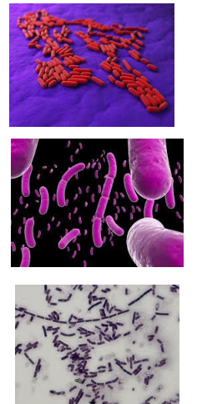
Microbes associated with spoilage :-
A- Spore-Forming Bacteria
1-Obligate Aerobes:-
Bacillus subtilis
Bacillus mycoides
2-Facultative Anaerobes:-
Bacillus stearothermophilus
Bacillus macerans
Bacillus polymyxa
Bacillus coagulans

Slide 11
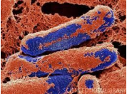
3-Obligate Anaerobes :-
C. Botulinum
C. Histalyticum
C. bifermentans
C. Sporogenes
C. Pasteurianum
C. butyricum

Slide 12
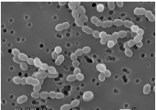
Non-Spore-Bearing Bacteria, Yeasts, and Molds:-
Lactobacillus
Leuconostoc spp.

Slide 13
DISEASES CAUSED
Botulism:- caused by Clostridium botulinum . Canned food infected with this disease are canned asparagus, green beans, garlic in oil, corn, soups, ripe olives, tuna fish, sausage, luncheon meats, fermented meats, salad dressings, and smoked fish containers.

Slide 14
Diarrohea:- causative agent is E.coli. This disease commonly occurs in canned sea foods like abalone, crawfish, Dungeness crab, fish sticks, halibut, octopus, etc.
Albuminuria :- It is a kidney problem in which filteration capacity of kidney reduces. BPA (Bisphenol A) which is used in the can lining can cause oxidative stress to kidney tissues .

Slide 15
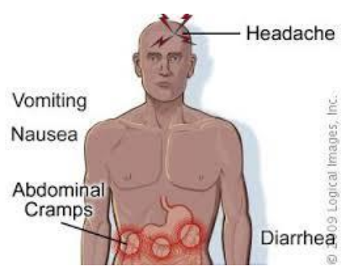
Gastroenteritis :- Causative agent responsible for this is Campylobacter jejuni and C. perfringens. Symptoms associated with gastroenteritis are diarrhea, high fever, severe inflammation of the intestine along with ulceration, and bloody stools.
Cholera :- It is caused by Vibrio cholerae . Cholera transmission through food can be eliminated by cooking the food at 700C .

Slide 16
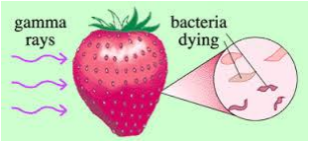
PRESERVATION
Improving canning processes :- High and low temperature treatment for better sterlization. Pasteurization, water bath boiling, pressure canning are used in accordance with the nature of food materials.
Radiation :- Ultraviolet radiations is used to control populations of microorganisms . Radappertization is a process in which sterlization is done through electromagnetic radiations which produce peroxides from water in microbial cells.

Slide 17
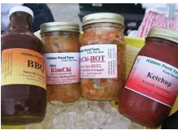
Chemical based preservatives :- Simple organic acids, sulfite, ethyleneoxide, sodium nitrite and ethyl formate are various chemicals categorised as GRAS (generally regarded as safe) by Food and Drug administration. These chemical agents affect microorganisms by disrupting a critical cell factor like protein, nucleic acid, plasma membrane, cell reproduction, etc .

Slide 18
Nutritional aspects of Canned
Fruits and vegetables used for canning are picked at peak freshness, ensuring the best flavor and nutrient quality.
Canned foods can be just as nutritious as fresh and frozen foods because canning preserves many nutrients.
The amount of minerals, fat-soluble vitamins, protein, fat and carbohydrate remain relatively unchanged by the process of canning. But, because the canning process requires high heat, canned goods may have less water-soluble vitamins such as vitamin C and B vitamins.

Slide 19
However, the heating process that may harm some vitamins can actually increase the antioxidant content. For instance, canning increases the amount of lycopene in tomatoes.

Slide 20
Making Wise Choices
, there are factors to consider when choosing nutritious options.
When purchasing canned fruit, pick varieties that are canned in water, 100 percent juice or in its own juices.
Many varieties of fruit come packed in light or heavy syrup, which equates to added sugars.
Choose canned vegetables without added salts, labeled “no salt added” or “low sodium.
” Be mindful that cans marked “reduced sodium” are not necessarily sodium-free. Draining and rinsing canned beans and vegetables can reduce the sodium content as well.

Slide 21
Avoid cans with dents, bulges, cracks or leaks. This may be a sign of the bacteria that causes botulism.
Damage to the can may allow air to enter, creating the ideal environment for Clostridium botulinum to grow.
Botulism is more common in home-made canned goods that are improperly handled and is extremely rare in commercially packaged canned goods.

