Slide 1
CARBOHYDRATES
carbohydrates are made of carbon,
hydrogen and oxygen with the general formula of Cm(H2O)n.
Major source of energy for the body.
1 gram of carbohydrates contains 4 calories.

Slide 2
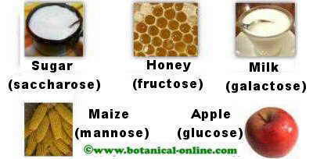
Classification of Carbohydrates
Simple Carbohydrates
Monosaccharide – “simple sugar”, is the simplest form of sugar.
a) Glucose – “blood sugar” (usually found in grapes, corn and blood)
b) Fructose – sweetest of simple sugar. Found in honey, fruits and vegetables.
c) Galactose – not found in free foods. Galactose is a result when
the lactose breakdown.

Slide 3
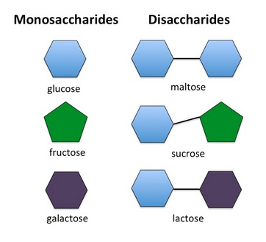
Classification of Carbohydrates
Disaccharide – “double sugar”. Made up of 2 monosaccharide.
a) Sucrose – ordinary table sugar (glucose & fructose)
b) Lactose – “milk sugar” (glucose & galactose)
c) Maltose –(malt sugar) is produced during the malting of
cereals such as barley.

Slide 4
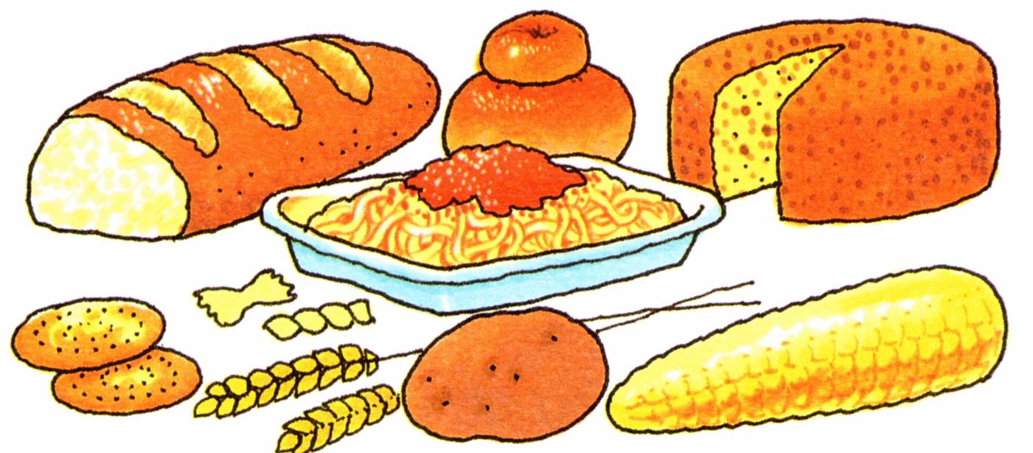
Polysaccharide – “ complex sugar”
Composed of many molecules of simple sugar
a) Starch – most important in human. They supply energy for longer period of time.
Examples: rice, wheat, corn, carrots and potatoes. Starches are not water-soluble and require digestive enzymes called amylases to break them apart.
b) Dextrins – formed by the breakdown of starch. obtained from starch by the application of heat or acids and used mainly as adhesives and thickening agents.

Slide 5
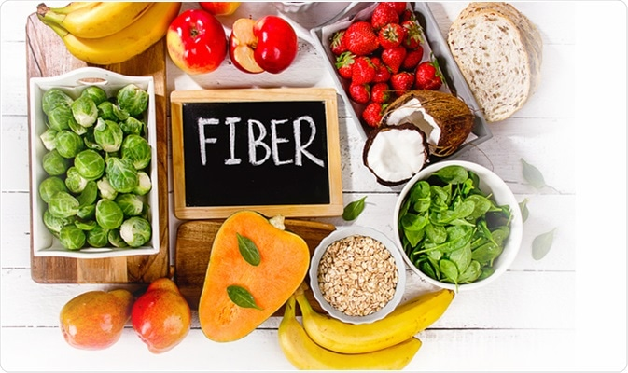
Complex carbohydrate Dietary Fibre
Cellulose – Non-digestible by humans. They lower the blood glucose level of people with diabetes.
that is composed of glucose units, forms the main constituent of the cell wall in most plants, and is important in the manufacture of numerous products, such as paper, textiles, pharmaceuticals
Pectin – Sources from fruits and are often used as a base for jellies. Glycogen – “animal starch”
f) Hemicellulose – also indigestible, found in agar, pectin, woody fibers, leaves, stems.
g) Inulin – Important medicine and nursing as it provides test of renal function.

Slide 6
Functions of Carbohydrates:
1) Main source of energy for the body.
2) Necessary for normal fat metabolism
3) Cellulose stimulate peristaltic movement of the gastrointestinal tract. Absorb water to give bulk to the intestines.
4) Lactose encourage the growth of beneficial bacteria, resulting in a laxative action.
5) Glucose is the sole source of energy in the brain. Proper functioning of the tissues

Slide 7
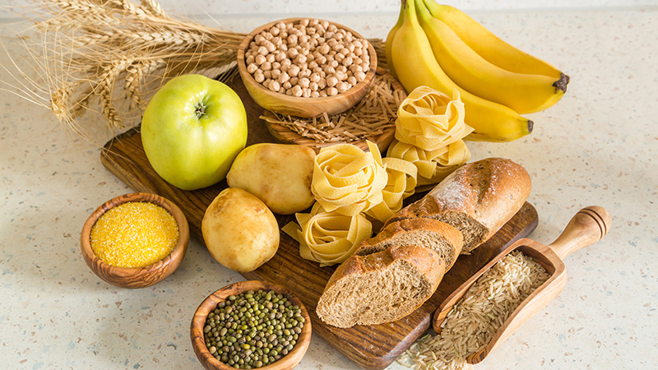
Sources of carbohydrate
Sources of Carbohydrates 1) Whole grains 2) Sweet potatoes & white potatoes. Bananas, dried fruits. 3) Milk (lactose) 4) Sugar , sweets, honey.

Slide 8
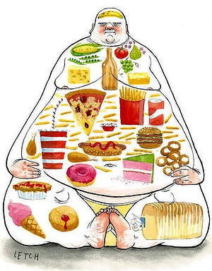
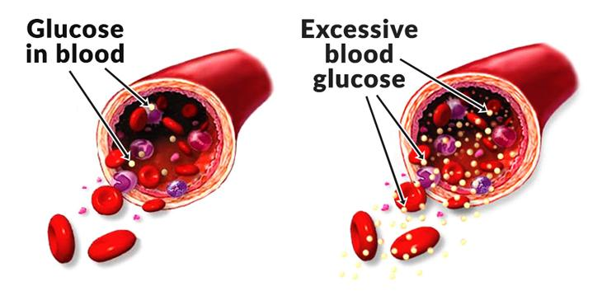
Common Diseases:
1. Overweight 2. Diabetes 3. Tooth Decay 4. Depressed appetite 5. Fermentation causing gas formation 6. Cancer
7. Addiction

Slide 9
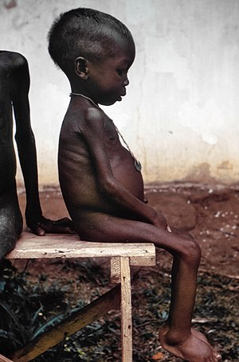
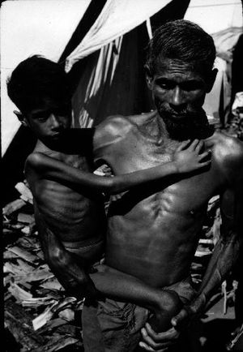
Deficiency
1)Ketosis – disease caused by lack of carbohydrates, in which the acid level of the body is raised
2)Protein _ Energy Malnutrition
a) Kwashiorkor – Protein Deficiency.
b) Marasmus-Calorie intake deficiency
Marasmus occurrence increases prior to age 1, whereas kwashiorkor occurrence increases after 18 months. It can be distinguished from kwashiorkor in that kwashiorkor is protein deficiency with adequate energy intake whereas marasmus is inadequate energy intake in all forms, including protein.
3) Low Blood Sugar Level

