Slide 1
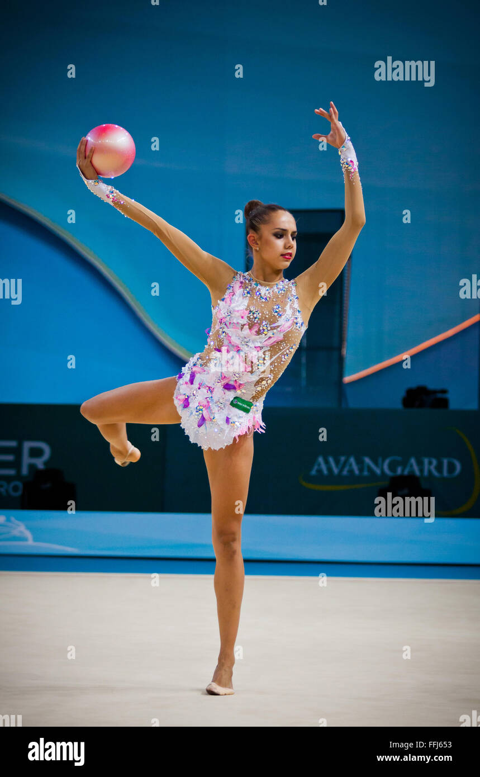
Mrgarita Mamun

Slide 2
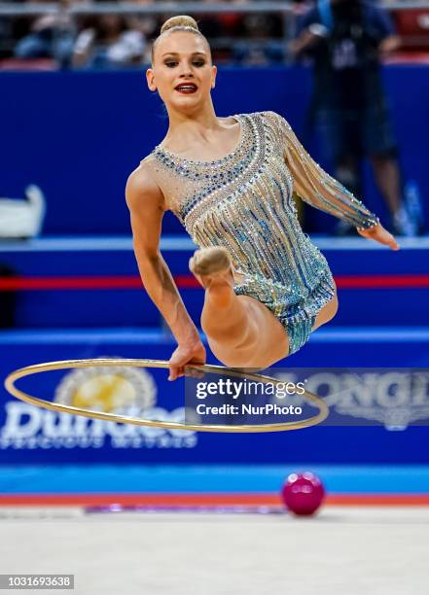
Introduction to Margarita Mamun
Margarita Mamun is a Russian rhythmic gymnast.
She was born on November 1, 1995, in Moscow.
She is an Olympic gold medalist (2016).
Known for elegance, flexibility, and discipline.

Slide 3
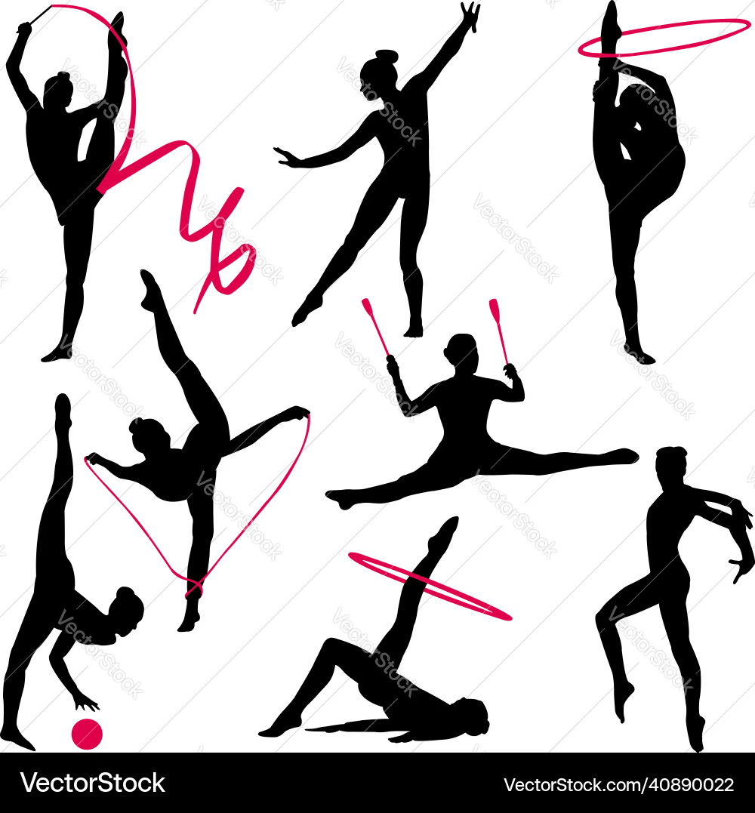
What is rhythmic Gymnastics?
Gymnastics is a sport that combines flexibility, strength, balance, and coordination.
Rhythmic gymnastics includes dance movements with ribbon, hoop, ball, and clubs.
It requires grace, precision, and control.

Slide 4
Early Lifestyle
Mamun was introduced to gymnastics by her mother.
She saw rhythmic gymnastics on TV and became inspired.
Started training at a young age in Russia while she was strongly supported by her mother and father.
She began rhythmic gymnastics at the age of seven.
As a young gymnast, she was known for her grace and natural flexibility but faced high pressure and intense training schedules that often kept her separated from her family.

Slide 5
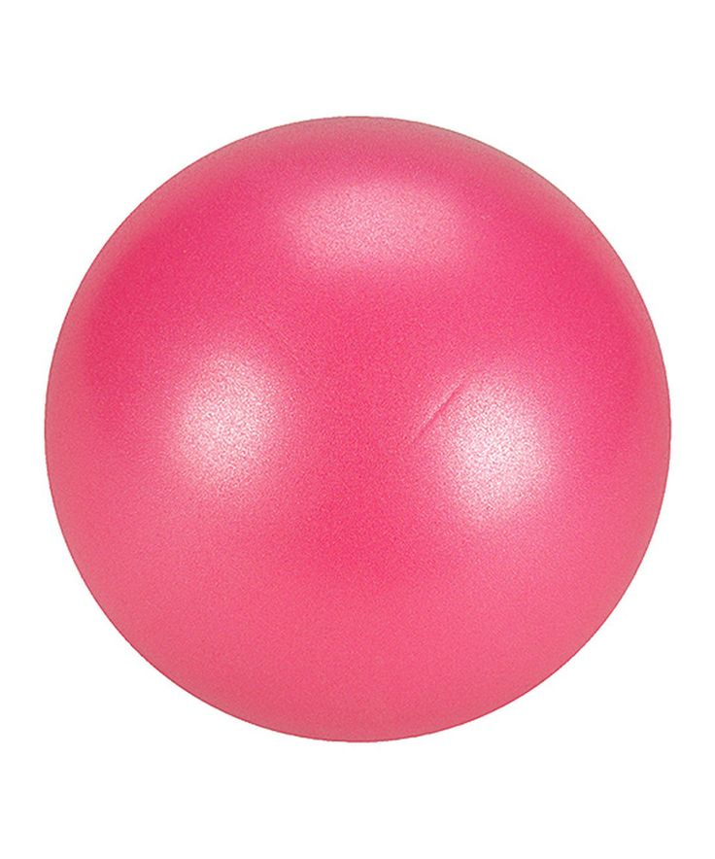
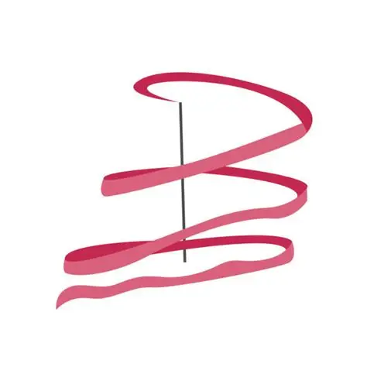
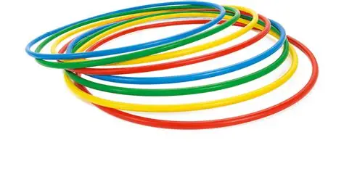
Training Routine
She trains 6–8 hours per day, includes stretching, dance, strength training and Practices routines with music and apparatus.
She burns 2000-3000 calories/day due to intense training
Heart rate becomes very high (like intense cardio) Requires: Strength💪
Endurance 🫀
Flexibility 🧘‍♀️
She trains with: Ribbon, Hoop, Ball, that includes
Throws & catches
Coordination with body movement
Precision timing

Slide 6
Macronutrients & Training Table
Category | Amount | Notes
Carbohydrates | 50–60% | Main energy source
Protein | 15–20% | Muscle repair
Fats | 25–30% | Long-term energy
Training | 6–8 hrs/day | High intensity

Slide 7
Daily diet routine
Meal | Food | Protein | Carbs | Fats
Breakfast | Oatmeal + Berries + 2 boiled eggs +Green tea | 20 Grams | 56 Grams | 15 Grams
Snack | Apple + handful almonds | 5 Grams | 25 Grams | 10 Grams
Lunch | Grilled chicken breast + steamed vegetables + Brown rice | 43 Grams | 57 Grams | 12 Grams
Dinner | Grilled fish + salad +olive oil | 32 Grams | 10 Grams | 30 Grams

Slide 8
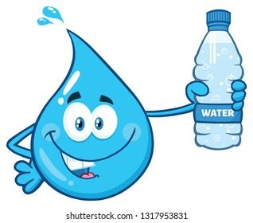
Hydration
Water intake: 2-3 liters per day.
More during training sessions.
She drinks Before training, during training (small sips) & after training (to recover)
She avoids: Sugary drinks, Soda & Energy drink

Slide 9
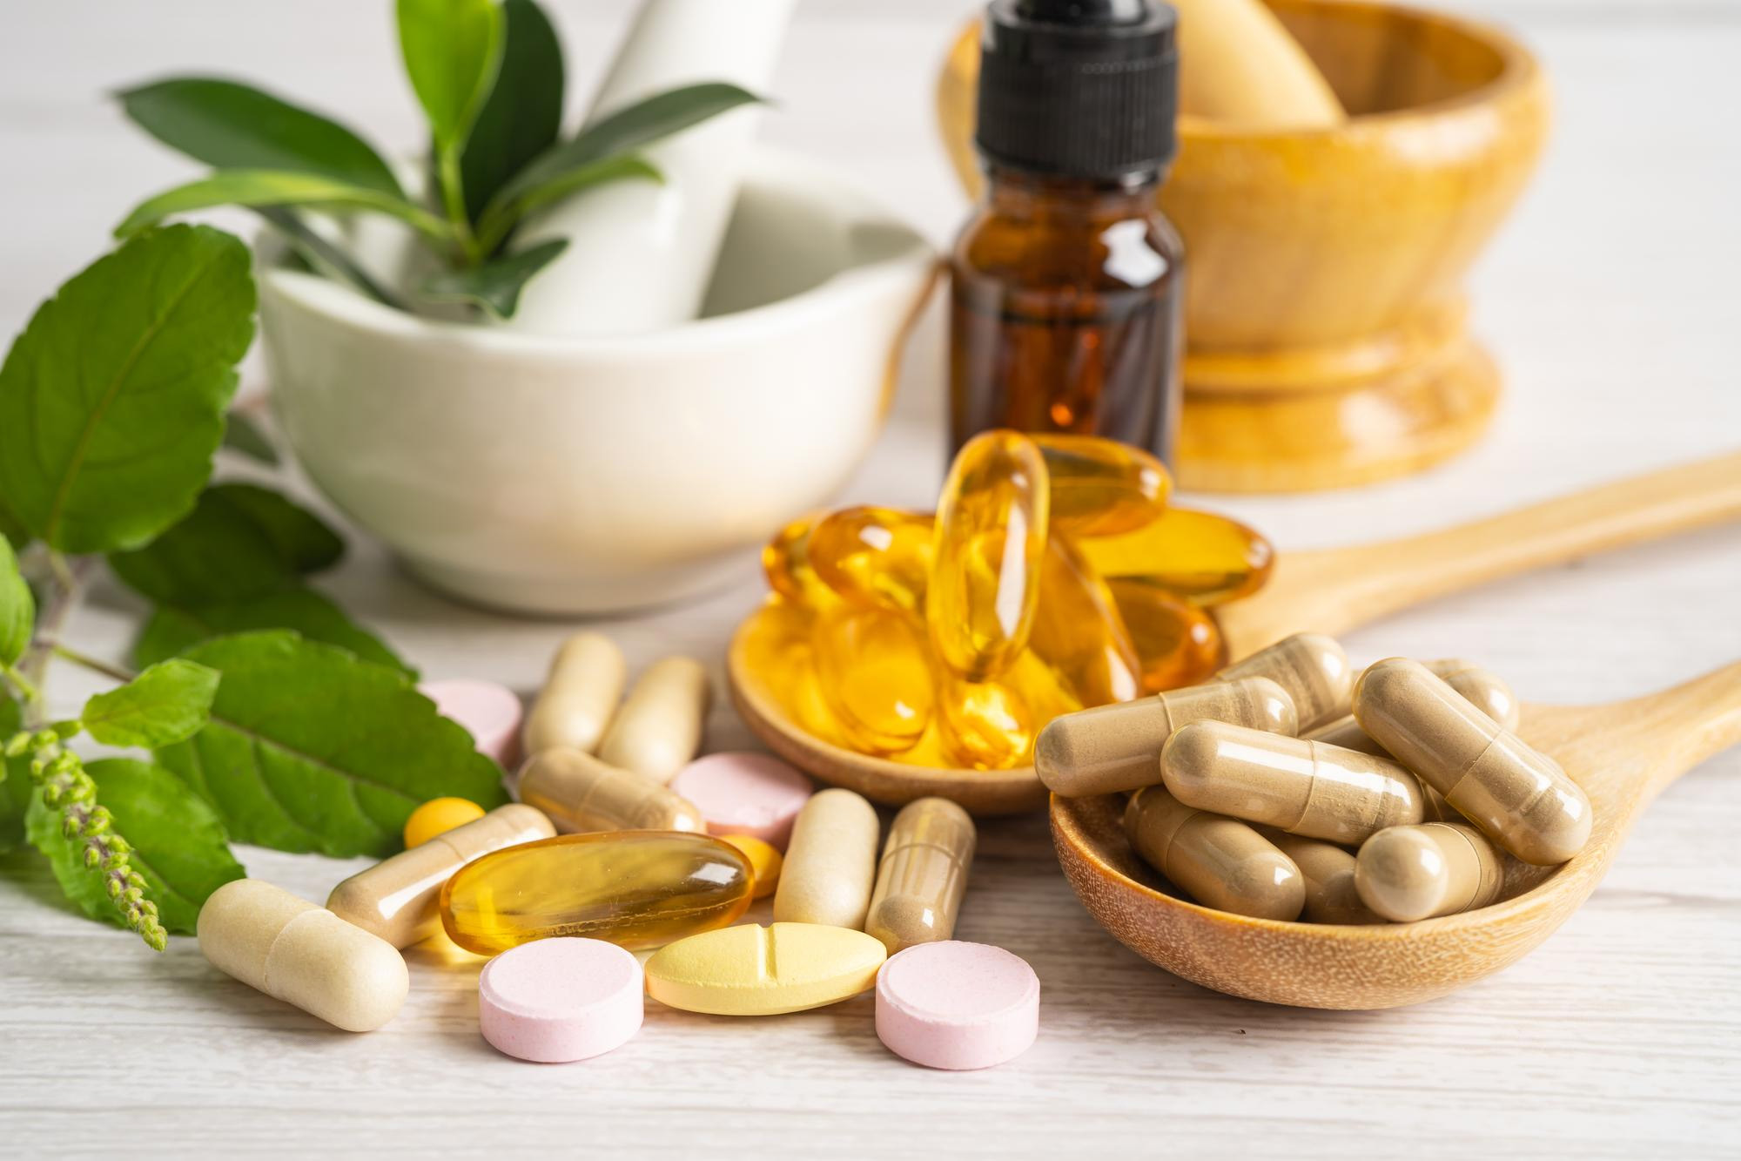
Micronutrients & Supplements
Important minerals: calcium, iron, magnesium, potassium & magnesium.
Vitamins: Vitamin D, B-complex.
Supplements (if needed): multivitamins, protein supplements ( helps recovery after training), & v.D+Calcium.

Slide 10
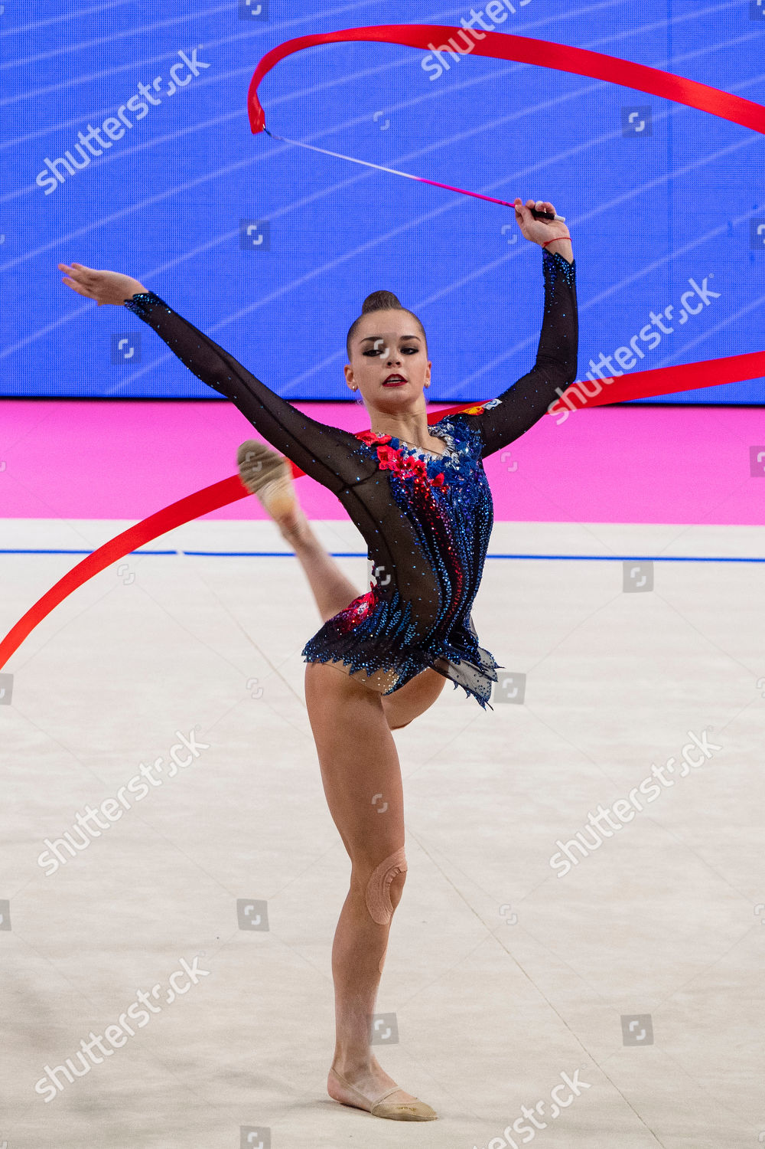
Calories Burned
She burns approximately 300–600 calories per hour during training, with a total daily energy expenditure of around 2,000–3,000 calories.
This high energy demand is due to continuous movement, strength exercises, and repeated routines. Adequate nutrition and hydration are essential to maintain performance and prevent fatigue.

Slide 11
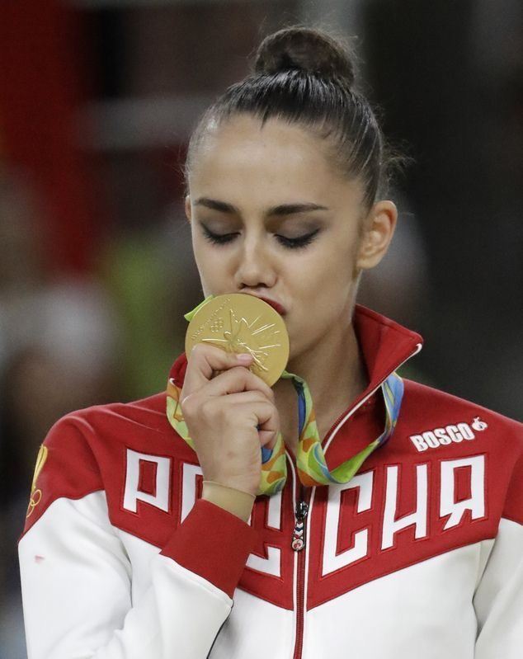
Conclusion
Margarita Mamun’s success reflects the combination of artistic beauty and physical strength required in rhythmic gymnastics. Through years of disciplined training, proper nutrition, and mental focus, she became an Olympic champion, proving that excellence comes from consistency, resilience, and passion.

Slide 12


