Slide 1


Tishk international university
Faculty of Applied science
Nutrition& Dietetics Department
Football Player Lifestyle

Slide 2
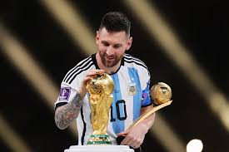
Title: The Blueprint of Greatness: Lionel Messi’s Lifestyle
Exercise, Nutrition, and the Routine of a Legend
A high-quality image of Messi in training gear or a split image of him on the pitch and in the gym.

Slide 3
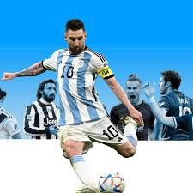
The Daily Schedule (Time of Exercise)
Messi’s routine is built on consistency and recovery rather than 24/7 intensity.
06:00 AM: Wake up and hydration.
07:00 – 08:00 AM: Family time (breakfast and school runs).
09:00 – 11:00 AM: Primary Training Session. This is his high-intensity window (focus on technical drills and speed).
12:00 PM: Post-training lunch and recovery.
02:00 – 04:30 PM: Mandatory nap/rest for muscle recovery.
05:00 – 08:00 PM: Team training or tactical analysis.
09:00 PM: Lights out (he prioritizes 8–9 hours of sleep).

Slide 4
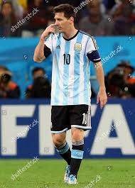
The Workout Philosophy
Messi doesn't train like a bodybuilder; he trains for functional agility.
Linear Speed: Short, explosive sprints (max 20 yards), hurdle hops, and pillar skips.
Multi-Directional Speed: Lateral bounds, cone drills, and "mirror drills" to improve his famous change-of-direction.
Strength & Stability: Focuses on core and lower body using bodyweight or light weights (squats, lunges, and planks).
The Secret Weapon: Stretching. Messi often spends up to 1 hour a day on flexibility to prevent injuries and maintain his low center of gravity.

Slide 5
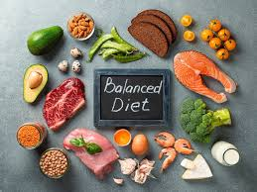
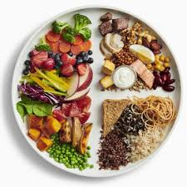
The Male Meal Plan(Pillars of Nutrition)
Since 2014, Messi has followed a "Whole Foods" Mediterranean-style diet designed by nutritionist Giuliano Poser.
The Five Pillars: Water, Olive Oil, Whole Grains, Fresh Fruit, and Fresh Vegetables.
Breakfast: Whole-grain toast with olive oil or a fruit smoothie.
Lunch: Grilled fish or chicken with brown rice/quinoa and steamed vegetables.
Dinner: A large salad with lean protein (fish or chicken).
Match Day (90 mins before): Seasonal fruit (bananas/apples) for quick-digesting energy.
Strict Avoidance: Refined sugar, processed flour, and fizzy sodas.

Slide 6
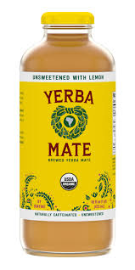
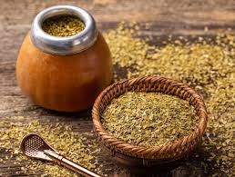
Nutritional Supplements & Recovery
Messi uses specific aids to keep his muscles firing and reduce inflammation.
Yerba Maté: A traditional South American tea. It provides caffeine for focus without the "crash" of coffee or sugar.
Protein Shakes: Usually consumed 3 times a day during high-intensity periods to repair muscle tissue.
Electrolytes: Added to water to maintain hydration levels during matches.
Natural Anti-inflammatories: His diet includes turmeric and ginger to reduce muscle soreness naturally.
Recovery Tools: Ice baths and massage therapy are daily staples after training.

Slide 7

Conclusion & Key Takeaways
Discipline over Intensity: It’s about doing the right things every single day.
Evolution: Messi changed his diet at age 27 to extend his career.
Balance: He balances world-class training with a "normal" family life to stay mentally fresh.

Slide 8


