Slide 1
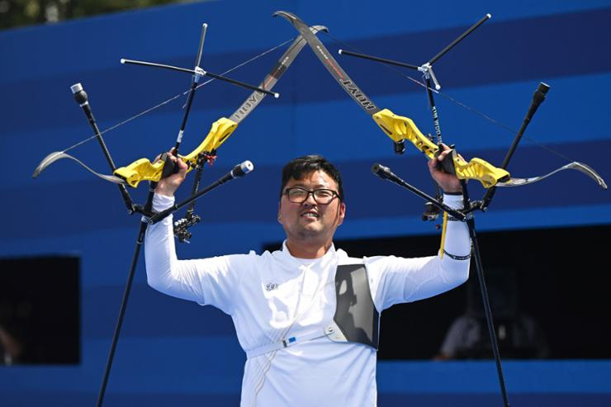
Kim Woo-jin
Elite Archer

Slide 2

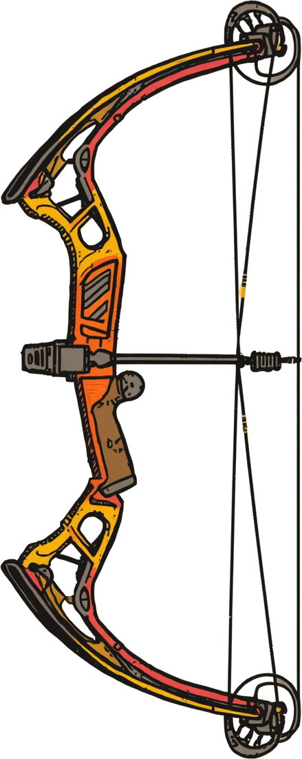

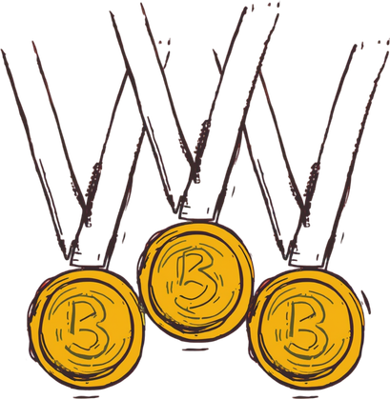
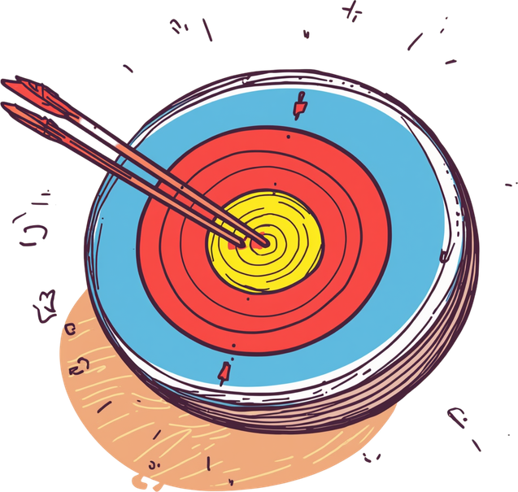



Biography & Achievements
• Born June 20, 1992, South Korea
• Three gold medals at 2016 Rio Olympics
• Competed at Tokyo 2020 Olympics
• Known for mental strength, consistency, precision
• World record holder in ranking rounds

Slide 3
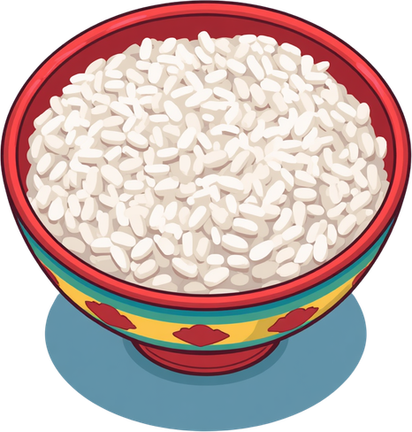
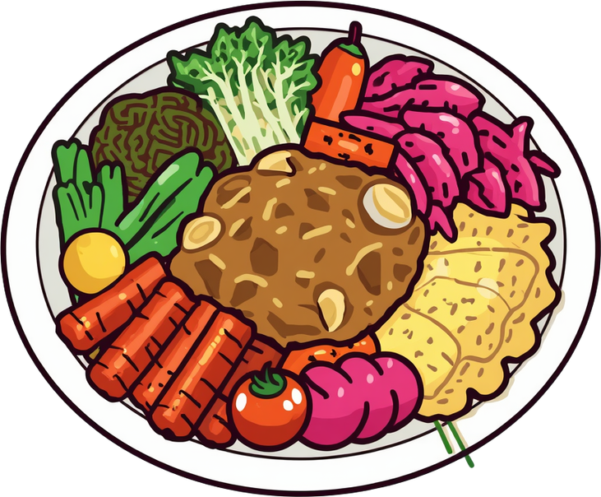
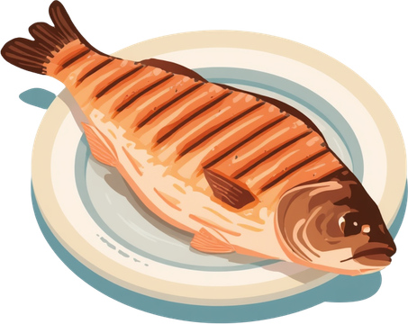

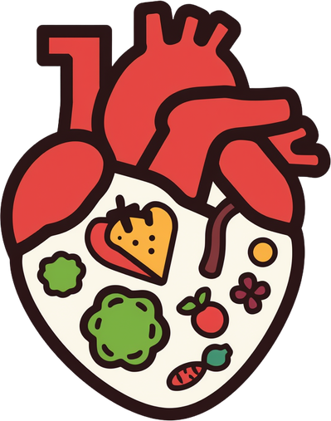




Daily Nutrition Overview
• Total daily calories: 2,100-2,400 (adjusted by training intensity)
• Balanced macros: carbohydrates, proteins, healthy fats
• Emphasis on traditional Korean foods rich in nutrients
• Strategic meal timing around training sessions
• Hydration maintained throughout the day

Slide 4


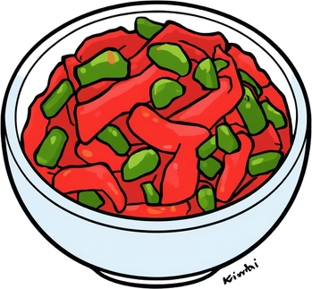






Daily Meals
Lunch & Dinner
Breakfast
• Steamed rice (300g)
• Grilled fish (salmon/mackerel)
• Kimchi & vegetables
• Seaweed soup
• Green tea
• ~600-700 calories
Lunch: Brown rice, chicken, veggies, tofu stew, fruit (~800-900 cal)
Dinner: White rice, lean beef, miso soup, steamed egg, herbal tea (~700-800 cal)

Slide 5


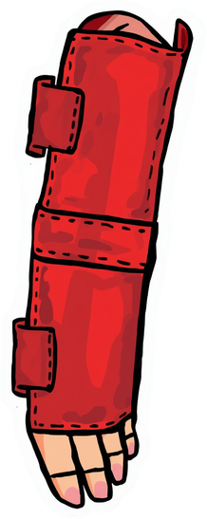
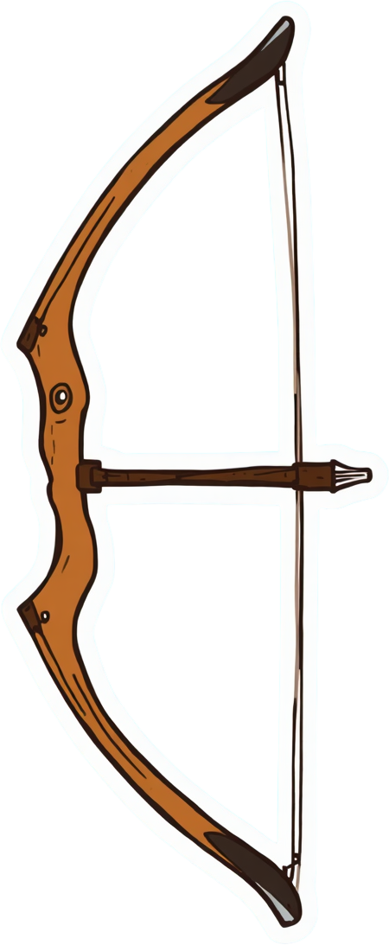
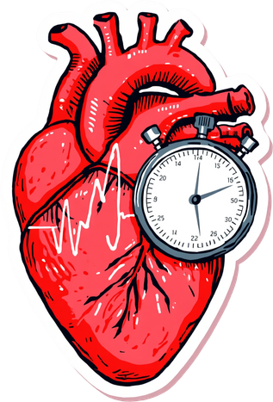



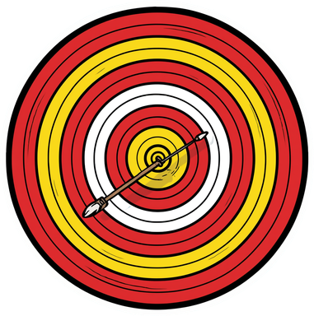
Morning Training Session
Warm-up: 15 min stretching + light cardio to prepare muscles and joints for precision shooting
Technical practice: 2.5 hours shooting 144-180 arrows at 70m, focus on form, consistency, visualization, followed by 15 min cool-down stretching
Afternoon Training Session
Strength training: 1 hour core, upper body, legs, stability exercises
Technical shooting: 1.5 hours with competition simulation + 30 min meditation and breathing

Slide 6



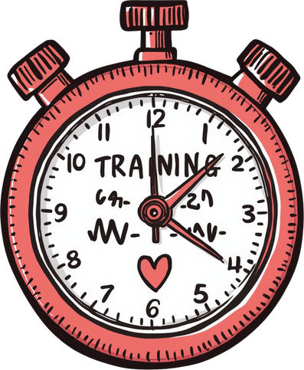
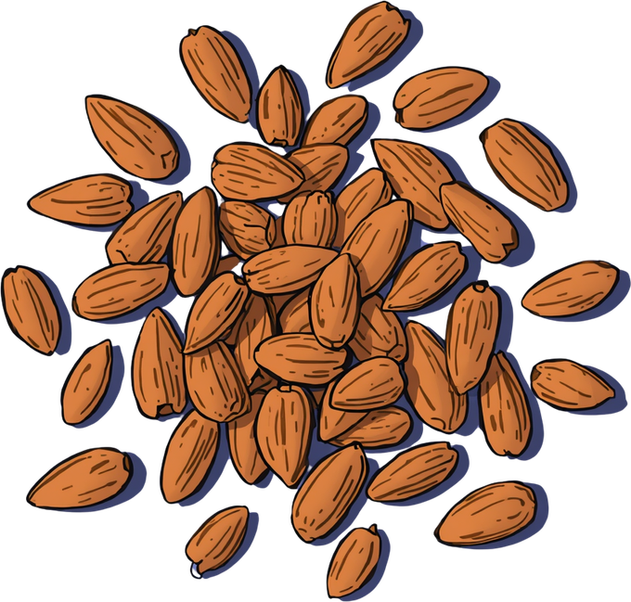




Training Nutrition
During Training
Pre-Training
• Banana or rice cake (~30g carbs)
• Handful of almonds (10-12 nuts)
• Water (250ml)
• Quick energy, easy digestion
• Electrolyte water (500-750ml)
• Sports drinks for 2+ hour sessions
• Energy gel or honey if needed
• Maintains hydration and focus

Slide 7
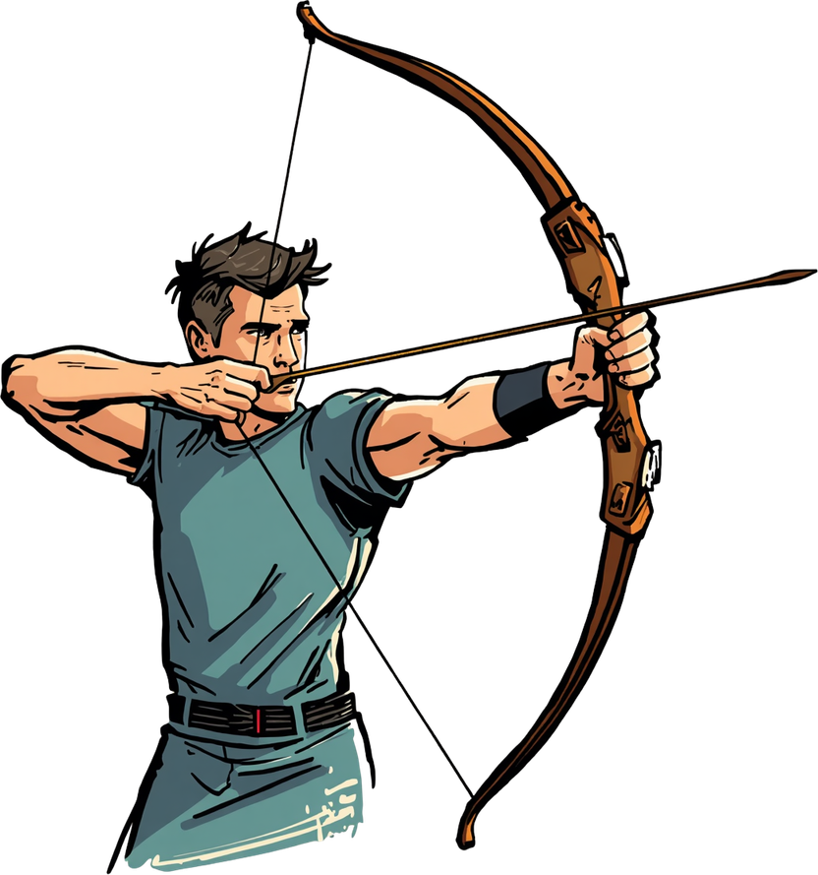



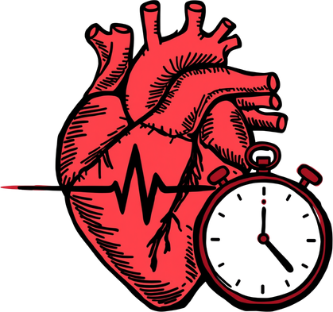


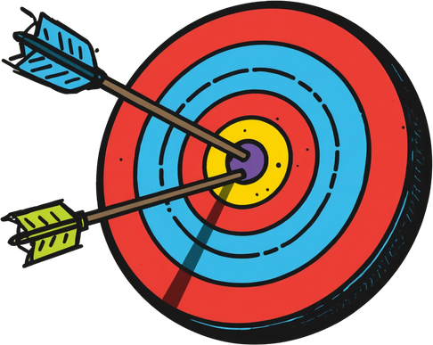
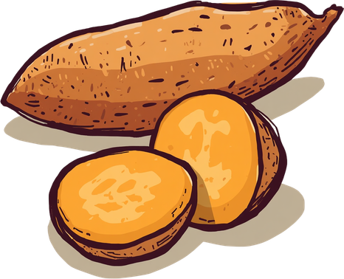
Post-Training Nutrition
• Protein shake (25g whey) or chocolate milk for muscle repair
• Banana or sweet potato (40g carbs) for glycogen replenishment
• Water (500ml) for rehydration
Purpose: Initiate recovery, reduce muscle breakdown, restore energy stores after intense archery training sessions.

Slide 8

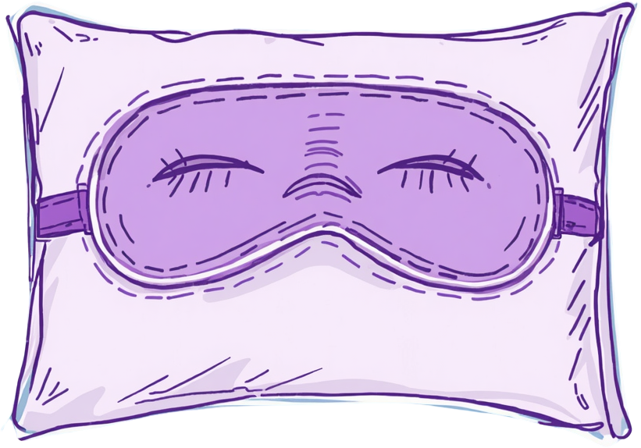
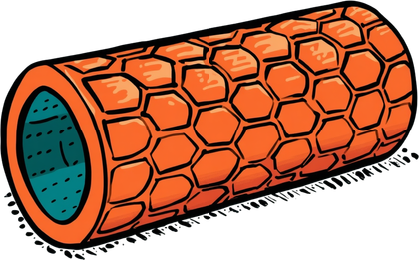
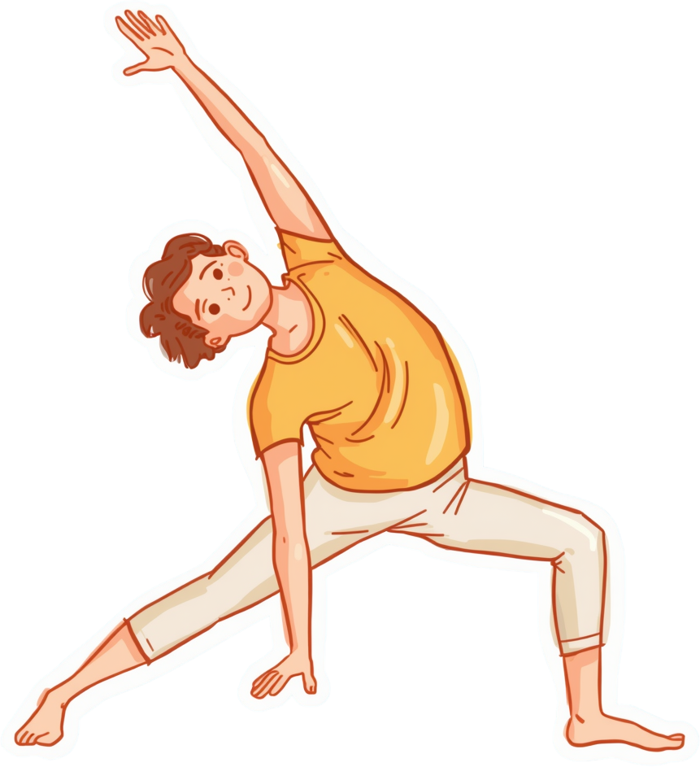


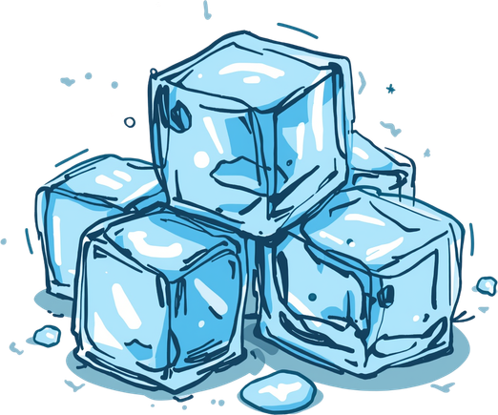


Sleep & Recovery Routine
• Bedtime 10:30 PM, wake 6:30 AM (8 hours sleep)
• Pre-sleep: stretching, warm shower, meditation
• No screens before bed
• Environment: dark, cool, quiet room
• Recovery tools: naps, massage, ice baths, foam rolling

Slide 9



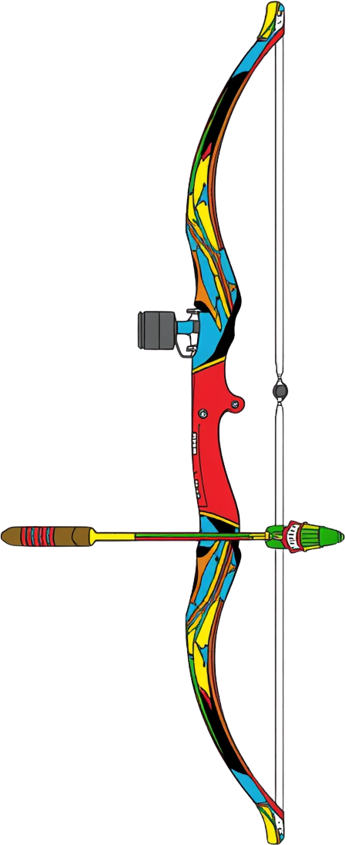
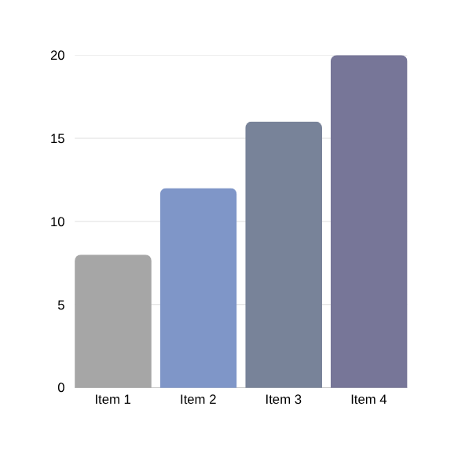


Synergy
• Nutrition fuels training energy & recovery
• Training improves sleep quality & focus
• Sleep optimizes nutrient utilization
• Cycle = steady focus, reduced stress, peak results

Slide 10

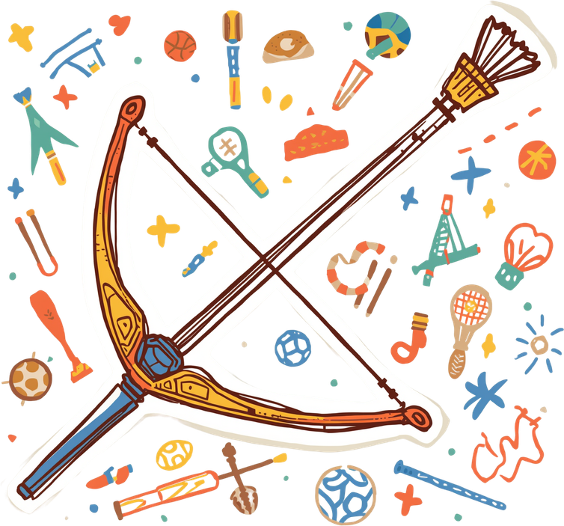
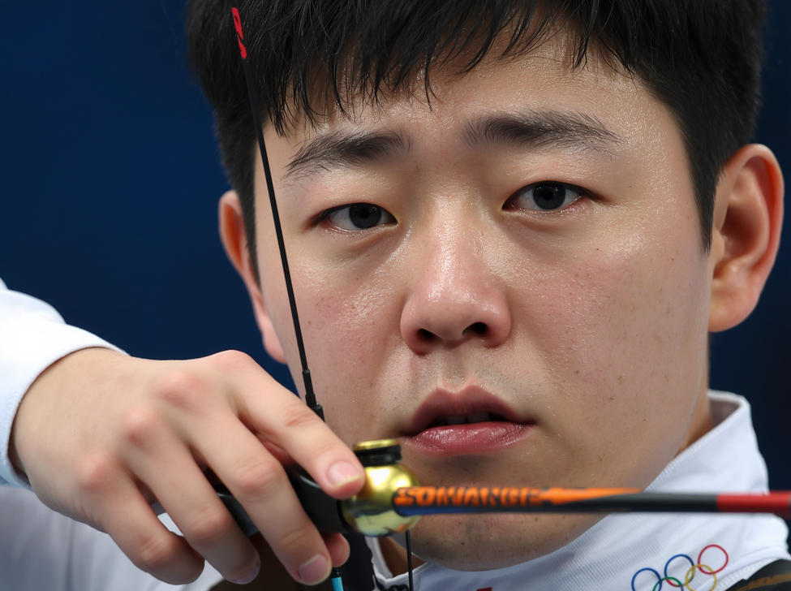
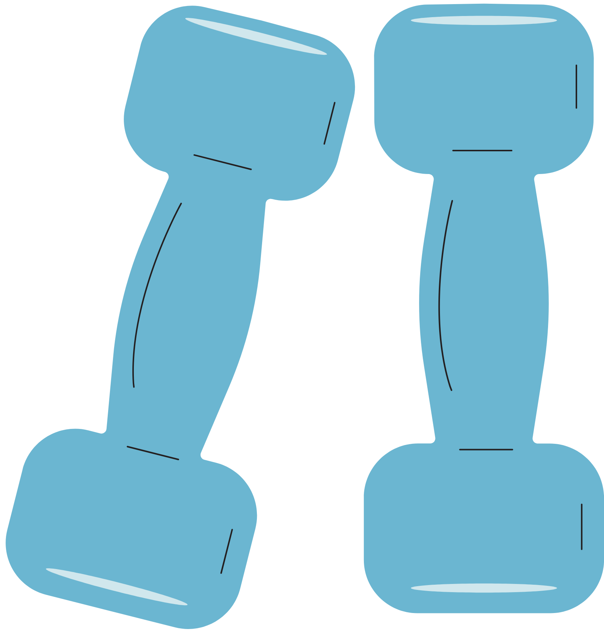



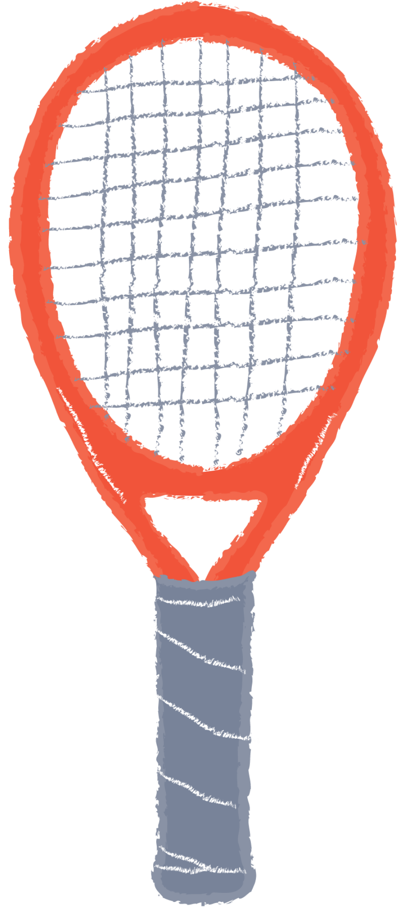

Mental Performance
• Stable blood sugar = steady hand & focus
• Adequate sleep = faster reactions
• Proper hydration = cognitive function
• Regular training = stress management & confidence

Slide 11



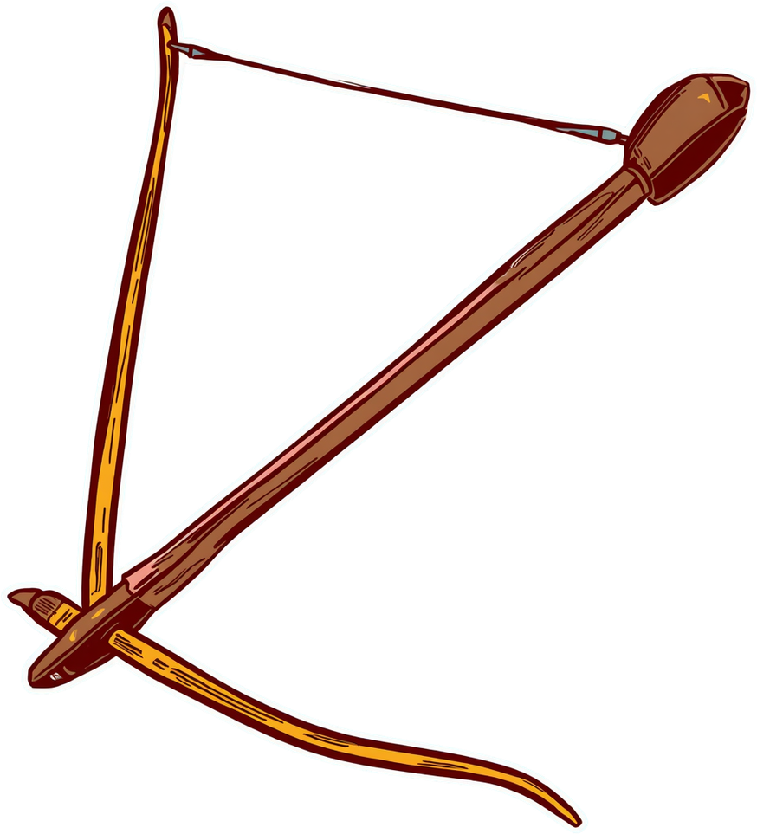
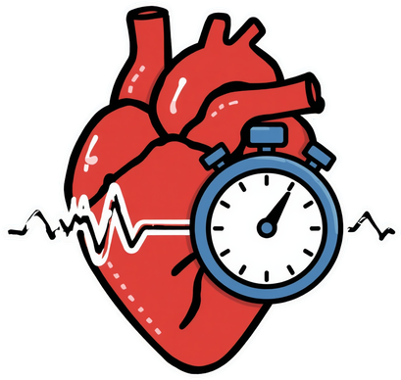

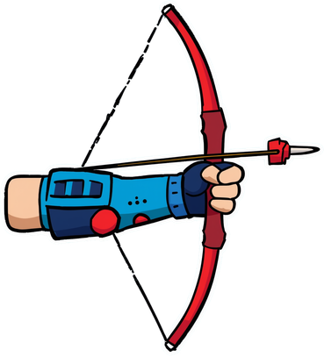

THANK YOU

