Slide 1

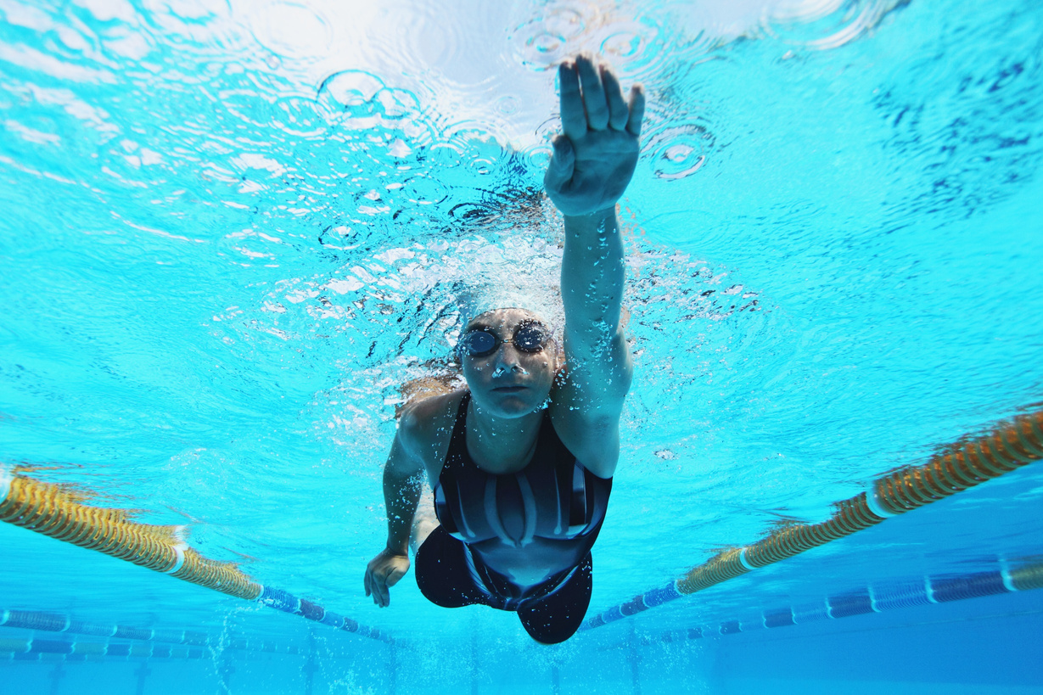
Sports and Exercise
Swimmers

Slide 2
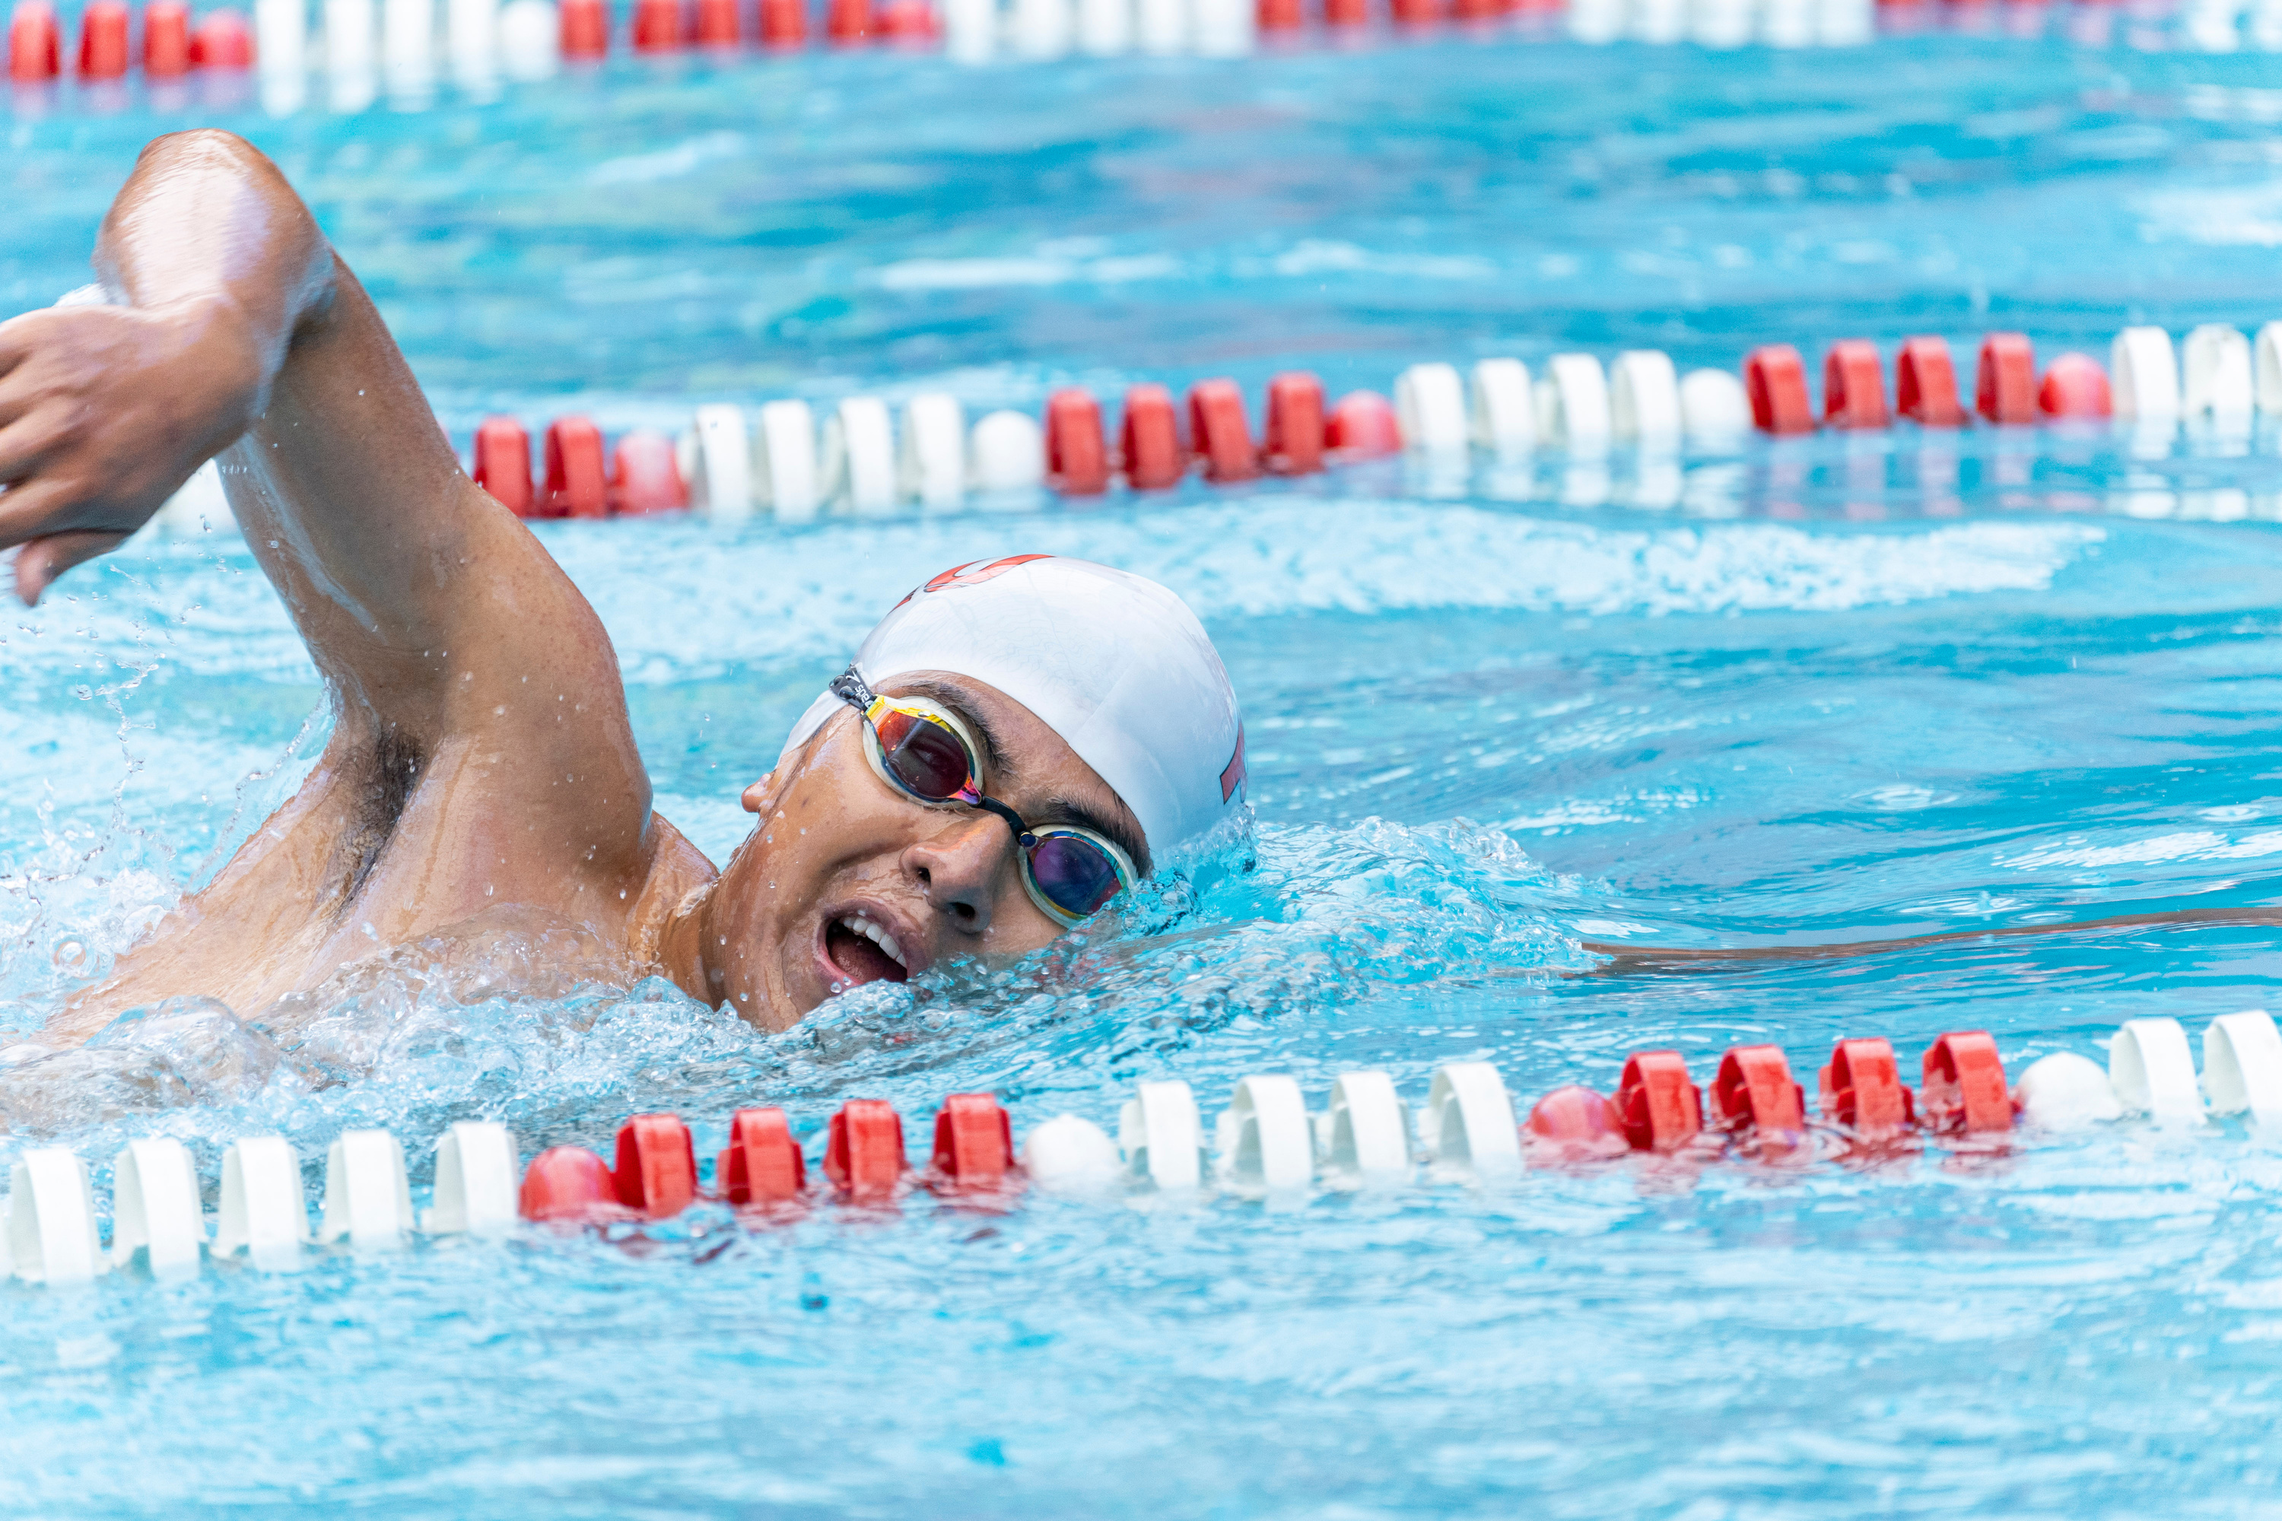
Contents:
Introduction
Case Study – Michael Phelps
Sports Supplements
Short Diet Plan
Athlete Lifestyle
Training Routine
Important Nutrients
Conclusion

Slide 3

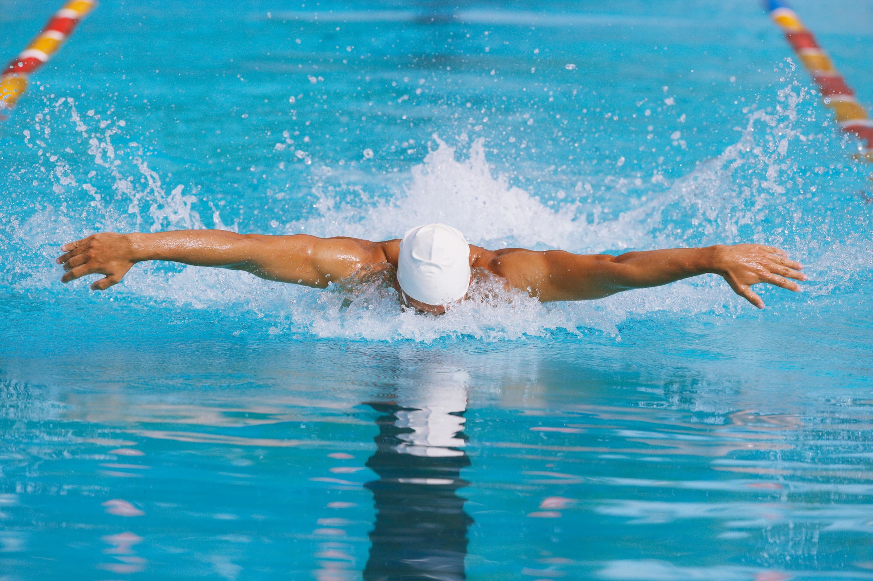

Introduction
•Swimming is a full-body sport
•Requires strength, endurance, and discipline
• Improves heart and lung fitness

Slide 4
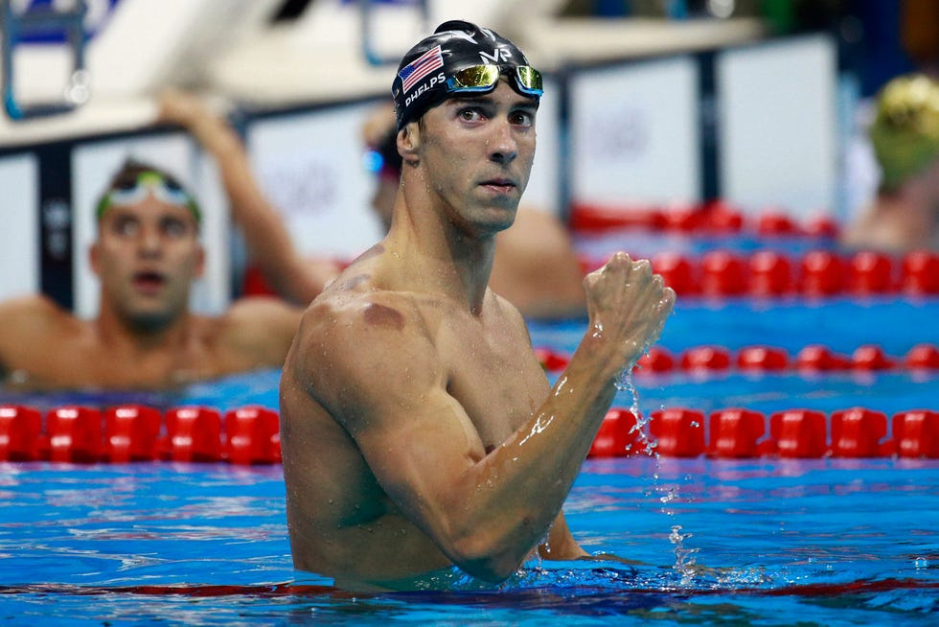
Case Study
• Michael Phelps is an American swimmer
• Most decorated Olympian
• Known for butterfly & freestyle

Slide 5
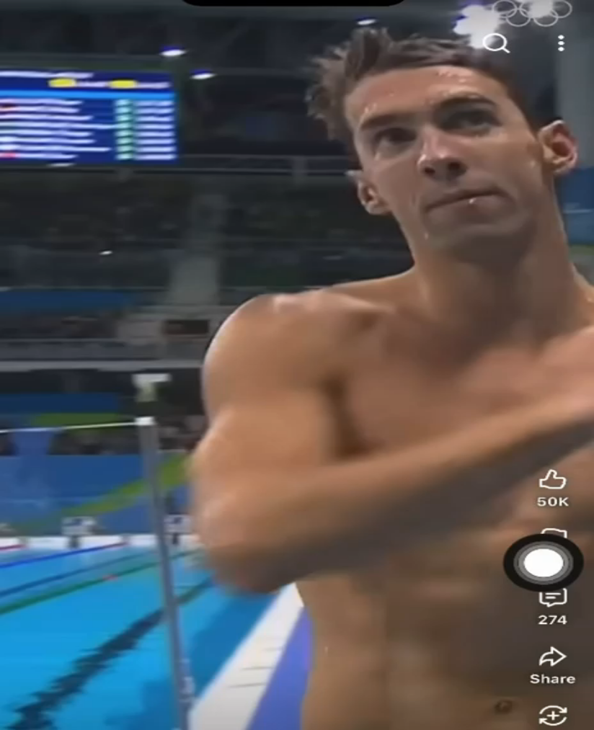

Slide 6
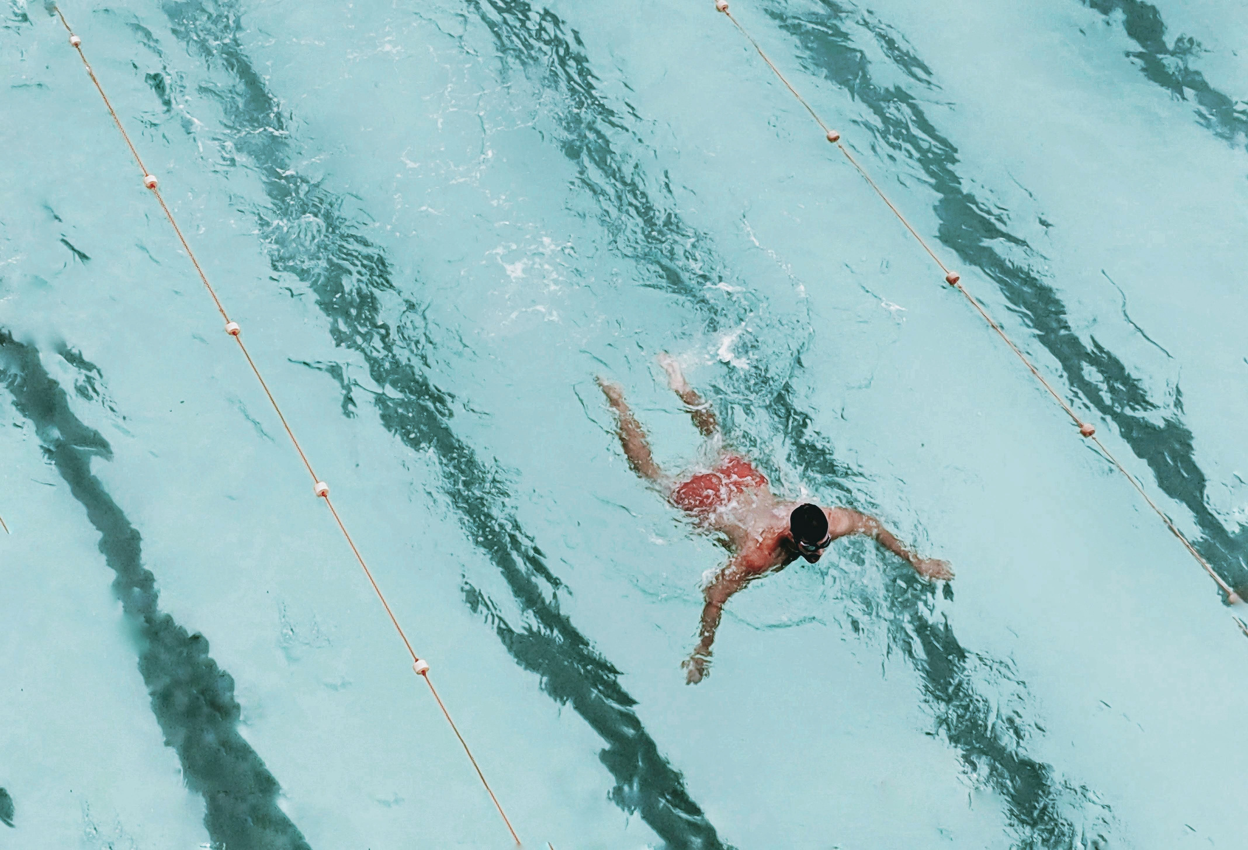

Sports Supplements
• Protein supplements
• Electrolytes
• Omega-3
• Multivitamins

Slide 7
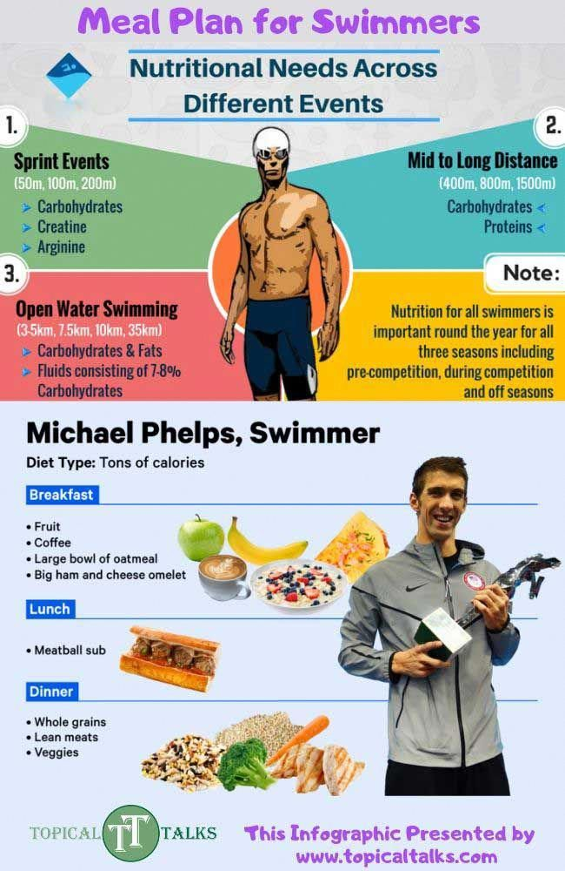
Diet Plan for a Swimmer
Breakfast: Oatmeal, eggs, fruit, and milk
Lunch: Grilled chicken or fish, rice or pasta, and vegetables
Snack: Yogurt, nuts, or fruit
Dinner: Lean protein, whole grains, and salad
Hydration: Drinking enough water throughout the day

Slide 8
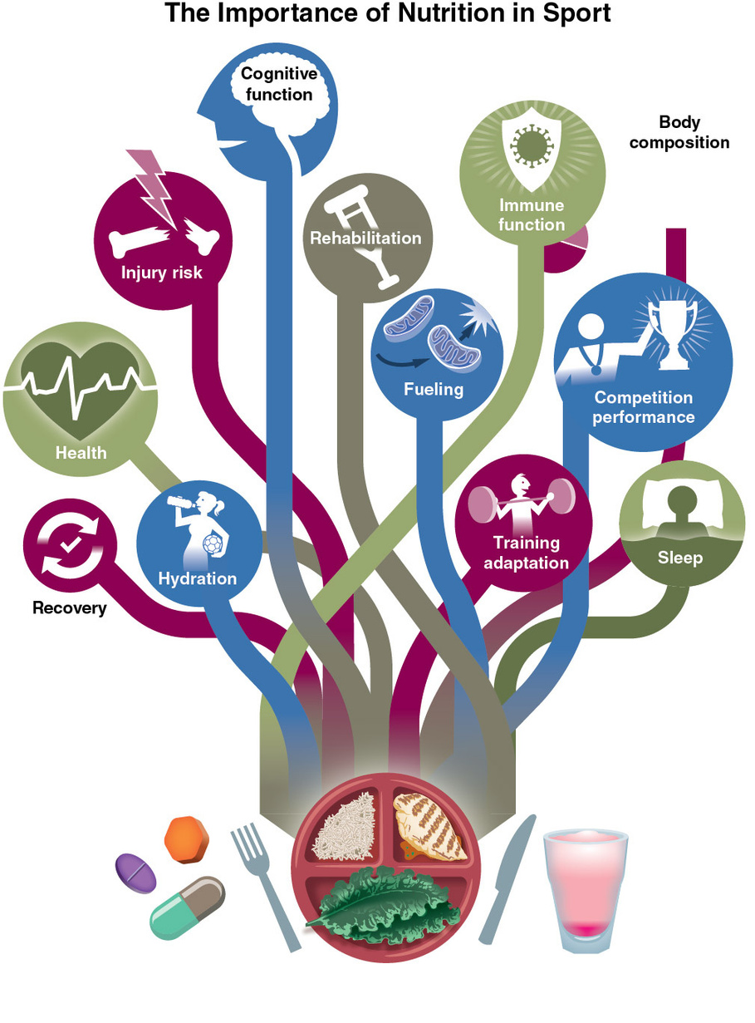
Athlete Lifestyle
KEY ASPECTS OF A SWIMMER’S LIFESTYLE INCLUDE:
1-TRAINING ONCE OR TWICE DAILY
2-GETTING ENOUGH SLEEP FOR MUSCLE RECOVERY
3-MANAGING STRESS AND MAINTAINING MENTAL FOCUS
4-AVOIDING SMOKING, ALCOHOL, AND UNHEALTHY HABITS

Slide 9
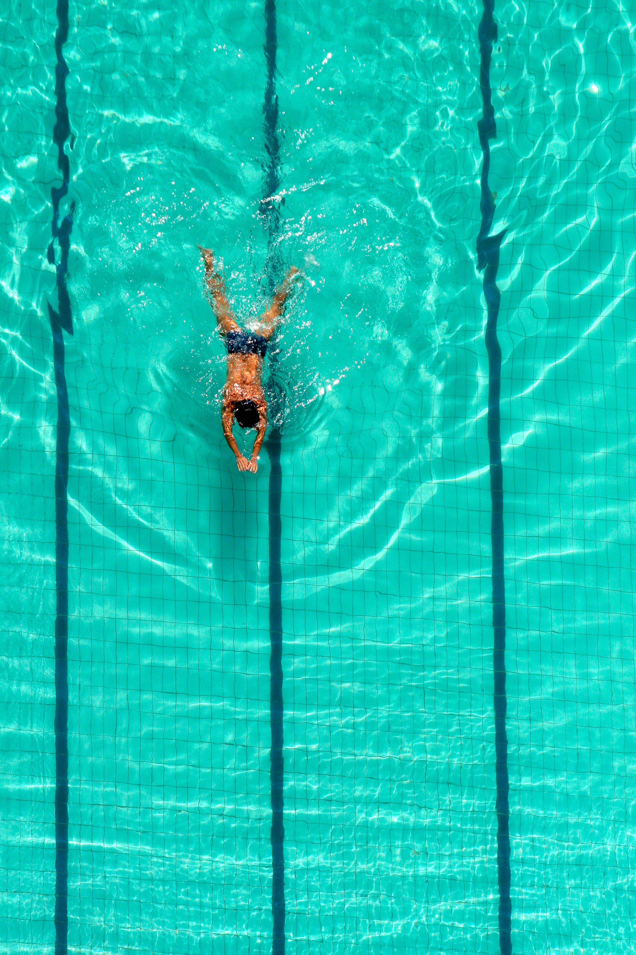
Swimmer Training Routine
SWIMMING TRAINING IS DIVIDED INTO TWO MAIN TYPES:
1-IN-WATER TRAINING, WHICH INCLUDES:
SWIMMING LAPS
SPEED AND ENDURANCE DRILLS
IMPROVING SWIMMING TECHNIQUE
2-DRY-LAND TRAINING, WHICH INCLUDES:
STRENGTH AND RESISTANCE EXERCISES
STRETCHING AND FLEXIBILITY TRAINING

Slide 10
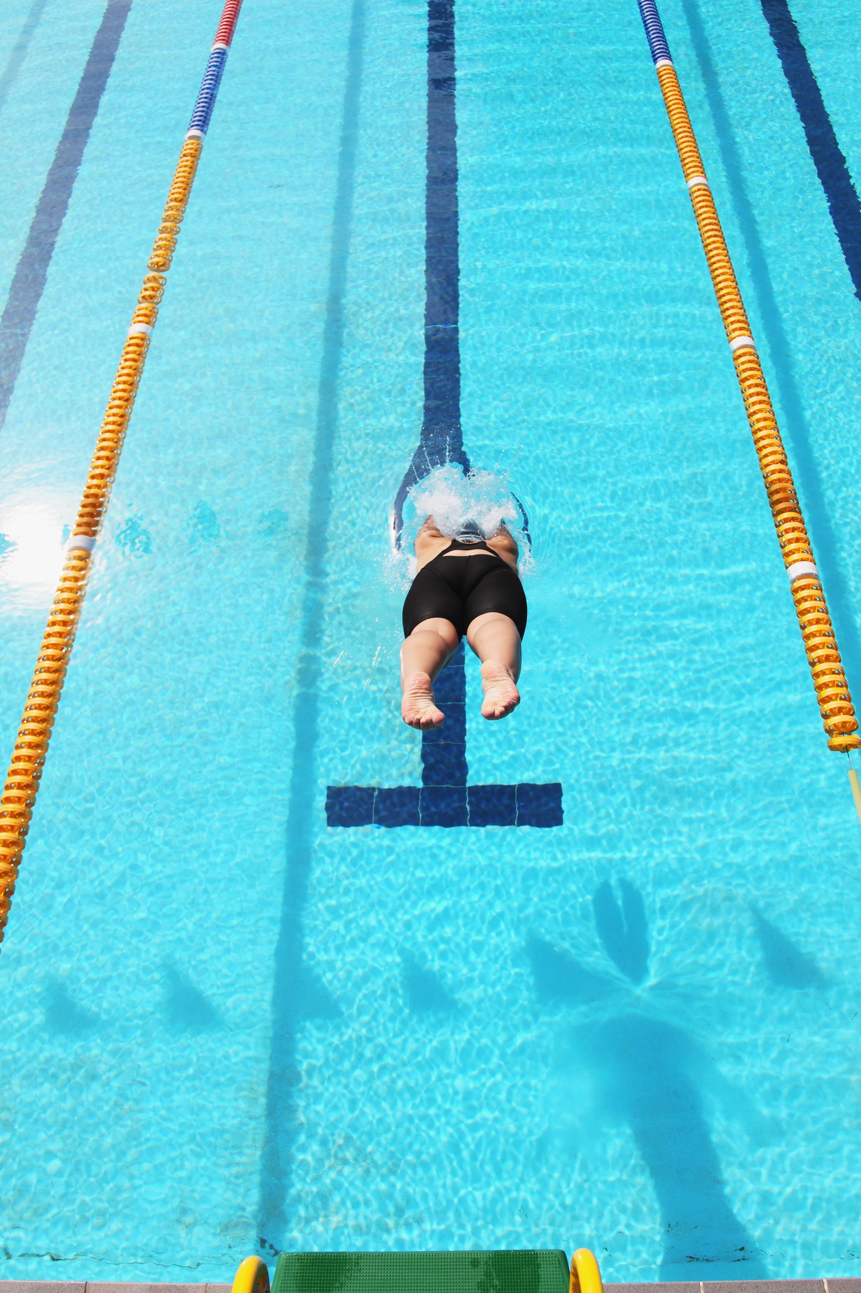
Important Nutrients for Swimmers
Swimmers need a balanced intake of nutrients, including:
1-Carbohydrates for energy
2-Proteins for muscle repair and growth
3-Fats for long-term energy
4-Vitamins and minerals for immunity and metabolism

Slide 11
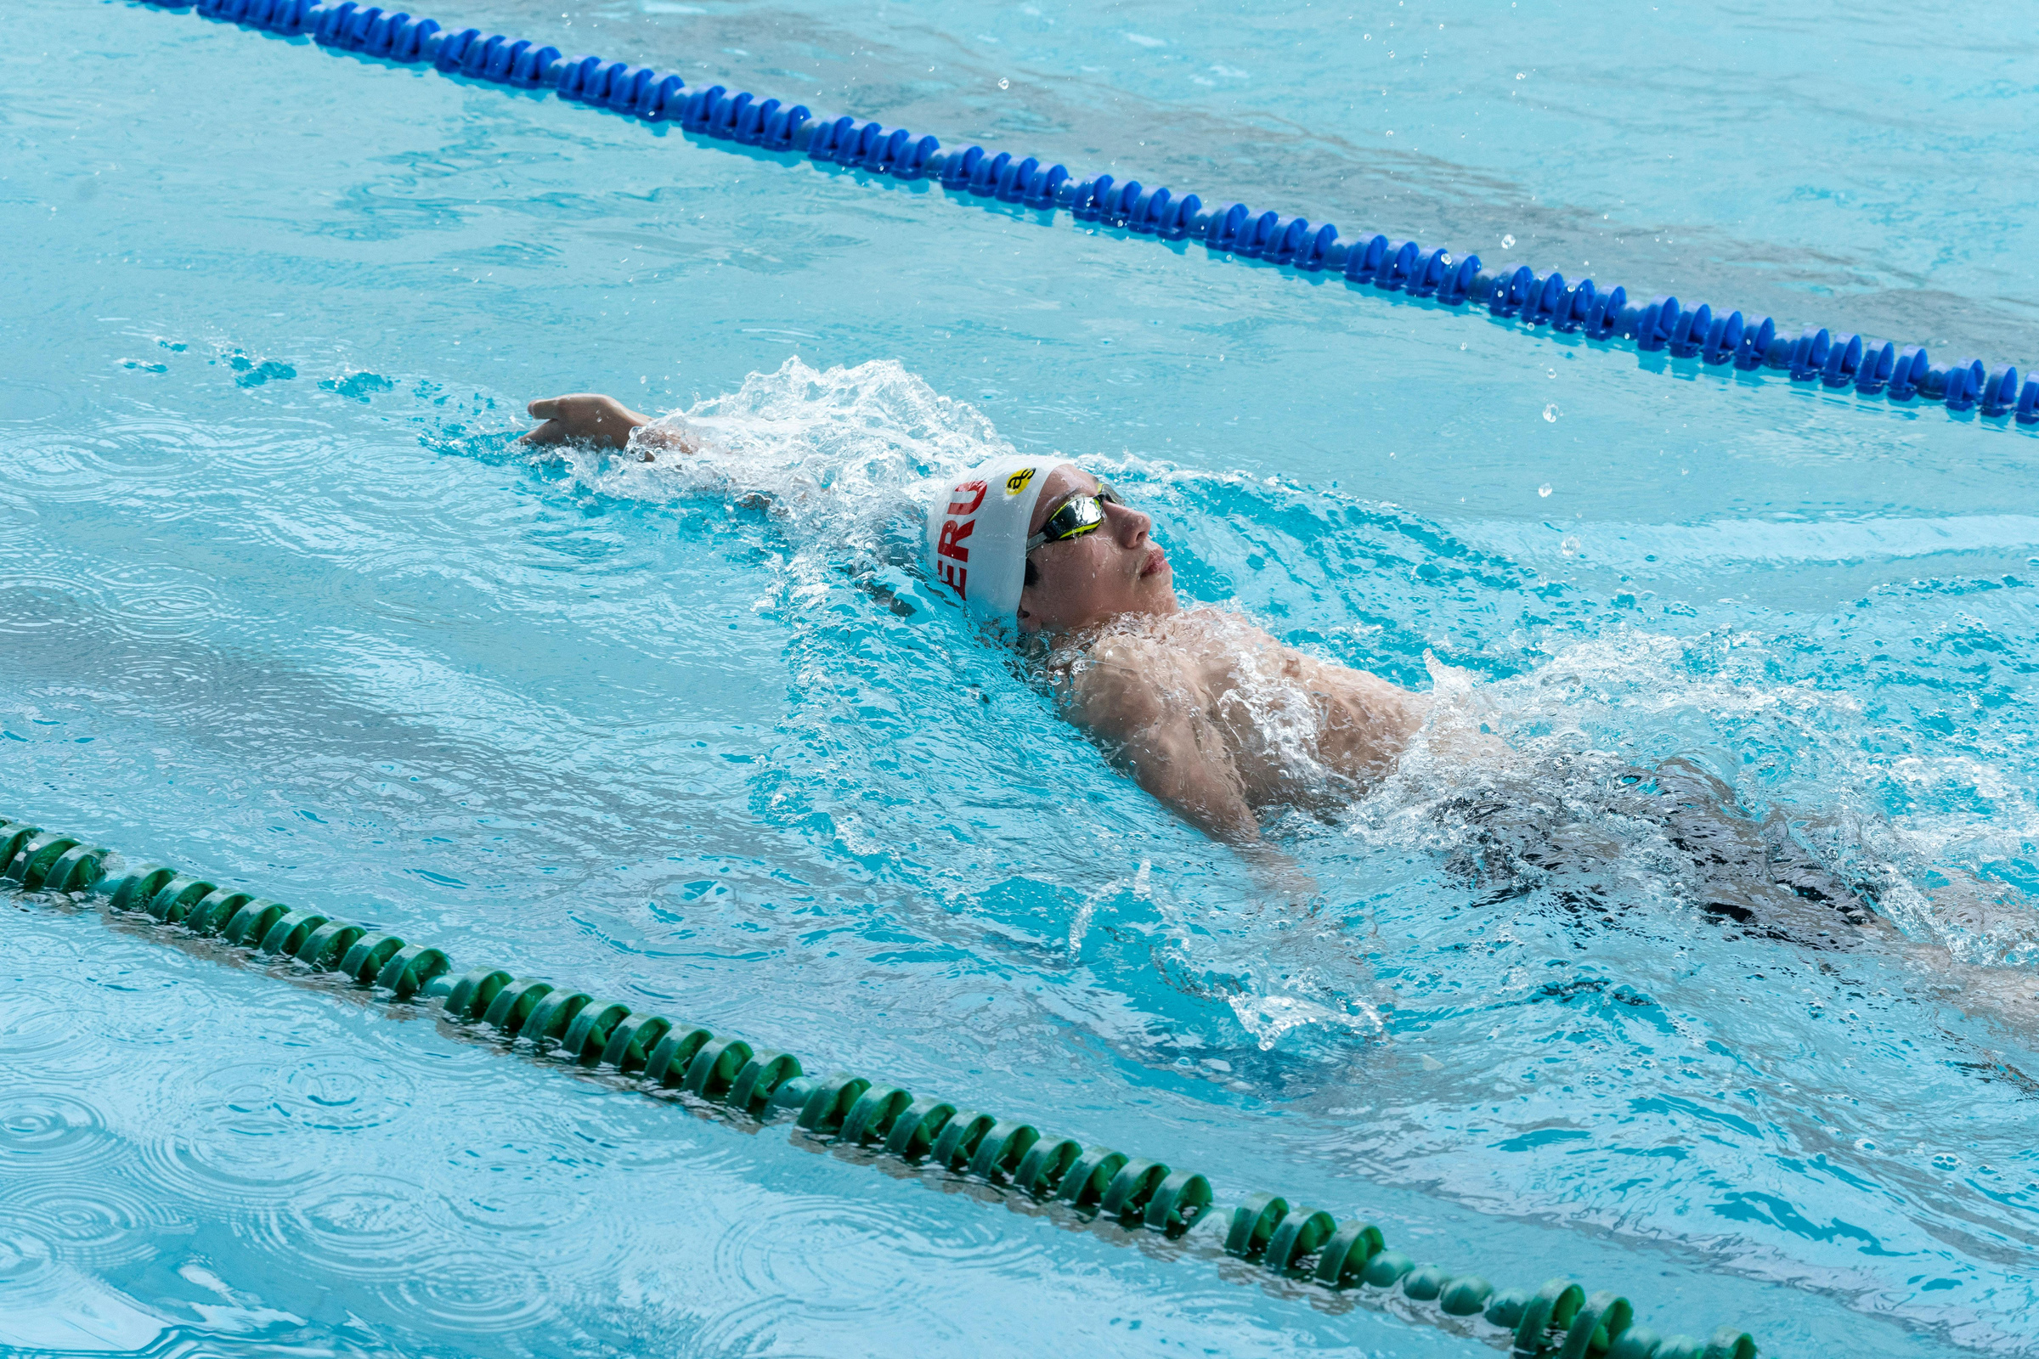
Conclusion
Michael Phelps is an excellent example of a successful professional swimmer. His achievements show that success in swimming depends on:
Regular and structured training
Proper nutrition
Correct use of supplements
A healthy and disciplined lifestyle

Slide 12


