Slide 1
Digestion and absorption of macronutrients in sport and exercise
Yaseen Galali
Nutrition department

Slide 2
DIGESTION
Digestion is the process by which the body breaks down food into nutrients, which are essential for normal bodily function
Digestion begins at the mouth and ends at the anus.
Food is digested mechanically ( chewing) and chemically (enzymatically).

Slide 3
MOUTH: THE STARTING POINT OF DIGESTION
While digestion begins in the mouth, food is primarily broken down mechanically at this.
Chewing is the first stage of digestion when food broken down and mixed with saliva.
Saliva contains amylase which breaks down starch to maltose.
Lingual lipase begins the digestion of fats and is
present in higher concentrations in the saliva of babies

Slide 4
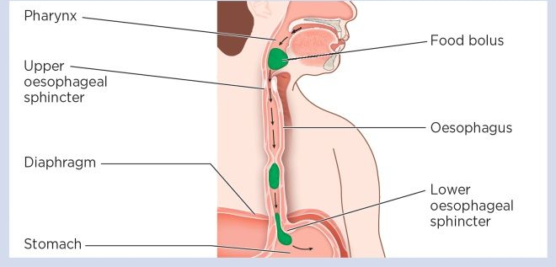
ESOPHAGUS:
Connecting the mouth to the stomach

Slide 5
STOMACH
Where hydrochloric acid plays an important role.
specialized cells secrete the gastric juices needed for digestion in the stomach.
Hydrochloric acid and intrinsic factor, which is needed for the absorption of vitamin B12, are produced at the bottom of the gastric pits

Slide 6
Hydrochloric acid is responsible for the acidic environment (pH 2) in the stomach and is important for:
• neutralisation of slightly alkaline salivary amylase, hence stopping starch digestion
• denaturation of proteins
• activation of inactive enzymes, notably activation of pepsinogen to pepsin
•Releasing vitamin B12 bound to proteins in food
• killing harmful bacteria that can cause infection or food poisoning.

Slide 7
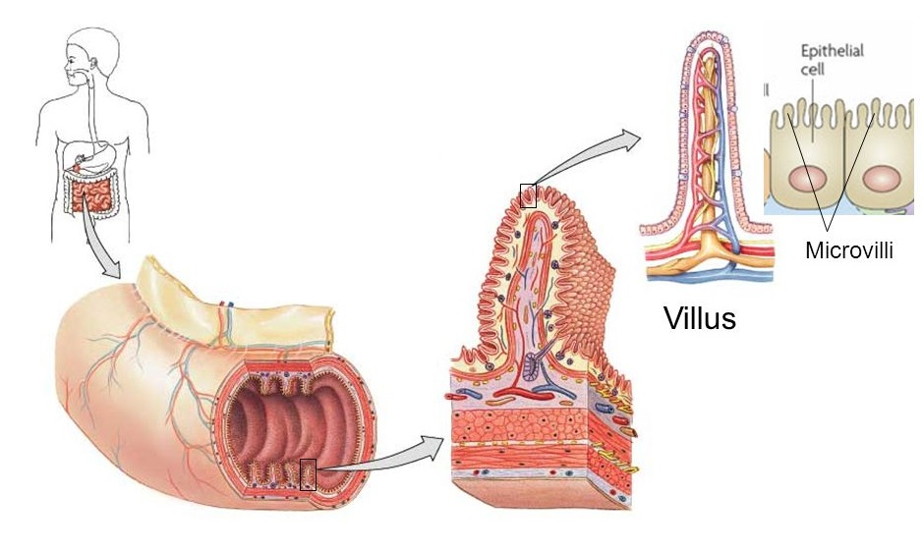
SMALL INTESTINE:
The longest part of the digestive tract.
The small intestine is a long tube (4.5 to 7.5 metres) that comprises the duodenum, jejunum and ileum.
the intestinal lumen is covered with finger-like projections called villi and microvilli.

Slide 8
Many enzymes are secreted in there where macromolecules are broken down.
The pancreas produces and secretes many enzymes used for the digestion of all three macromolecules.

Slide 9
Region of digestive tract | Substrate | Enzyme | Secreted by | End-product
Mouth | Starch | Salivary amylase (α amylase) | Salivary glands | Shorter polysaccharide chains and Dextrins
 | Fat | Lingual lipase (minor contribution to fat digestion in adults) | Salivary glands | Diglycerides and fatty acids
Stomach | Protein | Pepsinogen Activated to pepsin by HCl | Parietal cells of stomach | Polypeptides
Small intestine | Starch | Pancreatic amylase | Pancreas | Maltose
 | Sucrose | Sucrose | Small intestine | Glucose and Fructose

Slide 10
 | Maltose | Maltose | Small intestine | Glucose
Small intestine | Lactose | Lactase | Small intestine | Glucose and galactose
 | Fat | Pancreatic lipase | Pancreas | Fatty acids and glycerol
 | Polypeptides | Trypsinogen Activated to trypsin by enteropeptidases | Pancreas | Tripeptides, Dipeptides and amino acids
 | Polypeptides | Chymotrypsinogen Activated to chymotrypsin by trypsin | Pancreas | Tripeptides, dipeptides and amino acids

Slide 11
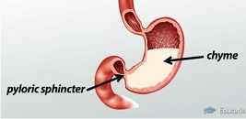
MOVEMENT OF CHYME ALONG THE SMALL INTESTINE
Upon leaving the stomach, the acidic chyme enters the duodenum via the pyloric sphincter. Upon sensing the acid, the sphincter closes until the pH rises and it relaxes again to allow the chyme to enter the duodenum.
Here the pancreatic juices neutralise stomach acid and the digestion of macronutrients continues. The frequency of opening of the pyloric sphincter is governed by stomach content, volume and chyme consistency

Slide 12
For example:
Gastric emptying is slower after a high-fat meal (hence high-fat chyme).
• Gastric emptying is faster after a large meal. The stretching and expansion of the stomach drives the opening frequency of this sphincter.
• Liquids pass through the small opening of the pyloric sphincter more easily than solid chyme.

Slide 13
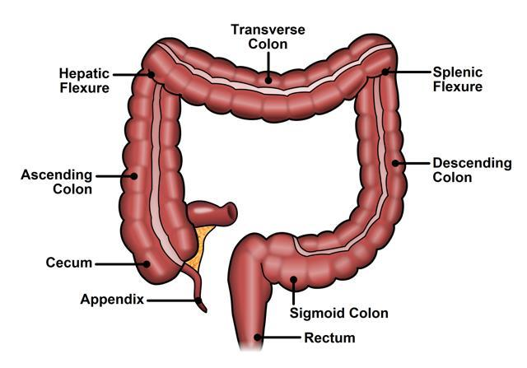
COLON (LARGE INTESTINE)
The colon is larger in diameter than the small intestine and comprises five regions.

Slide 14
The colon is larger in diameter than the small intestine and comprises five regions.
The colon serves to absorb water and some minerals from intestinal content, to sustain fermentation of intestinal content by gut bacteria and to form stools.
Transit time in the colon can range from 12 to 70 hours, during which colon content changes from liquefied form to semi-solid form due to absorption of water and digestive secretions.
Stools are generally composed of undigested food, some undigested nutrients, some water, sloughed intestinal cells, bacteria and indigestible fibre.

Slide 15
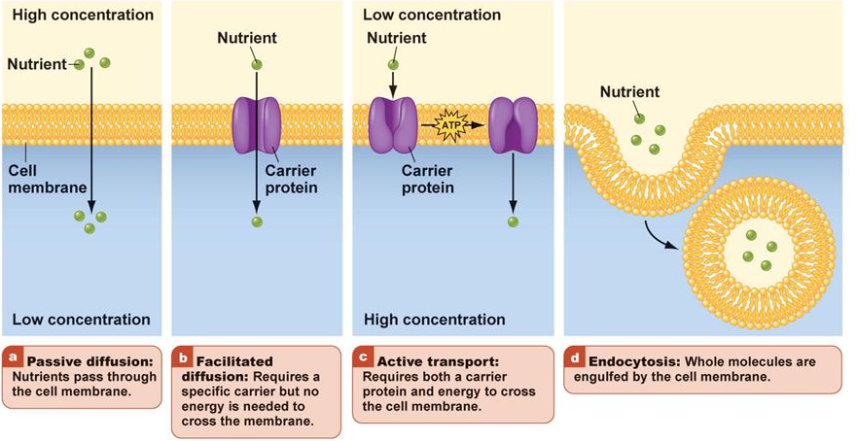
ABSORPTION
The majority of nutrients are absorbed into the enterocytes of small intestine.

Slide 16
Passive diffusion is when small molecules, such as water and small lipids, are freely absorbed into the enterocytes across the concentration gradient.
Facilitated diffusion occurs when a specific carrier is needed to transport
nutrients (for example, water-soluble vitamins) through the enterocyte cell membrane.
Active transport uses energy to transport some nutrients, against the concentration gradient.
From one side of the enterocyte cell membrane to the other.

Slide 17
1- Amino acids are absorbed through active transport,
2- Glucose which is absorbed via the transporter sodium-glucose linked transporter.
3-The water-soluble nutrients and small lipids are absorbed through the enterocytes, they enter the bloodstream and are transported to the liver for further metabolism and distribution to other parts of the body

Slide 18
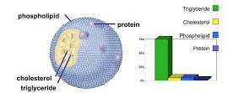
Once the water-soluble nutrients and small lipids are absorbed through the enterocytes, they enter the bloodstream and are transported to the liver for further metabolism and distribution to other parts of the body.
Larger lipids and fat-soluble vitamins are not water-soluble, and hence cannot be transported easily in blood. Instead, they are first absorbed into the enterocytes, where they are packaged with some proteins to form chylomicrons. These are then released into the lymphatic vessels for transport around the body.

