Slide 1


Department of Nutrition
2nd Stage/ 1st Semester “Nutritional Value of Processed Foods”
Effect of Heating Process on Nutritional Value
Lec .Yaseen Galali
Notes:
.

Slide 2
Heat processing
Heat processing is one of the most important methods for extending the storage life of foodstuffs.
Heat process that apply commercially include: cooking (baking, broiling, roasting, boiling, frying, and stewing), blanching, pasteurization, sterilization
Heat processing has a detrimental effect on nutrients, since thermal degradation does occur.
Thermal processing make it possible to extend shelf-life , but it may low have nutrient content than the fresh form.

Slide 3
Effects of processing and storage of food
Some vitamins are more stable (less affected by processing) than others. Water-soluble vitamins (B-group and C) are more unstable than fat-soluble vitamins (K, A, D and E) during food processing and storage. The most unstable vitamins include:
Folate B9
Thiamine B1
vitamin C.
More stable vitamins include:
niacin (vitamin B3)
vitamin K
vitamin D
biotin (vitamin B7)
pantothenic acid (vitamin B5).

Slide 4
How Cooking Affects the Nutrient Content of Foods
Eating nutritious foods can improve your health and energy levels.
Surprisingly, the way you cook your food has a major effect on the amount of nutrients it contains.
Nearly every food preparation process reduces the amount of nutrients in food. In particular, processes that expose foods to high levels of heat, light, and/or oxygen cause the greatest nutrient loss
Although cooking improves digestion and the absorption of many nutrients, it may reduce levels of some vitamins and minerals.

Slide 5
Preparation of vegetables
Most vegetables are peeled or trimmed before cooking to remove the tough skin or outer leaves. But most nutrients, such as vitamins, tend to lie close to the skin surface, so excessive trimming can mean a huge reduction in a vegetable’s nutrient value.

Slide 6
Boiling, simmering, and poaching
Boiling, simmering, and poaching are similar methods of water-based cooking.
These techniques differ by water temperature:
1- Poaching: less than 180°F (82°C)
2- Simmering: 185–200°F (85–93°C)
3- Boiling: 212°F (100°C)
For example, boiling a potato can cause much of the potato's B and C vitamins to migrate to the boiling water. You'll still benefit from those nutrients if you consume the liquid (i.e. if the potato and water are being turned into potato soup), but not if you throw away the liquid. Similar losses also occur when you broil, roast, or fry in oil, and then drain off the drippings.

Slide 7
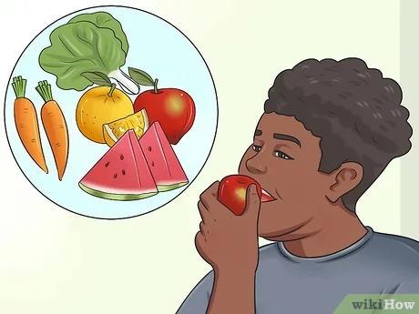
Consuming Raw Foods VS Cooked
The amount of nutrient loss caused by cooking has encouraged some health-conscious consumers to eat more raw foods. In general, this is a positive step.
However, cooking is also beneficial, because it kills potentially harmful microorganisms that are present in the food supply. In particular, poultry and ground meats (e.g. hamburger) should always be thoroughly cooked, and the surface of all fruits and vegetables should be carefully washed before eating

Slide 8

Benefits of cooking food
Cooking can be advantageous in many ways, including:
1-making the food tastier
2-breaking down parts of vegetables that would otherwise be indigestible
3-destroying bacteria or other harmful micro-organisms
4-making phytochemicals more available, for instance, phytochemicals are more available in cooked tomatoes than in raw tomatoes. (Phytochemicals are chemicals produced by plants).

Slide 9
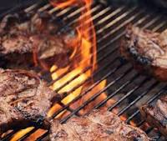
Grilling and broiling
Grilling and broiling are similar methods
of cooking with dry heat.
When grilling, the heat source comes from below, but when broiling, it comes from above.
Grilling is one of the most popular cooking methods because of the great flavor it gives food.
However, up to 40% of B vitamins and minerals may be lost during grilling or broiling when the nutrient-rich juice drips from the meat.
There are also concerns about polycyclic aromatic hydrocarbons (PAHs), which are potentially cancer-causing substances that form when meat is grilled and fat drips onto a hot surface.
However, researchers have found that PAHs can be decreased by 41–89% if drippings are removed and smoke is minimized

Slide 10

Grilling Meats
Outdoor grilling is a popular cooking method, primarily because of the wonderful taste it imparts on meats. It can also be a healthy alternative to other cooking methods, because some of the meat's saturated fat content is reduced by the grilling process. However, grilling also presents a health risk.
Two separate types of carcinogenic compounds are produced by high-temperature grilling:
1-heterocyclic amines (HCAs) HCAs form when a meat is directly exposed to a flame or very high-temperature surface. The rich meat juices react with the heat to form various HCAs. HCAs have been shown to cause DNA mutation, and may be a factor in the development of certain cancers.
2-polycyclic aromatic hydrocarbons (PAHs) PAHs form in smoke that's produced when fat from the meat drips on the hot coals of the grill. Various PAHs present in the resulting smoke,, adhere to the outside surface of the grilled meat. PAH exposure is also believed to be linked to certain cancers.

Slide 11
Grilling Meats
HCA and PAH content in meats can be dramatically reduced by slight alterations in your grilling method. In particular, the following practices will reduce the amount of HCAs and PAHs formed:
Select leaner meats. Leaner cuts of meat are less likely to drip fat on the grill and produce PAH-laden smoke.
Marinate meats before grilling. Researchers have determined that marinating meat prior to grilling, even for just a few minutes, can reduce HCA formation by 90% or more. It's believed that the marinade forms a protective barrier for the meat juices that prevents the HCA reaction from occurring.
Grill at lower temperatures. Lower temperature "roasting" also greatly reduces HCA formation.

Slide 12
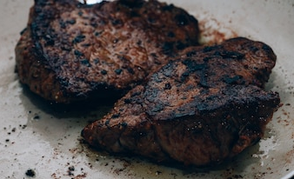
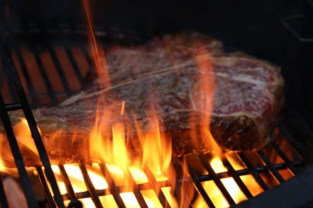
Prevent flare-ups.
Flames from grill flare-ups cause the formation of both HCAs and PAHs. Keep an eye on your grill and turn meats frequently to minimize the chance of flare-ups.
Don't overcook meats. While it's important to cook poultry and ground meats thoroughly, be careful not to overcook any meat. Well-done or burnt meats contain higher levels of HCAs than less cooked meats. For thicker cuts of meat, use a meat thermometer to measure doneness rather than just guessing.

Slide 13
Microwaving
Microwaving is an easy, convenient, and safe method of cooking.
Short cooking times and reduced exposure to heat preserve the nutrients in microwave food.
In fact, studies have found that microwaving is the best method for retaining the antioxidant activity of garlic and mushrooms .
Meanwhile, about 20–30% of the vitamin C in green vegetables is lost during microwaving, which is less than most cooking methods.
SUMMARY: Microwaving is a safe cooking method that preserves most nutrients due to short cooking times.

Slide 14
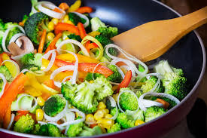
stir-frying
With sautéing and stir-frying, food is cooked in a saucepan over medium to high heat in a small amount of oil or butter.
These techniques are very similar, but with stir-frying, the food is stirred often, the temperature is higher, and the cooking time is shorter.
In general, this is a healthy way to prepare food.
Cooking for a short time without water prevents the loss of B vitamins, and the addition of fat improves the absorption of plant compounds and antioxidant.
One study found that the absorption of beta carotene was 6.5 times greater in stir-fried carrots than in raw ones.
In another study, blood lycopene levels increased 80% more when people consumed tomatoes sautéed in olive oil rather than without it
On the other hand, stir-frying has been shown to significantly reduce the amount of vitamin C in broccoli and red cabbage.
SUMMARY: Sautéing and stir-frying improve the absorption of fat-soluble vitamins and some plant compounds, but they decrease the amount of vitamin C in vegetables.

Slide 15
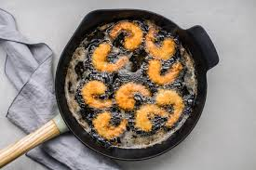
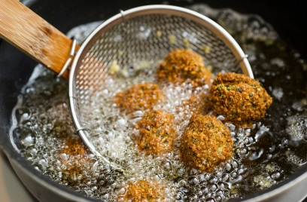
Frying
Frying involves cooking food in a large amount of fat — usually oil — at a high temperature. The food is often coated with batter or bread crumbs.
It's a popular way of preparing food because the skin or coating maintains a seal, which ensures that the inside remains moist and cooks evenly.
The fat used for frying also makes the food taste very good.
However, not all foods are appropriate for frying.
Fatty fish are the best sources of omega-3 fatty acids, which have many health benefits. However, these fats are very delicate and prone to damage at high temperatures.
For example, frying tuna has been shown to degrade its omega-3 content by up to 70–85%, while baking causes only minimal losses.

Slide 16
Frying
In contrast, frying preserves vitamin C and B vitamins, and it may also increase the amount of fiber in potatoes by converting their starch into resistant starch.
When oil is heated to a high temperature for a long period of time, toxic substances called aldehydes are formed. Aldehydes have been linked to an increased risk of cancer and other diseases.
The type of oil, temperature, and length of cooking time affect the amount of aldehydes produced. Reheating oil also increases aldehyde formation.
If you're going to fry food, don't overcook it, and use one of the healthiest oils for frying.
SUMMARY: Frying makes food taste delicious, and it can provide some benefits when healthy oils are used. It's best to avoid frying fatty fish and minimize the frying time of other foods.

Slide 17
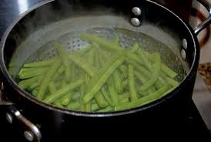
Steaming
Steaming is one of the best cooking methods for preserving nutrients, including water-soluble vitamins, which are sensitive to heat and water.
Researchers have found that steaming broccoli, spinach, and lettuce reduces their vitamin C content by only 9–15% .
The downside is that steamed vegetables may taste bland. However, this is easy to remedy by adding some seasoning and oil or butter after cooking.
SUMMARY: Steaming is one of the best cooking methods for preserving nutrients, including water-soluble vitamins.
Blanching
Before a food is canned or frozen, it is usually heated very quickly with steam or water. The water-soluble vitamins, including vitamin C and B-complex, are sensitive and easily destroyed by blanching.

Slide 18
The table below compares the typical maximum nutrient losses for common food processing methods.
This table is included as a general guide only. Actual losses will depend on many different factors, including type of food and cooking time and temperature. For additional data on specific preparation methods, please see the USDA Table of Nutrient Retention Factors (2003)

Slide 19
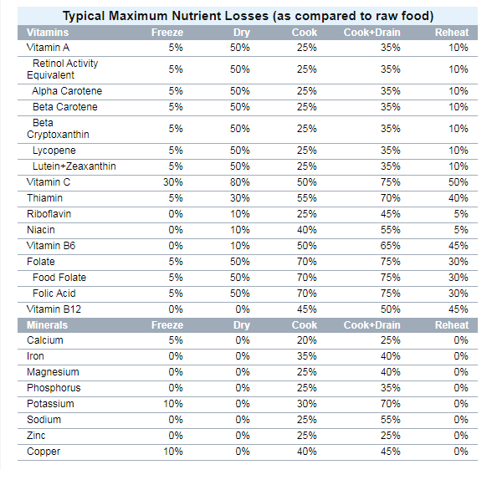

Slide 20
Tips to maximize nutrient retention during cooking
Use as little water as possible when poaching or boiling.
Consume the liquid left in the pan after cooking vegetables.
Add back juices from meat that drip into the pan.
Don't peel vegetables until after cooking them. Better yet, don't peel at all to maximize their fiber and nutrient density.
Cook vegetables in smaller amounts of water to reduce the loss of vitamin C and B vitamins.
Try to eat any cooked vegetables within a day or two, as their vitamin C content may continue to decline when the cooked food is exposed to air.
Cut food after — rather than before — cooking, if possible. When food is cooked whole, less of it is exposed to heat and water.
Cook vegetables for only a few minutes whenever possible.
When cooking meat, poultry, and fish, use the shortest cooking time needed for safe consumption.
Don't use baking soda when cooking vegetables. Although it helps maintain color, vitamin C will be lost in the alkaline environment produced by baking soda.

Slide 21
Preserving the nutrient value of vegetables
Some suggestions to retain the maximum nutrition in the foods you cook include:Store foods properly, such as keeping cold foods cold and sealing some foods in airtight containers.
Keep vegetables in the crisper section of the refrigerator.
Try washing or scrubbing vegetables rather than peeling them.
Use the outer leaves of vegetables like cabbage or lettuce unless they are wilted or unpalatable.
Microwave, steam, roast or grill vegetables rather than boiling them.
If you boil your vegetables, save the nutrient-laden water for soup stock.
Use fresh ingredients whenever possible.
Cook foods quickly.

Slide 22
Tips to maximize nutrient retention during cooking
It's important to select the right cooking method to maximize the nutritional quality of your meal.
However, there is no perfect cooking method that retains all nutrients.
In general, cooking for shorter periods at lower temperatures with minimal water will produce the best results.
Don't let the nutrients in your food go down the drain.

Slide 23
