Slide 1
Energy for Sport and exercise
Assist Prof Yaseen Galali
Nutrition Department

Slide 2
ENERGY FOR SPORT AND EXERCISE
Our bodies require a constant supply of energy to fuel our working organs, including the brain, heart, lungs and muscles.
The major energy currency within the human body is an energy-rich molecule known as adenosine triphosphate, or ATP.

Slide 3
At rest, the demand for ATP is low; however, sport and exercise can increase this demand as much as a thousand fold, requiring a coordinated metabolic response by the energy systems to replenish ATP levels.
The contribution of each energy system is determined by the interaction between the intensity and the duration of exercise, and is regulated by metabolic processes and the central nervous system.

Slide 4
THE RELATIONSHIP BETWEEN ENERGY, WORK AND POWER
The two major forms are
kinetic energy: is the energy in moving objects or mass, such as mechanical energy and electrical energy
potential energy: is any form of energy that has stored potential and can be put to future use such as nuclear energy and chemical energy (ATP)

Slide 5
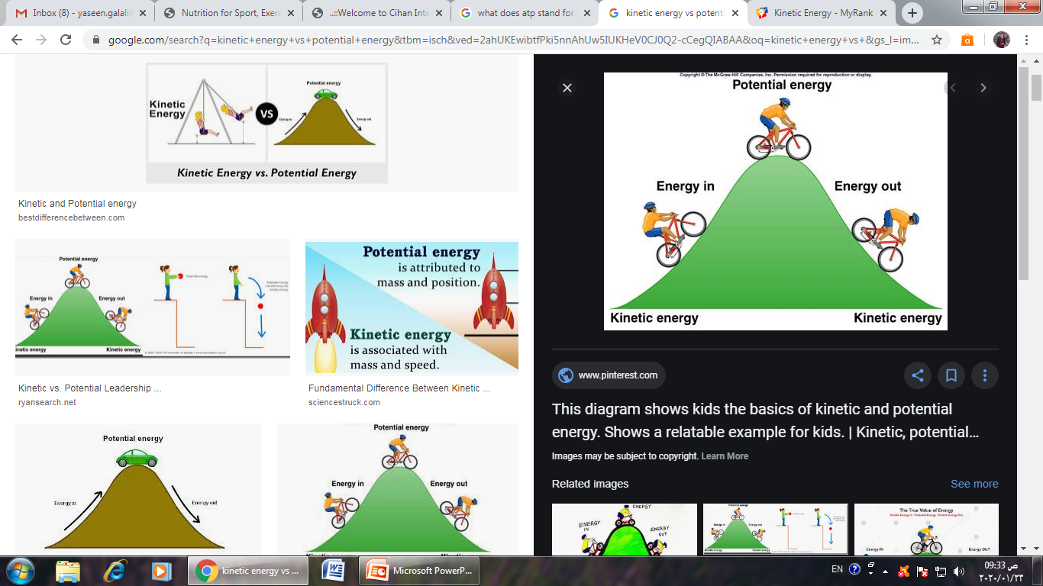
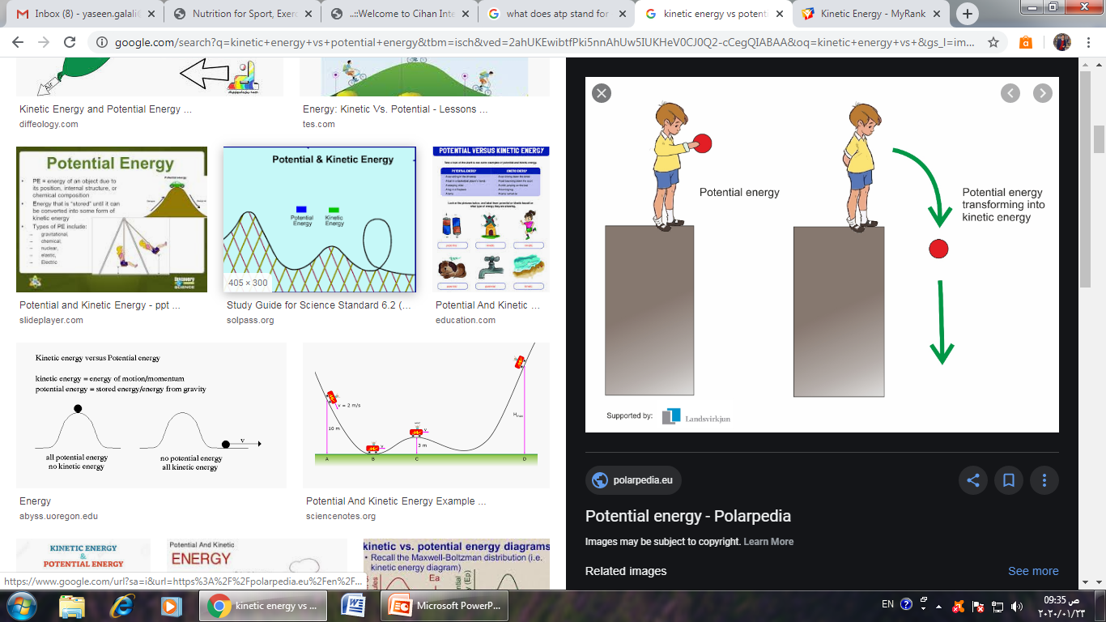
Kinetic energy is energy possessed by a body its movement.
Potential energy is the energy possessed by a body its position or state

Slide 6
Equation 1: Work done (Newton∙metres [N∙m] or Joules [J]) = Force (N) × Distance (m)
For example, the greater the force required to move an object, or the further the distance of the object to be moved, the greater the work done
Equation 2: Power (Watts [W]) = Work done (J) ÷ Time (s).
Therefore, the faster the rate at which work is completed, the higher the power output.
With sufficient training, athletes can develop physiological adaptations that allow them to perform a larger amount of work in a short period of time, thus generating higher power outputs

Slide 7
ENERGY IN THE HUMAN BODY
Chemical energy is a form of potential energy that is stored in the bonds of atoms and molecules.
Carbohydrates, protein, fats and alcohol re sources of energy in the diet. Under normal circumstances, more than 95 per cent of this food energy is digested and absorbed from the gastrointestinal tract, providing the body with its chemical energy needs

Slide 8
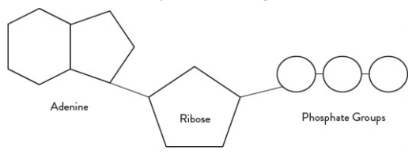
Within the body, the major energy currency is the ATP molecule, which comprises three components: An adenine ring (as part of adenosine), ribose sugar and three phosphate groups (triphosphate)

Slide 9
In the presence of water, ATP can be broken down to form adenosine diphosphate (ADP). This process is known as hydrolysis. Living cells contain ten times more ATP than ADP.
When ATP is hydrolysed to ADP, a large
amount of energy is released. The release of this free energy from the high energy bonds is used to drive energy-requiring reactions such as protein synthesis.

Slide 10
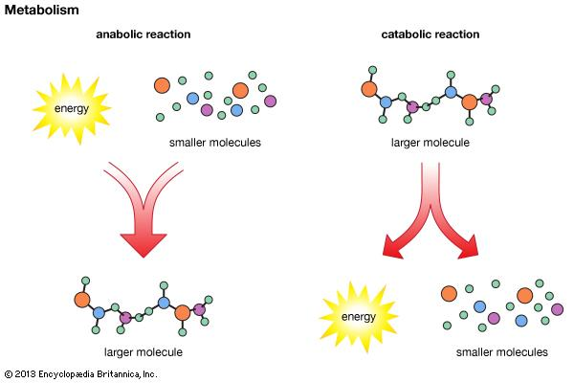
Reactions within a cell can be classed as either catabolic or anabolic.
Catabolic reactions involve breaking molecules down into their smaller components; energy is released as a by-product of these reactions.

Slide 11
Anabolic reactions involve combining simple molecules to form complex molecules, and energy in the form of ATP is required to support these reactions. Energy yielding reactions (catabolic) within a cell are typically coupled to energy requiring reactions (anabolic). The high-energy bonds of ATP thus play a central role in cell metabolism by serving as a usable storage form of free
energy.

Slide 12
PRODUCTION OF ENERGY: THE ROLE OF METABOLIC PATHWAYS
The three main metabolic pathways for ATP resynthesis
(a) the phosphagen system (ATP-PCr, alactacid),
(b) anaerobic glycolysis (lactic acid) and
(c) oxidative phosphorylation (mitochondrial ATP production).
Both the phosphagen system and glycolysis pathway occur in the cytoplasm (cytosol) of the cell. Oxidative phosphorylation occurs within the mitochondria. Mitochondria are known as the powerhouses of the cell. They are organelles that act like a digestive system to take in nutrients, break them down and create energy-rich molecules for the cell.

Slide 13
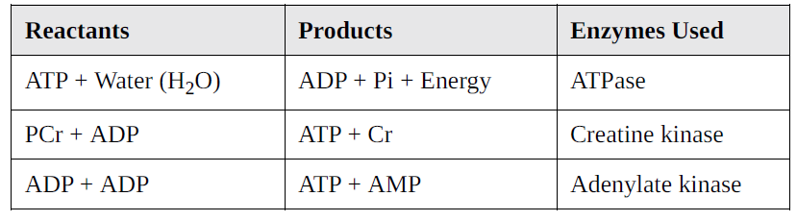
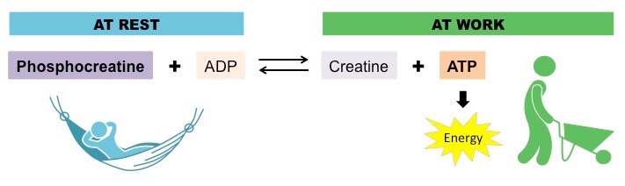
1-THE PHOSPHAGEN SYSTEM
The phosphagen system is the quickest way to resynthesise ATP, and comprises three reactions
Phosphocreatine (PCr) donates a phosphate to ADP to produce ATP. Despite its ability to rapidly resynthesise ATP, the total capacity of this high-energy phosphate system to sustain maximal muscle contraction is about four seconds, assuming complete depletion of PCr and ATP

Slide 14
2- GLYCOLYSIS
The complete oxidative breakdown of glucose to carbon dioxide (CO2) and water (H2O) is written as follows:
C6H12 + 6O2 → 6 CO2 + 6 H2O+energy
Glycolysis
The breakdown of glucose to form two molecules of ATP.

Slide 15
The terms ‘aerobic’ and ‘anaerobic’ are used to describe the different conditions by which oxidation of food molecules especially glucose, fatty acids and proteins occur (known as respiration).
Aerobic respiration occurs when adequate oxygen is present,
anaerobic respiration occurs when lack of oxygen is present and the demand for ATP is high

Slide 16
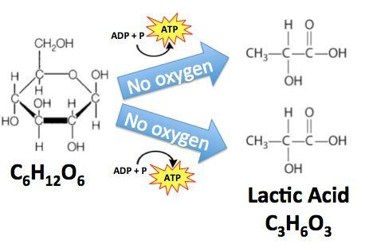
(Lactic acid: A by-product of anaerobic glycolysis that contributes to fatigue of the muscle)

Slide 17
MITOCHONDRIAL OXIDATIVE PHOSPHORYLATION
is the only source of ATP production that has the capacity to support prolonged exercise.
The total yield from the complete oxidation of a glucose molecule is 38 molecules of ATP.

Slide 18
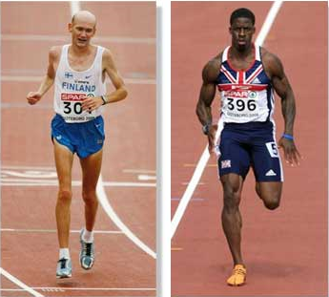
INTERACTION AMONG METABOLIC ENERGY SYSTEMS: INFLUENCE OF SPORT AND EXERCISE
The interaction and relative contribution of the three energy systems during different exercise intensities and sporting activities have been of considerable interest to exercise scientists.
Compare the demands of a 100-metre sprint to a 42.2-kilometre marathon?

Slide 19
The sprint is fast, with minimal oxygen breathed in during its ten-second duration, making the event almost exclusively anaerobic .
The marathon, on the other hand, is primarily an aerobic event completed in two to two-and-a-half hours at 80–85 per cent of an elite athlete’s maximal capacity

Slide 20
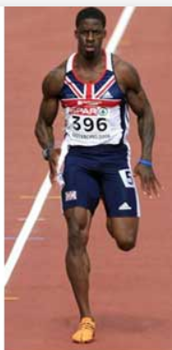
Despite the different demands of each event, all systems ( three pathways) are activated at the start of exercise to maintain ATP levels and ensure adequate supply for maximal power output and intensity.
The anaerobic (non-mitochondrial) systems, which are capable of supporting extremely high muscle force application and power outputs such as those during a 100-metre sprint, would be the predominant energy
system used at these times

Slide 21

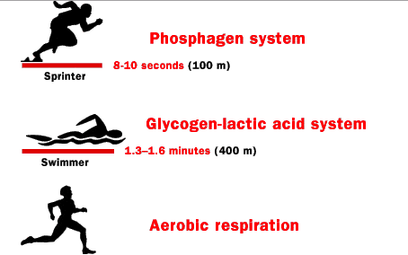
During a marathon race, the anaerobic system, which is limited in its capacity, is unable to meet the energy demands required by extended periods of intense exercise.
The aerobic energy system (oxidative metabolism) is the only system that can resynthesise ATP to meet required energy.

Slide 22
QUANTIFYING ENERGY EXPENDITURE: APPLICATIONS IN SPORT AND EXERCISE
Regardless of which energy system predominates during exercise, Measurement of an athlete’s energy expenditure helps determine the daily energy requirements for the athlete’s training and competition.
So, how do we measure energy expenditure?

Slide 23
We know that the rate of energy metabolism is directly proportional to the amount of heat our whole body produces. As such, the rate of metabolism can be quantified by measuring heat produced by the body. This direct measurement method is known as direct calorimetry

Slide 24
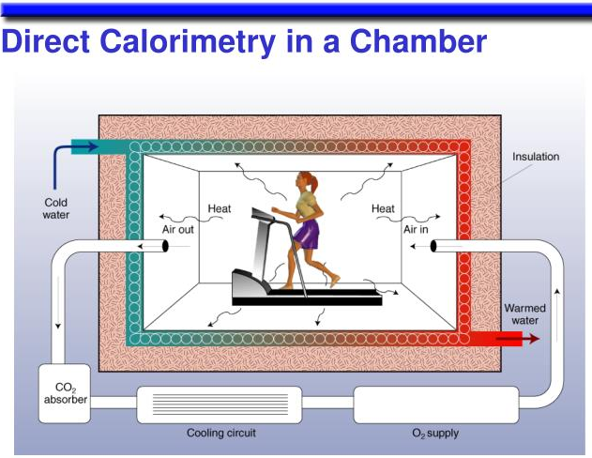
Direct calorimetry requires a person to be placed in an insulated chamber which allows all heat production within the chamber to be measured,highly accurate, building a calorimeter is expensive

Slide 25
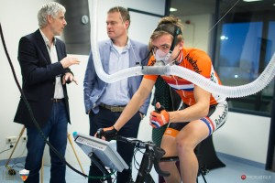
a cheaper and smaller—but still accurate—method known as indirect calorimetry is more widely used for measuring energy expenditure.
This involves collecting all exhaled gases into a mixing
chamber, which is then processed and analysed by a metabolic cart

Slide 26
Indirect calorimetry
A method of estimating energy expenditure by measuring oxygen consumption and carbohydrate
production.
CO2 produced and O2 consumed can also be expressed as a ratio (CO2/O2) to obtain a number that is normally between 0.7 and 1.0. This number is known as the respiratory exchange ratio (RER), and represents the composition of the mixture of lipids (fats) and carbohydrates oxidised through metabolism during submaximal exercise

Slide 27
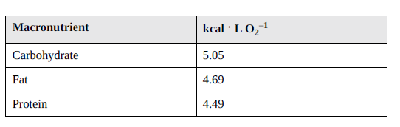
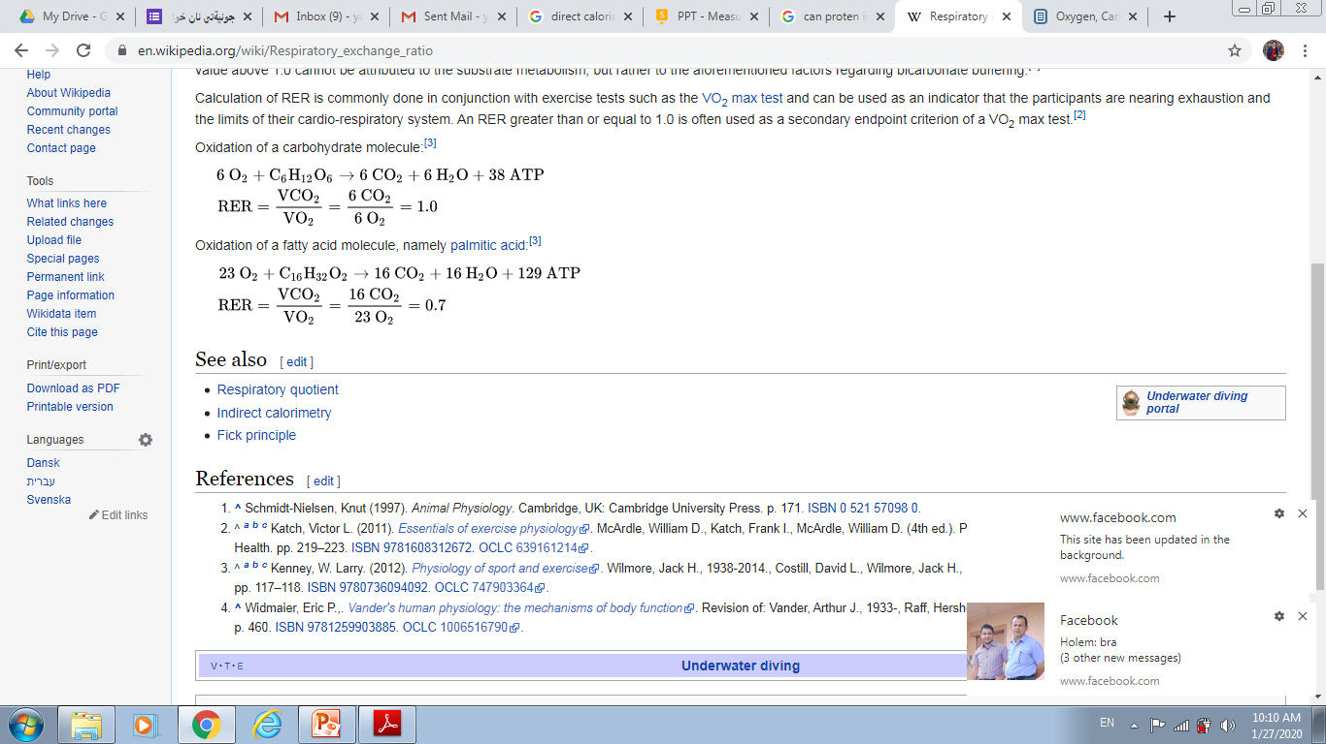
Energy produced per litre of O2 when metabolising different macronutrients

Slide 28
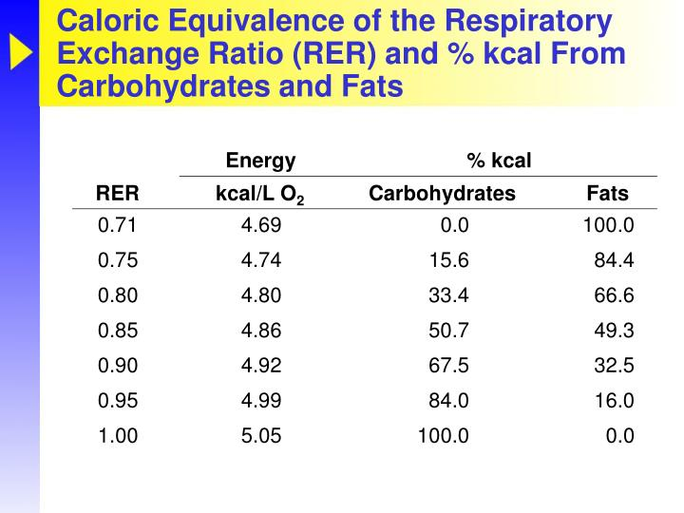
Respiratory exchange ratio (RER)
The ratio of carbon dioxide produced to oxygen consumed; used to indicate the relative contribution of substrates oxidized during submaximal exercise.

Slide 29
ESTIMATING DAILY ENERGY REQUIREMENTS
The daily energy expenditure for healthy adults can be calculated using
the equations below, formulated based on adults 19–78 years of age. It is
important to keep in mind that factors other than those accounted for
within these equations can also influence resting energy expenditure.
These factors include climate, body composition and surface area of the
body.
Equations:
For females: resting energy expenditure (kJ/day)
= 9.99 × (weight in kg) + 6.25 × (height in cm) – 4.92 × age – 161
For males: resting energy expenditure (kJ/day)
= 9.99 × (weight in kg) +
6.25 × (height in cm) – 4.92 × age + 5

Slide 30
Resting energy expenditure calculated from the above equations can be multiplied by a factor according to the individual’s physical activity level (PAL) for an estimated total daily energy expenditure. These factors are
defined as:
1.0–1.39: Sedentary, activities of daily living, sitting in office
1.4–1.59: Activities of daily living plus 30–60 minutes of light intensity activity (e.g. walking)
1.6–1.89: Activities of daily living plus standing, carrying lightloads, 60 minutes of walking
1.9–2.5: Activities of daily living plus strenuous work or highly active/ athletic lifestyle

