Slide 1
FATS or LIPIDS

Slide 2
FATS or Lipids
Most concentrated form of energy
- Contains 9 calories per gram fat
- It is recommended 15-25% fat in the diet (Normal diet)
- The basic unit of fat is called “triglyceride”, which consist of molecule of glycerol attached to the 3 fatty acids

Slide 3
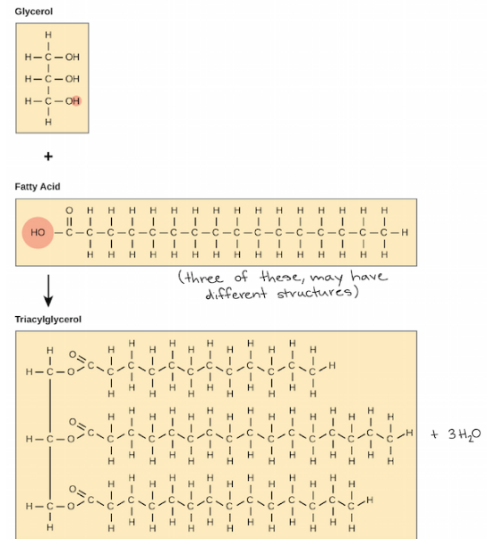

Slide 4
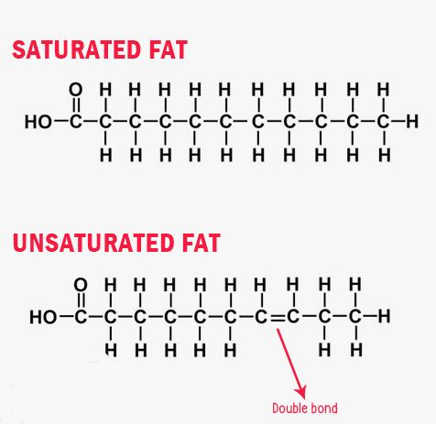
3 Forms Fatty Acids
1) Saturated Fats – Shown to raise blood cholesterol.
• Considered the “dangerous” type of fat that lead to raise blood cholesterol may lead to coronary heart disease if eaten
In high amount
• Difficult to metabolize causing weight gain
Sources: butter, lard, meat, cheese, eggs, coconut oil, chocolate, cakes, cookies

Slide 5
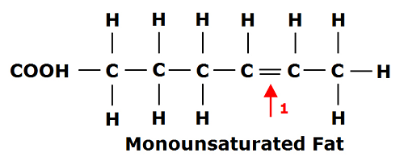
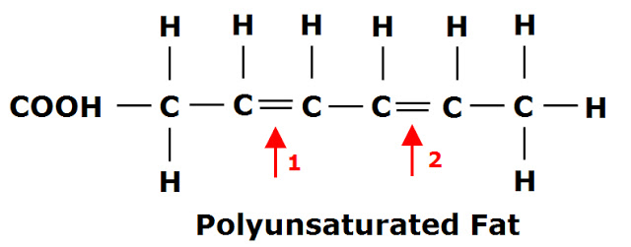
2) Monounsaturated fats – lower level of “bad” cholesterol
Sources:
Vegetable oil, peanut, soybean, corn, olive oil, canola oil
3) Polyunsaturated Fats :Lower levels of total cholesterol.
Sources Sunflower seeds., Flax seeds or flax oil ,Fish, such as salmon, mackerel, herring, albacore tuna, and trout. ,Corn oil. Soybean oil. Safflower oil

Slide 6
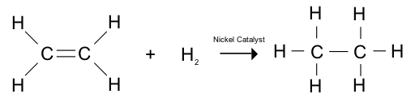
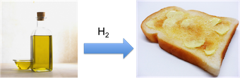
Hydrogenated fats are fatty acids that have been chemically altered. In general, hydrogenated fats were oils whose chemical structures were changed to become solid fats. ( E.g Spreads, mayonnaise, margarine, butter, Baked goods – cupcakes, donuts

Slide 7
Sources of Fat
1) Animal Fats – fat from meat, fish, poultry, milk, milk products and eggs.
2) Vegetable Fats – margarine, seed and vegetable oil, nuts
3) Visible Fats – butter, cream, margarine, lard, fish liver oils, pork fat
4) Invisible Fats – cheeses, olives, cakes, nuts, pastries

Slide 8
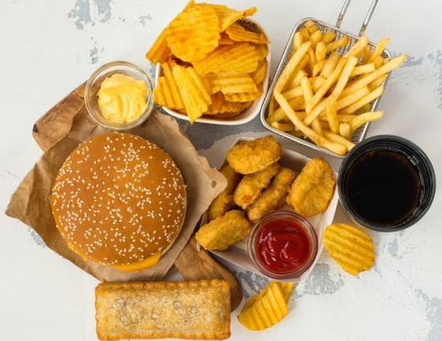
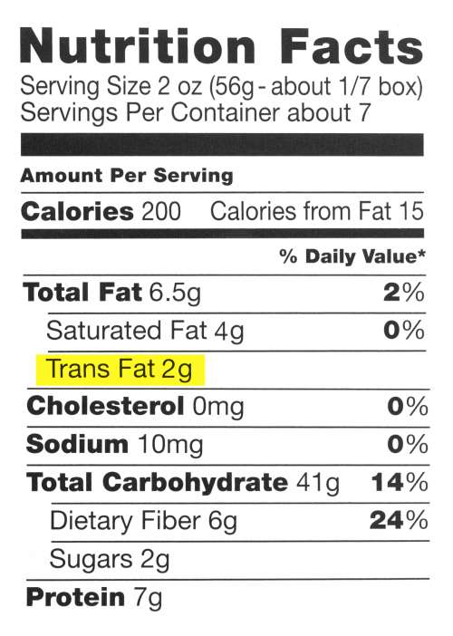
Foods may contain Trans fats
1. Spreads – mayonnaise, margarine, butter
2. Package foods – cake mixes, biscuits
3. Soups – noodle soups
4. Fast foods – Mcdonalds, Kentucky Fried Chicken
5. Frozen foods – frozen pies, pizza, breaded fish sticks, breaded chicken
6. Baked goods – cupcakes
7. Cookies & cakes
8. Donuts
9. Cream Filled cookies
10. Chips & Crackers

Slide 9
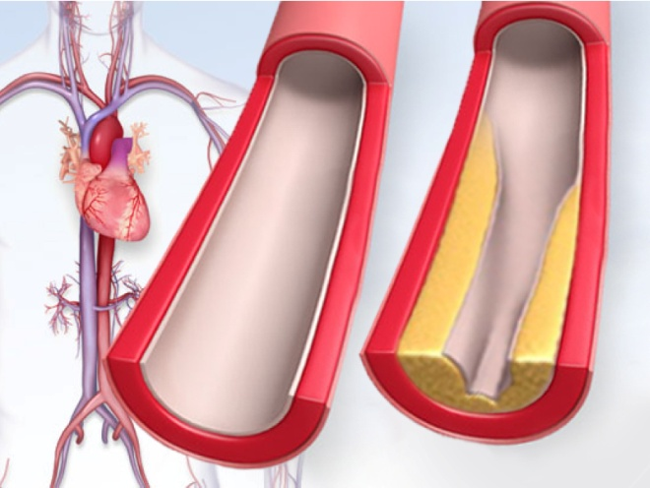
Cholesterol
Cholesterol is a major component of all cell membranes. It is required for synthesis of sex hormones,
bile acids, and vitamin D. It is also a precursor of the steroid hormones.
➢ Cholesterol is also made in the body and is taken also through foods
➢ But Cholesterol is a major factor in the development of heart diseases
➢ Daily intake should not exceed 300 mg./day

Slide 10
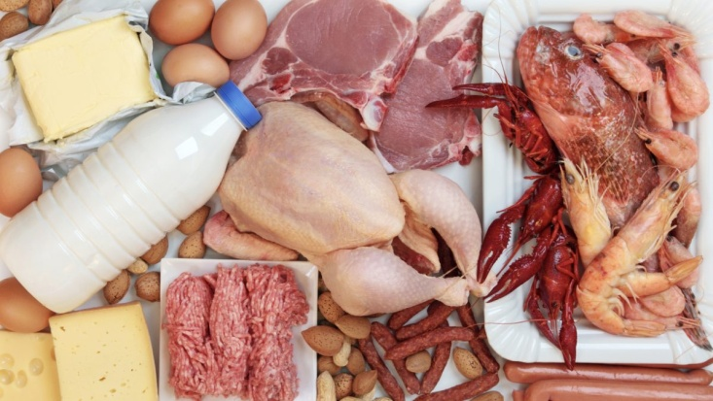
Source of Dietary Cholesterol
Richest: egg yolk, fish roes, mayonnaise and shell fish.
Moderate : Fat on meat, duck, goose, cold cuts, whole milks, cream, ice cream, cheese, butter
and most commercially made cakes, biscuits and pastries.
Poor : All fish and fish canned in vegetable oil, very lean meats, poultry without skin, skimmed
milk , low fat yoghurt and cottage cheese.
Cholesterol free : All vegetables, and vegetable oils, fruit (including avocados and olives), nuts,
rice, egg white and sugar.

Slide 11
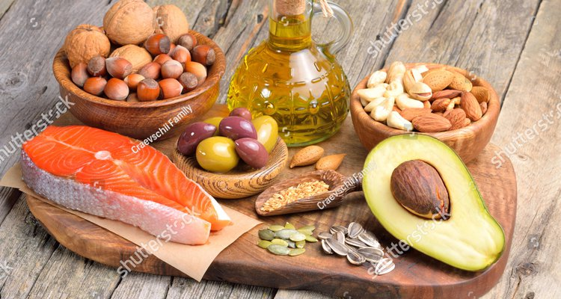
Functions:
1) Important source of calories to provide a continuous supply if energy.
2) Protein sparing
3) Maintain the constant blood temperature
4) Cushions vital organs such as kidney against injury
5) Facilitates the absorption of fat soluble vitamins (ADEK)
6) Provides satiety and delays hunger.
7) Contributes flavour and palatability to the diet.

Slide 12
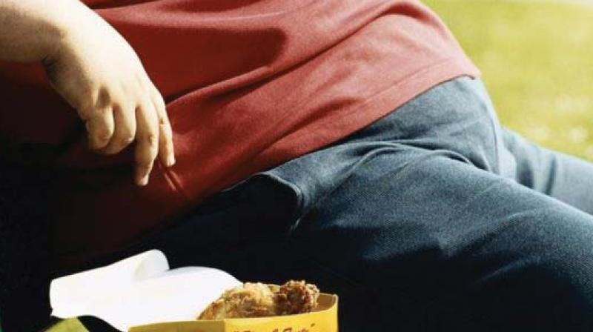
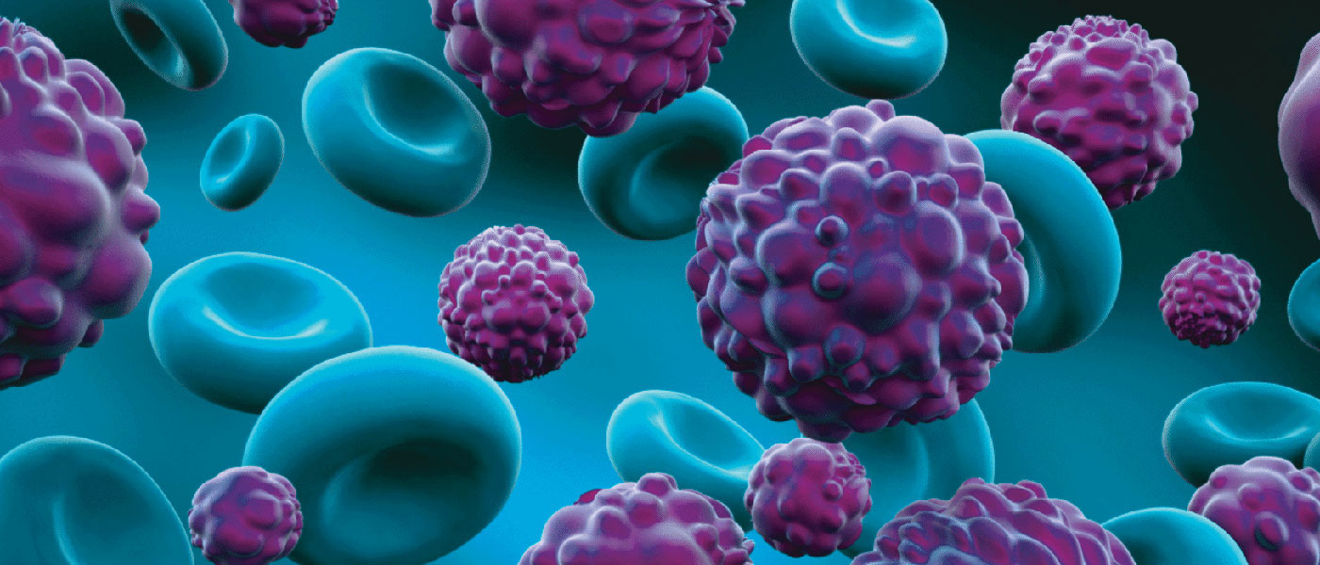
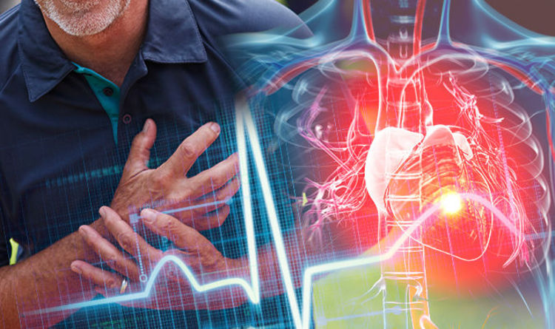
Diseases might be related to excessive fat consumption!
1) Heart Disease
2) Cancer
3) Obesity
4)diabetes

