Slide 1
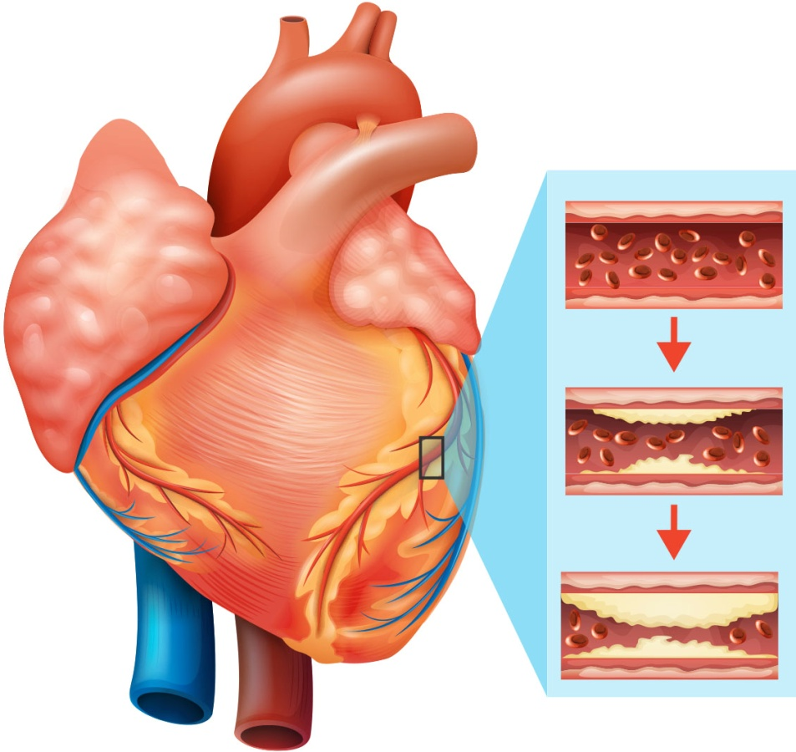
Coronary heart disease and functional food
Yaseen Galali
Nutrition department

Slide 2
Coronary heart disease
Coronary heart disease (CHD) is one of the major causes of death in adults in the Western world.
CHD is a condition in which the main coronary arteries supplying the heart
are no longer able to supply sufficient blood and oxygen to the heart muscle
(myocardium).

Slide 3
The main cause of the reduced flow is an accumulation of plaques, mainly in the intima of arteries, a disease known as atherosclerosis.
This is a slow but progressive disease which usually begins in childhood, but does not usually manifest itself until later life

Slide 4
Depending on the rate of the narrowing of the arteries and its ultimate severity, four syndromes may occur during the progression of CHD. These include angina pectoris, unstable angina pectoris, myocardial infarction and sudden death.

Slide 5
Risk factors
A number of risk factors known to predispose an individual to CHD have been categorised into:
those that are not modifiable, such as age, sex, race and family history
those that are modifiable, such as hyperlipidaemia (high levels of lipids (fat) in the blood), hypertension (high blood pressure), obesity, cigarette smoking and lack of exercise

Slide 6
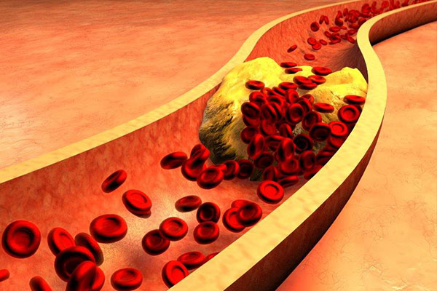
A recently recognised risk factor for CHD is an elevated level of triacylglycerol (TAG; major fat in the blood) in both the fasted and fed (postprandial) state

Slide 7
Individuals with CHD and those with a high risk of developing the condition are treated in a number of ways to help lower their LDL cholesterol and TAG concentrations while elevating their HDL cholesterol
Many studies have confirmed that modifying diet is one of the ways of treatment.
This is implemented by reducing the percentage of dietary energy derived from fat to approximately 30%, with a reduction of saturated fatty acids to 10% of the dietary energy derived from fat

Slide 8
The effect of the ingestion of different fatty acids on plasma cholesterol levels is varied and is summarised in Table 5.5. Substitution of SFAs by MUFAs or n-6 PUFAs significantly reduces LDL cholesterol levels although n-6 PUFA are more effective in this respect.

Slide 9
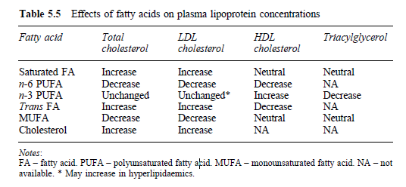

Slide 10
There has been doubt as to whether MUFAs are effective in cholesterol-lowering or whether the observed decrease in plasma cholesterol was simply due to a replacement of SFAs. Some studies have suggested that the effect of oleic acid (cis 18:1) (the major MUFA in the diet) and linoleic acid (18:2) (major n-6 PUFA in the diet) on LDL cholesterol are similar, and that the greater effect of linoleic acid on total cholesterol is through reduction of HDL cholesterol.

Slide 11
In addition to this, it has been reported that PUFAs incorporated into lipoproteins can increase their susceptibility to oxidation if there is insufficient antioxidant protection. Despite the beneficial lowering of LDL cholesterol associated with increased dietary PUFA, it has been proposed that the decreased levels of beneficial HDL cholesterol and greater susceptibility of lipoproteins containing n-6 PUFA to oxidation, result in pro-atherogenic effects of diets in which n-6 PUFA provide greater than 10% energy.

Slide 12
Substitution of saturates by oleic acid would avoid this and therefore MUFAs have theoretical advantages over PUFAs. It has long been recognised that, in Mediterranean populations, there is a significantly lower risk of CHD. Their diet traditionally contains high amounts of olive oil in addition to fruit and vegetables compared to the UK diet. It has been speculated that a higher intake of MUFAs could contribute to the lower rate of CHD within this population.

Slide 13
However, it could also be due to the higher antioxidants found in the fruit, vegetables and within virgin olive oil itself, in addition to other dietary and lifestyle factors. Research into the reasons for this link between the Mediterranean lifestyle and CHD risk is necessary to explain this observation fully.
As regards CHD, trans fatty acids appear to act similarly to SFA in their effects on blood cholesterol except that trans FA decreased HDL whereas SFA have little effect on HDL

Slide 14

Carbohydrate intake and CHD risk
Diets where about 60% of food energy is derived from carbohydrate are associated with lower HDL levels and higher TAG levels, and despite lower LDL levels have been suggested to be associated with a higher risk of CHD.
However, a smaller increase in dietary carbohydrate levels to accommodate a reduction in dietary fat to 30% of energy has been reported to result in a small rise in TAG levels and no fall in HDL levels, resulting in an overall positive benefit in CHD risk

Slide 15

Antioxidant nutrients and CHD risk
There is a large body of evidence supporting a protective effect of the antioxidant vitamins E and C. There are, however, inconsistencies in the amount of these antioxidants associated with reduced risk of CHD.
No specific recommendations on the levels of antioxidant intake have been given but a diet rich in vegetable and fruit and containing nuts and seeds is recommended.
The beneficial effects of sugar beet and olive oil on CHD risk could in part be attributed to antioxidants such as flavonoids and polyphenols contained within these foods

Slide 16
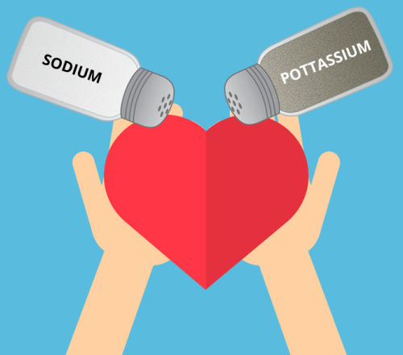
Sodium and potassium and CHD risk
Sodium intake appears to be an important determinant of blood pressure in the population as a whole, at least in part by influencing the rise in blood pressure with age.
A diet lower in common salt and higher in potassium would be expected to result in lower blood pressure and a smaller rise in blood pressure with age.

Slide 17
Salt is the predominant source of sodium in the diet with manufactured foods contributing to 65–85% of the total salt ingested. Blood pressure is an important risk factor for the development of CHD and strokes.
It has been recommended that the population should reduce its salt intake by 3 g/ day by reducing salt at the table and also the consumption of processed foods. Moreover, higher potassium levels within the diet are believed to reduce the blood pressure and foods such as fruit and vegetables, which contain this mineral, should be taken in higher amounts.

Slide 18
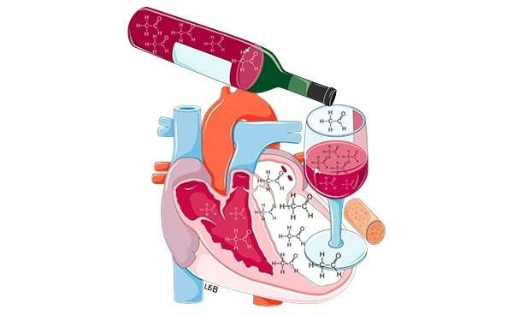
Alcohol and CHD risk
Although there is a debate on the benefits of alcohol consumption particularly red wine, there is evidence that high consumption of alcohol is related to increased mortality, especially from CHD.

Slide 19

Coffee and CHD risk
For over 20 years it has been suspected that caffeine or coffee consumption may contribute to the development of CHD, but the evidence remains unclear.
The Scandinavian practice of boiling coffee during its preparation appears to generate a hypercholesterolaemic fraction. Significant levels of these compounds have also been found in cafeteria coffee which have been found to increase plasma LDL cholesterol levels

Slide 20
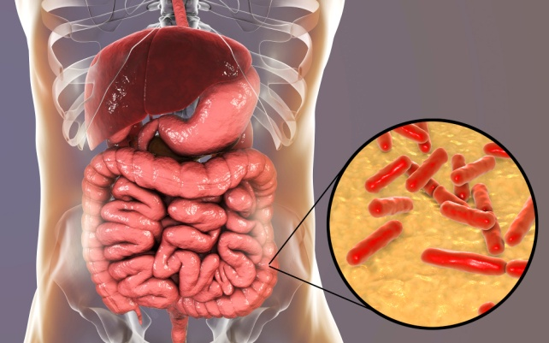
Probiotics and CHD
There are many studies suggesting that consuming fermented milk could
reduce risks of CHD. Possible mechanisms include
1- Deconjugation of bile acid and prevent re-absorption.
2- There is also some in vitro evidence to support the hypothesis that certain bacteria can assimilate (take up) cholesterol. This might suggested as a possible explanation for hypocholesterolaemic effects of probiotics.
3- The mechanism of cholesterol binding to bacterial cell walls has also been suggested as a possible explanation for hypocholesterolaemic effects of probiotics

Slide 21
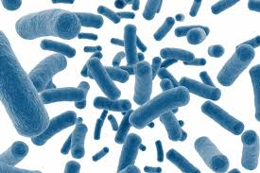
Prebiotic and CHD
Several studies that have investigated the effects of prebiotics on fasting plasma lipids have generated inconsistent findings (Table 5.8). In studies with individuals with raised blood lipids, three studies showed significant decreases in fasting total and LDL cholesterol, with no significant changes in TAGlevels

Slide 22
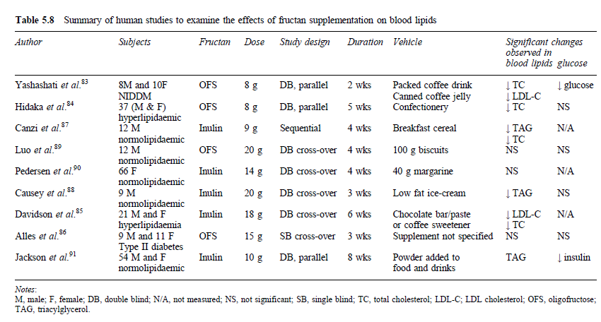

Slide 23

Proposed mechanism include
1- cholesterol synthesis inhibition by short chain fatty acids produced from prebiotic fermentation.
Synbiotic can also help reducing risks of CHD.

