Slide 1
Glycaemic Index of foods
What is the Glycaemic Index (GI)? The GI is a ranking of carbohydrate foods from 0 to 100 based on how quickly and how much they raise blood sugar levels after being eaten. This is related to how quickly a carbohydrate containing food is broken down into glucose.

Slide 2
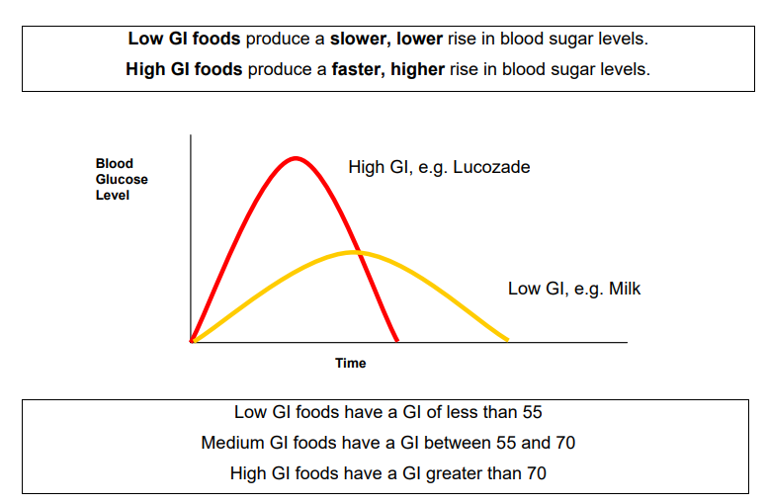

Slide 3
Why is the GI important?
Considering the GI of carbohydrate foods can help with good diabetes management as:
Lower GI foods produce lower, more stable blood sugar levels and therefore can help improve control of diabetes.
• Higher GI foods produce higher, faster rising blood sugar levels.
• Lower GI foods also help you to feel fuller for longer, which can help to control appetite and assist with weight management.

Slide 4
Factors affecting the GI of foods
There are many factors that have an effect on the GI of carbohydrate containing foods:
• The type of starch present
• The type of sugar present - fructose (fruit sugar) and lactose (milk sugar)
both have a lower GI than sucrose (table sugar)
• The amount of water soluble fibre. The more soluble fibre a food contains, the lower the GI value.
• Storage time and ripeness will affect the GI value; the more ripe a fruit or vegetable is, the higher the GI value.
• Cooking and processing food will usually increase the GI as there is less work required by the body to break the carbohydrates down. For example, juice has a higher GI value than whole fruits.
• Adding acidity to the food will lower the GI (e.g. adding lemon juice).
• Fat and protein consumed in the same meal will decrease the GI of a food or meal.

Slide 5
Remember, GI is not a reflection of how healthy a food is.
Fat content - Foods high in fat often have a low GI (e.g. chocolate or corn chips) and should only be included occasionally.
• The amount of food eaten- a small amount of a high GI food e.g. watermelon may only have a small effect on blood sugar levels.
• The quality of food- always aim to eat a wide range of carbohydrate containing foods including wholegrain breads and cereals, fresh fruit and vegetables and dairy which provide important nutrients and fibre.

Slide 6
Recommendations for using GI in your diet
• Aim to include at least 3 low GI foods throughout the day, ideally one with each meal or snack.
• When eating high GI foods, try to combine these with a low GI food in order to decrease the overall GI of a meal.
• Not all the carbohydrates you eat need to be low GI.

Slide 7
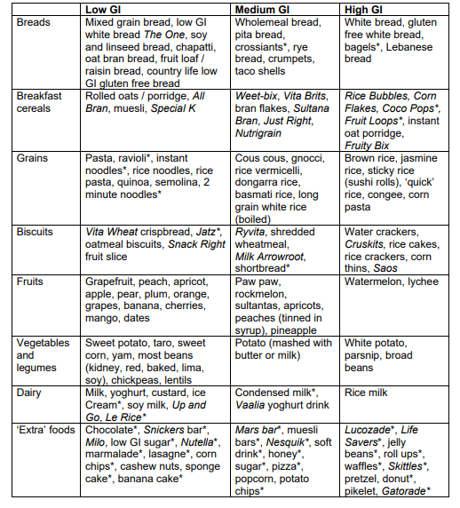
GI ranking of common carbohydrate foods

