Slide 1

Health Promotion
Dr. Salih A Abdulla Health promotion Part 2 Spring Semester Week 3 2025-2026

Slide 2
OUTLINE
• Determinants of Health
Types of determinants of health
• Important Health Promotion Concepts
• Key terms

Slide 3
HEALTH PROMOTION
LEARNING OBJEC TIVES
After reading this chapter, the student will be able to:
Discuss the determinants of health.
Identify Important Health Promotion Concepts
Understand Key terms

Slide 4
Determinants of Health
There is no one cause for the increase in behaviors related to chronic disease.
We cannot point to one factor or product, such as video games, as the singular cause of chronic disease.
Therefore, professionals need a comprehensive understanding of the determinants of health and a broad array of strategies to approach these issues.

Slide 5
The determinants of health are defined as factors that significantly influence or have an impact on the health of individuals and communities.
Determinants of health comprise genetic or biological factors, social and physical factors, health services, policies, and individual behaviors. The interrelationship of these factors determines the health of individuals and, collectively, the health of a population

Slide 6
The types of determinants of health are as follows:
• Biology and genetics. These factors related to family history because individuals can be predisposed to a condition from a parent. Other factors may be related to age; for example, as individuals age, they are predisposed to certain physical and cognitive changes.

Slide 7
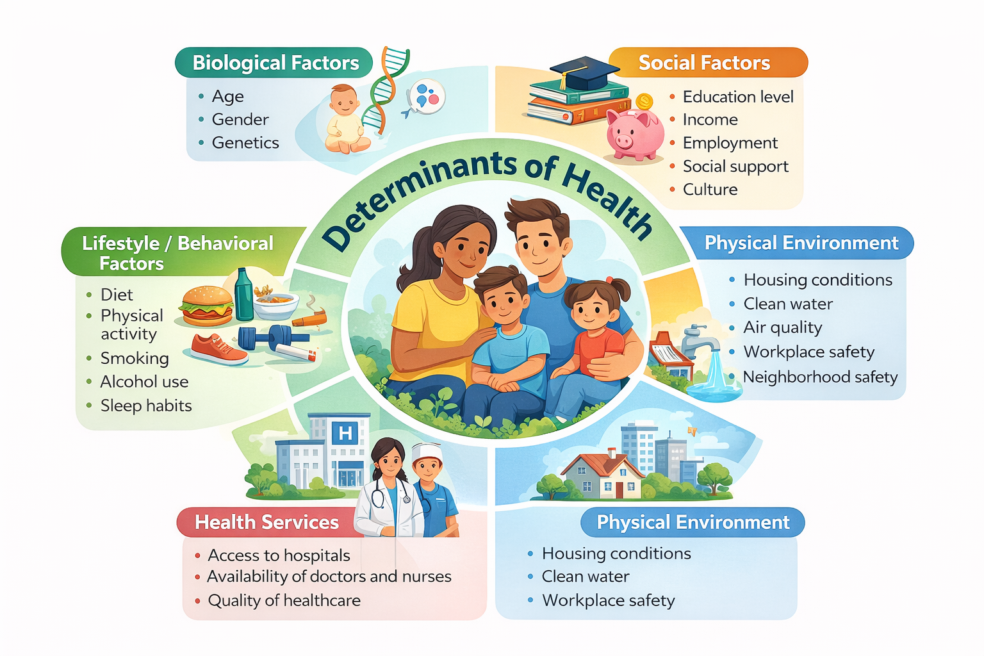

Slide 8
• Social and physical factors. Social determinant of health includes a range of issues that affect the health of people, including education, income, social supports, and quality of schools. Physical factors also affect health by expanding or limiting access to healthy food and opportunities for physical activity.

Slide 9
• Health services. Access to health services and the quality of these health services affect health. Improving access to preventive health services is a primary goal of the Affordable Care Act. However, medical care plays a minor role in preventing premature deaths.

Slide 10
• Policies. Policies at the local, state, and national levels, as well as the workplace, affect health. Clean indoor air policies and increased taxes influence the percentage of people who smoke tobacco.

Slide 11
• Individual behaviors. Individual behaviors, such as food choices, physical activity, managing stress, or cigarette use, influence the development of chronic health conditions.

Slide 12
Health promotion focuses primarily on individual behaviors and recognizes the importance of the physical and social environmental factors and policy formulation and implementation.

Slide 13
The physical environment includes the structures, buildings, or services that can either facilitate or hinder healthy behavior. For example, walking paths or lighted streets may encourage more walking in neighborhoods and deter crime.
The social environment is the personal relationships or networks that surround people.

Slide 14
Risk Factors, Chronic Diseases, and Empowerment
Specific health behaviors are directly associated with chronic disease. These health behaviors are termed risk factors. Risk factors may be modifiable or non-modifiable.

Slide 15
Modifiable risk factors are those that an individual can change through his or her own actions, such as levels of physical activity or eating habits. Non-modifiable risk factors are those that cannot be changed by the individual, such as age, gender, or family history.

Slide 16
Health promotion focuses on the modifiable risk factors that individuals have the ability to change when provided the necessary education, motivation, and a supportive environment.
Empowerment of individuals or communities is a key theme in the field of health promotion.

Slide 17
Prevention Activities: Primary, Secondary, and Tertiary
Health prevention is an important component of managing people’s health once a chronic condition develops. Individuals can actively engage in promoting their own health through regular physical activity or managing their stress, but they must also be informed about health prevention activities.

Slide 18
Prevention activities are categorized into three levels: primary, secondary, and tertiary. Prevention activities tend to be associated with the health care system.

Slide 19
Primary prevention
primary prevention aims to prevent the disease from occurring. primary prevention activities might include scheduled immunizations or appropriate cancer screenings.

Slide 20
Secondary Prevention
Secondary prevention emphasizes identifying diseases at their earliest stage and treating the conditions early.
Research suggests that when disease is detected early, there is a far greater chance of treatment with a successful outcome.
The health care system is sometimes called the “curative” system due to its focus on detecting and treating disease.

Slide 21
Tertiary Prevention
Tertiary prevention relies mainly on the health care system and highlights specific medical interventions to limit advancing conditions linked to chronic diseases.

Slide 22
Tertiary prevention aims to slow the progression of the chronic condition.
Rehabilitation services such as physical or occupational therapy are trademarks of this type of prevention.
Health promotion activities focus on engaging individuals in primary prevention to delay or avoid the onset of chronic conditions.

Slide 23
KEY TERMS
Life expectancy: the average number of years that a person from a specific group is projected to live
2. Noncommunicable disease: diseases not passed from one person to another; also known as chronic diseases
3. Chronic disease: a health condition or disease that lasts for a long period of time, usually for longer than three months
4. Health promotion: the process of helping people to move toward a state of optimal health through lifestyle changes

Slide 24
5. Health education: helping individuals and communities improve their health through learning experiences aimed toward increasing knowledge or influencing attitude
6. Public health: organized efforts to promote the health of the community as a whole through measures such as identifying health problems, creating public policies, and ensuring access to cost-effective care

Slide 25
7. Determinants of health: factors that significantly influence the health of individuals and communities, such as genetic or biological factors, social and physical factors, health services, individual behaviors, and policies
8. Physical environment: the structures, buildings, or services that can either facilitate or hinder healthy behavior

Slide 26
9. Social environment: the personal relationships or networks that surround people
10. Risk factors: specific health behaviors that are directly associated with chronic disease
11. Modifiable risk factors: risk factors that an individual can change through his or her own actions
12. Nonmodifiable risk factors: risk factors that cannot be changed by the individual, such as age, gender, or family history.

Slide 27
13. Primary prevention: primary prevention aims to prevent the disease from occurring
14. Secondary prevention: used after the disease has occurred, but before the person notices that anything is wrong
15. Tertiary prevention: targets the person who already has symptoms of the disease

Slide 28
Thanks

