Slide 1

Immunohistochemistry Embedding
Dr. Ahmad H. Ibrahim
Semester 2
Week 10
Date 15/4/2025

Slide 2
University of TISHK
Immunohistochemistry
Embedding
Dr. Ahmad H. Ibrahim 10
Email: ahmad.ibrahim@Tiu.edu.iq

Slide 3
Paraffin method
Embedding
Blocking out

Slide 4
MICROTECHNIQUES
Tissue
Cell
Cytology
Histopathology
Specimen
Biopsy / Autopsy
Body fluids/ Smears from
aspiration or exfoliation
Method
Paraffin / Frozen
Smears / Imprint

Slide 5
Reception of specimen
Fixation
Gross pathology
Processing
Embedding
Cutting with Microtome
Mounting
Staining
Cover slip
Steps of
Paraffin method

Slide 6
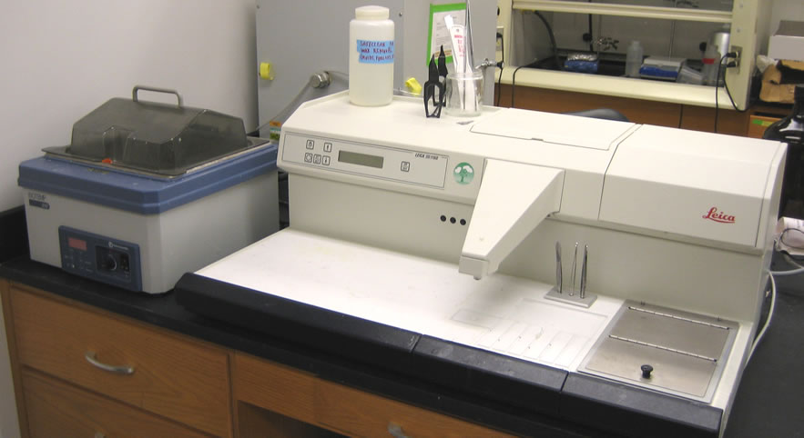
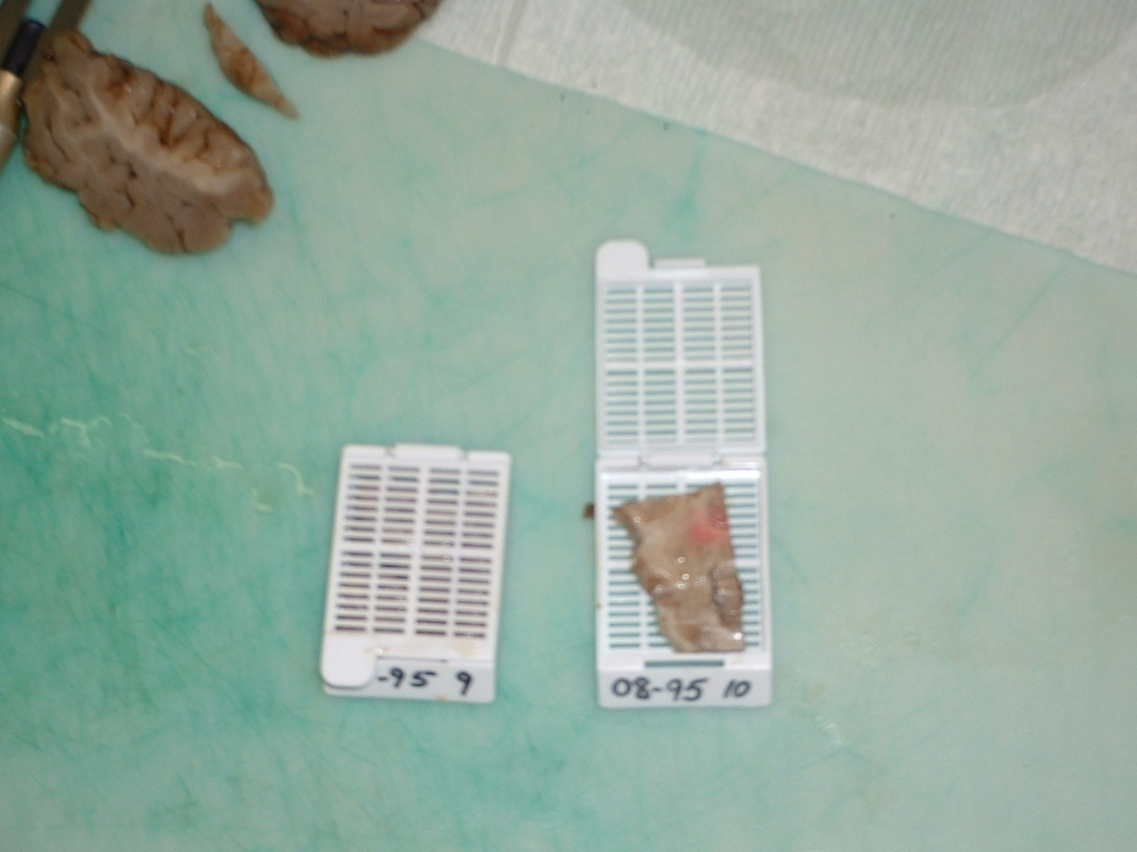
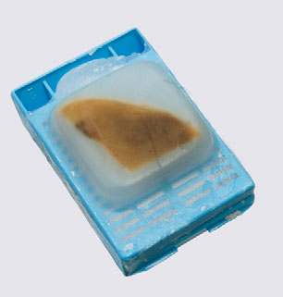

Slide 7
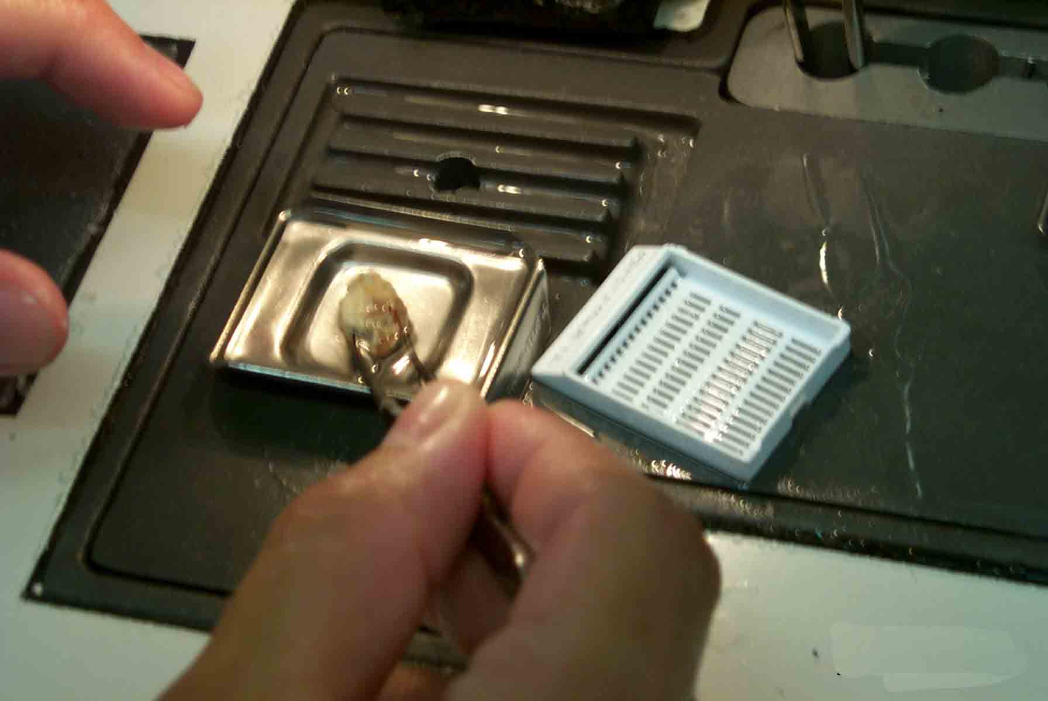
The processed tissue section is placed inside special molds to make solid paraffin block which fix and hold the tissue in well oriented position in order to get thin sections by microtome.
Principle

Slide 8
Embedding can be done by:
Manual
Special machine (Embedding station)

Slide 9
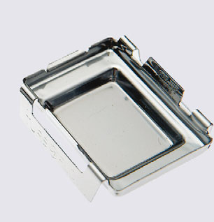
Generally we need the following parts or places:
Paraffin oven
Hot plate
Cold plate
Embedding molds
Paraffin oven: a hot container to keep the melted paraffin inside it which is connected to a drain to use it.

Slide 10
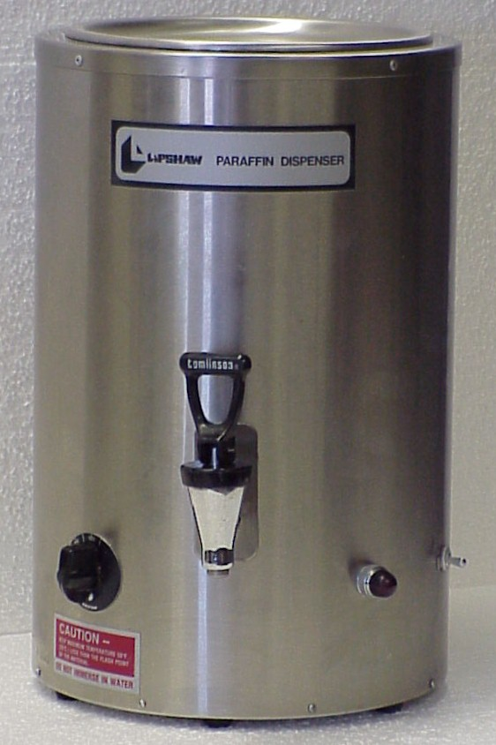
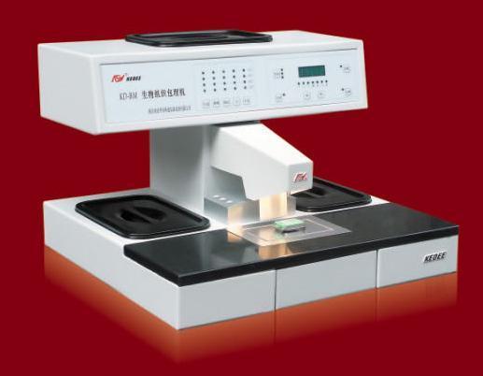

Slide 11
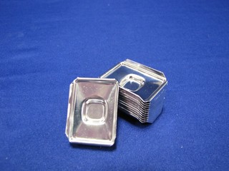
Molds
Metal molds
L-shaped brace

Slide 12
Blocking is carried out as follows:
Adjust the mold: to suitable size in case of L-shaped brace, or appropriate size of metal type, and then fill with melted wax.

Slide 13
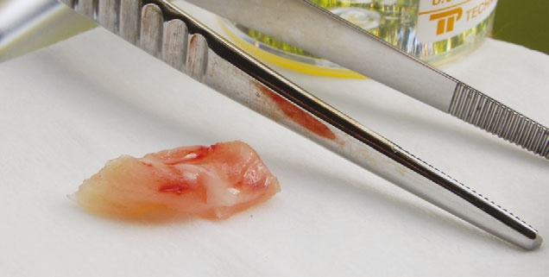
Blocking is carried out as follows:
2. Take the tissue container out of the oven, open the cassettes and hold the tissue gently with a warmed forceps.

Slide 14
Blocking is carried out as follows:
3. put it down the melted wax-filled mold

Slide 15
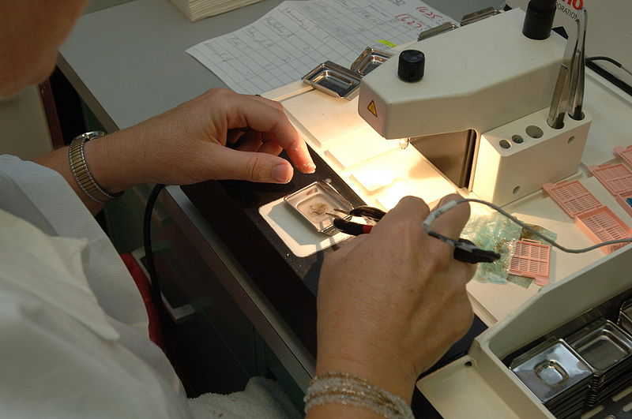
Blocking is carried out as follows:
4. Wait until the lower layer of paraffin solidify.

Slide 16
Blocking is carried out as follows:
5. Gently press the tissue down as far as it will go in the wax and allow it to harden.

Slide 17
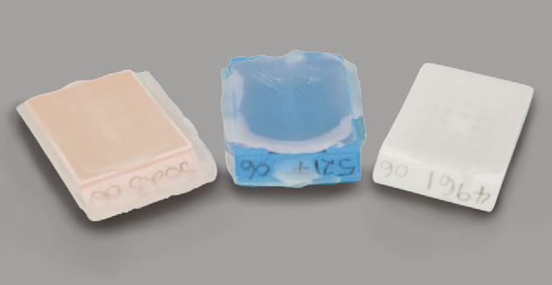
Blocking is carried out as follows:
6. fill the remaining of the mold with paraffin to make paraffin block, and place the label over it, either a paper or labeled tissue cassettes.

Slide 18
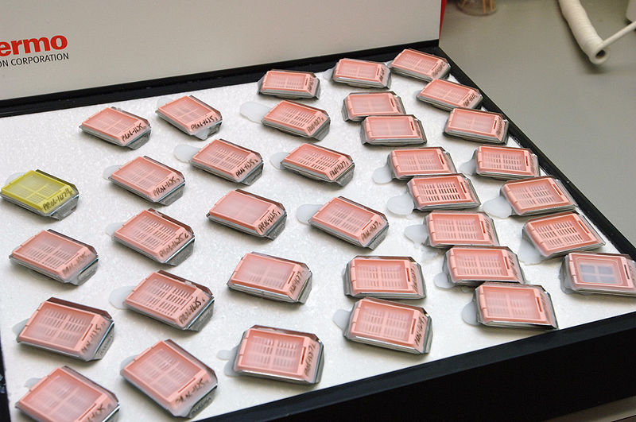
Blocking is carried out as follows:
7. Put it on a cold plate to become harden and allow to remove the paraffin block contain the tissue, which will be ready for further steps.

Slide 19
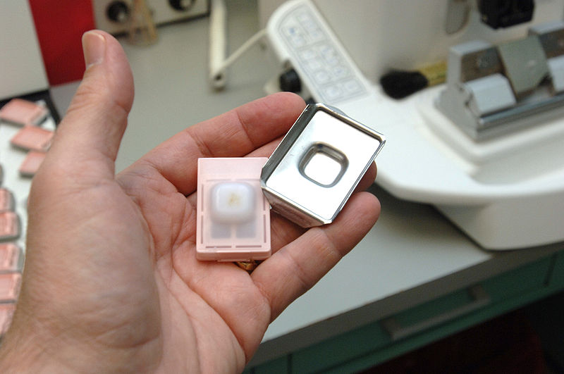

Slide 20
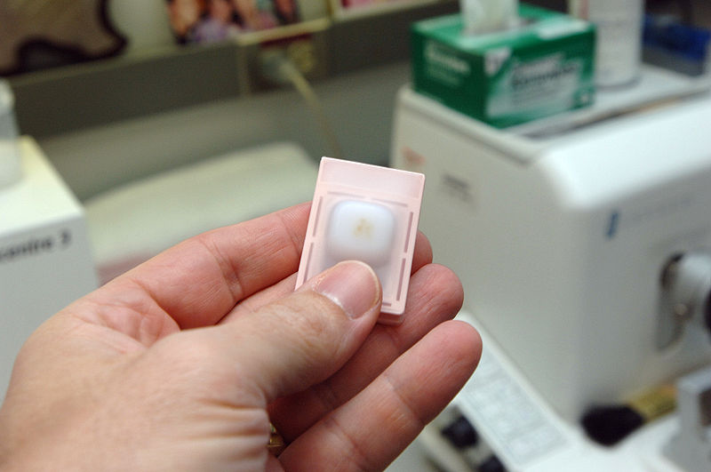

Slide 21
Orientation of specimens:
The tissue must be putted down the paraffin block according to the following points:
The cut surface or flat surface.
The layers of tissue or organs.
The surface that not stained by ink.

Slide 23
Embedding

Slide 24
The END

Slide 25
References
Dabbs DJ. Diagnostic Immunohistochemistry: Theranostic and Genomic Applications. 5th edition. Elsevier; 2019. ISBN-13: 978-0323567448.
Bancroft JD, Gamble M. Theory and Practice of Histological Techniques. 7th edition. Churchill Livingstone; 2013. ISBN-13: 978-0702042263.
Gown AM. Diagnostic Immunohistochemistry: What Can Go Wrong and How to Prevent It. 1st edition. Springer; 2009. ISBN-13: 978-0387894099.
Ramos-Vara JA, Kiupel M. Veterinary Comparative Hematopathology. 1st edition. Wiley-Blackwell; 2007. ISBN-13: 978-0813803890.
Shi SR, Gu J, Cote RJ, Taylor CR. Antigen Retrieval Techniques: Immunohistochemistry and Molecular Morphology. 1st edition. Eaton Publishing; 2000. ISBN-13: 978-

Slide 26
References
Taylor CR, Levenson RM. Quantification of immunohistochemistry--issues concerning methods, utility and semiquantitative assessment II. Histopathology. 2006 Sep;49(3):411-24. doi: 10.1111/j.1365-2559.2006.02513.x. PMID: 16922739.
Shi SR, Cote RJ, Taylor CR. Antigen retrieval techniques: current perspectives. J Histochem Cytochem. 2001 Sep;49(9):931-7. doi: 10.1177/002215540104900801. PMID: 11511661.
Ramos-Vara JA. Technical aspects of immunohistochemistry. Vet Pathol. 2005 Sep;42(5):405-26. doi: 10.1354/vp.42-5-405. PMID: 16145243.
Brown DC, Gatter KC. Monoclonal antibody Ki-67: its use in histopathology. Histopathology. 1990 Jul;17(2):489-503. doi: 10.1111/j.1365-2559.1990.tb01129.x. PMID: 1706161.
Rizzardi AE, Johnson AT, Vogel RI, Pambuccian SE, Henriksen J, Skubitz AP, Metzger GJ, Schmechel SC. Quantitative comparison of immunohistochemical staining measured by digital image analysis versus pathologist visual scoring. Diagn Pathol. 2012 Mar 19;7:42. doi: 10.1186/1746-1596-7-42. PMID: 22433176; PMCID: PMC3340902.

