Slide 1

Immunohistochemistry
Dr. Ahmad H. Ibrahim
Semester 2
Week 11
Date 21/4/2025

Slide 2
University of TISHK
Imunohistochemistry
Staining of Slides
Dr. Ahmad H. Ibrahim 11
Email: ahmad.ibrahim@Tiu.edu.iq

Slide 3

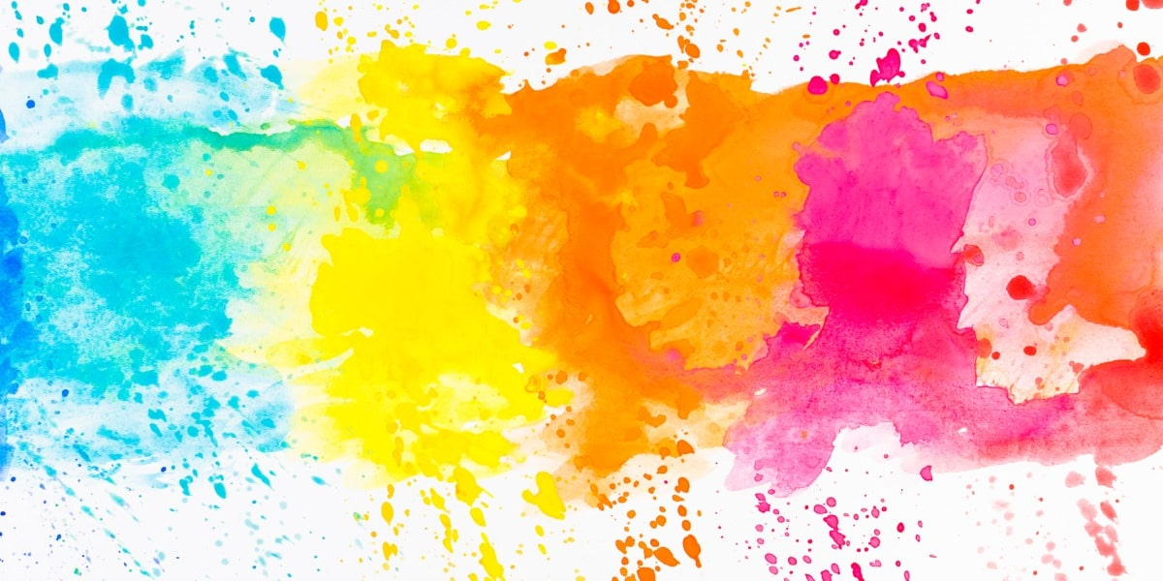
Staining of Slides

Slide 4
Introduction to Staining of Slides
Staining is a technique used in microscopy to enhance contrast in the microscopic image in biology and medicine to highlight structures in cell populations or organelles within individual cells.
The term stain and dye are not the same.
A dye is a coloring agent that is used for general purposes.
A stain is one that is used for biological purposes.

Slide 5
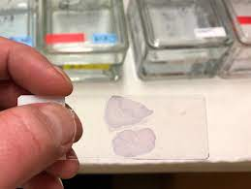
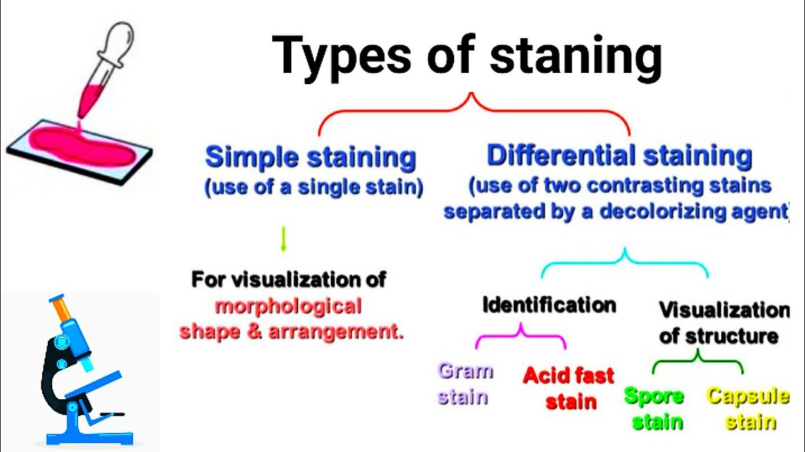
Introduction
Purpose of staining: enhancing contrast in microscopic images in biology and medicine

Slide 6
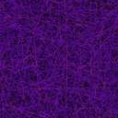

Structure of dyes and stains
Dyes are colored organic compounds synthesized from simpler organic molecules
Chromophore: group that makes an organic compound colored

Slide 7
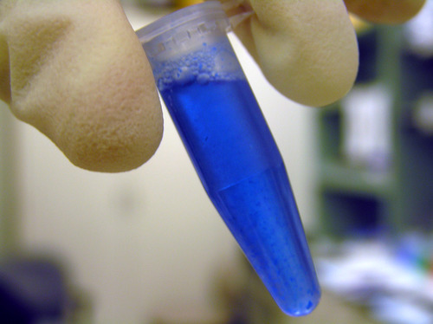
The staining process
Immersion of the sample in dye solution, rinsing, and observation
Some dyes require the use of a mordant to form an insoluble colored precipitate

Slide 8

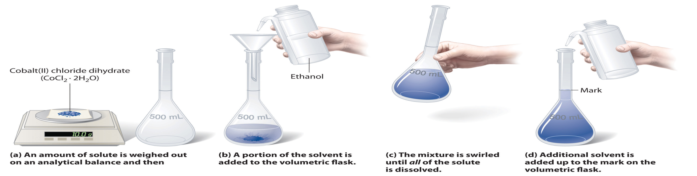
Preparation of staining solutions
Aqueous solutions are commonly used.
Stock solutions may be prepared in alcohol and diluted with water.
Avoid using pure alcoholic solutions as they remove stains.

Slide 9
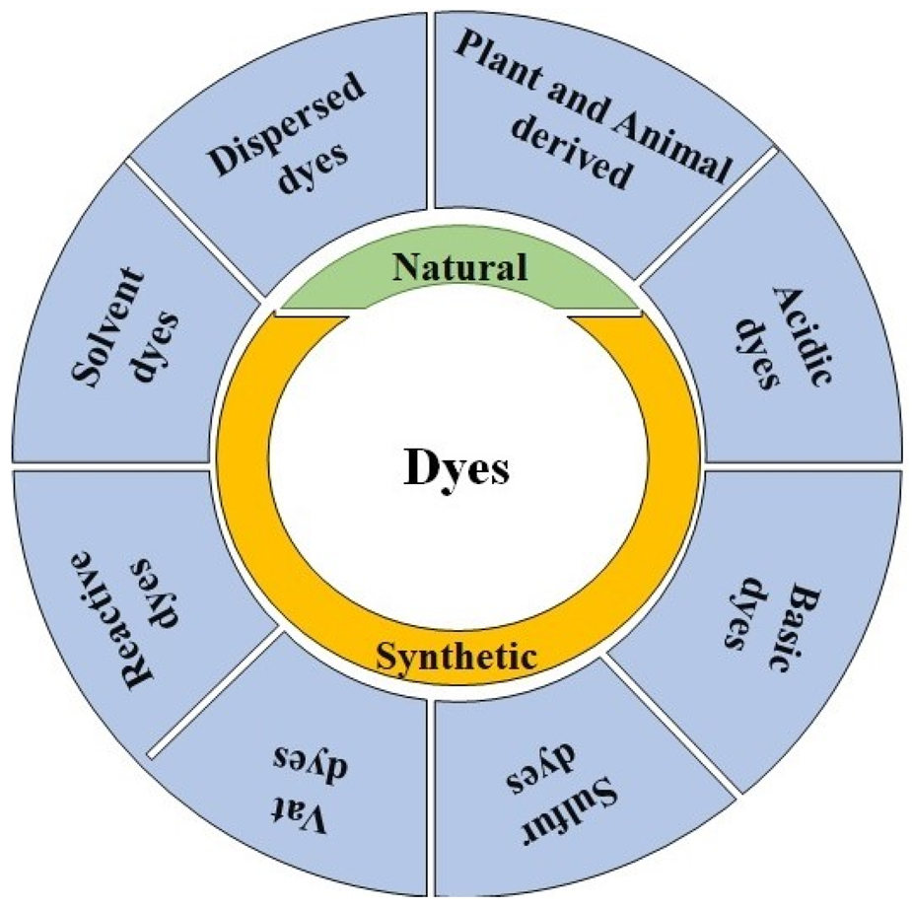
Classification of Dyes (Stains)
Acidic dyes: Negatively charged, bind to positively charged cell structures
2. Basic dyes: Positively charged, bind to negatively charged molecules
3. Neutral dyes: Complex salt of a dye acid with a dye base

Slide 10
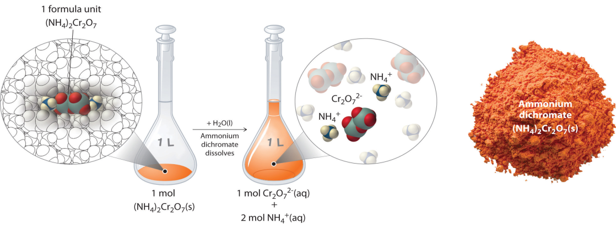
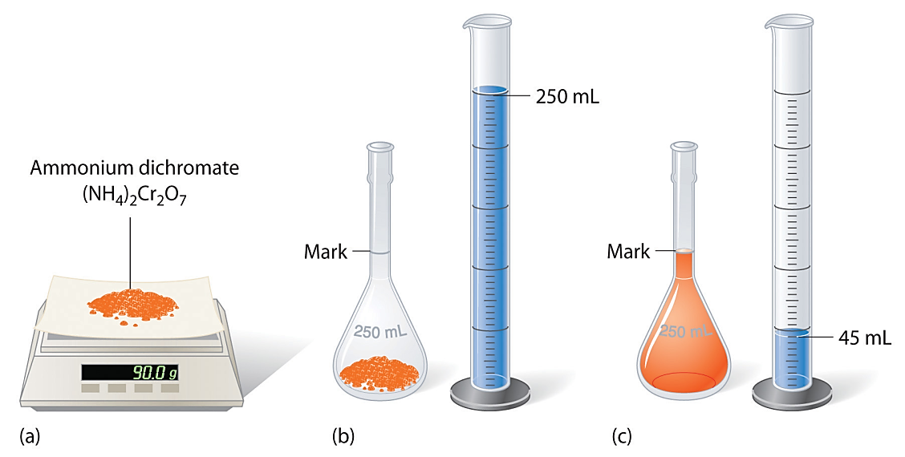
Commonly Used Dyes in Microscopy
Names given by manufacturers (e.g., eosin, Congo red)
Caution: Different manufacturers may produce dyes under the same name, affecting staining results

Slide 11
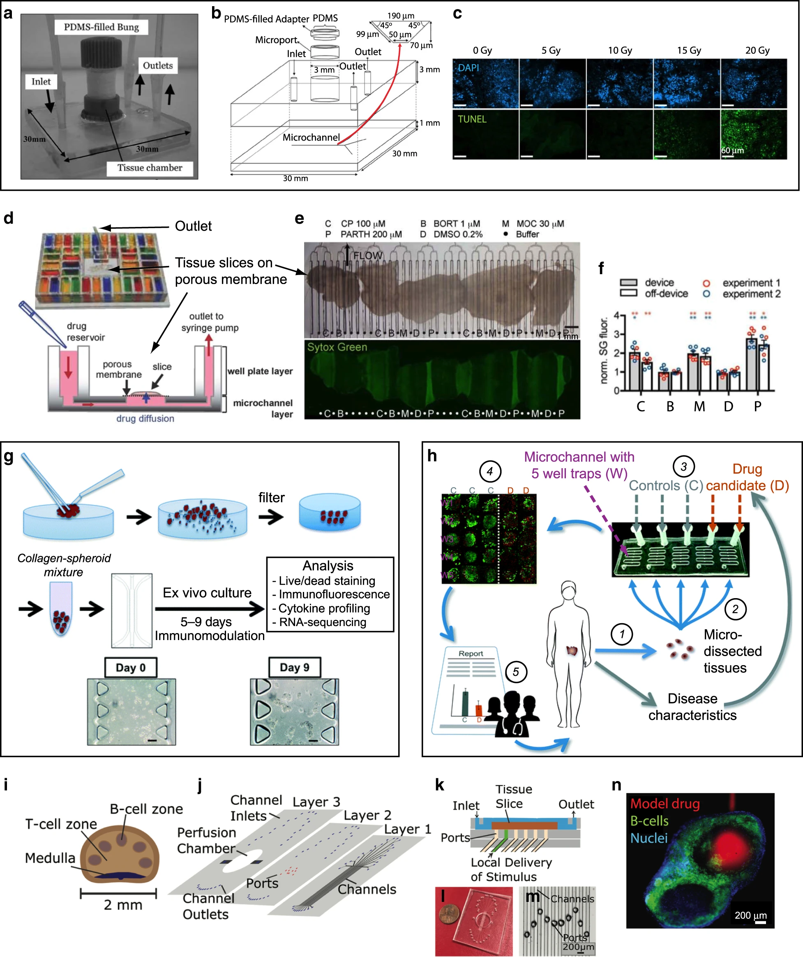
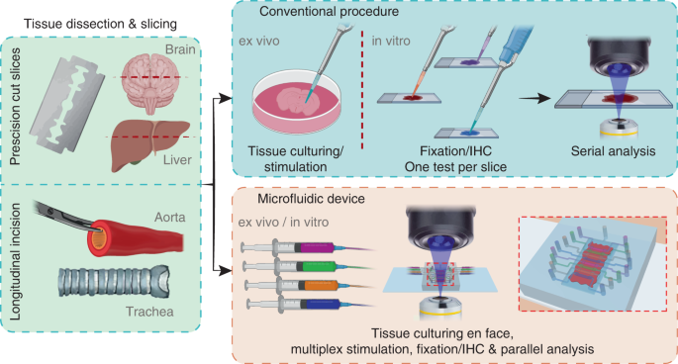
In vivo Staining and In vitro Staining
In vivo staining: Dyeing living tissues to study morphology and position.
In vitro staining: Coloring removed cells or structures outside their biological context.

Slide 12
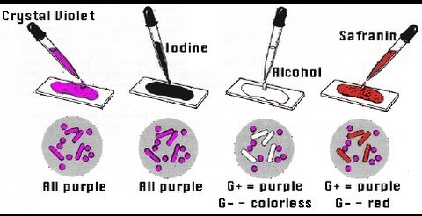
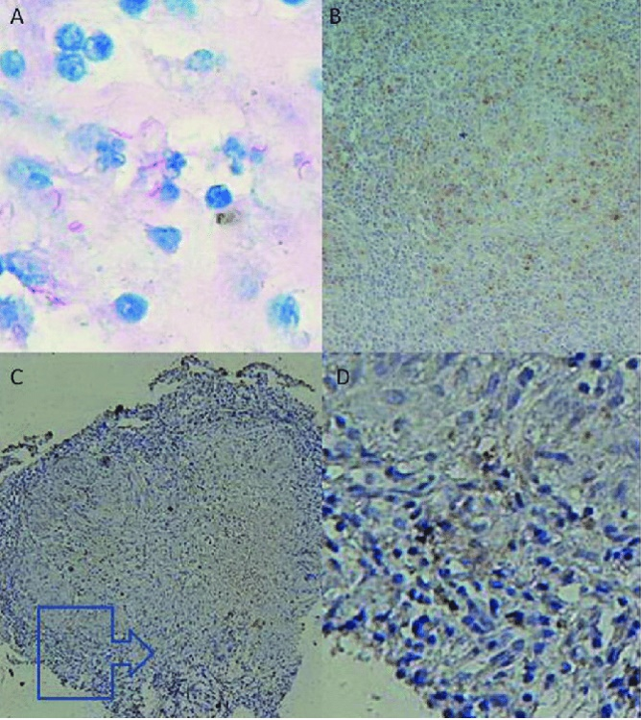
Common Biological Stains
Gram staining: Differentiates bacteria based on cell wall composition
Negative staining: Uses nigrosin or Indian ink for contrasting microorganisms
Ziehl-Neelsen stain: Identifies Mycobacterium tuberculosis
Haematoxylin and Eosin (H&E) staining: Stains nuclei and cytoplasm in histology

Slide 13
Common Biological Stains (contd.)
Acridine orange: Fluorescent dye for cell cycle determination
Crystal violet: Stains cell walls purple in Gram staining
Ethidium bromide: Stains DNA, used in apoptosis detection
Acid fuchsine: Stains collagen, smooth muscle, and mitochondria

Slide 14
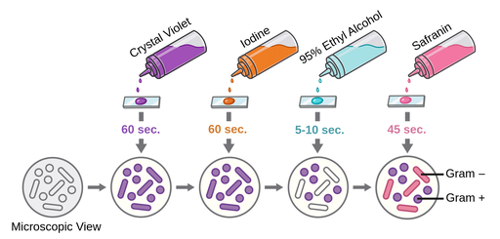
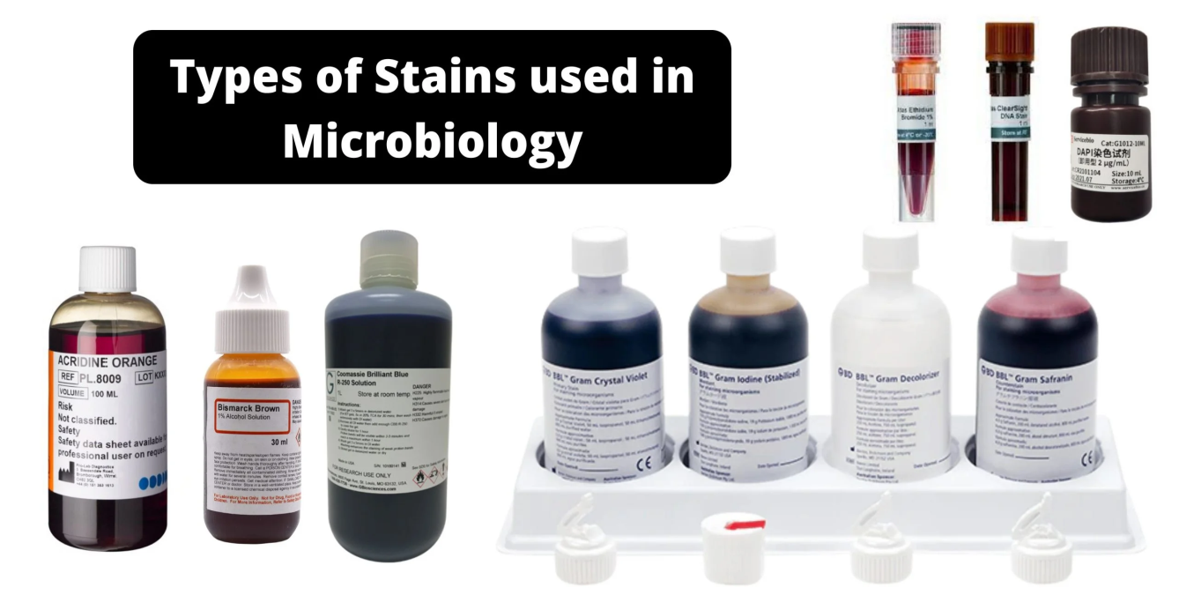
Common Biological Stains (contd.)
Iodine: Stains starch, used in Gram staining as a mordant
Malachite green: Counter stain in Gimenez staining for bacteria, stains spores
Methylene blue: Stains animal cells, used in blood film and cytology
Neutral red: Counter stain in combination with other dyes

Slide 15
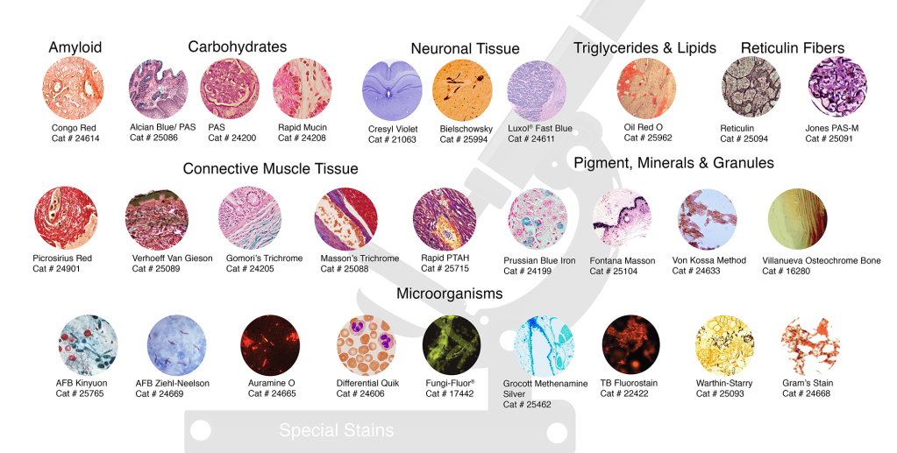
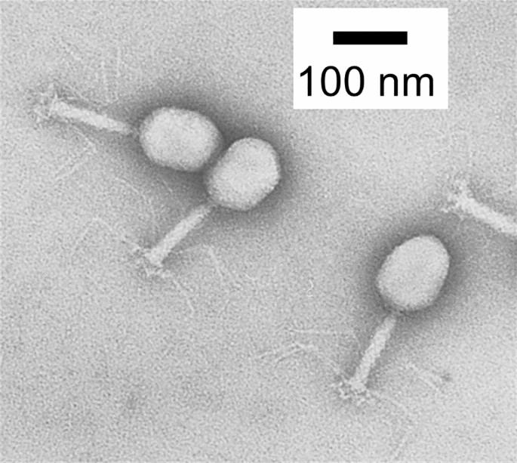
Electron Microscopy Stains
Phosphotungstic acid: Negative stain for viruses, nerves, polysaccharides
Osmium tetroxide: Stains lipids and commonly used for morphology in electron microscopy
Other chemicals used in electron microscopy staining

Slide 16
Conclusion
Staining is a vital technique in microscopy for enhancing contrast and highlighting structures
Understanding the different types of stains and their applications is crucial for accurate results

Slide 17
References
Borovec, J., Munoz-Barrutia, A. and Kybic, J., 2018, October. Benchmarking of image registration methods for differently stained histological slides. In 2018 25th IEEE International Conference on Image Processing (ICIP) (pp. 3368-3372). IEEE.
Baron, E.J., Mix, S. and Moradi, W., 2010. Clinical utility of an automated instrument for gram staining single slides. Journal of clinical microbiology, 48(6), pp.2014-2015.
Schaumberg, A.J., Rubin, M.A. and Fuchs, T.J., 2016. H&E-stained whole slide image deep learning predicts SPOP mutation state in prostate cancer. BioRxiv, p.064279.
Hackett, A.J. and Macpherson, J.W., 1965. Some staining procedures for spermatozoa. The Canadian Veterinary Journal, 6(3), p.55.
Becker, I., Becker, K.F., Röhrl, M.H., Minkus, G., Schütze, K. and Höfler, H., 1996. Single-cell mutation analysis of tumors from stained histologic slides. Laboratory investigation; a journal of technical methods and pathology, 75(6), pp.801-807.

Slide 18
Thank you

