Slide 1

Immunohistochemistry
Introduction to Immunohistochemistry
Dr. Ahmad H. Ibrahim
Semester 2
Week 2
Date 7/2/2025

Slide 2
University of TISHK
Immunohistochemistry
Introduction to Immunohistochemistry
Dr. Ahmad H. Ibrahim Lecture 1, 2 and 3
Email: ahmad.ibrahim@tiu.edu.iq
Feb -2024

Slide 3
Objectives
1. To Study the Historical review on Immunohistochemistry
2. To know about the Classification of Immunohistochemical methods
3. To know Types of
a. Chemical methods
b. Physical methods
c. Biological methods
4. To learn about Immunohistochemistry: general and special

Slide 4
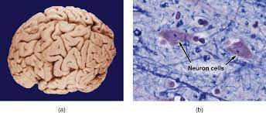
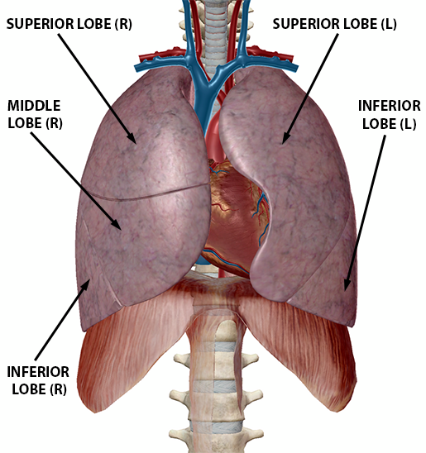
Histochemistry
It is a recent advances in research methodology in medicine, Pharmacy and biological sciences have been made at the borders between the morphology and functionology, between anatomy-pathology and biochemistry-physiology.
This new frontier is designated as histochemistry and cytochemistry, which is a field to localize chemical components of cells and tissues on histological sections by using various techniques and analyze the functions based on morphology.

Slide 5
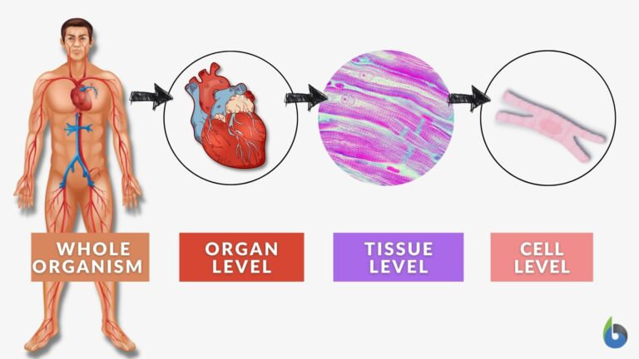
Morphology and Functionology
Divisions of Morphology
There are different types of morphology:
Cellular Morphology
2. Tissue Morphology
3. Organ Morphology
4.The Whole Organism
Different types (levels) of morphology. Image

Slide 6
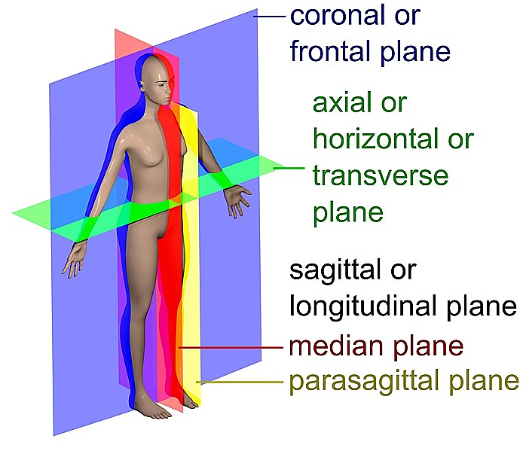
Human Body plan and symmetry
In higher animals like humans, only a cut from head to foot in the middle separates the body into equal halves.
Anterior and posterior ends may be differentiated, as dorsal and ventral sides.
Certain human internal organs (such as the heart) are not symmetrical, even the right and left sides of the body are not perfectly equal.

Slide 7
Classification of Immunohistochemical methods
To classify the immunohistochemical techniques into 3 categories;
1. Chemical methods such as chemical reactions by staining .
2. Physical methods such as radiations
3. Biological methods such as immunity

Slide 8
Chemical methods
The chemical methods in Immunohistochemistry consist of various chemical reactions, e.g. the color staining of DNA with Feulgen reaction.
The principles and methods categories the color reactions for light microscopy and dense deposits for electron microscopy.
The color reactions were first developed in Immunohistochemistry such as:
1. DNA Feulgen reaction, staining of proteins with Millon reactions,.
2. Lipids with Sudan
3. Some enzymes such as alkaline and acid phosphatases.

Slide 9
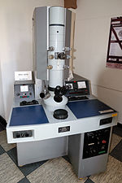
Physical methods
The principles and methods using physical reactions consist of various physical reactions such changes of temperature of specimens as microincineration or cryo-techniques, and effects of wavelength on absorption such as:
Electron cryotomography (redirect from Cryo Electron Tomography) in other electron cryomicroscopy techniques.

Slide 10
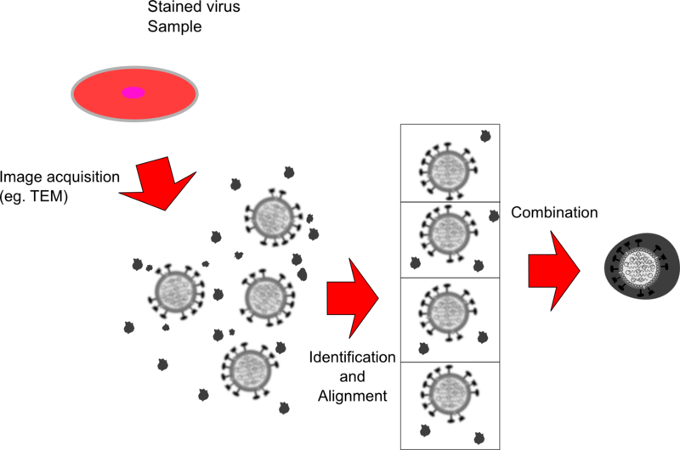
Electron cryotomography (redirect from Cryo Electron Tomography)
Single particle analysis segments and averages many particles from a sample, allowing for computer algorithms to process the individual images into a combined "representative" image.
samples for CryoET (typically small cells such as Bacteria, Archaea, or viruses) are prepared in standard.

Slide 11
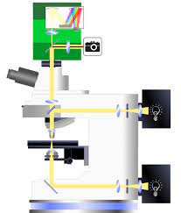
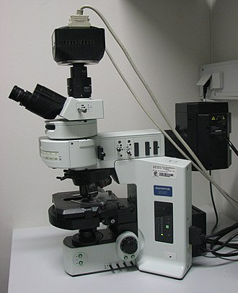
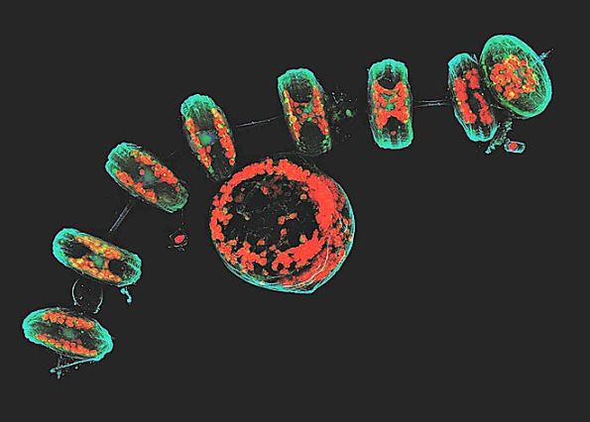
Physical methods
Or effects of wavelength on absorption such as:
1. Microspectrophotometry,
2. Fluorescence microscopy,
3. Confocal laser scanning microscopy.
Or utilization of radiation such as
radioautography and X-ray microanalysis.

Slide 12
Biological methods
The biological methods in cytochemistry consist of mainly two biological reactions, which can be observed in living organism. The biological reaction was first introduced into cytochemistry.
It demonstrated by:
1. The localization of proteins by the fluorescent antibody method using the immunity .
2. Lectins obtained from plants were also introduced into cytochemistry as another biological reaction to demonstrate sugar residues of glycoproteins .

Slide 13
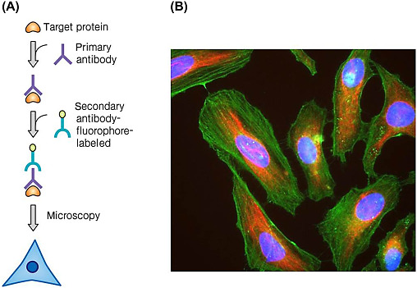
proteins by the fluorescent antibody

Slide 14
Plant Lectin
Lectin-free diet
foods that contain high amounts of lectins will prevent and cure disease. There is no clinical evidence that a lectin-free diet is effective to treat any disease.
Digestive system cancers those of the esophagus, stomach, small intestine, colon-rectum, liver, and pancreas are highly related to genetics and lifestyle.
Most are considered highly mortal due to the frequency of late diagnosis, usually in advanced stages, caused by the absence of symptoms or masked by other pathologies.

Slide 15
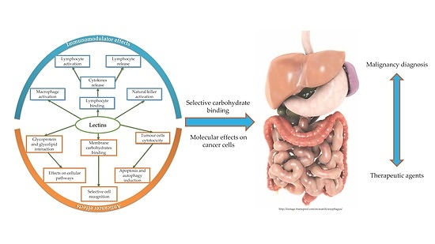
Lectins obtained from plants were also introduced into cytochemistry

Slide 16
Plant Lectin
Different tools are being investigated in the search of a more precise diagnosis and treatment.
Plant lectins have been studied because of their ability to recognize and bind to carbohydrates, exerting a variety of biological activities on animal cells, including anticancer activities.

Slide 17
Thank you
End

Slide 18
Appendix and extra readings
Question What is Symmetry?
Most animals and plants have spherical, radial, or bilateral symmetry. A spherically symmetrical body has the same shape throughout and may be sliced in half in any plane, for example, the body of a protozoan (e.g. Heliozoa).
Starfish and mushrooms have radially symmetrical bodies with distinct top and bottom and body sections radiating from a central axis.
Any plane with an axis passing through the core of the starfish may divide it in half. The anterior end has a mouth and the posterior end has an anus.
Some species, including amoebas, slime molds, and some sponges, have no plane of symmetry.

Slide 19
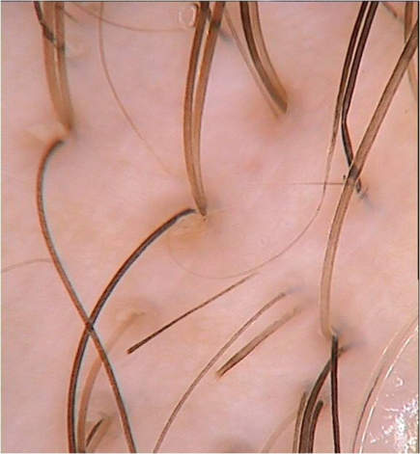
Home work
Application to the class Alopecia Case

Slide 20
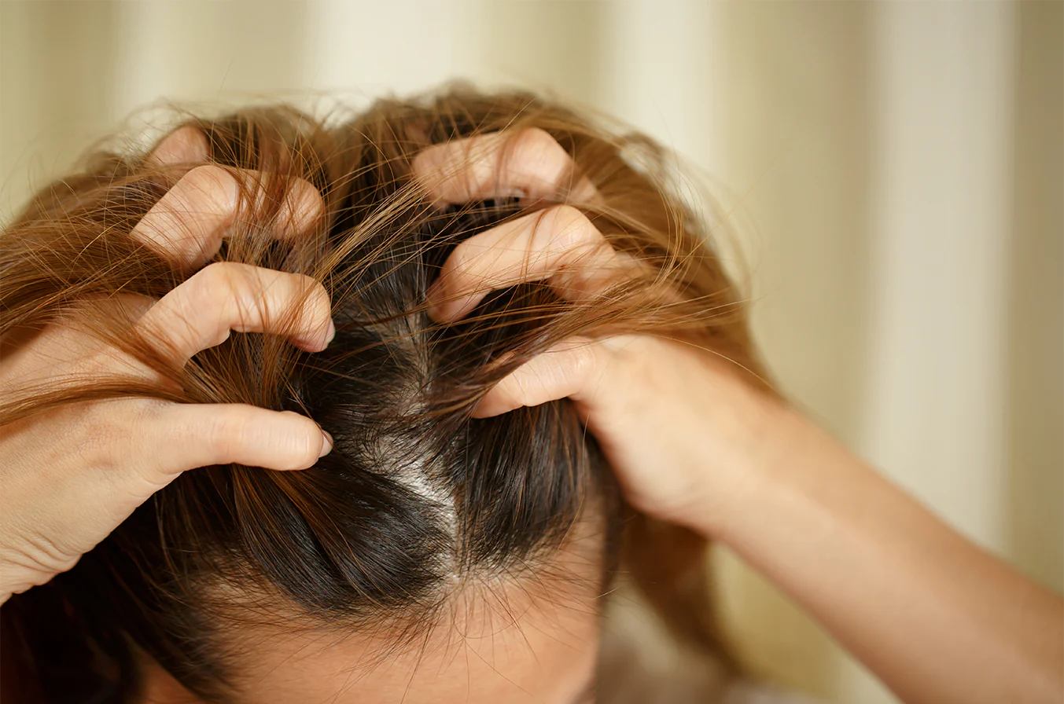
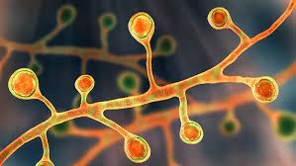
Scenario case
A woman, 30 years of age, presented with patchy hair loss on her head. It started 1 year ago when she developed an itchy, slightly painful, red scaling rash on her scalp 1 month after she dyed her hair. She had been treated with antifungal and other treatments unknown to her by several primary care doctors. However, the lesion worsened, and new lesions appeared. She was referred to a dermatologist.

Slide 21
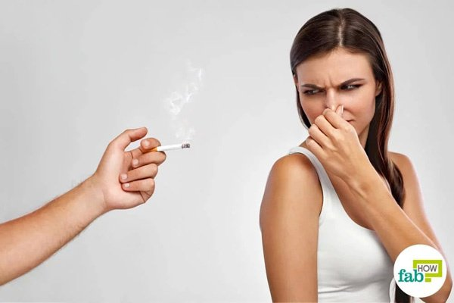
Scenario case
Aside from the devastating psychological effects from the disfigurement and the effect on her occupation as a cosmetics sales promoter, she had no other symptoms. There was no significant past or family history. She did not smoke, but her husband smoked heavily in the house.

Slide 22
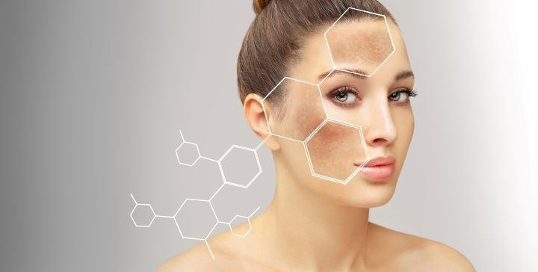
Scenario case
An examination of the scalp revealed focal coin-shaped, scaly, erythematous lesions, some of which had coalesced . Closer examination revealed shiny, central hypopigmentation and absence of hair follicles, and some thickened areas of hyperpigmention peripherally. Where there were no lesions, her hair was black, thick, straight and long. At the periphery of the lesions, her hair became sparse and thin. A full examination of her face, neck, body and nails revealed no other skin lesions.

Slide 23
Question
What differential diagnoses should be considered?

Slide 24
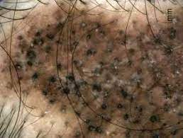
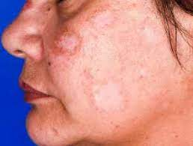
Answer
On the basis of the clinical features, including nummular-shaped lesions with central permanent scarring alopecia due to total loss of hair follicles, and peripheral hyperpigmented adherent thick scales, the most likely diagnosis is discoid lupus erythematosus (DLE).1–4 DLE is the most common form of chronic cutaneous lupus erythematosus and is usually localised on the face (eg cheeks, nose and ears). It is termed ‘generalised’ if found on the neck, upper back and dorsum of hands.
On the scalp, it causes dilatation and plugging of hair follicles with adherent scales. This leads to destruction of hair follicles and permanent balding. Initial manifestation of DLE can be difficult to recognize. Early referral to a dermatologist is recommended if in doubt, or if there is disease progression and treatment failure.

Slide 25
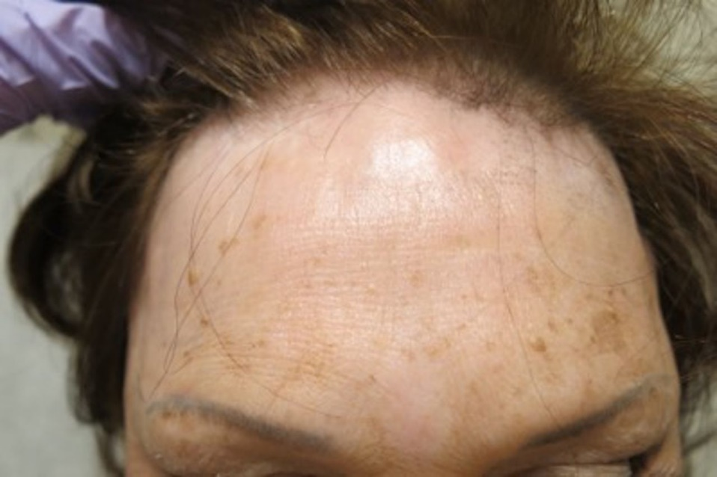
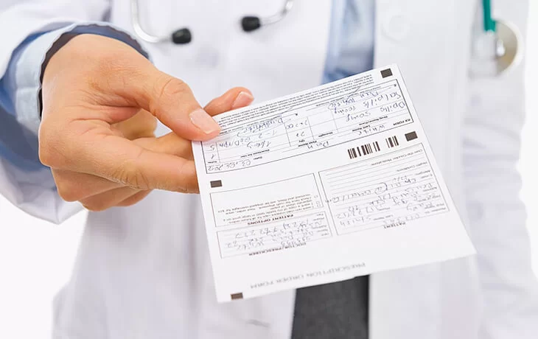
Answer
On the scalp, it causes dilatation and plugging of hair follicles with adherent scales. This leads to destruction of hair follicles and permanent balding. Initial manifestation of DLE can be difficult to recognise.
Early referral to a dermatologist is recommended if in doubt, or if there is disease progression and treatment failure.

Slide 26
University of TISHK
Immunohistochemistry
Fine Needle Aspiration Cytology - an overview
Dr. Ahmad H. Ibrahim
Email: ahmad.ibrahim@Tiu.edu.iq
Lecture 2
Feb -2024

Slide 27
Fine Needle Aspiration Cytology - an overview
Dr. Ahmad H. Ibrahim
Pharmacy Dept. TIU

Slide 28
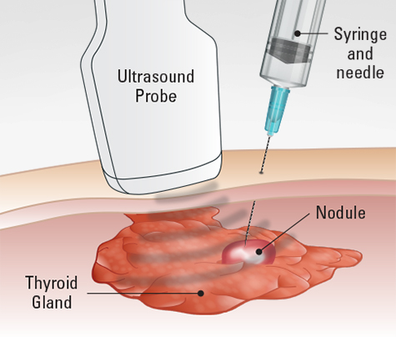
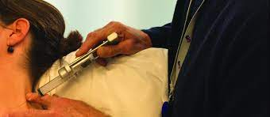
Fine Needle Aspiration Cytology
Performed by ‘professional hybrids’ - clinicians who used it for rapid diagnosis

Slide 29
FNAC - definition
Aspiration of cells/ tissue fragments using fine needles ( 22 , 23, 25 G) ; external diameter 0.6 to 1.0 mm
1.5 inches long needle ( radiologists use longer needles)
Diagnostic materials in the needle and not in the syringe even in cystic lesions

Slide 30
Clinical skill required
Familiarity with general anatomy eg thyroid vs other neck swelling
Ability to take a focused clinical history
Sharp skill in performing physical examination eg solid vs cystic, benign vs maligant lesions

Slide 31
Clinical skill required -2
Good knowledge in normal cellular elements from various organs and tissue and how they appear on smears eg fats cells vs breast tumour cells
Comprehensive knowledge of surgical pathology

Slide 32
Clinical skill required -3
Ability to translate traditional tissue patterns of lesions to their appearance in smears

Slide 33
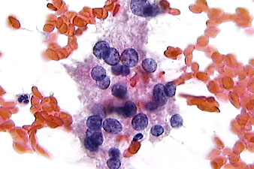
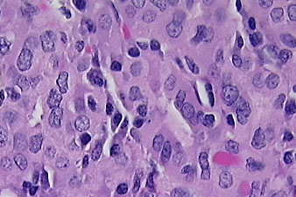
Cytology vs Histology
Papillary carcinoma of thyroid - follicular variant

Slide 34
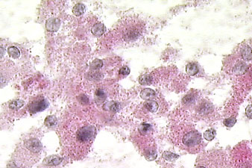
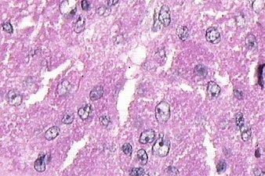
Cytology vs Histology - 2
Granular Cell Myoblastoma

Slide 35
Who should do FNA?
Clinicians
Cytotechnologists
Radiologists
Pathologists
The one who examines the patients , does the aspiration,
makes the smears, interprets the cytology
is the best one to do FNA -
PATHOLOGIST

Slide 36
Current status
Palpable lesions
Outpatients , in- patients
Thyroid , breast, lymph nodes, salivary glands , soft tissue lumps...
Lung, intra-abdominal and retroperitoneal by radiologic imaging : CT, ultrasound, flouroscopy

Slide 37
LIMITATIONS
Soft vs hard ( bone) lesions
Solid vs cystic lesions
Poor cellular yield vs poor technique
Reactive vs specific diseases eg reactive lymphadenitis vs Hodgkins disease
Diffuse vs nodular lymphoma

Slide 38
Complications
Needle trauma
  granulation tissue formation
  granuloma formation
  Sarcoma like changes
  Needle linear tract haemorrhage
  tissue necrosis
Interfere with surgical pathology
Needle track seeding - testicular tm, chondrosar
Hematoma
Pain
Pneumothorax???

Slide 39
ADVANTAGES
Fast - early diagnosis
Less pain, less trauma
No anaesthesia
Acceptable by patients and doctors
Accurate

Slide 40
How to interpret?
Aspiration materials eg colloid, blood, mucus?
Cellular yield vs acellular yield
Smear pattern - 3 dimensional balls vs flat monolayered sheet os cells
Cohesiveness vs discreet cells
Cell morphometry

Slide 41
Adjunct tools
Cell blocks
Histochemistry
Immunohistochemistry
Electron microscopy
Flow cytometry
Immuno electron microscopy
Molecular pathology -In situ hybridization, PCR etc

Slide 42
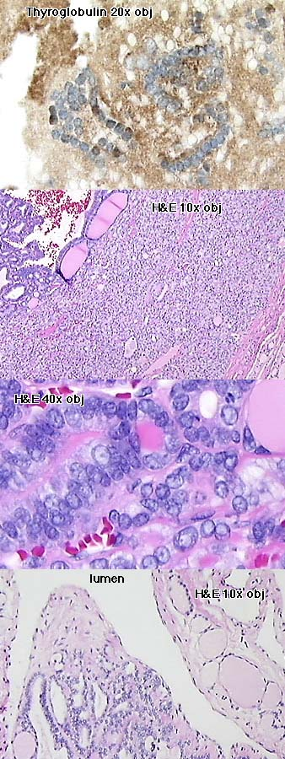
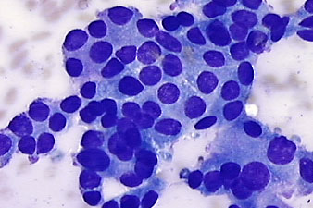
Adjunct tools
IHC
cytology
Histo - thyroid
Cell block
45 yr old woman with
lytic bone lesion
Histo -bone

Slide 43
Future directions
Aspirating non palpable lesions using MRI
Molecular pathology eg In Situ Hybridization
Replacing diagnostic surgical pathology?
Combined with MRI - replacing autopsy?

Slide 44
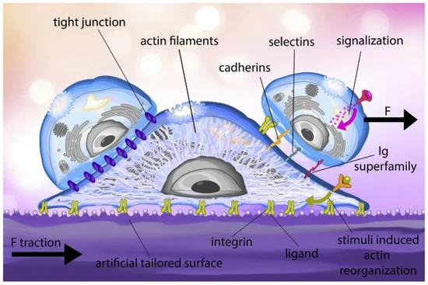
Q: What is Cell adhesion Process ?
Cell adhesion process in ECM extracellular Matrix. It is the ligand on the artificially tailored surface binds to the integrin receptors found on the cell membrane.
Throughout the adhesion process, the actin filament structure of the cell is reorganized, and a traction force is generated in the substrate.
External stimuli also regulate the reorganization of cytoskeletal.

Slide 45
After surface adhesion, the cell can interact with other cells through membrane proteins such as cadherins, selectins and the Immunoglobulin (Ig) superfamily. In tissues, cell junctions, a variety of multiprotein complexes (e.g., tight junctions), can form between cells to promote intercellular communication and mechanical stability.

Slide 46
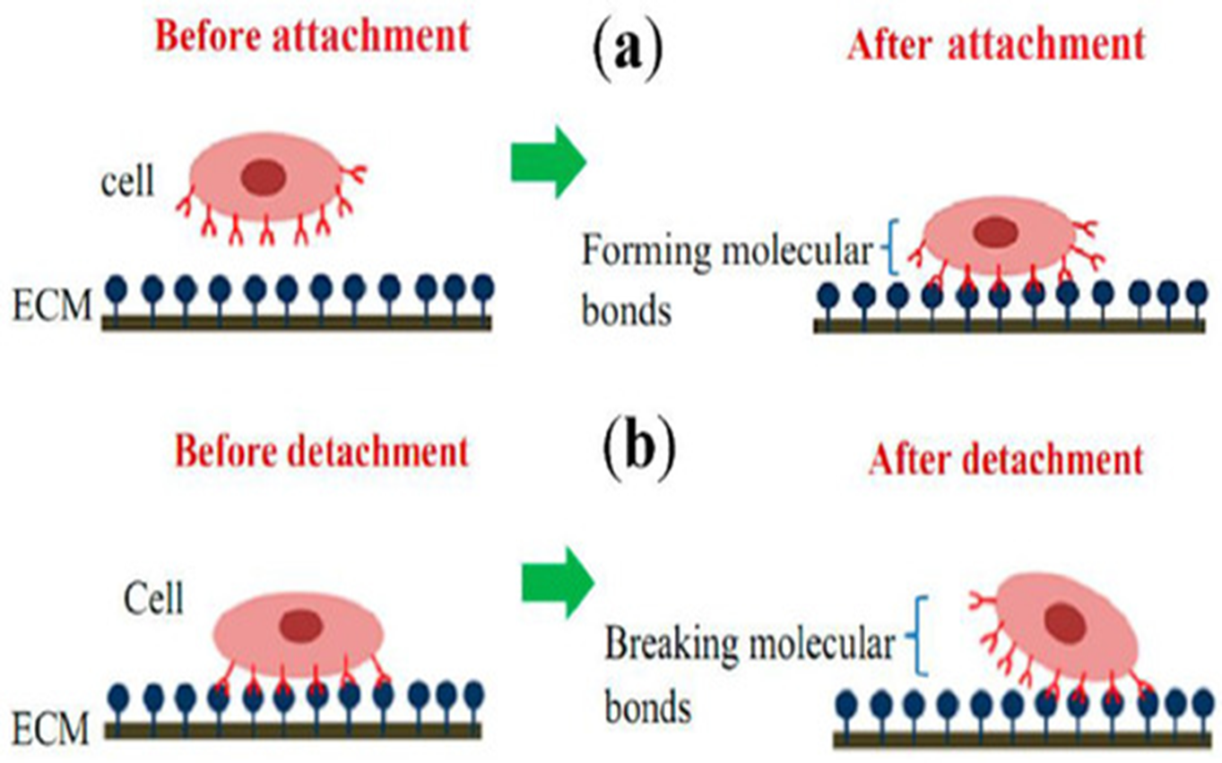
Schematic diagram of single-cell adhesion (a) attachment event via the formation of molecular bonds, (b) detachment event via breakage of molecular bonds. (ECM—Extracellular matrix)

Slide 47
Thank you
End

Slide 48
Homework
Case Scenario: Fine Needle Aspiration Cytology - An Overview
Patient Information: Mrs. Smith, a 52-year-old female, presents to her primary care physician with a palpable lump in her left breast. She reports that she first noticed the lump about two weeks ago and it has been gradually increasing in size. She denies any history of trauma to the breast or any recent changes in her breast size or shape. Mrs. Smith is otherwise healthy and has no significant medical history.
Clinical Examination: Upon clinical examination, the physician notes a firm, non-tender mass measuring approximately 3 centimeters in diameter in the upper outer quadrant of the left breast. There are no visible signs of skin changes, nipple retraction, or discharge. The axillary lymph nodes appear non-palpable.

Slide 49
Homework Solution
Discussion:
Fine Needle Aspiration Cytology (FNAC): FNAC is a minimally invasive procedure used to obtain tissue samples for cytological examination. It is often performed as an initial diagnostic test for evaluating suspicious breast lumps, thyroid nodules, and other palpable masses.
Advantages of FNAC: FNAC is a quick and cost-effective procedure that can provide rapid diagnostic information, allowing for timely management decisions. It is associated with minimal discomfort and has a low risk of complications.
Limitations of FNAC: While FNAC is useful for providing a preliminary diagnosis, it may not always yield definitive results, particularly in cases where the sample is insufficient or non-representative. In such cases, additional diagnostic tests, such as core needle biopsy or surgical excision, may be required for further evaluation.

Slide 50
Homework
Management Plan: Based on the cytology results confirming invasive ductal carcinoma, Mrs. Smith is referred to an oncologist for further management. She undergoes additional imaging studies to assess for the extent of disease and is scheduled for surgery to remove the breast tumor. Subsequent treatment options, such as chemotherapy, radiation therapy, and hormone therapy, are discussed with Mrs. Smith as part of her comprehensive cancer care plan.
At the end: Fine Needle Aspiration Cytology (FNAC) is a valuable diagnostic tool for evaluating suspicious lesions in various anatomical sites, including the breast. In the case of Mrs. Smith, FNAC played a crucial role in the timely diagnosis of invasive ductal carcinoma, facilitating prompt initiation of appropriate treatment measures.

