Slide 1

Immunohistochemistry Introduction to Immunohistochemistry
Dr. Ahmad H. Ibrahim
Semester 2
Week 3
Date 14/2/2025

Slide 2
University of TISHK
Immunohistochemistry
Immunohistochmistry: Introduction and Methods
Dr. Ahmad H. Ibrahim
Email: ahmad.ibrahim@Tiu.edu.iq
Lec. 3

Slide 3
Outcomes:
Students will gain a comprehensive understanding of the principles and applications of immunohistochemistry in histological analysis.
2. Students will be able to identify the different types of antibody solutions used in immunohistochemistry and understand their production and characteristics.
3. Students will develop the skills to recognize and address background staining issues associated with whole serum solutions in immunohistochemistry.

Slide 4
Objectives
To understand the principles of immunohistochemistry (IHC) and its significance in histological analysis.
2. To differentiate between different types of antibody solutions used in IHC, including whole serum solution, antigen-specific antibody, and conjugated antibody.
3. To comprehend the production process and characteristics of whole serum solution, including antibody specificity and background staining.
4. To explain the concept of antigen-specific antibody preparation and its increased specificity for specific antigens.

Slide 5
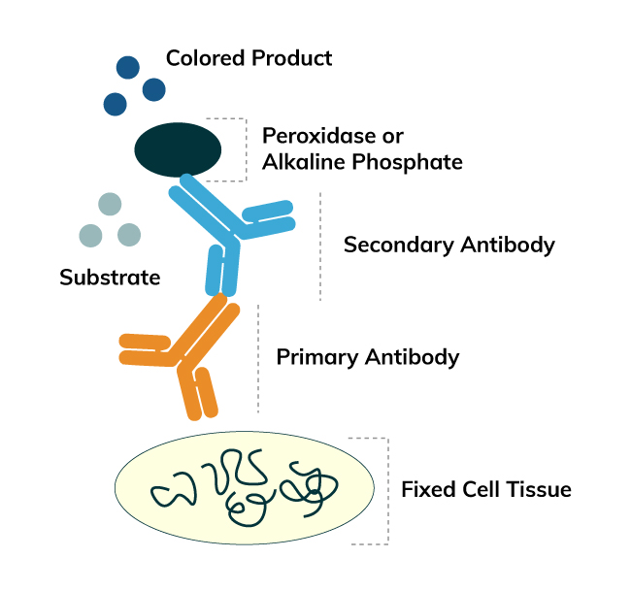
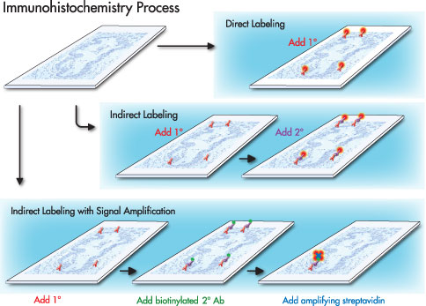
Introduction
Immunohistochemistry (IHC) is a technique used in histology to visualize specific antigens in tissue sections.
It utilizes antigen-antibody complexes for staining and provides sensitive and specific results.

Slide 6
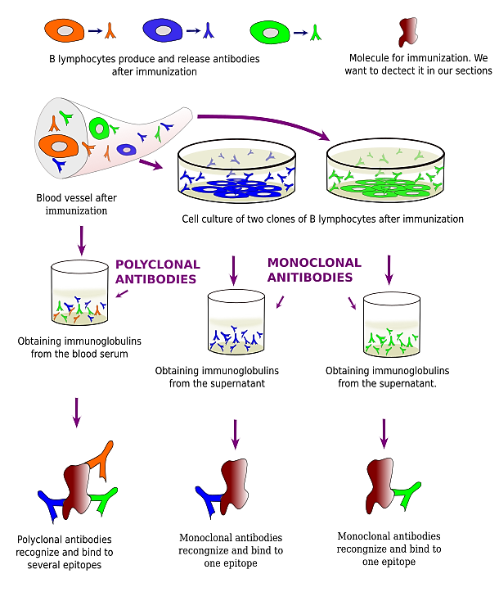
Antigens and Antibodies:
• Antigens have immunogenicity (induce antibody formation) and specific reactivity (react with produced antibodies).
•Antibodies are serum proteins that react specifically with antigens to form immune complexes.

Slide 7
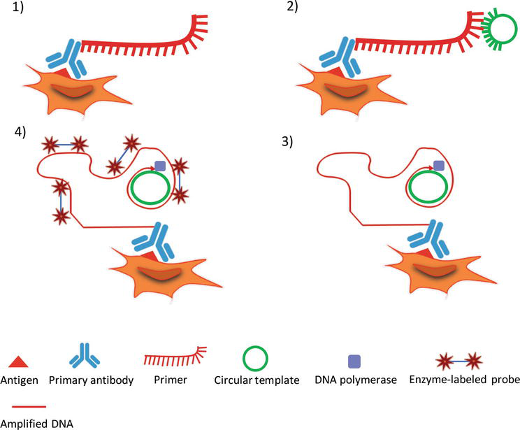
Staining Methods:
Immunoperoxidase staining is a common IHC method.
It uses an enzyme (peroxidase) to catalyze a reaction that produces a visible stain.

Slide 8
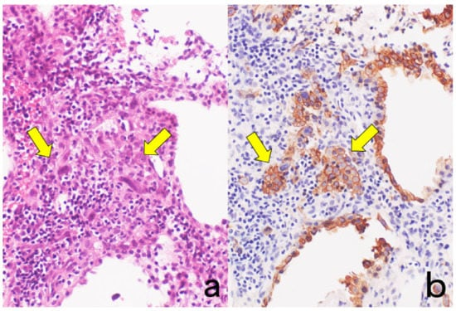
Staining Procedures:
Step-by-step procedures are followed for successful immunoperoxidase staining.
Controls, fixation, processing of specimens, and special hints are considered.
Figure . Cytokeratin for identifying intermediate trophoblasts in the placenta. (a): H&E, (b): cytokeratin immunostaining. Intermediate trophoblasts (arrows) are observed in the stroma of the placental tissue sampled by curettage. Cytokeratin immunoreactivity with a monoclonal antibody CAM5.2 clearly illustrates their distribution.

Slide 9
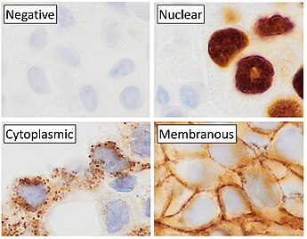
Classification of IHC Markers
IHC markers can be classified into four types: diagnostic, prognostic, predictive, and therapeutic.
Each type of marker provides valuable information about the nature, course, response to therapy, and potential therapeutic targets.
Main staining patterns on chromogenic immunohistochemistry.

Slide 10
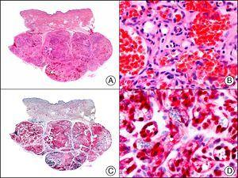
Diagnostic Markers:
Diagnostic markers define the histogenesis or origin of the lesion.
They help identify the nature of neoplasms and non-neoplastic lesions.
Example: Cytokeratins are useful markers to demonstrate the epithelial nature of cells.
Lobular capillary hemangioma. A, Low-power magnification (×10). B, Detail of capillary vessels lined with the endothelial cells that constitute the lesion (×400). C, The same sample studied immunohistochemically with ERG (v-ets erythroblastosis virus E26 oncogene homolog [avian]) (×10). D, Detail of ERG-positive nuclei in the proliferating endothelial cells (×400).

Slide 11
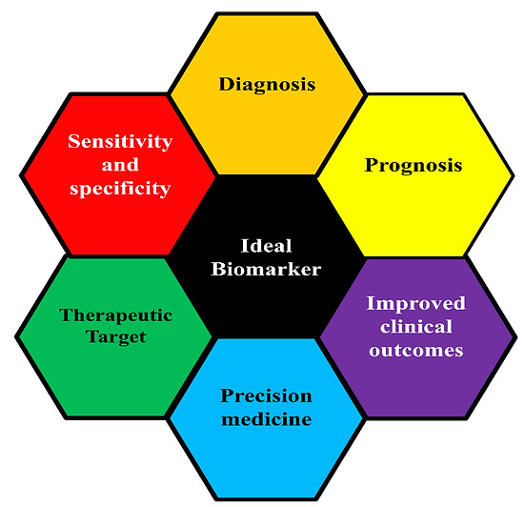
Prognostic Markers:
Prognostic markers suggest clinical and biological characteristics that provide information about the likely course of the disease and patient outcome.
They help assess the aggressiveness or progression of the disease.
Examples: Prognostic markers specific to certain cancers (not specified in the given information).
Ideal biomarkers are key to improved patient outcome. Biomarkers can be targeted for improved diagnosis, prognosis, and therapeutics.

Slide 12
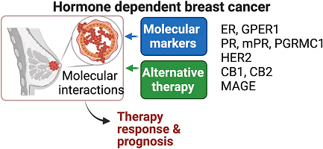
Predictive and Therapeutic Markers:
Predictive markers help predict the response of the lesion to targeted therapy.
Therapeutic markers represent structures that can be targeted for therapy.
Example: In breast cancer, markers such as estrogen receptor (ER), progesterone receptor (PgR), human epidermal growth factor receptor-2 (HER2), and Ki-67 are commonly immunostained to guide molecular targeted therapy.
Histological and B. molecular subtyping of breast cancer underly prognosis and therapeutic options.

Slide 13
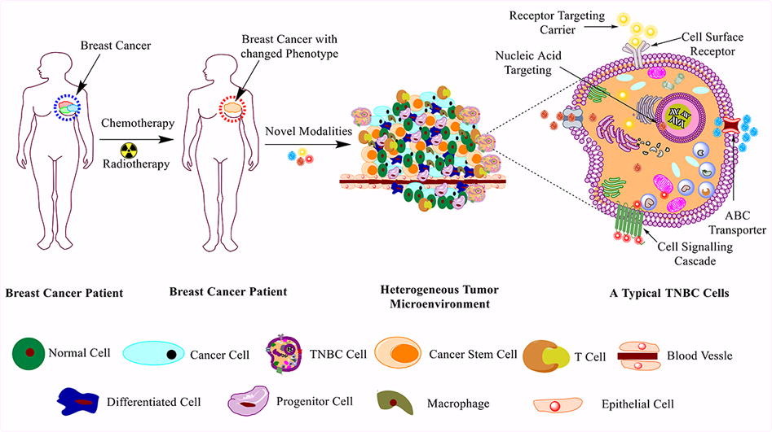

Slide 14
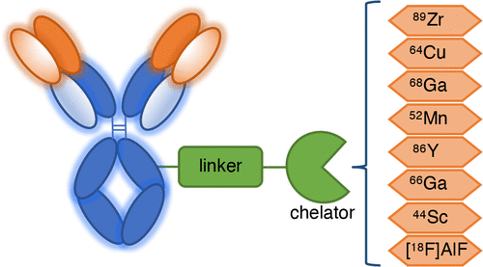
Interpretation of Antibodies:
Immunohistochemical reactions are more precise than ordinary histochemical techniques.
Antigen-antibody reactions form immune complexes that can be measured.
Radiometals and chelators have extensively been evaluated to come to the most ideal radiometal–chelator pair for each type of antibody derivative. Although PET imaging of antibodies is a relatively recent tool, applications with 89Zr, 64Cu, and 68Ga have greatly increased in recent years, especially in the clinical setting, while other less common radionuclides such as 52Mn, 86Y, 66Ga, and 44Sc, but also 18F as in [18F]AlF are emerging promising candidates for the radiolabeling of antibodies.

Slide 15
Antibodies and their Structure:
Antibodies (immunoglobulins) are serum proteins formed in response to exposure to an antigen.
They can be divided into classes: IgA, IgD, IgE, IgG, and IgM.
Antibody Structure:
Antibodies consist of heavy chains and light chains.
The heavy chains determine the antibody class, while light chains can be kappa or lambda.

Slide 16
Antibody Production:
To produce antibodies for laboratory use, antigens are purified and injected into animals.
Animals produce antibodies specifically directed against the antigen.

Slide 17
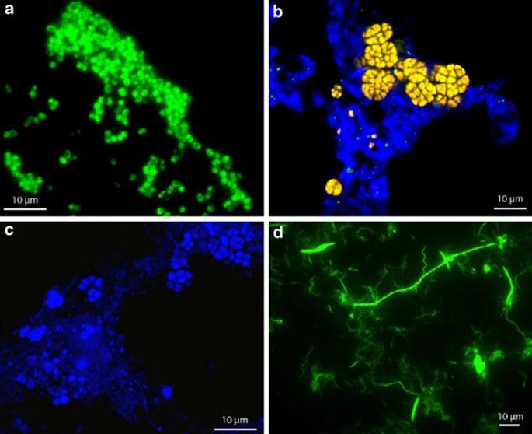
CISH: Chromogen Staining:
CISH is used to detect and localize DNA sequences on chromosomes.
Epifluorescence microscopy images of fixation-free FISH applied to
(a) FISH imaging of CAP II-specific probe in EBPR sludge, showing characteristic CAP bacteria. (b) FISH imaging of archaeal-specific probes in DAMO sludge, highlighting ANME-2D archaea clusters. (c) Broad-specificity bacterial probe used in FISH imaging of EBPR sludge, revealing diverse morphotypes. (d) Broad-specificity bacterial probe used in FISH imaging of Nasutitermes corniger hindgut community, displaying diverse morphotypes..

Slide 18
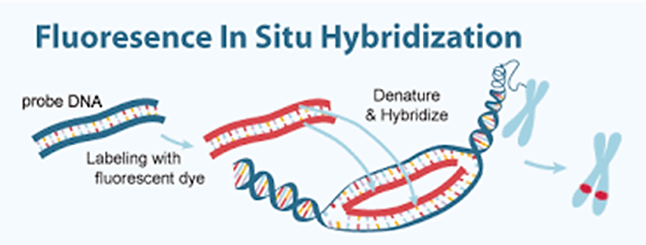
Chromogen in situ hybridization (CISH) is an alternative technique to FISH (fluorescence in situ hybridization).
FISH (Fluorescence In Situ Hybridization) is a cytogenetic technique used to detect and localize the presence or absence of specific DNA sequences on chromosomes. This technique is based on the mechanism of nucleic acid base pairing, only those parts of the chromosome with high degree of sequence complementarity will be recognized and bound by fluorescent probes.

Slide 19
Summary:
• Immunohistochemistry is a technique used to visualize specific antigens in tissue sections.
• It relies on antigen-antibody complexes and staining methods like immunoperoxidase.
Understanding antigen-antibody interactions and staining procedures is crucial for successful IHC.

Slide 20
The END

Slide 21
Immunohistochemistry Types of Antibody Solutions
Dr. Ahmad H. Ibrahim
Semester 2
Week 4
Date 21/2/2024

Slide 22
University of TISHK
Immunohstochemistry
Immunohistochmistry: Types of Antibody Solutions
Dr. Ahmad H. Ibrahim
Email: ahmad.ibrahim@Tiu.edu.iq
Lec 4

Slide 23
Outcomes:
1. Students will understand the importance of antigen-specific antibodies and conjugated antibodies in enhancing specificity and sensitivity in immunohistochemical staining.
2. Students will grasp the concept of immune complexes and their role in antigen-antibody interactions in immunohistochemistry.
3. Students will differentiate between polyclonal and monoclonal antibodies and comprehend the process of monoclonal antibody production using hybridoma technology.
4. Students will appreciate the significance of monoclonal antibodies in various biomedical research and diagnostic applications.

Slide 24
Objectives
1. To discuss the chemical linkage of markers to antibody molecules in conjugated antibody and the impact on reagent performance.
2. To introduce the formation and characteristics of immune complexes and their role in IHC.
3. To differentiate between polyclonal and monoclonal antibodies and understand the production process of monoclonal antibodies using hybridoma technology.
4.To explain the steps involved in hybridoma formation and monoclonal antibody production using the hybridoma technique.

Slide 25
Introduction
Overview of immunohistochemistry and its importance
Focus on the different types of antibody solutions
Whole Serum Solution
Production of whole serum solution
Composition and characteristics of whole serum solution

Slide 26
Whole Serum Solution: Antibody Specificity
Antibodies specific to the immunized antigen
Naturally occurring antibodies present in the whole serum
Whole Serum Solution: Background Staining
Affinity of serum proteins for tissue components
Unwanted background staining due to serum components

Slide 27
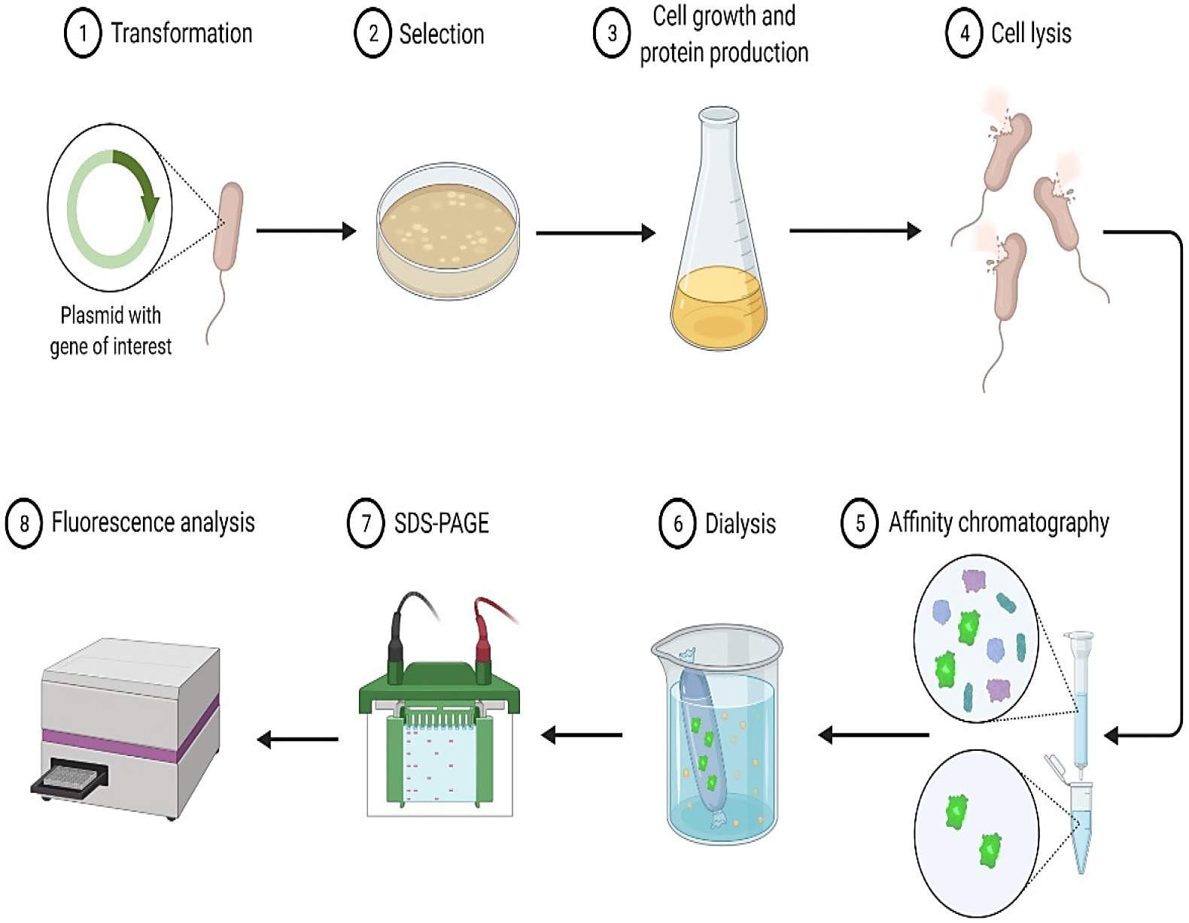
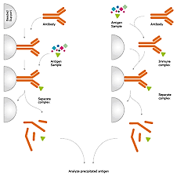

Slide 28
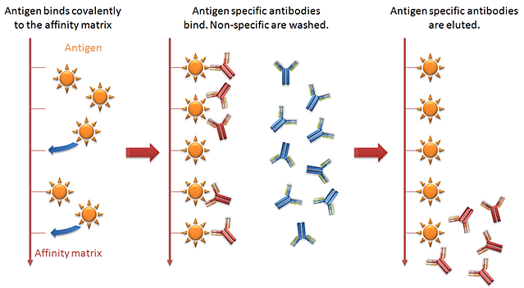
Immunoglobulin (Ig) Fraction
Preparation of Ig fraction
Reduction of nonspecific reactions by eliminating serum components
in response to foreign molecules. This is the body’s self-defence mechanism against foreign bodies. B- Lymphocytes in the body have cell surface receptors for foreign bodies. On attachment of these bodies, they differentiate to form lymphoid or plasma cells, which in turn produce antibodies.

Slide 29
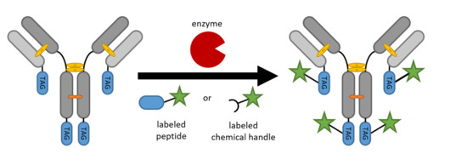
Antigen Specific Antibody
• Preparation of antigen-specific antibody
• Increased specificity for specific antigens
Conjugated Antibody
• Introduction to conjugated antibody
• Chemical linkage of markers to antibody molecules
• Fluorescent labels and enzyme markers

Slide 30
Conjugated Antibody: Sensitivity and Specificity
• Potential loss of sensitivity and specificity in conjugation process
• Impact on reagent performance
Immune Complexes
• Introduction to immune complexes
• Formation of immune complexes using antigen and specific antibody

Slide 31
Immune Complexes
• Formation of immune complexes using antigen and specific antibody
• Solubility and stability of immune complexes
Peroxidase Antiperoxidase (PAP) Complex
• Example of a naturally formed immune complex
• Composition and characteristics of PAP complex

Slide 32
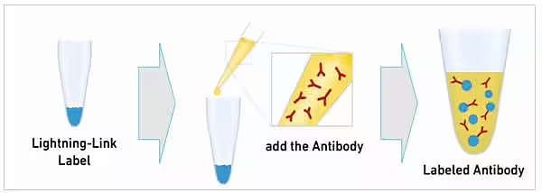
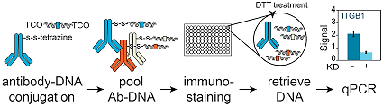

Slide 33
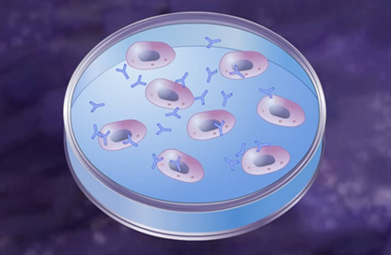
Monoclonal Antibodies
Differentiating polyclonal and monoclonal antibodies
Production of monoclonal antibodies using B-cell clones

Slide 34
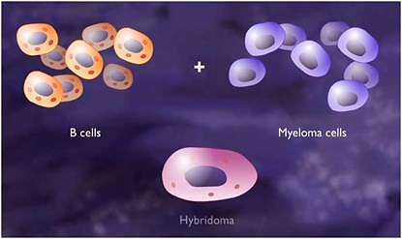
Monoclonal Antibodies: Hybridoma Formation
Fusion of B-cell clone with myeloma cell
Generation of hybridoma cells for antibody production

Slide 35
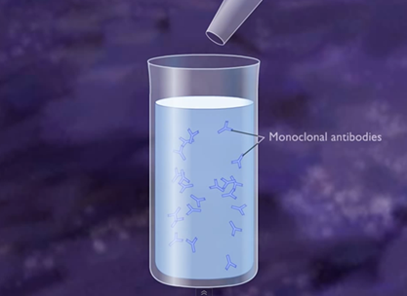
Monoclonal Antibodies: Production and Use
Stability and consistency of monoclonal antibodies
Comparison of ascitic fluid and culture supernatants as antibody sources

Slide 36
MONOCLONAL ANTIBODIES PRODUCTION
Method : HYBRIDOMA TECHNOLOGY
Hybridoma Technology developed by Kohler and Milstein has been widely used for the production of Monoclonal Antibodies.
Monoclonal Antibodies (MAbs) are antibodies that arise from a single clone of cells.
They are homogenous in a plasma cell tumour (Myeloma).
B cells can produce antibodies of single specificity.
Myeloma cells or tumor cells are capable of continuous division forming large number of cells .
The fusion of two types of cells form cells called hybridomas.

Slide 37
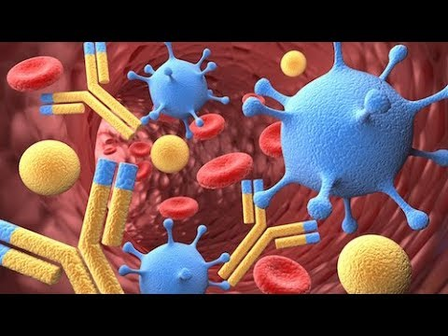
MONOCLONAL ANTIBODIES PRODUCTION

Slide 38
MONOCLONAL ANTIBODIES PRODUCTION
Method : HYBRIDOMA TECHNOLOGY
Hybrid cells will be having the property of B cells antibody production and tumour cells ability of continuous division.
Hybrid cell ensures antibody production continuously in dividing cells.
The mixture of cells are cultured under conditions which permit growth of only hybridoma cells .
Each hybridoma cell will produce a single type of antibody against a single epitope.
The hybridoma cells producing the desired monoclonal antibody are the cultured
Monoclonal antibodies are isolated and purified.

Slide 39
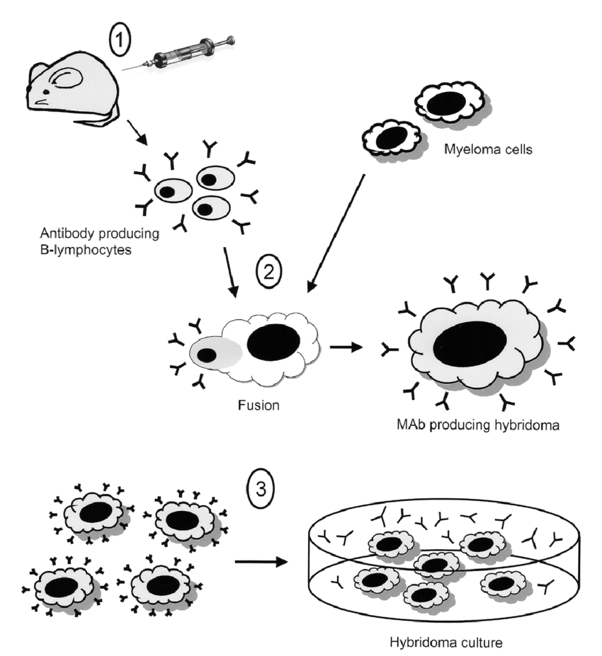
The hybridoma technique produces monoclonal antibodies (MAbs) in three steps:
Immunize a mouse with the antigen to stimulate antibody production.
Fuse antibody-producing B-lymphocytes with myeloma cells to create immortal hybridomas.
Culture and multiply the hybridomas to obtain a continuous supply of identical MAbs.

Slide 40
Summery
The lecture provided an overview of immunohistochemistry (IHC) and its importance in histological analysis.
It covered different types of antibody solutions used in IHC, including whole serum solution, antigen-specific antibody, and conjugated antibody, along with their production processes and characteristics.
The lecture highlighted the significance of antigen-specific antibodies in enhancing specificity for specific antigens and discussed the chemical linkage of markers to antibody molecules in conjugated antibody solutions.

Slide 41
Summery
Furthermore, the formation and characteristics of immune complexes were introduced, and the differentiation between polyclonal and monoclonal antibodies was discussed.
The lecture concluded with an explanation of the hybridoma technology for monoclonal antibody production and its applications in biomedical research and diagnostics.

Slide 42
The END

Slide 43
References
Dabbs DJ. Diagnostic Immunohistochemistry: Theranostic and Genomic Applications. 5th edition. Elsevier; 2019. ISBN-13: 978-0323567448.
Bancroft JD, Gamble M. Theory and Practice of Histological Techniques. 7th edition. Churchill Livingstone; 2013. ISBN-13: 978-0702042263.
Gown AM. Diagnostic Immunohistochemistry: What Can Go Wrong and How to Prevent It. 1st edition. Springer; 2009. ISBN-13: 978-0387894099.
Ramos-Vara JA, Kiupel M. Veterinary Comparative Hematopathology. 1st edition. Wiley-Blackwell; 2007. ISBN-13: 978-0813803890.
Shi SR, Gu J, Cote RJ, Taylor CR. Antigen Retrieval Techniques: Immunohistochemistry and Molecular Morphology. 1st edition. Eaton Publishing; 2000. ISBN-13: 978-

Slide 44
References
Taylor CR, Levenson RM. Quantification of immunohistochemistry--issues concerning methods, utility and semiquantitative assessment II. Histopathology. 2006 Sep;49(3):411-24. doi: 10.1111/j.1365-2559.2006.02513.x. PMID: 16922739.
Shi SR, Cote RJ, Taylor CR. Antigen retrieval techniques: current perspectives. J Histochem Cytochem. 2001 Sep;49(9):931-7. doi: 10.1177/002215540104900801. PMID: 11511661.
Ramos-Vara JA. Technical aspects of immunohistochemistry. Vet Pathol. 2005 Sep;42(5):405-26. doi: 10.1354/vp.42-5-405. PMID: 16145243.
Brown DC, Gatter KC. Monoclonal antibody Ki-67: its use in histopathology. Histopathology. 1990 Jul;17(2):489-503. doi: 10.1111/j.1365-2559.1990.tb01129.x. PMID: 1706161.
Rizzardi AE, Johnson AT, Vogel RI, Pambuccian SE, Henriksen J, Skubitz AP, Metzger GJ, Schmechel SC. Quantitative comparison of immunohistochemical staining measured by digital image analysis versus pathologist visual scoring. Diagn Pathol. 2012 Mar 19;7:42. doi: 10.1186/1746-1596-7-42. PMID: 22433176; PMCID: PMC3340902.

Slide 45
Homework
Case Scenario: During a research project investigating the expression of a specific protein in breast cancer tissues using immunohistochemistry (IHC), a researcher encounters unexpected results.
The researcher has been diligently following established protocols for tissue preparation, antigen retrieval, and antibody staining. However, upon microscopic examination of the stained tissue sections, the researcher observes inconsistent staining patterns across different tissue samples.
Some samples show strong and specific staining for the target protein, while others exhibit weak or non-specific staining, and some show no staining at all.

Slide 46
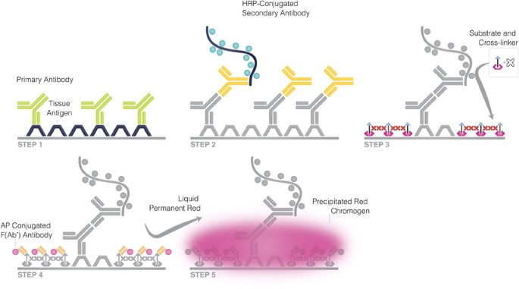
A novel quantitative immunohistochemistry method for precise protein measurements directly

Slide 47
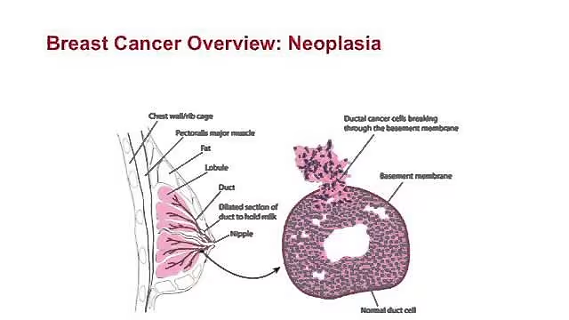
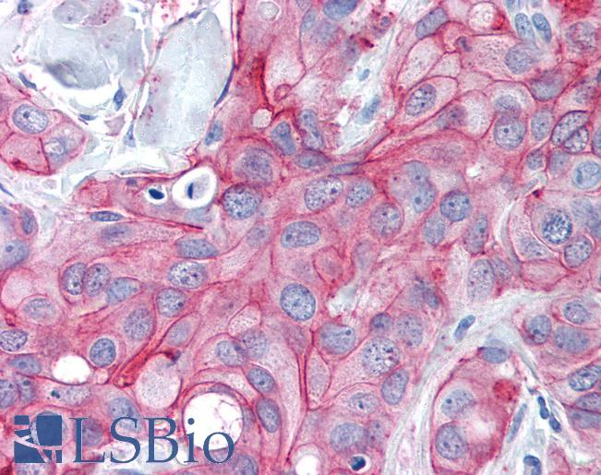
Breast Cancer Antibodies used in Immunohistochemistry
Breast Cancer and Immunohistochemistry

Slide 48
Homework (continue)
The researcher is puzzled by these discrepancies and seeks assistance in troubleshooting the issue to ensure the reliability and reproducibility of the IHC results.
Solution:
Assessment of Staining Protocol:
Review the staining protocol used by the researcher to ensure adherence to standardized procedures for tissue fixation, antigen retrieval, blocking, and antibody incubation.
Verify the consistency of protocol implementation across all tissue samples and staining batches.

Slide 49
Homework (contenu)
Evaluation of Tissue Quality:
Assess the quality of tissue samples used for IHC staining, including tissue fixation methods, processing artifacts, and sample integrity.
Consider the possibility of tissue degradation or variability in tissue composition affecting staining results.
Antibody Specificity and Dilution:
Evaluate the specificity and dilution of the primary antibody used in the IHC staining.
Verify the antibody specificity through positive and negative controls and optimize antibody dilution to ensure optimal binding.

Slide 50
Homework (contenu)
Blocking and Wash Steps:
Review the effectiveness of blocking and wash steps in the staining protocol to minimize non-specific binding and background staining.
Ensure thorough blocking of endogenous peroxidases, proteins, and other potential sources of non-specific staining.
Detection System and Signal Amplification:
Assess the sensitivity and signal amplification system used for detecting the target protein.
Consider alternative detection methods or signal amplification strategies to enhance signal-to-noise ratio and improve staining consistency.

Slide 51
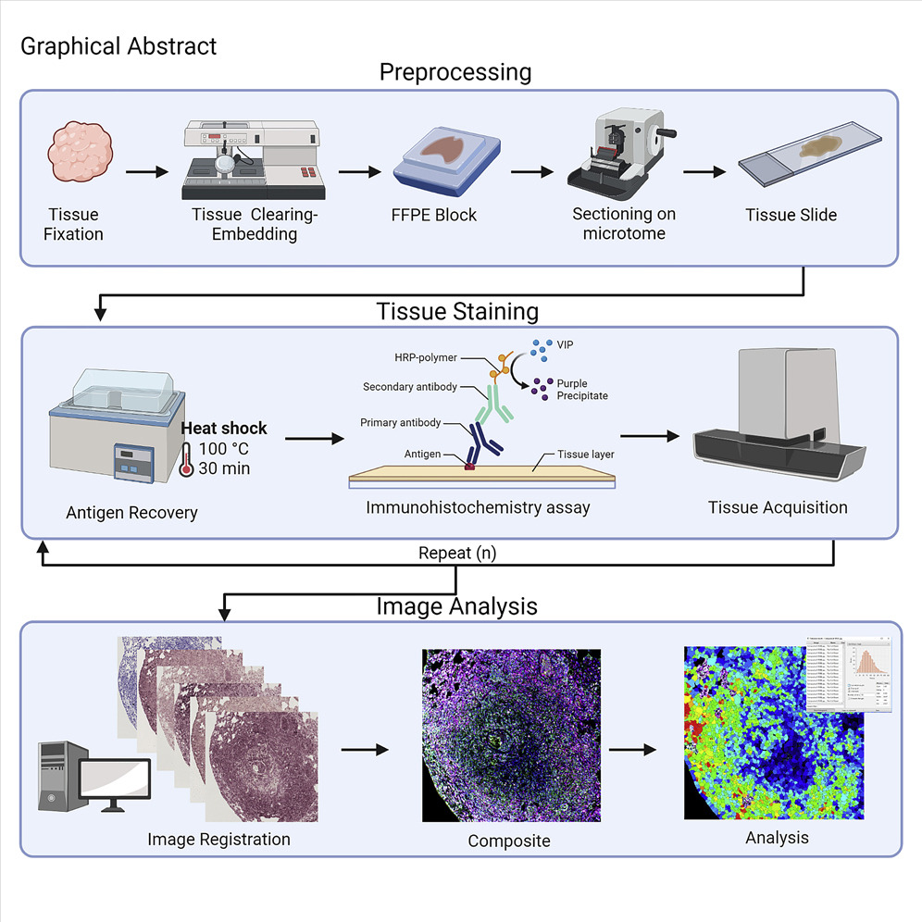

Slide 52
Homework (contenu)
Validation of Results:
Perform validation experiments using additional techniques, such as Western blotting or quantitative PCR, to confirm the expression levels of the target protein in the tissue samples.
Compare IHC results with other molecular assays to verify the accuracy and reliability of the staining.
Consultation with Colleagues and Experts:
Seek input from colleagues or experts with expertise in immunohistochemistry and molecular pathology to troubleshoot the staining inconsistencies.
Collaborate with pathologists or experienced researchers to interpret staining patterns and identify potential issues affecting staining reliability.

Slide 53
Homework (contenu)
Documentation and Record Keeping:
Maintain detailed records of experimental procedures, including tissue processing, staining conditions, and observation of staining patterns.
Document any deviations from standard protocols and note potential sources of variability or errors in experimental execution.

