Slide 1

Immunohistochemistry Introduction to Microtechniques
Dr. Ahmad H. Ibrahim
Semester 2
Week 5
Date 14/2/2024

Slide 2
University of TISHK
Immunohistochemistry
Introduction to Microtechniques
Dr. Ahmad H. Ibrahim
Ph.D. Molecular Pharmacology
Email: ahmad.ibrahim@tiu.edu.iq
4^{rth} Lecture
March 6 -2024

Slide 3

Welcome

Slide 4
Objectives
1. To Study of histochemistry
2. To know Types of Microtechniques
3. To learn about methods of Microtechniques
4. To learn about Histochemistry Microtechniques in general and special.

Slide 5

In this lecture
Introduction to Microtechniques
General guide lines in Microtechniques

Slide 6
Terminology

Slide 7
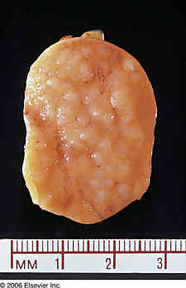
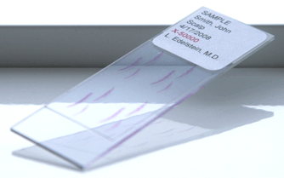
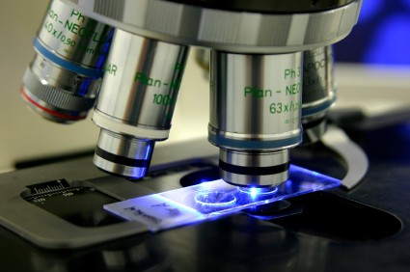
Histochemistry and Microtechniques
They are methods used for processing the tissues taken from the body to produce microscopic slides for examination under the microscope.

Slide 8
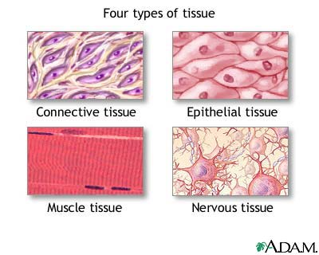
Tissue
An aggregate of specialized cells which together perform certain special function

Slide 9
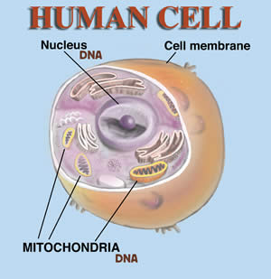
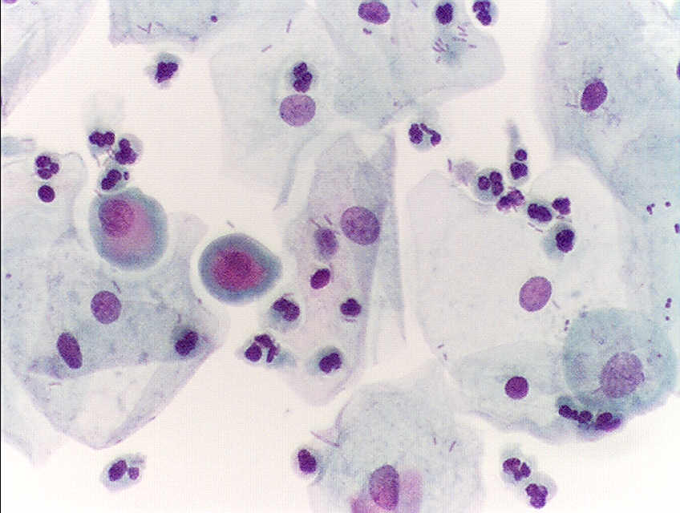
The cell
the fundamental, structural and functional unit of living organism.

Slide 10
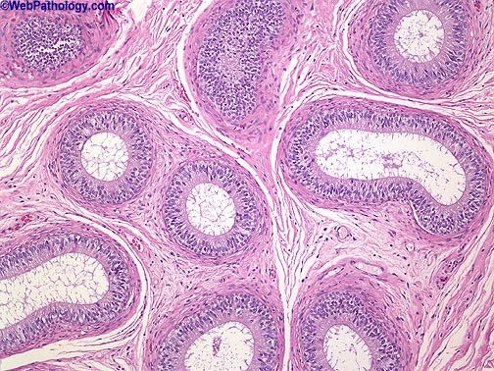
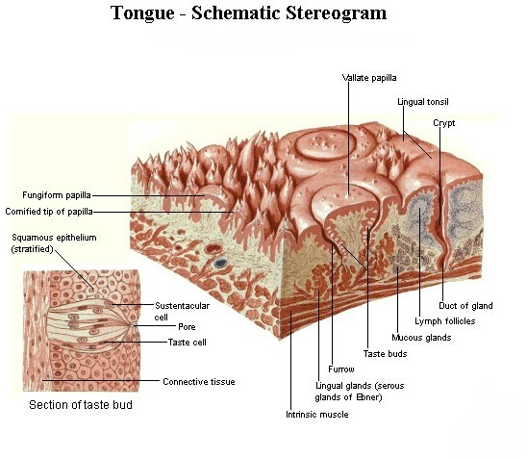
Histology
is the science that deals with microscopic structures, composition and function of normal tissues

Slide 11

Pathology
is the study of the structural and functional changes in cells, tissues, and organs that underlie disease.

Slide 12
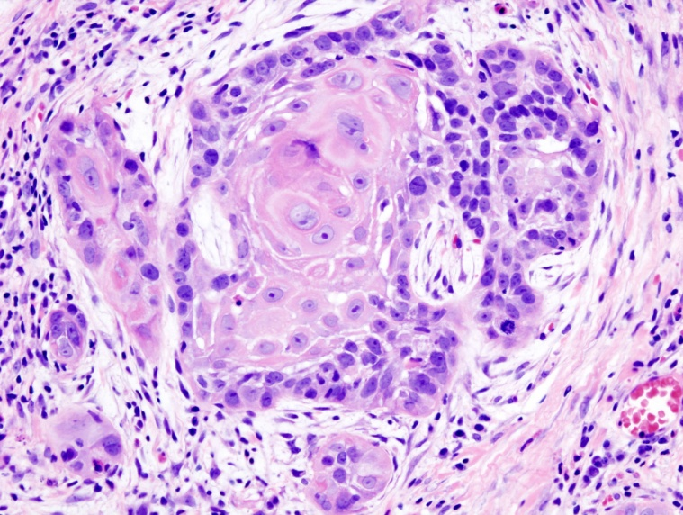
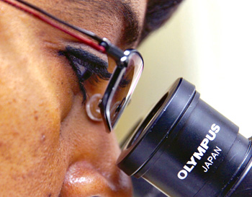
Histopathology
is the macroscopic and microscopic study of the diseased tissue or organs.

Slide 13
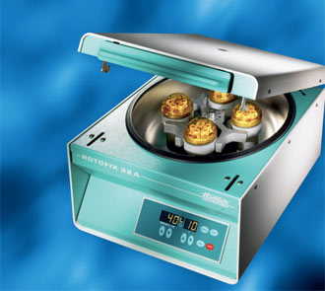
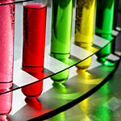
Cytology
is the study of cells; their origin, structure, function and pathology

Slide 14
Branches of Histochemistry-

Slide 15
Branches of Histochemistry
Hematology
Blood
Biochemistry
Chemical analysis
Microbiology
micro-organisms
tissues and cells
Histopathology

Slide 16
Histopathological examinations are used for

Slide 17
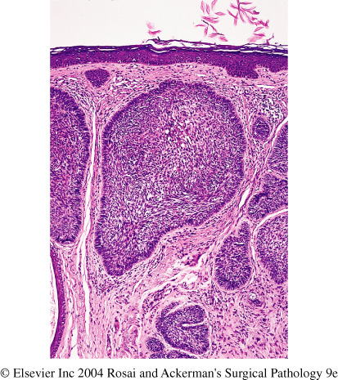
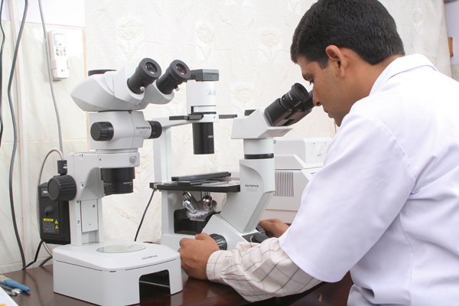
Histopathological examinations are used for
Diagnosis of diseases.

Slide 18
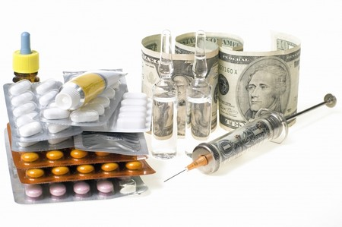

2. Determining the treatment, prognosis, and grading.

Slide 19

3. Medico-legal conditions, to determine the cause of death.

Slide 20
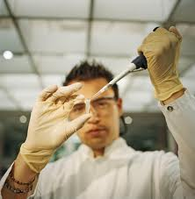
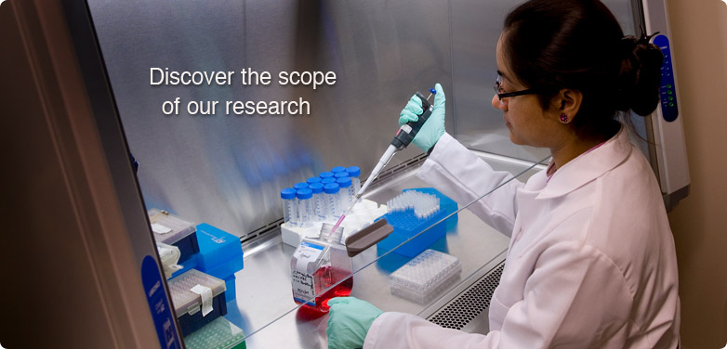
4. Researches and medical discovery.

Slide 21
Methods of Histochemistry Microtechniques

Slide 22
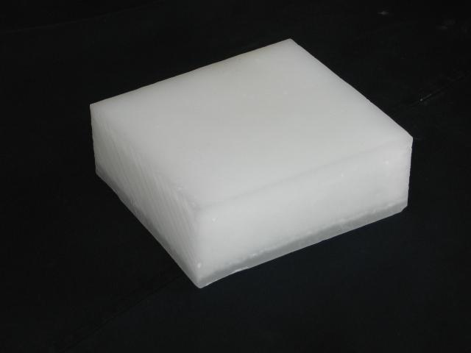
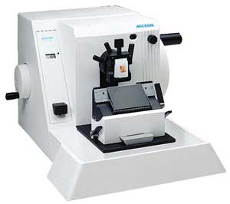
Methods of Histochemistry Microtechniques
The methods can be classified according to the type of sample into
Histopathological methods
Paraffin method
Frozen method

Slide 23
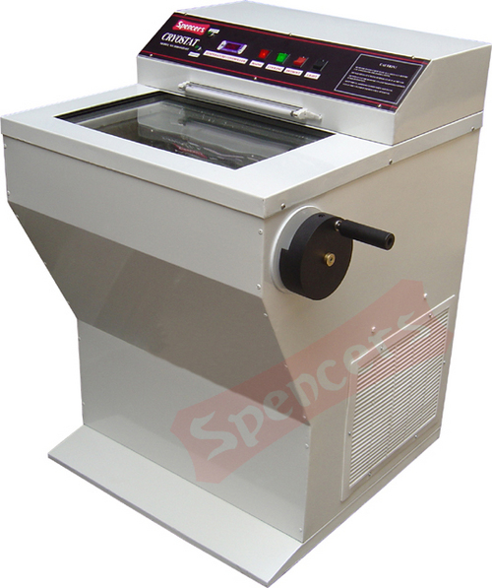
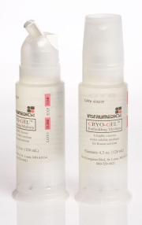
Methods of Histochemistry Microtechniques
The methods can be classified according to the type of sample into
Histopathological methods
Paraffin method
Frozen method

Slide 24
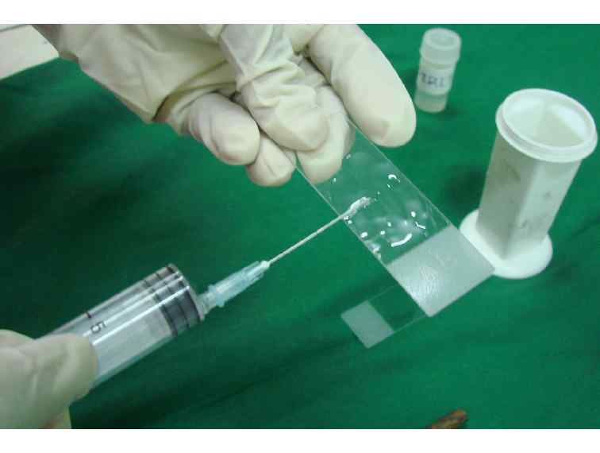
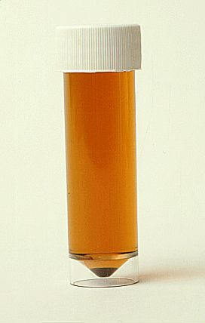
Methods of Histochemistry Microtechniques
The methods can be classified according to the type of sample into
Cytological methods
Routine smears preparation method.
Touch imprint cytology.

Slide 25
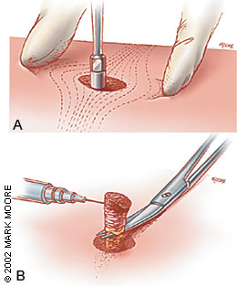
Types of specimens
Pathology laboratories deal with different types of specimens taken. They can be divided into
Histopathological Specimen
Biopsy
Cytological Specimen
Body fluids
Autopsy
Smears from aspiration or exfoliation

Slide 26

Any Question?
Thank you

Slide 27

End

