Slide 1

Immunohistochemistry Special fixatives
Dr. Ahmad H. Ibrahim
Semester 2
Week 7
Date 1/4/2025

Slide 2
University of TISHK
Immunohistochemistry
Special fixatives
Dr. Ahmad H. Ibrahim
Email: ahmad.ibrahim@Tiu.edu.iq Lecture7

Slide 3
Special fixatives

Slide 4
Special fixatives
Used for special purposes or particular tissue or method e.g.:
Alcohol: Fixation of cytological smears.
Glutaraldehyde (Clear): fixation of tissue for electron microscopy

Slide 5

Compound fixatives

Slide 6
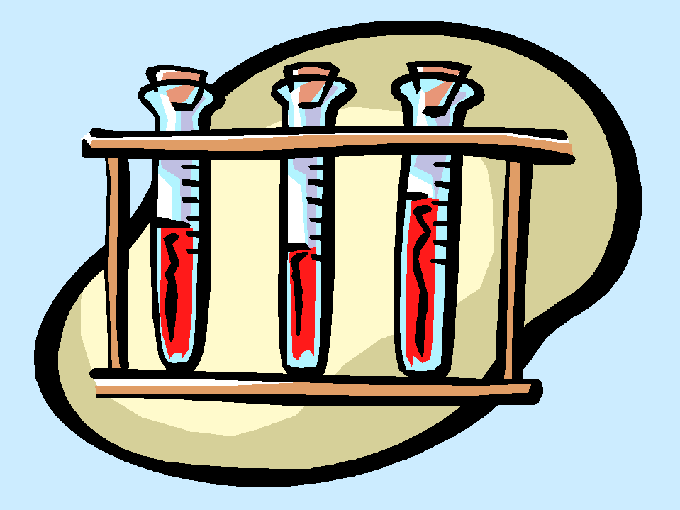
Compound fixatives
They are fixative solution contains more than one type of fixative agents used for specific conditions in order to give best fixation result.

Slide 7
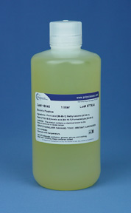
Bouins Solution; (Yellow):
Picric acid,
formaldehyde
acetic cid

Slide 8
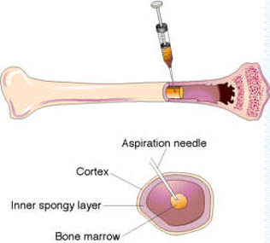
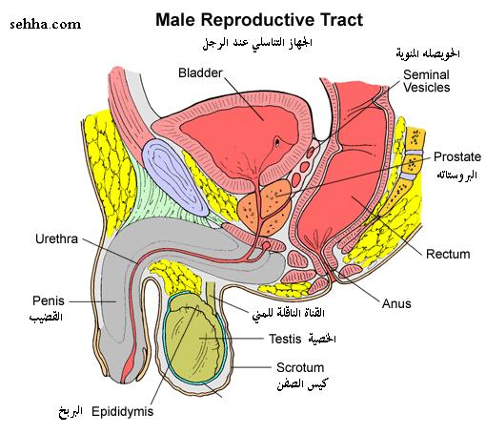
Bouins Solution; (Yellow):
Used for: fixation of testis and bone marrow biopsy.
Bone marrow
Testis

Slide 9
Bouins Solution; (Yellow):
Effect:
RBCs are lysed
iron and small calcium deposits are dissolved.

Slide 10
Bouins Solution; (Yellow):
Note:
It need washing with alcohol 70% for 3-8 hours to remove unbound picric acid.

Slide 11
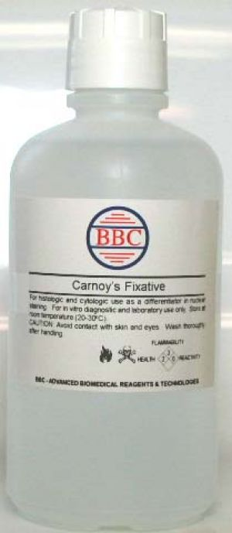
Carnoy's (Clear)
Glacial
Acetic Acid
absolute
ethanol
chloroform

Slide 12
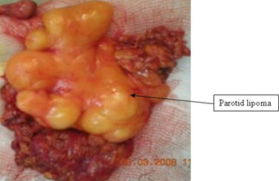
Carnoy's (Clear)
Used for: dissolving the fat tissue and lysis of RBC
Disadvantages: Chloroform is hazardous to handle.

Slide 13
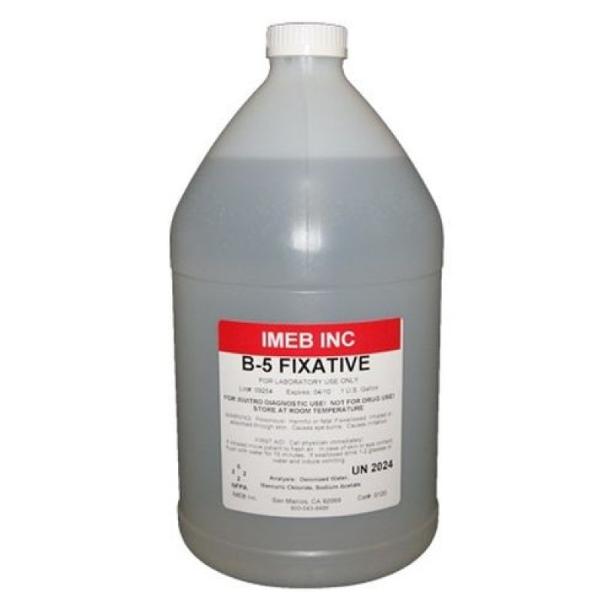
B-5 Fixative
Mercuric
chloride
Sodium acetate
anhydrous
40%
formaldehyde.

Slide 14
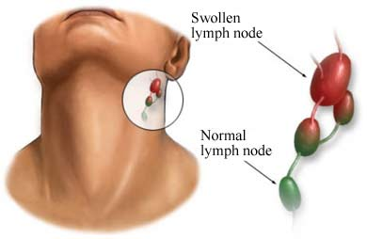
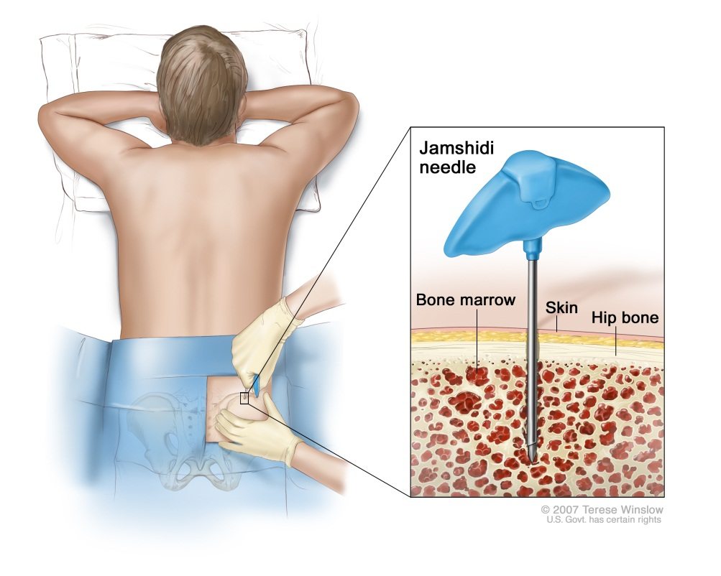
Used for: fixation of haematopoietic and lymphoid tissue

Slide 15
Advantage: It produces excellent nuclear detail and good results of special stains.
Disadvantage:
Sections will require the removal of mercury pigment prior to staining.
Mercury need careful disposal.

Slide 16
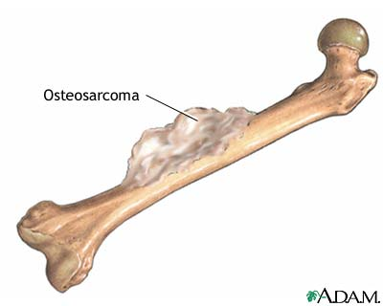
How to deal with bone tissue

Slide 17
How to deal with bone tissue
Bone tissue should be soften before cutting and further processing by a method called
"Decalcification"

Slide 18
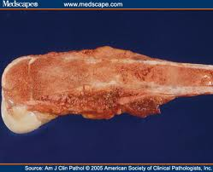
How to deal with bone tissue
Decalcification:
is the removal of calcium ions from the bone making the bone flexible and easy for pathological investigation.

Slide 19

Decalcification

Slide 20
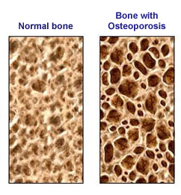

Slide 21
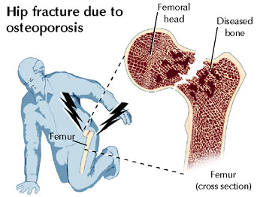

Slide 22
How it done
It can be done by many agents; the most common is the acids: example:
strong acid (nitric and hydrochloric acid)
Weak (picric, acetic and formic acid).

Slide 23
How long it takes
The bone is placed in the decalcification solutions for hours to weeks depend on the;
size,
Type
Strength of the bone.
The solution should be changed every day.

Slide 24
Factors affecting the decalcification
Concentration: high conc. decalcifies rapidly but harms the tissue.
Temperature: better at room temp. because high temp will decalcifies more rapidly but unfortunately the damage effect also increase.
Physical movement: some said it reduce the time required.

Slide 25
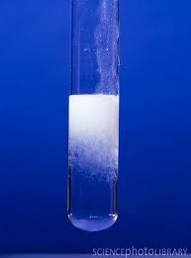
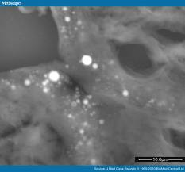
Decalcification end points
Radiography by X-ray
Chemically: by calcium oxalate test

Slide 26
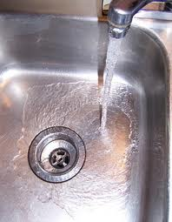
After decalcification
The biopsy should be washed by water to remove the excess acid on the surface for at least 30 min

Slide 27
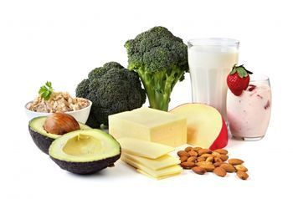

For better bone health keep balance between
Calcium rich food
Physical activity

Slide 28
True and false questions
GA. Q1: What is Decalcification:
Is the Bone tissue should be soften before cutting and further
Answer : ................................
GB:
Q1: What is Carnoy's (Clear) solution:
Is Used for: dissolving the fat tissue and lysis of RBC
Answer....................................

Slide 29
The END

Slide 30
References
Dabbs DJ. Diagnostic Immunohistochemistry: Theranostic and Genomic Applications. 5th edition. Elsevier; 2019. ISBN-13: 978-0323567448.
Bancroft JD, Gamble M. Theory and Practice of Histological Techniques. 7th edition. Churchill Livingstone; 2013. ISBN-13: 978-0702042263.
Gown AM. Diagnostic Immunohistochemistry: What Can Go Wrong and How to Prevent It. 1st edition. Springer; 2009. ISBN-13: 978-0387894099.
Ramos-Vara JA, Kiupel M. Veterinary Comparative Hematopathology. 1st edition. Wiley-Blackwell; 2007. ISBN-13: 978-0813803890.
Shi SR, Gu J, Cote RJ, Taylor CR. Antigen Retrieval Techniques: Immunohistochemistry and Molecular Morphology. 1st edition. Eaton Publishing; 2000. ISBN-13: 978-

Slide 31
References
Taylor CR, Levenson RM. Quantification of immunohistochemistry--issues concerning methods, utility and semiquantitative assessment II. Histopathology. 2006 Sep;49(3):411-24. doi: 10.1111/j.1365-2559.2006.02513.x. PMID: 16922739.
Shi SR, Cote RJ, Taylor CR. Antigen retrieval techniques: current perspectives. J Histochem Cytochem. 2001 Sep;49(9):931-7. doi: 10.1177/002215540104900801. PMID: 11511661.
Ramos-Vara JA. Technical aspects of immunohistochemistry. Vet Pathol. 2005 Sep;42(5):405-26. doi: 10.1354/vp.42-5-405. PMID: 16145243.
Brown DC, Gatter KC. Monoclonal antibody Ki-67: its use in histopathology. Histopathology. 1990 Jul;17(2):489-503. doi: 10.1111/j.1365-2559.1990.tb01129.x. PMID: 1706161.
Rizzardi AE, Johnson AT, Vogel RI, Pambuccian SE, Henriksen J, Skubitz AP, Metzger GJ, Schmechel SC. Quantitative comparison of immunohistochemical staining measured by digital image analysis versus pathologist visual scoring. Diagn Pathol. 2012 Mar 19;7:42. doi: 10.1186/1746-1596-7-42. PMID: 22433176; PMCID: PMC3340902.

